Slide 1
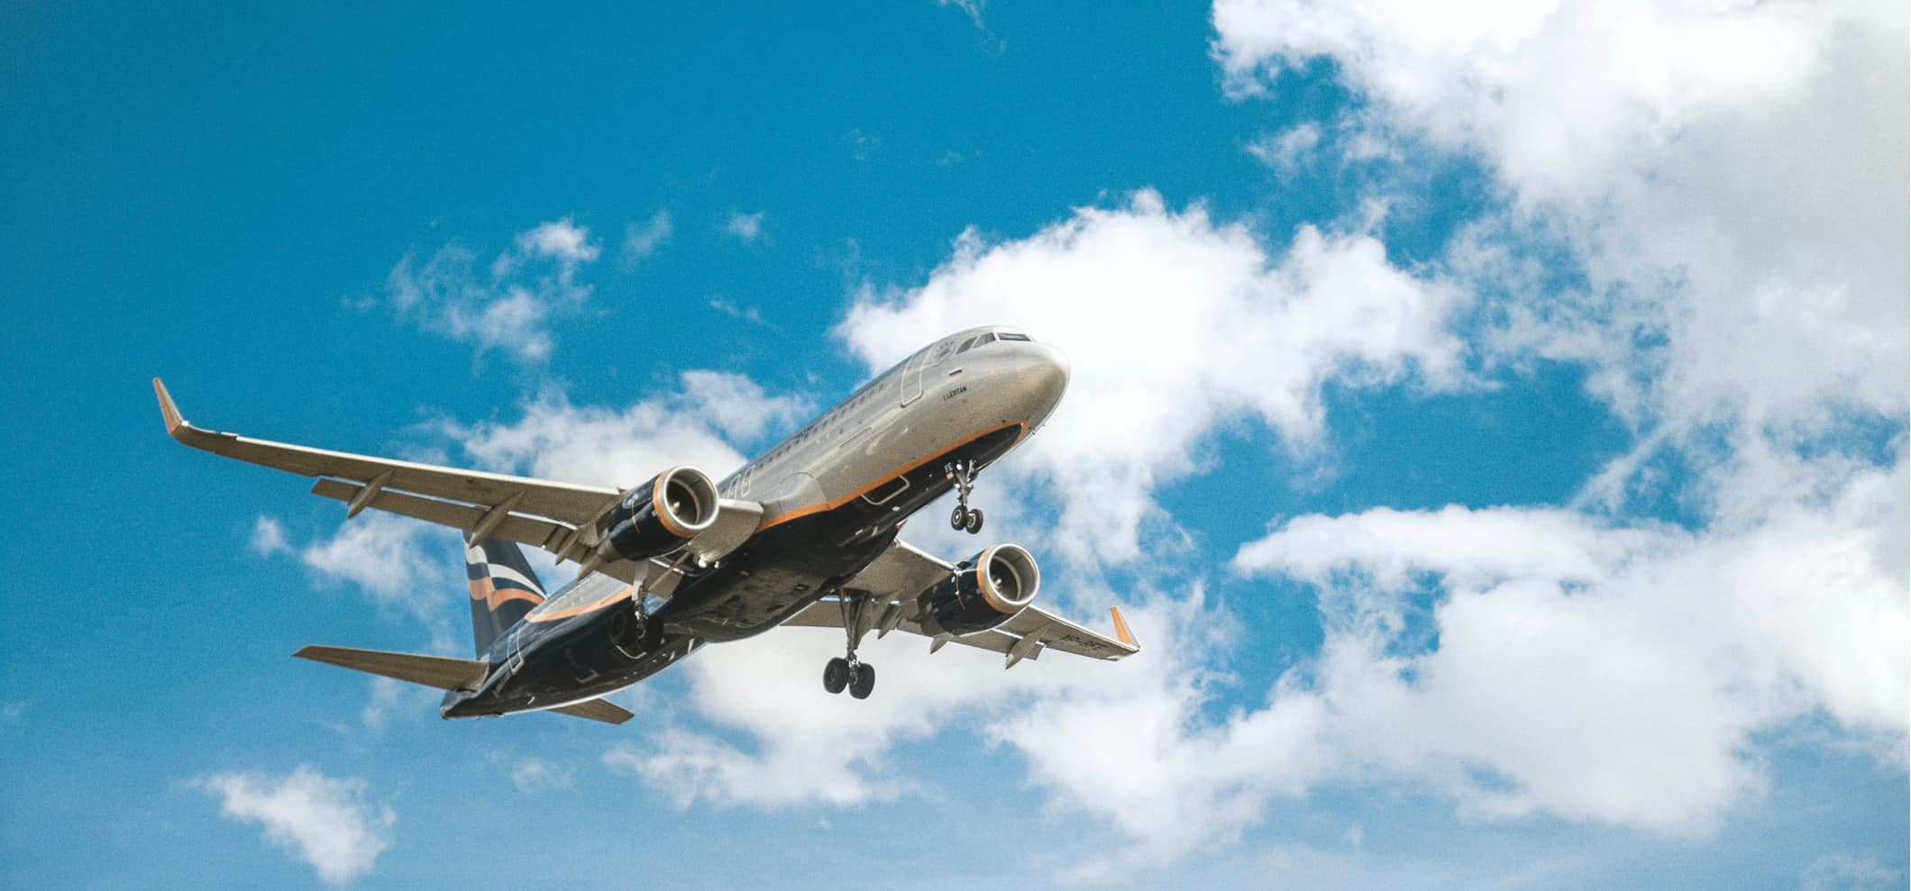
FLIGHT PRICE PREDICTION PROJECT

Slide 2

Problem Statement

Slide 3
Bussiness Problem
Anyone who has booked a flight ticket knows how unexpectedly the prices vary. The cheapest available ticket on a given flight gets more and less expensive over time. This usually happens as an attempt to maximize revenue based on –
1. Time of purchase patterns (making sure last-minute purchases are expensive)
2. Keeping the flight as full as they want it (raising prices on a flight which is filling up in order to reduce sales and hold back inventory for those expensive last-minute expensive purchases) So, we have to work on a project where we collect data of flight fares with other features and work to make a model to predict fares of flights.

Slide 4
Purpose of Project
Companies such as sastasafar.com, yatra.com, skyscanner.com, makemytrip etc which are booking site of flights. But before booking a flight we used to predict good and relevant value of the flight price. Similarly in the given task we have to build a model that can predict flight price from the extracted dataset from the older booking price of the flight.
Flight Price Valuation
Valuation requires expertise. And when it comes to valuing booking flight price, it becomes all the more critical. Getting tricked by the last minute of booking flight price valuation isn’t something new so you need to be extra cautious to strike the right chord while evaluating in booking . Hence a model needs to be build to evaluate price prediction.

Slide 5


Slide 6
Flight Name
Parameters of Flight Price
Arrival Location
Destination Location
Booking price of flight
No of stops
Day
Flight Date
Month
Arr time
Des. time

Slide 7

Data mining
We have extracted data from sastasafar.com

Slide 8
EDA steps
Data Preprocessing Done adding new columns for better model
Removed Skewness
Detected outliers
Ordinal encoding and PCA done

Slide 9
Visualization of important features for understanding
Flight name according to prices
Observations:
From above graph we can find that Air Asia, Air India and Vistara having high price value flight while rest flights having lower cost

Slide 10
Price vs Flight_name
No of stops vs Price

Slide 11
Price vs Week days
Brand vs Price

Slide 12
Destination time hour vs different flight price
Arrival time hour vs different flight price

Slide 13
Price vs No of stops

Slide 14
Flight Name
No of Stops

Slide 15
Price variation with number of stops

Slide 16
Arrival and Destination Location

Slide 17
Observations
Vistara having very high no. of flights as per dataset.
2. 1 stop flights are more as per comparison to Non stops and 2 stops.
3. On Sundays there are more number of flights availables.
4. 1 Stop flights prices are very high as compared to others.
5. We have selected flight of arrival location for Delhi and destination location for Bangalore.

Slide 18
Density of different dataset

Slide 19
Correlation of the Dataset

Slide 20
Describe of the Dataset

Slide 21
We have done PCA for checking best components of dataset

Slide 22
Selecting kbest Features

Slide 23
Model Building and Results

Slide 24
Best models
KNeighborsRegressor : Model shows low r2 score in training and testing accuracy hence we cannot consider it.
DecisionTreeRegressor: Same as DecisionTreeRegressor shows very much difference in training and testing accuracy hence we cannot consider it. Model becames underfit.
XGBRegressor: Same as above two model it shows similar in CV score and testing r2 score hence we can’t consider it.
GradientBoostingRegressor: GradientBoostingRegressor shows closer R2 test
ing and crpss val score but still training score it much greater than it testings R2 score which makes model underfit also R2 score not good yet from all models hence we can’t consider it.
- LGBMRegressor : Model shows good results as it gives less RMSE score with good R2 score rather than other models.

Slide 25
Final Model Results

Slide 26
Model Deployment

Slide 27
Thanks You

