Slide 1
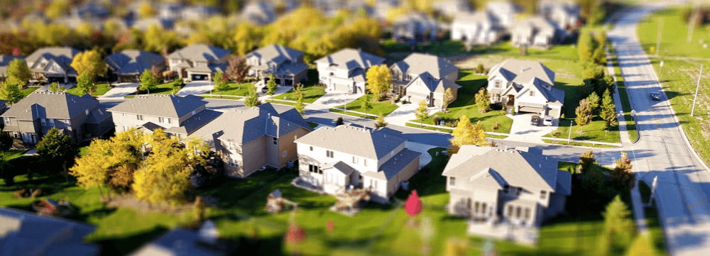
HOUSING PRICE PREDICTION PROJECT

Slide 2
Problem Statement
Houses are one of the necessary need of each and every person around the globe and therefore housing and real estate market is one of the markets which is one of the major contributors in the world’s economy. It is a very large market and there are various companies working in the domain. Data science comes as a very important tool to solve problems in the domain to help the companies increase their overall revenue, profits, improving their marketing strategies and focusing on changing trends in house sales and purchases. Predictive modeling, Market mix modelling, recommendation systems are some of the machine learning techniques used for achieving the business goals for housing companies. Our problem is related to one such housing company.

Slide 3
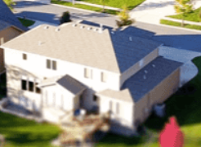
Buys the house
Housing Real Estate Companies
Sells the house to obtain profit

Slide 4
Machine learning in Housing Projects
Purpose
Method
Companies increase their overall revenue and profits.
Focusing on changing trends in house sales and purchases.
Predictive modelling

Slide 5
Houses Parameters
MSSubClass: Identifies the type of dwelling involved in the sale.
MSZoning: Identifies the general zoning classification of the sale.
LotFrontage: Linear feet of street connected to property
LotArea: Lot size in square feet
Street: Type of road access to property
LotFrontage: Linear feet of street connected to property
LotArea: Lot size in square feet
Street: Type of road access to property
Alley: Type of alley access to property
LotShape: General shape of property
LandContour: Flatness of the property
Utilities: Type of utilities available
LotConfig: Lot configuration
LandSlope: Slope of property
Neighborhood: Physical locations within Ames city limits
Condition1: Proximity to various conditions
Condition2: Proximity to various conditions (if more than one is present)
BldgType: Type of dwelling
HouseStyle: Style of dwelling
OverallQual: Rates the overall material and finish of the house
OverallCond: Rates the overall condition of the house
YearBuilt: Original construction date
YearRemodAdd: Remodel date (same as construction date if no remodeling or additions)
RoofStyle: Type of roof
RoofMatl: Roof material
Exterior1st: Exterior covering on house
Exterior2nd: Exterior covering on house (if more than one material)
MasVnrType: Masonry veneer type
MasVnrArea: Masonry veneer area in square feet
ExterQual: Evaluates the quality of the material on the exterior
ExterCond: Evaluates the present condition of the material on the exterior
Foundation: Type of foundation
BsmtQual: Evaluates the height of the basement
BsmtCond: Evaluates the general condition of the basement
BsmtExposure: Refers to walkout or garden level walls

Slide 6
BsmtFinSF2: Type 2 finished square feet
BsmtUnfSF: Unfinished square feet of basement area
TotalBsmtSF: Total square feet of basement area
Heating: Type of heating
HeatingQC: Heating quality and condition
CentralAir: Central air conditioning
Electrical: Electrical system
1stFlrSF: First Floor square feet
2ndFlrSF: Second floor square feet
LowQualFinSF: Low quality finished square feet (all floors)
G LivArea: Above grade (ground) living area square feet
Bs mtFullBath: Basement full bathrooms
BsmtHalfBath: Basement half bathrooms
FullBath: Full bathrooms above grade
HalfBath: Half baths above grade
Bedroom: Bedrooms above grade (does NOT include basement bedrooms)
Kitchen: Kitchens above grade
KitchenQual: Kitchen quality
TotRmsAbvGrd: Total rooms above grade (does not include bathrooms)
Functional: Home functionality (Assume typical unless deductions are warranted)
Fireplaces: Number of fireplaces
FireplaceQu: Fireplace quality
GarageType: Garage location
GarageYrBlt: Year garage was built
GarageFinish: Interior finish of the garage
GarageCars: Size of garage in car capacity
GarageArea: Size of garage in square feet
GarageQual: Garage quality
GarageCond: Garage condition
PavedDrive: Paved driveway
WoodDeckSF: Wood deck area in square feet
OpenPorchSF: Open porch area in square feet
EnclosedPorch: Enclosed porch area in square feet
3SsnPorch: Three season porch area in square feet
ScreenPorch: Screen porch area in square feet
PoolArea: Pool area in square feet
PoolQC: Pool quality
Fence: Fence quality
MiscFeature: Miscellaneous feature not covered in other categories
MiscVal: $Value of miscellaneous feature
MoSold: Month Sold (MM)
YrSold: Year Sold (YYYY)
SaleType: Type of sale
SaleCondition: Condition of sale

Slide 7
EDA steps
Dropped the unique value column Utilities
Dropped unnecessary columns
Manage dataset as per requirement for better model prediction. Some of necessary highlight are below.

Slide 8
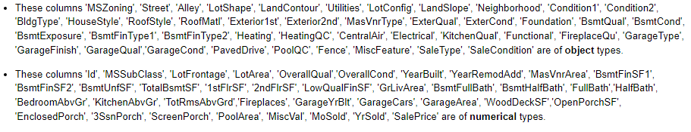
Exploratory Data Analysis Highlights
Loading Dataset
Dataset Information

Slide 9
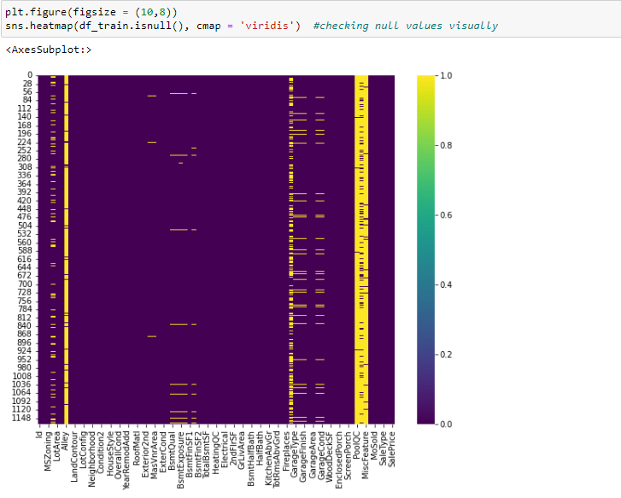
Checking Null Values of the dataset
Highlighted yellowish columns having null values in the dataset.
We dealed with all null values filling values with mode.

Slide 10
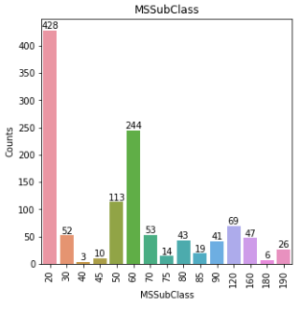
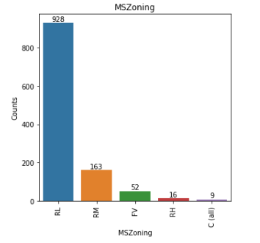
Visualizing Parameters for better understandings
Bar Plot

Slide 11
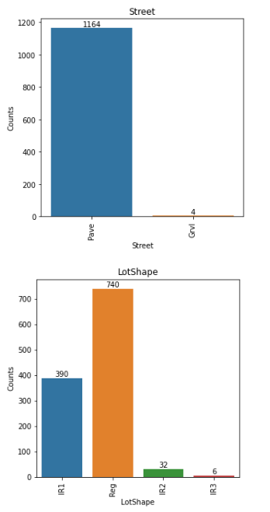
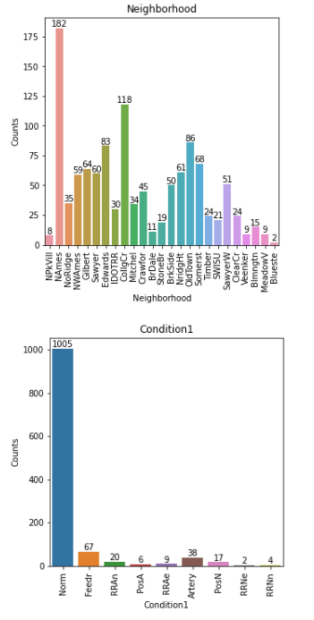
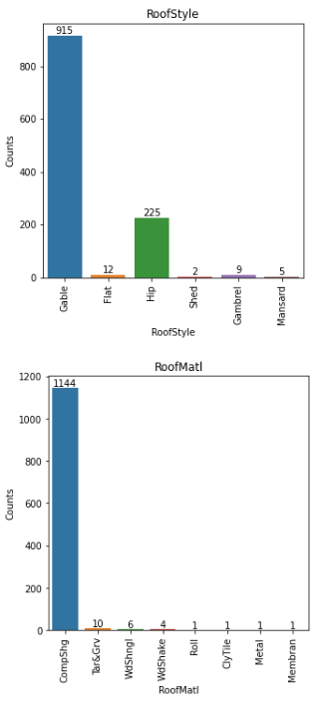
Visualization

Slide 12
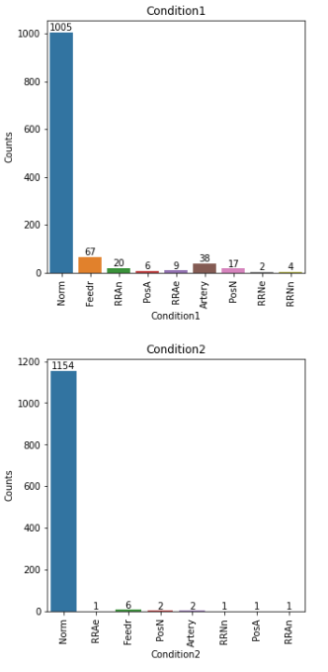
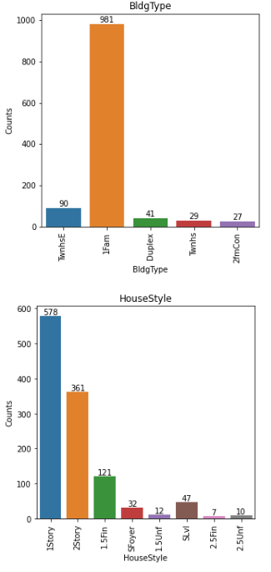
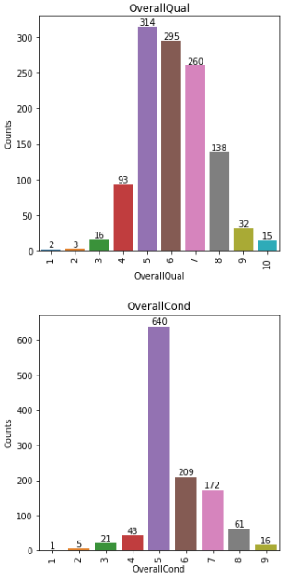
Visualization

Slide 13
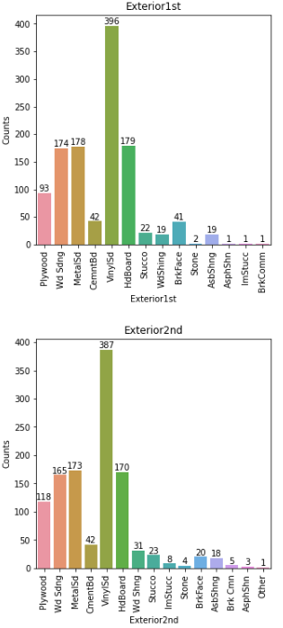
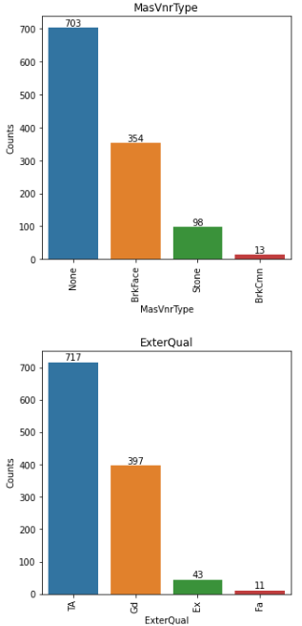
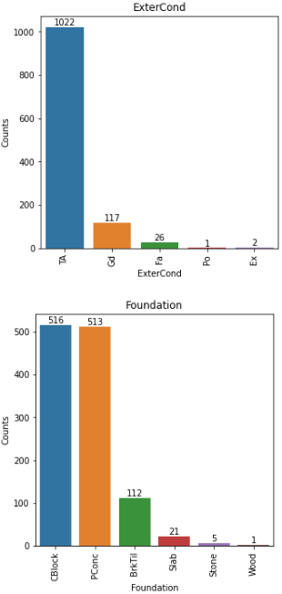

Slide 14
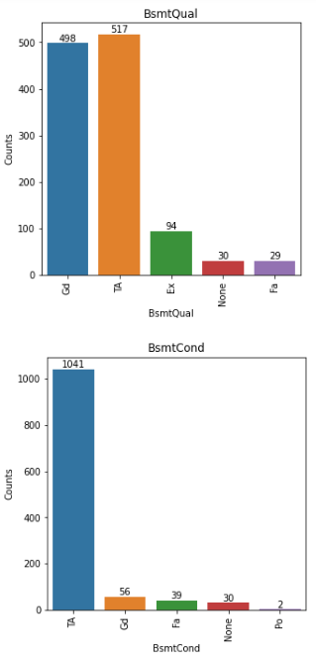
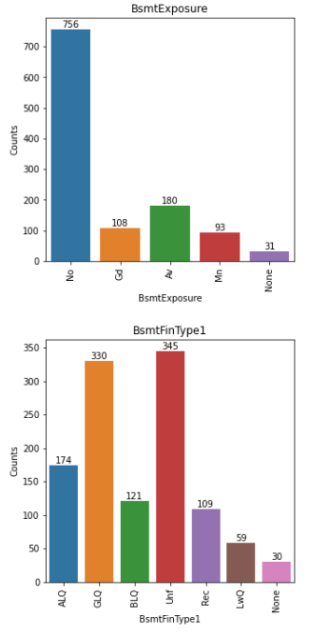
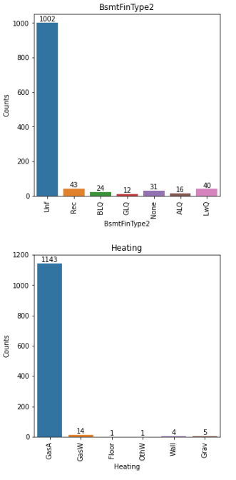
Visualization

Slide 15
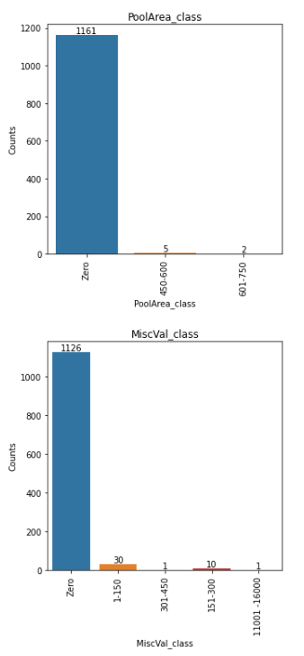
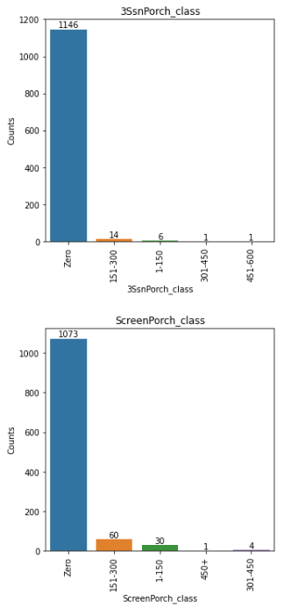
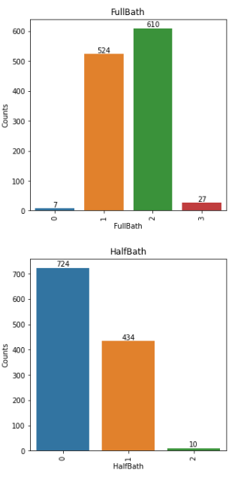
Visualization

Slide 16
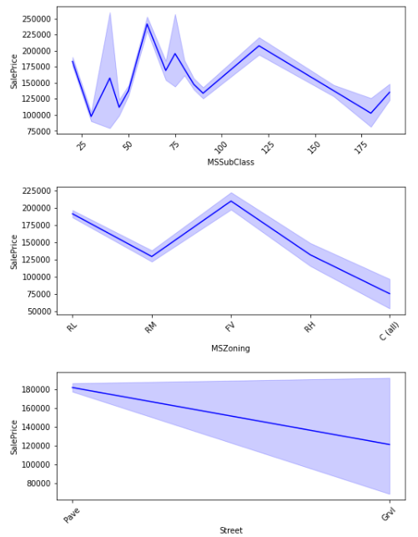
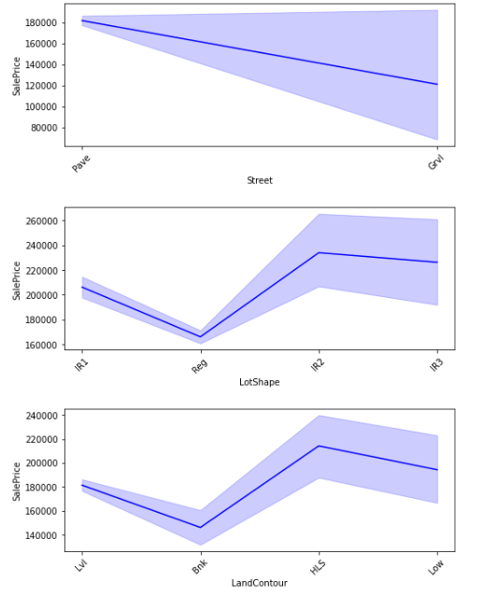
Line Plot

Slide 17
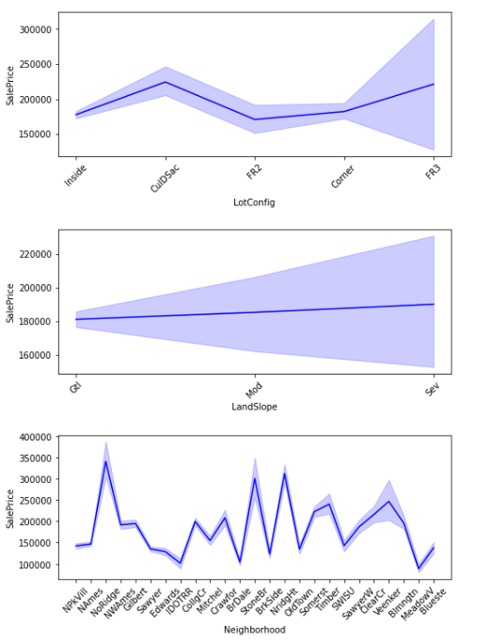
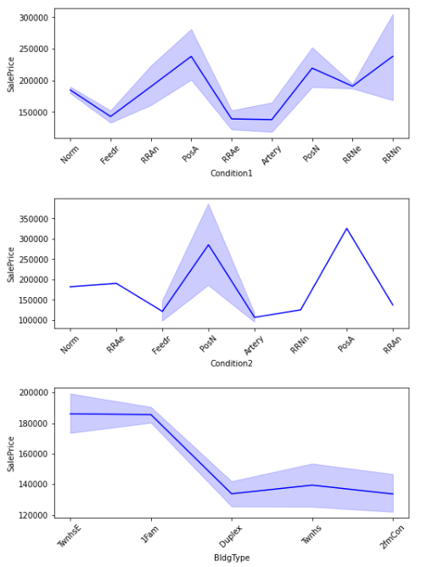
Line Plot

Slide 18
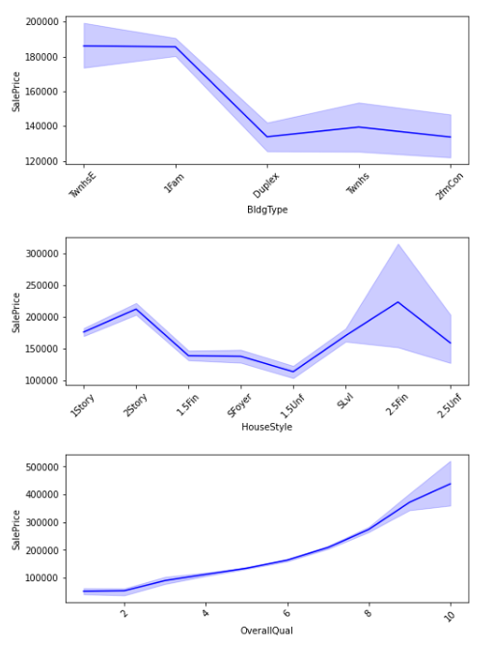
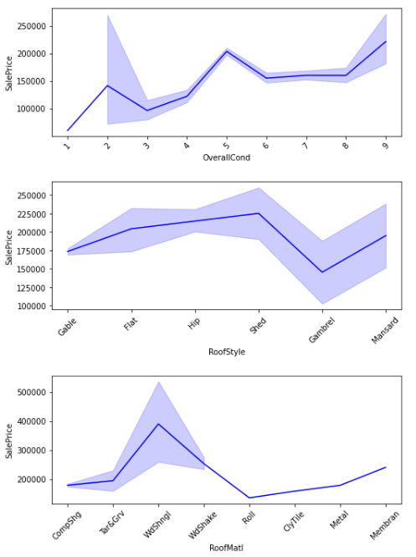
Line Plot

Slide 19
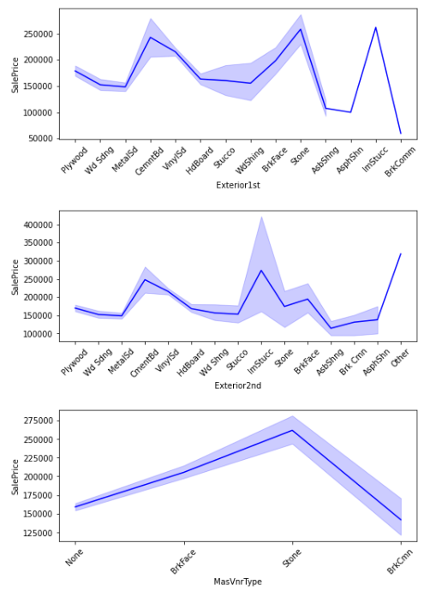
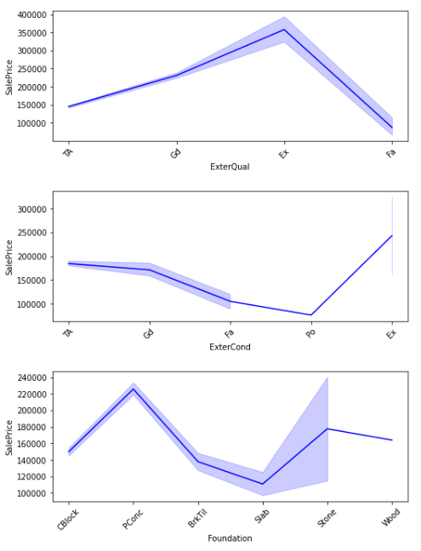
Line Plot

Slide 20
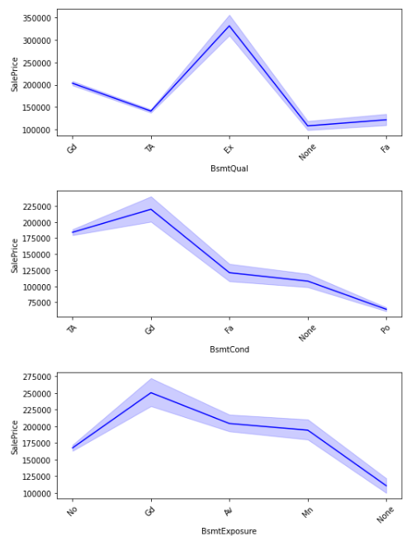
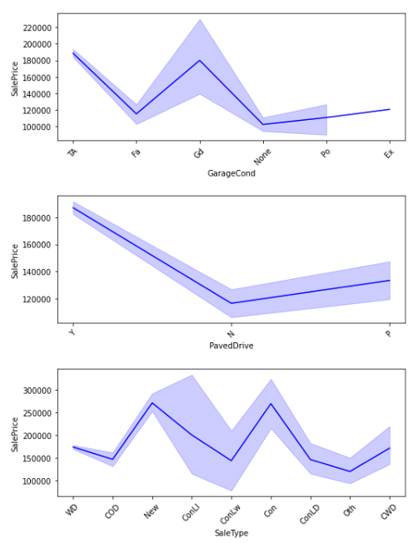
Line Plot

Slide 21
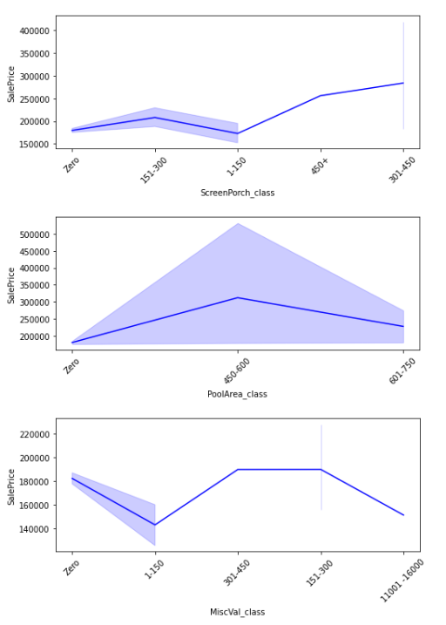
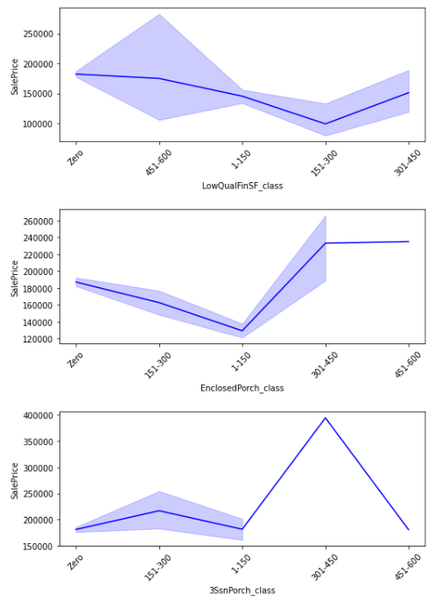
Line Plot

Slide 22
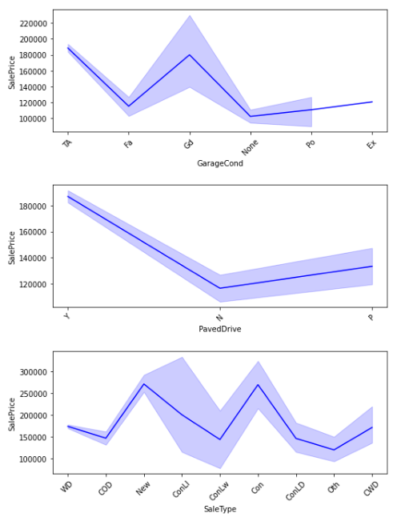
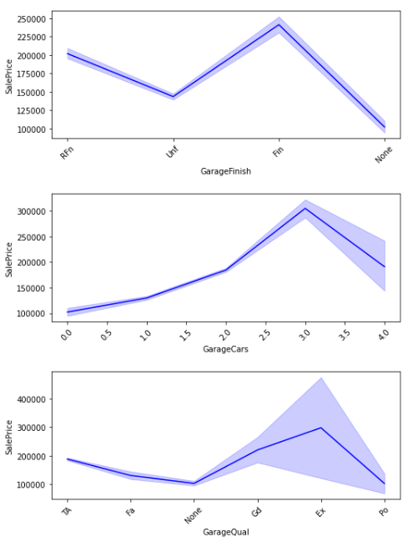
Line Plot

Slide 23
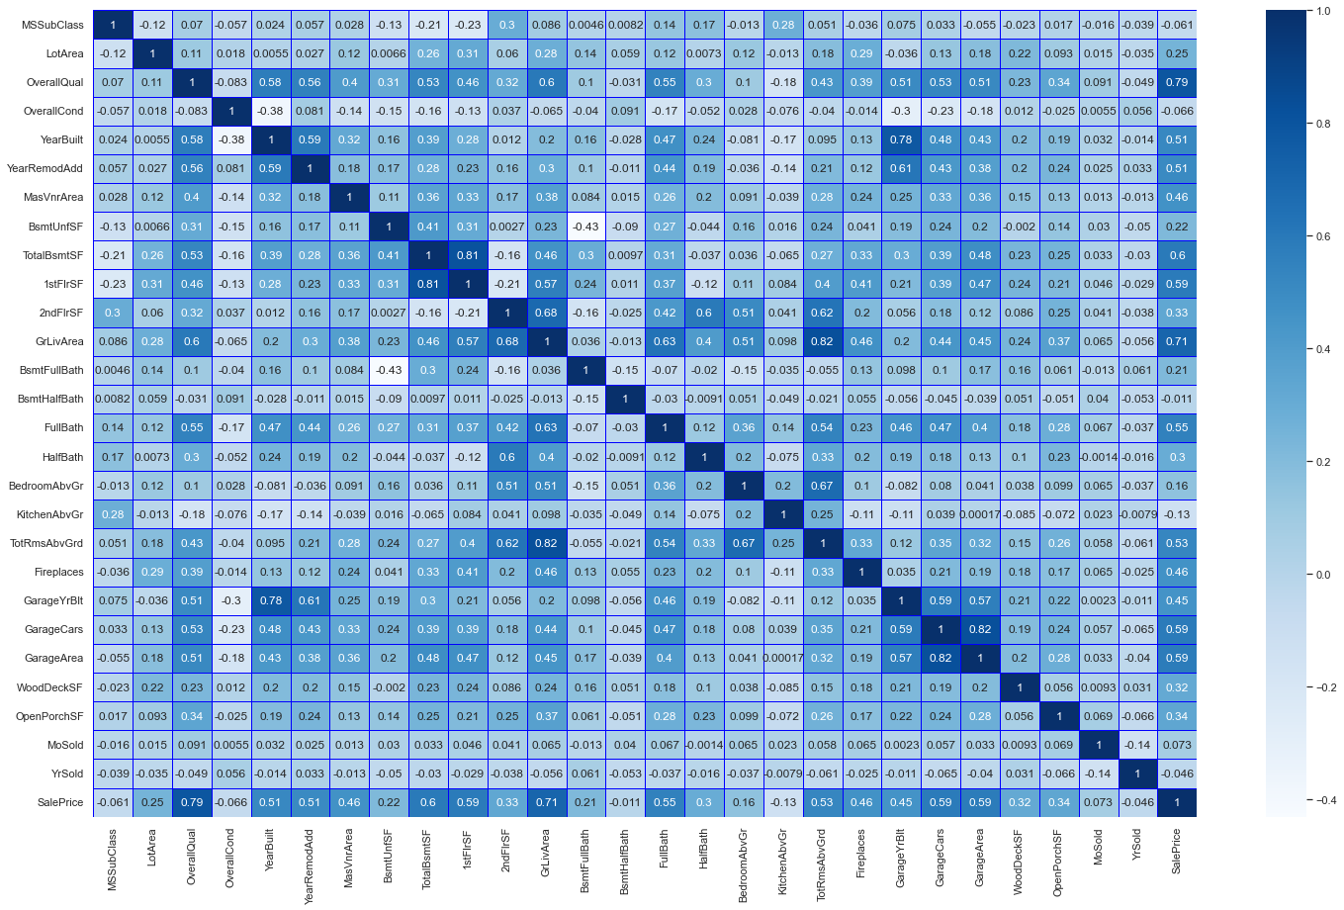
Correlation of the Dataset

Slide 24
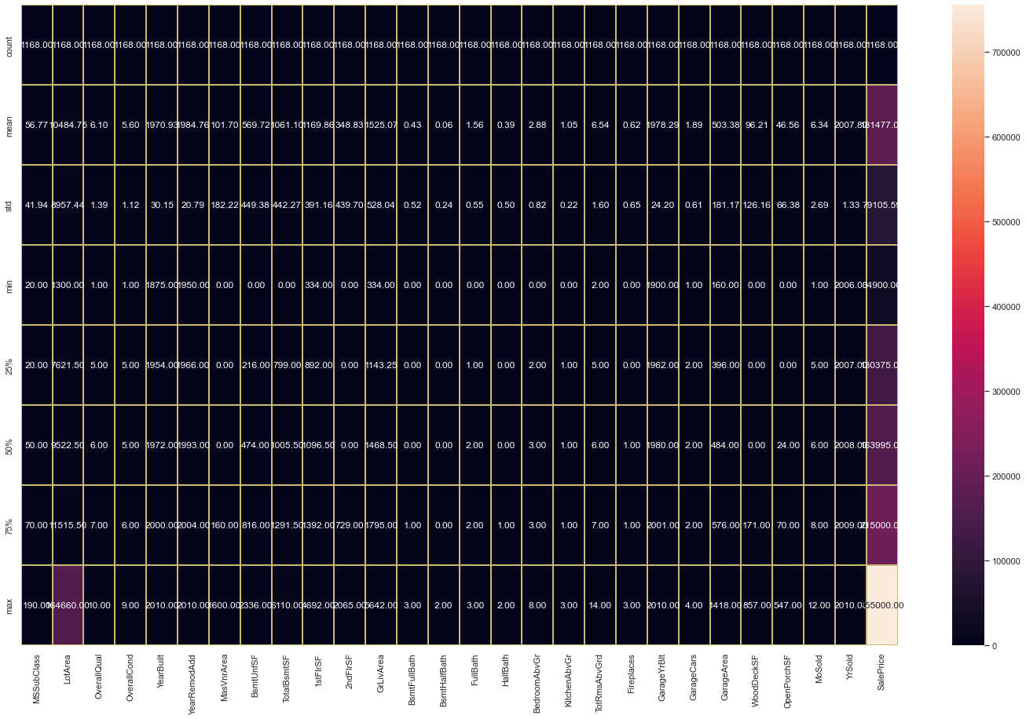
Describe of the Dataset

Slide 25
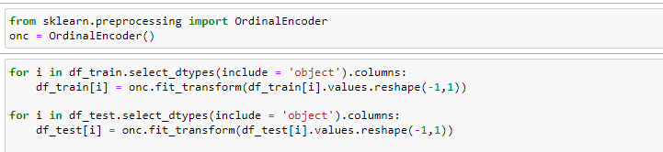
Converting objects dataset into numerical form we are using Ordinal Encoder
Outliers
We have applied Z score and Interquartile method for outlier removal but both shows very high amount of data loss upto 50 percent hence we can’t consider it.

Slide 26
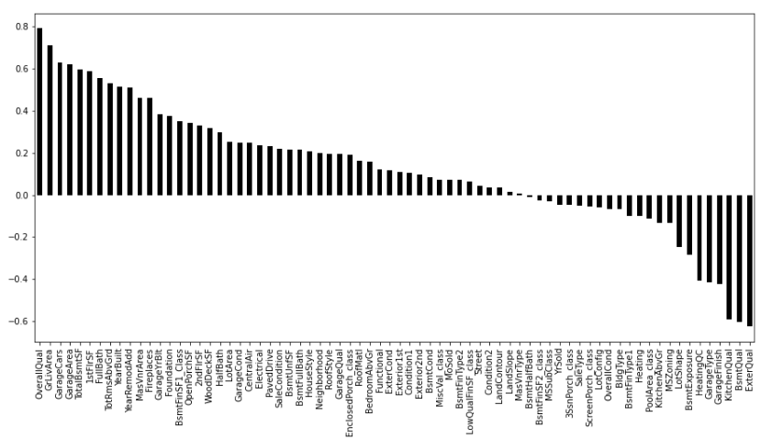
Checking Positive and Negative Correlation

Slide 27
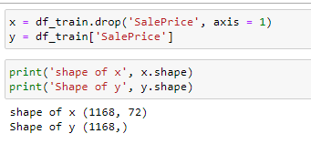
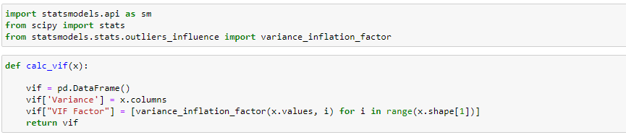
Dividing data for feature selection
Checking Mutlicollinearity

Slide 28
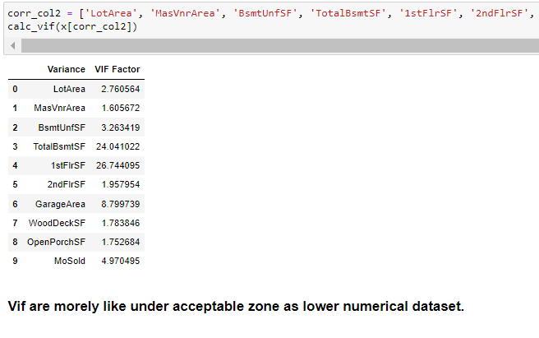

Slide 29
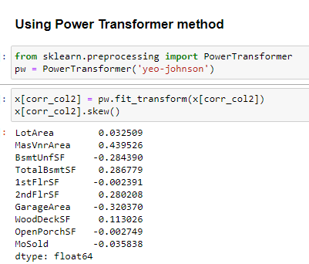
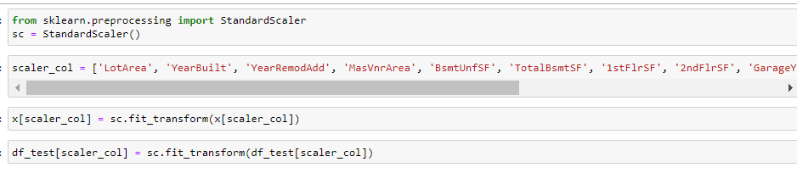
Removing Skewness
Standard Scalling

Slide 30
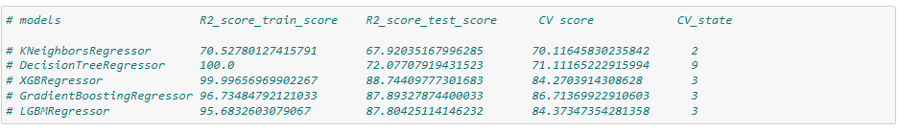
Feature Selection
Model Building and Results
- KNeighborsRegressor : Model shows low r2 score in training and testing accuracy hence we cannot consider it.
- DecisionTreeRegressor: Same as DecisionTreeRegressor shows very much difference in training and testing accuracy hence we cannot consider it. Model becames underfit.
- XGBRegressor: Same as above two model it shows very much difference in training and testing accuracy hence we cannot consider it. Model becames underfit.
- GradientBoostingRegressor: GradientBoostingRegressor shows closer R2 testing and training score but still training score it much greater than it testings R2 score which makes model underfit also R2 score not good yet from all models hence we can't consider it.
- LGBMRegressor : Moder shows very close R2 score of testing and training also CV score is also good hence we can consider it for model building.

Slide 31
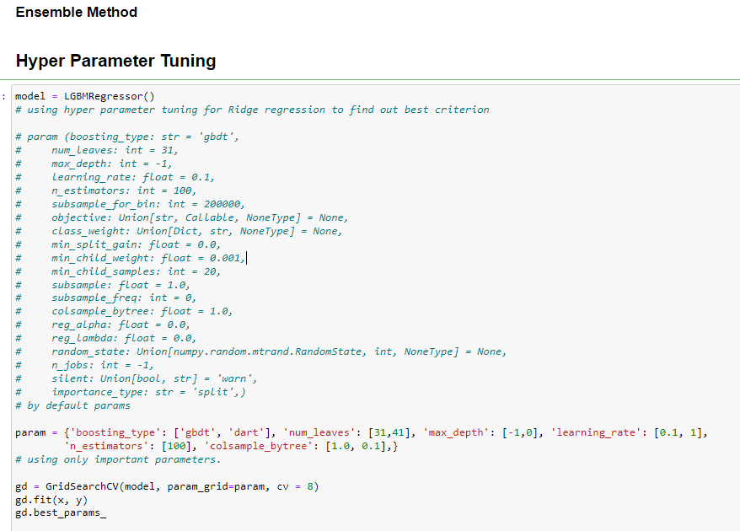

Slide 32
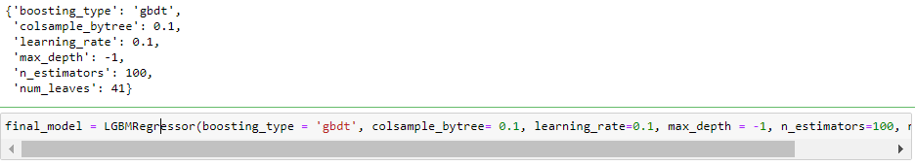
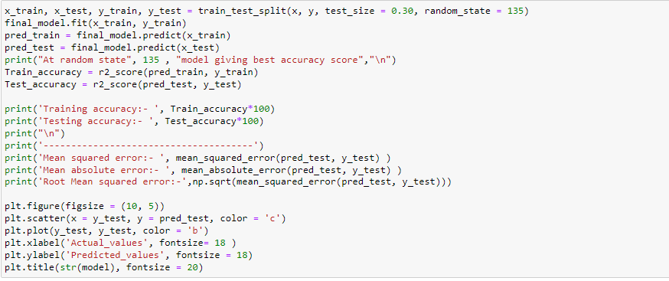

Slide 33
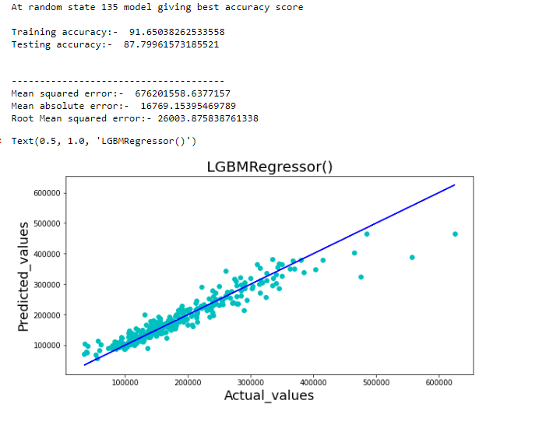
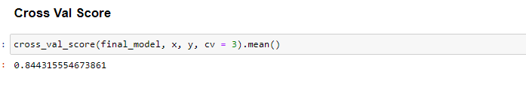

Slide 34


Slide 35


Slide 36
Thank You

