Slide 1
Arjun
An Indian ai based on python programming language
Notes:
____________________________________ (vats )__________________________________________________
Good morning teachers and friends ,
Today we the team of development of arjun ai are going to introduce about our product ,
So you can see it is made in the popular coding language called python,
And it is proudly made in India .
_____________________________________________________________________________________________

Slide 2

Features of Arjun
Takes commands
Speaks
Makes daily tasks easier
Easy to use
Makes a boring job like Penetration Testing easy and short
Notes:
____________________________(Harsh Gupta)___________________________________
Arjun is packed with functionality it can
(rest of the content in the slide)
{
Takes commands
Can Speak
Makes daily tasks easier
Easy to use
Makes a boring job like Penetration Testing easy and short
}

Slide 3
Modules of arjun
1} installation module
2) sh installation module
3} arjun’s arrows
Notes:
VATS:
The whole setup of arjun can be divide into modules the sh … is to be run on the wsl kali in windows , the installation .. Is to be run on windows os . The arjun’s arrow is a specific powerful tool witch can sent syn-ack packages to ddos a target website.

Slide 4
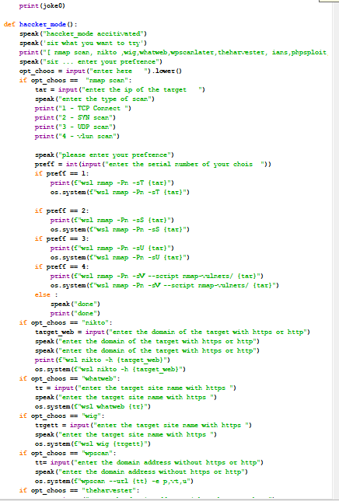
Detailed overview of the code
Functions of arjun
face_rcon()
countdown()
Speak()
takeCommand()
Wish()
sendEmail()
joke()
haccker_mode()
trans()
music()
the_Time()
Gme()
Other auxiliary functions
Notes:
______________(vats)_______________________________________________________________________________________________
So, our team have broke the python code into these functions and we are going to look into them one by one
____________________________________________________________________________________________________________________

Slide 5

Speak()
def speak(audio):
engine.say(audio)
engine.runAndWait()
This code evokes the windows speech engine to say the audio given as a argument to the function
Notes:
_____________________(Mayank)___________________________
Speak function does what its name suggests , every virtual assistant needs to speak to shear its feelings
So the code does that,
It invokes the windows speech engine inbuilt in the windows operating system to say the audio given as a argument to the function
_____________________________________________________________________________________________________

Slide 6
takeCommand()
def takeCommand():
r = sr.Recognizer()
with sr.Microphone() as source:
print("Listening...")
r.pause_threshold = 1
audio = r.listen(source)
try:
print("Recognizing...")
query = r.recognize_google(audio, language='en-in')
print(f"User said: {query}\n")
except Exception as e:
print("Say that again please...")
return "None"
return query
This function takes the command or input from the user and this input is later validated and the command is executed .
Notes:
______________________(Mayank)_________________________________________________________________
Given in the slide():
Execept (this) say
(takeCommand)
__________________________________________________________________________________________________

Slide 7
Wish()
def wish():
hour=int(datetime.datetime.now().hour)
if hour>=0 and hour<12:
speak(“Good Morning! Sir”)
elif hour>=12 and hour<18:
speak(“Good Afternoon! Sir”)
else:
speak("Good Evening! sir")
speak("I am arjun Sir. Please tell me how may I help you")
As the name says it is a function which makes our assistant wish a user every time a user uses it.
Notes:
_______________________(Harsh Gupta)__________________________________________________
Wish function is a function which makes our assistant wish a user every time a user uses it.
It uses the time module in python to check the time and greet or wish accordingly .
Like if its morning then he will say good morning sir , if it is afternoon then he will say good afternoon.
______________________________________________________________________________________________

Slide 8
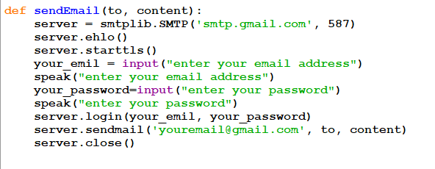
sendEmail()
This function uses smtlib server and login’s to your email and sends the email through the server to the receiver.
Notes:
____________________________________________________(mayank)__________________________________________________
This function uses smtlib server and login’s to your email and sends the email through the server to the receiver.
_________________________________________________________________________________________________________________________

Slide 9

joke()
This function evokes the pyjokes module and says the joke to the user.
Notes:
______________________________________(vats)_____________________________________________________
joke function evokes the pyjokes module and says the joke to the user.
_________________________________________________________________________________________________

Slide 10
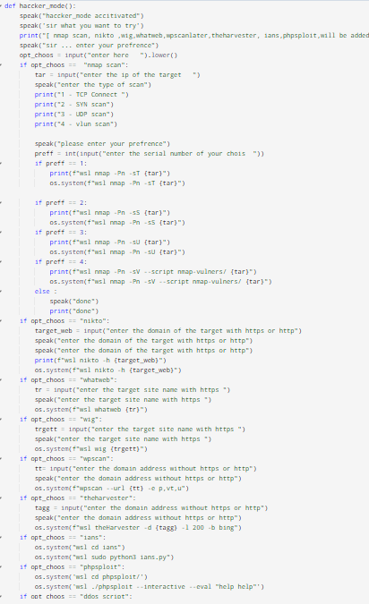
haccker_mode()
This is a function witch is specifically for ethical hackers and penetration testers . This makes their work easier . Just a few clicks and they can launch ddos attacks , network scans , sql injection , php remote execution … etc.
Notes:
_________________________________________________(mayank)_________________________________________________________
This is a function witch is specifically for ethical hackers and penetration testers .
This makes their work easier . Just a few clicks and they can launch ddos attacks , network scans , sql injection , php remote execution … etc.
__________________________________________________________________________________________________________________________________

Slide 11
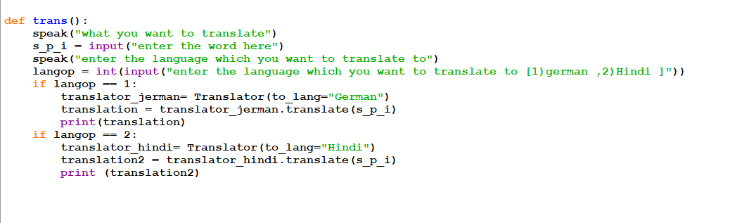
trans()
This function is used to translate a text to Hindi or germen text.
Notes:
______________________________________________________(harsh gupta)________________________________________
This function is used to translate a text to Hindi or germen text.
_____________________________________________________________________________________________________________

Slide 12
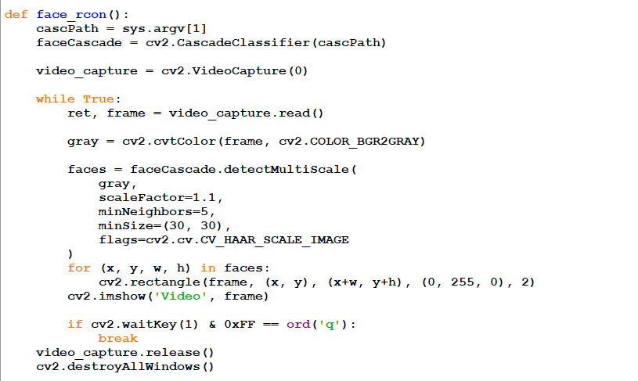
face_rcon()
This function evokes the face diction ai witch is inbuilt in python and detects faces.
Notes:
_______________________________________________(harsh gupta)_____________________________________________________
This function evokes the face diction ai witch is inbuilt in python and detects faces.
__________________________________________________________________________________________________________________

Slide 13
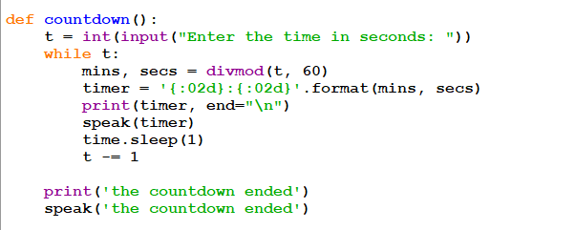
countdown()
This function generates or starts a countdown from the given number of seconds to 0 seconds.
Notes:
________________________________________________________(Aditi)_______________________________________________
countdown function generates or starts a countdown from the given number of seconds to 0 seconds.
____________________________________________________________________________________________________________________

Slide 14
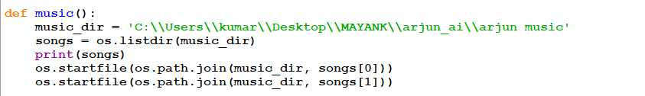
music()
Arjun comes with inbuilt music and this function opens the or plays the music files.
Notes:
_____________________________________________________________________(Mayank kumar)____________________________________________
Arjun comes with inbuilt music and music function opens the or plays the music files.
___________________________________________________________________________________________________________________________________

Slide 15

the_Time()
This function evokes the os to search for the current time.
Notes:
Harsh-________________________________________________________
The time function evokes the os to search for the current time.
____________________________________________________________________

Slide 16
Other auxiliary function
We cant describe all the functions in a video so we will make a manual in later time.
Notes:
VATS______________________________________________________________________________
We cant describe all the functions in a video so we will make a manual in later time.
____________________________________________________________________________________________

Slide 17

Thank you
This Photo by Unknown Author is licensed under CC BY-SA-NC
Notes:
(ALL): thank you

