Slide 1
SALES DATA ANALYTICS
Capstone Project
An end-to-end analytics workflow — from raw data to an interactive business dashboard
Prepared by: Arjun
Tools: Python · Power BI · Git & GitHub

Slide 2
Objective
Analyze sales performance across regions and product categories to uncover growth opportunities — using Python for analysis and Power BI for interactive reporting.
1
Clean & Prepare Data
2
Explore & Analyze
Handle missing values and duplicates in a real-world sales dataset
Uncover trends, correlations, and outliers through EDA
3
Visualize Findings
4
Deliver a Dashboard
Build 5 clear charts that communicate patterns at a glance
Package results into an interactive Power BI report

Slide 3
Dataset & Data Cleaning
25
Orders After Cleaning
Cleaning Process
1
Inspected dataset shape, column types, and structure using pandas
2
Identified 1 duplicate order (OrderID O1021) and removed it with drop_duplicates()
1
Duplicate Row Removed
3
Found missing values in CustomerAge and SatisfactionRating — filled each with the column median
4
Converted OrderDate from text to a proper datetime format for time-based analysis
2
Missing Values Fixed
5
Exported the cleaned dataset as sales_data_cleaned.csv for all downstream analysis

Slide 4
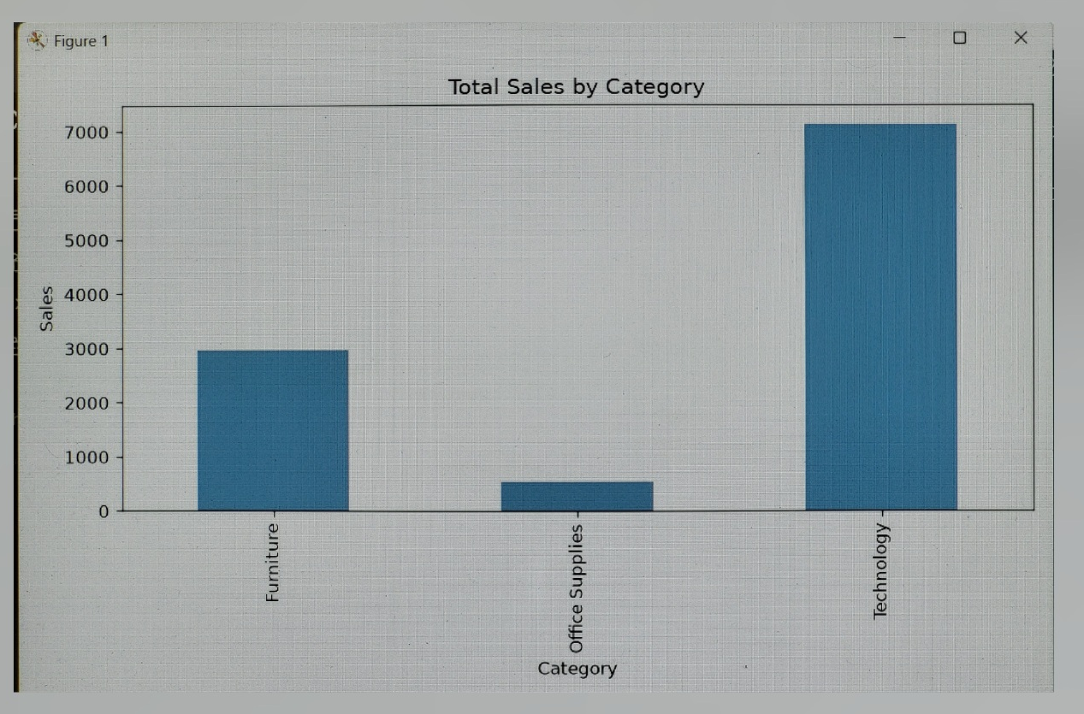
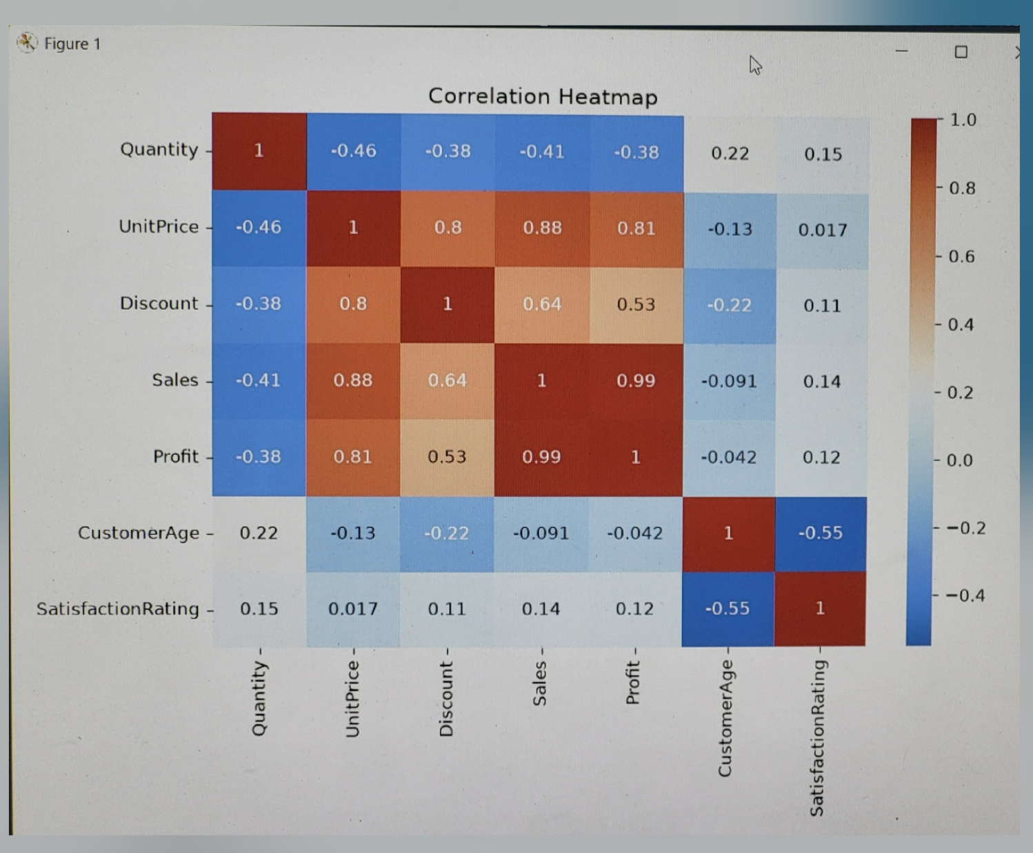
Exploratory Data Analysis
Total Sales by Category
Correlation Heatmap
Technology dominates, driven by high-value laptop orders.
Sales ↔ Profit: 0.99 · Outlier: O1022, $2,160

Slide 5
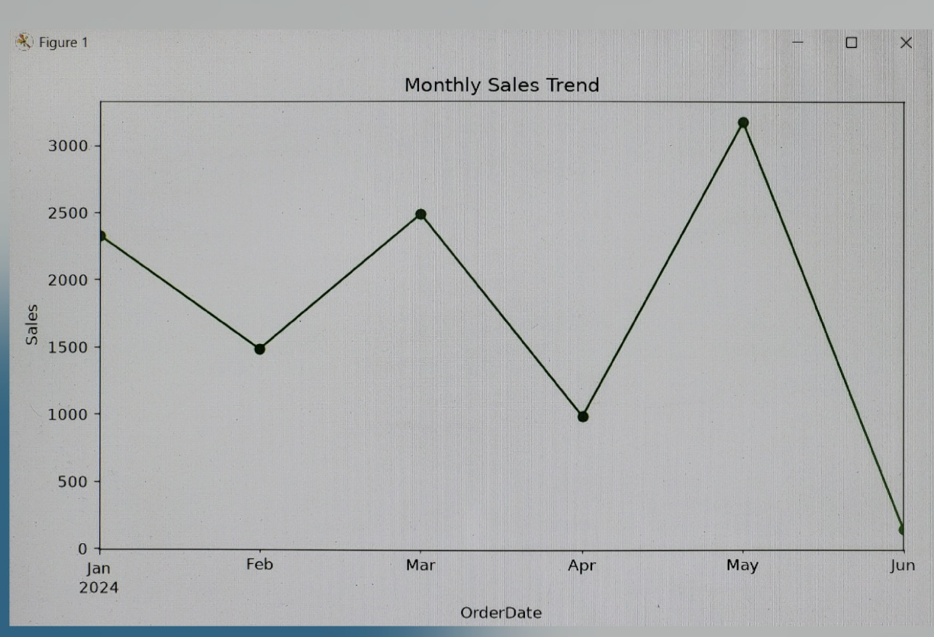
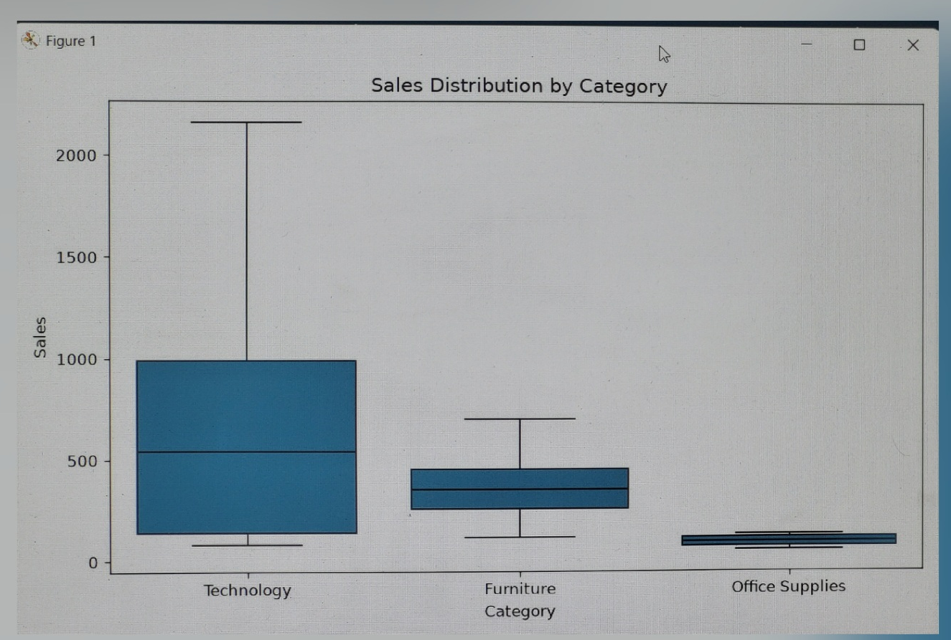
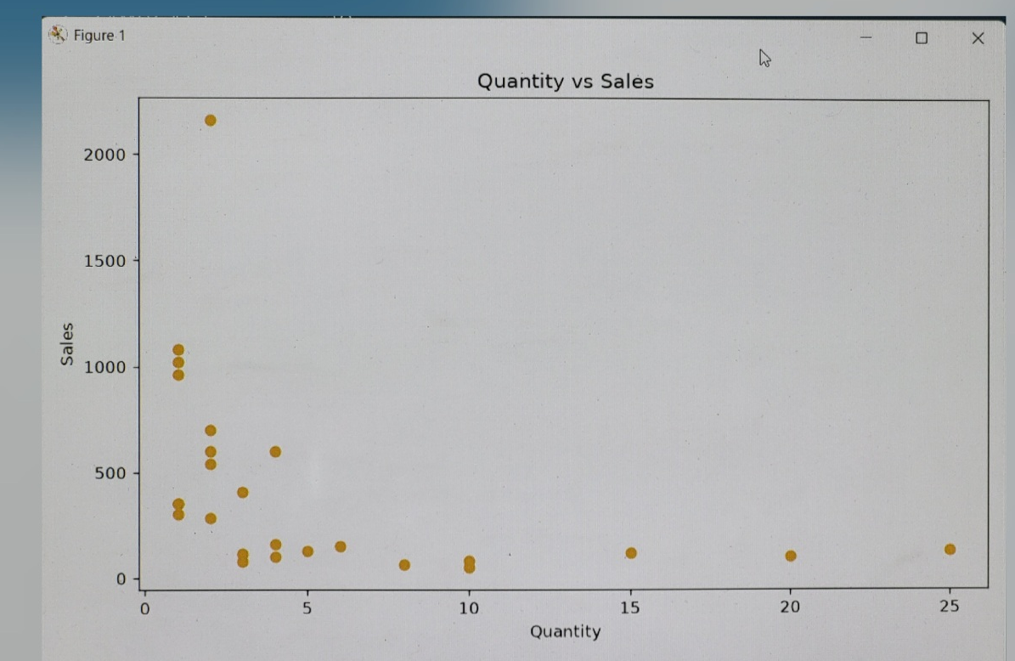
Additional Visualizations
Monthly Sales Trend
Sales Distribution by Category
Quantity vs Sales
May was the peak month, driven by a large bulk order.
Technology shows the widest spread and highest ceiling.
Most high-value orders involve low quantities — big-ticket items.

Slide 6
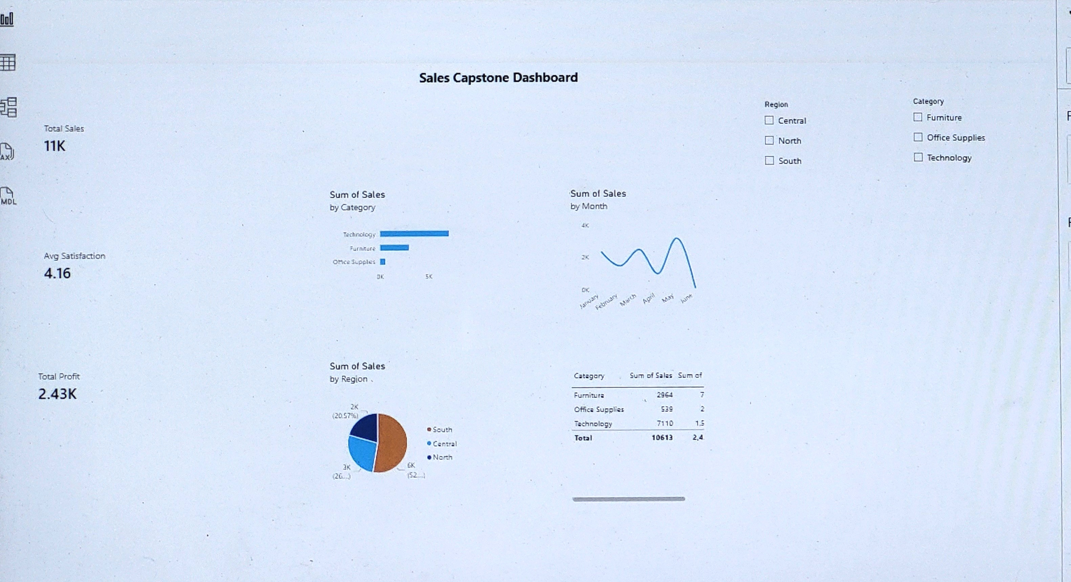
Power BI Dashboard
"Sales Capstone Dashboard" — interactive report with KPIs, charts, and slicers

Slide 7
Insights & Recommendations
5 Key Insights
Performance Extremes
1
Technology is the top-performing category, driven heavily by laptop sales.
Highest Category
Technology
Lowest Category
Office Supplies
Office Supplies has the highest order volume but the lowest revenue per order, due to low unit prices.
Highest Region
South
2
Lowest Region
North
3
The South region leads in total sales — more than double the North region.
Recommendations
1
Expand Technology inventory and marketing, since it drives the most revenue and profit.
4
Sales and Profit are strongly correlated (0.99) — high-value orders reliably generate proportional profit.
5
May was the peak sales month, coinciding with a large bulk laptop order (O1022, $2,160).
2
Investigate underperformance in the North region — targeted promotions could help close the gap with South.

