Slide 1
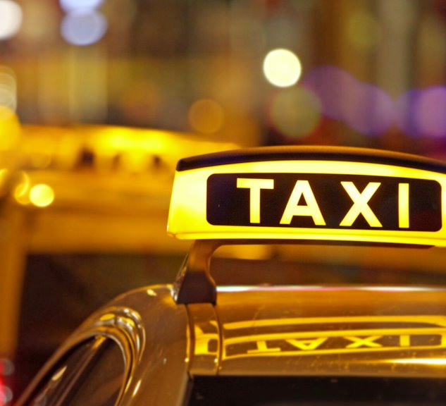
Big Data -
Chicago Taxi Analysis
Group 4
Arjun Venkatesh,
Petra Hutabarat,
Ziyoda Saidova

Slide 2
Agenda
Business Objectives
Executive Summary
Data Infrastructure and Description
Exploratory Data Analysis
Time Analysis
Cost Analysis
Location Analysis
Machine Learning Models
Pricing Model
Demand Model

Slide 3
Executive Summary
The taxi industry has struggled in recent years both due to increased competition from rideshare services, as well market events such as COVID-19.
To address this, and provide recommendations for the the taxi industry to be more competitive in today’s climate we conducted a big data analysis analyzing these trends, and building machine learning models to address gaps in competitiveness
We found several interesting conclusions in how use case of the taxi industry has changed over, and built two machine learning models to aid in taxi competitiveness.

Slide 4
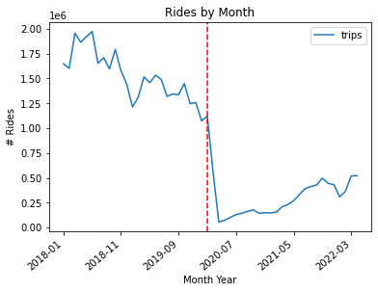
Business Objectives
Drastic drop in taxi usage
Goals:
Study current makeup of taxi rides
Explore reasons for drop off in taxi usage
Rideshare competition
External factors (COVID)
Use machine learning models to improve experience and drive growth

Slide 5
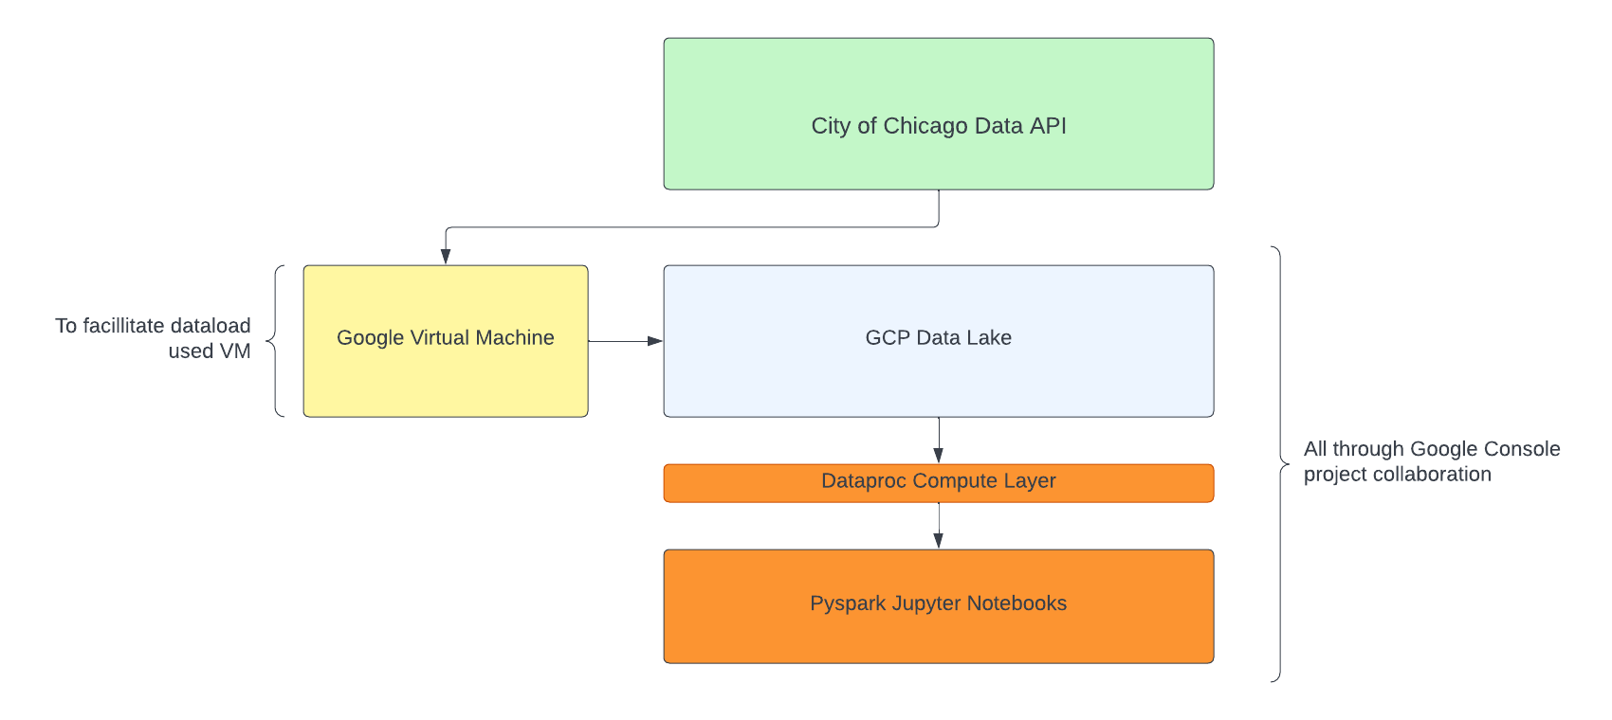
Data Infrastructure/Methodology

Slide 6
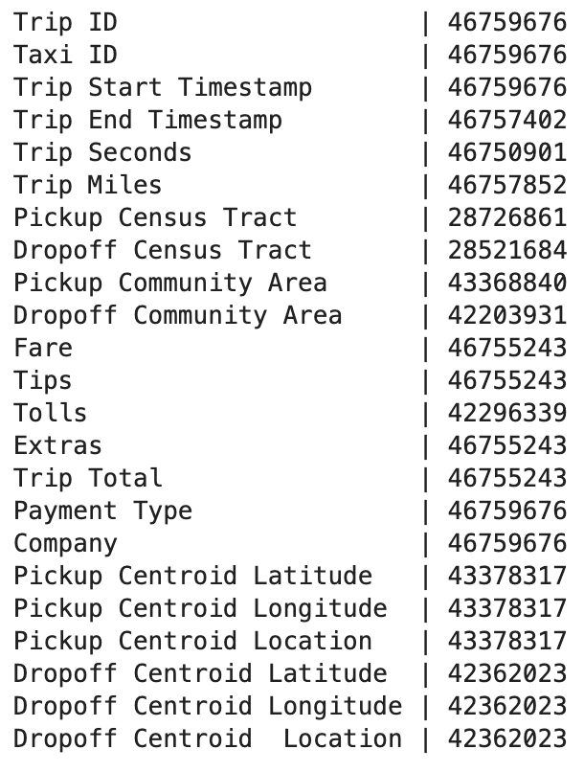
Data Profile
46 million rows of data/ 23 columns
Approximately 18 GB of data
Taxi data ranging from 2018 - 2022
One row per taxi ride
Densely populated - only some geographical information missing

Slide 7
Data Preparation
Dropped geographical columns that were sparsely populated and not as useful for our analysis
Added columns around timing including day of week, hour of day, month, and year for comparing time series performance.
Joined data with weather, holiday data to add more context and features to models
Where appropriate (in models) excluded outliers, looked at certain time periods and binned columns as necessary
For pricing and location models separated pre and post covid
Excluded high fare outliers from pricing model

Slide 8
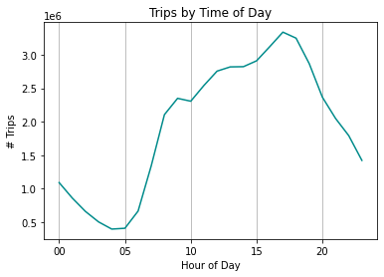
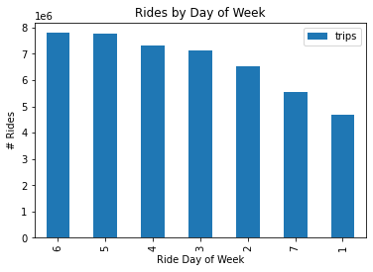
Exploratory Data Analysis - Common Trip Times
Most of the taxi trips happen at 16.00-18.00
Highest number of trips happens in Friday and Saturday

Slide 9
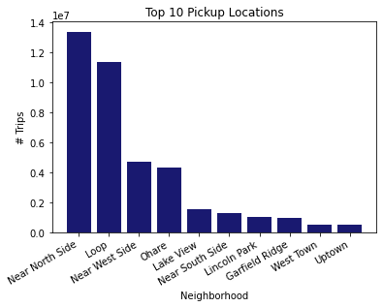
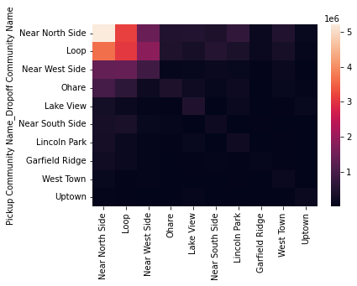
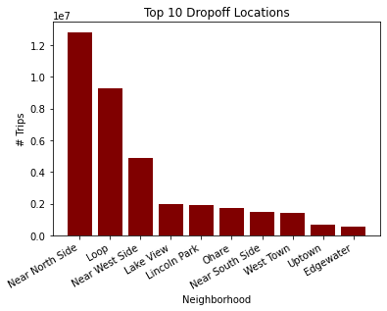
Exploratory Data Analysis - Common Trips
Majority of trips happen in top 10 neighborhoods - most commonly Near North Side, Loop, Near Westside and O’hare

Slide 10
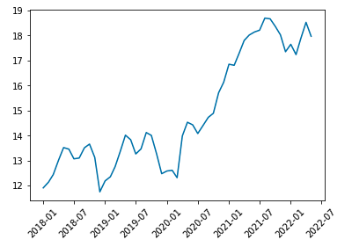
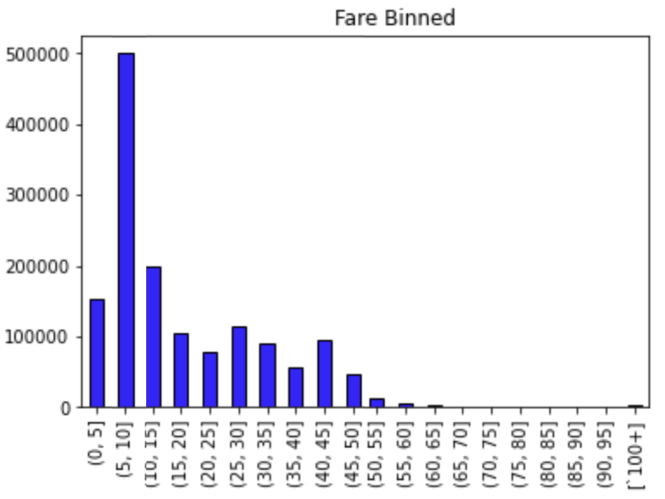
EDA: Cost Analysis -
Average Fare 2018-2022
Seasonal trend before covid 2018-2019
2020 - 2021 price spike, inflation affect
2022 returning to prior covid pattern
$15.21 average fare
Removed outliers - selected fare less than $65
New average price $13.74

Slide 11
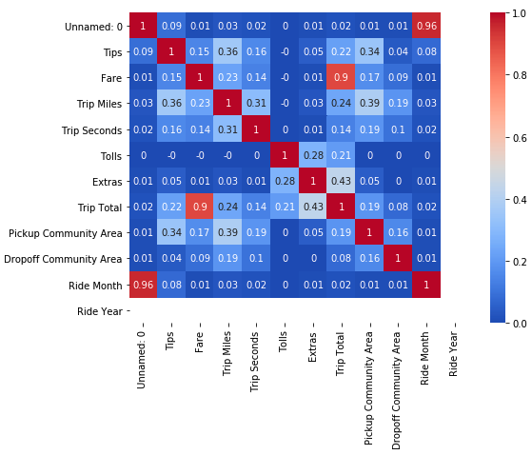
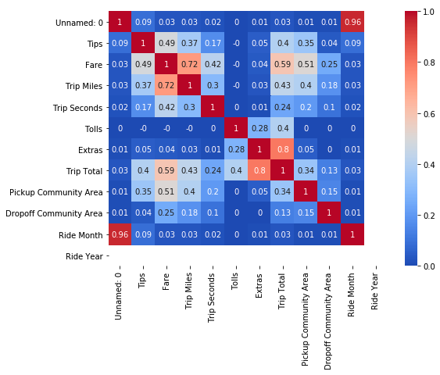
EDA - Cost Analysis
Almost no correlation between Fare and other variables
After filtering < $65, correlation improved
Added additional feature dropoff longitude and latitude, pickup longitude and latitude (highest correlation with fare)

Slide 12
Chicago Taxi Fare Prediction
Purpose: Provide advance trip fare cost to customers and help Taxi companies to compete with Uber and Lyft
Variables:
Target: Fare
Features: Tips, Trip Miles, Trip Seconds, Tolls, Extras, Pickup Area Name, Dropoff Area Name, Pickup Longitude and Latitude, Dropoff Longitude and Latitude
Train Test Split: Random 80 , 20
Models:
Linear Regression: Simple model works well with continuous variables, consumes less computing power
Random Forest Regressor: ensemble model and runs efficiently on large datasets

Slide 13
Chicago Taxi Fare Prediction: Result
Model | Score
Linear Regression | RMSE: 6.013 MAE: 3.205 R-Squared: 0.754
Random Forest Regressor | RMSE: 3.129 MAE: 1.670 R-Squared: 0.937

Slide 14
Chicago Taxi Demand Prediction
Purpose: To help taxi companies understand their demand and optimize their fleet management
Variables
Target : Trips
Features : Year, Month, Week, Day of Week, Hour, Pickup Community Area, is_weekend, is_holiday, trip_seconds, Precipitation, Snow, after_COVID
Train Test Split: Random, 80, 20
Models:
Linear Regression
Random Forest Regression
Decision Tree Regression
Gradient Boosted Tree Regression

Slide 15
Chicago Taxi Demand Prediction: Result
Model | Score
Linear Regression | RMSE: 17.801 MAE: 6.876 R-Squared: 0.801
Random Forest Regression | RMSE: 17.085 MAE: 5.936 R-Squared: 0.817
Decision Tree Regression | RMSE: 14.533 MAE: 4.757 R-Squared: 0.867
Gradient Boosted Tree Regression | RMSE: 10.030 MAE: 2.993 R-Squared: 0.937

Slide 16
Lesson Learned and Recommendation
Sampling data to run exploratory analysis and models
Larger data takes longer time to run
Detecting outliers
Check whether Multicollinearity occurs to avoid overfitting
Run and compare multiple models to obtain the most optimal model

Slide 17
Appendix

Slide 18
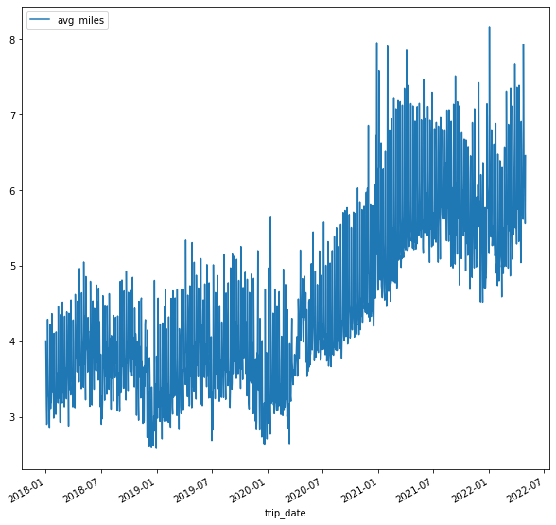
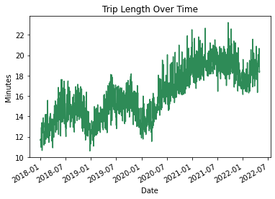
Exploratory Data Analysis - Trends over Time
COVID-19
COVID-19
Though the number of trips decreases, the avg duration and miles per trip have increased since the end of 2020
*Avg Miles: from 3-5 miles, increased to 5-7 miles
*Avg Trip Length: from 10-16 minutes, increased to 16-20 minutes

Slide 19
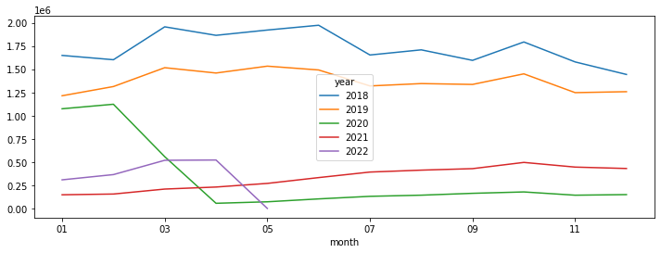
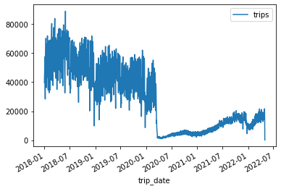
Number of Trips Daily and YoY Trends

Slide 20
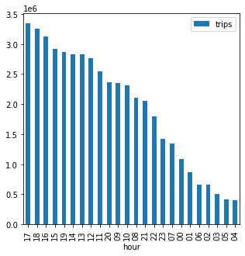
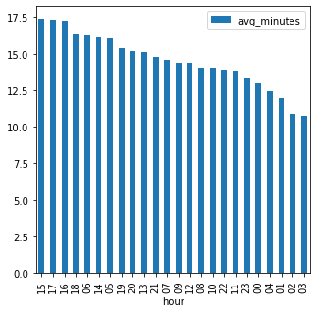
Number of Trips and Avg Minutes by Hour

Slide 21
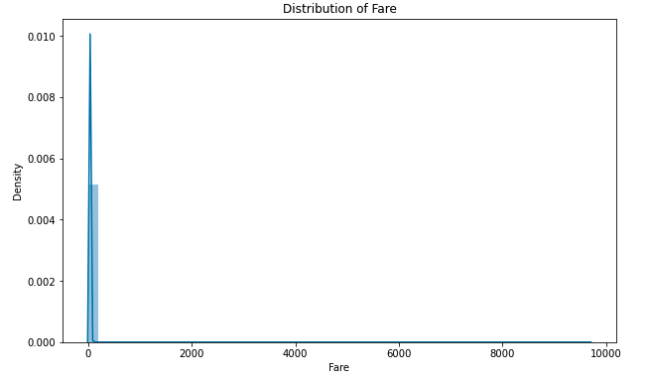
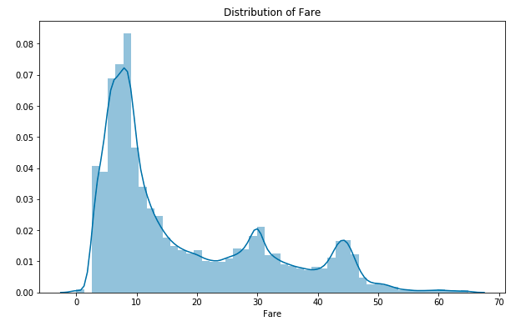
EDA - Cost Analysis

