Slide 1
Improved Edge Detection using ACS
Syam Gullipalli
Seminar: Recent Results in Swarm Intelligence
L.079.08005

Slide 2
Edge Detection
Estimate structural features of image.
Conventional Methods:
Require smoothing.
Complex mathematical functions:
First and second order derivatives
Zero crossing
Sensitive to noise.

Slide 3
Ant Colony System (ACS)
Two levels of pheromone update:
Local
Global

Slide 4
Image as Graph
Represent image as nodes and edges:
Heuristc for edge detection:

Slide 5
Edge Detection using ACS
Global pheromone update by all ants, not just by the best-so-far ant.

Slide 6
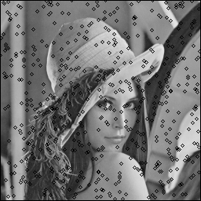
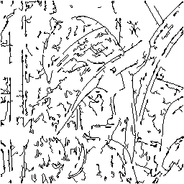
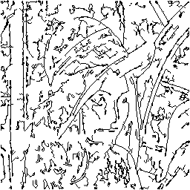
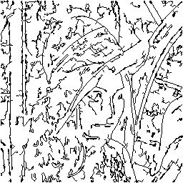
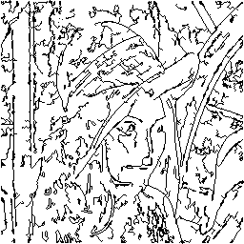
Random Init
Initialize ants on image using uniform random distribution.
Prone to noise.
Requires thresholding techniques to remove noise.
initialization
iteration 1
iteration 5
iteration 7
iteration 10

Slide 7
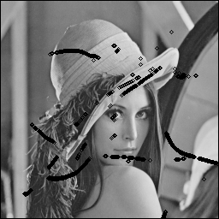
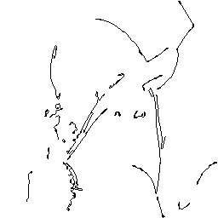
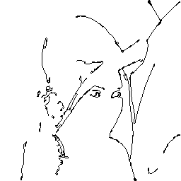
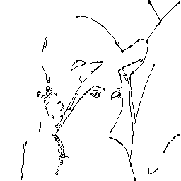

Initialize on Best Heuristics
Initialize on best heuristics.
Best heuristics are the positions where heuristic values are high.
No noise filter required.
Results stagnate after certain iterations.
initialization
iteration 1
iteration 5
iteration 7
iteration 10

Slide 8
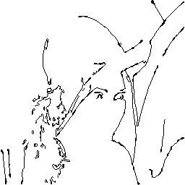
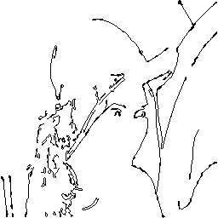
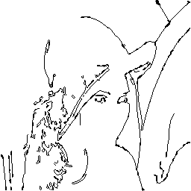
Re-initialize
On each iteration re-initialize ants which performed below the average.
Re-initialize on next best heuristic poasitions.
No noise filtering required.
No stagnation of results.
initialization
iteration 1
iteration 5
iteration 7
iteration 10

Slide 9
Comparision(1)
Average Pheromone Deposit

Slide 10
Comparision(2)
Performance

Slide 11
Thank you

