Slide 1

Security Issues in Distributed Database System
Literature Review
Arjun Kumar
Dharmil Shah
Krishna Patel
Arjun Kumar
Dharmil Shah
Krishna Patel

Slide 2
Agenda
What is Distributed Database?
Summary
Types of security issues
Security approaches in distributed database
Authentication Based
Access Control Based
Authentication vs Access Control
Is this review comprehensive?
Security issues and challenges
Conclusion

Slide 3
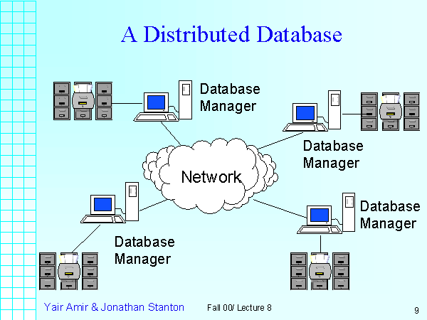
What is Distributed Database?
A single logical database that is spread physically across computers in multiple locations that are connected by a data communications link.
Database may be physically stored in two or more computer systems or it can be split into different segments and each segment stored in different location.
Transactions may access data on one or more sites.

Slide 4
Summary
Security is a complicated business that wasn’t given much thought until uses of computer networks increased and the potential for abuse became interesting (i.e. Profitable)
Types of Security issues in DDB
Data security
Communication security
Network security
Approaches in Data security
Authentication based
Access control based
Audit based

Slide 5
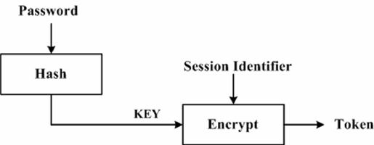
Authentication Based
Authentication is a process by which one principal verifies the identity of other principal.
Authentication Protocol
Cryptographic technique
Symmetric & Asymmetric technique
Kerberos authentication protocol

Slide 6
Access control based
Access control guarantees authorized users perform operations they are allowed to perform on the database.
Types of Access control
Discretionary access control- or authorization control defines access rights based on the users, the type of access (e.g., SELECT, UPDATE) and the objects to be accessed.
Multi-level access control- or mandatory improves security by defining different security levels for both subjects and data objects.

Slide 7
Authentication vs Access control
Authentication | Access Control
Verifies the identity of a user. | Grants or revokes the right to access data.
Protects from: - the whole world | Protects from: - Stolen credentials
Authentication technologies: - Biometric, OTP, Passwords, Facial recognition | Access control technologies: - UserLock, Active directory
It is the first step of every process. | No process starts with this, it comes in picture only when the user is authenticated.

Slide 8
Is the review comprehensive?
Yes, The objective of this study were to conduct a comprehensive review of the literature on security in distributed database.
The review includes various aspects of security. But the focus is on authentication and multi-level access control and methods to improve security in future.
We examined different papers on security issues in the distributed database and concluded that authentication and access control are the two key approaches that should be taken into consideration.

Slide 9
Security Challenges
Appropriate Access Control
Security Problems with Distributed Data Mining
Concurrency Control Performance

Slide 10
Most common security challenges
Brute force attack: A brute force attack is an effort to break a password or a code, or locate the key to encrypt a message by means of the check and error technique, and subsequent expectations that it will be right.
DDOS: Denial of services is an attack (DDOS) in which the main purpose of attacker or hacker is to destroy the service of resources used by the legitimate user when this attack occur in distributed system.
Data Breaching: A data breach is an incident where information is stolen or taken from a system without the knowledge or authorization of the system’s owner such as credit card details, personal data. Eg: Facebook Data Breaching.

Slide 11
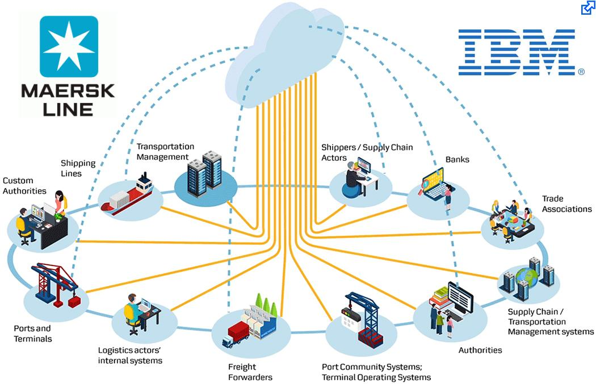
Future Implementation
Adapting BlockChain Technology
Blockchain: A blockchain is a growing list of records, called blocks, which are linked using cryptography. Each block contains a cryptographic hash of the previous block, a timestamp, and transaction data.
Eg : IBM Shipping Industry

Slide 12
Improvement Methods
Hybrid Lock Buffer
Using Convert Channel
Wound Wait

Slide 13
Conclusion
With Current Security protocols there are still spaces for security breach.
Authentication and Access Control helps to provide data access to legitimate user only.
Adapting Blockchain, using Hybrid Lock Buffer and avoiding Deadlock problems will improve a layer of security to a larger aspect.

Slide 14
References
https://docs.oracle.com/cd/B12037_01/network.101/b10777/authuser.htm
https://www.tutorialspoint.com/distributed_dbms/distributed_dbms_security_distributed_databases.htm
https://link-springer-com.proxy-bc.researchport.umd.edu/content/pdf/10.1007%2F978-1-4419-8834-8_5.pdf
https://www.trendmicro.com/vinfo/us/security/definition/data-breach
https://www.researchgate.net/publication/319214742_Blockchain_Security_in_Cloud_Computing_Use_Cases_Challenges_and_Solutions
https://www.tutorialspoint.com/blockchain/index.htm

Slide 15
Thank You

