Slide 1
Singly Linked List

Slide 2
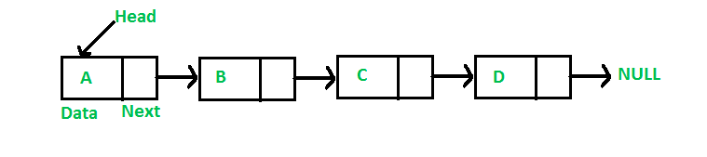
SINGLY LINKED LIST
Singly linked list is a linear dynamic data structure, where elements are linked using pointers. It is a sequence in which every element has link to its next element in the sequence.
Singly linked list is represented by a pointer to the first node, known as head.
Every node in singly linked list has two attributes:
1) Data field 2) Pointer to ‘next’ node.

Slide 3
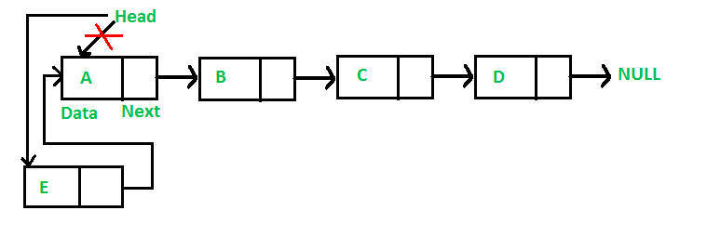
SINGLY LINKED LIST - INSERTION
A node can be inserted in singly linked list in following three ways:
1) At the front of linked list: [Time complexity: O(1)]

Slide 4
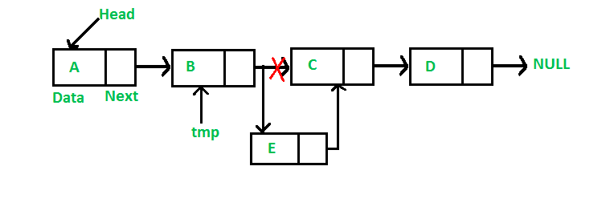
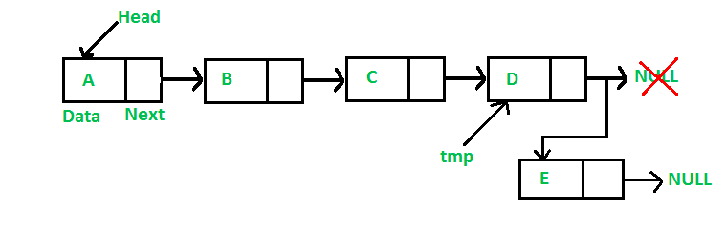
SINGLY LINKED LIST - INSERTION
2) After a given node: [Time complexity: O(1)]
3) At the end of linked list: [Time complexity: O(n)]

Slide 5
DATA USED :
Number Of Inputs | Time ( in seconds )
100 | 0.0002030619691
500 | 0.001847310831
1000 | 0.001711804498
2000 | 0.002926620753
10000 | 0.01414125133
20000 | 0.02518521503
35000 | 0.04137762929
50000 | 0.06490595347
100000 | 0.1336854918

Slide 6
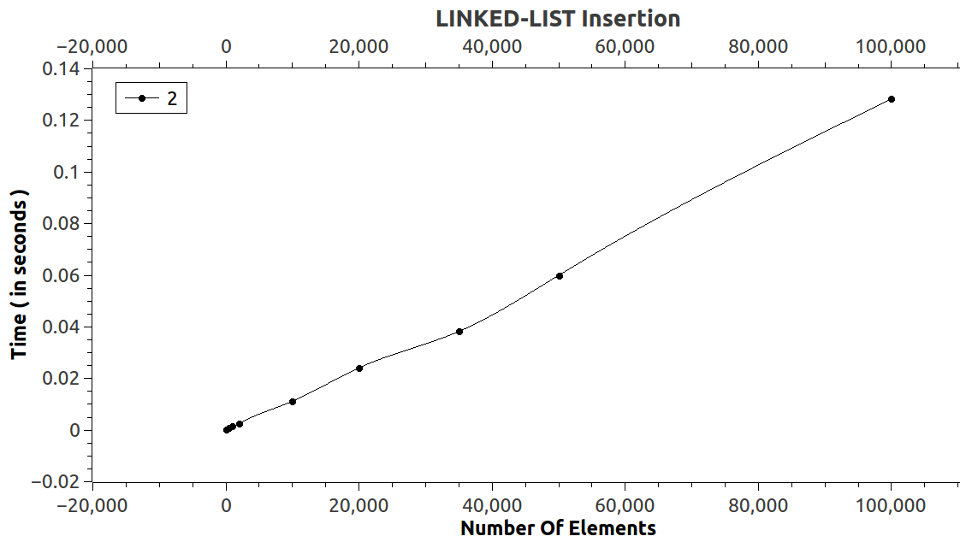
SINGLY LINKED LIST - INSERTION

Slide 7
SINGLY LINKED LIST - SEARCHING
Searching in linked list is based on the following algorithm:
Initialize a node pointer, current = head.
Do following while current is not NULL
a) if current.key is equal to the key being searched, then return current.
b) current = current.next
Return None
The worst-case runtime of search is O(n).

Slide 8
DATA USED :
Number Of Inputs | Time ( in seconds )
100 | 1.03E-05
500 | 5.77E-05
1000 | 1.50E-04
2000 | 1.52E-04
10000 | 1.29E-03
20000 | 1.61E-03
50000 | 4.65E-03
100000 | 8.48E-03

Slide 9
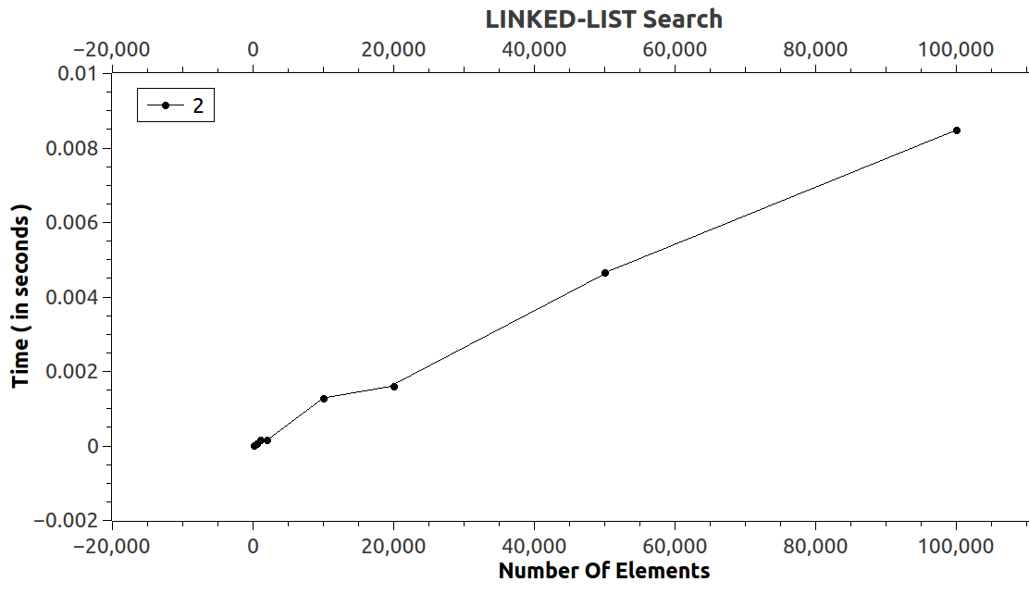
SINGLY LINKED LIST - SEARCHING

Slide 10
SINGLY LINKED LIST - DELETION
To delete a node from linked list, we need to do following steps:
Find the node whose next node is the node to be deleted and set it as current.
Change next of the current node to next of the next node.
The worst-case runtime of delete is O(n).

Slide 11
DATA USED :
Number Of Inputs | Time ( in seconds )
100 | 1.58E-05
500 | 7.82E-05
1000 | 0.0002354570692
2000 | 0.0002575805522
10000 | 0.001645829111
20000 | 0.00224632365
35000 | 0.004301437197
50000 | 0.006472699029
100000 | 0.01245670612

Slide 12
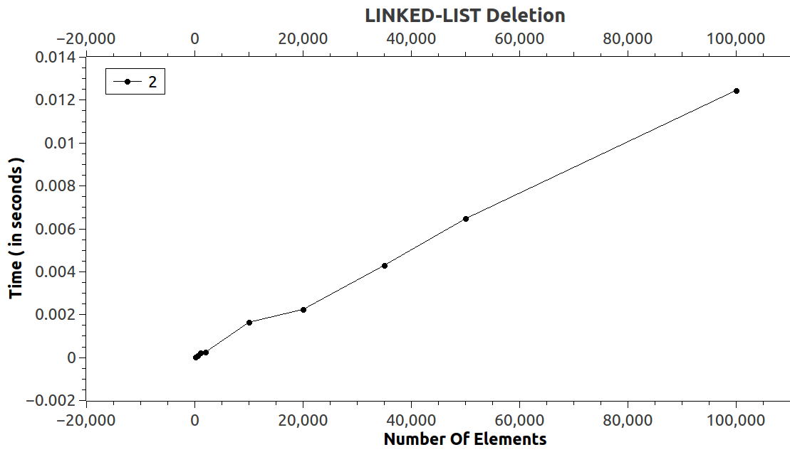
SINGLY LINKED LIST - DELETION

Slide 13
Skip List

Slide 14
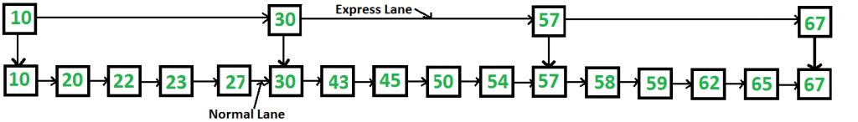
SKIP LIST
Skip list is a data structure which maintains a linked hierarchy of subsequences, with each successive subsequence skipping over fewer elements than the previous one.
Skip list allows fast search within an ordered sequence of elements.

Slide 15
SKIP LIST- LEVEL ALLOCATION
Each element in the skip list is represented by a node and the level of the node is chosen randomly while insertion in the list. It does not depend on the number of elements in the node.
Level allocation is done on the basis of following algorithm:
randomLevel()
    lvl = 1
    while random() < p and lvl < MaxLevel do
    lvl = lvl + 1
    return lvl

Slide 16
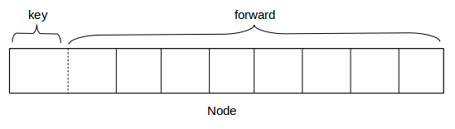
SKIP LIST- NODE STRUCTURE
Each node in the skip list carries a key and a forward array carrying pointers to nodes of a different level. A level i node carries i forward pointers indexed through 0 to i.

Slide 17
SKIP LIST- INSERTION
While doing insertion, we start from highest level in the skip list and compare key of next node of the current node with the key to be inserted. If –
    Key of next node is less than key to be inserted then we keep on moving forward on the same level.
    Key of next node is greater than the key to be inserted then we store the pointer to current node i at update[i] and move one level down and continue our search.
At level 0, we are sure to find a spot to insert the key.

Slide 18
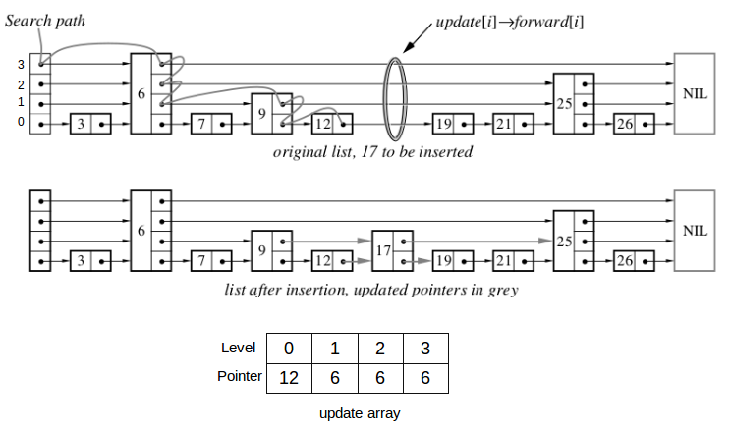
SKIP LIST- INSERTION

Slide 19
DATA USED :
Number Of Inputs | Time ( in seconds )
100 | 0.00179318731
500 | 0.004431807722
1000 | 0.007493539745
2000 | 0.01413018959
10000 | 0.07245914761
20000 | 0.1604319926
35000 | 0.3300317986
50000 | 0.5341564849
100000 | 1.493129671

Slide 20
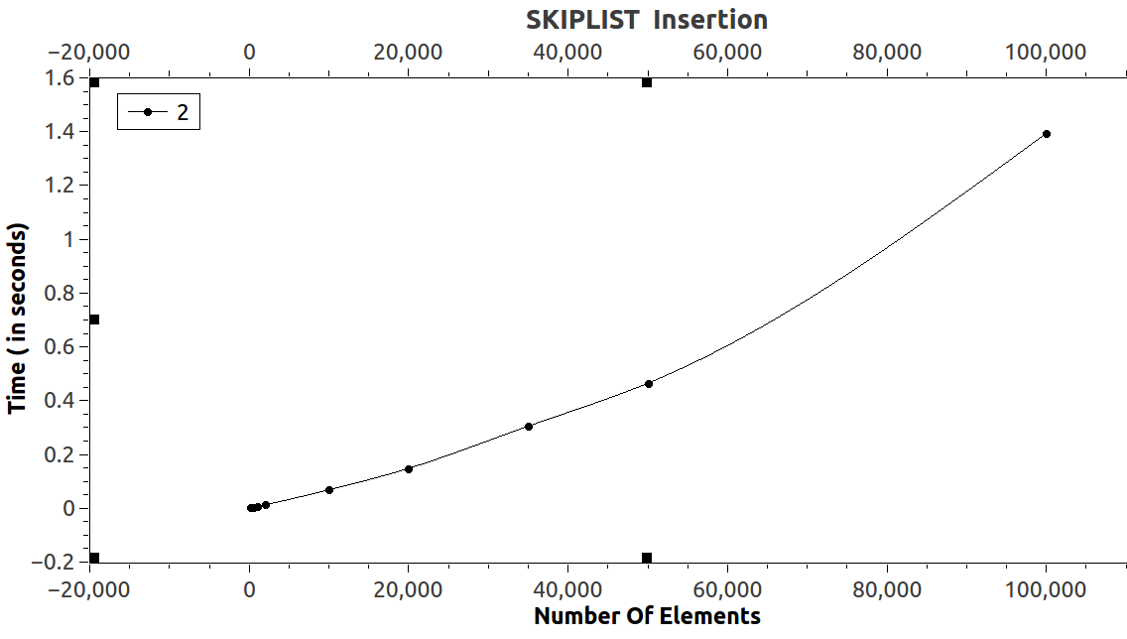
SKIP LIST- INSERTION

Slide 21

SKIP LIST- SEARCHING
Searching an element is similar to searching a spot for insertion in skip list. The basic idea is same as if-
    Key of next node is less than key to be inserted then we keep on moving forward on the same level.
    Key of next node is greater than the key to be inserted then we store the pointer to current node i at update[i] and move one level down and continue our search.
At level 0, if the element next to update[0] has key equal to the search key, then success else failure.

Slide 22
DATA USED :
Number Of Inputs | Time ( in seconds )
100 | 7.94E-05
500 | 0.0001319507737
1000 | 0.0001679014336
2000 | 0.0002085928398
10000 | 0.0002623212986
20000 | 0.000190815041
50000 | 0.0001951607251
100000 | 0.0001121976638

Slide 23
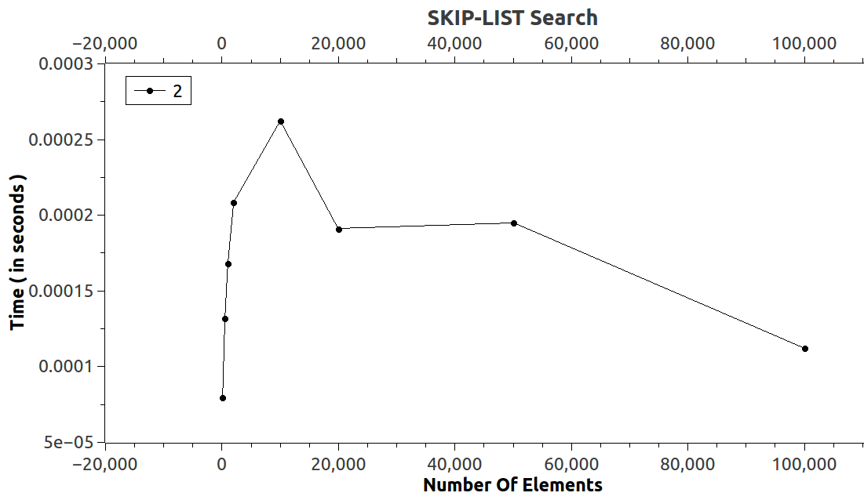
SKIP LIST- SEARCHING

Slide 24
SKIP LIST- DELETION
Deletion of an element k is preceded by locating element in the skip list using search algorithm. After that, rearrangement of pointers is done to remove element from the skip list.
We start from lowest level and do rearrangement until element next to update[i] is not k.
After deletion of element there could remain some levels with no elements, so we remove these levels as well by decrementing the level of Skip list.

Slide 25
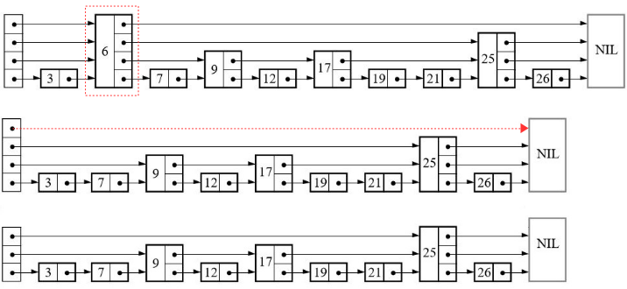
SKIP LIST- DELETION
The worst case runtime of each operation in skip list is O(n).

Slide 26
DATA USED :
Number Of Inputs | Time ( in seconds )
100 | 0.0001216791566
500 | 0.0001449878262
1000 | 0.0001015309845
2000 | 0.0001074569175
10000 | 0.0002026669069
20000 | 0.0002046422178
35000 | 0.0002038520935
50000 | 0.0002188644569
100000 | 0.0002157039594

Slide 27
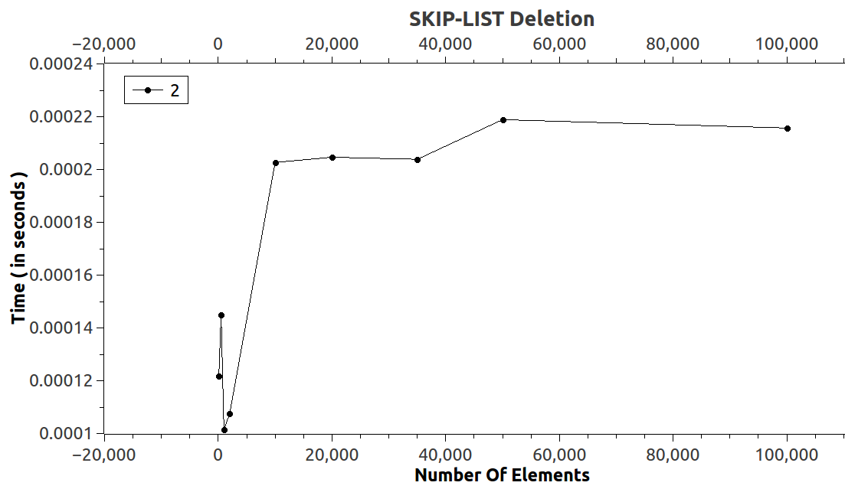
SKIP LIST- DELETION

Slide 28
Splay Tree

Slide 29
SPLAY TREE
Splay tree is a self - adjusted Binary Search Tree in which every operation on an element rearrange the tree so that the (recently accessed) element is placed at the root position of the tree.
“SPLAYING” an element is the process of bringing it to the root position by performing suitable rotation operations.
Here, all normal operations on a binary search tree are combined with one basic operation, called splaying.

Slide 30
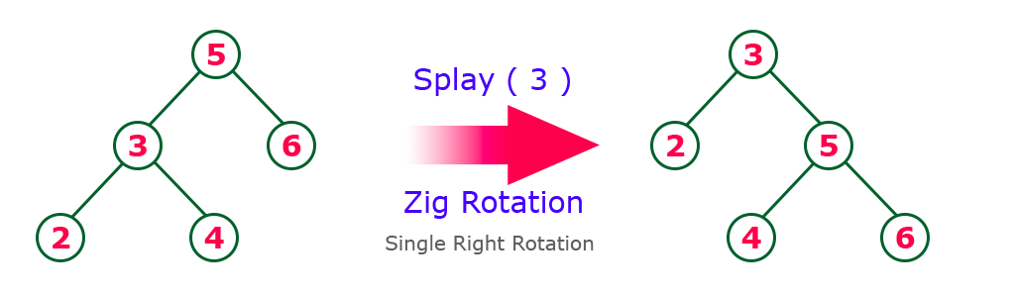
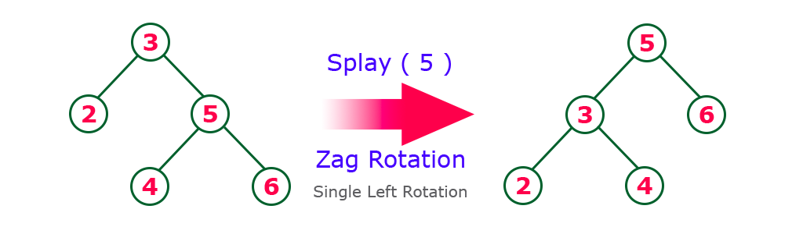
SPLAY TREE- INSERTION
ZIG Rotation: Node is a left child of root.
ZAG Rotation: Node is a right child of root.

Slide 31
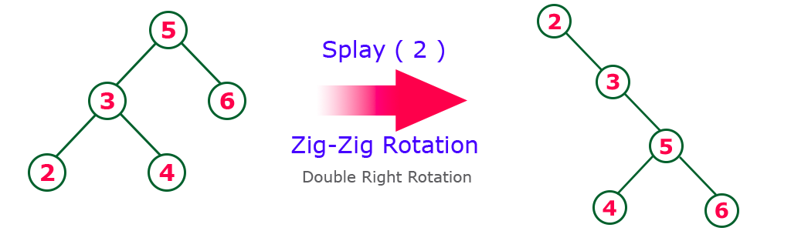
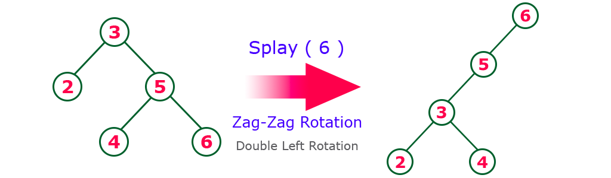
SPLAY TREE- ROTATIONS
ZIG-ZIG Rotation: Node is left child of parent and parent is also left child of grand parent.
ZAG-ZAG Rotation: Node is right child of parent and parent is also right child of grand parent.

Slide 32
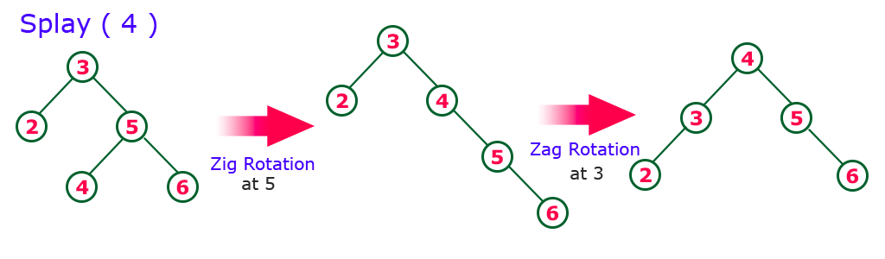
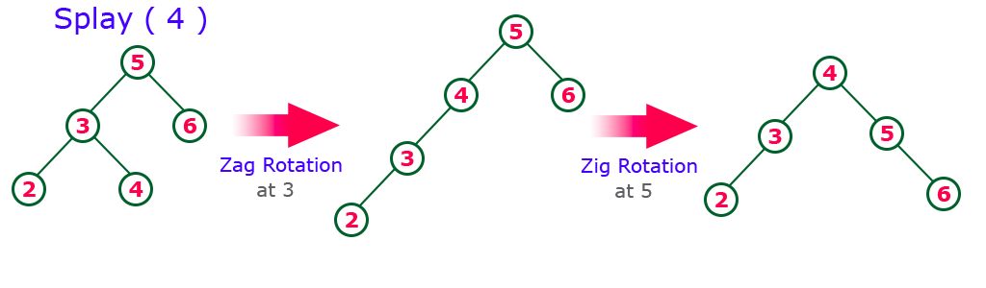
SPLAY TREE- ROTATIONS
ZIG-ZAG Rotation: Node is left child of parent and parent is right child of grandparent.
ZAG-ZIG Rotation: Node is right child of parent and parent is left child of grandparent.

Slide 33
SPLAY TREE- INSERTION
Insertion in the splay tree is done as follows:
  If root is null, then allocate a new node and return it as root.
  Else splay the given key k. If k is already present, then it becomes the new root. If not present, then last accessed leaf node becomes the new root.
  If new root’s key is same as k, then we don’t do anything as k is already present.

Slide 34
SPLAY TREE- INSERTION
  IV. Else allocate memory for new node and compare root’s key with k.
      If k is smaller than root’s key, make root as right child of new node, copy left child of root as left child of new node and make left child of root as NULL.
      If k is greater than root’s key, make root as left child of new node, copy right child of root as right child of new node and make right child of root as NULL.

Slide 35
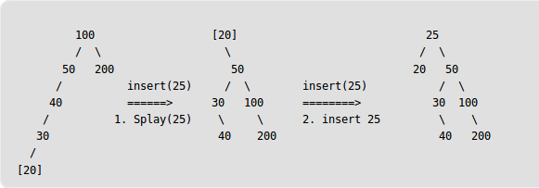
SPLAY TREE- INSERTION
V. Set the new node as new root of tree.
(Inserting 25)

Slide 36
DATA USED :
Number Of Inputs | Time ( in seconds )
100 | 0.00126261878
500 | 0.003164053133
1000 | 0.006311513653
2000 | 0.01101946985
10000 | 0.06421261931
20000 | 0.1372995208
35000 | 0.2514412857
50000 | 0.4242418855
100000 | 0.9638668214

Slide 37
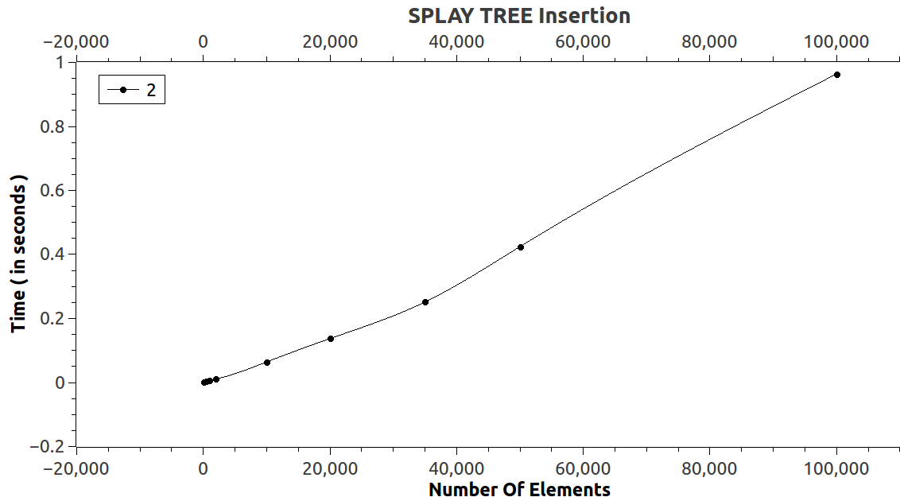
SPLAY TREE- INSERTION

Slide 38
SPLAY TREE- SEARCHING
Searching in the splay tree is done as follows:
  If root is null, then it returns None.
  Else splay the given key k.
  If key of root is not equal to given key k, return None, else return root.

Slide 39
DATA USED :
Number Of Inputs | Time ( in seconds )
100 | 4.74E-06
500 | 2.45E-05
1000 | 2.05E-05
2000 | 2.37E-05
10000 | 2.77E-05
20000 | 2.21E-05
50000 | 9.09E-06
100000 | 5.93E-06

Slide 40
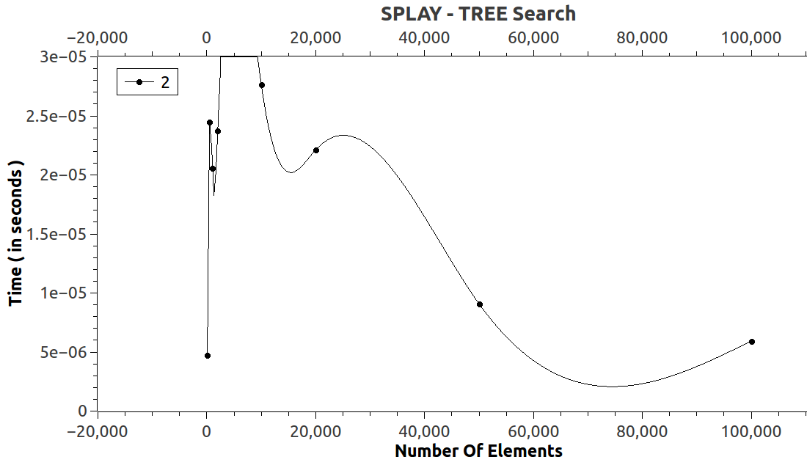
SPLAY TREE- SEARCHING

Slide 41
SPLAY TREE- DELETION
Deletion in the splay tree is done as follows:
  Splay the given key k.
  If key of root is not equal to given key, then there is no node having key equal to given key k.
  Else if left child of root is None, then set root to right child of root.

Slide 42
SPLAY TREE- DELETION
  IV. Otherwise, setting a variable node ‘x’ to right child of root and splaying left child of root will result in a tree with no right child of root and maximum key in left subtree gets splayed.
  V. Now, we can set right child of root as ‘x’ and return the root of the updated splay tree.
  The time complexity of

Slide 43
DATA USED :
Number Of Inputs | Time ( in seconds )
100 | 8.30E-06
500 | 2.49E-05
1000 | 1.90E-05
2000 | 2.37E-05
10000 | 2.49E-05
20000 | 3.04E-05
35000 | 1.74E-05
50000 | 1.66E-05
100000 | 0.00002607410498

Slide 44
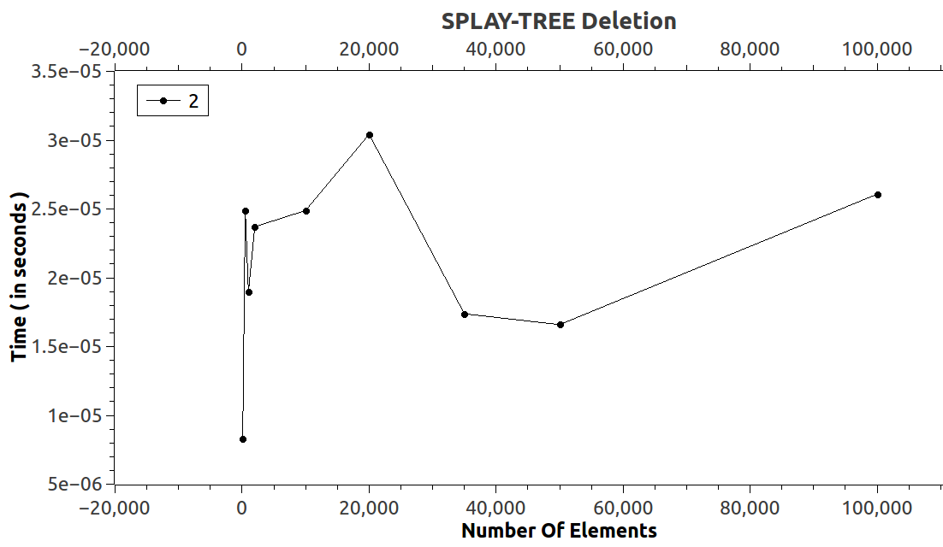
SPLAY TREE- DELETION

Slide 45
THANK YOU

