Slide 1
ECS-Cockroachdb
15) POWERPOINT
Abhishek chatterjee
Arjun bora

Slide 2
Agenda
Why Cockroach?
High-level Architecture
Distributed Data
Mapping Table data to Key-Value

Slide 3
Why cockroach ?
Horizontal scalability
High consistency
Survivability
Easy to install
Notes:
Survivability, self repairing/balancing

Slide 4
Why cockroach ?
Horizontal scalability
High consistency
Survivability
Easy to install
And…
Open Source
Notes:
Survivability, self repairing/balancing

Slide 5
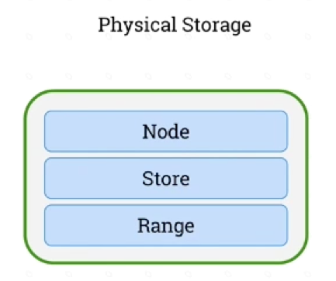
Cockroach DB
Architecture
Notes:
Ranges : small enough to be moved/split quickly
large enough to amortize indexing ovehead

Slide 6
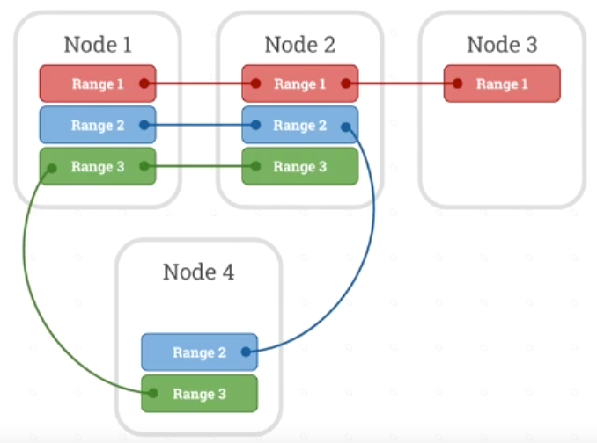
Cockroach DB
Architecture
Notes:
Ranges : small enough to be moved/split quickly
large enough to amortize indexing ovehead

Slide 7

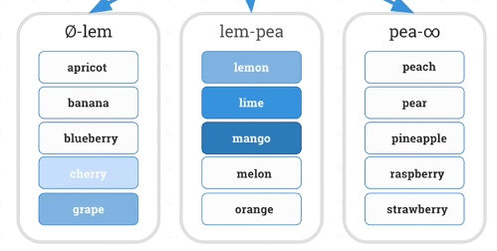
Cockroach DB
Distributed data : Order-Preserving
Range scans (fruits >= “cherry” AND <= “mango”) are efficient

Slide 8
Cockroach DB
KEY-VALUE PAIRS
All tables have a primary key
One key/value pair per column
Key encoding:
/<table>/<index>/<key>/<column>

Slide 9
Cockroach DB
Example table
CREATE TABLE test (
id INTEGER PRIMARY KEY,
name VARCHAR,
price FLOAT,
);

Slide 10
Cockroach DB
Example KV
INSERT INTO test VALUES (1, “ball”, 2.22);
Key:/<table>/<index>/<key>/<column> | Value
/test/primary/1/name | “ball”
/test/primary/1/price | 2.22

Slide 11
Cockroach DB
Example KV
INSERT INTO test VALUES (1, “ball”, 2.22);
INSERT INTO test VALUES (2, “glove”, 3.33);
Key:/<table>/<index>/<key>/<column> | Value
/test/primary/1/name | “ball”
/test/primary/1/price | 2.22
/test/primary/2/name | “glove”
/test/primary/2/price | 3.33

Slide 12
Cockroach DB
Example KV
“test” Table ID | 1000
“id” Column ID | 1
“name” Column ID | 2
“price” Column ID | 3
Key:/<table>/<index>/<key>/<column> | Value
/1000/1/1/2 | “ball”
/1000/1/1/3 | 2.22
/1000/1/2/2 | “glove”
/1000/1/2/3 | 3.33

Slide 13
Cockroach DB
Example KV
“test” Table ID | 1000
“id” Column ID | 1
“name” Column ID | 2
“price” Column ID | 3
Key:/<table>/<index>/<key>/<column> | Value
/1000/1/1/2 | “ball”
/1000/1/1/3 | 2.22
/1000/1/2/2 | “glove”
/1000/1/2/3 | 3.33
Suffixed by Timestamp to support Multi Version Concurrency Control (MVCC)

Slide 14
Cockroach DB
Example KV
“test” Table ID | 1000
“id” Column ID | 1
“name” Column ID | 2
“price” Column ID | 3
Key:/<table>/<index>/<key>/<column> | Value
/1000/1/1/2 | “ball”
/1000/1/1/3 | 2.22
/1000/1/2/2 | “glove”
/1000/1/2/3 | 3.33
Prefix compression by RocksDB

Slide 15
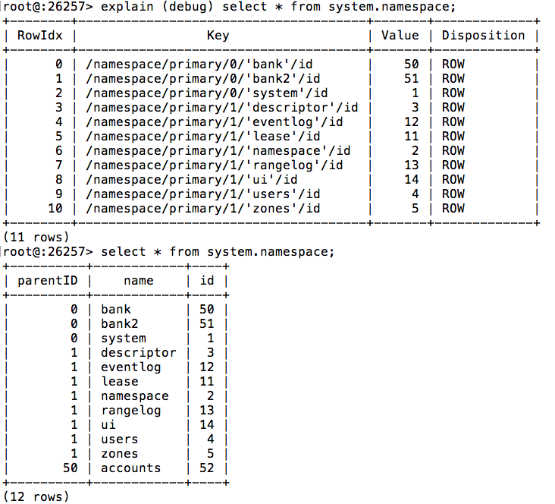
Cockroach DB
Example KV

Slide 16
Cockroach DB
The query:
SELECT * FROM test WHERE id = 10;

Slide 17
Cockroach DB
The query:
SELECT * FROM test WHERE id = 10;
Will be translated into:
Scan(/test/primary/10/, /test/primary/10/Ω)

Slide 18
Cockroach DB
What if you want to search over non-primary index ?

Slide 19
Cockroach DB
What if you want to search over non-primary index ?
Secondary Indexes
CREATE INDEX foo ON TEST(name);
/test/foo/”hello”/1 | NULL
/test/foo/”hello”/2 | NULL

Slide 20
Cockroach DB
Continued…

Slide 21
Agenda
CockroachDB Storage Engine
Incorporating ECS
Replication Model
Future Work
Conclusion

Slide 22
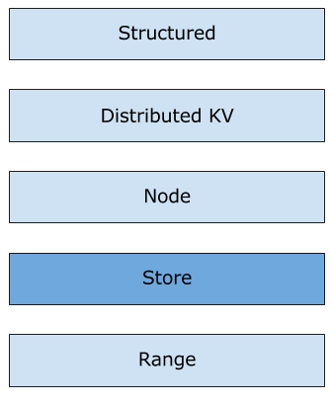
CockroachDB storage engine
rocksdb
RocksDB
CockroachDB Architecture

Slide 23
Incorporating Ecs
Replacing RocksDB
Enter ECS
Communication with ECS

Slide 24
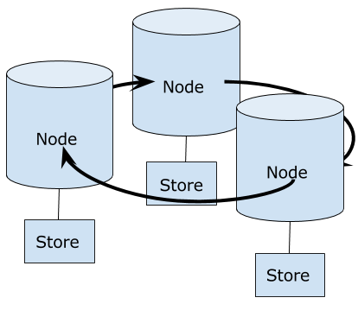
Incorporating ecs
Cockroachdb
(RocksDB)
(RocksDB)
(RocksDB)

Slide 25
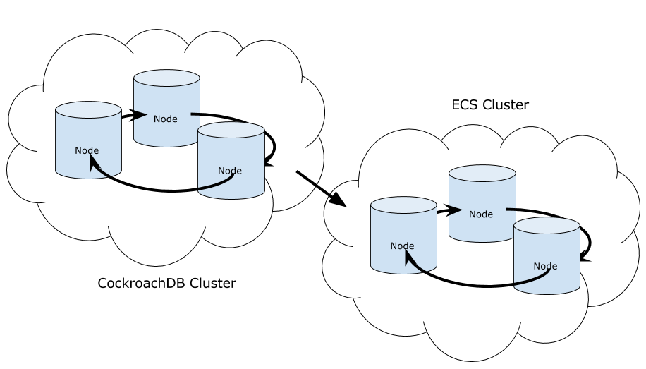
Incorporating ecs
Ecs-cockroachdb

Slide 26
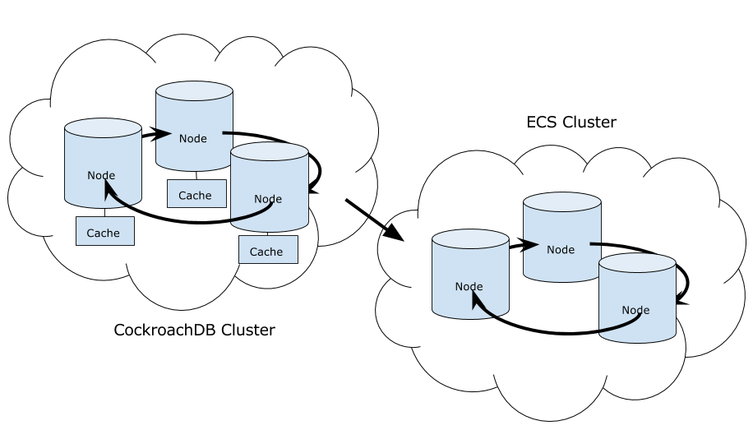
Incorporating ecs
Ecs-cockroachdb

Slide 27
Replication Model
CockroachDB
Raft protocol for consensus
ECS KV DB
DB data replicated across cluster in chunks
No Paxos/Raft for consensus

Slide 28
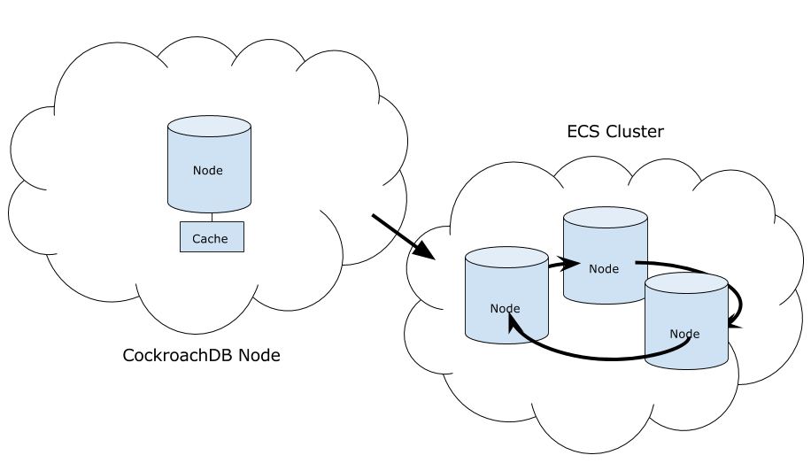
Replication model

Slide 29
Future work
Replace CockroachDB replication with ECS KV DB replication
Communication with ECS:
Replace S3 with extended ECS API
Link ECS blob client to CockroachDB
Compare performance in ECS-CockroachDB with CockroachDB
How to leverage ECS Geo for CockroachDB?

Slide 30
Conclusion
Proof of concept
More data services on top of ECS
Structured and unstructured data

Slide 31
Questions?

