Slide 1
Healthcare Claims Analytics: Where Is the Money Going?
Executive Insights Dashboard
Arjun Premji

Slide 2
Business Context
Health insurance companies process large volumes of claims.
Without analytics, it is difficult to identify cost drivers.
The organization is currently experiencing financial losses.
Executives need visibility into where money is being spent.

Slide 3
Problem Statement
The insurance company is losing money and does not have clear visibility into which claim types, procedures, diagnoses, or members are driving the highest costs.
No centralized analytical view
Difficult to detect cost leakage
Limited support for executive decision-making

Slide 4
Project Objective
Analyze healthcare claims data to identify cost drivers.
Break down spending by:
Claim type
CPT and ICD codes
Members
Compare billed amounts with paid amounts.
Build an executive-level interactive dashboard.

Slide 5
Dataset & Tools Used

Slide 6
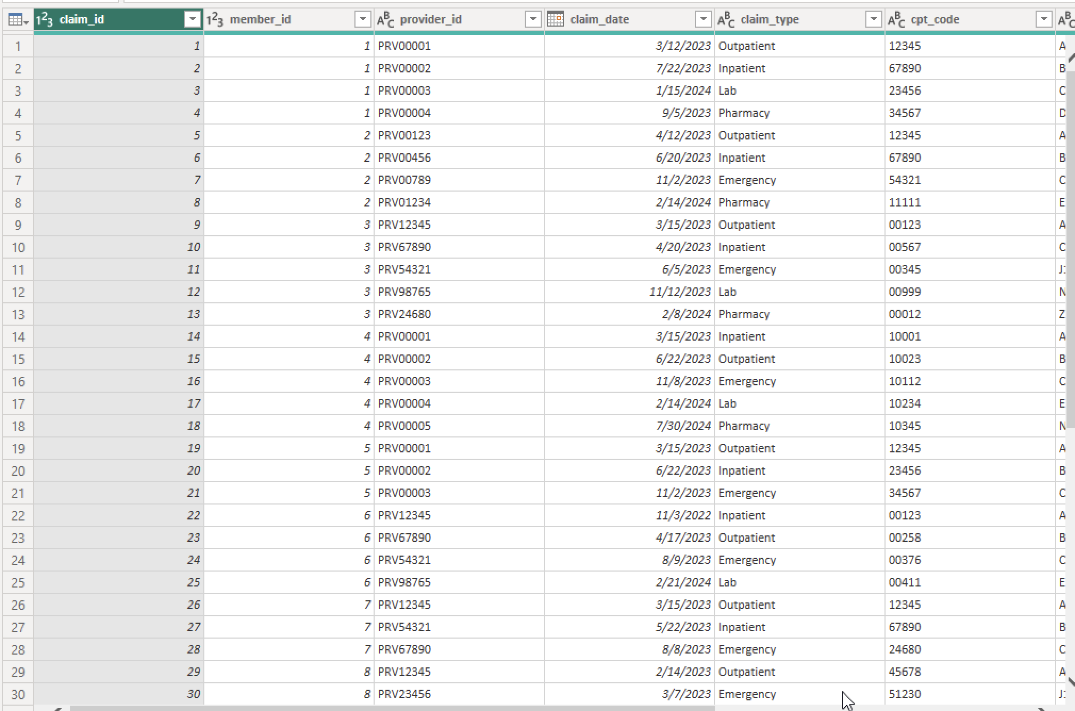
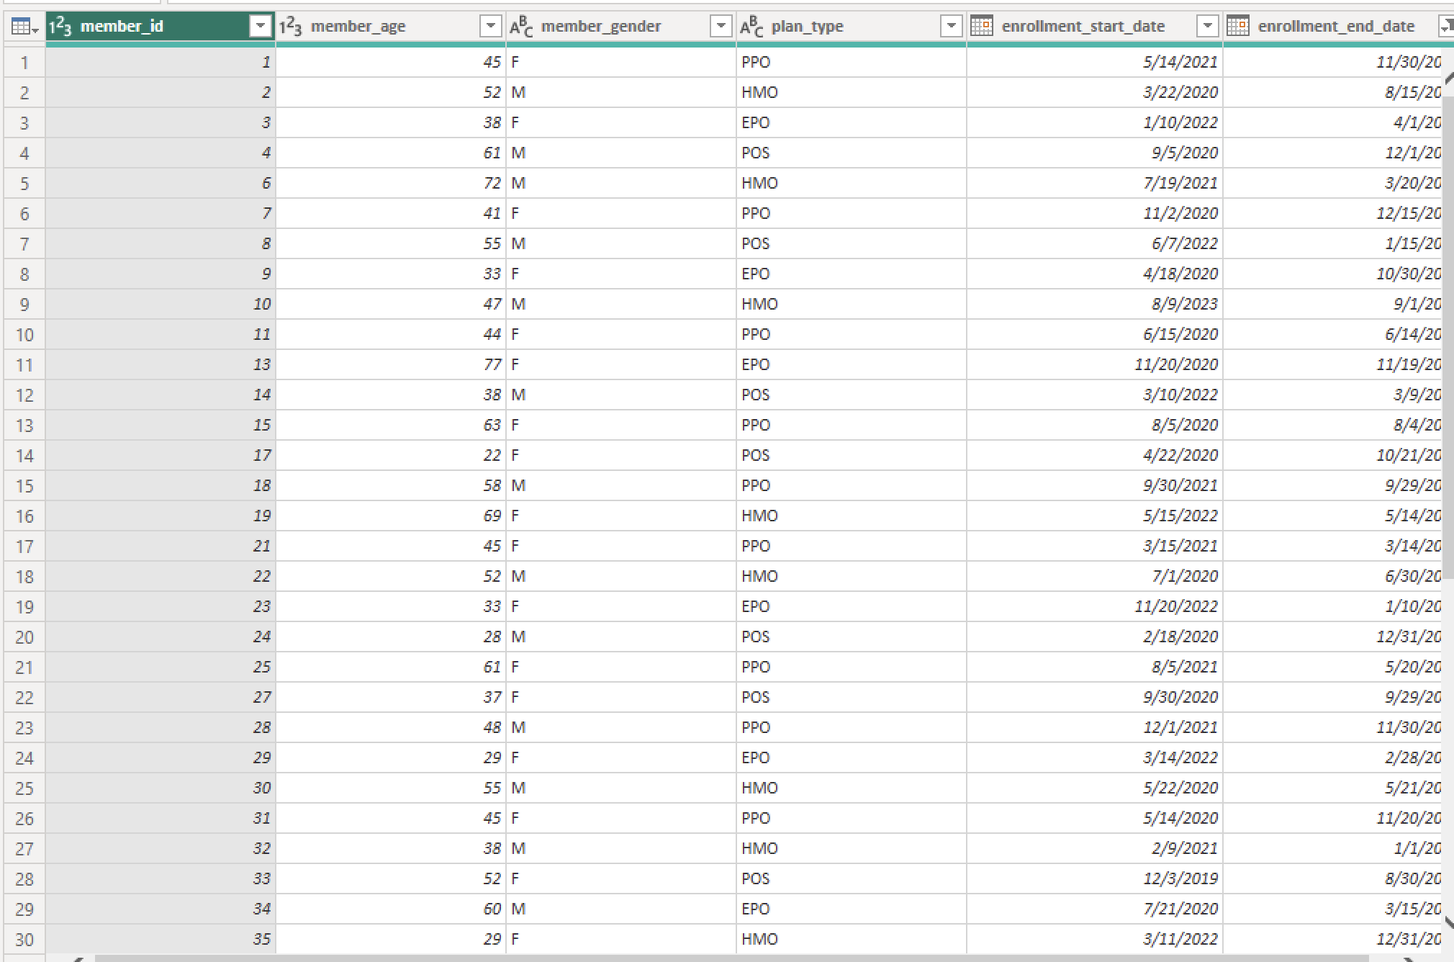
Dataset
Synthetic healthcare claims dataset
Includes:
Claim types
CPT & ICD codes
Billed and paid amounts
Member and provider details

Slide 7

Tools
Data preparation: Power BI (Power Query)
Analysis: Power BI
Visualization: Power BI

Slide 8
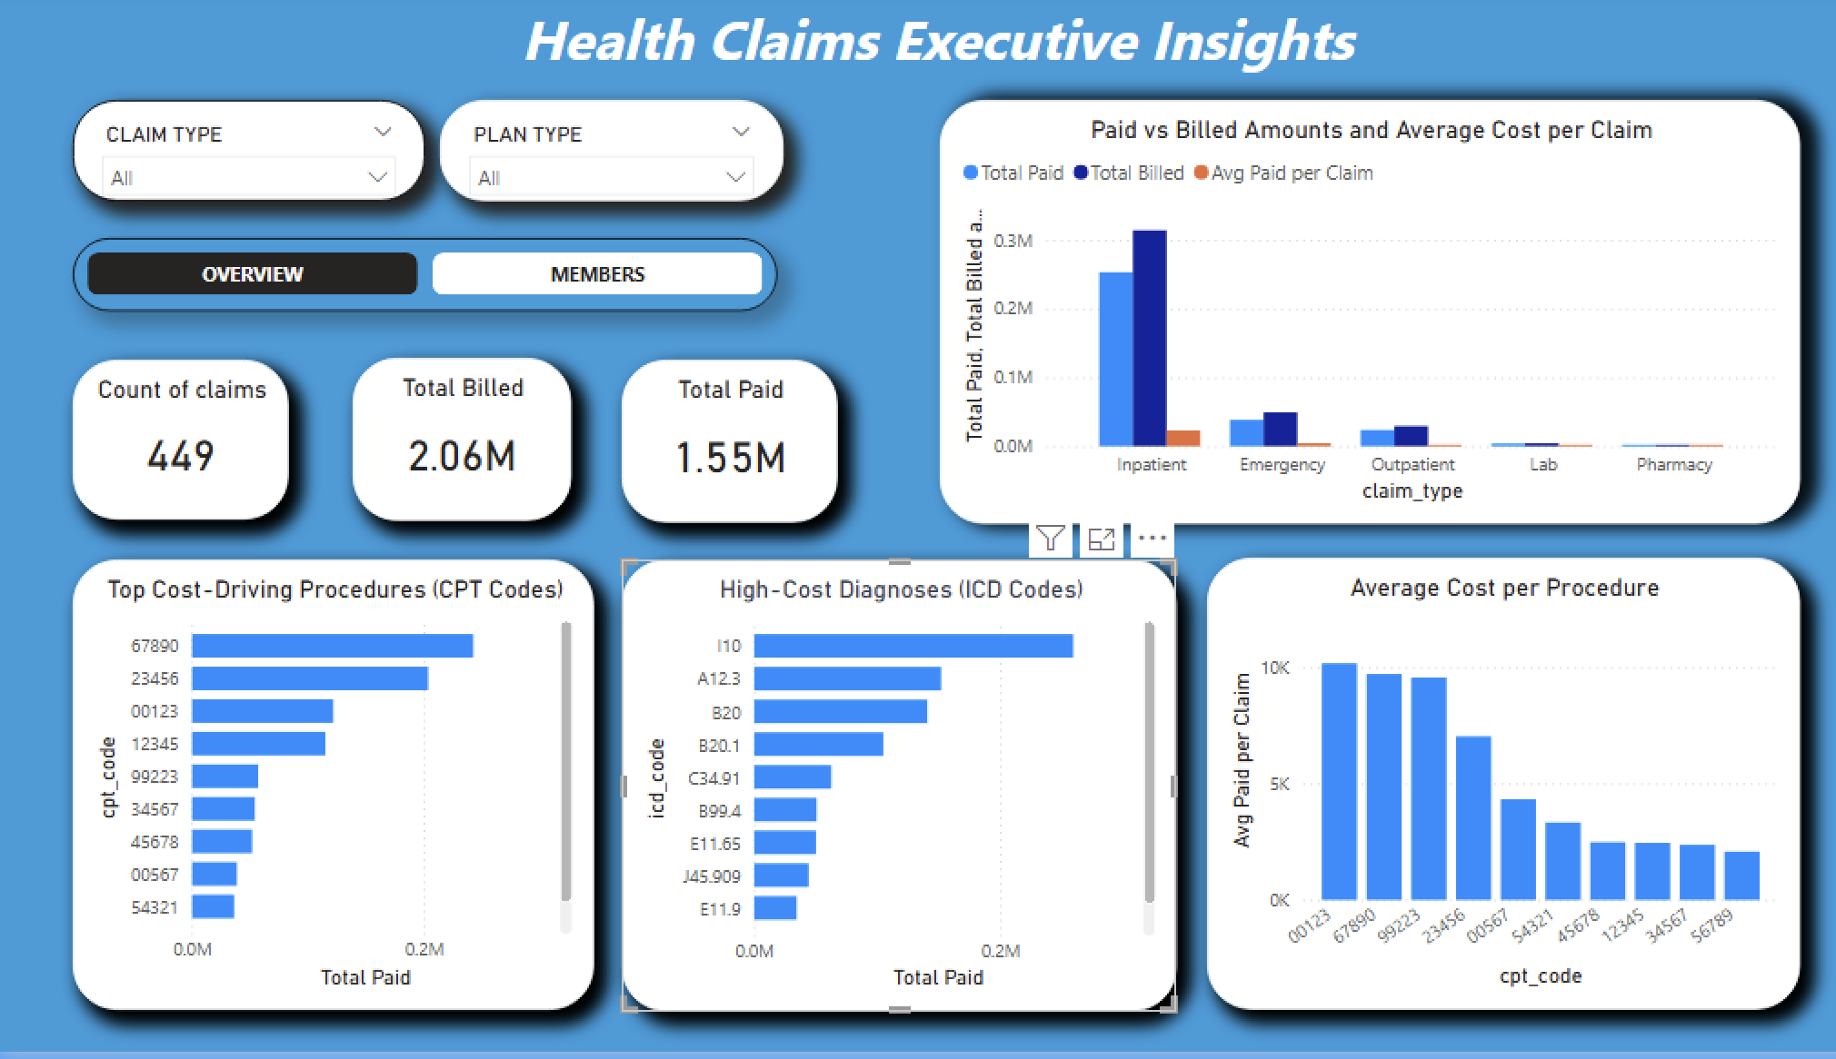
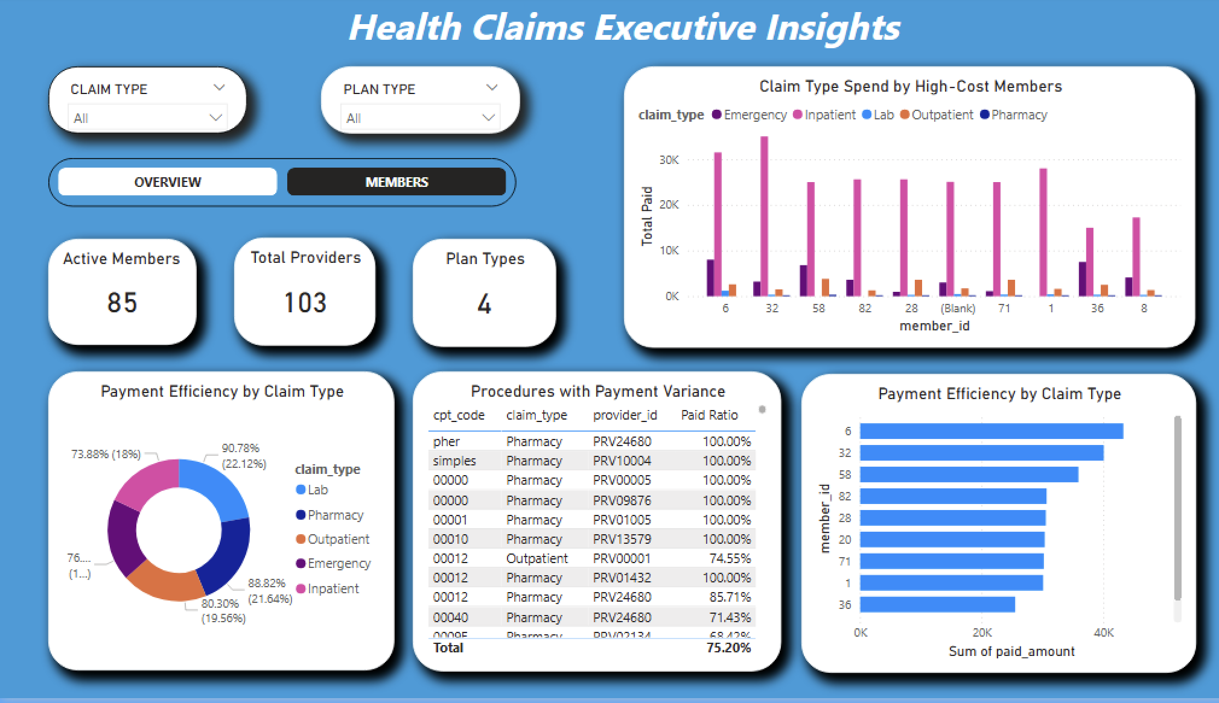
Dashboard Overview
Provides a high-level financial summary for executives.
Displays total claims, total billed amount, and total paid amount.

Slide 9
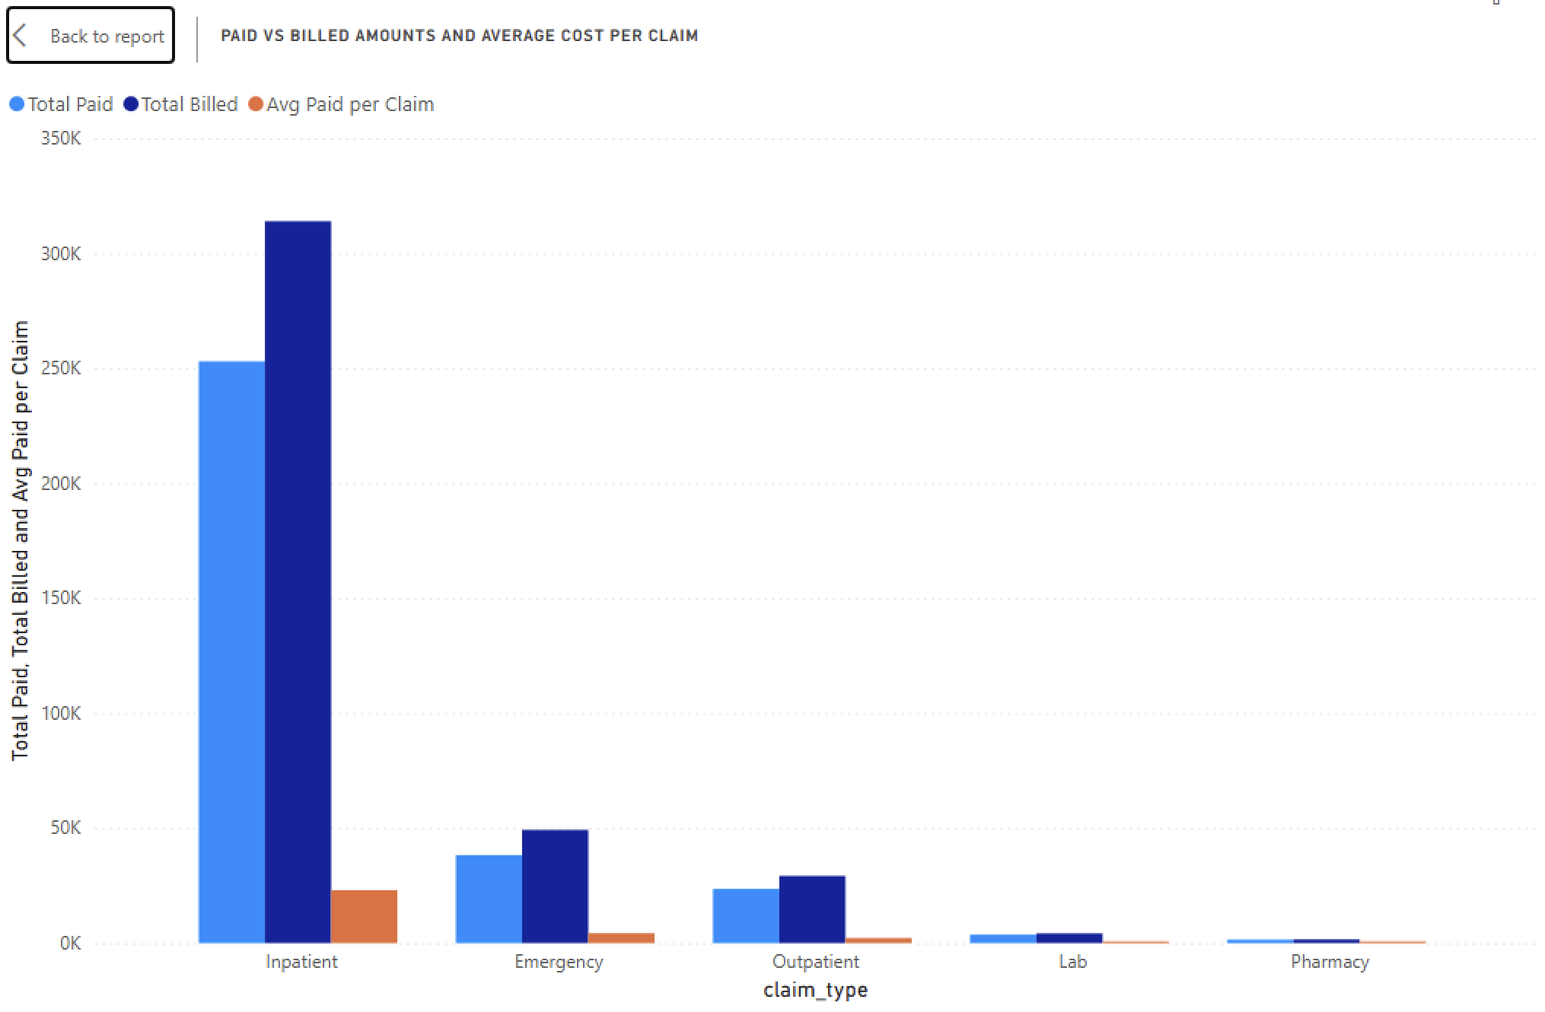
Claim Type Cost Breakdown
Inpatient claims contribute the highest total paid amount.
Emergency and outpatient claims have moderate cost impact.
Pharmacy and lab claims are lower-cost but higher-frequency.

Slide 10
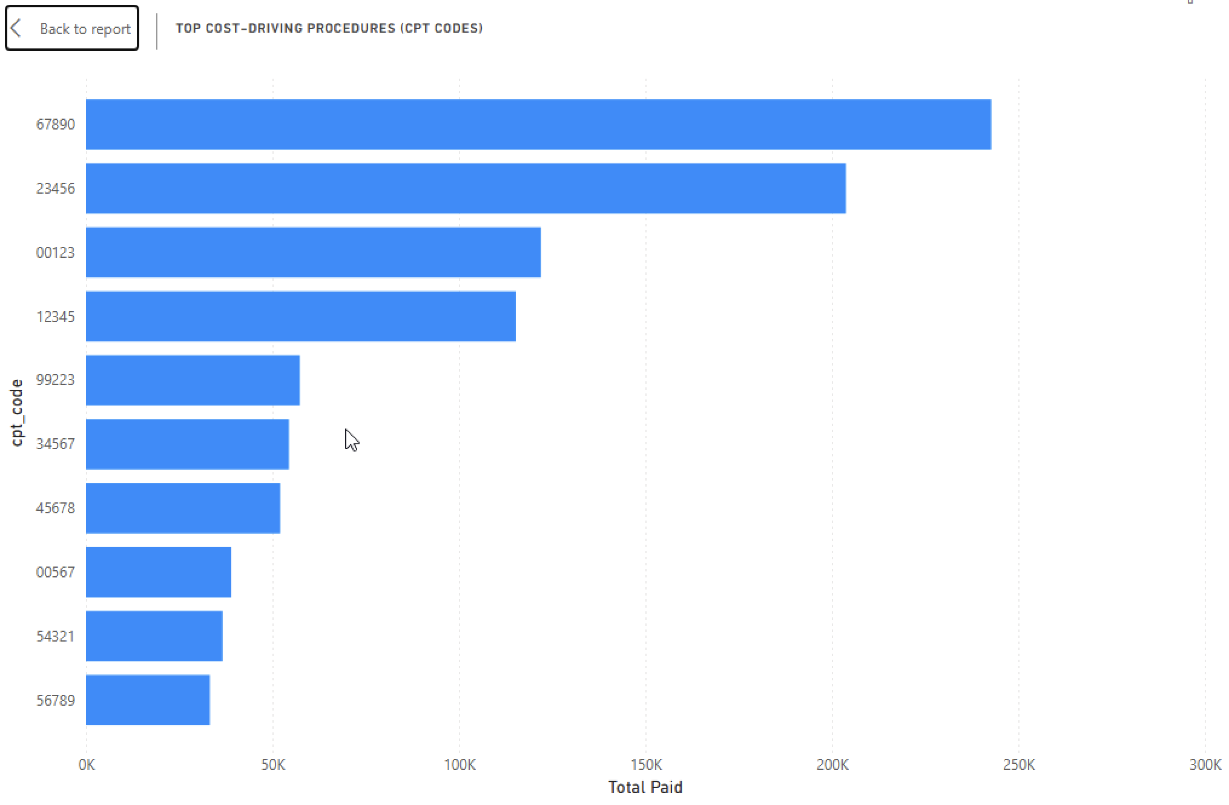
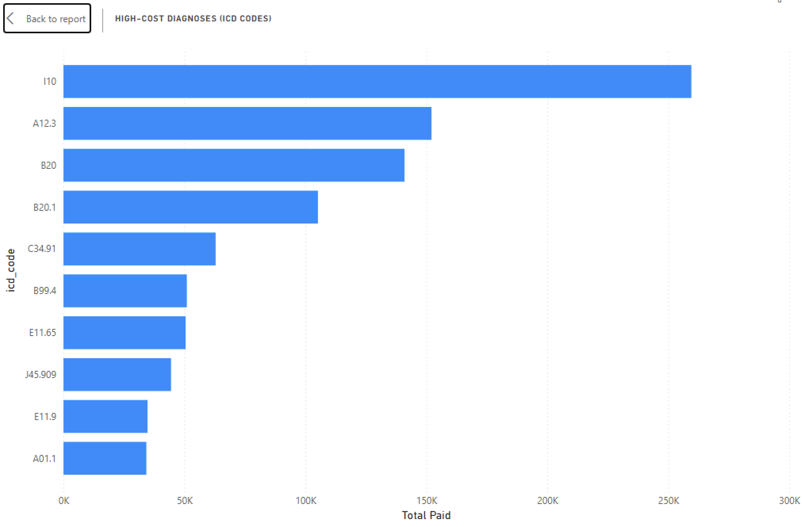
Procedure and Diagnosis Cost Drivers
Inpatient claims contribute the highest total paid amount.
Emergency and outpatient claims have moderate cost impact.
Pharmacy and lab claims are lower-cost but higher-frequency.

Slide 11
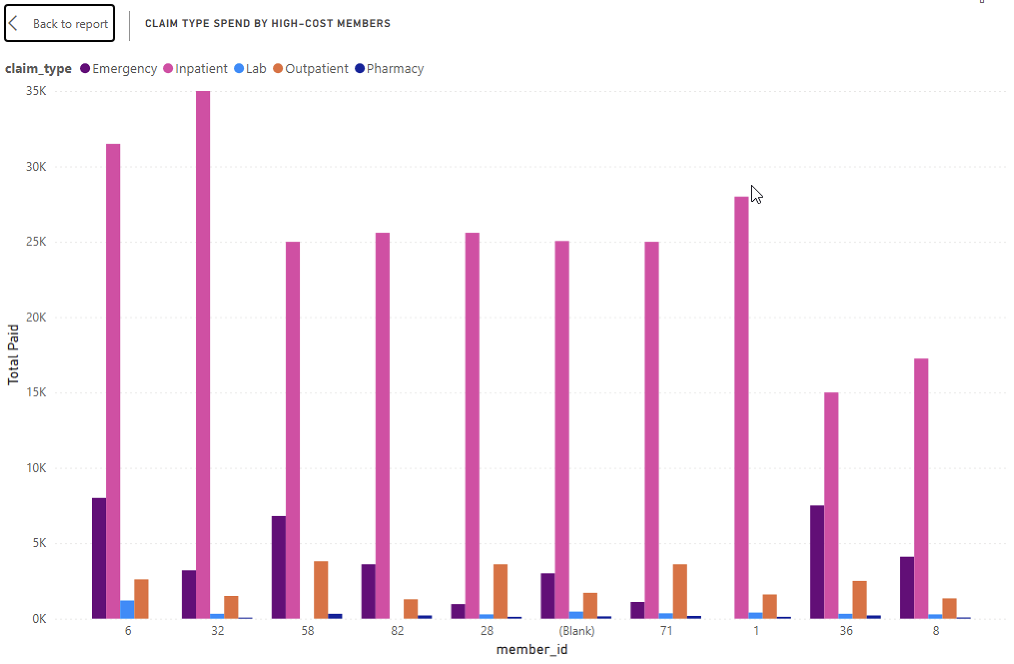
High-Cost Member Analysis
Healthcare spending is concentrated among a small group of members.
Inpatient claims dominate spending for high-cost members.

Slide 12
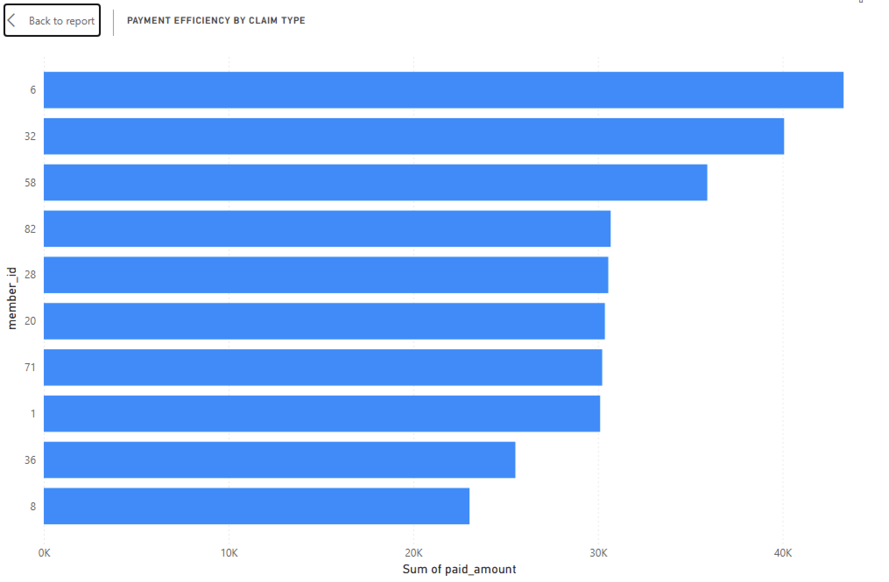
Billed vs Paid Ratio
Paid Ratio = Paid Amount ÷ Billed Amount
Ratios vary across claim types and procedures.
Indicates negotiation efficiency and policy limits.

Slide 13
Business Context
Inpatient claims are the largest cost drivers.
Few CPT and ICD codes dominate healthcare spending.
A small number of members account for high payouts.
Paid ratios vary significantly across claim types.

Slide 14
KEY INSIGHTS
Inpatient claims are the largest contributors to total paid amounts.
A small number of CPT and ICD codes drive a significant portion of healthcare spending.
Healthcare costs are concentrated among a limited number of members.
Paid ratios vary across claim types, indicating differences in payment efficiency.

Slide 15
CONCLUSION & BUSINESS IMPACT

Slide 16
KEY INSIGHTS & CONCLUSION
Inpatient claims are the largest cost drivers.
Few CPT and ICD codes dominate total spending.
A small number of members account for high payouts.
Paid ratios vary significantly across claim types.

