Slide 1
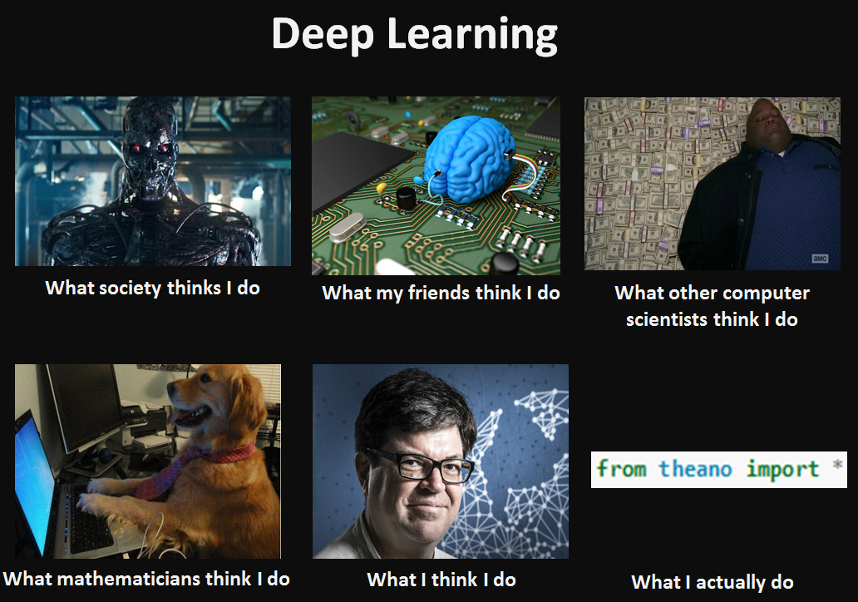
A Shallow Intro to Deep Learning
Yue Wu

Slide 2
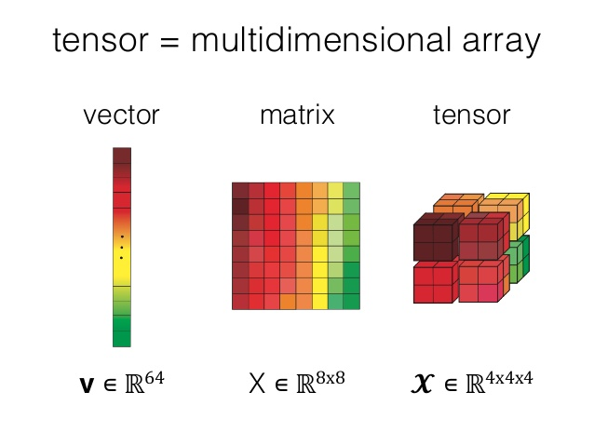

Slide 3
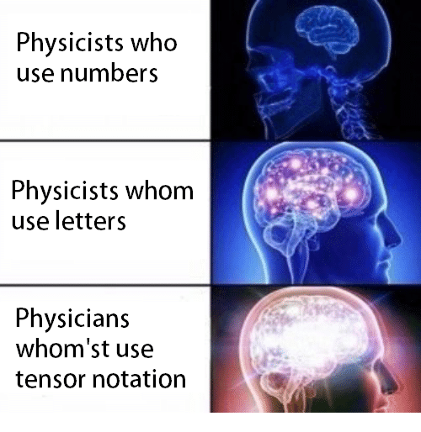
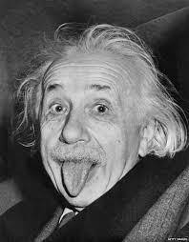

Slide 4
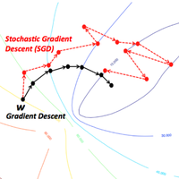
SGD

Slide 5
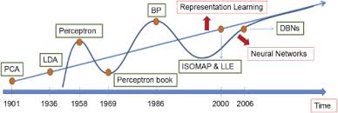
Why CNN?

Slide 6
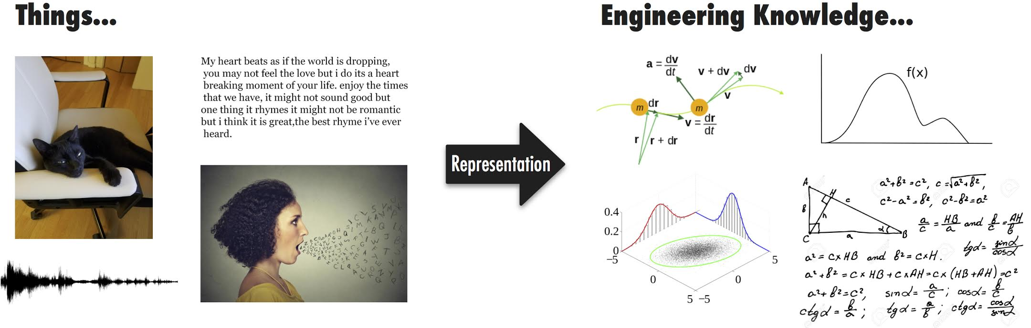

Slide 7
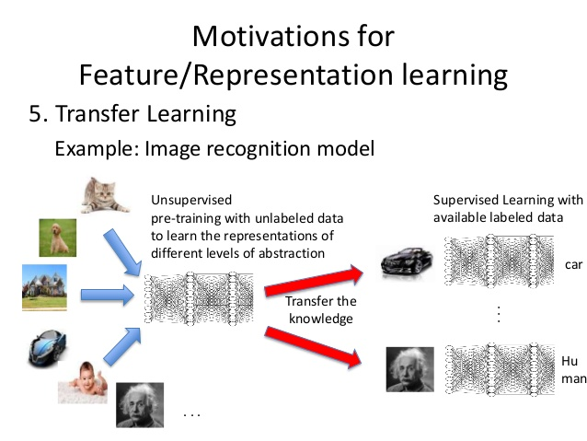

Slide 8
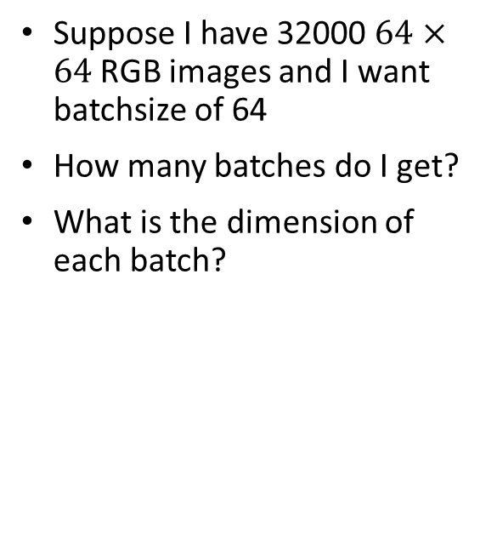
Minibatch
Suppose I have 32000 $64×64$ RGB images and I want batchsize of 64
How many batches do I get?
What is the dimension of each batch?

Slide 9
Convolution!

Slide 11
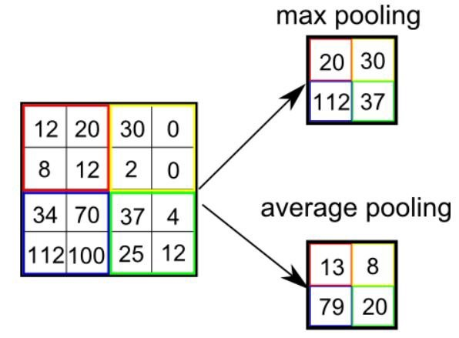
Pooling!

Slide 12
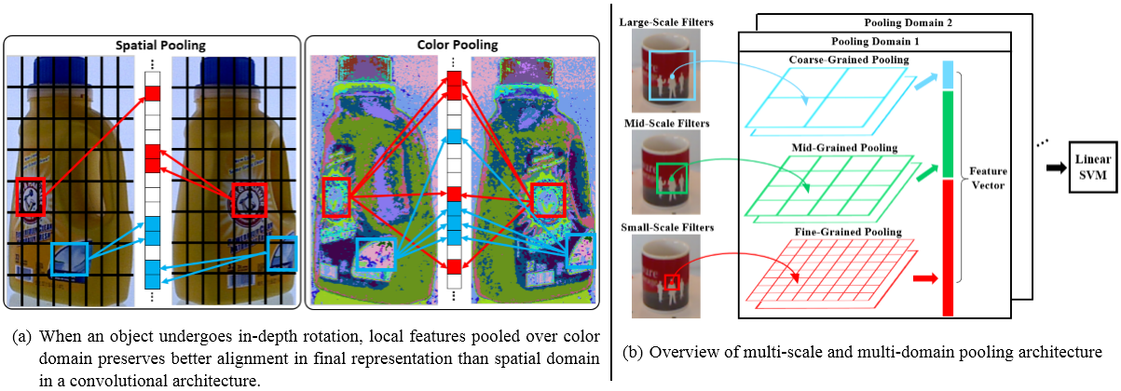
Pooling

Slide 13
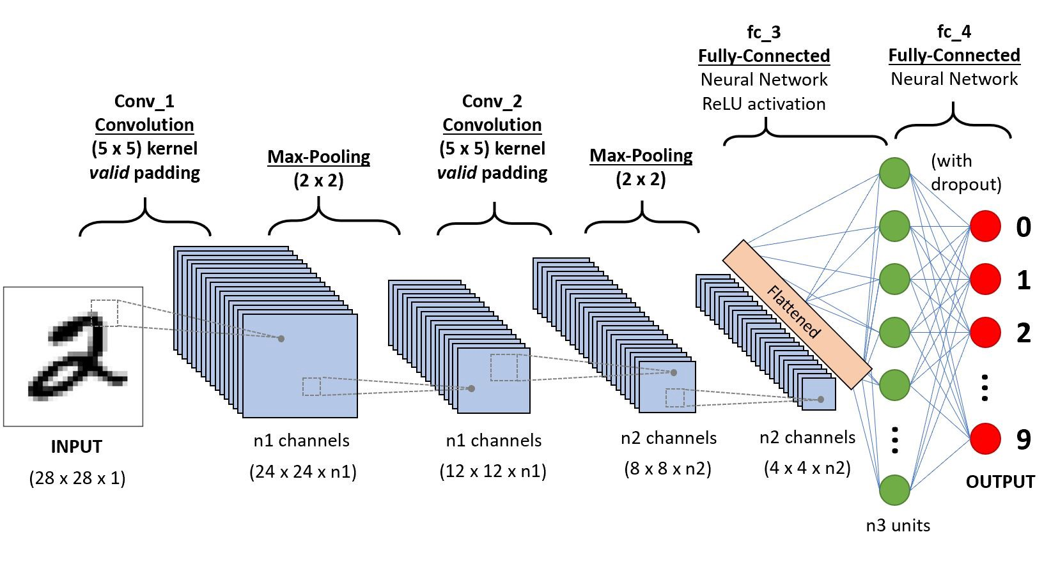
LeNet!

