Slide 1
EMPLOYEE MANAGEMENT SYSTEM
Arjun Pandey
Software engineer

Slide 2
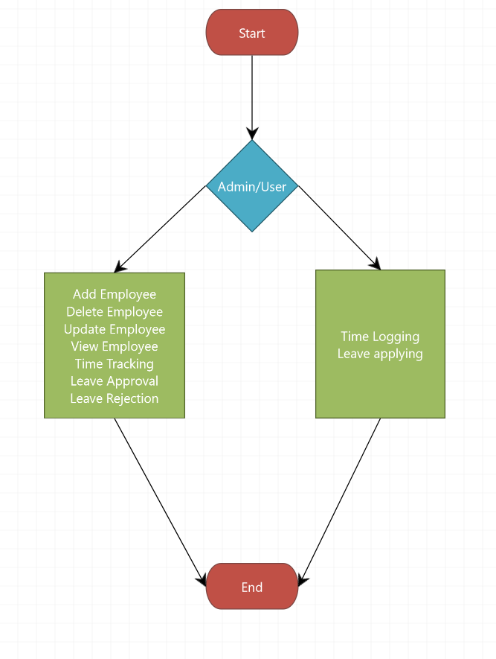
FLOWCHART OF THE APPLICATION

Slide 3
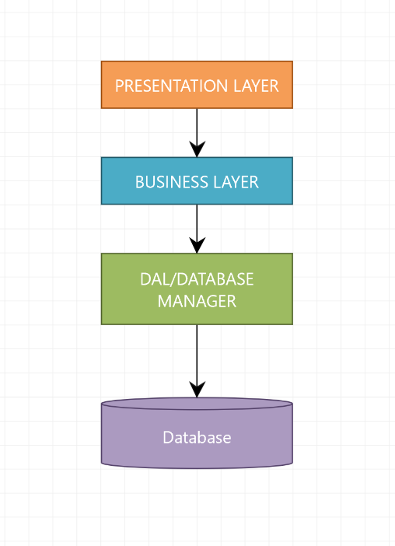
APPLICATION DESIGN

Slide 4
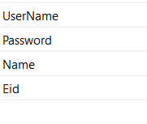
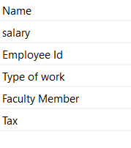
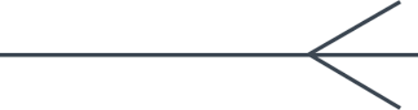

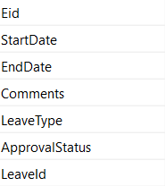
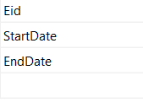
DATABASE DESIGN DIAGRAM
Users
Employee
Leave Table
Time Log

Slide 5
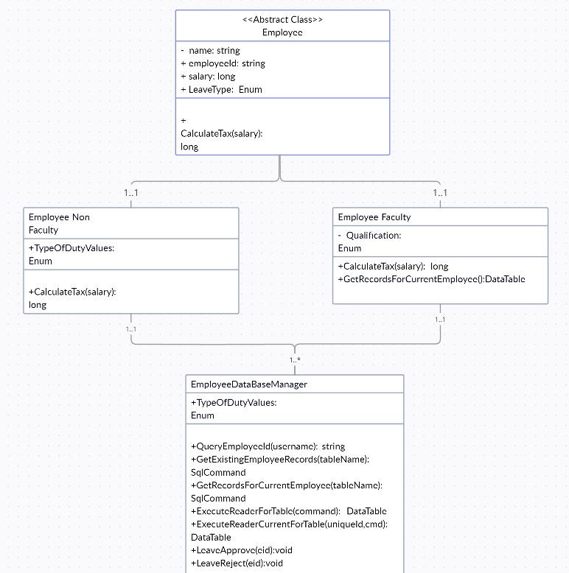
CLASS DIAGRAM

Slide 6
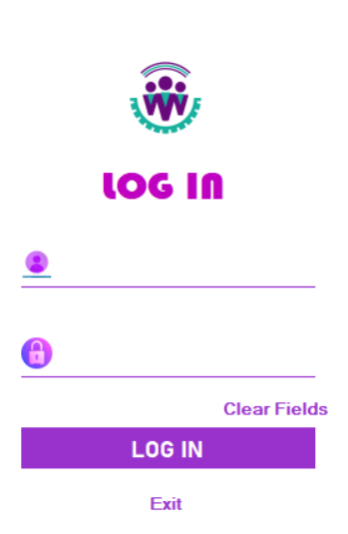
LOGIN FORM

Slide 7
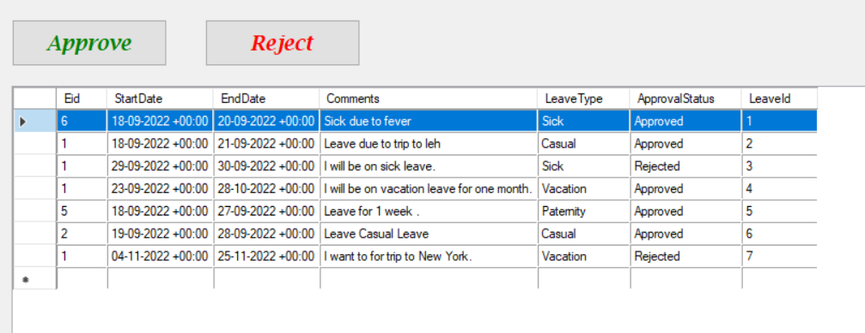
LEAVE PORTAL

Slide 8
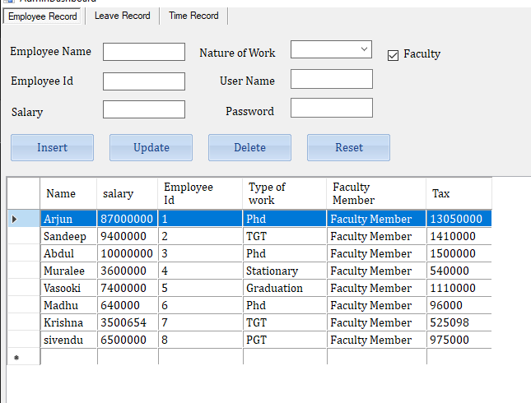
Admin Dashboard

Slide 9
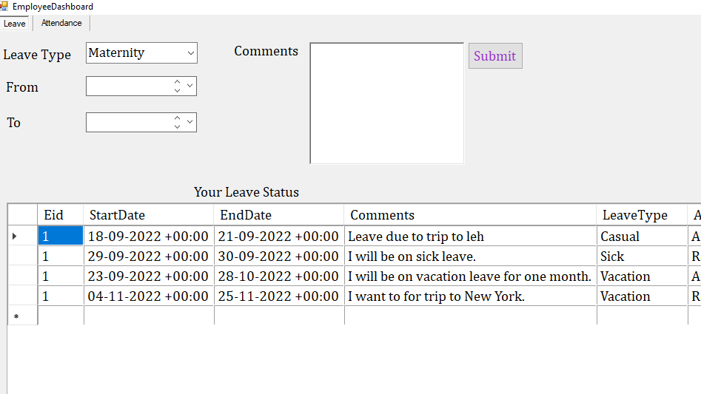
Employee Leave Apply

Slide 10
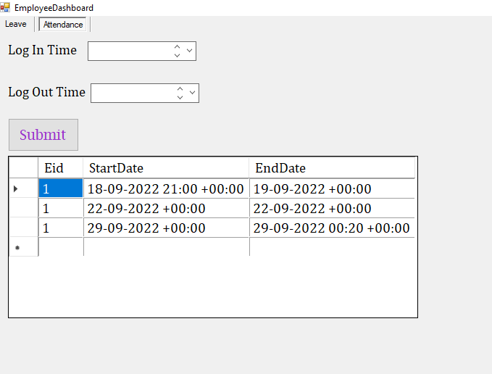
Employee Attendance

Slide 11
Conclusion
Two Use cases.
Admin Panel and Employee Dashboard.
Admin is capable of approving or rejecting leaves, and creating Employee accounts with their username and password and the actions of Admin will be visible in Employee for which the action is taken on. E.g. Arjun applies for a leave and if the leave is approved or rejected by the admin it will be shown when Arjun logs in his account and there can be n number of leave that can be applied by a single user and every leave is handled differently using there leave id.
Employee Dashboard can be login once a user has been created by the admin.
Employees can request leaves and mark attendance.

Slide 12

THANK YOU

