Slide 1
RoomFinder
A Presentation By:
Arjun Adhikari
Abishek Bhusal
Anurag Dahal
Supervisor: Er. Tara Bahadur Thapa
GANDAKI COLLEGE OF ENGINEERING AND SCIENCE

Slide 2
Outline
Background
Introduction
Problems, Objectives and Implications
Literature Review
Diagrams
Future Enhancements
Conclusions
User Interfaces

Slide 3
Background
People’s movement in new places is a common thing nowadays.
Finding temporary and long lasting accommodations is quite harder and peoples dont get much options for comparison.
Room owners dont have a mean to showcase their rooms and features.

Slide 4
Introduction
“Room Finder” is a mobile application that maps available rental rooms in a certain location. System admin publishes rooms with detailed descriptions powered by images and videos. Any ordinary user can explore these rooms in specified locations and contact owners through this application.

Slide 5
Problems, Objectives and Implications

Slide 6
Problems
Finding available rentable rooms in a certain area is a troublesome.
People searching for rooms have very few options to compare one room with another in terms of the room's environment, price, location and other faculties.
No means for vendors to showcase their services.

Slide 7
Objectives
To provide information about available rooms on the basis of location, price and other details.
Provide room’s information through text and photos.

Slide 8
Literature Review
Similar Systems developed prior to ours
RoomFinder Nepal
GharBheti

Slide 9
Diagrams

Slide 10
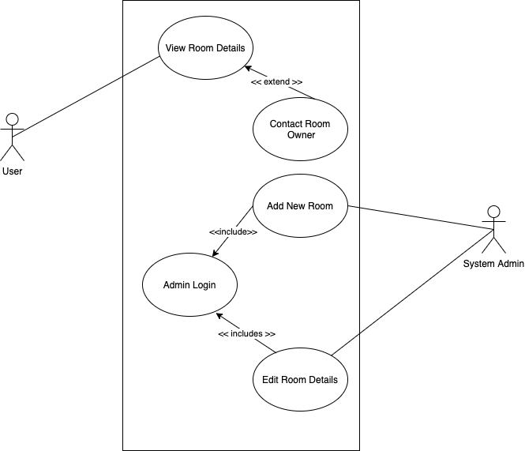
Use Case
Diagram

Slide 11
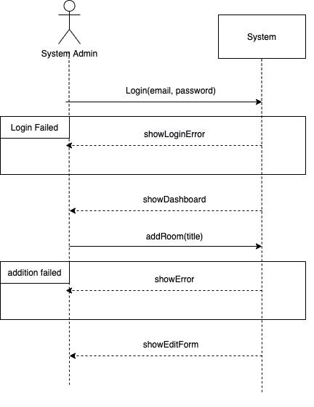
System
Sequence
Diagram
SSD of Adding a new Room

Slide 12
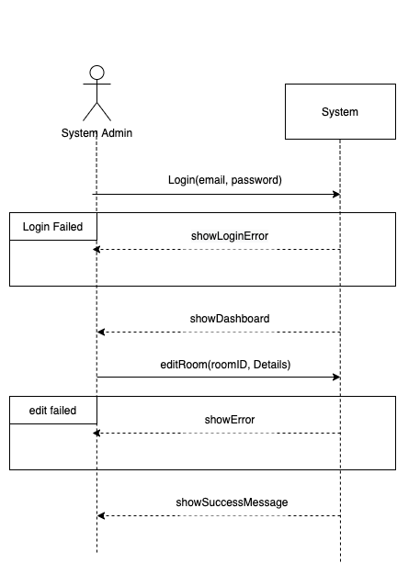
System
Sequence
Diagram
SSD of Editing a Room

Slide 13
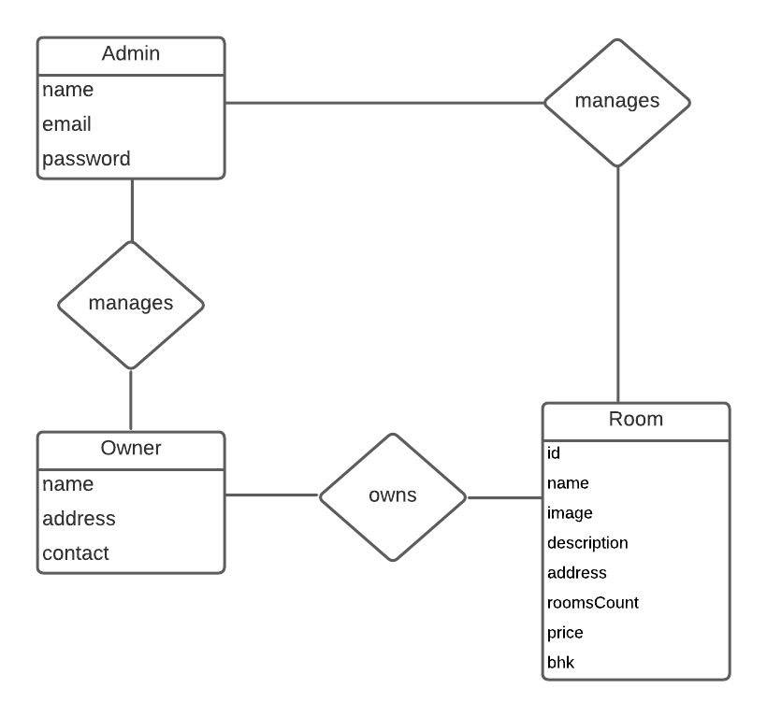
Entity
Relationship
Diagram

Slide 14
User Interfaces

Slide 15
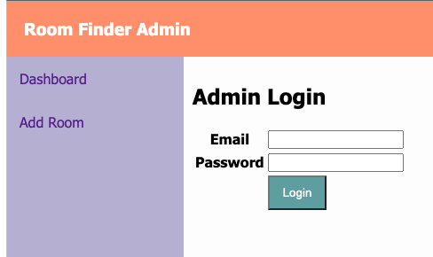
User Interface
Admin Login

Slide 16
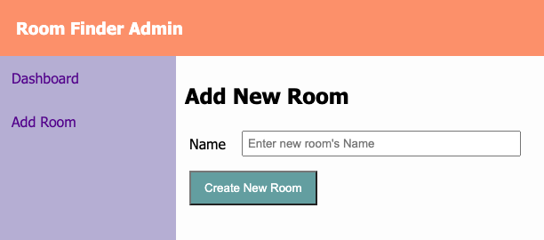
User Interface
Adding new room

Slide 17
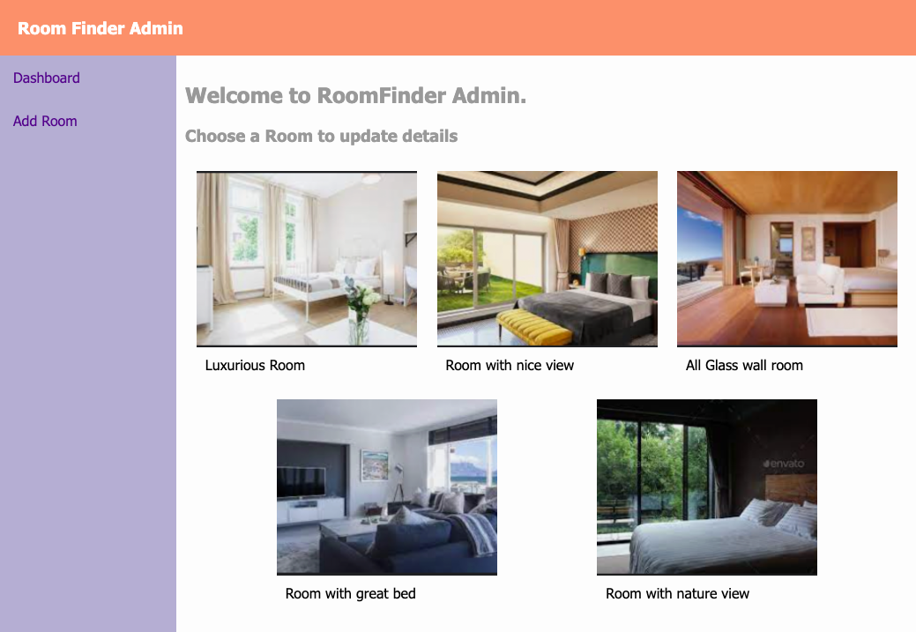
User Interface
Dashboard

Slide 18
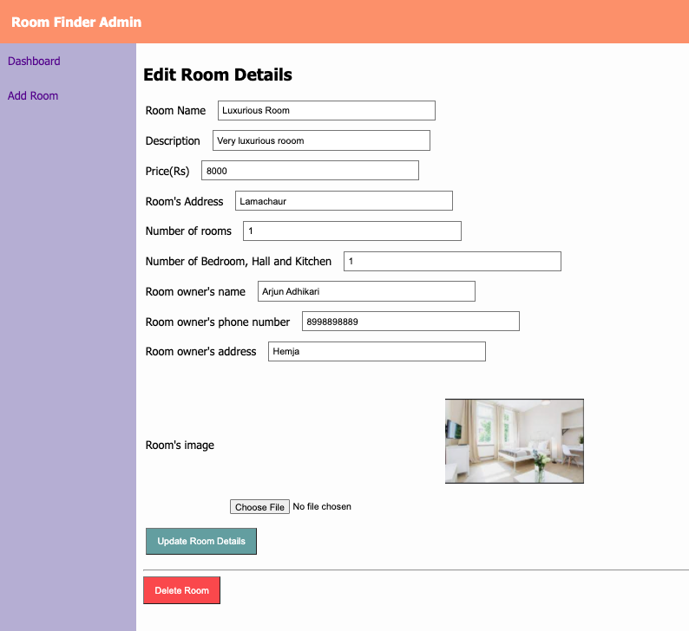
User Interface
Editing room

Slide 19
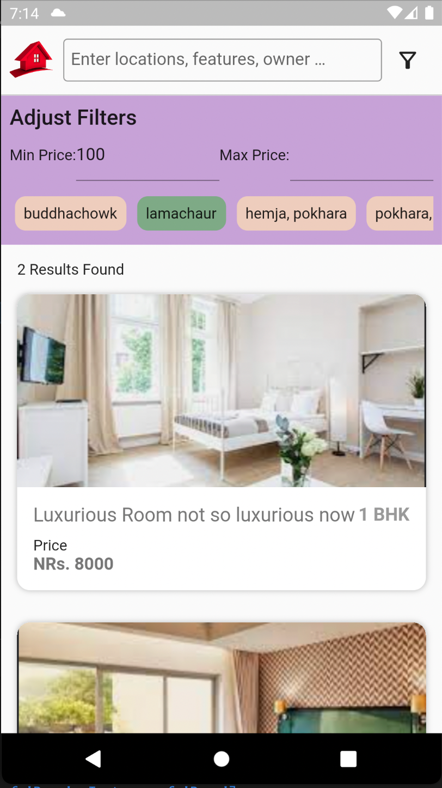
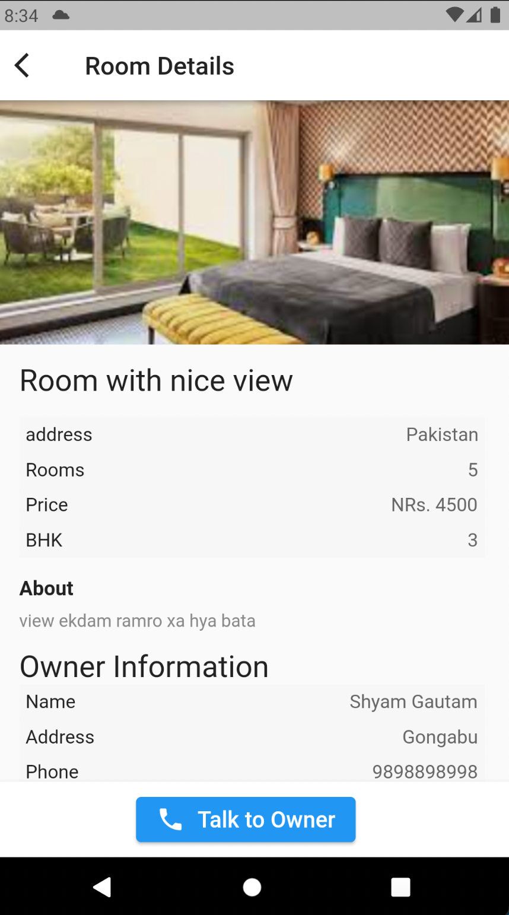
User Interface
Application Interfaces

Slide 20
Conclusion
This system helps people to find rooms near them or any other place. People from different places can explore through our application and find rooms which are available near them. System admin can publish rooms with detailed descriptions powered by images and videos. Admin can edit Room’s information. An ordinary user who is searching for rooms can directly contact owners through our application.

Slide 21
Future Improvements
This project can be improved in following ways
Making it available for vendors to manage their rooms on their own.
Developing means to receive feedback from users.

Slide 22
References
Agile Model Diagram
https://lh3.googleusercontent.com/xExOJYzP2K3su8NcSabsLozpM8jYVplZzireNIm10Ndt6nrtsimSuKT6tz8K9MuavNJSRxYq14-sWh5QKg8VYa1jkAyd4wOIbD8dUz6T7zan6PSl3GBpBeMxoo6vJl9tQHbL3dT7
UCD and SSD made from https://draw.io
ERD made from https://lucid.co/

Slide 23
Thank You

