Slide 1
RISBIC: Data Publishing Process
Screen shots:
  Data Publisher selecting Agreement Template on Publisher Portal
  Data Publisher fills in Agreement form on Publisher Portal
  Submitting form cause Policy within Agility to create a Data Flow within the DataBroker
  Data Publisher uploads data to be published via Portal Portal to endpoint of Data Flow with the DataBroker
  Metadata is extracted from Data, by DataBroker
  Adverts, derived from Metadata, are searched via User Portal
  Advert details is examined via User Portal

Slide 2
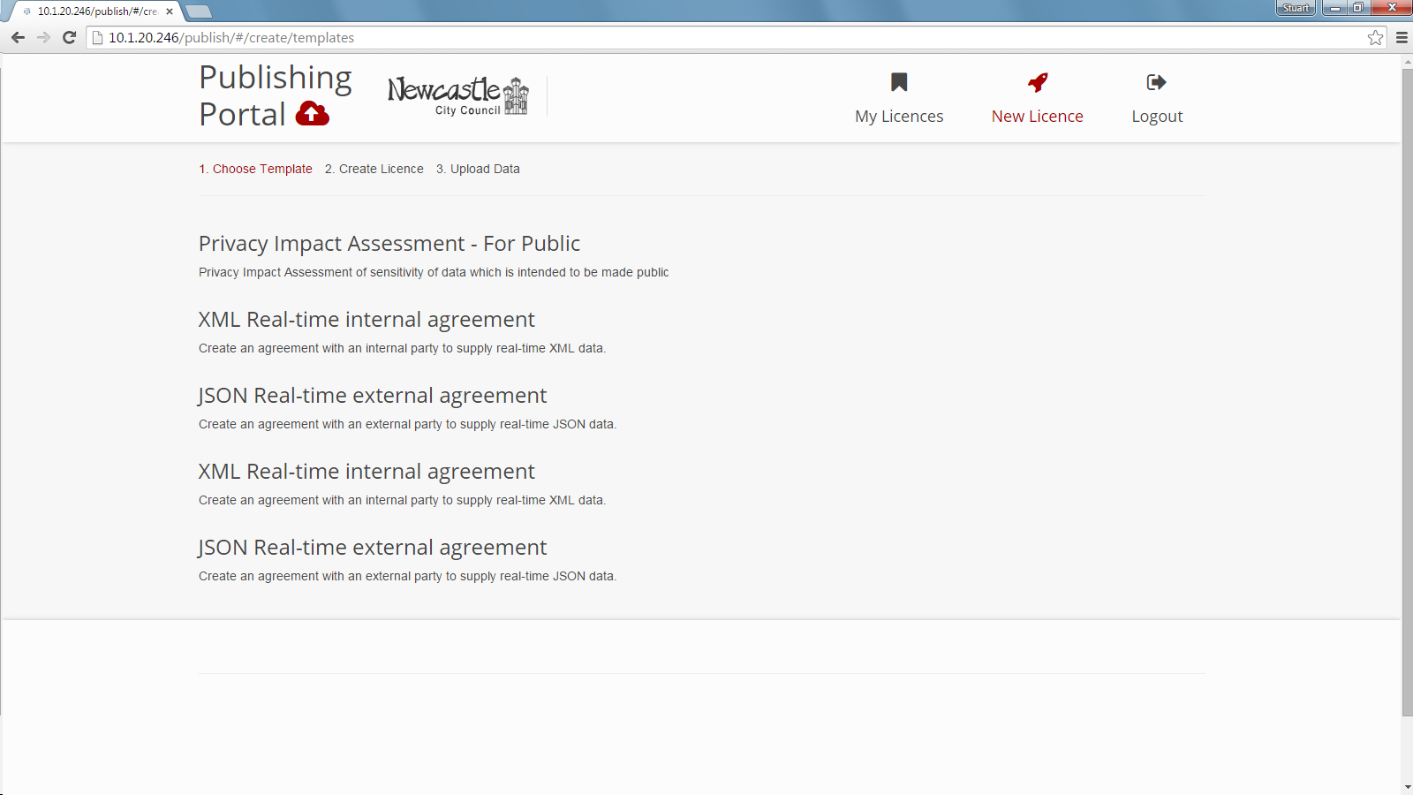

Slide 3
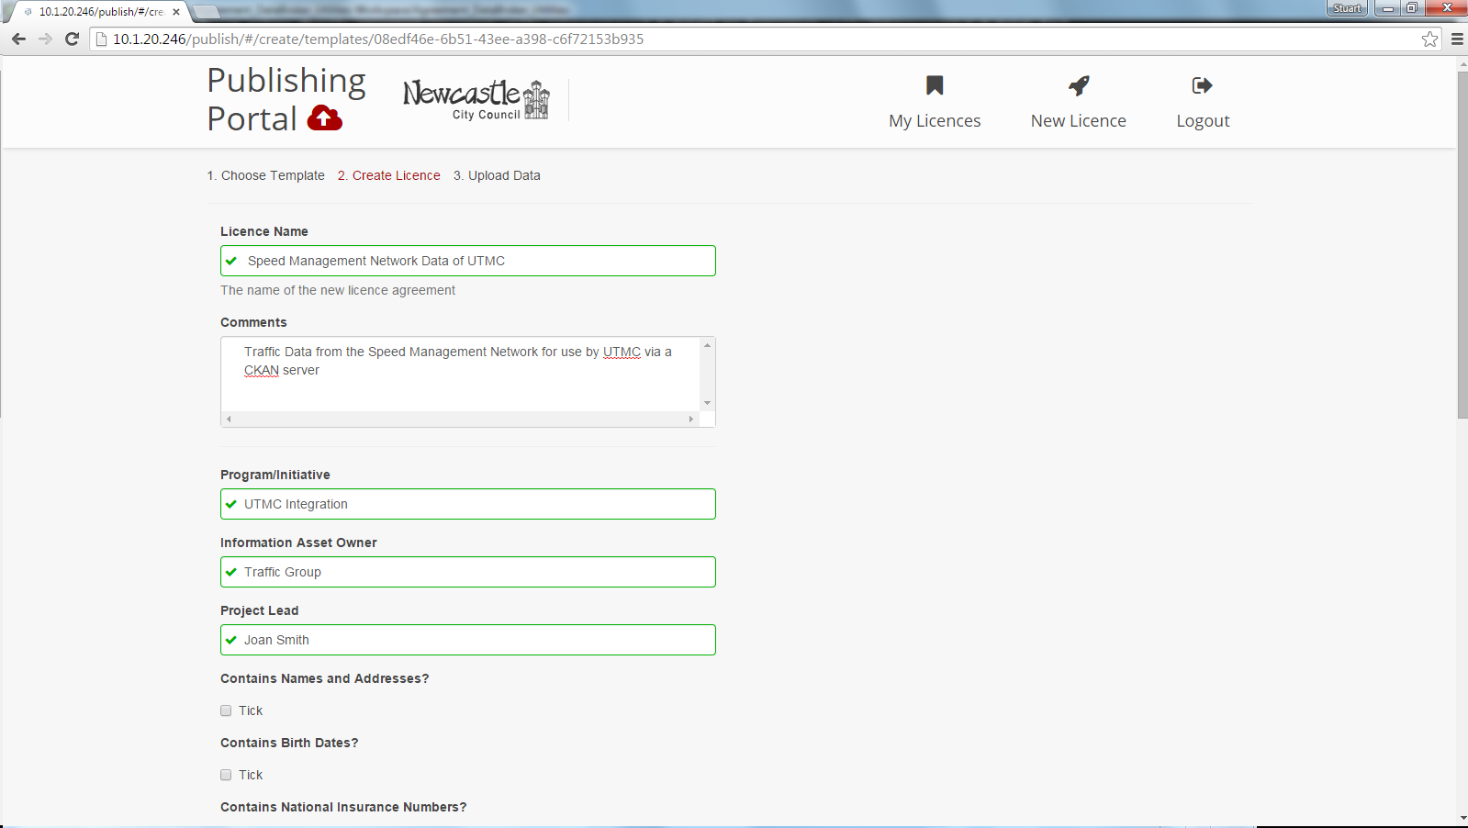

Slide 4
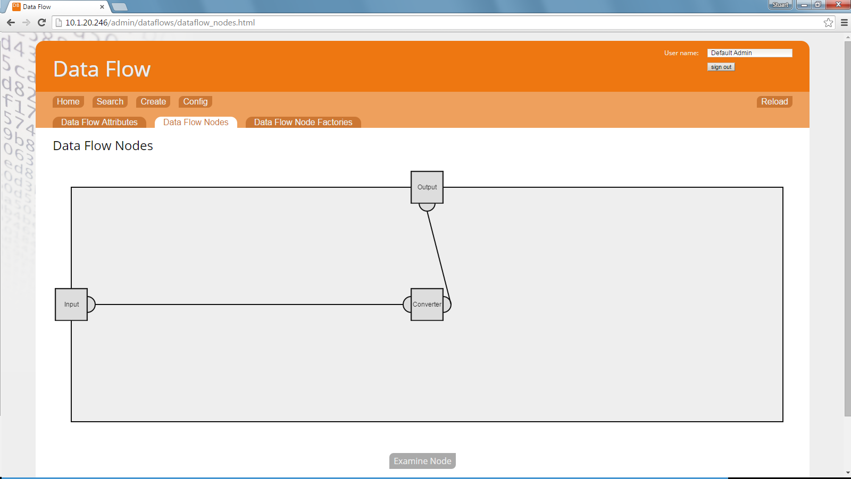

Slide 5
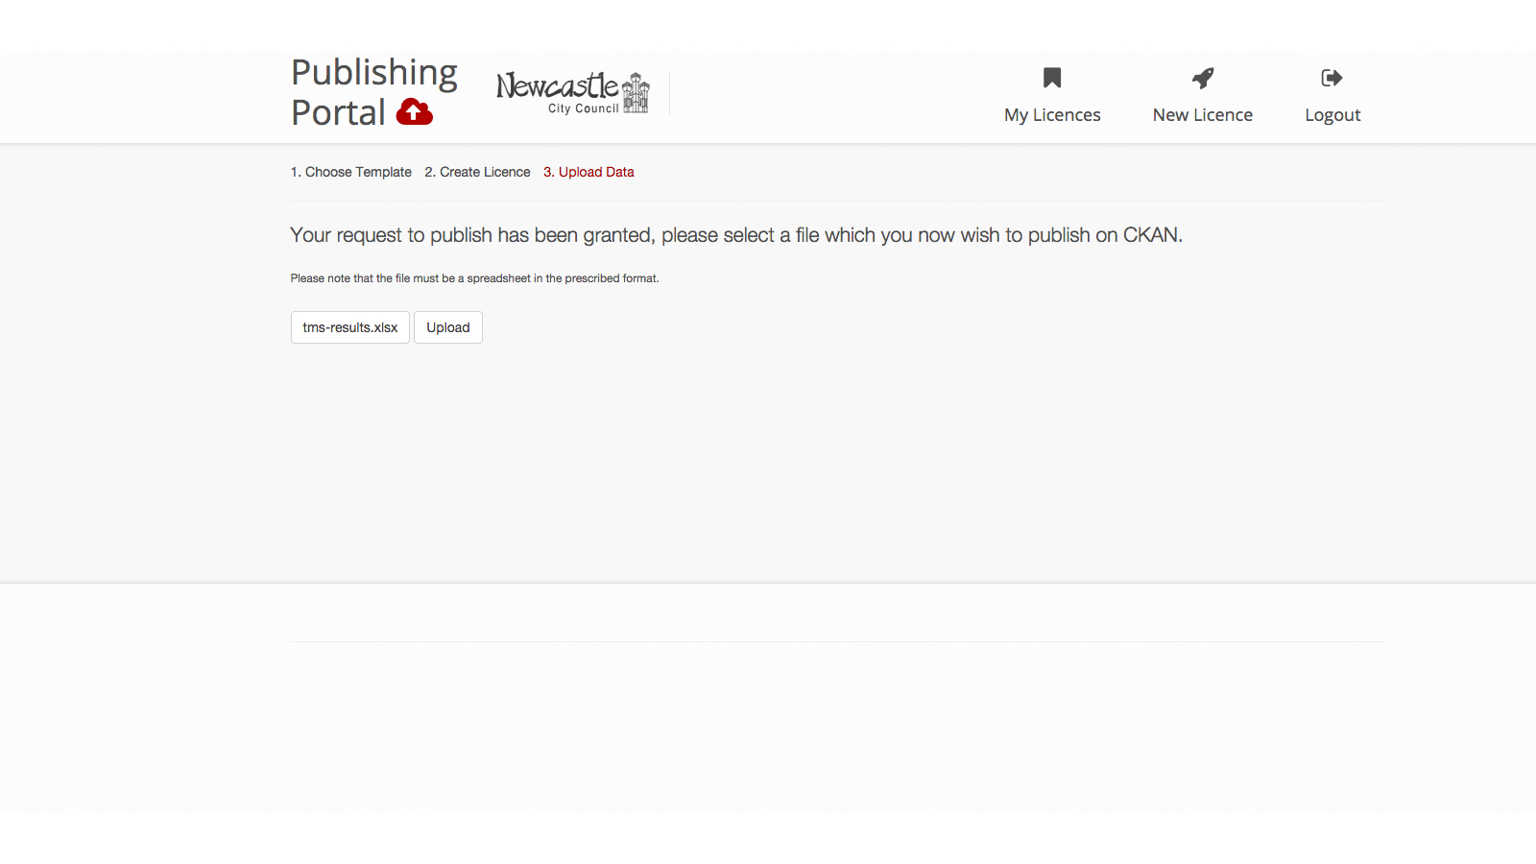

Slide 6
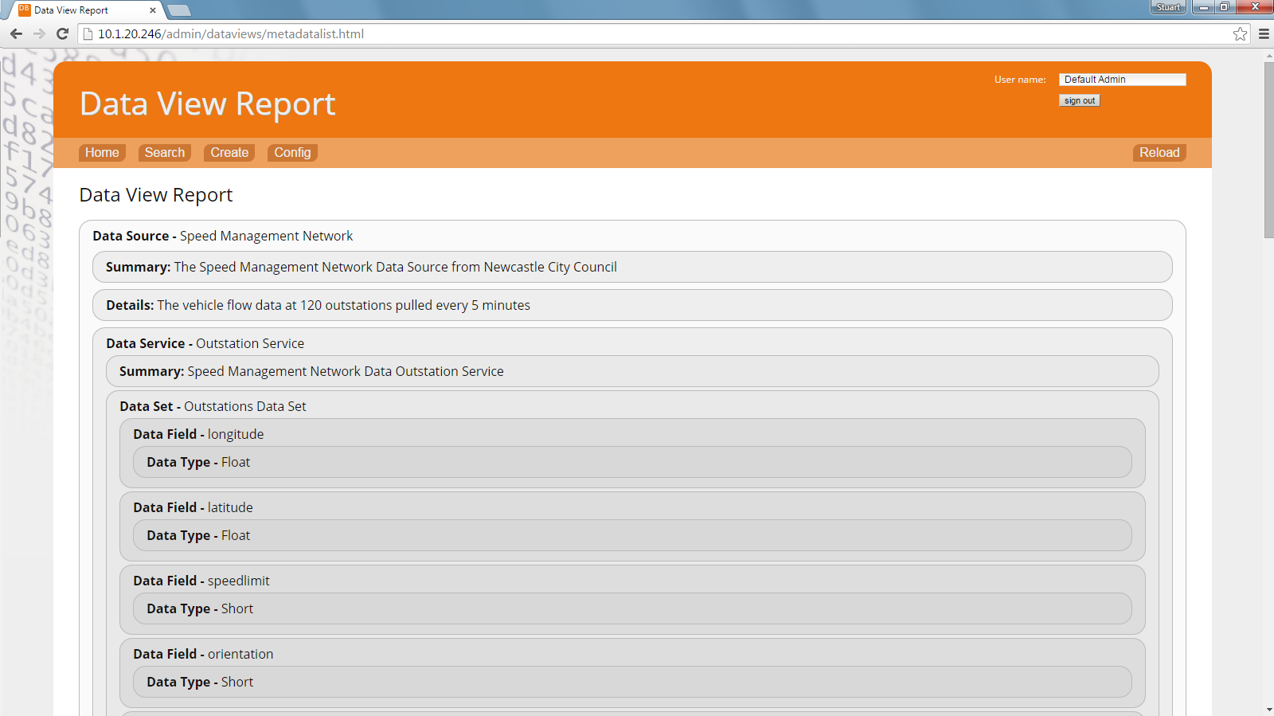

Slide 7
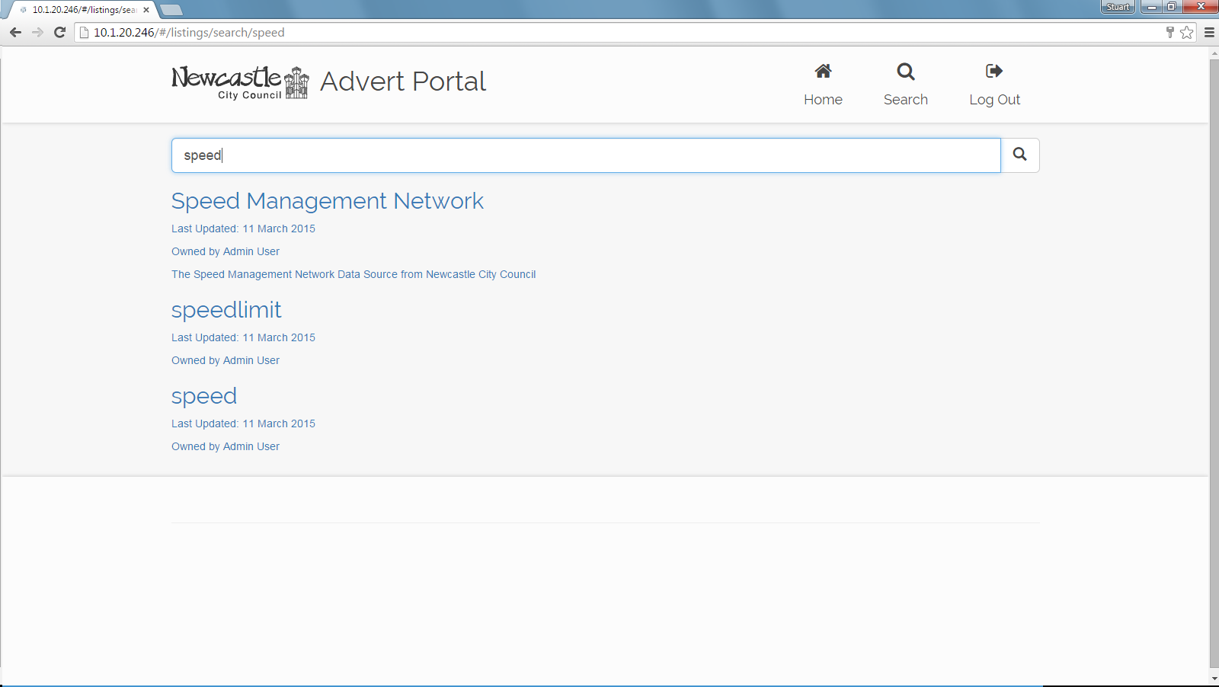

Slide 8
