Slide 1
Databricks

Slide 2
Agenda
https://docs.google.com/document/d/1rhDELxkYGjXBqLmI_Swl4jhEI7ewDUCB/edit#heading=h.gjdgxs

Slide 3
Training Format
Concepts
Hands-on exercises
Challenge/Assignments 15 to 20 min
Interactive

Slide 4
Timing
Start time at 9 am IST
Break - 11 am
Lunch - 1pm to 2pm
Break - 3 .30 pm
End at 5 pm

Slide 5
Infra setup
Databricks account
AWS account
Docker
Jenkins

Slide 6
Data Evolution and Engineering Needs
Early Days of Data:
Mainframes and Relational Databases: In the early days, data was primarily stored in mainframes and relational databases. Data was structured, and storage was limited.
Transactional Systems: The focus was on transactional systems that handled business operations like inventory management, payroll, and accounting.
The Internet Era:
Web Data: With the advent of the internet, there was an explosion of web data. Websites started generating massive amounts of clickstream data, log files, and user interactions.
Semi-Structured Data: This period saw an increase in semi-structured data (e.g., JSON, XML), which was not as rigidly structured as relational data but still had some level of organization.

Slide 7
Data Evolution and Engineering Needs
The Big Data Revolution
Unstructured Data: The rise of social media, multimedia content, and IoT devices introduced vast amounts of unstructured data (e.g., text, images, videos, sensor data).
Volume, Velocity, Variety: Data started growing in volume, arriving at high velocity, and coming from a variety of sources, giving rise to the term "Big Data."
The Cloud Era
Cloud Storage and Computing: Cloud technologies enabled scalable storage and processing power, making it feasible to handle large datasets without significant upfront investments in infrastructure.

Slide 8
Data Evolution and Engineering Needs
The Cloud Era
Data Lakes: Organizations began adopting data lakes to store vast amounts of raw data in its native format, making it easier to collect and store data without immediate structuring.
The AI and Machine Learning Era
Advanced Analytics: The need for advanced analytics and real-time insights led to the development of machine learning and AI applications.
Data-Driven Decision Making: Organizations started leveraging data for predictive analytics, personalization, and automation, driving business strategies and operations.

Slide 9
Need for Data Engineering
Handling Large Volumes of Data
Scalability: As data volumes grew, it became essential to develop scalable solutions for storage and processing.
Efficiency: Efficient data handling mechanisms are required to ensure timely access and processing of large datasets.
Diverse Data Sources
Integration: Data comes from a variety of sources, including databases, web services, IoT devices, and third-party APIs. Integrating these diverse data sources is crucial for comprehensive analysis.
Normalization: Data from different sources often needs to be normalized and transformed to be useful for analysis.

Slide 10
Need for Data Engineering
Data Quality and Reliability
Consistency: Ensuring data consistency and reliability is critical for accurate analysis. Data engineering helps maintain data quality through validation, cleaning, and enrichment processes.
Reliability: Robust data pipelines ensure that data is reliably ingested, processed, and stored, minimizing errors and downtime.
Real-Time Data Processing
Streaming Data: Many modern applications require real-time data processing to provide immediate insights and responses (e.g., fraud detection, recommendation systems).
Low Latency: Data engineering enables low-latency data processing, crucial for real-time analytics and decision-making.

Slide 11
Need for Data Engineering
Complex Data Transformations
ETL Pipelines: Extract, Transform, Load (ETL) pipelines are essential for transforming raw data into structured formats suitable for analysis.
Data Enrichment: Data often needs to be enriched with additional context or combined with other datasets to provide meaningful insights.
Advanced Analytics and Machine Learning
Preprocessing: Preparing data for machine learning models requires significant preprocessing, including feature engineering, normalization, and splitting datasets.
Model Training and Deployment: Data engineering supports the entire machine learning lifecycle, from data preparation to model training and deployment.

Slide 12
Need for Data Engineering
Security and Compliance
Data Governance: Ensuring data governance and compliance with regulations (e.g., GDPR, HIPAA) is crucial for protecting sensitive data and avoiding legal issues.
Access Control: Data engineering helps implement robust access control mechanisms to secure data against unauthorized access and breaches.
Collaboration and Workflow Management
Cross-Functional Teams: Data engineering enables collaboration between data engineers, data scientists, analysts, and business stakeholders by providing shared tools and environments.
Automated Workflows: Automating data workflows and processes improves efficiency and reduces manual intervention, allowing teams to focus on higher-value tasks.

Slide 13
What is Databricks?
Unified Analytics Platform:
Databricks is a cloud-based platform designed to handle the entire data lifecycle, from ingestion and transformation to analysis and machine learning. It unifies data engineering, data science, and machine learning in a single environment, making it easier for teams to collaborate and innovate.
Built on Apache Spark:
Databricks is built on Apache Spark, an open-source distributed computing system known for its speed and ease of use in big data processing. Spark provides Databricks with powerful capabilities for large-scale data processing, allowing for high-performance batch and streaming data operations.

Slide 14
Core Features of Databricks
Interactive Notebooks:
Multi-Language Support: Databricks notebooks support multiple programming languages including Python, R, Scala, and SQL, allowing users to choose the best language for their tasks.
Real-Time Collaboration: Multiple users can work on the same notebook simultaneously, enabling real-time collaboration and sharing of insights.
Visualization: Built-in visualizations help users to quickly interpret data and share results through interactive plots and graphs.
Delta Lake:
ACID Transactions: Delta Lake brings ACID (Atomicity, Consistency, Isolation, Durability) transactions to big data workloads, ensuring data integrity and reliability.
Data Reliability: It provides a mechanism for handling data versioning and ensuring consistency, which simplifies the management of large datasets.
Simplified Data Pipelines: Delta Lake makes it easier to build and maintain data pipelines by providing features like schema enforcement, data indexing, and efficient upserts (inserts and updates).

Slide 15
Core Features of Databricks
Structured Streaming:
Real-Time Data Processing: Databricks supports Structured Streaming, which allows for the real-time processing of streaming data with the same API used for batch processing.
Low Latency: This feature ensures low-latency data processing, making it suitable for applications that require real-time analytics and insights.
MLflow:
Lifecycle Management: MLflow is an open-source platform integrated with Databricks that manages the entire machine learning lifecycle, including experiment tracking, model management, and deployment.
Experiment Tracking: Keeps track of experiments, parameters, and results to facilitate reproducibility and collaboration.
Model Deployment: Simplifies the deployment of machine learning models to production environments, ensuring that models can be served and monitored effectively.

Slide 16
Core Features of Databricks
Integration and Flexibility:
Data Sources: Databricks can connect to a wide variety of data sources including databases, data lakes, and third-party services, offering flexibility in data ingestion.
BI Tools: It integrates seamlessly with business intelligence (BI) tools like Tableau and Power BI, enabling users to create dashboards and reports.
Custom Libraries: Users can install and use custom libraries and packages, enhancing the platform's flexibility and functionality.
Security and Governance:
Role-Based Access Control: Databricks provides robust role-based access control (RBAC), ensuring that only authorized users can access specific data and resources.
Data Encryption: It supports data encryption both at rest and in transit, protecting sensitive data from unauthorized access.
Compliance Tools: Databricks offers tools to help organizations comply with regulatory requirements (e.g., GDPR, HIPAA), including audit logging and data masking.

Slide 17
What is Databricks used for
Databricks provides tools that help you connect your sources of data to one platform to process, store, share, analyze, model, and monetize datasets with solutions from BI to generative AI.
Data processing scheduling and management, in particular ETL
Generating dashboards and visualizations
Managing security, governance, high availability, and disaster recovery
Data discovery, annotation, and exploration
Machine learning (ML) modeling, tracking, and model serving
Generative AI solutions

Slide 18
Tools and programmatic access
Databricks maintains a number of proprietary tools that integrate and expand these technologies to add optimized performance and ease of use, such as the following:
Workflows
Unity Catalog
Delta Live Tables
Databricks SQL
Photon compute clusters
In addition to the workspace UI, you can interact with Databricks programmatically with the following tools:
REST API
CLI
Terraform

Slide 19
How does Databricks work with AWS?
The Databricks platform architecture comprises two primary parts:
The infrastructure used by Databricks to deploy, configure, and manage the platform and services.
The customer-owned infrastructure managed in collaboration by Databricks and your company.
Unlike many enterprise data companies, Databricks does not force you to migrate your data into proprietary storage systems to use the platform. Instead, you configure a Databricks workspace by configuring secure integrations between the Databricks platform and your cloud account, and then Databricks deploys compute clusters using cloud resources in your account to process and store data in object storage and other integrated services you control.

Slide 20
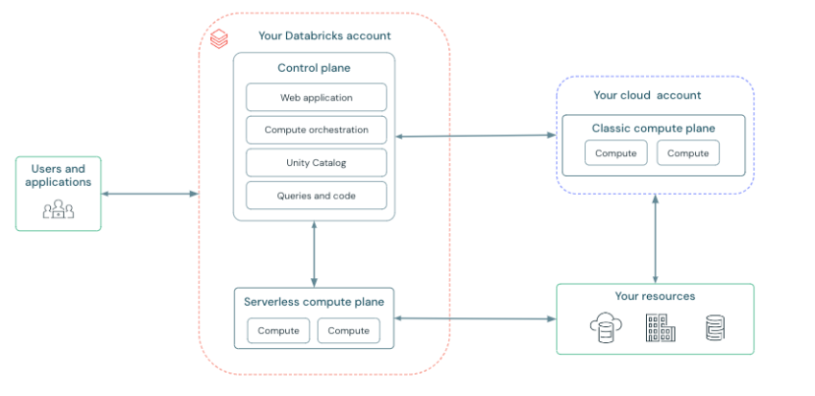
Databricks architecture

Slide 21
Databricks architecture
Databricks operates out of a control plane and a compute plane.
The control plane includes the backend services that Databricks manages in your Databricks account. The web application is in the control plane.
The compute plane is where your data is processed. There are two types of compute planes depending on the compute that you are using.
For serverless compute, the serverless compute resources run in a serverless compute plane in your Databricks account.
For classic Databricks compute, the compute resources are in your AWS account in what is called the classic compute plane. This refers to the network in your AWS account and its resources.

Slide 22
Databricks architecture
Serverless compute plane
In the serverless compute plane, Databricks compute resources run in a compute layer within your Databricks account. Databricks creates a serverless compute plane in the same AWS region as your workspace’s classic compute plane.
To protect customer data within the serverless compute plane, serverless compute runs within a network boundary for the workspace, with various layers of security to isolate different Databricks customer workspaces and additional network controls between clusters of the same customer.
To learn more about networking in the serverless compute plane, Serverless compute plane networking.
Classic compute plane
In the classic compute plane, Databricks compute resources run in your AWS account. New compute resources are created within each workspace’s virtual network in the customer’s AWS account.
A classic compute plane has natural isolation because it runs in each customer’s own AWS account. To learn more about networking in the classic compute plane

Slide 23
Setup Databricks workspace on AWS
Provide AWS IAM Access and login to AWS console
Access https://www.databricks.com/ and click on Try Databricks
Fill your details and continue
Execute AWS cloudformation template

Slide 24
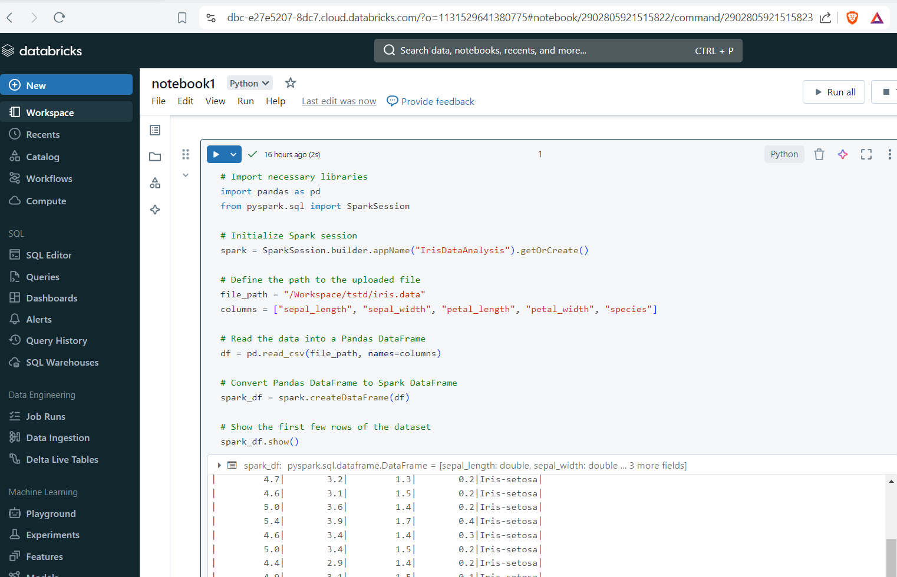
Databricks UI walkthrough

Slide 25
Create Cluster
https://accounts.cloud.databricks.com/workspaces
https://dbc-e27e5207-8dc7.cloud.databricks.com/?o=1131529641380775

Slide 26
Notebooks
Notebooks in Databricks are interactive documents that allow you to combine code, visualizations, and narrative text.
They are a powerful tool for data analysis, exploration, and machine learning workflows
Interactive Coding: You can write and execute code in multiple languages (Python, SQL, Scala, R) within the same notebook. This flexibility is achieved using magic commands (e.g., %python, %sql).
Visualization: Notebooks support built-in visualization tools, allowing you to create and display plots directly within the notebook. You can also use popular visualization libraries like Matplotlib, Seaborn, and Plotly.
Narrative Text: You can add narrative text using Markdown to document your analysis, explain code, and share insights. This makes notebooks great for creating reports and tutorials.

Slide 27
Notebooks
Version Control: Databricks provides version control for notebooks, allowing you to track changes, revert to previous versions, and collaborate more effectively.
Widgets: Notebooks support widgets, which can be used to create interactive controls (e.g., dropdowns, sliders) that make your notebooks more dynamic and user-friendly.
Scheduling: You can schedule notebooks to run at specific times or intervals, making it easy to automate tasks like data ingestion, ETL processes, and scheduled reporting.

Slide 28
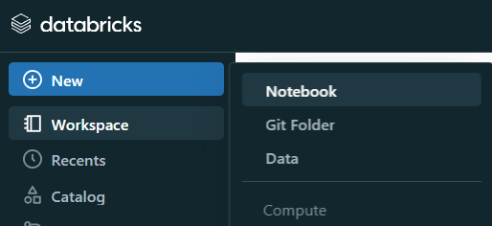
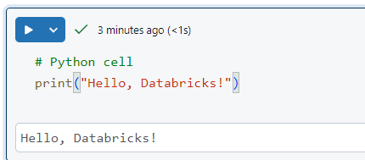
Notebooks
Create a new notebook
Add sample code and run
# Python cell
print("Hello, Databricks!")
Select Markdown
%md
# Welcome to Databricks Notebooks
This is a **Markdown** cell.

Slide 29
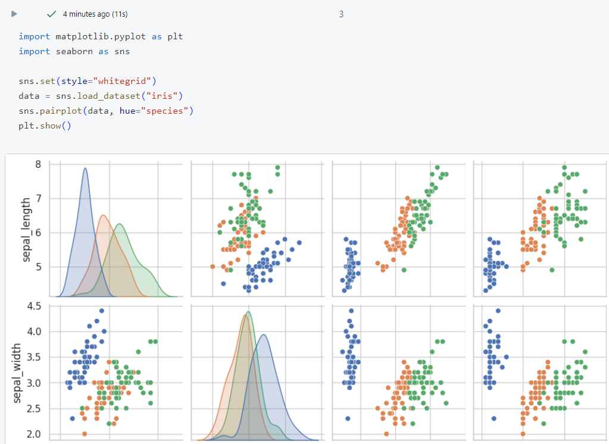
Notebooks
Sample visualization
import matplotlib.pyplot as plt
import seaborn as sns
# Set the style for the plot
sns.set(style="whitegrid")
# Load the Iris dataset from Seaborn's built-in datasets
data = sns.load_dataset("iris")
# Create a pairplot of the dataset, colored by species
sns.pairplot(data, hue="species")
# Show the plot
plt.show()

Slide 30
Magic commands
Language Magic Commands
%python: Switch to Python mode.
%r: Switch to R mode.
%scala: Switch to Scala mode.
%sql: Switch to SQL mode.

Slide 31
Magic commands
File System Commands
%fs: Access Databricks File System (DBFS).
%fs ls: List files in DBFS.
%fs mkdirs: Create directories in DBFS.
%fs cp: Copy files within DBFS or from external sources.
%fs head: Display the first N lines of a file.
%fs rm: Remove files or directories from DBFS.

Slide 32
Magic commands
%python
print("This is a Python cell")
%sql
SELECT "This is an SQL cell"
%scala
println("This is a Scala cell")
%r
print("This is an R cell")

Slide 33
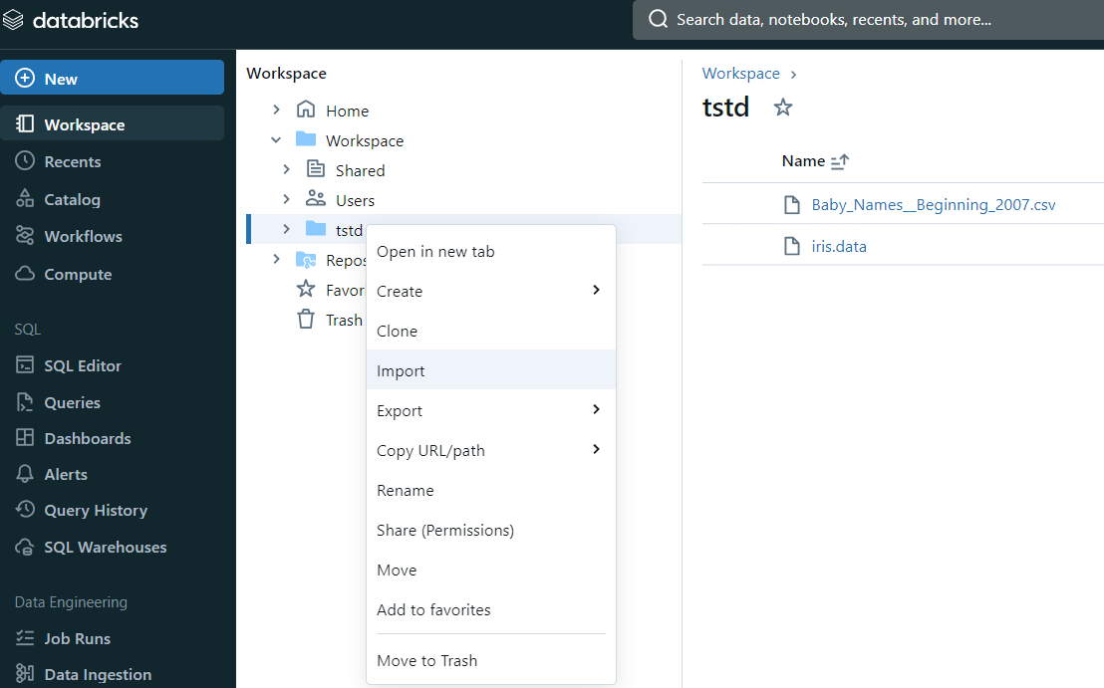
Upload Files
Download sample file, save on your computer and upload to workspace https://archive.ics.uci.edu/ml/machine-learning-databases/iris/iris.data

Slide 34
Python
https://github.com/arjunachari12/learn-python

Slide 35
Apache Spark
Apache Spark is an open-source, distributed computing system that provides an interface for programming entire clusters with implicit data parallelism and fault tolerance. Spark is known for its speed, ease of use, and support for sophisticated analytics.
Spark Core: The underlying execution engine responsible for memory management, task scheduling, and fault recovery.
Spark SQL: A module for structured data processing using SQL queries.
Spark Streaming: A module for real-time stream processing.
MLlib: A library for machine learning algorithms.
GraphX: A library for graph processing.

Slide 36
Initialize Spark Session and Load Data
# Import necessary libraries
import pandas as pd
from pyspark.sql import SparkSession
# Initialize Spark session
spark = SparkSession.builder.appName("IrisDataAnalysis").getOrCreate()
# Define the path to the uploaded file
file_path = "/Workspace/tstd/iris.data"
columns = ["sepal_length", "sepal_width", "petal_length", "petal_width", "species"]
# Read the data into a Pandas DataFrame
df = pd.read_csv(file_path, names=columns)
# Convert Pandas DataFrame to Spark DataFrame
spark_df = spark.createDataFrame(df)
# Show the first few rows of the dataset
spark_df.show()

Slide 37
Basic Data Exploration
# Print the schema of the DataFrame
spark_df.printSchema()
# Get summary statistics
spark_df.describe().show()

Slide 38
Basic Data Exploration
# Count the number of rows
row_count = spark_df.count()
print(f"Number of rows: {row_count}")
# Show distinct species
spark_df.select("species").distinct().show()

Slide 39
Data Filtering
# Filter rows where sepal_length is greater than 5.0
filtered_df = spark_df.filter(spark_df.sepal_length > 5.0)
filtered_df.show()
# Filter rows where sepal_length is greater than 5.0 and species is 'Iris-setosa'
filtered_df = spark_df.filter((spark_df.sepal_length > 5.0) & (spark_df.species == "Iris-setosa"))
filtered_df.show()

Slide 40
Aggregation and Group By
# Group by species and calculate average sepal_length
avg_sepal_length_df = spark_df.groupBy("species").avg("sepal_length")
avg_sepal_length_df.show()
# Group by species and count the number of rows
count_by_species_df = spark_df.groupBy("species").count()
count_by_species_df.show()

Slide 41
Data Transformation
# Add a new column that is the ratio of petal_length to petal_width
df_with_ratio = spark_df.withColumn("petal_length_width_ratio", spark_df.petal_length / spark_df.petal_width)
df_with_ratio.show()
# Rename the column 'species' to 'flower_species'
renamed_df = spark_df.withColumnRenamed("species", "flower_species")
renamed_df.show()
# Drop the column 'petal_width'
df_dropped = spark_df.drop("petal_width")
df_dropped.show()
# Sort data by sepal_length in descending order
sorted_df = spark_df.orderBy(spark_df.sepal_length.desc())
sorted_df.show()

Slide 42
Assignment: Analyzing Superstore Sales Data with PySpark
Objective: Use PySpark to analyze the Superstore Sales dataset. Perform basic data manipulation operations to gain insights into sales trends and customer behavior.
Tasks:
Load the Superstore Sales dataset into a PySpark DataFrame.
Calculate total sales per category.
Identify the top-selling products.
Analyze sales trends over time.
Segment customers based on purchasing behavior (optional).

Slide 43
Spark SQL
Spark SQL is a component of Apache Spark designed for processing structured data. It allows you to run SQL queries directly on your data, providing an interface for data processing that is familiar to users of relational databases.
Spark SQL integrates with Spark's core API to allow seamless switching between SQL queries and complex analytics.
DataFrames:
Similar to a table in a relational database or a data frame in R/Python.
A distributed collection of data organized into named columns.
Can be constructed from various data sources, such as structured data files, tables in Hive, external databases, or existing RDDs.

Slide 44
Spark SQL
SQL Queries:
Allows querying data via SQL syntax.
Can be executed on DataFrames and datasets registered as temporary tables/views.
Datasets:
An extension of DataFrame API.
Provides the benefits of both RDD (resilient distributed dataset) and DataFrame APIs.
Uses JVM object types.
Catalyst Optimizer:
An advanced query optimizer used to analyze and optimize query plans.
Seamless Integration:
Can be easily integrated with various data sources, including Hive, HDFS, JSON, JDBC, and more

Slide 45
Basic Data Analysis
%sql
SELECT * FROM iris_table
Select Specific Columns:
%sql
SELECT sepal_length, sepal_width, species FROM iris_table
Filter Rows:
%sql
SELECT * FROM iris_table WHERE sepal_length > 5.0

Slide 46
Basic Data Analysis
Group By and Aggregate:
%sql
SELECT species, AVG(sepal_length) AS avg_sepal_length
FROM iris_table
GROUP BY species
Order By:
%sql
SELECT * FROM iris_table ORDER BY sepal_length DESC

Slide 47
Create Additional DataFrame for Species Details
# Create a Pandas DataFrame with species details
species_details_data = {
"species": ["Iris-setosa", "Iris-versicolor", "Iris-virginica"],
"scientific_name": ["Setosa", "Versicolor", "Virginica"],
"common_name": ["Setosa Iris", "Versicolor Iris", "Virginica Iris"]
}
species_details_df = pd.DataFrame(species_details_data)
# Convert Pandas DataFrame to Spark DataFrame
species_details_spark_df = spark.createDataFrame(species_details_df)
# Show the first few rows of the species details DataFrame
species_details_spark_df.show()
# Create a temporary view for species details
species_details_spark_df.createOrReplaceTempView("species_details_table")

Slide 48
Join the DataFrames and show the first few rows
%sql
SELECT *
FROM iris_table i
INNER JOIN species_details_table s
ON i.species = s.species
LIMIT 10

Slide 49
Print the schema of the joined DataFrame
%sql
DESCRIBE TABLE iris_table

Slide 50
Get summary statistics
%sql
SELECT species, AVG(sepal_length) AS avg_sepal_length, AVG(sepal_width) AS avg_sepal_width, AVG(petal_length) AS avg_petal_length, AVG(petal_width) AS avg_petal_width
FROM iris_table
GROUP BY species

Slide 51
Count the number of rows
%sql
SELECT COUNT(*) AS row_count
FROM iris_table

Slide 52
Show distinct species with their scientific and common names
%sql
SELECT DISTINCT species, scientific_name, common_name
FROM species_details_table

Slide 53
Filter rows where sepal_length is greater than 5.0 and show species details
%sql SELECT * FROM iris_table i INNER JOIN species_details_table s ON i.species = s.species WHERE sepal_length > 5.0

Slide 54
Group by species and calculate average sepal_length
%sql
SELECT i.species, s.scientific_name, s.common_name, AVG(i.sepal_length) AS avg_sepal_length
FROM iris_table i
INNER JOIN species_details_table s
ON i.species = s.species
GROUP BY i.species, s.scientific_name, s.common_name

Slide 55
Sort data by sepal_length in descending order
%sql
SELECT *
FROM iris_table i
INNER JOIN species_details_table s
ON i.species = s.species
ORDER BY sepal_length DESC

Slide 56
Assignment: Analyzing Titanic Dataset with Spark SQL
Objective: Use Spark SQL to analyze the Titanic dataset. Perform data exploration, aggregation, and derive insights from the dataset.
Tasks:
Load the Titanic dataset into Spark SQL.
Write SQL queries to:
Calculate the average age of passengers.
Count the number of survivors and non-survivors.
Find the percentage of passengers who survived.
Identify the passenger class with the highest survival rate.
Explore relationships between variables (e.g., survival rate by gender or age group).

Slide 57
Solution
Task 1: Calculate the average age of passengers
SELECT AVG(Age) AS avg_age
FROM titanic_table;
Task 2: Count the number of survivors and non-survivors
SELECT Survived, COUNT(*) AS count
FROM titanic_table
GROUP BY Survived;

Slide 58
Solution
Task 3: Find the percentage of passengers who survived
SELECT (COUNT(CASE WHEN Survived = 1 THEN 1 END) / COUNT(*)) * 100 AS survival_percentage
FROM titanic_table;
Task 4: Identify the passenger class with the highest survival rate
SELECT Pclass, AVG(Survived) AS survival_rate
FROM titanic_table
GROUP BY Pclass
ORDER BY survival_rate DESC
LIMIT 1;

Slide 59
Solution
Task 5: Explore relationships between variables (e.g., survival rate by gender or age group)
Survival rate by gender
SELECT Sex, AVG(Survived) AS survival_rate
FROM titanic_table
GROUP BY Sex;

Slide 60
Delta Lake
Delta Lake is an open-source storage layer that brings reliability to data lakes. It offers ACID (Atomicity, Consistency, Isolation, Durability) transactions, scalable metadata handling, and unifies streaming and batch data processing. Here are some key benefits of Delta Lake:
ACID Transactions:
Delta Lake ensures data integrity and reliability by supporting ACID transactions. This means that complex operations like merging data from different sources or updating records are handled consistently and atomically.
Scalability:
Delta Lake's architecture is designed to handle large-scale data with ease. It efficiently manages metadata and optimizes query performance, making it suitable for big data workloads.

Slide 61
Delta Lake
Unified Batch and Streaming:
Delta Lake provides a unified approach to handle both batch and streaming data. This allows users to build robust data pipelines that can process real-time and historical data seamlessly.
Schema Enforcement and Evolution:
Delta Lake enforces schemas to ensure data quality and consistency. Additionally, it supports schema evolution, allowing users to easily update their data schema as requirements change without disrupting existing data.
Time Travel:
Delta Lake supports time travel, enabling users to access and query previous versions of their data. This is useful for debugging, auditing, and rolling back changes if necessary.

Slide 62
Delta Lake
Upserts and Deletes:
Unlike traditional data lakes, Delta Lake allows for upserts (inserts and updates) and deletes. This is particularly useful for maintaining the accuracy and freshness of data in scenarios like change data capture and GDPR compliance.
Performance Optimization:
Delta Lake optimizes data storage and query performance through techniques like data compaction, indexing, and data skipping. These optimizations help to reduce query times and improve overall system performance.
Integration with Apache Spark:
Delta Lake is deeply integrated with Apache Spark, allowing users to leverage Spark's powerful data processing capabilities for their Delta Lake data. This integration makes it easy to build and manage scalable data pipelines.

Slide 63
Delta lake exercise: Create a Delta Table
# Create a DataFrame
data = [
(1, "Alice", 28),
(2, "Bob", 32),
(3, "Catherine", 25)
]
columns = ["id", "name", "age"]
df = spark.createDataFrame(data, columns)
# Write the DataFrame to a Delta table
df.write.format("delta").save("/tmp/delta-table")

Slide 64
Read from a Delta Table
# Read data from the Delta table
delta_df = spark.read.format("delta").load("/tmp/delta-table")
# Show the data
delta_df.show()

Slide 65
Upsert (Merge) Data into Delta Table
# New data to merge
new_data = [
(1, "Alice", 29), # Update Alice's age
(4, "David", 35) # Insert new record for David
]
new_df = spark.createDataFrame(new_data, columns)
from delta.tables import DeltaTable
# Load the Delta table as a DeltaTable
delta_table = DeltaTable.forPath(spark, "/tmp/delta-table")
# Perform the merge (upsert)
delta_table.alias("old_data").merge(
new_df.alias("new_data"),
"old_data.id = new_data.id"
).whenMatchedUpdateAll(
).whenNotMatchedInsertAll(
).execute()

Slide 66
Query the Delta Table after Upsert
# Read data from the Delta table again
updated_df = spark.read.format("delta").load("/tmp/delta-table")
# Show the updated data
updated_df.show()

Slide 67
Time Travel
# Query an earlier version of the Delta table
previous_version_df = spark.read.format("delta").option("versionAsOf", 0).load("/tmp/delta-table")
# Show the data from the previous version
previous_version_df.show()

Slide 68
Schema Enforcement and Evolution
# Data with a new column
new_data_with_new_column = [
(1, "Alice", 30, "F"),
(4, "David", 36, "M")
]
columns_with_new_column = ["id", "name", "age", "gender"]
new_df_with_new_column = spark.createDataFrame(new_data_with_new_column, columns_with_new_column)
# Perform the merge with schema evolution
delta_table.alias("old_data").merge(
new_df_with_new_column.alias("new_data"),
"old_data.id = new_data.id"
).whenMatchedUpdateAll(
).whenNotMatchedInsertAll(
).execute()

Slide 69
Query the Delta Table after Schema Evolution
# Read data from the Delta table after schema evolution
updated_df_with_new_column = spark.read.format("delta").load("/tmp/delta-table")
# Show the updated data
updated_df_with_new_column.show()

Slide 70
Assignment: Delta table
Using the Titanic dataset from Kaggle:
Create a Delta table in Databricks from the CSV file.
Perform an upsert (merge) operation to update existing passenger records and insert new records based on a new dataset of passengers.
Query the Delta table to display the updated passenger data after the merge operation.
Explain how Delta Lake handles schema evolution and provide an example scenario using the Titanic dataset.

Slide 71
Assignment: Delta table
import pandas as pd
from pyspark.sql import SparkSession
from delta.tables import DeltaTable
spark = SparkSession.builder.appName("titanicData").getOrCreate()
filepath = "/Workspace/training/day01/Titanic-Dataset.data"
df = pd.read_csv(filepath)
spark_df = spark.createDataFrame(df)
spark_df.show()
spark_df.createOrReplaceTempView("titanic_data")
spark_df.write.format("delta").mode("overwrite").save("/tmp/delta/titanic")
delta_df = spark.read.format("delta").load("/tmp/delta/titanic")
delta_df.show()
print(delta_df.count())
new_data = [
(1, 0, 3,"Braund, Mr. Owen Harris","male",25.0,1,0,"A/5 21171",7.25,0,"S"),
(893, 0, 3,"Alice","female",30.0,1,0,"A/5 21171",7.25,0,"S"),
(894, 0, 3,"Bob","male",35.0,1,0,"A/5 21171",7.25,0,"S"),
]
columns = ["PassengerId","Survived","Pclass","Name","Sex","Age","SibSp","Parch","Ticket","Fare","Cabin","Embarked"]
new_df = spark.createDataFrame(new_data,columns)
new_df.show()
delta_table = DeltaTable.forPath(spark, "/tmp/delta/titanic")
delta_table.alias("old_data").merge(
new_df.alias("new_data"),
"old_data.PassengerId = new_data.PassengerId"
).whenMatchedUpdateAll(
).whenNotMatchedInsertAll(
).execute()
updated_df = spark.read.format("delta").load("/tmp/delta/titanic")
print(updated_df.count())
updated_df.show()
updated_df.createOrReplaceTempView("new_titanic_data")

Slide 72
Data Engineering Pipelines
Data engineering pipelines are crucial components in data processing workflows, designed to ingest, transform, and deliver data reliably and efficiently. Here's a structured approach to understanding and building data engineering pipelines:
Data Ingestion:
This involves acquiring data from various sources such as databases, files (CSV, JSON, etc.), APIs, streaming platforms (like Kafka), or IoT devices. Tools like Apache Kafka, AWS Kinesis, or simple scripts in Python can be used for ingestion.
Data Storage:
Once data is ingested, it needs to be stored reliably. Options include traditional databases (SQL or NoSQL), data lakes (like Amazon S3, Azure Data Lake), or specialized storage systems optimized for analytics (e.g., Google BigQuery).

Slide 73
Data Engineering Pipelines
Data Transformation:
This step involves cleaning, filtering, aggregating, and transforming raw data into a structured format suitable for analysis. Technologies like Apache Spark, Apache Flink, or cloud-native services like AWS Glue, Azure Data Factory are used here.
Data Orchestration:
Managing the execution of workflows and dependencies between different pipeline tasks. Tools like Apache Airflow, Luigi, or cloud services such as AWS Step Functions and Azure Data Factory are used for orchestration.
Data Quality and Monitoring:
Ensuring data quality through validation checks, error handling, and monitoring pipeline performance (latency, throughput, etc.). This step is critical for maintaining reliable and accurate data pipelines.

Slide 74
Data Engineering Pipelines
Data Delivery:
Once processed and validated, data can be delivered to downstream systems for consumption, such as business intelligence tools, machine learning models, or reporting dashboards.
Pipeline Automation and Scalability:
Automating pipeline execution to handle large volumes of data and scaling resources (compute and storage) based on workload demands. Cloud platforms like AWS, Azure, and Google Cloud provide scalable infrastructure for data pipelines.
Security and Compliance:
Implementing measures to secure data during transit and at rest, ensuring compliance with data privacy regulations (e.g., GDPR, HIPAA).

Slide 75
ETL pipelines in databricks with AWS
Building ETL (Extract, Transform, Load) pipelines in Databricks with AWS involves integrating various AWS services for data ingestion, storage, transformation, and orchestration.

Slide 76
ETL pipelines: Data Ingestion
Sources:
Data can come from AWS S3 buckets, AWS Redshift, AWS RDS (Relational Database Service), AWS DynamoDB, or other AWS services.
Integration:
Use Databricks to read data directly from AWS S3 using Spark's built-in connectors or the aws-glue library.
For databases like Redshift or RDS, use JDBC connectors to pull data into Databricks.

Slide 77
ETL pipelines: Data Ingestion
# Example of reading data from S3
df = spark.read.format("csv").option("header", "true").load("s3://your-bucket/path/to/data.csv")
# Example of reading data from Redshift using JDBC
df_redshift = spark.read.format("jdbc") \
.option("url", "jdbc:redshift://redshift-cluster-name:5439/database-name") \
.option("dbtable", "table-name") \
.option("user", "username") \
.option("password", "password") \
.load()

Slide 78
ETL pipelines: Data Storage
Storage Options:
Store data in AWS S3 buckets or in Delta Lake format on AWS S3 for optimized performance and reliability.
Delta Lake:
Use Delta Lake for managing data reliability, schema enforcement, and performance optimizations.
# Example of writing data to Delta Lake on S3
df.write.format("delta").mode("overwrite").save("s3://your-bucket/path/to/delta-table")

Slide 79
ETL pipelines: Data Transformation
Spark Transformations:
Use Spark on Databricks for data cleaning, filtering, aggregation, and complex transformations.
# Example transformation
df_transformed = df.filter(df["column"] > 100).groupBy("category").agg(avg("value"))

Slide 80
ETL pipelines: Data Orchestration
Databricks Workflows:
Schedule and automate ETL jobs within Databricks using Databricks Jobs or integrating with external schedulers
# Example of scheduling a job in Databricks
from databricks import workflow
workflow.Job("ETLJob").set_tasks([task_extract, task_transform, task_load]).schedule("0 0 * * *")

Slide 81
ETL pipelines: Data Quality and Monitoring
Delta Lake:
Utilize schema validation, data versioning, and integrity checks provided by Delta Lake.
Monitoring:
Integrate with AWS CloudWatch or third-party monitoring tools for performance monitoring and alerting.

Slide 82
ETL pipelines: Data Delivery
BI Tools:
Deliver processed data to BI tools like AWS QuickSight, Tableau, or Power BI for visualization and reporting.
Databricks SQL:
Query and analyze data directly within Databricks using SQL or integrate with BI tools via JDBC/ODBC connections.

Slide 83
ETL pipelines
Data Ingestion: Data sourced from AWS S3, Redshift, or RDS.
Data Storage: Store raw and processed data in Delta Lake on AWS S3.
Data Transformation: Perform transformations using Spark on Databricks.
Data Orchestration: Schedule ETL workflows using Databricks Jobs or AWS Glue.
Data Quality and Monitoring: Ensure data quality using Delta Lake and monitor with AWS CloudWatch.
Data Delivery: Visualize and analyze data with BI tools connected to Databricks.

Slide 84
ETL: Real-Life Use Case: Retail Sales Data Analysis
Scenario:
A retail company wants to analyze its sales data to identify trends, optimize inventory, and improve customer satisfaction.
The data comes from various sources such as online sales platforms, in-store transactions, and third-party vendors.
The company needs a robust pipeline to ingest, process, analyze, and visualize this data to make informed business decisions.

Slide 85
ETL: Data Ingestion:
Sources:
Data from online sales platforms (API), in-store transactions (CSV/JSON files), and third-party vendors (JDBC).
Databricks:
Use Databricks Auto Loader to ingest streaming data from online platforms and batch data from CSV/JSON files stored in S3 or Azure Blob Storage. For third-party vendor data, use JDBC connectors to pull data from databases.
# Example of ingesting CSV data from S3
df_online_sales = spark.read.format("csv").option("header", "true").load("s3://path/to/online_sales.csv")
df_store_sales = spark.read.format("json").load("s3://path/to/store_sales.json")
df_vendor_data = spark.read.format("jdbc").option("url", jdbc_url).option("dbtable", "vendor_sales").load()

Slide 86
ETL: Data Storage
Delta Lake:
Store ingested data in Delta tables to ensure ACID transactions, schema enforcement, and efficient querying.
df_online_sales.write.format("delta").mode("append").save("/delta/online_sales")
df_store_sales.write.format("delta").mode("append").save("/delta/store_sales")
df_vendor_data.write.format("delta").mode("append").save("/delta/vendor_sales")

Slide 87
ETL: Data Transformation
Spark on Databricks:
Perform transformations like cleaning, filtering, and aggregating data to prepare it for analysis.
# Example transformation
df_sales = spark.read.format("delta").load("/delta/online_sales")
df_sales = df_sales.withColumn("total_amount", df_sales["quantity"] * df_sales["price"])
df_sales_cleaned = df_sales.dropna(subset=["product_id", "total_amount"])
df_sales_aggregated = df_sales_cleaned.groupBy("product_id").agg(sum("total_amount").alias("total_sales"))

Slide 88
ETL: Data Orchestration:
Databricks Workflows:
Create workflows to automate the ingestion, transformation, and loading (ETL) processes. Schedule jobs to run at specific intervals or trigger them based on data availability.
from databricks import workflow
workflow.Job("SalesDataETL").set_tasks([task_ingest, task_transform, task_load]).schedule("0 0 * * *")

Slide 89
ETL: Data Quality and Monitoring:
Delta Lake:
Use schema enforcement and data validation checks to ensure data quality.
Monitoring:
Integrate with monitoring tools like Datadog to track pipeline performance.
# Example data quality check
if df_sales_cleaned.filter("total_amount <= 0").count() > 0:
raise ValueError("Invalid sales data: total_amount must be greater than 0")

Slide 90
ETL: Data Delivery
BI Tools:
Deliver processed data to BI tools like Power BI or Tableau for visualization and reporting.
Databricks:
Use Databricks SQL to create dashboards and reports within the platform.
SELECT product_id, SUM(total_sales) AS total_sales FROM delta.`/delta/online_sales` GROUP BY product_id

Slide 91
Assignment: Write ETL process
Scenario:
Cisco data engineers are tasked with analyzing network traffic data to identify patterns, optimize network performance, and predict potential issues before they impact users. This involves processing large volumes of data from various network devices, logs, and sensors in real-time and applying machine learning models for predictive analytics.

Slide 92
Excercise
# Import necessary libraries
import pandas as pd
from pyspark.sql import SparkSession
from pyspark.sql.functions import col
# Initialize Spark session
spark = SparkSession.builder \
.appName("IrisDataAnalysis") \
.getOrCreate()
# Define file path and column names
file_path = "/Workspace/tstd/iris.data"
columns = ["sepal_length", "sepal_width", "petal_length", "petal_width", "species"]
# Extract: Load the Iris dataset into a Pandas DataFrame
df = pd.read_csv(file_path, names=columns)
# Convert Pandas DataFrame to Spark DataFrame
spark_df = spark.createDataFrame(df)
# Show the DataFrame and its schema
spark_df.show()
spark_df.printSchema()
# Register the DataFrame as a temporary view
spark_df.createOrReplaceTempView("iris_table")
# Describe the DataFrame
spark_df.describe().show()
# Transform: Rename columns to make them more readable
df_transformed = spark_df.select(
col("sepal_length"),
col("sepal_width"),
col("petal_length"),
col("petal_width"),
col("species")
)
# Show transformed DataFrame
print("Transformed Iris DataFrame:")
df_transformed.show(5)
# Handle missing values (if any) by replacing them with the mean of the column
df_transformed = df_transformed.na.fill({
"sepal_length": df_transformed.agg({"sepal_length": "mean"}).first()[0],
"sepal_width": df_transformed.agg({"sepal_width": "mean"}).first()[0],
"petal_length": df_transformed.agg({"petal_length": "mean"}).first()[0],
"petal_width": df_transformed.agg({"petal_width": "mean"}).first()[0]
})
# Create a mapping of species names to numeric values
species_mapping = {value: idx for idx, value in enumerate(df_transformed.select("species").distinct().rdd.flatMap(lambda x: x).collect())}
# Convert species to numeric values using the mapping
species_mapping_expr = col("species").cast("string")
for species, index in species_mapping.items():
species_mapping_expr = when(col("species") == species, index).otherwise(species_mapping_expr)
df_transformed = df_transformed.withColumn("species_index", species_mapping_expr.cast("int"))
# Show the transformed DataFrame after handling missing values and converting species
df_transformed.show()
# Define Delta table path in DBFS (Databricks File System)
delta_path = "dbfs:/tmp/delta/iris"
# Write transformed DataFrame to Delta format
df_transformed.write.format("delta") \
.mode("overwrite") \
.option("mergeSchema", "true") \
.save(delta_path)

Slide 93
Scheduling jobs in databricks
Create a Job:
Navigate to the Jobs page in the Databricks workspace.
Click on "Create Job" to start defining a new job.
Define Job Details:
Provide a name and description for the job.
Select the type of task you want to run (notebook, jar, or Python script).
Configure Job Settings:
Specify the notebook, jar, or script path that the job should execute.
Set up any parameters or environment variables required by your task.

Slide 94
Scheduling jobs in databricks
Schedule the Job:
Choose the schedule frequency (e.g., hourly, daily) and start time.
Optionally, set advanced scheduling options like retries, timeouts, and notification settings.
Manage and Monitor Jobs:
Once scheduled, you can view and manage jobs from the Jobs page.
Monitor job runs, view logs, and adjust settings as needed.
Permissions and Access:
Ensure that the appropriate permissions are set for users who need to create, manage, or view jobs.

Slide 95
Scheduling Job
A Databricks job is a way to run your data processing and analysis applications in a Databricks workspace.
Your job can consist of a single task or can be a large, multi-task workflow with complex dependencies. Databricks manages the task orchestration, cluster management, monitoring, and error reporting for all of your jobs.
You can run your jobs immediately, periodically through an easy-to-use scheduling system, whenever new files arrive in an external location, or continuously to ensure an instance of the job is always running.

Slide 96
Databricks Workflows
Databricks Workflows orchestrates data processing, machine learning, and analytics pipelines on the Databricks Data Intelligence Platform.
Workflows has fully managed orchestration services integrated with the Databricks platform, including Databricks Jobs to run non-interactive code in your Databricks workspace and Delta Live Tables to build reliable and maintainable ETL pipelines

Slide 97
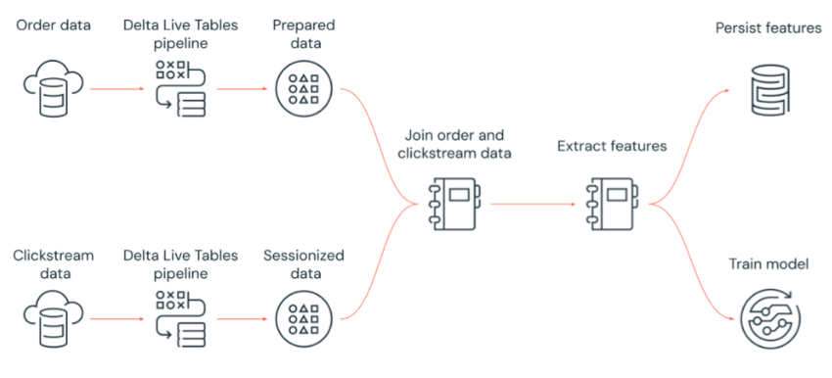
Example Databricks workflow

Slide 98
Example Databricks workflow
Run a Delta Live Tables pipeline that ingests raw clickstream data from cloud storage, cleans and prepares the data, sessionizes the data, and persists the final sessionized data set to Delta Lake.
Run a Delta Live Tables pipeline that ingests order data from cloud storage, cleans and transforms the data for processing, and persist the final data set to Delta Lake.
Join the order and sessionized clickstream data to create a new data set for analysis.
Extract features from the prepared data.
Perform tasks in parallel to persist the features and train a machine learning model.

Slide 99
Assignment
Create a job and schedule it on Workflow and add trigger

Slide 100
PySpark
PySpark is the Python API for Apache Spark, a powerful open-source distributed computing system widely used for big data processing and analytics.
PySpark is the Python API for Spark. It allows Python programmers to interface with the Spark framework and its ecosystem of libraries like Spark SQL, MLlib (Machine Learning Library), GraphX (Graph Processing), and Spark Streaming.

Slide 101
PySpark
Distributed Processing: PySpark leverages distributed computing, meaning it can process large volumes of data across a cluster of computers.
In-Memory Computation: Data is stored in memory as much as possible, enabling fast iterative processing and interactive querying.
Ease of Use: Python developers can use familiar Python constructs and libraries while taking advantage of Spark's scalability.
Integration: PySpark integrates well with other Python libraries like Pandas for data manipulation and Matplotlib for visualization.

Slide 102
PySpark
Data Loading: Data can be loaded from various sources like HDFS, S3, relational databases, etc.
Data Transformation: Use Spark transformations (e.g., map, filter, reduce, join) to manipulate data.
Data Analysis: Perform complex analytics using built-in functions or custom Python code.
Model Training and Evaluation: Utilize MLlib for machine learning tasks, including model training and evaluation.
Output: Save results back to storage or visualize them using external libraries.

Slide 103
PySpark Use cases
Processing large-scale datasets for analytics.
Machine learning tasks such as classification, regression, clustering, etc.
Real-time data processing and streaming analytics.
Graph analytics and processing.

Slide 104
RDD
RDD stands for Resilient Distributed Dataset, and it is the fundamental data structure in Apache Spark, including PySpark (the Python API for Spark).
Basic Abstraction: RDD is the fundamental data abstraction in Spark.
Low-Level: RDDs offer a low-level API that provides control over data partitioning, memory management, and fault tolerance.
No Schema: RDDs do not have a predefined schema, meaning each element can be of any Python object.

Slide 105
RDD
Unstructured Data: Ideal for processing unstructured data or when fine-grained control over transformations and actions is necessary.
Pythonic: RDDs are more Pythonic and allow complex operations with arbitrary Python functions.
Performance: Offers less optimization compared to DataFrames and Datasets.

Slide 106
DataFrame
Structured Data: DataFrames are higher-level abstractions that provide a structured representation of data, similar to a table in a relational database.
Schema: DataFrames have a schema that defines the names and types of columns, offering type safety and optimizations.
Optimized Execution: Operations on DataFrames are optimized by Spark’s Catalyst optimizer, leading to better performance than RDDs for most use cases.
Ease of Use: Provides a simpler API for common data operations like filtering, grouping, and aggregation.
Interoperability: DataFrames seamlessly integrate with Spark SQL and external data sources, making them suitable for SQL queries and data integration tasks.
Python, Scala, Java: Available in Python, Scala, and Java APIs.

Slide 107
Dataset
Strongly Typed: Datasets combine the type safety of RDDs with the optimization benefits of DataFrames.
Structured and Semi-structured Data: Supports both structured (using a defined schema) and semi-structured data.
High-Level API: Offers a high-level API similar to DataFrames but with compile-time type safety and optimization opportunities.
Interoperability: Datasets can interoperate with RDDs and DataFrames, providing flexibility in data processing workflows.
Performance: Optimized execution plans similar to DataFrames, suitable for complex data processing tasks requiring type safety.

Slide 108
Choosing Between Them
RDD: Use RDDs when you need fine-grained control over data partitioning, memory management, and operations with unstructured data.
DataFrame: Prefer DataFrames for structured data processing tasks, SQL queries, and when performance optimization and ease of use are important.
Dataset: Choose Datasets when you need type safety, structured and semi-structured data support, and optimization opportunities similar to DataFrames but with stronger typing.

Slide 109
RDD Example
# Import necessary modules
from pyspark import SparkConf, SparkContext
# Create a SparkConf and SparkContext (already created in Databricks cluster)
# conf = SparkConf().setAppName("RDD Example") # Note: Not needed in Databricks
# sc = SparkContext(conf=conf) # Note: Not needed in Databricks
# Sample data
data = [1, 2, 3, 4, 5]
# Create an RDD from a list
rdd = sc.parallelize(data)
# Perform transformations and actions on RDD
# Example 1: Compute sum of squares of elements
sum_of_squares = rdd.map(lambda x: x**2).reduce(lambda x, y: x + y)
print("Sum of squares:", sum_of_squares)
# Example 2: Filter elements greater than 3
filtered_rdd = rdd.filter(lambda x: x > 3)
filtered_elements = filtered_rdd.collect()
print("Filtered elements greater than 3:", filtered_elements)
# Example 3: Calculate average
avg = rdd.reduce(lambda x, y: x + y) / rdd.count()
print("Average:", avg)
# Stop SparkContext (not necessary in Databricks as it manages the SparkContext)
# sc.stop()

Slide 110
Dataset
# Import necessary modules
from pyspark.sql import SparkSession
from pyspark.sql.types import StructType, StructField, StringType, IntegerType
# Initialize SparkSession
spark = SparkSession.builder.appName("DataFrame Example").getOrCreate()
# Sample data
data = [("John", 25), ("Alice", 30), ("Bob", 35)]
# Define schema for the DataFrame
schema = StructType([
StructField("name", StringType(), True),
StructField("age", IntegerType(), True)
])
# Create DataFrame
df = spark.createDataFrame(data, schema)
# Show the content of the DataFrame
df.show()
# Perform operations on DataFrame
# Example: Filter data where age is greater than 30
filtered_df = df.filter(df["age"] > 30)
filtered_df.show()

Slide 111
Security
In Databricks, security and governance are essential aspects of managing data, ensuring compliance, and protecting sensitive information.
Authentication and Access Control:
Single Sign-On (SSO): Integration with SSO providers like SAML and OpenID Connect for centralized authentication.

Slide 112
Security
Authentication and Access Control:
Role-Based Access Control (RBAC): Fine-grained permissions at the workspace, cluster, notebook, and table levels.
https://docs.databricks.com/en/security/auth-authz/index.html
Data Protection:
Encryption: Data is encrypted both at rest and in transit. Databricks uses AES-256 encryption for data at rest.
https://docs.databricks.com/en/security/keys/index.html

Slide 113
Security
Network Security: Secure cluster connectivity via Virtual Private Cloud (VPC) and private links. Support for firewall rules to restrict access.
Cluster Security:
Secure Clusters: Configuration options to ensure that clusters are isolated and secure, including control over network access and cluster-scoped credentials.
Init Scripts: Securely manage initialization scripts and packages to ensure consistency and compliance across clusters.

Slide 114
Governance
Governance in Databricks refers to the set of processes, policies, and controls implemented to manage and protect data assets effectively. It encompasses various aspects aimed at ensuring data quality, security, compliance, and overall management across the Databricks platform.
Data Security:
Encryption: Ensuring data is encrypted at rest and in transit to protect against unauthorized access.
Access Control: Implementing role-based access control (RBAC) to manage permissions and restrict access to sensitive data and resources.
Authentication: Integrating with identity providers (e.g., Azure Active Directory, AWS IAM) for secure authentication and single sign-on (SSO) capabilities.

Slide 115
Governance
Data Quality:
Data Lineage: Tracking data flow and transformations to understand data origin, usage, and dependencies.
Data Catalog: Utilizing metadata management to document and catalog datasets, schemas, and their relationships.
Data Profiling: Analyzing data to assess its quality, completeness, and consistency.
Compliance and Regulatory Requirements:
Auditing: Capturing and analyzing audit logs to monitor user activities, data access, and changes for compliance with regulatory standards (e.g., GDPR, HIPAA).
Data Retention Policies: Defining and enforcing policies for data retention and deletion to comply with legal and regulatory requirements.

Slide 116
Governance
Data Quality:
Data Lineage: Tracking data flow and transformations to understand data origin, usage, and dependencies.
Data Catalog: Utilizing metadata management to document and catalog datasets, schemas, and their relationships.
Data Profiling: Analyzing data to assess its quality, completeness, and consistency.
Compliance and Regulatory Requirements:
Auditing: Capturing and analyzing audit logs to monitor user activities, data access, and changes for compliance with regulatory standards (e.g., GDPR, HIPAA).
Data Retention Policies: Defining and enforcing policies for data retention and deletion to comply with legal and regulatory requirements.

Slide 117
Governance
Operational Control and Monitoring:
Monitoring: Monitoring system performance, resource usage, and data access patterns to ensure efficient operations and detect anomalies.
Cost Management: Implementing cost management practices to optimize resource usage and control expenses associated with data processing and storage.
Collaboration and Governance Frameworks:
Governance Frameworks: Establishing governance frameworks and best practices tailored to organizational needs and regulatory environments.
Collaboration: Facilitating collaboration among data teams, data engineers, data scientists, and business users while maintaining governance standards.
https://www.databricks.com/discover/data-governance

Slide 118
Data Partition
Data partitioning in Databricks is a technique used to improve query performance and optimize data management. By dividing a large dataset into smaller, more manageable parts (partitions), Databricks can process data more efficiently.
Partitioning Benefits:
Improved Query Performance: Queries can skip entire partitions if the partition key is not relevant to the query, reducing the amount of data scanned.
Enhanced Parallelism: Multiple partitions can be processed in parallel, leveraging the distributed nature of Databricks.
Efficient Data Management: Easier to manage and maintain data as each partition can be handled independently.

Slide 119
Data Partition: Partitioning Strategies
Range Partitioning: Data is divided based on a specific range of values, often used for time-series data.
Hash Partitioning: Data is distributed based on the hash value of one or more columns, ensuring an even distribution of data across partitions.
List Partitioning: Data is partitioned based on a list of discrete values.

Slide 120
Data Partition: Implementing Partitioning
When writing data to a Delta table in Databricks, you can specify partition columns using the partitionBy option.
df.write.format("delta").partitionBy("column_name").save("path/to/delta/table")
For existing tables, you can optimize partitioning using the OPTIMIZE command with ZORDER:
OPTIMIZE delta.`path/to/table` ZORDER BY (column_name)
The OPTIMIZE command with ZORDER BY in Delta Lake is used to improve query performance by organizing data within each partition based on the specified column(s). Here's a detailed explanation of each part of the command:

Slide 121
Data Partition
Partition Pruning:
Databricks automatically prunes partitions at query time, which means it will skip reading partitions that do not satisfy the query predicates.
Considerations:
Partition Size: Aim for a balance in partition size. Too many small partitions can lead to overhead, while too large partitions can slow down query performance.
Skew: Ensure the partitioning key does not lead to skew, where some partitions are significantly larger than others.

Slide 122
Range Partition
import pandas as pd
from pyspark.sql import SparkSession
# Initialize Spark session
spark = SparkSession.builder.appName("IrisDataAnalysis").getOrCreate()
# Path to the Iris dataset
file_path = "/Workspace/tstd/iris.data"
# Define column names for the dataset
columns = ["sepal_length", "sepal_width", "petal_length", "petal_width", "species"]
# Load data into Pandas DataFrame
df = pd.read_csv(file_path, names=columns)
# Create Spark DataFrame from Pandas DataFrame
spark_df = spark.createDataFrame(df)
# Range partitioning logic
range_partition_columns = ["sepal_length", "sepal_width"]
# Write DataFrame with range partitioning using Delta Lake format
spark_df.write.partitionBy(range_partition_columns).format("delta").save("/Workspace/tstd/iris_delta_range_partitioned")
# Show DataFrame content
spark_df.show()
# Print DataFrame schema
spark_df.printSchema()
# Create temporary view for querying
spark_df.createOrReplaceTempView("iris_table")
# Show descriptive statistics
spark_df.describe().show()

Slide 123
Hash Partition
import pandas as pd
from pyspark.sql import SparkSession
# Initialize Spark session
spark = SparkSession.builder.appName("IrisDataAnalysis").getOrCreate()
# Path to the Iris dataset
file_path = "/Workspace/tstd/iris.data"
# Define column names for the dataset
columns = ["sepal_length", "sepal_width", "petal_length", "petal_width", "species"]
# Load data into Pandas DataFrame
df = pd.read_csv(file_path, names=columns)
# Create Spark DataFrame from Pandas DataFrame
spark_df = spark.createDataFrame(df)
# Hash partitioning logic
hash_partition_column = "species"
# Write DataFrame with hash partitioning using Delta Lake format
spark_df.write.partitionBy(hash_partition_column).format("delta").save("/Workspace/tstd/iris_delta_hash_partitioned")
# Show DataFrame content
spark_df.show()
# Print DataFrame schema
spark_df.printSchema()
# Create temporary view for querying
spark_df.createOrReplaceTempView("iris_table")
# Show descriptive statistics
spark_df.describe().show()

Slide 124
List Partition
import pandas as pd
from pyspark.sql import SparkSession
# Initialize Spark session
spark = SparkSession.builder.appName("IrisDataAnalysis").getOrCreate()
# Path to the Iris dataset
file_path = "/Workspace/tstd/iris.data"
# Define column names for the dataset
columns = ["sepal_length", "sepal_width", "petal_length", "petal_width", "species"]
# Load data into Pandas DataFrame
df = pd.read_csv(file_path, names=columns)
# Create Spark DataFrame from Pandas DataFrame
spark_df = spark.createDataFrame(df)
# List partitioning logic
list_partition_column = "species"
# Define partition values for list partitioning
partition_values = ["setosa", "versicolor", "virginica"]
# Filter DataFrame for each partition value and save separately
for value in partition_values:
partitioned_df = spark_df.filter(spark_df[list_partition_column] == value)
partitioned_df.write.format("delta").save(f"/Workspace/tstd/iris_delta_list_partitioned/{value}")
# Show DataFrame content
spark_df.show()
# Print DataFrame schema
spark_df.printSchema()
# Create temporary view for querying
spark_df.createOrReplaceTempView("iris_table")
# Show descriptive statistics
spark_df.describe().show()

Slide 125
Assignment
Implement Partitioning on Sales data and identify the difference in performance

Slide 126
Caching in databricks
In Databricks, caching is a technique used to improve the performance of Spark jobs by storing intermediate data in memory.
Caching Mechanism: Databricks allows you to cache DataFrames, RDDs (Resilient Distributed Datasets), and other Spark objects in memory. This is particularly useful when you have iterative or interactive workloads where the same data is accessed multiple times.
Syntax: To cache a DataFrame in Databricks, you typically use the cache() method. For example:
df.cache()
Persistence Levels: Databricks supports different persistence levels (MEMORY_ONLY, MEMORY_AND_DISK, etc.) which determine how the data is stored in memory and/or on disk. This allows you to control the trade-off between memory usage and fault tolerance.

Slide 127
Caching in databricks
Automatic Caching: Databricks can automatically cache data when certain actions are performed, such as count() or show(), if the DataFrame has not been cached yet. This can optimize performance by avoiding recomputation of the same data.
Managing Cache: It's important to manage your cache to avoid excessive memory usage. You can unpersist cached data using the unpersist() method.
df.unpersist()
Best Practices:
Cache only the data that is reused in subsequent operations.
Consider the size of your data and available memory when deciding on caching strategies.
Monitor memory usage and performance to optimize caching effectiveness.

Slide 128
Caching in databricks
In Apache Spark, when you cache a DataFrame using df.cache() or df.persist(), the cached data remains in memory until one of the following happens:
Manually Unpersisted: You explicitly call df.unpersist() to remove the DataFrame from the cache. This releases the memory occupied by the DataFrame immediately.
Spark Session Ends: The cached DataFrame is automatically unpersisted when the Spark session ends or when you explicitly stop the Spark context (spark.stop()). This happens because the memory allocated to the Spark session, including cached data, is released when the session is terminated.
Memory Management by Spark: Spark manages memory dynamically and may evict cached data from memory based on its memory management policies. This can happen if Spark needs to free up memory for other operations or if the cached data hasn't been accessed for a long time (LRU - Least Recently Used caching policy).

Slide 129
Exercise
import pandas as pd
from pyspark.sql import SparkSession
# Create a Spark session
spark = SparkSession.builder.appName("IrisDataAnalysis").getOrCreate()
# File path for the Iris dataset
file_path = "/Workspace/tstd/iris.data"
# Define columns for the DataFrame
columns = ["sepal_length", "sepal_width", "petal_length", "petal_width", "species"]
# Read the CSV into a Pandas DataFrame
df = pd.read_csv(file_path, names=columns)
# Create a Spark DataFrame from the Pandas DataFrame
spark_df = spark.createDataFrame(df)
# Cache the Spark DataFrame
spark_df.cache()
# Show the first few rows of the Spark DataFrame
spark_df.show()
# Print the schema of the Spark DataFrame
spark_df.printSchema()
# Create a temporary view for SQL queries
spark_df.createOrReplaceTempView("iris_table")
# Show descriptive statistics of the DataFrame
spark_df.describe().show()
# Unpersist the Spark DataFrame when done with caching (optional)
# spark_df.unpersist()
# Stop the Spark session
spark.stop()

Slide 130
Scalable Solution
Building scalable solutions in Databricks for data engineering involves a combination of best practices spanning architecture, data management, processing efficiency, and operational considerations.
Optimized Cluster Configuration:
Configure Databricks clusters with appropriate instance types, number of nodes, and auto-scaling settings based on workload characteristics. Monitor and adjust cluster configurations to optimize performance and cost efficiency.
Data Partitioning and Indexing:
Partition large datasets based on frequently used columns to optimize data retrieval and processing efficiency. Use indexing where applicable to speed up query execution, especially for complex joins and aggregations.
Use of Delta Lake:
Utilize Delta Lake for managing large-scale datasets. Delta Lake provides ACID transactions, schema enforcement, and data versioning capabilities, ensuring data reliability and consistency across ETL and analytics workflows.

Slide 131
Scalable Solution
Advanced Data Pipelines:
Design efficient data pipelines using Databricks Jobs or Apache Airflow for orchestration. Implement incremental data processing, where possible, to handle updates and additions efficiently without reprocessing entire datasets.
Performance Optimization:
Leverage Spark SQL optimizations such as predicate pushdown, column pruning, and caching to improve query performance. Monitor query execution plans using Spark UI to identify and address performance bottlenecks.
Data Compression and Storage Optimization:
Choose efficient file formats like Parquet or ORC for storing data, which offer columnar storage and compression. Compress data using codecs like Snappy or GZip to reduce storage costs and improve query performance.

Slide 132
Scalable Solution
Scalable Data Sources and Sinks:
Integrate with scalable data sources such as AWS S3, Azure Blob Storage, or Google Cloud Storage. Use Databricks connectors and optimized libraries for seamless data integration and efficient data transfer.
Error Handling and Monitoring:
Implement robust error handling mechanisms and data quality checks within ETL pipelines. Monitor pipeline execution using Databricks' monitoring tools to detect failures, bottlenecks, or data anomalies early and take corrective actions.

Slide 133
Scalable Solution
Security and Compliance:
Implement data encryption, access controls, and compliance policies to protect sensitive data. Utilize Databricks' security features and integrate with identity management systems to ensure data security and regulatory compliance.
Documentation and Collaboration:
Document data pipelines, schemas, and transformations thoroughly using Databricks notebooks. Collaborate effectively with team members using Databricks Workspace and version control systems like Git for maintaining codebase integrity and traceability.

Slide 134
accessing Delta tables from external systems
Databricks Connect: This allows you to connect your favorite IDE (e.g., PyCharm, IntelliJ, Eclipse) to your Databricks cluster. You can run Delta Lake queries using your local machine but execute them on the Databricks cluster.
JDBC/ODBC Drivers: Databricks provides JDBC and ODBC drivers to connect to your Databricks cluster from other systems or applications.
REST API: Databricks REST API allows programmatic access to Databricks resources, including Delta tables.
Spark SQL Thrift Server: Databricks provides a Spark SQL Thrift Server which allows you to connect to Spark SQL from BI tools like Tableau, Power BI, or any other tool that supports JDBC/ODBC.
AWS Glue
Delta Sharing: This allows secure sharing of live data from your Delta Lake with other organizations. Recipients can access the shared data using Delta Sharing clients or tools that support Delta Sharing.

