Slide 1
Datadog
Training

Slide 2
Agenda
https://docs.google.com/document/d/1vrQY9q2C4ZinvZcl2hc56bf-sGoF_lYcGg8YPBE6t3Y/edit

Slide 3
Training Format
Concepts
Hands-on exercises
Assignments
Interactive

Slide 4
Timing
Start time at 9.30 am
Break 11.15
Lunch 1pm to 2pm
Break 3.45
End at 5.30 pm

Slide 5
Infra setup
Datadog account
Azure account
VM Access
VS Code

Slide 6
Monitoring Overview
Monitoring is the process of collecting, processing, analyzing, and visualizing data from systems and applications to gain insights into their performance, availability, and overall health.
It involves tracking key metrics, detecting anomalies, and proactively responding to potential issues.

Slide 7
Key Components of Monitoring
Metrics: Quantitative measurements of system performance, such as CPU utilization, memory usage, network traffic, response time, and error rates.
Logs: Textual records of system events, application activities, and user interactions.
Traces: Records of requests as they propagate through distributed systems, helping identify performance bottlenecks.
Dashboards: Visual representations of metrics and logs to provide a centralized view of system health.
Alerts: Notifications triggered when metrics or log patterns exceed predefined thresholds, allowing for timely responses to issues.

Slide 8
Benefits of Monitoring
Improved Performance: Identify performance bottlenecks and optimize system resources.
Increased Availability: Detect and resolve issues before they impact users.
Enhanced Security: Monitor for security threats and anomalies.
Cost Optimization: Identify opportunities to reduce resource utilization and costs.
Compliance: Ensure adherence to regulatory requirements through log analysis and auditing.

Slide 9
Types of Monitoring
Infrastructure Monitoring: Tracks the health and performance of hardware and software components, such as servers, networks, and databases.
Application Performance Monitoring (APM): Focuses on monitoring the performance of applications, including response times, error rates, and dependencies.
Log Monitoring: Collects, analyzes, and stores log data to identify issues, track user behavior, and gain insights into system behavior.
Network Monitoring: Monitors network traffic, latency, and packet loss to ensure optimal network performance.
Security Monitoring: Detects security threats, unauthorized access, and other security-related events.

Slide 10
Challenges in Monitoring
Data Volume: Modern systems generate vast amounts of data, making it challenging to store, process, and analyze efficiently.
Data Complexity: Different data sources and formats can make data correlation and analysis difficult.
Real-time Processing: Processing data in real-time to detect anomalies and trigger alerts requires efficient systems.
Alert Fatigue: Excessive alerts can lead to alert fatigue, making it difficult to prioritize and respond to critical issues
By effectively implementing monitoring strategies, organizations can gain valuable insights into their systems, improve performance, reduce downtime, and enhance overall operational efficiency

Slide 11
DataDog overview
Datadog is a cloud-based monitoring and analytics platform that provides real-time insights into the performance and health of your applications, infrastructure, and services.
It offers a unified view of your entire technology stack, enabling you to troubleshoot issues, optimize performance, and ensure the overall reliability of your systems.
https://www.datadoghq.com/

Slide 12
Core Features
Metrics: Collect and visualize performance metrics from various sources, including servers, applications, databases, and cloud platforms.
Logs: Ingest, search, and analyze logs from your applications, infrastructure, and cloud services.
Traces: Monitor the performance of distributed systems by tracking requests as they flow through your applications.
Synthetics: Test the availability and performance of your external services and APIs.

Slide 13
Core Features
Dashboards: Create custom dashboards to visualize key performance indicators (KPIs) and monitor system health.
Alerts: Set up alerts based on metric thresholds, log patterns, or other conditions.
Security Monitoring: Detect and respond to security threats with features like anomaly detection and security information and event management (SIEM).

Slide 14
Benefits
Unified Platform: Monitor multiple systems and applications from a single interface.
Real-time Insights: Gain immediate visibility into system performance and health.
Anomaly Detection: Identify unusual patterns and potential issues before they impact users.
Root Cause Analysis: Correlate metrics, logs, and traces to pinpoint the root cause of problems.
Collaboration: Share insights and collaborate with teams through dashboards and alerts.
Cost Optimization: Identify areas for resource optimization based on performance data.

Slide 15
How Datadog Works
Agent 6 and 7 are composed of a main process responsible for collecting infrastructure metrics and logs, and receiving DogStatsD metrics. The main components to this process are:
The Collector, which runs checks and collects metrics.
The Forwarder, which sends payloads to Datadog.
Two optional processes are spawned by the Agent if enabled in the datadog.yaml configuration file:
The APM Agent is a process that collects traces. It is enabled by default.
The Process Agent is a process that collects live process information. By default, the Process Agent only collects available containers, otherwise it is disabled.

Slide 16
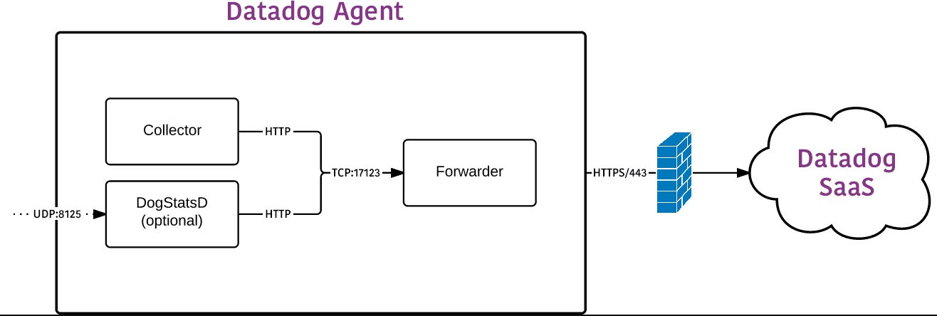
How Datadog Works
https://docs.datadoghq.com/agent/architecture/?tab=agentv6v7

Slide 17
Datadog Integrations
Datadog Integrations: A Powerful Ecosystem
Datadog’s strength lies in its ability to integrate with a vast array of tools and platforms, enabling comprehensive monitoring and analysis
https://docs.datadoghq.com/integrations/

Slide 18
Create DataDog Account
https://www.datadoghq.com/

Slide 19
Agent Integration
Windows Server
Linux Server
Docker and Kubernetes
AWS or Azure

Slide 20
Datadog agent settings
http://127.0.0.1:5002/

Slide 21
Datadog fundamentals
Event
Infrastructure
Dashboard
Monitor
Notebook
Log management

Slide 22
Datadog Events
Datadog Events provide a centralized repository for tracking changes and activities across your infrastructure and applications.
They offer a structured way to correlate different data points, such as metrics, logs, and traces, to gain deeper insights into system behavior.

Slide 23
Dashboard
Datadog Dashboards provide a centralized and interactive way to visualize and analyze your monitoring data.
They allow you to create custom displays of metrics, logs, and traces, enabling you to quickly identify trends, anomalies, and potential issues within your infrastructure and applications.
https://docs.datadoghq.com/dashboards/

Slide 24
Key Features and Benefits
Customization: Build dashboards tailored to your specific needs using a drag-and-drop interface.
Visualization: Choose from a variety of chart types (line graphs, bar charts, histograms, heatmaps, etc.) to represent your data effectively.
Real-time Updates: Dashboards display live data, ensuring you always have the latest insights.
Collaboration: Share dashboards with team members for enhanced collaboration and communication.
Templates: Utilize pre-built templates to accelerate dashboard creation.
Annotations: Add notes and comments to dashboards for context and collaboration.
Mobile Access: View and interact with dashboards on mobile devices for on-the-go monitoring.

Slide 25
Creating Effective Dashboards
Define Your Goals: Clearly outline the purpose of your dashboard and the key metrics you want to track.
Choose the Right Visualizations: Select chart types that best represent the data you're displaying.
Organize Layout: Arrange widgets logically for easy navigation and understanding.
Leverage Filters and Timeframes: Use filters to focus on specific data sets and adjust timeframes to analyze trends.
Collaborate with Teams: Share dashboards and gather feedback to improve their effectiveness.

Slide 26
Example Dashboards
Infrastructure Dashboard: Monitor server health, network traffic, and resource utilization.
Application Performance Dashboard: Track response times, error rates, and user activity.
Database Dashboard: Monitor database performance, query latency, and connection pools.
Security Dashboard: Visualize security-related metrics and events.

Slide 27
Dashboard Lists in Datadog
Datadog Dashboard Lists is a feature designed to help you organize and manage your dashboards effectively. It allows you to group related dashboards together, making it easier to find and navigate through your collection.
Organization: Create multiple lists to categorize dashboards based on teams, environments, or functionalities.
Collaboration: Easily share dashboard lists with team members to foster collaboration.
Navigation: Quickly access relevant dashboards by browsing through lists.
Customization: Customize the name and description of each list to reflect its purpose.

Slide 28
Assignment
Clone sample dashboard and modify metrics and widgets

Slide 29
Dashboard Types
Standard Dashboards
Purpose: General-purpose dashboards for visualizing metrics, logs, and traces.
Features: Customizable widgets, time series graphs, query values, heat maps, and more.
Screenboards
Purpose: Designed for display on large screens, often used for live monitoring in operations centers.
Features: Highly customizable layouts with drag-and-drop capabilities, ideal for creating real-time, visually appealing dashboards.
Timeboards
Purpose: Focused on time-series data, ideal for tracking metrics over time.
Features: Includes time-series graphs, query values, and other widgets that show metrics changes over a selected time range.

Slide 30
Creating a Dashboard
Navigate to Dashboards:
Go to the Datadog web application and select “Dashboards” from the main menu.
Create New Dashboard:
Click on the “New Dashboard” button.
Choose a Dashboard Type:
You can start with a blank dashboard or use a pre-built template.

Slide 31
Creating a Dashboard
Add Widgets:
Click the “Add Widget” button to insert various types of widgets, such as time series graphs, query values, heat maps, etc.
Each widget can be customized to display specific metrics or logs.
Configure Widgets:
For each widget, you can configure the data source, set up queries, and adjust visual settings to suit your needs.
Save and Share:
Once you’ve set up your dashboard, click “Save” to keep your changes.
You can share dashboards with team members or set them to be public.

Slide 32
Managing Dashboards
Edit:
You can edit existing dashboards by selecting the “Edit” option. This allows you to modify widgets, adjust layout, and update settings.
Clone:
To create a similar dashboard with slight modifications, use the “Clone” feature.
Delete:
Dashboards can be deleted if they are no longer needed. Be cautious as this action cannot be undone.
Dashboard Layout:
Drag and drop widgets to arrange them on the dashboard. You can resize widgets for better visibility.
Time Range:
Set a global time range for all widgets or customize time ranges for individual widgets to view historical data or real-time metrics.

Slide 33
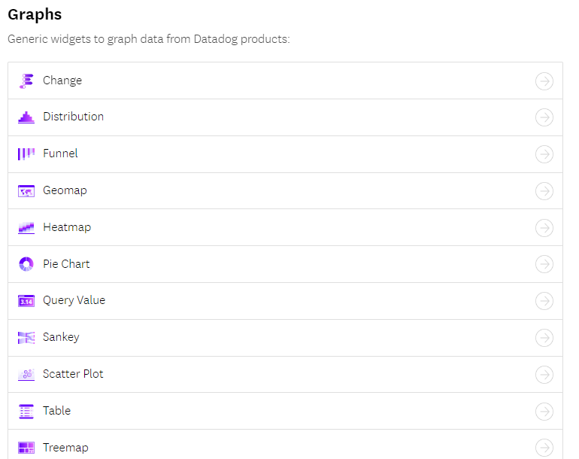
Widgets
https://docs.datadoghq.com/dashboards/widgets/

Slide 34
widgets
1. Timeseries
Use Case: Track and visualize metrics over time. This is useful for monitoring performance trends, identifying spikes or drops in metrics, and understanding patterns.
2. Top List
Use Case: Display the top N values of a specific metric. This is helpful for identifying the top resource consumers, such as the highest CPU or memory usage across servers.
3. Query Value
Use Case: Show a single metric value. Ideal for key performance indicators (KPIs) or critical metrics that need constant monitoring, like current error rates or response times.

Slide 35
widgets
4. Heatmap
Use Case: Visualize the distribution of values over time. Useful for understanding the variability and distribution of a metric, such as response times or request rates.
5. Distribution
Use Case: Display the distribution of metric values across a range of data points. This can help in identifying outliers and understanding the overall spread of the data.
6. Change
Use Case: Highlight the change in a metric over a specified period. Useful for quickly identifying trends or changes in behavior, such as an increase or decrease in traffic.

Slide 36
widgets
7. Host Map
Use Case: Visualize the status of multiple hosts in a grid format. This is particularly useful for monitoring the health and performance of a large number of servers.
8. Service Map
Use Case: Show the relationships and dependencies between services. This helps in understanding the architecture and pinpointing issues in a microservices environment.
9. Toplist
Use Case: Display a ranked list of metrics, useful for seeing top consumers or contributors to a particular metric, like the top error-generating endpoints.

Slide 37
widgets
10. Alert Graph
Use Case: Combine alert conditions with visualizations to show when alerts are triggered. This helps in correlating alerts with metric data for better incident response.
11. Check Status
Use Case: Monitor the status of service checks. Ideal for keeping an eye on the health and status of different services and components.
12. Note
Use Case: Add annotations or explanatory text to dashboards. Useful for providing context or instructions related to the displayed data.

Slide 38
widgets
13. IFrame
Use Case: Embed external web content within a dashboard. Useful for integrating third-party tools or additional context directly into the monitoring dashboard.
14. Log Stream
Use Case: Display live logs from various sources. Useful for real-time monitoring of log data to quickly identify and troubleshoot issues.
15. SLO
Use Case: Monitor Service Level Objectives (SLOs). This helps in tracking the performance and reliability of services against defined targets.

Slide 39
Querying
Whether you are using metrics, logs, traces, monitors, dashboards, notebooks, etc., all graphs in Datadog have the same basic functionality.
https://docs.datadoghq.com/dashboards/querying/

Slide 40
Functions
Functions can modify how the results of a metric query are returned for visualizations. Most functions are applied after the results of the metric query are returned, but functions can also change the parameters before the query is made.
For example, the Rollup function changes the time aggregation of a query before the results are returned. Alternatively, arithmetic functions apply changes to the returned results of the metric query.
https://docs.datadoghq.com/dashboards/functions/

Slide 41
Functions
1. Aggregator
Function: Aggregates data points over a specified time period using operations such as avg, sum, min, max, etc.
Use Case: Useful for summarizing data to understand overall trends. For instance, using avg to view the average CPU usage of a server over the last 24 hours.
2. Rollup
Function: Changes the granularity of the data points, effectively rolling up data into larger time buckets (e.g., 1 minute, 10 minutes).
Use Case: Helps in reducing noise and visualizing long-term trends by averaging data over larger intervals. For example, rolling up data to 10-minute intervals to smooth out a noisy timeseries.

Slide 42
Functions
5. Forecast
Function: Projects future values of a metric based on historical data using machine learning models.
Use Case: Enables predictive monitoring by forecasting future trends, such as predicting future resource usage to prevent capacity issues.
6. Arithmetic
Function: Allows you to perform arithmetic operations on metrics (e.g., addition, subtraction, multiplication, division).
Use Case: Useful for creating custom metrics or combining multiple metrics into a single view. For instance, calculating the error rate as the ratio of error count to total requests

Slide 43
Functions
7. Rate
Function: Calculates the rate of change of a metric per second.
Use Case: Helpful for understanding the speed at which a metric is changing, such as the rate of incoming network traffic.
8. Topk
Function: Filters the data to show only the top k values of a metric.
Use Case: Useful for focusing on the most significant data points, such as the top 10 servers with the highest CPU usage.

Slide 44
Functions
9. Fill
Function: Fills gaps in the data with specified values or methods (e.g., linear interpolation).
Use Case: Ensures continuous data visualization even when there are missing data points, such as filling gaps in timeseries data with interpolated values.
10. Conditional Formatting
Function: Applies color coding to data points based on specified conditions.
Use Case: Enhances data readability by highlighting critical values, such as coloring high latency values in red to quickly identify performance issues.

Slide 45
Functions
11. Smooth
Function: Applies a smoothing function to the data to reduce noise and make trends clearer.
Use Case: Useful for visualizing underlying trends without being distracted by short-term fluctuations, such as smoothing daily temperature readings to see seasonal trends.
12. Event Overlay
Function: Overlay events on a timeseries graph to correlate metrics with events.
Use Case: Helps in understanding the impact of specific events on metrics, such as overlaying deployment events on response time metrics to see if a new release caused performance issues.

Slide 46
Functions
13. Query Editor
Function: Provides an interface to create complex queries using the Datadog query language.
Use Case: Allows for advanced data manipulation and visualization, such as creating a query that combines multiple metrics with conditional logic to monitor complex systems.

Slide 47
Metric Correlations
Metric Correlations can help you find potential root causes for an observed issue by searching for other metrics that exhibited irregular behavior around the same time. Correlations scans your metrics from different sources such as dashboards, integrations, APM, and custom metrics.
https://docs.datadoghq.com/dashboards/correlations/

Slide 48
Template Variables
https://docs.datadoghq.com/dashboards/template_variables/

Slide 49
Datadog Logs
Logs are detailed records of events that occur within an application, system, or network.
They provide valuable insights into the functioning and behavior of these systems, helping developers and operations teams to troubleshoot issues, monitor performance, and maintain security.

Slide 50
Importance of Logs
Troubleshooting: Logs are crucial for identifying and resolving issues within applications and infrastructure.
Performance Monitoring: Logs help in tracking the performance of systems and applications, identifying bottlenecks and optimizing performance.
Security: Logs provide a record of activities, which is essential for detecting and investigating security incidents.
Audit and Compliance: Logs maintain a history of system events, useful for audits and compliance purposes.

Slide 51
Datadog Logs
Datadog Logs is a comprehensive logging solution that provides real-time visibility into the logs generated by your applications and infrastructure. It offers powerful features to collect, process, analyze, and visualize logs, enabling efficient log management and monitoring.
Unified Logging and Monitoring: Datadog integrates logs with metrics, traces, and other monitoring data, providing a holistic view of your systems.
Log Collection: Datadog supports log collection from various sources, including applications, servers, containers, and cloud services.

Slide 52
Datadog Logs
Log Processing: Datadog offers advanced log processing capabilities, including parsing, enrichment, and transformation of logs.
Log Analytics: Powerful search and filtering capabilities allow you to explore and analyze logs in real time.
Dashboards and Visualizations: Create custom dashboards to visualize log data and gain insights at a glance.
Alerting and Notifications: Set up alerts based on log patterns and receive notifications to stay informed about critical issues.

Slide 53
Use Cases for Datadog Logs
Application Monitoring: Track and analyze application logs to ensure optimal performance and quick issue resolution.
Infrastructure Monitoring: Monitor logs from servers, containers, and cloud services to maintain infrastructure health and performance.
Security Monitoring: Detect and investigate security threats by analyzing logs for suspicious activities.
Compliance and Auditing: Maintain detailed logs for audit trails and compliance reporting.

Slide 54
How Datadog Logs Works
Log Collection: Datadog Agent collects logs from various sources, including files, Syslog, Windows Event Logs, and cloud services.
Log Ingestion: Collected logs are ingested into Datadog, where they are processed and indexed for analysis.
Log Processing: Logs can be parsed, enriched, and transformed using processors and pipelines to extract meaningful information.
Log Storage: Processed logs are stored in Datadog, allowing for efficient querying and analysis.
Log Analysis: Use Datadog's powerful search and filtering capabilities to explore logs and gain insights.
Dashboards and Alerts: Create custom dashboards to visualize log data and set up alerts to notify you of important events.

Slide 55
Datadog logs
https://docs.datadoghq.com/logs/log_configuration/

Slide 56
Monitor and Alert
Monitoring all of your infrastructure in one place wouldn’t be complete without the ability to know when critical changes are occurring. Datadog gives you the ability to create monitors that actively check metrics, integration availability, network endpoints, and more.
Configure monitors, configure notifications and automations, and manage alerts at a glance on the Alerting platform.
https://docs.datadoghq.com/monitors/

Slide 57
Notebooks
Notebooks combine graphs and text in a linear, cell-based format. They help you explore and share stories with your data by creating postmortems, investigations, runbooks, documentation, and more
https://docs.datadoghq.com/notebooks/

