Slide 1

Walmart App
Team:
Utkarsh Pathak
Charushila jagdale
Pramod Kulkarni
Pankaj

Slide 2
Project Case Study
Our objective is to provide best user experience to X so that X can get Walmart online shopping without any difficulties.
A user should be to select a product on home page but only logged in users can keep products in wish list for its prices.

Slide 3
Functional And Non-Functional Requirements
Functional Requirements :
1. Authorization Service
2. API Service
3. User Service
4. Admin Service
Non-Functional Requirements :
Responsive UI Components

Slide 4
Project Overview
Authentication API
Wishlist API
Admin functionalities
Admin
Favorite
Login
Customer
SQL
Server
API

Slide 5






Technologies and Tools Used
Technology Used

Slide 6
Architecture
Authentication API
JWT validator
POST request
SQL Server
Login/Register
Token generated
Front End
Angular
POST /GET/
DELETE
Wishlist API
Get favorite
Delete favorite
SQL
Server
GET/DELETE

Slide 7
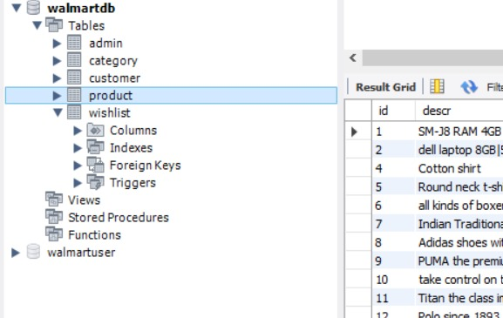
Database Design
MySQL

Slide 8
Backend Design
Walmart App Database
Auth Service
MySQL
Wishlist Service
MySQL
Wishlist Database
Product Services
Product Database
MySQL

Slide 9
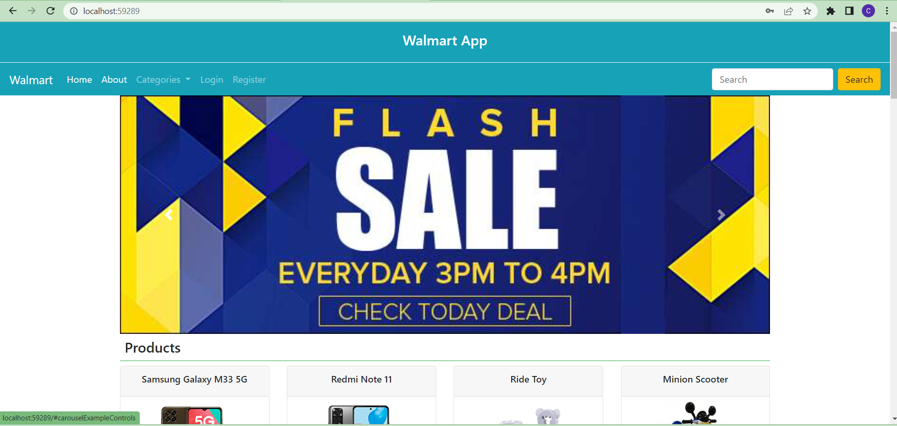
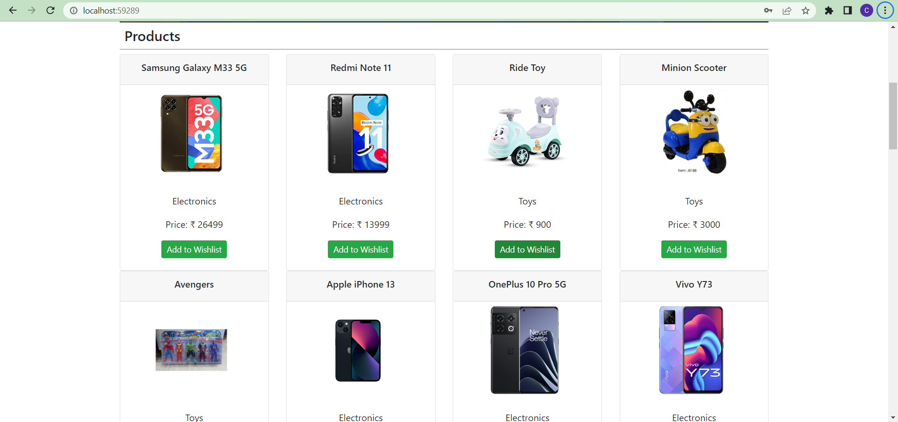
UI Design

Slide 10
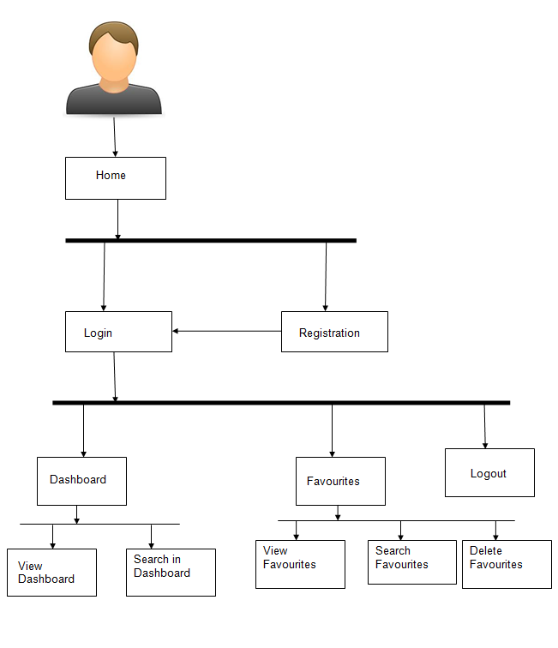
Project Flow
User Login
User Register
Admin Login
Home
Create Product Categories
Add Products into list
Products
Customers
Profile
Wishlist
Customer details

Slide 11
Challenges :-
Faced Many challenges regarding frontend services which were useful to fetch backend data from front end.
Faced issues while fetching the data from Web API ,because it’s Services were deprecated . That’s the reason we used static data for the Website .
Faced issues which is related to database i.e. how to store data from front end to database and how to connect them.

Slide 12
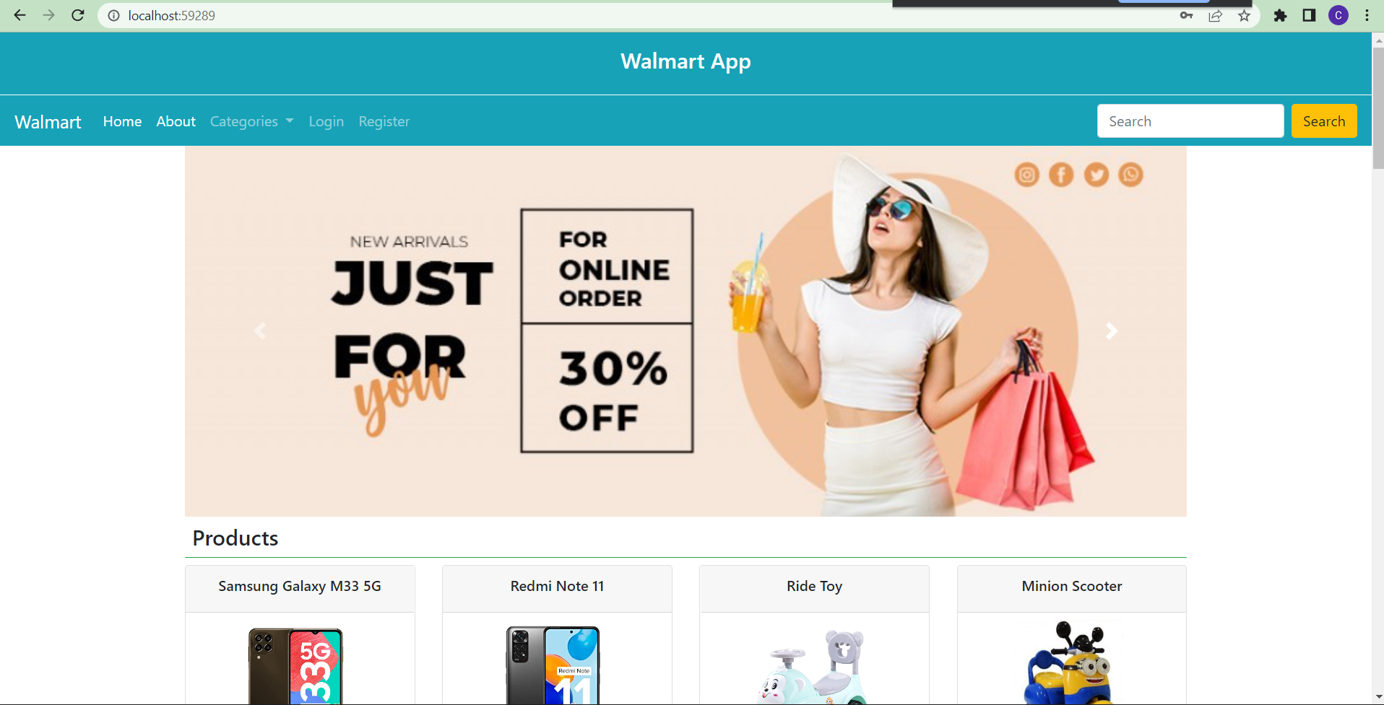
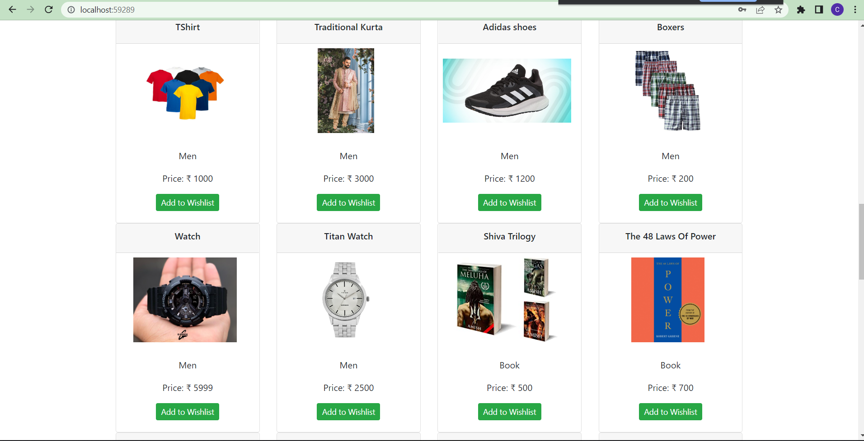
Important Screen shot of UI
..

Slide 13
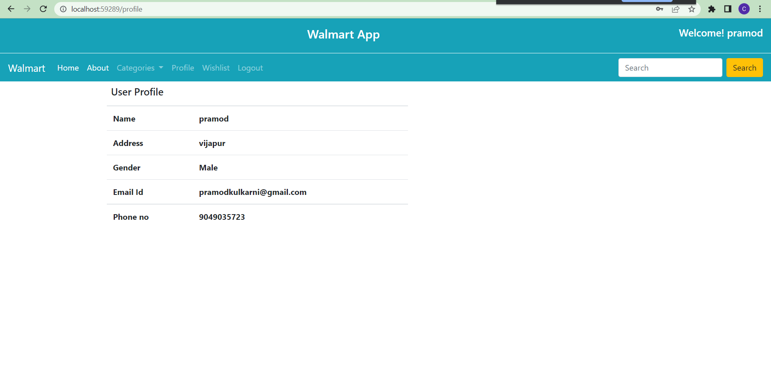
Important Screen shot of Login System
..

Slide 14
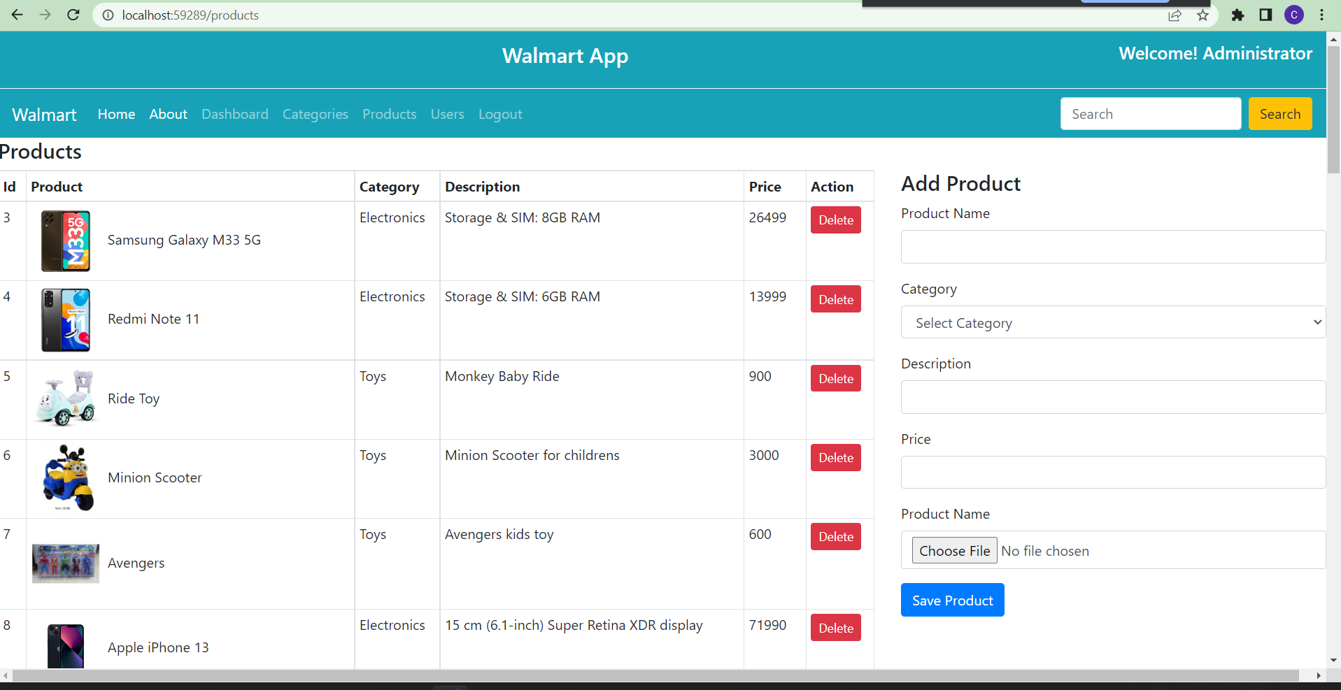
Important Screen Shot of Product List
..

Slide 15
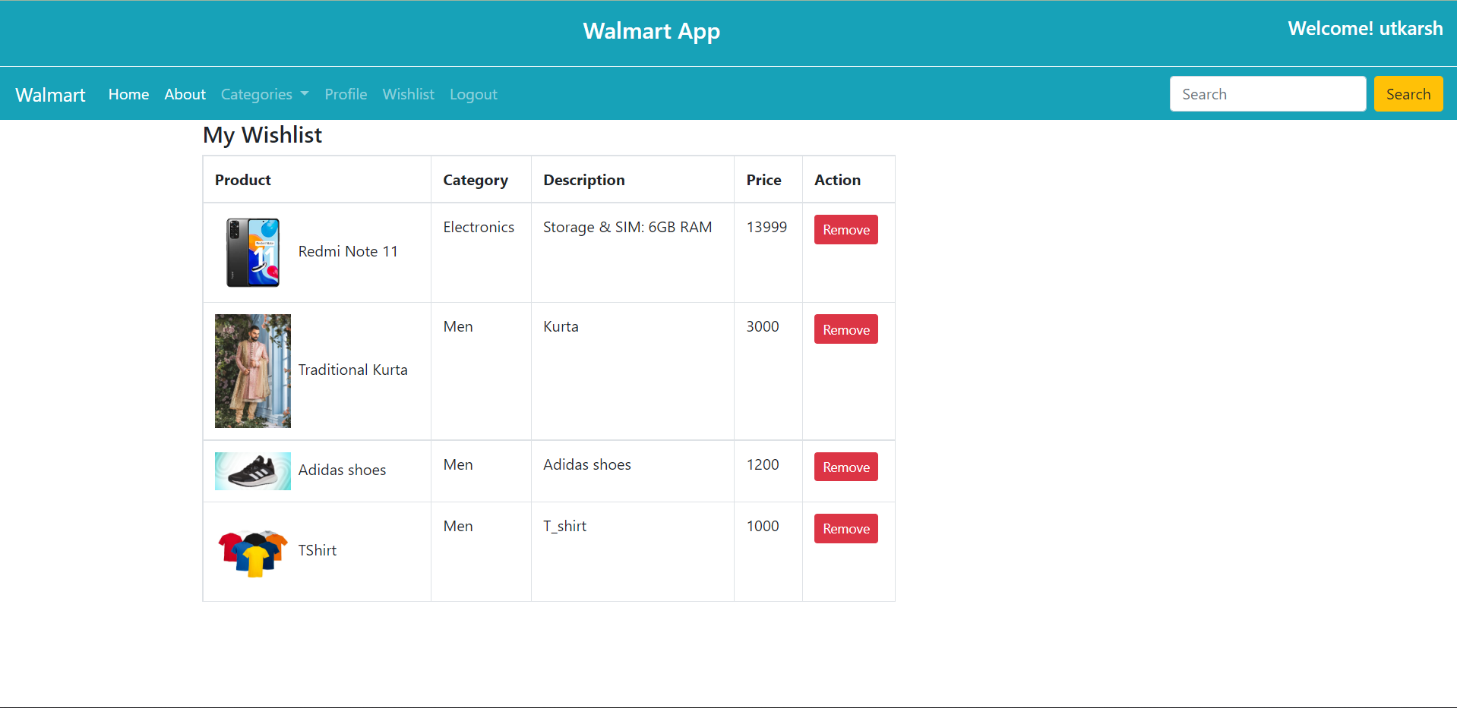
Important Screen shot of Wishlist
..

Slide 16
Acknowledgement
During the selection of “Walmart App" we received help from our Mentor and Teammates, we are forever thankful to them.
Firstly We would like to express our gratitude to our project Mentor Mr. Sanjit Jha Sir . For their immense support, suggestion, encouragement and interest in our project work.
Without their valuable suggestion our project would be incomplete . We would like to thank our friends and group members for their belief and patience in our struggle.

Slide 17
Thank You

