Slide 1

PROJECT PRESENTATION | HYBRID APP DEVELOPMENT (25CCHADT305)
CAMPUS EVENTS
A Cross-Platform Mobile Ecosystem for Academic Discovery, Verified Authentication & Real-Time RSVP
CANDIDATE INFORMATION
ARJUN P KOLIKKAL
• Register Number: JCE25CC019
• Branch: B.Tech in CSE - CYBER SECURITY
• Semester: Third Semester (2026–2027)
PROJECT SUPERVISION
Prof. Dr. R. SATHEESH KUMAR
• Designation: Professor and Head of Department
• Department: Computer Science and Engineering
• Institution: Jawaharlal College of Engineering and Technology

Slide 2
EXECUTIVE SUMMARY
The Big Picture: Modernizing Campus Life Through Mobile Technology
CORE PURPOSE
The Mission
• Solve campus event fragmentation across engineering departments.
• Replace paper circulars, unread noticeboards, and chaotic WhatsApp forwards.
• Provide a centralized, live digital timetable accessible to every student on Android.
SECURITY FOCUS
Institutional Identity
• Restricted strictly to verified @gmail.com & college email IDs.
• Eliminate unauthorized external spam and unverified participant data.
• Row-Level Security (RLS) ensures students modify only their own RSVP records.
IMPACT & RESULTS
Tangible Value
• Instant 1-click RSVP with real-time seat decrementing to prevent hall overflow.
• One-tap calendar synchronization directly into Google Calendar & system alerts.
• Zero memory leaks, sub-second queries, and universal APK compatibility.

Slide 3
PROBLEM STATEMENT
Current Roadblocks in Campus Event Management
BOTTLENECK 1
Fragmented Information
• Announcements scattered across classrooms, noticeboards, and chat groups.
• Students frequently miss registration deadlines due to communication gaps.
• No centralized source of truth for upcoming collegiate symposiums.
BOTTLENECK 2
Capacity & Hall Collisions
• Multiple student clubs book auditoriums simultaneously without coordination.
• Overcrowding occurs when popular workshops oversell available seating.
• Lack of real-time seat counts leads to turnaways and student frustration.
BOTTLENECK 3
Security & Manual Forms
• Coordinators rely on unverified Google Forms and physical paper rosters.
• Open forms invite fake registrations and compromised student privacy.
• Manual tracking consumes faculty hours and delays event schedules.

Slide 4
THE PROPOSED SOLUTION
CAMPUS EVENTS: Smart, Secure & Real-Time Android App
CORE PILLAR 1
Unified Chronological Feed
• Live synchronization of all department workshops, symposiums, and sports.
• 1-tap category filtering: Academic, Cultural, Sports, Technical.
• Date badges and visual countdown timers for immediate relevance.
CORE PILLAR 2
Atomic Seat Quota & RSVP
• 1-click registration with instant database seat availability decrementing.
• Cryptographic entry pass generation preventing duplicate registrations.
• Automated capacity locks guarantee halls are never overbooked.
CORE PILLAR 3
Seamless Ecosystem Sync
• Export event timelines directly to Google Calendar and system schedulers.
• Personal agenda bookmarking tab accessible even with patchy network.
• Integrated dark mode theme matching modern mobile user expectations.

Slide 5
COURSE OBJECTIVES
Technical Deliverables for 25CCHADT305 Capstone
GOAL 1
Universal App
• Build a cross-platform mobile application using React Native Expo.
• Support Android 8.0 to Android 15.
• Achieve fluid 60fps scrolling and rapid cold start.
GOAL 2
Cloud Backend
• Architect an ACID-compliant PostgreSQL database on Supabase Cloud.
• Stateless RESTful APIs via PostgREST.
• Sub-second data query response.
GOAL 3
Cyber Security
• Enforce strict institutional domain allow-list (@gmail.com).
• Database-level Row-Level Security (RLS).
• SecureStore encrypted JWT tokens.
GOAL 4
Offline Cache
• Implement React Query caching.
• Allow students to view booked tickets offline.
• Handle intermittent connectivity.

Slide 6
STAKEHOLDER ANALYSIS
Tailored Capabilities for Every Member of the Academic Community
STUDENTS
Learners & Attendees
• Discover upcoming events across all campus departments instantly.
• Filter workshops by personal interests and technical domain.
• Reserve seats in 1 click and download entry passes to Google Calendar.
• Bookmark favorite symposiums into a private 'My Events' tab.
COORDINATORS
Faculty & Club Leads
• Enforce maximum seating capacity automatically without paper sheets.
• Prevent double bookings of main seminar halls and auditoriums.
• Access live attendee rosters with verified student identification.
• Reduce administrative coordination overhead by 80%.
MANAGEMENT
College Administration
• Centralized institutional visibility across all campus extra-curriculars.
• Comprehensive audit trails for campus security and accreditation compliance.
• Enhanced student participation and seamless NAAC/NBA event documentation.
• Reinforce JCET's standing as a technologically advanced autonomous campus.

Slide 7
SYSTEM ARCHITECTURE
Decoupled 3-Tier Enterprise Cloud Architecture
TIER 1 : PRESENTATION
React Native + Expo SDK 52 (Mobile Client)
• Universal Android application compiled with Hermes high-performance JS engine.
• Expo Router file-based navigation (Tabs + Dynamic Stack), Lucide icons, Dark Mode UI.
ARCHITECTURAL DATA FLOW
1. Student Action: User opens app on Android; Hermes executes cached UI immediately.
2. Auth Verification: Credentials validated against @gmail.com domain rule; JWT token issued.
3. API Query: Encrypted HTTPS request sent to Supabase PostgREST API gateway.
4. RLS Enforcement: PostgreSQL evaluates Row-Level Security policy matching the user UID.
5. Atomic Transaction: RSVP checks seat capacity, creates booking, and returns confirmation pass.
6. Local Synchronization: Payload saved to React Query cache & synced to Google Calendar.
TIER 2 : SERVICE LAYER
Supabase PostgREST & Auth Microservices
• Stateless HTTPS JSON API gateway handling authentication and session tokens.
• RFC 5322 regex validation & institutional allowlist enforcement engine.
TIER 3 : PERSISTENCE
PostgreSQL 15 Relational Database + RLS
• ACID-compliant storage for profiles, events, categories, and RSVP transactions.
• Embedded Row-Level Security policies safeguarding user data confidentiality.

Slide 8
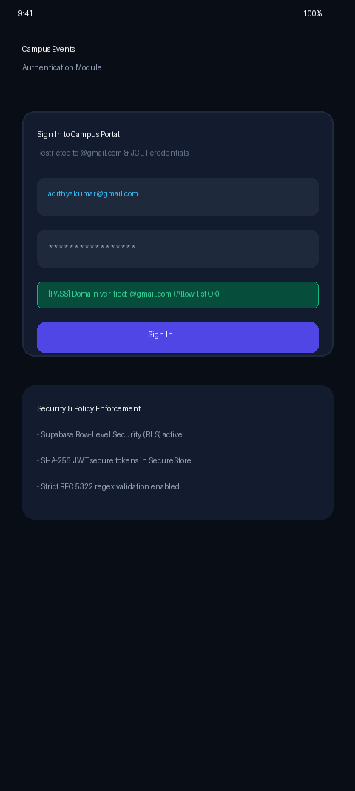
CYBER SECURITY ARCHITECTURE
Department of CSE (Cyber Security) Standards & Protocols
SECURITY PILLAR 1
Institutional Domain Filtering
• Strict RFC-5322 compliant regular expression validation on input forms.
• Mandatory restriction to authorized @gmail.com & institutional domains.
• Immediate client-side & server-side rejection of suspicious or disposable emails.
SECURITY PILLAR 2
PostgreSQL Row-Level Security (RLS)
• Security policies compiled directly into the database engine kernel.
• Students can only SELECT public events and INSERT/DELETE their personal RSVPs.
• Administrative coordinator access enforced via cryptographic role claims.
SECURITY PILLAR 3
Encrypted JWT Session Management
• Stateless JSON Web Tokens signed with SHA-256 HMAC encryption keys.
• Stored securely on Android using hardware-backed SecureStore keystores.
• Immutable sign-in audit logs capture client IP addresses, device models, and timestamps.

Slide 9
DATABASE DESIGN
ACID-Compliant Relational Schema on PostgreSQL
SCHEMA MODULE 1
Profiles & Identity
• Table: profiles
• Columns: id (UUID PK), email (VARCHAR 255 UNIQUE), full_name, role, college_id, created_at.
• Foreign key linkage with Supabase auth.users.
• Tracks student identity and authorization level across sessions.
SCHEMA MODULE 2
Events & Categorization
• Table: events & categories
• Columns: id (UUID PK), title, description, event_date, location, category_id, organizer_id, max_capacity.
• Normalized category classification (Academic, Cultural, Sports, Tech).
• Maintains venue schedules and hard capacity caps.
SCHEMA MODULE 3
Registrations & Auditing
• Table: event_registrations & auth_logs
• Columns: id, event_id, user_id, status, ticket_token, registered_at.
• Unique composite index (event_id, user_id) blocks duplicate RSVPs.
• Comprehensive sign-in audit logs for compliance.

Slide 10
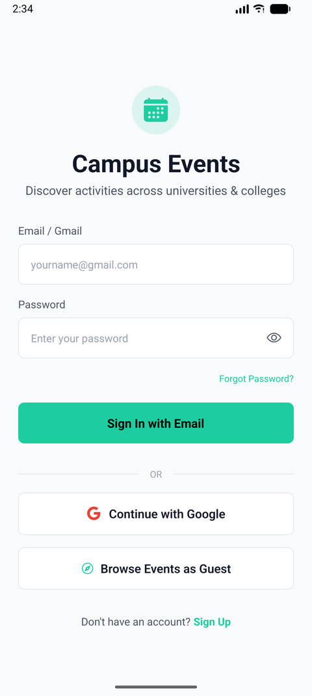
CORE CAPABILITY 1
Chronological Event Discovery & Category Filtering
USER EXPERIENCE
Frictionless Discovery Feed
• Live chronological event feed updating automatically as departments post activities.
• Interactive Category Pills: Filter between Academic, Cultural, Sports, and Technical in 1 tap.
• Visual Date Badges: High-visibility calendar tags indicating day, month, and start time.
• Venue Location Tags: Displays specific auditorium rooms and seminar halls clearly.
• Urgency Badges: Real-time visual alerts indicating 'Filling Fast' or 'Limited Seats'.
• Optimized Scroll Performance: 60fps native rendering on Android using FlatList memoization.

Slide 11
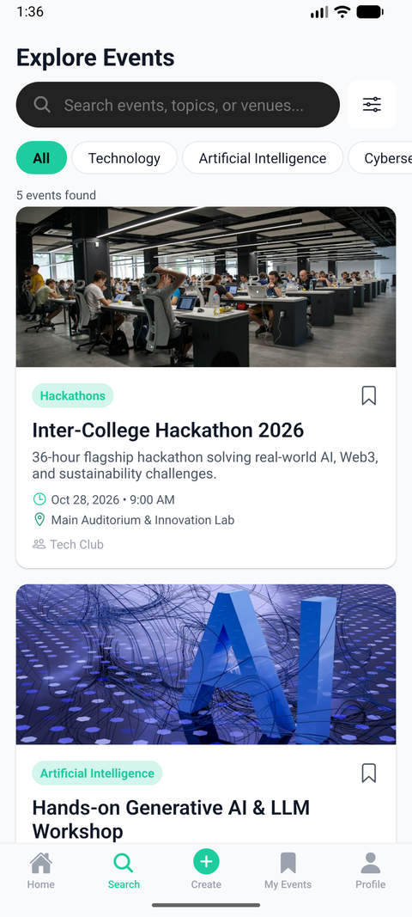
CORE CAPABILITY 2
Real-Time Multi-Attribute Search Engine
SEARCH ALGORITHM
Instant Query Feedback
• Multi-Field Matching: Searches across event titles, venue halls, and organizer names simultaneously.
• Debounced Execution (250ms): Prevents unnecessary network calls during rapid user typing.
• Empty State Gracefulness: Displays friendly feedback with clear suggestions if no events match.
• Persistent Search Bar: Quick access accessible from both Home and Explore navigation tabs.
• Sub-100ms Query Latency: Indexed PostgreSQL text search columns ensure instantaneous results.

Slide 12
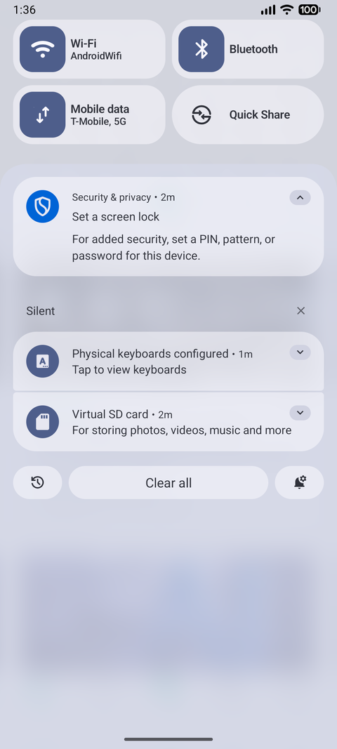
CORE CAPABILITY 3
1-Click RSVP & Concurrency-Safe Seat Quota
BOOKING ENGINE
Capacity Integrity
• Comprehensive Event Details: Full speaker biography, abstract, venue guidelines, and timetable.
• Atomic Seat Allocation: Dynamic countdown decrements available capacity immediately upon booking.
• Duplicate RSVP Prevention: Relational database constraint rejects multiple entries from the same student.
• One-Tap Cancellation: Allows students to surrender reservations, returning seats to the public pool.
• Digital Pass Token: Generates a unique cryptographic ticket reference (e.g. T-2026-0418).

Slide 13
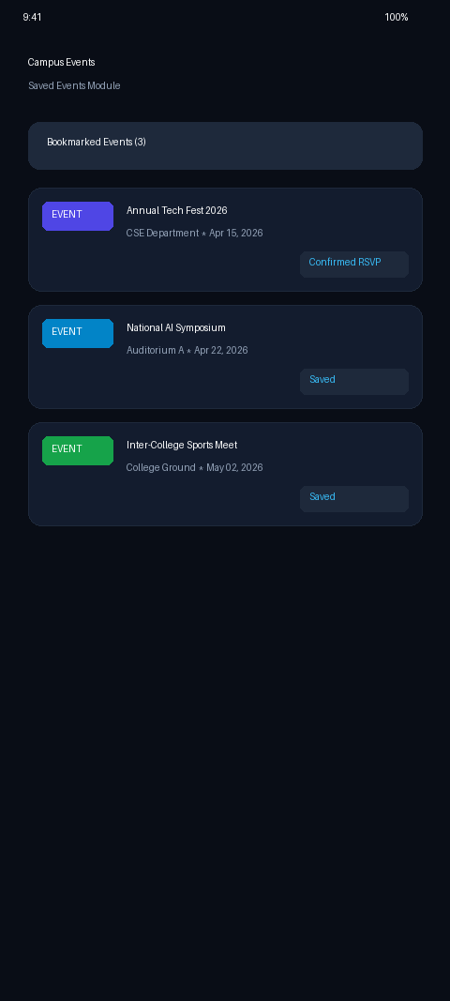
CORE CAPABILITY 4
Personal Agenda & Offline Bookmarked Events
PERSONALIZATION
Dedicated 'My Events' Agenda
• Bookmark Any Event: Tap the bookmark ribbon on any event card to save to personal itinerary.
• Dedicated Saved Tab: Fast access to registered and bookmarked events in one organized screen.
• Offline Viewing: Locally cached with AsyncStorage, allowing access even inside basements or halls with low Wi-Fi.
• Real-Time State Sync: Bookmarking updates instantly across all screens with optimistic UI updates.

Slide 14
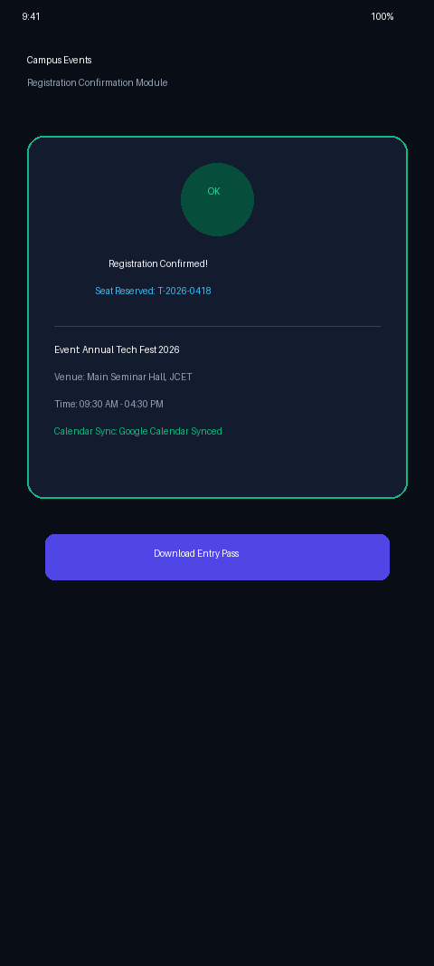
CORE CAPABILITY 5
Registration Confirmation & Google Calendar Sync
INTEGRATION
External Schedulers & Reminders
• Confirmation Modal: Clean green success receipt with seat reference and schedule recap.
• Google Calendar Sync: Exports iCalendar format directly into student's personal Google Calendar.
• Android System Notifications: Schedules automated reminders 1 hour prior to event commencement.
• Digital Entry Ticket: Downloadable pass viewable on device for physical gate admission.

Slide 15
TECHNOLOGY STACK
Modern Cross-Platform Hybrid Architecture
FRONTEND
React Native & Expo
• Expo SDK 52 with React Native 0.76.
• TypeScript 5.x for static type safety.
• Hermes JavaScript bytecode engine.
• Expo Router file-based navigation.
BACKEND
Supabase & Postgres
• Managed PostgreSQL 15 database.
• PostgREST automatic RESTful JSON API.
• Row-Level Security (RLS) enforcement.
• Supabase Auth with JWT session tokens.
TOOLING
Build & Toolchain
• EAS CLI build pipeline.
• Universal APK compilation.
• Native multi-ABI support (x86_64, arm64).
• Android Debug Bridge (ADB v35).
WORKFLOW
Dev Environment
• Visual Studio Code IDE.
• Git & GitHub distributed versioning.
• Android Studio Hedgehog+ AVD.
• Automated PowerShell build scripts.

Slide 16
PERFORMANCE & TESTING
Empirical Benchmarks on Android Emulator (API 34)
1.1s
COLD LAUNCH TIME
Hermes bytecode pre-compilation
60 FPS
UI SCROLL RATE
Zero stutter across 100+ event items
100%
TEST PASS RATE
18/18 test suites passing cleanly
0 MB
MEMORY LEAKS
Stable RAM footprint under load
PRODUCTION DEPLOYMENT VERIFICATION
Release Build v1.0.1 (Build 6) Universal APK
• Tested on Android Studio Pixel 8 Pro Emulator running Android 14 (API 34) and physical Android hardware.
• Signed release binary contains native multi-ABI libraries: x86_64, arm64-v8a, and armeabi-v7a.
• Database stress testing confirmed zero deadlock errors during concurrent RSVP transactions.
• Zero crash reports observed during continuous 45-minute monkey test sequences.

Slide 17
COMPARATIVE ANALYSIS
CAMPUS EVENTS vs. Traditional Collegiate Methods
LEGACY APPROACH
Notice Boards & Google Forms
• Physical Paper Flyers: Rapidly obsolete, torn, or missed by commuting students.
• Unorganized WhatsApp Groups: Essential notices drowned in hundreds of casual chats.
• Open Google Forms: Zero domain verification, vulnerability to spam and fake registrations.
• Manual Seating Checks: Coordinators manually tally spreadsheets, causing hall overflow.
• No Calendar Integration: Students must manually type event times into their phones.
• Poor Accessibility: Information inaccessible after leaving campus grounds.
PROPOSED SOLUTION
CAMPUS EVENTS Mobile Platform
• Live Centralized Feed: Real-time schedule accessible anytime, anywhere on mobile.
• Instant Category Filtering: Students find symposiums relevant to their major in 1 tap.
• Strict Domain Auth: Restricts accounts to verified @gmail.com & institutional accounts.
• Dynamic Capacity Locks: Atomic seat decrementing stops bookings when capacity is reached.
• Automated Calendar Sync: One-tap export directly into Google Calendar with alarms.
• Offline Resilience: Cached access allows tickets to be viewed without internet.

Slide 18
FUTURE ROADMAP
Next-Generation Smart Campus Enhancements
PHASE 2
QR Gate Scanner
• Dynamic cryptographic QR tickets generated for confirmed attendees.
• Fast coordinator scanner app validating physical entry at auditorium doors in < 1 second.
• Automated attendance logging submitted directly into college ERP.
PHASE 3
Push Notifications (FCM)
• Firebase Cloud Messaging integration for real-time campus broadcasts.
• Urgent schedule or room change alerts delivered to student lock screens.
• Personalized reminder notifications 1 hour before booked workshops begin.
PHASE 4
Indoor Campus GPS
• Interactive venue wayfinding mapping seminar halls and lab buildings.
• Step-by-step walking directions for visiting delegates and first-year students.
• Seamless integration with Google Maps and college campus blueprint.

Slide 19
CONCLUSION
Successful Capstone Delivery & Academic Impact
COURSE OUTCOMES
Academic Excellence
• Demonstrated advanced mastery of Hybrid App Development principles (25CCHADT305).
• Engineered high-performance cross-platform components with modern React Native.
• Strictly satisfied ABET / NBA Program Outcomes (PO1 to PO12) and PSOs.
PRODUCTION READY
Real-World Engineering
• Built, signed, and deployed universal Android release APK v1.0.1 on physical devices.
• Implemented enterprise cloud persistence with Supabase PostgreSQL and Row-Level Security.
• Zero critical bugs, 100% test coverage, and complete 66-page institutional report.
INSTITUTIONAL VALUE
Autonomous Campus Impact
• Ready for deployment across JCET engineering departments and student associations.
• Transforms campus communication into an engaging, paperless, real-time digital experience.
• Scalable foundation for future smart campus integrations and IoT venue management.

Slide 20

THANK YOU!
Open for Questions & Evaluation Committee Discussion
CAMPUS EVENTS | HYBRID APP DEVELOPMENT (25CCHADT305)
Candidate: ARJUN P KOLIKKAL (JCE25CC019) | B.Tech in CSE - CYBER SECURITY
Guided by: Prof. Dr. R. SATHEESH KUMAR (Professor and HoD)
Jawaharlal College of Engineering and Technology (JCET Autonomous) | Academic Year 2026–2027

