Slide 1
Video Event Representation
Video Event Markup Language (VEML)
  XML representation of semantic information
  Translated to RDF-OWL
Text Generation
Text Generation Engine
Text
Planner
Sentence
Planner
XML
Feature-value
pairs
Text
Realizer
Semantic
XML
VEML
Text
Reports
Document
Structure
Functional
Structure
Phrase structure
Grammar
Symbolic
Generator
Application dependent
“Application” independent
Language specific
Ref: R. Nevatia, J. Hobbs and B. Bolles, "An Ontology for Video Event Representation", IEEE Workshop on Event Detection and Recognition, June 2004
M.W. Lee, A. Hakeem, N. Haering, and S.C. Zhu, "SAVE: A Framework for Semantic Annotation of Visual Events" Proc. 1st Int'l Workshop on Internet Vision, Anchorage, Alaska, 2008

Slide 2
Feature-value pair structure: examples
Feature-value pair structure
  Process (event)
  Actor / agent
  Predicates
  Context/lexical properties
Common text generation input scheme
  Sentence Planning Language (SPL)
  HALogen (ISI - USC)
(e1 / move
:AGENT (d1 / Boat_0)
:PATIENT (d2/114.5 meter)
:POSTMOD (d3/left direction
:ANCHOR in
:DETERMINER definite)
:TEMPORAL_LOCATING (d4 / time
:ORIGIN 08:25
:DESTINATION 09:02)
:ORIGIN: bottom-right
:DESTINATION bottom-left
:SPATIAL_LOCATING (d5 / region
:ANCHOR on
:PREMOD water))
Boat_0 moves 114.5 meter in the left direction from bottom-right to bottom-left on water region between 08:25 to 09:02.
(e1 / follow
:AGENT (d1 / Boat_1 )
:PATIENT (d2 / Boat_0)
:TEMPORAL_LOCATING (d3 / time
:ORIGIN 08:34
:DESTINATION 09:18))
Boat_1 follows Boat_0 between 08:34 to 09:18.
Ref: Irene Langkilde-Geary and Kevin Knight, "HALogen Input Representation", http://www.isi.edu/publications/licensed-sw/halogen/interlingua.html.

Slide 3
Sentence Generation: from XML to Text
Head-driven phase structure grammar (HPSG)
Production rules
  S → NP VP
  NP → DET (A) N
  VP → V NP
  VP → V PP
  VP → V ADV
  PP → P NP
event
S
actor
event-type
NP VP
object
event-property
DET N V PP
P NP
Unification process
  Matches input with grammar
  Linearize lexical tree to form sentences
DET A N
A vehicle moves at a fast speed
Indexed keywords using TF-IDF
Searchable using FULLTEXT engine in SQL

Slide 4
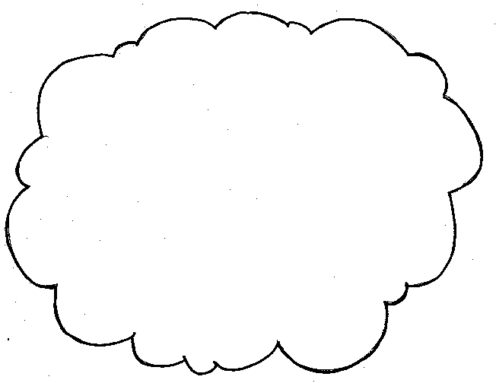

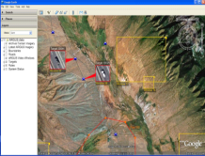
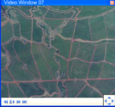
Integration with Semantic Web Technologies
Video
Analytics
Semantic
Engine
context
Knowledge base
GIS / Semantic Web
Video content representation
  To be highly portable
  Allow heterogeneous data integration
  Linked semantically to other datasets
RDF/OWL
Semantic Web
Semantic
Video
Content
GIS
Video
Event
Ontology
WordNet
Semantic data
  Ontology-based
  Diverse, semi-structured, evolving data
  Open architecture, information sharing, aggregation
  Portable and readable by 3rd party software
SPARQL
Engine
Natural Language Query
Alerts
Text report
Visualization
Search
Forensics
Data mining
M. Lee, A. Hakeem, H. Deng, O. Javed, T. E. Choe, N. Haering, “Context-Sensitive Semantic Representation and Query of Surveillance Video Events”, submitted to Multimedia and Ubiquitous Engineering, 2010.
Notes:
The most promising solution is the semantic web standards
There are already many information published, including GIS and wordnet.
OWL is an ontology language
. SW Is flexible, allow us reuse standard ontology that has already been published, but also allow us to develop additional ontology for our domain.
. Information are diverse, semi-structure and evolving, and distributed
.

Slide 5
Semantic Query using SPARQL
Query: Find red vehicle entering AOI between 12/28/2008 and 12/30/2008
SELECT ?o
WHERE {
?e rdf:type vsmarkup:Event.
?e vsmarkup:hasType “enter".
?e vsmarkup:subject ?o.
?o rdf:type vsmarkup:Vehicle.
?e vsmarkup:object “AOI”.
?o vsmarkup:color “red”
?e time:hasBeginning ?beginTime.
?e time:hasEnd ?endTime.
FILTER (
?beginTime >= “12/28/2008” &&
?endTime <= “12/30/2008”
)}
SPARQLQuery

Slide 6
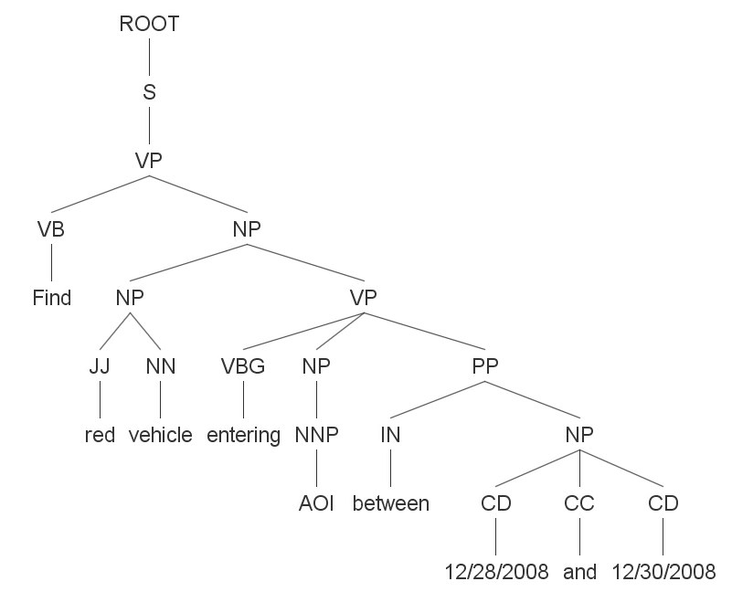
Natural Language Query Parsing
Translation of NL Query to SPARQL
with A. Hakeem
Query: Find red vehicle entering AOI between 12/28/2008 and 12/30/2008
modifier extractor:
StanfordParser:
<vehicle, entering, AOI>
Head Verb: Find
Head Noun: vehicle
time0: 12/28/2008
time1: 12/30/2008
SELECT ?o
WHERE {
?e rdf:type vsmarkup:Event.
?e vsmarkup:hasType “enter".
?e vsmarkup:subject ?o.
?o rdf:type vsmarkup:Vehicle.
?e vsmarkup:object “AOI”.
?o vsmarkup:color “red”
?e time:hasBeginning ?beginTime.
?e time:hasEnd ?endTime.
FILTER (
?beginTime >= “12/28/2008” &&
?endTime <= “12/30/2008”
)}
amod(vehicle-3, red-2)
dobj(Find-1, vehicle-3)
partmod(vehicle-3, entering-4)
dobj(entering-4, AOI-5)
prep_between(AOI-5, 12/28/2008-7)
prep_between(AOI-5, 12/30/2008-9)
conj_and(12/28/2008-7, 12/30/2008-9)
SPARQLQuery
Hakeem, Lee, Javed, Haering, "Semantic Video Search using Natural Language Queries" ACM MultiMedia, 2009

Slide 7
Conclusions
Video Understanding: Analysis, Fusion, Applications
Golden opportunity
  Proliferation of camera
  Emergence of high-res. camera
  Lower cost of network, storage, computing hardware
Exciting topics
  Complex event reasoning
    Multi-agent events, contextual and semantic understanding
  Sensor fusion
    Radar, laser, ultrasound
  Distributed computer vision
    Parallelization of vision algorithms
  Robotics vision and navigation
    Active vision, task oriented
  User Interface and tools
    Visualization and query
Industry R&D plays an important role

Slide 8
Semantics inference and text generation
Semantics Inference
Engine
Text Generation
Engine
Spatial
Analyzer
Semantics
Analyzer
Ontology
Document
Structure
Phrase structure
Grammar
Video Parsing
Semantic
XML
Semantics
Inference
Coordinator
Xml
Semantics
Generator
Text
Planner
Text
Realizer
Reports
Temporal
Analyzer
Event
Analyzer
Video Event
Representn.
Function
Structure
Symbolic
Generator

Slide 9
Video event representation
Video Event Markup Language (VEML)
  ARDA sponsored development in 2003
  XML representation of semantic information
  Flexible and easily scalable
  Related to Video Event Representation Language (VERL)
    Ontology of events
Main sections of VEML document
  Ontology. Definition files for visual entities, subtype relations, and other relations and properties.
  Streams. Information about the video source.
  Context. Describes contextual information related to the video. These include static scene elements, roads, intersections, etc.
  Objects. Describes objects that are presented in the scene.
  Events. Describes events in the scene.
Ref: R. Nevatia, J. Hobbs and B. Bolles, "An Ontology for Video Event Representation", IEEE Workshop on Event Detection and Recognition, June 2004

Slide 10
Semantic-XML example (VEML)
<scene> <ontology> <source> ../ontologies/VisualScene.verl </source> </ontology> <streams> <source> <location> E:\TownCenter1.avs </location> <type>video</type> <width>360</width> <height>240</height> </source> </streams> <context> <sceneContext> <sceneType>urban</sceneType> <sceneElement> <sceneElementType> road </sceneElementType> <area>0.441007</area> <location>bottom</location> <location>center</location> | </sceneElement> <sceneElement> <sceneElementType> land </sceneElementType> ... </sceneElement> ... <roads> <road> <id>road_0</id> <locations> <location> top-right </location> <location> top-left </location> </locations> </road> ... </roads> ... </sceneContext> </context> ...

Slide 11
Semantic-XML example (cont)
... <objects> <object> <id>Human_0</id> <type>HUMAN</type> <width>17</width> <height>24</height> ... </object> <object> <id>Land_vehicle_1</id> <type>LAND_VEHICLE</type> <width>28</width> <height>21</height> ... </object> ... <objects> <events> <event> <type>moves</type> <agent>Land_vehicle_16</agent> | <speed>6.7 km/h </speed> <zone>zone_3</zone> <time> <type>sec</type> <at>111.386944</at> </time> </event> <event> <type>moves</type> <agent>Human_410</agent> <distance>3.0 meter</distance> <direction>bottom-right</direction> <regionType>land</regionType> <location>top-right</location> <time> <type>sec</type> <begin>3471.461000</begin> <end>3497.153000</end> </time> </event> ... <events> </scene>

Slide 12
Stochastic context-free grammar (SCFG)
Production rules
  activities broken down into sub-activities or actions
Probability of a production rule being utilized
  Learn from training data
Earley-Stolcke algorithm
  Parsing of observed sequence
  Compute the most likely event based on grammar
  Iterations consist of 3 steps: prediction, scanning and completion
Ref: Darnell Moore, Irfan Essa, "Recognizing Multitasked Activities using Stochastic Context-Free Grammar" CVPR 2001

Slide 13
Text generation
A common architecture: Two-task pipeline
Text planning
  Decide what information to express (up to sentence level)
Text realization
  Sentence forming
Text Generation Engine
Text
Planner
Text
Realizer
Planner
XML
Feature-value
pair
Semantic
XML
VEML
Text
Reports
Document
Structure
Functional
Structure
Phrase structure
Grammar
Symbolic
Generator
Application dependent
“Application” independent
Language specific

Slide 14
Text planner
Document structure for text report
Scene Understanding Report generated on <date and time> Source Information Information on video source … Scene Context Scene context description … Object Summary Brief description of objects in the scene … Events of Significance Significant events detected … Detailed Object Information Detailed events description … | <document> <title>Scene Understanding</title> <section> <title>Source Information</title> <paragraph> <sentence> … </sentence> … </paragraph> … </section> <section> <title>Scene Context </title> … </section> … </document>
Text report layout | Text-planner-xml structure

Slide 15
Text Planner – Feature-value pair structure
Feature-value pair structure
  Process (event)
  Actor / agent
  Predicates
  Context/lexical properties
Common text generation input scheme
  Sentence Planning Language (SPL)
  HALogen (ISI - USC)
Text-planner-xml structure
<node>
<label>e1</label>
<value>BEING</value>
<property>
<property_type>SUBJECT</property_type>
<node>
<label>d1</label>
<value>scene</value>
<property>
<property_type>
DETERMINER
</property_type>
<value>definite</value>
</property>
</node>
</property>
<property>
<property_type>PRED</property_type>
<node>
<label>d2</label>
<value>urban</value>
</node>
</property>
</node>
Logical notation “The scene is urban.”
( e1 / being : subject (d1 / scene :determiner definite) : pred (d2 / urban) )
Ref: Irene Langkilde-Geary and Kevin Knight, "HALogen Input Representation",

Slide 16
Feature-value pair structure: examples
(e1 / EXIST
:DOMAIN (d1 / target)
:QUANT 9)
There are 9 targets.
(e1 / move
:AGENT (d1 / Boat_0)
:PATIENT (d2/114.5 meter)
:POSTMOD (d3/left direction
:ANCHOR in
:DETERMINER definite)
:TEMPORAL_LOCATING (d4 / time
:ORIGIN 08:25
:DESTINATION 09:02)
:ORIGIN: bottom-right
:DESTINATION bottom-left
:SPATIAL_LOCATING (d5 / region
:ANCHOR on
:PREMOD water))
Boat_0 moves 114.5 meter in the left direction from bottom-right to bottom-left on water region between 08:25 to 09:02.
(e1 / follow
:AGENT (d1 / Boat_1 )
:PATIENT (d2 / Boat_0)
:TEMPORAL_LOCATING (d3 / time
:ORIGIN 08:34
:DESTINATION 09:18))
Boat_1 follows Boat_0 between 08:34 to 09:18.
Ref: Irene Langkilde-Geary and Kevin Knight, "HALogen Input Representation", http://www.isi.edu/publications/licensed-sw/halogen/interlingua.html.

Slide 17
Head-driven Phrase Structure Grammar (HPSG)
Generate text sentences from functional description
Grammatical categories
  S, sentences
  NP, noun phrase
  VP, verb phrase
  PP, preposition phrase
  N, noun, e.g. car, road
  V, verb, e.g. move, turn,
  A, adjective, e.g. red, fast
  DET, determiner, e.g. the, a, an
  Pron, pronoun, e.g. he, she, he/she, it
  P preposition, e.g. to, in
  ADV adverb, e.g. left, up
Ref: C. Pollard, I.A. Sag, (1994). Head-Driven Phrase Structure Grammar. Chicago, IL: University of Chicago Press.

Slide 18
HPSG – Production Rules
Production rules
  S → NP VP
  NP → DET (A) N
  VP → V NP
  VP → V PP
  VP → V ADV
  PP → P NP
Augment rules with features, for person-number agreement
  E.g.: S → NP(per,num) VP (per,num)

Slide 19
Sentence Generation: from XML to Text
Unification process
  Matches input with grammar
  Linearize lexical tree to form sentences
event
S
actor
event-type
NP VP
object
event-property
DET N V PP
P NP
DET A N
A vehicle moves at a fast speed

Slide 20
Text Generation - examples
Urban scene: traffic monitoring
  ROIs
    Road, intersection
  Events
    Abnormal speed
    Failure to yield at intersection
Maritime scene
  ROIs
    Water area near land
  Events
    Watercraft moving near land
    Watercraft following another
Urban | Semantic XML
 | Text Planner XML
 | Text report HTML
Maritime | Semantic XML
 | Text Planner XML
 | Text report HTML
Semantics
Inference
Text
Planner
Text
Realizer
Text
Report
HTML
Semantic
XML
Text Planner
XML

Slide 21
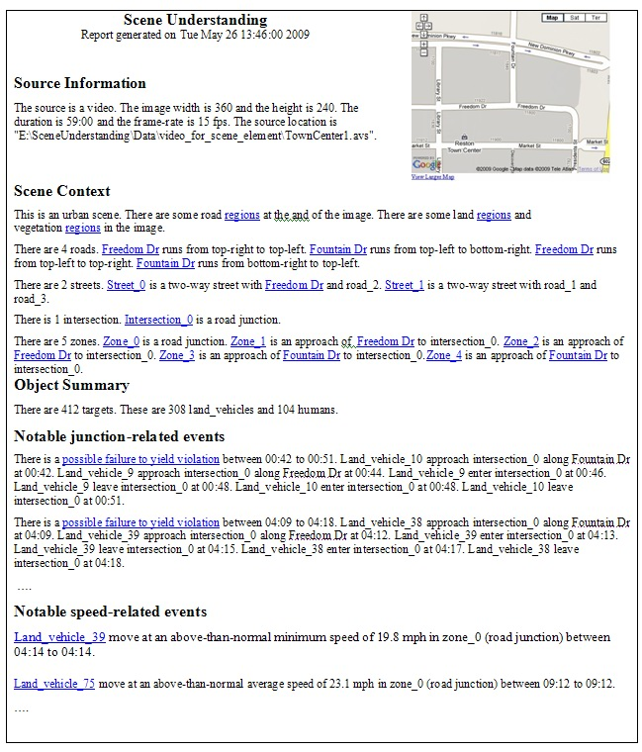

Slide 22
Scene region analysis: Semantic relations
Subclass relation
  Vehicle, human, and watercraft are subclasses of mobile_object
  Road, sidewalk, and waterway are subclasses of pathway
Functional relation
  Each pathway has a property usedBy
  Road.usedBy = vehicle
  Sidewalk.usedBy = human
  Waterway.usedBy = watercraft
Structural relation
  junction is an intersection of pathway

Slide 23
Natural Language Query
Developments in Natural Language Processing
  1984, Head-driven phrase structure grammar (HPSG) (C. Pollard, I. Sag)
  1985, WordNet (Princeton)
  1995, Penn Treebank, WSJ corpus,
    1 million annotated words
    Statistical NLP
  2002, Stanford NL Parser, 1st release
Developments in Semantic Web
  1999, Resource Description Framework (RDF)
  2001, DARPA Agent Markup Language (DAML)
  2004, Web Ontology Language (OWL)
  2008, SPARQL, query language
Emergence of NL-based semantic search technology
  Synergy of NLP and Semantic Web

Slide 24
SPARQL on Multiple Dataset: another example
Query on “Graph” of interlinked dataset
Semantic
Video
Content
WordNet
:inSynSet
GIS
:geoname
Ontology
Client
User
Sensor
network
SPARQL
Engine
Find schools from GeoNames data
PREFIX geoname: <http://www.geonames.org/ontology#>
SELECT ?name
WHERE {
GRAPH ?g {
?f geoname:featureCode geoname:S.SCH .
?f geoname:name ?name .
}}

Slide 25
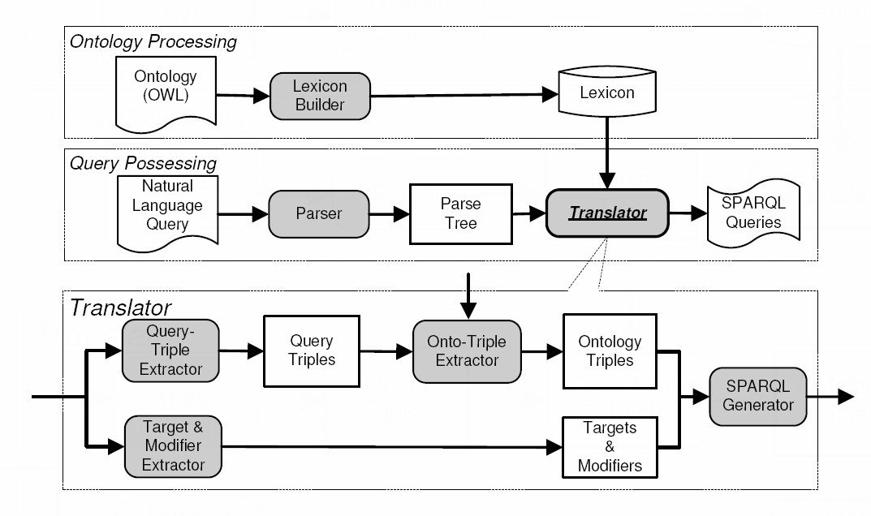
PANTO
Portable Natural Language Interface to Ontologies,
  C. Wang, et.al. ESWC 2007
Translates NL-question to SPARQL-query
Architecture
Wordnet
Stanford
Parser
(Source: C. Wang, et.al. ESWC 2007)

Slide 26
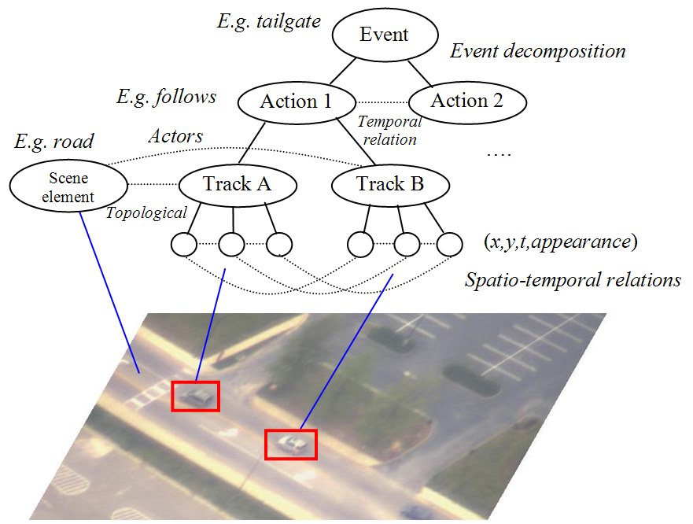
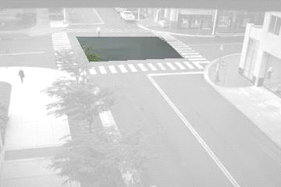
Motion and event analysis
Hierarchy of activities
  Complex activities composed of simpler actions
  Grammar-based model
Context-driven event analysis
  Represent actions with respect to scene context
  Relations between visual elements
Move left
Exiting zone
turn left
Speed
Inside
zone
Entering zone
Move up
Notes:
For event analysis,
We use a graph representation. Complex event are compose of simpler actions.
Knowing the scene structure is very useful for event analysis.
We can now describe object motion with respect to the scene context.
For example, for vehicle motion, instead of a set of primitive, x-y-t, we can describe in more semantic way, such as …
With this, we are moving from raw-data primitive to more semantic representation of the scene.

Slide 27
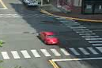
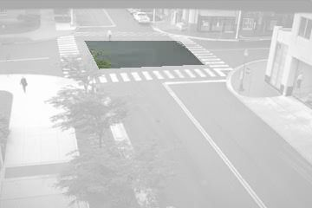
Content Summarization
Generate summary of events at different levels of granularity
  Allow user to scan and browse
Content aggregation based on semantic attributes
  Location, time, object-class, event-type
…
There were 5 speeding events in the afternoon …
…
…
A speeding event occurred at 3.05pm at Junction_A …
…
…
A red car was speeding across Junction_A in the north direction at a speed of 60mph at 3.05pm.
…
Content importance weighting
  Identify important and rare events
Notes:
Content summarization is a year-2 task, have not started work on this yet, here is some ideas.
. Motivation is to describe events at different levels of granularity, to allow user to scan and browse, and find information easily
This involves content aggregation to combine video content based on attributes such as location, time, object class and event type
Important task is to assign importance weight to these content

Slide 28
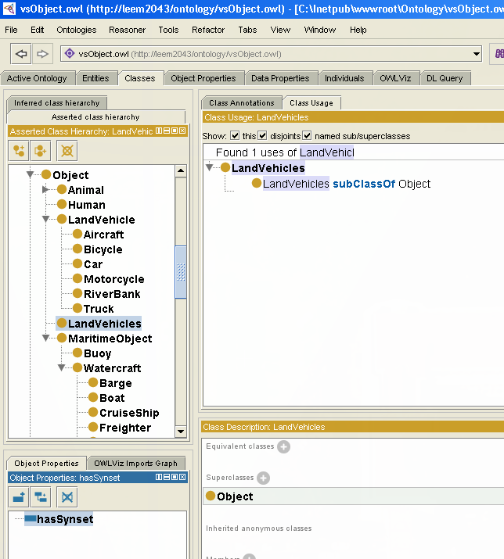
Standard Ontology and RDF/OWL Tools
Standard ontology
  KB: SKOS, Dublin Core, FOAF
  Linguistics: WordNet
  GIS
    WGS84, World Geodetic System
    GeoNames
    OpenGIS, GeoXG
Ontology editors
  Protégé
Semantic web browser, search engine
  Swoogle
Reasoners
  Pellet and FaCT++
SPARQL – Query Language
  Protégé

Slide 29
Data Fusion
Context information
Video
Analytics
Knowledge base
GIS / Semantic Web
Machine-readable output
Data Fusion
Alerts
Text report
Search and query
Forensics
Data mining
Video content representation
  Must be highly portable
  Allow heterogeneous data integration
  Linked semantically to other dataset
Notes:
Have seen example of GIS information can be use to provide context information to improve analytic.
In general way, video analytics output can be combine with 3rd party data source in a general data fusion framework.
This will significant improve user applications, in terms of generating better alerts, text report, and improve performance in search and query, forensic and data mining.
How can we achieve this?
The main issue is in video content representation.
Output must be machine readable, not just my OV software, but also 3rd party software.
Should be highly portable
. It should allow integration with different and diverse dataset.
. More specifically, the video content that we extract should be semantically to these dataset. So that user and 3rd party software can understanding the semantic relationship between these information.

Slide 30
Spatial Inference
Query over spatial-temporal data
  E.g. find objects crossing tripwire, or enter ROI
Convert forensic queries into SQL queries.
Execute queries and render the results in GUI.
Alerts
  Tripwire
  AOI
    Inside
    Enter
    Exit
USE IRI_DATABASE
DECLARE @tripwire geometry
SET @tripwire = geometry::STGeomFromText('MULTILINESTRING((0.181 0.417, 0.781 0.375))',0);
SELECT StartTime, TargetID, geom, geom.STIntersects(@tripwire) AS event
FROM Primitives
WHERE ClipName= ' Reston town center ' ORDER BY event DESC

Slide 31
Event Inference
Integrate Existing Inference Capabilities with SQL
  Single Target Actions
    Tripwire Crossing
    AOI enter/exit
    Loiter
  Multi-Target Interactions
    Target Approaching Asset
    Target Approaching Multiple Assets One by One
    Targets Meeting
    Convoy
Explore connection networks
  Retrieve all persons that came in contact with target
  Retrieve degrees of separation: Recursively find connections
    Target 1 is liked to Target 10 through Target 5

Slide 32
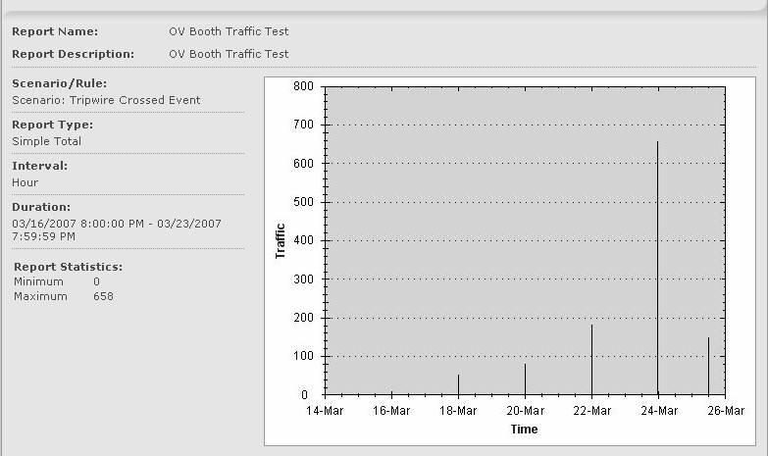
Event Inference
Use Database Reporting Tools
  Retrieval of event statistics on temporal (daily, weekly, monthly, etc.) basis.
    Number of cars entering a parking lot
    Number of stationary cars in an area of interest
    Number of meetings taking place
    Number of speeding vehicles

Slide 33
Contextual Scene Analysis
Inference on Scene Analysis
  Find all targets walking from road into dense vegetation
  Find targets moving from water into land
Support for Semantic Search
  Explore benefits of ontology
  Search using SPARQL
* S.C. Zhu and D.B. Mumford, “Quest for a stochastic grammar of images”, Foundations and Trends of Computer Graphics and Vision, 2006.

Slide 34
Semantic Integration

Slide 35
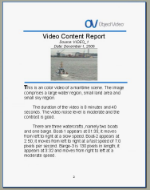
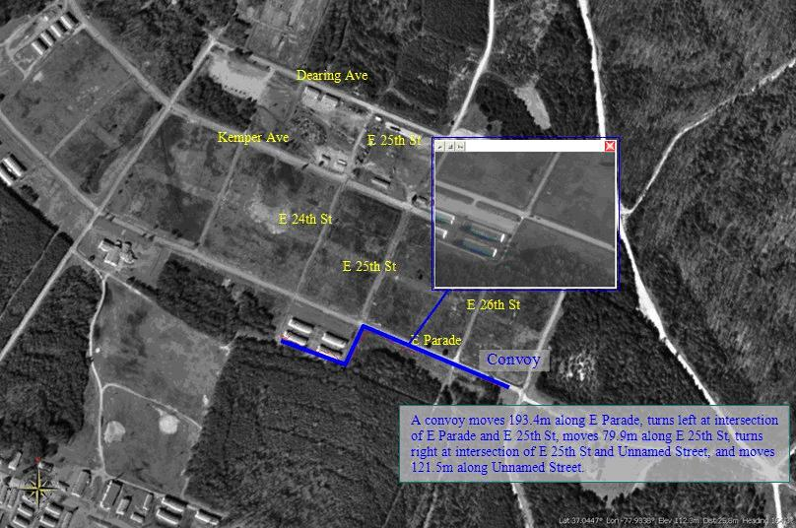
Text Generation
Phase 1
VERL, VEML
Document
Structure
Sentence Planning Language
Semantic
Video
Content
Semantic
Engine
Planner
Text
Generator
Phrase Structure
Grammar
Land_vehicle_359 enters intersection_0 at 57:35. It turns right at 57:39. It leaves intersection_0 at 57:36. It exits the scene at the top-left of the image at 57:18.
Content
Summarization
Phase 2
GIS
Place names, Streets,
Landmarks
Keyword
search
NASA World Wind
R. Nevatia, J. Hobbs and B. Bolles, "An Ontology for Video Event Representation", IEEE Workshop on Event Detection and Recognition, June 2004
C. Pollard, I.A. Sag, (1994). Head-Driven Phrase Structure Grammar. Chicago, IL: University of Chicago Press.
Irene Langkilde-Geary and Kevin Knight, "HALogen Input Representation",
Notes:
. Text generation is not a boiler-plate template ad-hor implementation.
. This is based on grammar, flexible and scalable.
. designed to be highly modularized, and very flexible.
. based on NLP representation and technology
. Depending on application needs, we can easily customized to generate different types of text reports.
such as email, rss, instant messaging.
. In phase 2, we are enhancing each module to provide between text generation.
. In addition, we are augmenting additional module,
1. Integration of GIS information, including placename, streets, and landmarks,
2. For planner, we need to an addition module to summarize the content. (will discuss later)
3. We integration the text description with Worldwind.
assume calibration is available, we can show text on their geo-location in ww.
. We add a keyword search interface,
.

Slide 36
Integration with Semantic Web
Video
Analytics
Semantic
Engine
Knowledge base
GIS / Semantic Web
GIS
Semantic
Video
Content
Video content representation
  To be highly portable
  Allow heterogeneous data integration
  Linked semantically to other dataset
WordNet
Ontology
Semantic Web
RDF/OWL
Semantic data
  Ontology-based
  Diverse, semi-structured, evolving data
  Open architecture, information sharing, aggregation
  Geographically distributed content
  Portable and readable by 3rd party software
Alerts
Text report
Search and query
Forensics
Data mining
Notes:
The most promising solution is the semantic web standards
There are already many information published, including GIS and wordnet.
OWL is an ontology language
. SW Is flexible, allow us reuse standard ontology that has already been published, but also allow us to develop additional ontology for our domain.
. Information are diverse, semi-structure and evolving, and distributed
.

Slide 37
Semantic Representation: RDF / OWL
Resource Description Framework (RDF)
  W3C standards:
  “… general-purpose language for representing information in the Web.”
RDF Graph Data Model
  RDF triples
Subject
Predicate
Object
Web Ontology Language (OWL)
  W3C standard for knowledge representation
  Originated from DARPA DAML project
  Language to describe classes, relationship between classes, and their properties
rdfs:Class | rdf:Property
owl:Class owl:FunctionalProperty owl:ObjectProperty owl:Nothing owl:SymmetricProperty … | owl:equivalentClass owl:inverseOf owl:sameAs owl:unionOf owl:disjointWith …
Notes:
RDF, is a w3c standard as a general purpose language for representing information on the web.
Basic data structure is very simple, is a graph model, each link is represented by a triples.
OWL, is based on RDF,
It is a more formal language for describe classes , relationship and proper
Semantic Web — a Web with linked data easily readable by machines
http://news.zdnet.co.uk/communications/0,1000000085,39279175,00.htm

Slide 38
Semantic Representation: Example
Triple form
car, rdfs:subclassof, vehicle
car_A, rdf:type, car
car_A, :size, size_A
car_A, :Geolocation, loc_A
size_A, :Length, 4.3m
size_A, :Height, 1.4m
loc_A, :Latitude, 38.959693
loc_A, :Longitude, -77.356923
vehicle
rdfs:subClassof
owl:class
car
rdf:type
car_A
:Size
:Geolocation
rdf:instance
size_A
loc_A
:Length
:Height
:Latitude
:Longitude
4.3m
1.4m
38.959693
-77.356923
rdf:literal

Slide 39
SPARQL – Query Language
Query language for RDF (became W3C standards in 2008)
Several implementations exist
  Jena (open source, Java)
Syntax similar to SQL
Query: Find land vehicle
PREFIX vsmarkup:<http://leem2043/ontology/vsMarkup.owl#>
PREFIX vsobject:<http://leem2043/ontology/vsObject.owl#>
SELECT ?x
WHERE {
?x rdf:type vsobject:LandVehicle.
}
Ongoing development:
  Further SPARQL extension: e.g. counting
  Integrate machine-learning and data-mining capabilities (e.g. U. Zurich)
  Translate Natural Language Query to SPARQL (e.g. PANTO)

Slide 40
SPARQL Examples
Query: Find land vehicles
Query: Find 5 fastest vehicles
SELECT ?x
WHERE {
?x rdf:type vsobject:LandVehicle.
}
SELECT ?x ?maxspeed
WHERE {
?x rdf:type vsobject:LandVehicle.
?x vsmarkup:hasMaxSpeed ?speed.
}
ORDER BY ?speed
LIMIT 5
Query: Find turning events
SELECT ?x
WHERE {
?x rdf:type vsmarkup:Event.
?x vsmarkup:hasType "turn".
}
Query: Find events filtered by geo-location
SELECT ?x ?lon ?lat
WHERE {
?x rdf:type vsmarkup:Event.
?x vsmarkup:hasGeoPoint ?geopoint.
?geopoint geo:long ?lon.
?geopoint geo:lat ?lat.
FILTER (?lon > -77.356855 &&
?lon < -77.356853 &&
?lat > 37.043220 &&
?lat < 37.043909)
}
Query: Find objects based on size
SELECT ?x ?wd ?ht
WHERE {
?x rdf:type vsobject:LandVehicle.
?x vsmarkup:hasImageHeight ?ht.
?x vsmarkup:hasImageWidth ?wd.
FILTER (max(?ht, ?wd) > 50)
}

Slide 41
SPARQL on Multiple Dataset
Query on “Graph” of interlinked dataset
Semantic
Video
Content
Information “aggregation”
WordNet
:inSynSet
GIS
:geoname
Ontology
Client
User
Sensor
network
SPARQL
Engine
Query: Find “person” using WordNet lexicon
PREFIX wn: <http://www.w3.org/2006/03/wn/wn20/schema/>
SELECT ?x
WHERE {
GRAPH ?g { ?c wn:inSynSet wn:synset-person-noun-1. }
?x rdf:type ?c.
}
Query without knowledge of OV data model
Notes:
Semantic web is semantic + web
Exploit the information already available on the semantic web, by making connection to other ontology.
Very much like hyperlinks, the documents are identified by URI, but instead of html document, we have the ontology documents
And connection is given by semantic relationship.
The amazing thing that I discover during my research, is that the SPARQL engine is able to query on multiple dataset.
This is a SPARQL specification requirement, and I have confirmed that the Jena implementation support this.

Slide 42
SPARQL: Specialized Rules and Functions
Jena supports customized SPARQL Filters
Semantic
Video
Content
Domain-specific filters
Spatio-temporal analysis
Appearance similarity analysis
WordNet
:inSynSet
GIS
:geoname
OV-Plugin
Ontology
Client
User
Sensor
network
SPARQL
Engine
Query: Find events within 1.0 km radius from any school
PREFIX myfn: <java:Java_code.>
SELECT ?x
WHERE {
GRAPH ?g {
?f geoname:featureCode geoname:S.SCH .
?f geo:lat ?latA . ?f geo:long ?lonA .
}
?x rdf:type vsmarkup:Event.
?x geo:long ?lonB. ?x geo:lat ?latB.
FILTER ( myfn:distance(?latA, ?lonA, ?latB, ?lonB) < 1000 )
}
Sample custom function:
distance(…)

Slide 43
Natural Language Query
SPARQL issues
  User requires some training
  User requires knowledge of RDF-labels (auto-suggestion may help)
Natural language query
  No training necessary
  Formal query language becomes transparent
Challenges
  Parsing input NL text
  Translation to query language
  Linguistic variability and ambiguities

Slide 44
Natural Language Query
Translation of NL Query to SPARQL
Query: Find red vehicle entering AOI between 12/28/2008 and 12/30/2008
WordNet
:inSynSet
Semantic
Video
Content
GIS
:geoname
OV-Plugin
Client
User
Sensor
network
SPARQL
Engine
NL
Parser
SPARQL QUERY
Natural Language Query

Slide 45

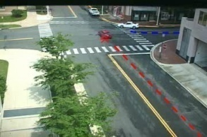
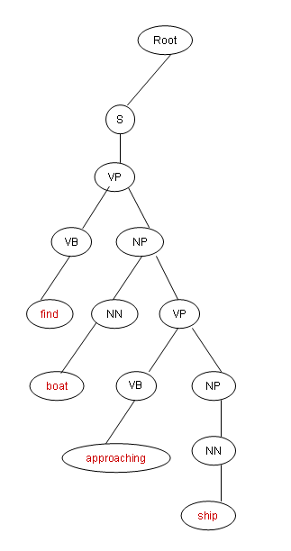
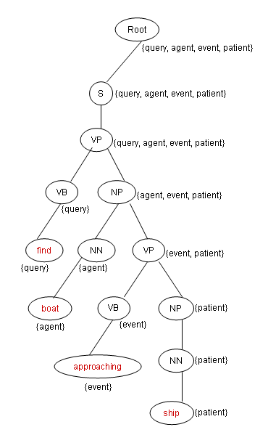
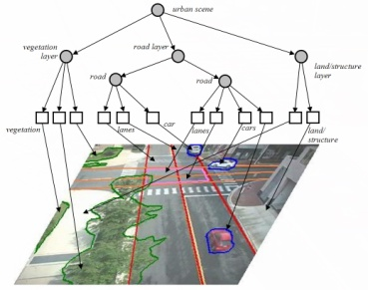
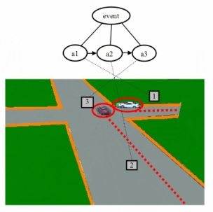
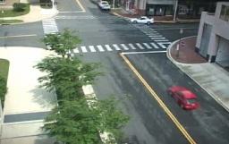
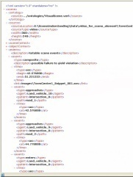
Natural Language Query Framework
Semantic
Video
Search
Query Result
RDF-OWL
Database
Input Query
Syntactic Analysis
WordNet + Morphology
Training
Query
Grammar
Training Queries
Syntactic Analysis
Semantic Analysis
SPARQL Query Grammar
Training Queries
Training Queries
Metadata
Generation
Input
Videos
Image
Parsing
Event
Inference
RDF-OWL
Generation

Slide 46
Natural Language Query Parsing
Query: Find red vehicle entering AOI between 12/28/2008 and 12/30/2008
modifier extractor:
StanfordParser:
<vehicle, entering, AOI>
Head Verb: Find
Head Noun: vehicle
time0: 12/28/2008
time1: 12/30/2008
SELECT ?o
WHERE {
?e rdf:type vsmarkup:Event.
?e vsmarkup:hasType “enter".
?e vsmarkup:subject ?o.
?o rdf:type vsmarkup:Vehicle.
?e vsmarkup:object “AOI”.
?e time:hasBeginning ?beginTime.
?e time:hasEnd ?endTime.
FILTER (
?beginTime >= “12/28/2008” &&
?endTime <= “12/30/2008”
)}
amod(vehicle-3, red-2)
dobj(Find-1, vehicle-3)
partmod(vehicle-3, entering-4)
dobj(entering-4, AOI-5)
prep_between(AOI-5, 12/28/2008-7)
prep_between(AOI-5, 12/30/2008-9)
conj_and(12/28/2008-7, 12/30/2008-9)

Slide 47
Semantic Stochastic Context Free Grammar
Queries tagged with semantic and part-of-speech labels for training SSCFG Query Grammar
Semantic Label: Find(Query) boat(Agent) approach(Event) boat(Patient)
Syntactic Output: Find/VB boat/NN approach/NN boat/NN
…
Semantic Label: Find(Query) boat(Agent) reach(Event) ship(Patient)
Syntactic Output: Find/VB boat/NN reach/NN ship/NN
Learnt query grammar: semantic labels in production rules
ROOT => S{Qry,Agt,Evt,Ptnt}
ROOT => SINV{Qry,Agt,Evt,Ptnt}
ROOT => FRAG{Qry,Agt,Evt,Ptnt}
SINV{Qry,Agt,Evt,Ptnt}=>VP{Qry,Agt} NP{Evt,Ptnt}
S{Qry,Agt,Evt,Ptnt}=>VP{Qry,Agt,Evt,Ptnt}
S{Qry,Agt,Evt,Ptnt} => NP{Qry,Agt} VP{Evt,Ptnt}
S{Qry,Agt,Evt,Ptnt} => NP{Qry} VP{Agt,Evt,Ptnt}
FRAG{Qry,Agt,Evt,Ptnt} => NP{Qry,Agt,Evt,Ptnt}
VP{Qry,Agt,Evt,Ptnt} => VB{Qry} NP{Agt,Evt,Ptnt}
VP{Qry,Agt,Evt,Ptnt}=>VB{Qry}NP{Agt}VP{Evt,Ptnt}
VP{Qry,Agt,Evt,Ptnt} => VB{Qry} VP{Agt,Evt,Ptnt}
VP{Qry,Agt,Evt,Ptnt} => NN{Qry} VP{Agt,Evt,Ptnt}
VP{Qry,Agt} => VBP{Qry} NP{Agt}
VP{Agt,Evt,Ptnt} => VB{Agt} NP{Evt,Ptnt}
VP{Agt,Evt,Ptnt} => VBP{Agt} NP{Evt,Ptnt}
VP{Agt,Evt,Ptnt} => VBP{Agt} VP{Evt,Ptnt}
VP{Evt,Ptnt} => VB{Evt} NP{Ptnt}
VP{Evt,Ptnt} => VBP{Evt} NP{Ptnt}
NP{Agt,Evt,Ptnt} => NN{Agt} NN{Evt} NN{Ptnt}
NP{Qry,Agt,Evt,Ptnt}=>NN{Qry}NN{Agt}NN{Evt}NN{Ptnt}
NP{Qry,Agt} => NN{Qry} NN{Agt}
NP{Agt} => NN{Agt}
NP{Evt,Ptnt} => JJ{Evt} NN{Ptnt}
NP{Ptnt} => NN{Ptnt}
NP{Qry} => NN{Qry}
VB{Qry} => get | find | seek | detect
VB{Agt} => target | object | ship
VB{Evt} => follow
VBP{Qry} => find | show
VBP{Agt} => object
VBP{Evt} => follow
JJ{Evt} => tail-gating
JJ{Evt} => chase
NN{Qry} => search | show | display
NN{Agt} => ship | vessel | target | object | boat
NN{Evt} => approach | reach | chase | tail-gating
NN{Ptnt} => boat | ship | vessel | target | object
Ref: A. Hakeem, M. Lee, O. Javed, N. Haering, "Semantic Video Search using Natural Language Queries" ACM Multimedia, 2009

Slide 48
NL Query parsing
Query: Find boat approaching ship with length greater than 200m
Root
{qu1, ag1, ev1, pat1, di1, eq1, va1}
(QUERY SELECT ?e)
S
FRAG
{qu1, ag1, ev1, pat1}
{di1, eq1, va1}
(?di1 FILTER:eq1 va1)
VP
PP
{di1}
NP
{eq1, va1}
{qu1y, ag1, ev1, pat1}
VB
NP
IN
NP
NP
PP
{va1}
{qu1}
{ag1, ev1, pat1}
(?e vsmarkup:hasAgent ?a)
(?e vsmarkup:hasPatient ?p)
{di1}
{eq1}
find
NN
VP
with
NN
JJR
IN
NP
{ev1, pat1}
(?e vsmarkup:hasPatient ?p)
{di1}
{eq1}
{va1}
{qu1}
{ag1}
length
greater
than
CD
boat
VBG
NP
{pat1}
{eq1}
{va1}
{ag1}
(?a rdf:type vsobject:ag1)
{ev1}
{di1}
(?p vsmarkup:hasLength ?di1)
200m
approaching
NN
{pat1}
{va1}
{ev1}
(?e vsmarkup:hasType ev1)
ship
{pat1}
(?p rdf:type vsobject:pat1)

Slide 49
SELECT ?x ?beginXsdTime ?endXsdTime ?description
WHERE {
?x vsmarkup:hasXsdTimeInterval ?interval.
?interval time:hasBeginning ?begin.
?interval time:hasEnd ?end.
?begin time:inXSDDateTime ?beginXsdTime.
?end time:inXSDDateTime ?endXsdTime.
?x vsmarkup:hasType "loiter".
OPTIONAL { ?x vsmarkup:hasTextDescription ?description. }
}
Find loitering events
Search

