Slide 1

Azure ML Demo Analyzing Customer Churn
Sebastian Birk
01.04.2020
Notes:
Analysts tend to concentrate on voluntary churn because it typically occures due to factors of the company-customer relationship which companies control such as how billing interactions are handled or how after-sales help is provided

Slide 2
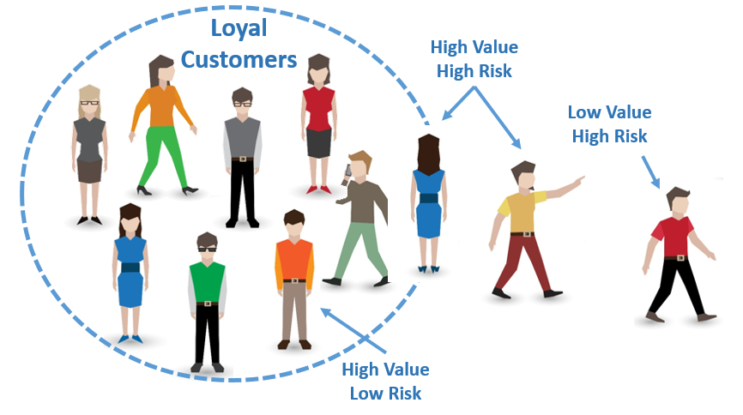
Use Case Overview
Value from knowing customer churn
Customer retention cost < Customer acquisition cost
Customer retention programs & customer service focus
Notes:
Analysts tend to concentrate on voluntary churn because it typically occures due to factors of the company-customer relationship which companies control such as how billing interactions are handled or how after-sales help is provided

Slide 3
Dataset Overview
Churn
Customer products
Customer account info
Customer demographic
Supervised learning
Classification model
Phone service (flag)
Multiple lines (flag)
Internet service type
Online security (flag)
Online backup (flag)
Device protection (flag)
Tech support (flag)
Streaming TV (flag)
Streaming movies (flag)
Tenure (months)
Contract term
Paperless billing
Payment method
Monthly charges
Total charges
Gender
Senior citizen (flag)
....
Partner (flag)
Dependents (flag)
Notes:
Image Recognition/Autonomous Driving -> Tesla
Ad Personalization -> Facebook
Recommendation Engines -> Netflix, Amazon
Spam Filters -> Google, Microsoft
Forecasting, Price Optimization
Fraud Detection (Credit Cards)
Search Engines (Google, Microsoft...)
Chatbots

Slide 4
Machine Learning Lifecycle
Use Case
Build Model
Operate Model
Consume Model
Understand Business Goals
Discover/
Gather Data
Ingest Data
Explore/
Understand
Data
Curate/
Transform
Data
Apps
Train Model
Model Evaluation
Deploy Model
Services
Debug
Error Analysis
Respond to Model Drift
Monitor/
Maintain Model
Data Engines
Data and Model Management
Share Results with Business
Version Control & ML Ops
Collaboration & Documentation
Primary process
Iterative process
Notes:
Analysts tend to concentrate on voluntary churn because it typically occures due to factors of the company-customer relationship which companies control such as how billing interactions are handled or how after-sales help is provided

Slide 5
What is Azure Machine Learning?
Unified platform for creating, managing and operating machine learning solutions at scale in the cloud
Build end-to-end pipelines of continuously developing, managing and deploying models
Automate your data science workloads, resulting in better results in less time
Model
creation
Iterative improvements
Automation

Slide 6
