Slide 1
Operating System
Tutorial 11
File System

Slide 2
File systems
Files
Directories & naming
File system implementation
Example file systems

Slide 3
File System
A filesystem is the methods and data structures that an operating system uses to keep track of files on a disk or partition; that is, the way the files are organized on the disk.
The word is also used to refer to a partition or disk.
Before a partition or disk can be used as a filesystem, it needs to be initialized, and the bookkeeping data structures need to be written to the disk. This process is called making a filesystem.

Slide 4
Long-term information storage
Must store large amounts of data
Gigabytes -> terabytes -> petabytes
Stored information must survive the termination of the process using it
Lifetime can be seconds to years
Must have some way of finding it!
Multiple processes must be able to access the information concurrently

Slide 5
Naming files
Important to be able to find files after they’re created
Every file has at least one name
Name can be
Human-accessible: “foo.c”, “my photo”, “Go Panthers!”, “Go Banana Slugs!”
Machine-usable: 4502, 33481
Case may or may not matter
Depends on the file system
Name may include information about the file’s contents
Certainly does for the user (the name should make it easy to figure out what’s in it!)
Computer may use part of the name to determine the file type

Slide 6
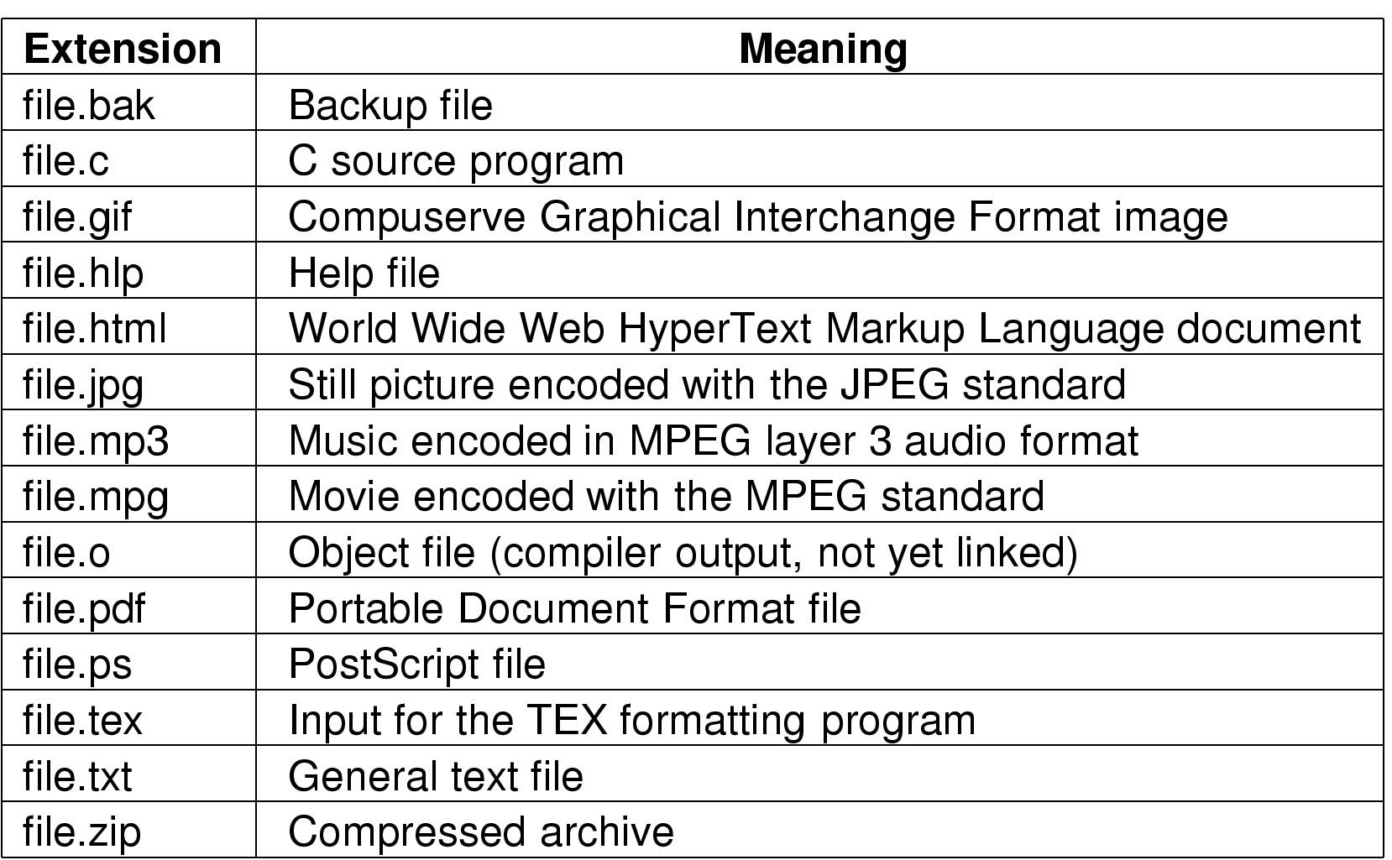
Typical file extensions

Slide 7
File Structure
None - sequence of words, bytes
Simple record structure
Lines
Fixed length
Variable length
Complex Structures
Formatted document
Relocatable load file
Can simulate last two with first method by inserting appropriate control characters
Who decides:
Operating system
Program / programmer

Slide 8
File structures
1 record
1 byte
12A
101
111
sab
wm
cm
avg
ejw
sab
elm
br
Sequence of bytes
Sequence of records
S02
F01
W02
Tree

Slide 9
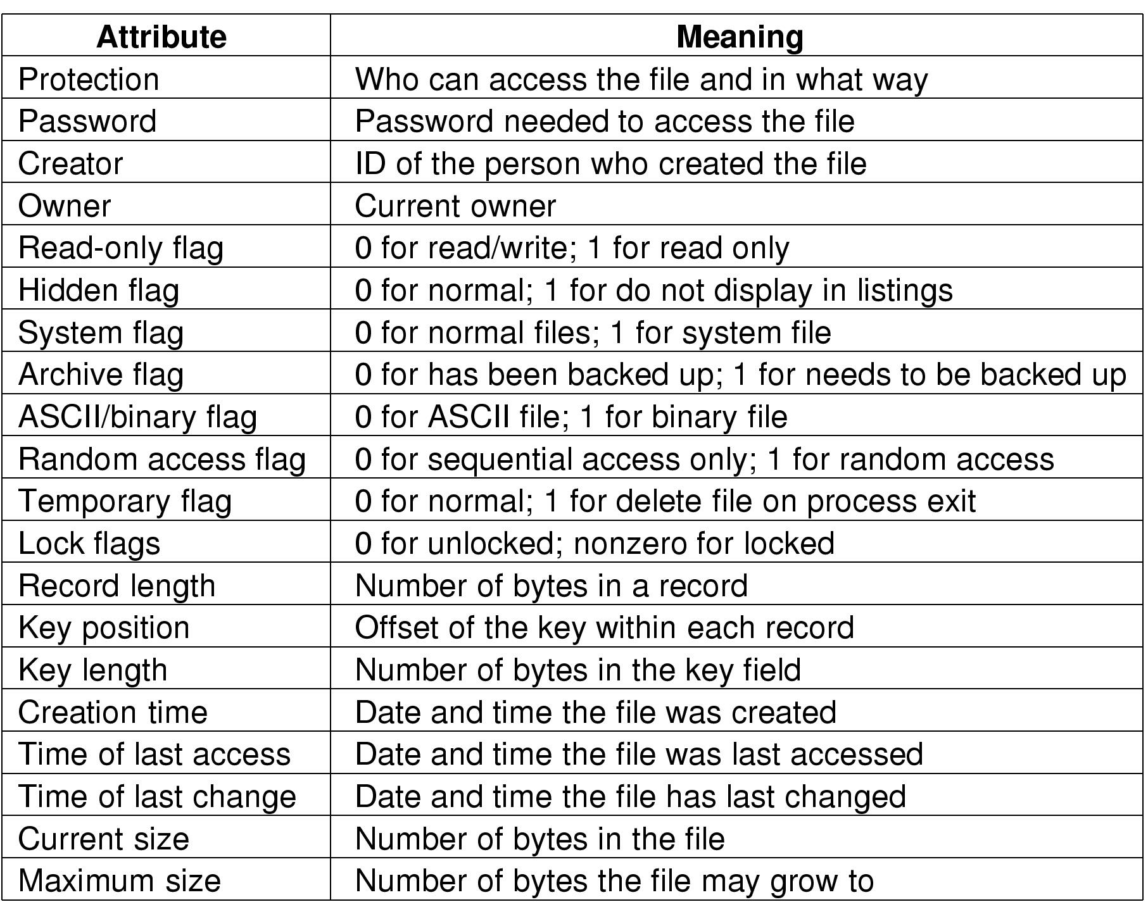
File attributes

Slide 10
File operations
Create: make a new file
Delete: remove an existing file
Open: prepare a file to be accessed
Close: indicate that a file is no longer being accessed
Read: get data from a file
Write: put data to a file
Append: like write, but only at the end of the file
Seek: move the “current” pointer elsewhere in the file
Get attributes: retrieve attribute information
Set attributes: modify attribute information
Rename: change a file’s name

Slide 11
Accessing a file
Sequential access
Read all bytes/records from the beginning
Cannot jump around
May rewind or back up, however
Convenient when medium was magnetic tape
Often useful when whole file is needed
Random access
Bytes (or records) read in any order
Essential for database systems
Read can be …
Move file marker (seek), then read or …
Read and then move file marker

Slide 12
Directories
Naming is nice, but limited
Humans like to group things together for convenience
File systems allow this to be done with directories (sometimes called folders)
Grouping makes it easier to
Find files in the first place: remember the enclosing directories for the file
Locate related files (or just determine which files are related)

Slide 13
Single-level directory systems
Root directory
A foo
A bar
B baz
C blah
One directory in the file system
Example directory
Contains 4 files (foo, bar, baz, blah)
owned by 3 different people: A, B, and C (owners shown in red)
Problem: what if user B wants to create a file called foo?

Slide 14
Two-level directory system
Root directory
A
B
C
A foo
A bar
B foo
B baz
C bar
C foo
C blah
Solves naming problem: each user has her own directory
Multiple users can use the same file name
By default, users access files in their own directories
Extension: allow users to access files in others’ directories

Slide 15
Hierarchical directory system
Root directory
A
B
C
A
Papers
A foo
A
Photos
B foo
B
Papers
C bar
C foo
C blah
A os.tex
A sunset
A
Family
B foo.tex
B foo.ps
A sunset
A kids
A Mom

Slide 16
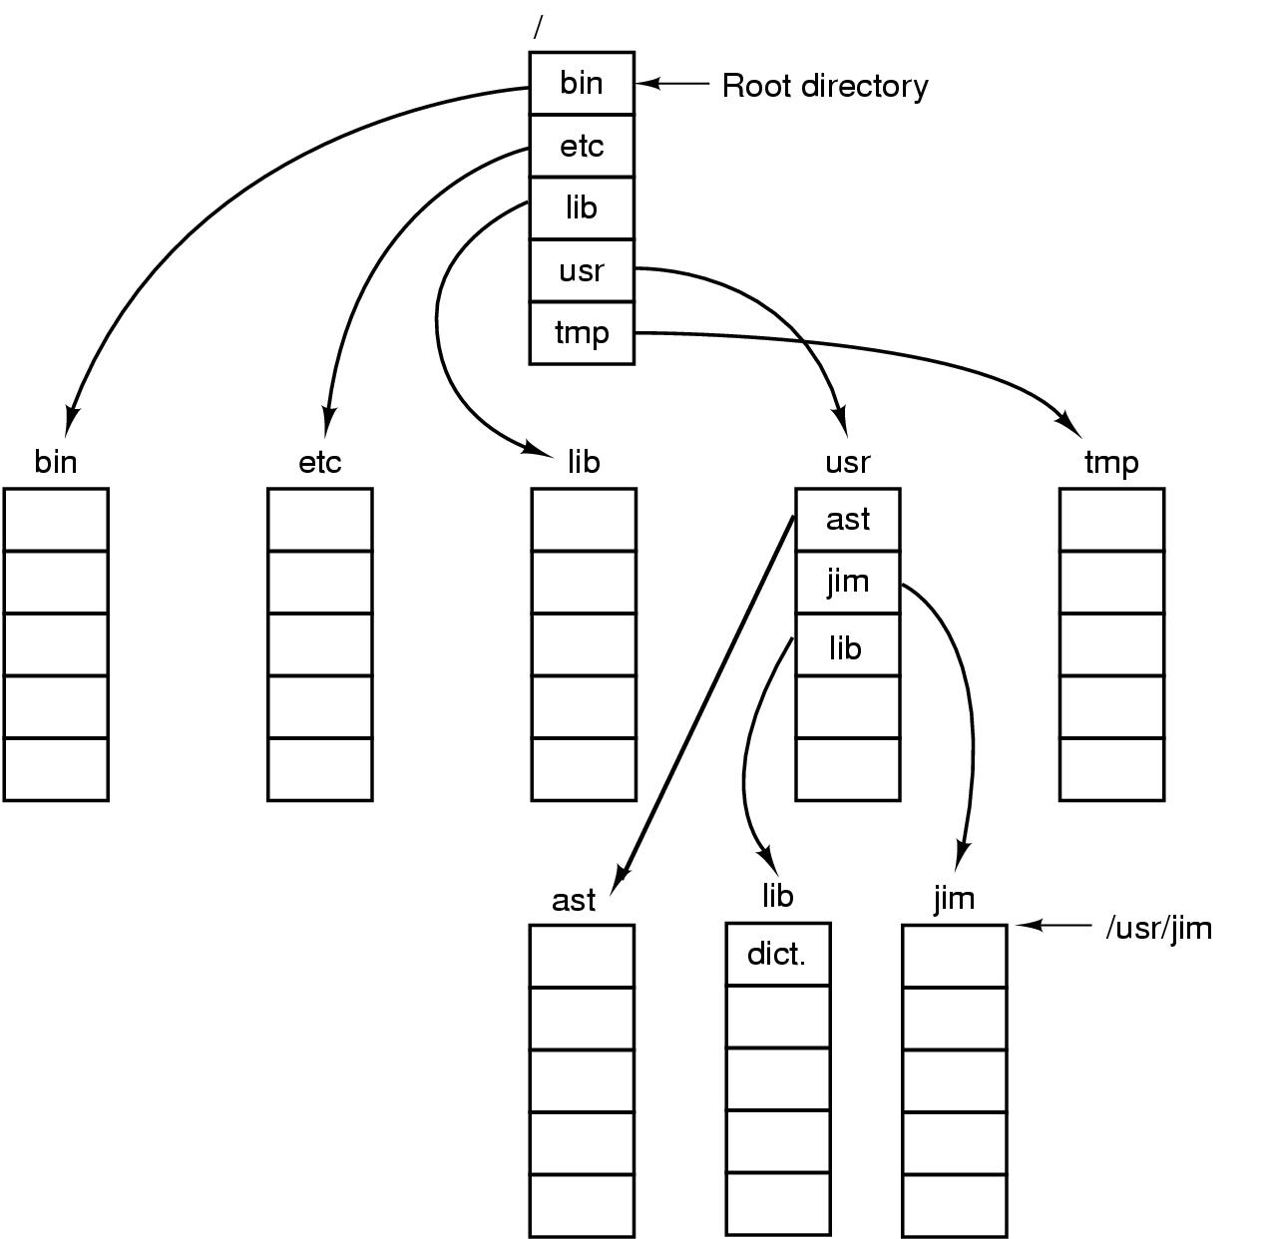
Unix directory tree

Slide 17
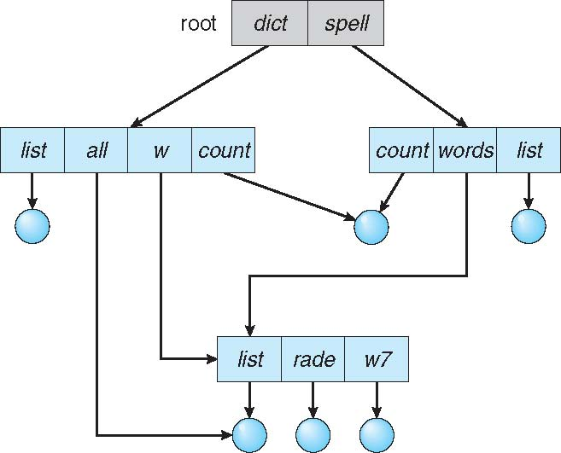
Acyclic-Graph Directories
Have shared subdirectories and files

Slide 18
Acyclic-Graph Directories (Cont.)
Adds ability to directly share directories between users
But can now have multiple absolute paths to the same file
Two different names (aliasing)
If dict deletes list ⇒ dangling pointer
Solutions:
Backpointers, so we can delete all pointers Variable size records a problem
Entry-hold-count solution

Slide 19
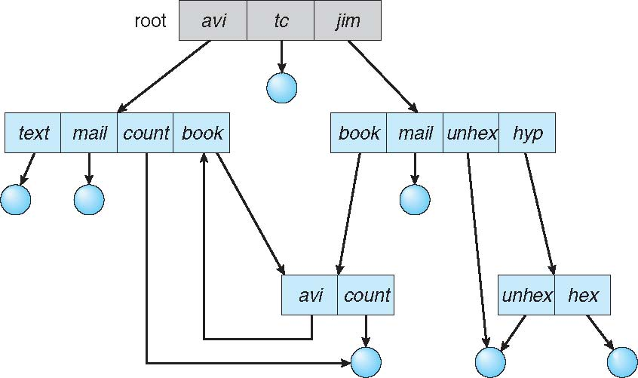
General Graph Directory

Slide 20
Operations on directories
Create: make a new directory
Delete: remove a directory (usually must be empty)
Opendir: open a directory to allow searching it
Closedir: close a directory (done searching)
Readdir: read a directory entry
Rename: change the name of a directory
Similar to renaming a file
Link: create a new entry in a directory to link to an existing file
Unlink: remove an entry in a directory
Remove the file if this is the last link to this file

Slide 21
File system implementation issues
How are disks divided up into file systems?
How does the file system allocate blocks to files?
How does the file system manage free space?
How are directories handled?
How can the file system improve…
Performance?
Reliability?

Slide 22
File System Mounting
File system must be mounted before it can be available to processes on the system.
Sometime, the directory structure may be built out of multiple volumes, which must be mounted to make them available within the file-system name space.
Mounting is:
Privileged operation
First check for valid file system on volume
Kernel data structure to track mount points

Slide 23
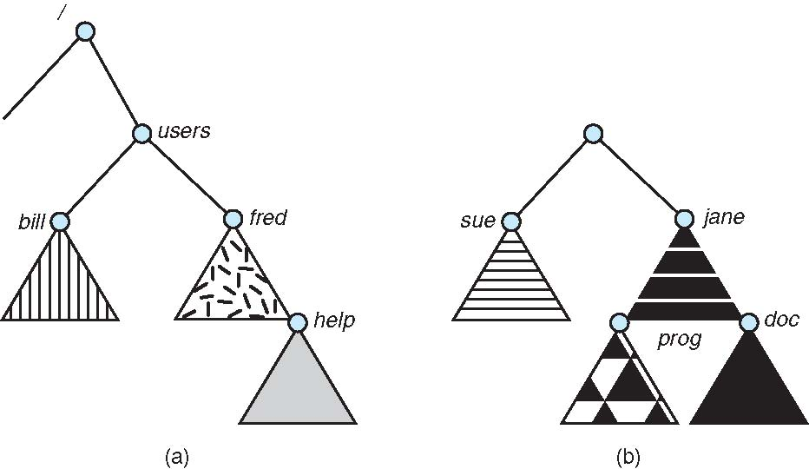
(a) Existing (b) Unmounted Partition

Slide 24
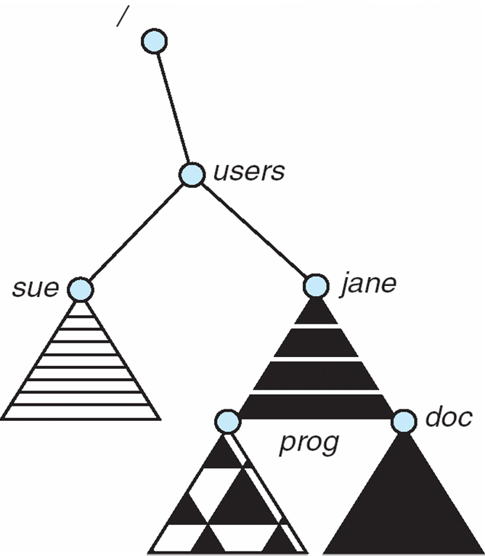
Mount Point

Slide 25
Carving up the disk
Entire disk
Partition table
Master boot record
Partition 1
Partition 2
Partition 3
Partition 4
Boot block
Super block
Free space management
Index nodes
Files & directories

Slide 26
Allocation Methods - Contiguous
An allocation method refers to how disk blocks are allocated for files:
Contiguous allocation – each file occupies set of contiguous blocks
Best performance in most cases
Simple – only starting location (block #) and length (number of blocks) are required
Problems include finding space for file, knowing file size, external fragmentation, need for compaction off-line (downtime) or on-line

Slide 27
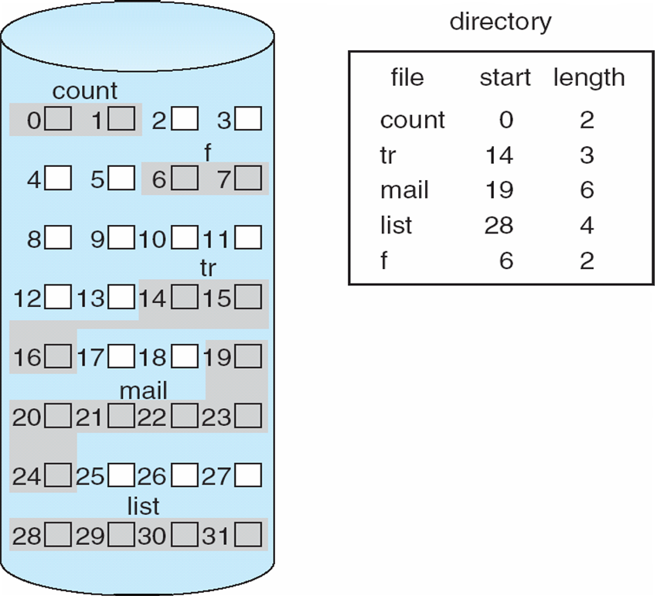
Contiguous Allocation of Disk Space

Slide 28
Allocation Methods - Linked
Linked allocation – each file a linked list of blocks
File ends at nil pointer
No external fragmentation
Each block contains pointer to next block
No compaction, external fragmentation
Free space management system called when new block needed
Improve efficiency by clustering blocks into groups but increases internal fragmentation
Reliability can be a problem
Locating a block can take many I/Os and disk seeks

Slide 29
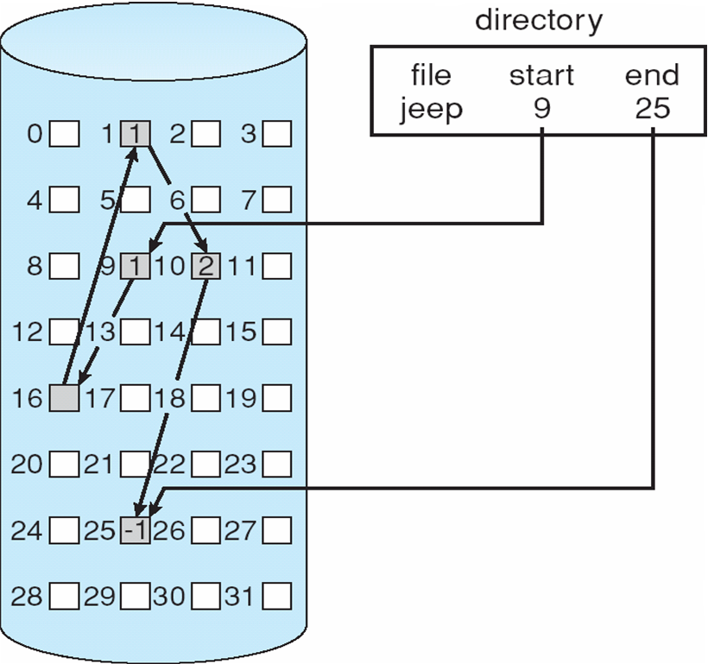
Linked Allocation

Slide 30
FAT
FAT (File Allocation Table) variation
Beginning of volume has table, indexed by block number
Much like a linked list, but faster on disk and cacheable
New block allocation simple

Slide 31
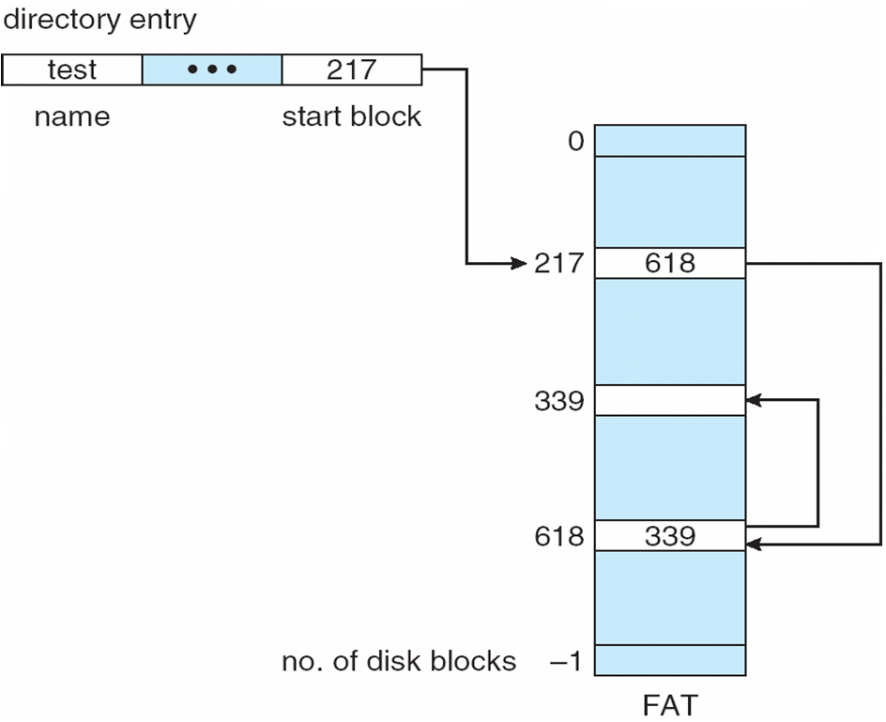
File-Allocation Table

Slide 32
Allocation Methods - Indexed
Indexed allocation
Each file has its own index block(s) of pointers to its data blocks
Logical view
index table

Slide 33
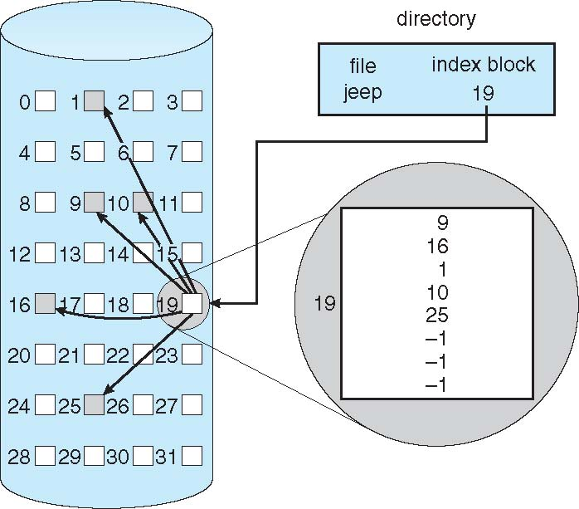
Example of Indexed Allocation

Slide 34
Indexed Allocation (Cont.)
Need index table
Random access
Dynamic access without external fragmentation, but have overhead of index block
Mapping from logical to physical in a file of maximum size of 256K bytes and block size of 512 bytes. We need only 1 block for index table

Slide 35
MS-DOS File Allocation Table
Block size | FAT-12 | FAT-16 | FAT-32
0.5 KB | 2 MB
1 KB | 4 MB
2 KB | 8 MB | 128 MB
4 KB | 16 MB | 256 MB | 1 TB
8 KB |  | 512 MB | 2 TB
16 KB |  | 1024 MB | 2 TB
32 KB |  | 2048 MB | 2 TB

