Slide 1



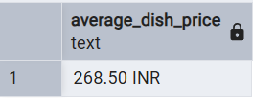
Swiggy Business Data Analysis
KPI(Key Performance Indicator)
1-What is the total number of orders placed on the platform?
select count(*) as Total_Orders from fact_swiggy_orders
2- What is the revenue generated in INR(Indian National Rupees) Millions?
SELECT ROUND(SUM(price_inr)::NUMERIC / 1000000, 2) || ' INR Million' AS Total_revenue FROM fact_swiggy_orders;
3- Average Dish Price
SELECT ROUND(avg(price_inr)::NUMERIC, 2) || ' INR' AS Average_Dish_Price
FROM fact_swiggy_orders;

Slide 2
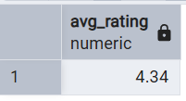
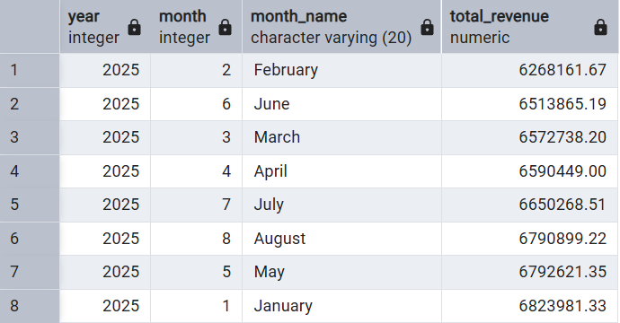
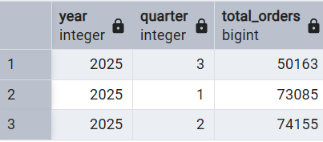
4-Average Rating
select round(avg(rating),2) as Avg_Rating
from fact_swiggy_orders
Deep-Dive Business Analysis
5-Monthly order trends
Select d.year,
d.month,
d.month_name,
sum(price_inr) as Total_Revenue
from fact_swiggy_orders f
join dim_date d on f.date_id=d.date_id
group by d.year,
d.month,
d.month_name
order by sum(price_inr) asc
6-Quarterly order trends
Select
d.year,
d.quarter,
count(*) as Total_Orders from fact_swiggy_orders f join dim_date d on f.date_id=d.date_id group by d.year,d.quarterorder by count(*) asc

Slide 3
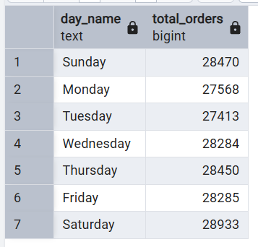
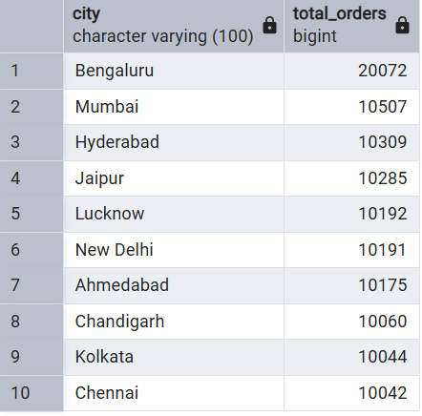
7-Year-wise growth
Select
d.year,
sum(price_inr) as Total_Revenuefrom fact_swiggy_orders f join dim_date d on f.date_id=d.date_id
group by d.year
order by sum(price_inr)
8-Orders by Day of week (Mon-Sun)
SELECT TRIM(TO_CHAR(d.full_date, 'Day')) AS day_name,
COUNT(*) AS total_orders
FROM fact_swiggy_orders f join dim_date d on f.date_id = d.date_id
GROUP BY TRIM(TO_CHAR(d.full_date, 'Day’)),
EXTRACT(DOW FROM d.full_date)
ORDER BY EXTRACT(DOW FROM d.full_date);
9-Top 10 cities by order volume
As per Total_order
select l.city,count(*) as Total_orders from fact_swiggy_orders f join dim_location l
onl.location_id=f.location_id
group by l.city
order by count(*) desc limit 10

Slide 4
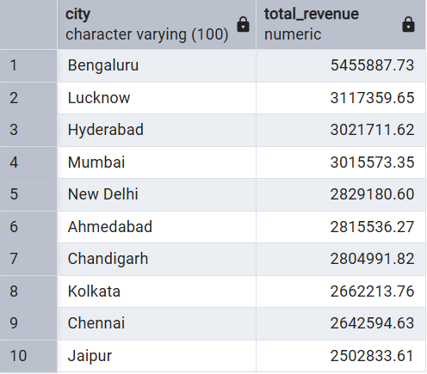
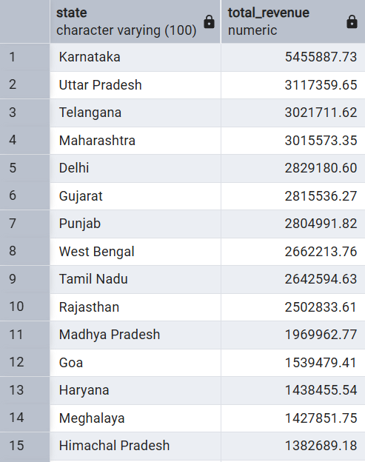
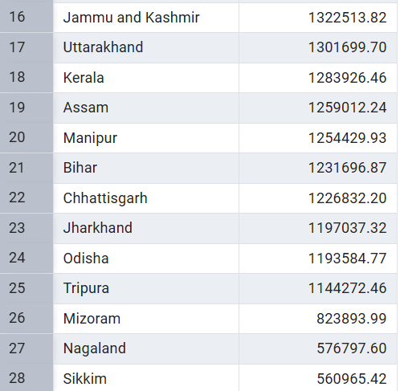
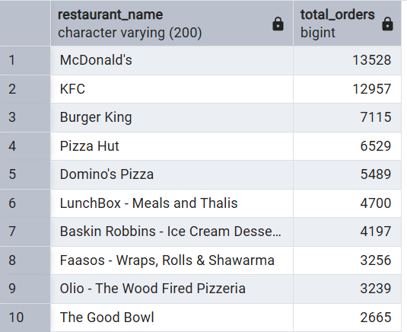
As per Revenue
select l.city,sum(f.price_inr) as Total_revenue
from fact_food_orders fjoin dim_location l
on l.location_id=f.location_id
group by l.city
order by sum(f.price_inr) desc limit 10
10-Revenue contribution by states
select l.state,
sum(f.price_inr) as Total_revenue
from fact_swiggy_orders f
join dim_location lonl.location_id=f.location_id
group by l.state
order by sum(f.price_inr) desc
Food Performance
11-Top 10 restaurants by orders
select r.restaurant_name,
count(*) as Total_orders from fact_swiggy_orders f
join dim_restaurant r
onr.restaurant_id=f.restaurant_id
group by r.restaurant_name
order by count(*) desc limit 10

Slide 5
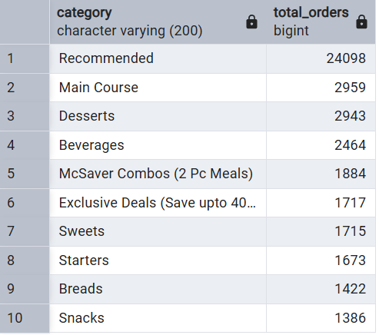
12- Top 10 categories by Order Volume
select c.category,count(*) as Total_orders
from fact_swiggy_orders f
join dim_category conc.category_id=f.category_id
group by c.category
order by count(*) desc limit 10
13-Most Ordered Dishes
select d.dish_name,count(*) as Order_count
from fact_swiggy_orders f
join dim_dish dond.dish_id=f.dish_id
group by d.dish_name
order by Order_count desc
14-Cuisine Performance (Orders + Avg Rating)
select c.category,count(*) as Total_orders,
round(avg(f.rating),2) as avg_ratingfrom
fact_swiggy_orders f
join dim_category c on f.category_id=c.category_id
group by c.category
order by Total_Orders desc;

Slide 6
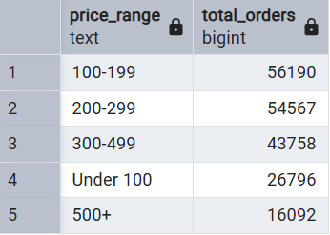
15-Total Orders by Price Range
SELECT CASE WHEN price_inr::FLOAT < 100 THEN 'Under 100’
WHEN price_inr::FLOAT BETWEEN 100 AND 199 THEN '100-199’
WHEN price_inr::FLOAT BETWEEN 200 AND 299 THEN '200-299'
WHEN price_inr::FLOAT BETWEEN 300 AND 499 THEN '300-499'
ELSE '500+' END AS price_range,
COUNT(*) AS total_ordersFROM fact_swiggy_orders
GROUP BY CASE WHEN price_inr::FLOAT < 100 THEN 'Under 100'
WHEN price_inr::FLOAT BETWEEN 100 AND 199 THEN '100-199'
WHEN price_inr::FLOAT BETWEEN 200 AND 299 THEN '200-299'
WHEN price_inr::FLOAT BETWEEN 300 AND 499 THEN '300-499'
ELSE '500+'
END
ORDER BY total_orders DESC;
16-Rating Count Distribution
select rating,
count(*) as rating_count from fact_swiggy_orders group by rating
order by rating

