Slide 1

National Institute of Technology Calicut
TOPIC
Kernel syscall that displays process details by using its pid
PROJECT GUIDE
Dr. JAYRAJ P B
CREATED BY
ARJUN NANDLAL BHARDWAJ

Slide 2
INTRODUCTION
Process descriptor is a simple kernel system call
that takes input as process id from the user and
display its details on screen
It shows the details such as Process name, Process ID,
Process priority, Process parent name and
Process exit state

Slide 3
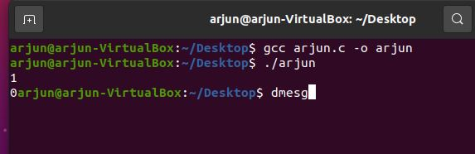
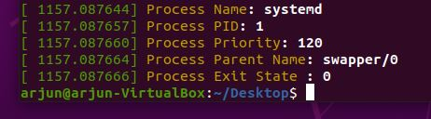
WORKING
Example 1: Taking random pid as input
File arjun.c performs the syscall
Let pid input as 1
User input for pid
OUTPUT

Slide 4
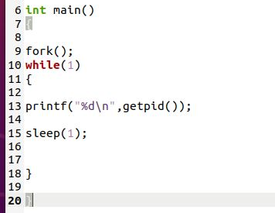
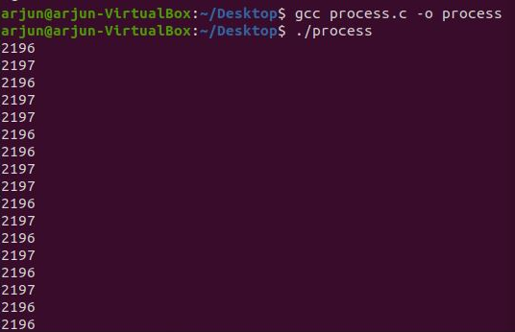
WORKING
Example 2 : Taking known pid as input
Lets create a new process (process.c) that display its pid and its child pid alternately in infinite loop
Run process.c file in Terminal_1
process.c file code
Terminal_1 Output
parents pid
childs pid

Slide 5
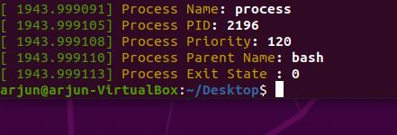

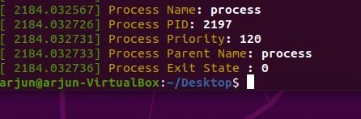

We have
Parents PID: 2196
Childs PID : 2197
INPUT
OUTPUT ( In Terminal_2 )
For parents pid
For childs pid

Slide 6
Thank You

