Slide 1
8085 INTEGRATED DEVELOPMENT ENVIRONMENT(IDE)
Demo Presentation

Slide 2
INTRODUCTION
8085 Microprocessor
8-bit microprocessor Introduced by Intel in 1977
Seven 8-bit registers A, B, C, D, E, H, and L
A is the 8-bit accumulator
Used as 8 bit or 16 bit registers
16-bit stack pointer to memory
All instructions are encoded in a single byte (including register-numbers, but excluding immediate data)
Followed by an immediate operand/address/port no.(1 or 2 bytes)
Supported up to 256 input/output (I/O) ports

Slide 3
Currently several development systems are used for 8085 programming. (Anshuman, STC etc) But these all requires manual efforts to convert mnemonic program to hex code
The 8085 IDE provides all the programming facilities of 8085 Microprocessor.
Translates 8085 mnemonic program into its hex code equivalent.
Detects and reports errors.
Runs the program and outputs results at corresponding address.

Slide 4
KEY FEATURES
Provide a facility to enter and run the 8085 mnemonic programs without worrying about the hex code.
Facility for the users to view the memory locations.
Helps the users to detect and debug the errors.
Facility to save programs and reuse them later.
Search and View the details of instructions

Slide 5
EXISTING SYSTEM
More human effort for conversion of mnemonic program into hex code.
Time consuming.
Entering the hex is difficult
User cannot see the values what each register will going to get at the each line execution
No error messages. So it is difficult to find out errors in program.
Programs can’t be saved for future references

Slide 6
PROPOSED SYSTEM
Reduces the human effort.
Saves time.
Ensures accuracy of computation.
Minimum time needed for the various processing
Greater efficiency
Programmer is able to see the register values after the execution of one instruction.
User friendliness and interactive
Chances of error reduced
Programs can be saved and reused in future.

Slide 7
HARDWARE SPECIFICATION
System : IBM-Compatible PC
Processor : Pentium IV
Speed : 2.0 GHZ
Memory : 512 MB RAM
Hard Disk Drive : 20 GB

Slide 8
SOFTWARE SPECIFICATION
Operating System : Windows XP and above
Language used : JAVA
Tools Used : NetBeans IDE 7.1.2, eclipse

Slide 9
DESIGN
Modules
DFD

Slide 10
MODULES
TRANSLATION MODULE:
This module translates the input mnemonic program into equivalent hex code.
This module first reads the mnemonic program instructions one by one
The instructions are divided into opcodes and operands
These opcodes are compared with the previously stored 8085 instruction opcodes
If match is found, the equivalent hex code for the opcode is added to the hex program
Then adds the operands(data/memory location) to the hex program)

Slide 11
This takes place over two passes- PASS1 and PASS2
Pass 1- For identification of opcodes
Pass 2- For identification of memory addresses
The entire mnemonic program is translated into hex code by the end of PASS2.
The hex code are placed at their corresponding memory locations

Slide 12
DEBUGGER MODULE
This module helps to find out various errors in the input program.
Different error routines are called for each type of errors.
Errors are detected during both modules(translation and run module)
The details regarding type and location of error are displayed on the console screen.

Slide 13
RUN Program MODULE
This module runs the hex program obtained after translation
A sequencing method is used for running hex program.
The first hex code is assumed to be that of an instruction.
Using the properties of hex code of each instruction(size, no. of operands, immediate operand position etc), the following operands are determined.
According to the instructions and its sequencing, the compiler perform operations and produce the results.
The registers and flags are also updated accordingly.

Slide 14
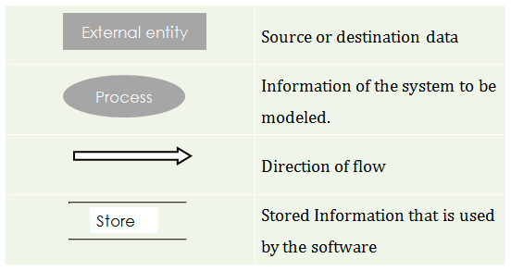
DATA FLOW DIAGRAM

Slide 15
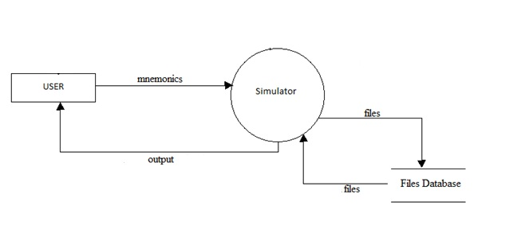
LEVEL 0 DFD

Slide 16
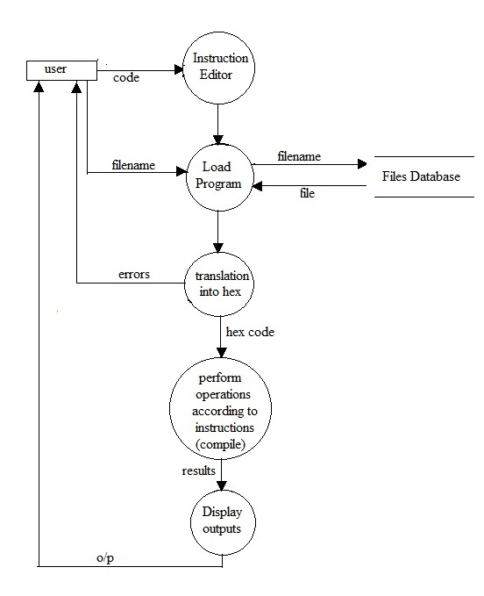
LEVEL 1 DFD

Slide 17
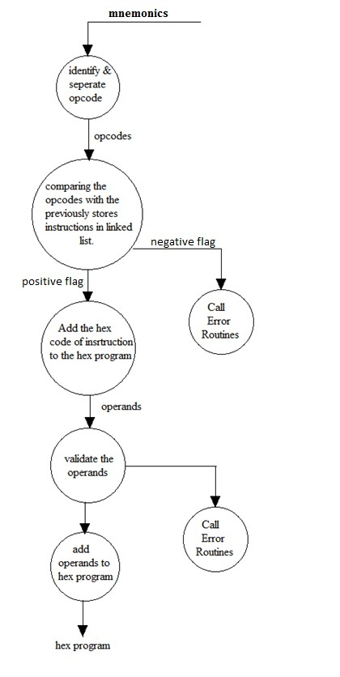
LEVEL 2 DFD
2.1:Assembling phase (conversion to hex code)

Slide 18
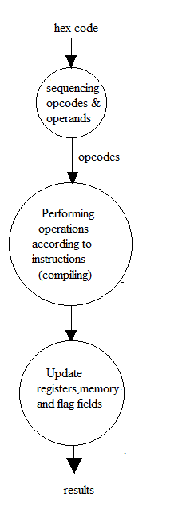
2.2. Compiling phase (Running program)

Slide 19
PSEUDO CODE
1.READING PROGRAM
1.Read the mnemonic program inputted by user
2.Split each line of program
3.Store each line of code in an array called ‘iparray’
2.CONVERTING INTO HEX CODE
This is done in two passes:
PASS 1 – pass 1 creates an array of hexcodes of all opcodes and operands
START
1.Declare an array ‘hex’ to store hexcodes of all opcodes & operands
2.Initialize ‘hex’ array and all other variables
3.For each remaining instructionin ‘iparray’ do,
4.Compare the opcode part of the instruction with the instructions stored in the link list
‘instructions’
5.If it matches do the following else go to 11
6.Insert the hexcode for the opcode of the matched instruction into ‘hex’
7.If there are no operands OR there are only register operands, go to 4 else
8.If there are immediate operands do 9 else go to 10
9.Check the operand size

Slide 20
9.1.Call error routine to check if the operand is valid
9.2.If operand is one byte, then insert it to the next position in ‘hex’
9.3. If operand is two byte, then split the operand one byte each and insert them into the next consecutive
positions in ‘hex’
9.4. go to 4
10. If the instruction is either a call or jump instruction do else go to 11
10.1.Put the operand (here it will be a label) into ‘hex’ array
10.2. Leave the next position in the hex array free to add the address later
10.3. go to 4
11.If it is a label definition, then do
11.1. Search the label name in the symbol table
11.2. If the label is already defined then report error “Multiple declaration”, otherwise
11.3. Insert the label and its address into symbol table for future reference
11.4. go to 4
END OF PASS 1

Slide 21
PASS 2 – pass 2 replaces all the labels in the hex array with the address in the symbol table
START
1.For all labels in the hex array do the following
2.Refer the symbol table and find the label
3.If found do 4 else go to 5
4.Substitute the address instead of the label in the hex array
5.Report error “Undefined Symbol”
END OF PASS 2

Slide 22
3.RUN MODULE
To run the program after mnemonics have been translated to hex
START
1.The first hex code in the array ‘hex’ represents an opcode
2.Compare the opcode with all 8085 instruction opcode’s hex values
3.When a match is found do 4 and 5
4.Use the operand’s size, numbers, immediate position etc to find out which of the following
hexcodes are the operands
5.Once the operands are determined perform the operations specified by the instruction
6.Take the next operand hexcode
7.Go to 2
END
4.ERROR ROUTINE
To check whether the passed hex value is valid or not
START
1.Check whether the size of the hexcode and the expected values are equal
2.If they are not equal report error “Operand size doesn’t match” otherwise
3.If any one of character in the hexcode is other than 0-9 or A-F then
4.Report error “invalid value/operand”
END

Slide 23
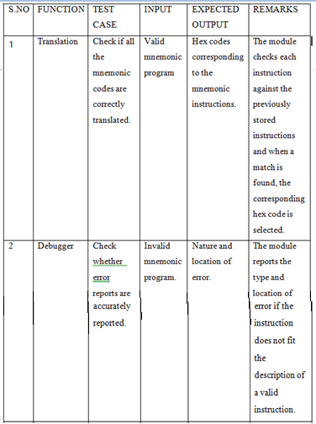
TEST CASES

Slide 24
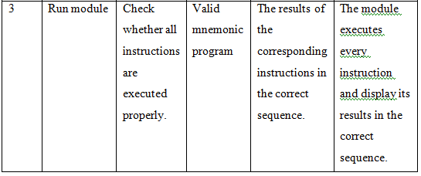

Slide 25
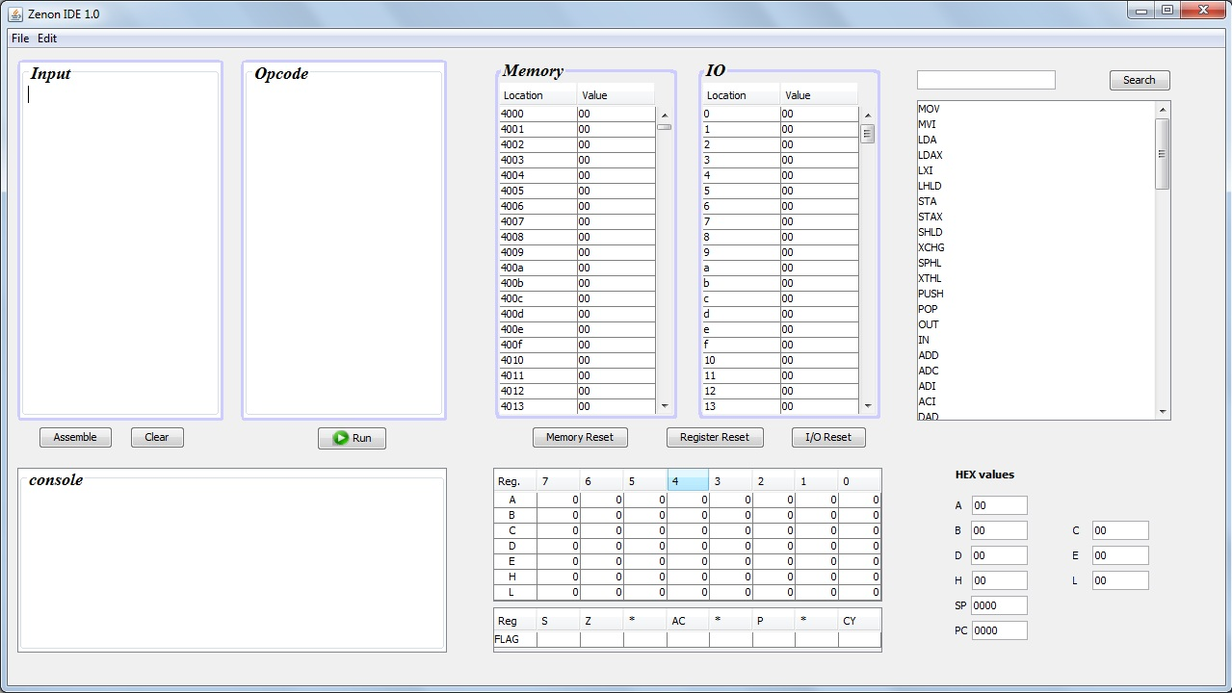
SCREENSHOTS
8085 IDE

Slide 26
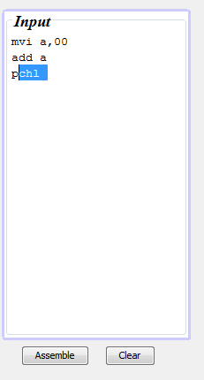
ENTERING THE PROGRAM

Slide 27
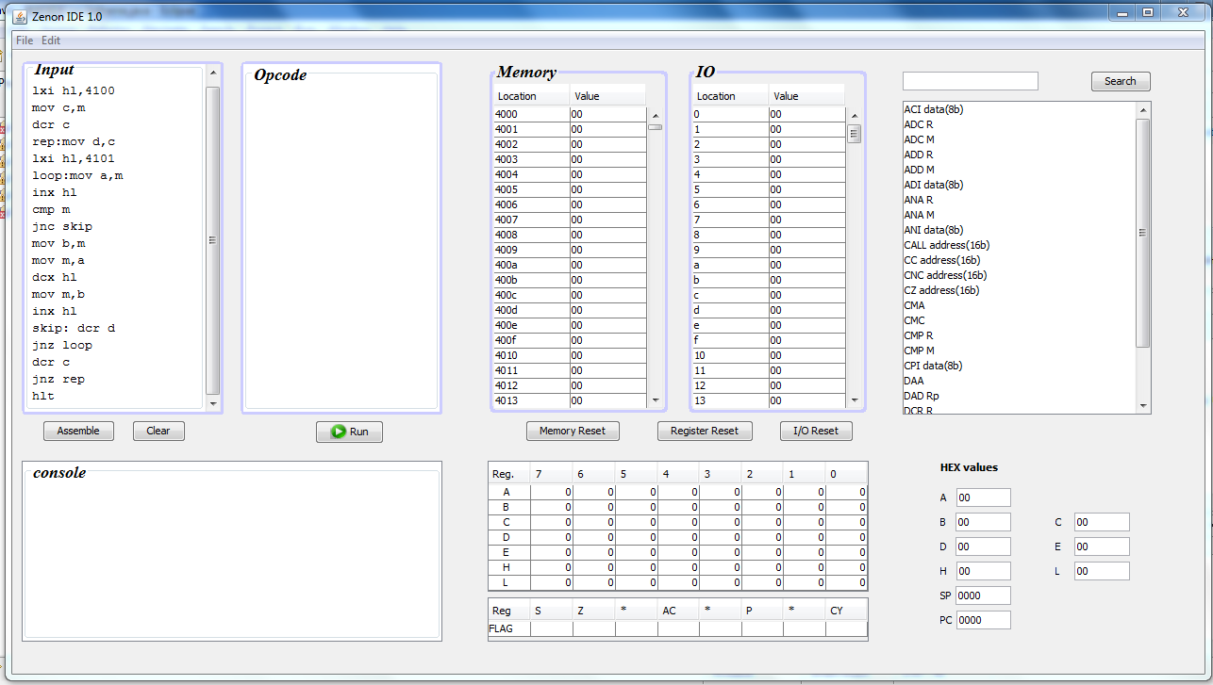
PROGRAM

Slide 28
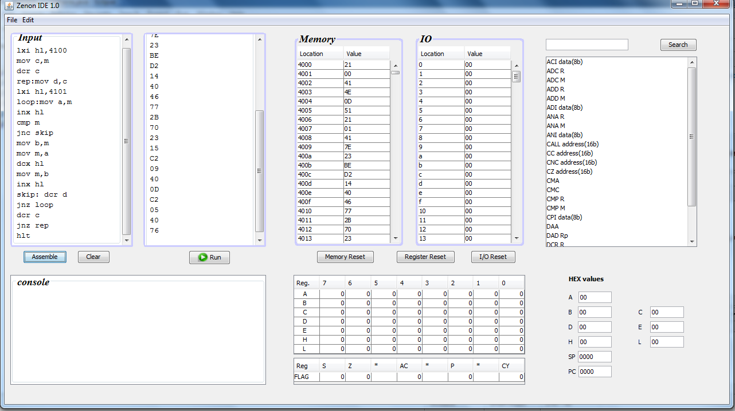
ASSEMBLE

Slide 29
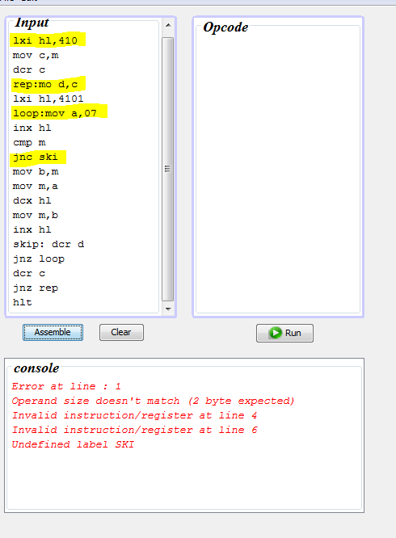
ERROR REPORT

Slide 30
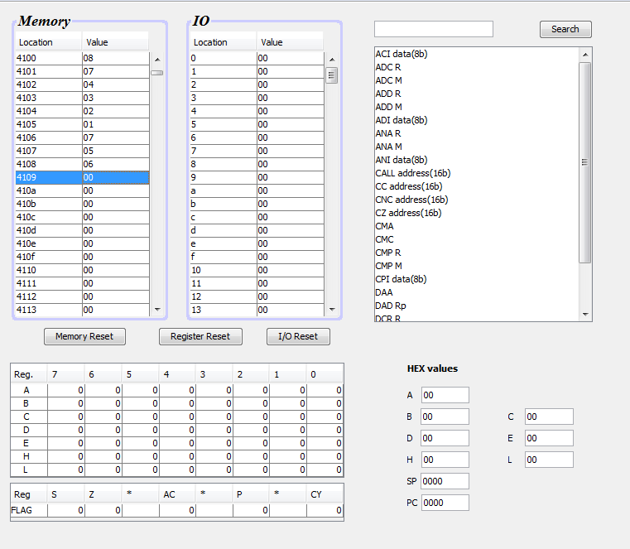
INPUT

Slide 31
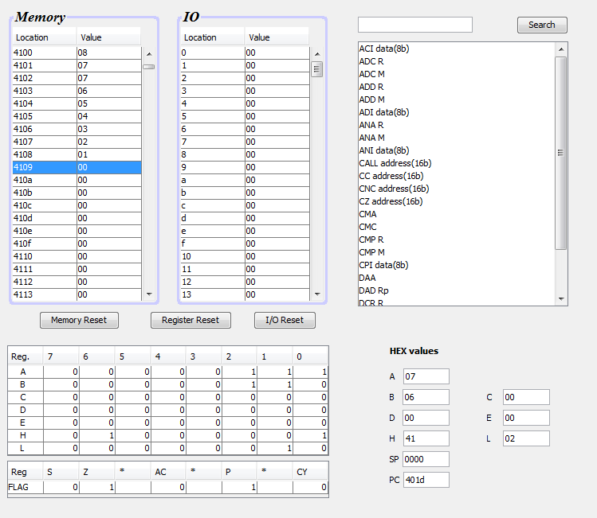
OUTPUT

Slide 32
ADVANTAGES
User-friendly and easy to handle.
Storage of programs if needed.
Easy to edit.
Error reports makes it easy to debug.
Students can practice 8085 programming at home.

Slide 33
CONCLUSION
Very useful for students; easier 8085 programming.
Suitable alternative to trainer kit.

