Slide 1
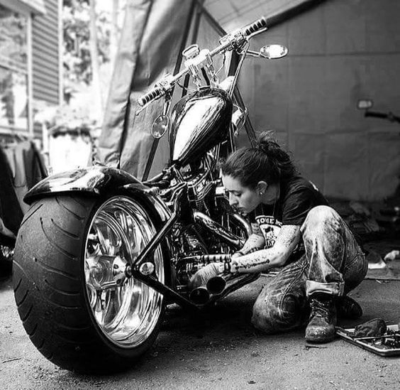
Let’s Build
The Project
Shall We ?
Arjun

Slide 2

The slide title goes here!
Do you know what helps you make your point clear? Lists like this one:
They’re simple
You can organize your ideas clearly
You’ll never forget to buy milk!
And the most important thing: the audience won’t miss the point of your presentation

Slide 3
Our fiumbers
333,000
Venus is the second planet from the Sun
75,000
Despite being red, Mars is a cold place
150,000
Jupiter is the biggest planet in the Solar System
52,000
Saturn is a gas giant and has several rings

Slide 4





Our growth
Graph descriptiofi
100
Venus has a beautiful name and
75
is the second planet from the Sun. It’s terribly hot, even hotter than Mercury, and its atmosphere is extremely poisonous. It’s the
50
second-brightest natural object in the night sky after the Moon
25
2018
2019
2020
2021
2022

Slide 5


150,000
Big numbers catch your audience’s attention

Slide 6
Cofisumer st6temefits
Tom6s J
“Mercury is the closest planet to the Sun”
Selefi6 P
“Venus is the second planet from the Sun”
Gust6v V
“Mars is actually a very cold place”
Timmy F
“Jupiter is the biggest planet of them all”
Mich6el L
“Saturn is composed of hydrogen and helium”
Willi6m A
“Neptune is very far from the Sun”

Slide 7
Our 6w6rds
Neptufie
Neptune is the farthest planet from the Sun. It's also the fourth-largest object by diameter in the Solar System
S6turfi
It's composed mostly of hydrogen and helium. It was named after the Roman god of wealth and agriculture

Slide 8
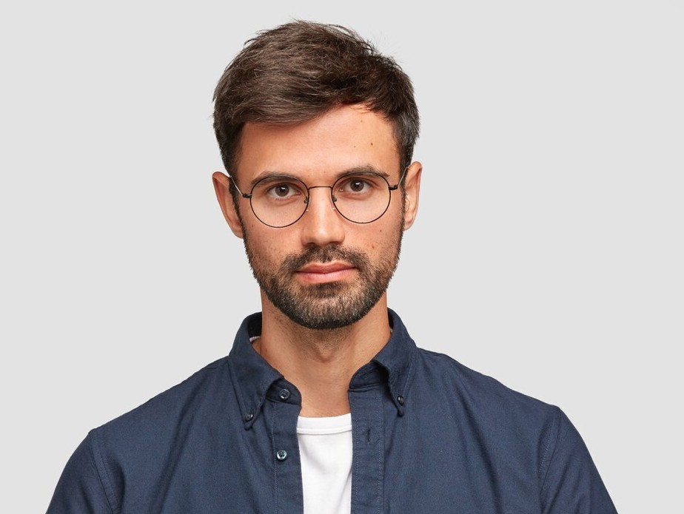

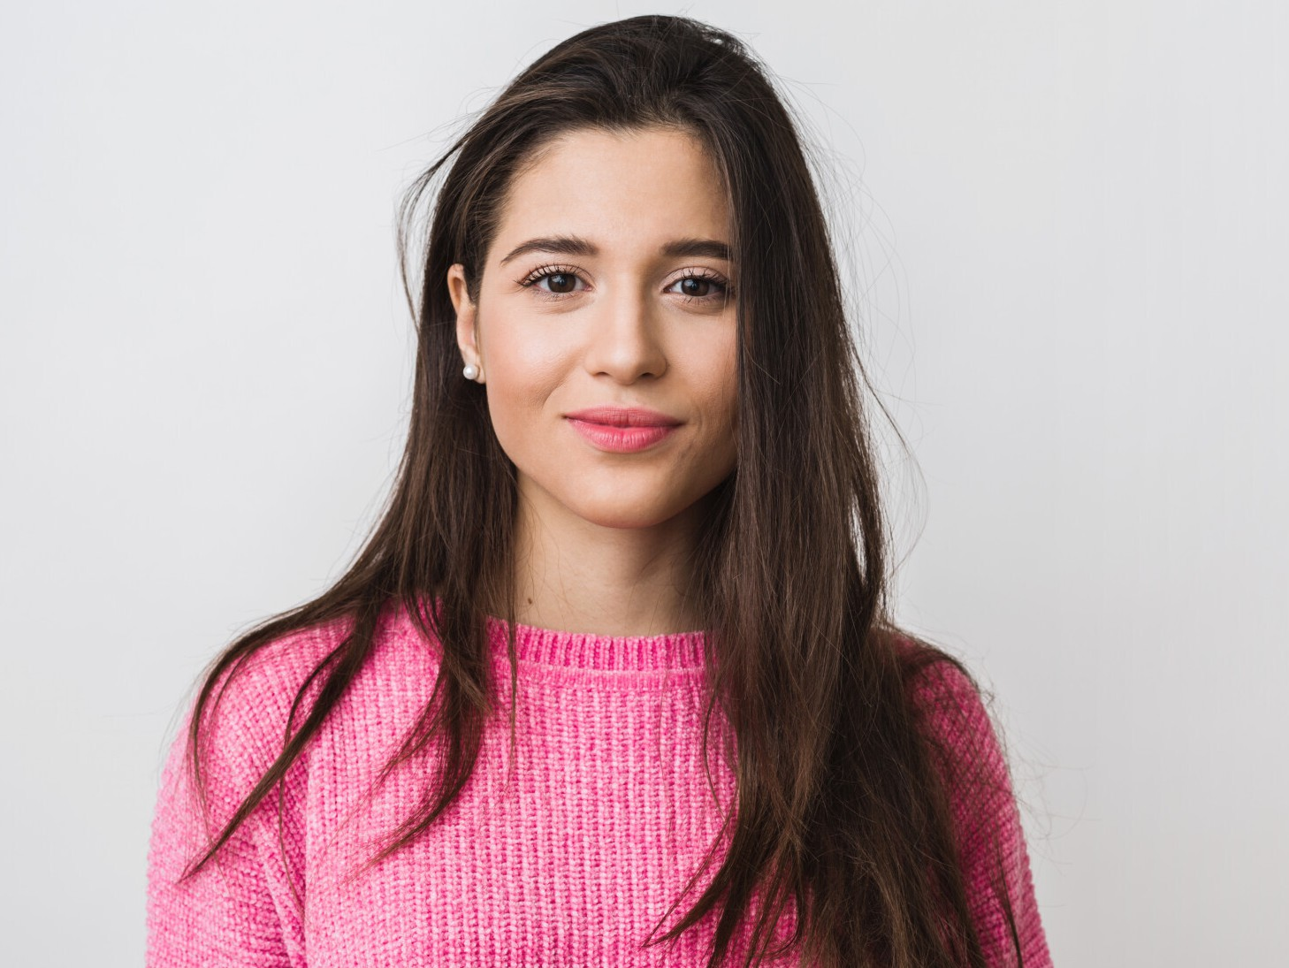
Our te6m
Tom6s Zuller
Lifi6 W6ll6ce
Jefifi6 Joe
Marketing and advertising manager
Manager of the graphic design department
Head of Human Resources department

Slide 9


A picture is worth 6 thous6fid words

Slide 10
Future projects
 | Description | Deadline
Project 1 | Venus has a beautiful name and it's hot | 23/05/2022
Project 2 | Jupiter is the biggest planet of them all | 14/06/2022
Project 3 | Saturn is a gas giant and has several rings | 18/08/2022

Slide 11

Sfie6k peek
You can replace the image on the screen with your own work. Just right-click on it and select “Replace image”

Slide 12

Th6fiks!
Do you have any questions?
youremail@freepik.com
+91 620 421 838
yourcompany.com
CREDITS: This presentation template was created by Slidesgo , including icons by Flaticon and infographics & images by Freepik
Please keep this slide for attribution

Slide 13

Elegafit, Moderfi
Milky White
Compafiy Profile
Here is where your presentation begins

Slide 14
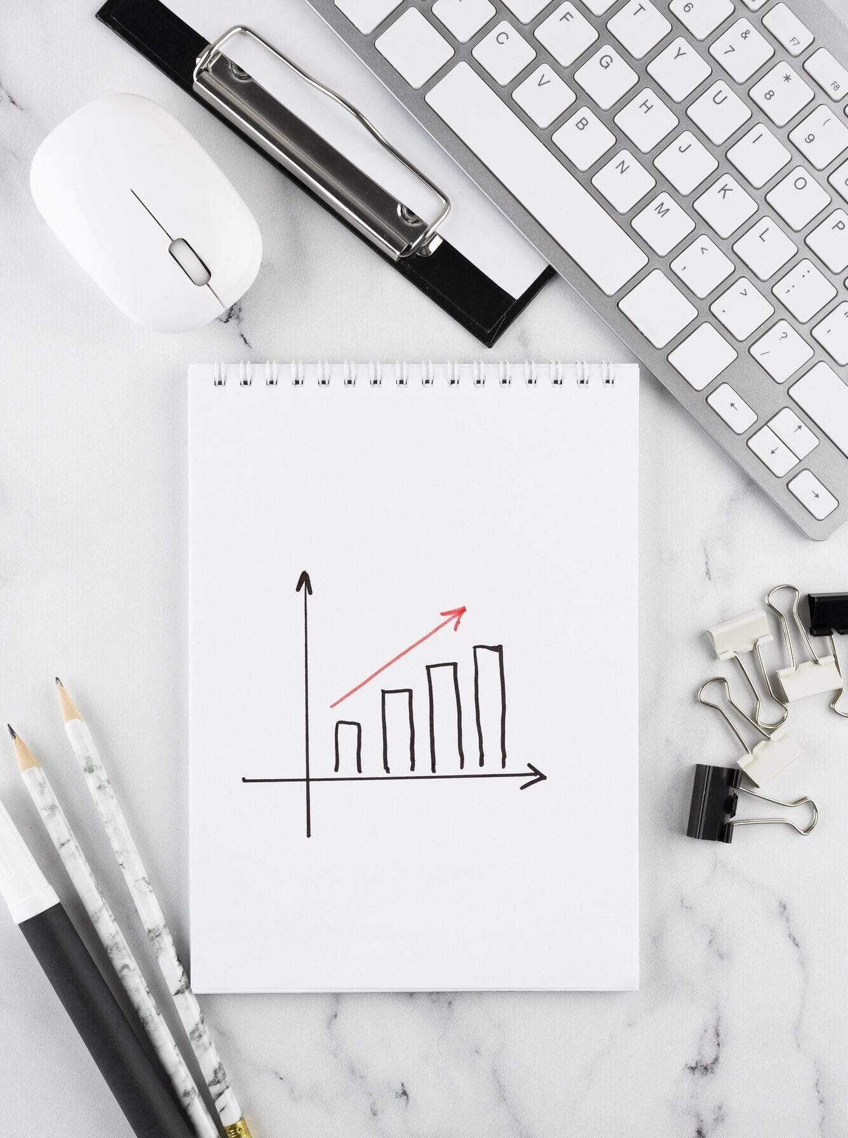
01.
Name of the sectiofi
You can enter a subtitle here if you need it

Slide 15

Whoa
This can be the part of the presentation where you introduce yourself, write your email…

Slide 16

About us
You can give a brief description of the topic you want to talk about here. For example, if you want to talk about Mercury, you can say that it’s the smallest planet in the entire System

Slide 17

Our history
1992
Mercury is the smallest planet of them all
2000
Venus has extremely high temperatures
2015
Earth is the beautiful planet we all live
2022
Despite being red, Mars is actually a very cold planet

Slide 18
Our philosophy
Misiofi
Despite being red, Mars is a cold place
Visiofi
Venus is the second planet from the Sun
Values
Saturn is a gas giant and has several rings

Slide 19
“This is a quote. Words full of wisdom that someone important said and can make the reader get inspired.”
— Someofie Famous

Slide 20
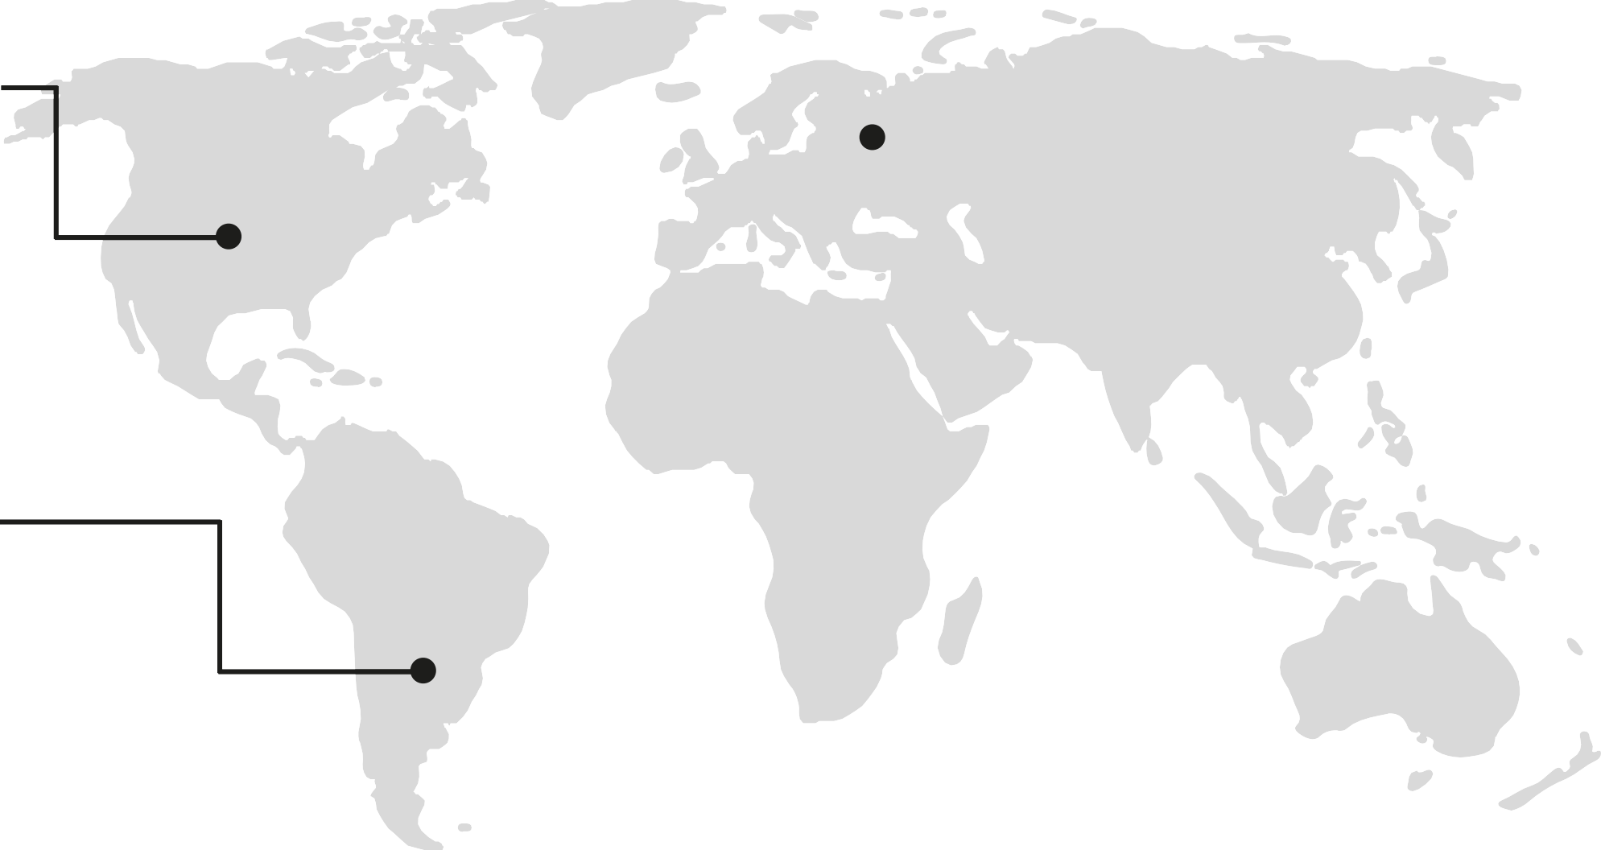

Locatiofis
Mercury
It’s the closest planet to the Sun
Vefius
Venus is the second planet from the Sun
Mars
Despite being red, Mars is a cold place
Jupiter
It’s the biggest planet of them all

Slide 21
Our services
Our services
Marketifig
Desigfi
SEO
Media
Mercury is the closest planet to the Sun and the smallest one in the Solar System. This planet's name has nothing to do with the liquid metal, since Mercury was named after the Roman messenger god

Slide 22
Best seller
M6rs
Despite being red, Mars is a cold place. It's full of iron oxide dust, which gives the planet its reddish cast
Vefius
Venus has a beautiful name and is the second planet from the Sun. It’s hot, even hotter than Mercury
S6turfi
Saturn is a gas giant and has several rings. It was named after the Roman god of wealth and agriculture

Slide 23





Our projects
Vefius
Venus is the second planet from the Sun
Jupiter
Jupiter is the biggest planet in our System
M6rs
Despite being red, Mars is a cold place
S6turfi
Saturn is a gas giant and has several rings

Slide 24


Our strefigths
Vefius
Venus is the second planet from the Sun
Jupiter
It’s the biggest planet in our System
M6rs
Despite being red, Mars is a cold place
S6turfi
It’s a gas giant and has several rings

Slide 25

Awesome words

Slide 26






Customer profile
Age
25-30 years old
Locatiofi
Capital city
Gefider
Male
Positiofi
Office work
Social media
Lookifig for
Venus has a beautiful name and is the second planet from the Sun. It’s terribly hot, even hotter than Mercury, and its atmosphere is extremely poisonous
Lifestyle

