Slide 1
Role of Design Thinking in the Human-Centered Design Process, Design Space in Team Environments, and Team Formation
DESIGN THINKING
Arjun C C

Slide 2
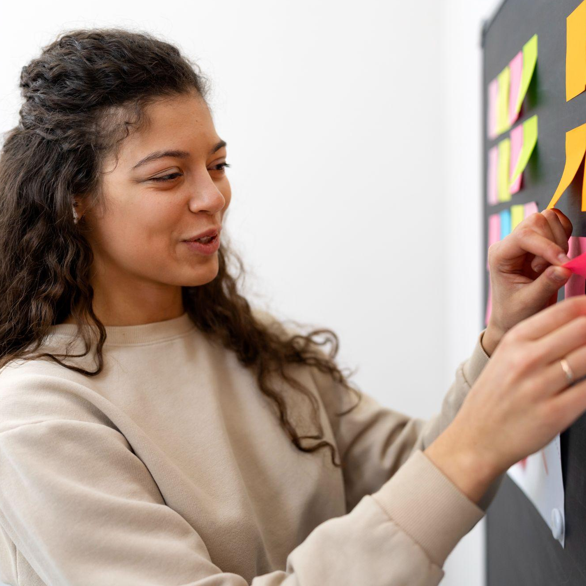
What is design thinking?
Design Thinking is a methodology that focuses on solving complex problems through a deep understanding of users' needs and behaviors. It prioritizes empathy, creativity, and collaboration to develop innovative solutions. The process is human-centered, iterative, allowing teams to continuously refine ideas based on user feedback

Slide 3
Human-Centered Design
01.
Role of Design Thinking in the Human-Centered Design Process

Slide 4
Human-Centered Design (HCD)
Definition: HCD is a design approach that prioritizes the user's needs, preferences, and experiences throughout the design and development process. It’s about creating solutions that are truly user-centric, focusing on empathy and an iterative design cycle.
Purpose: To ensure that the product or solution addresses real user problems and is functional, usable, and desirable.

Slide 5
Design Thinking as a Methodology in HCD
Stages of Design Thinking:
Empathize: Understand the needs, experiences, and emotions of users by observing, interviewing, and interacting with them. This step is foundational in HCD, where empathy forms the basis for creating solutions that genuinely address users' needs.
Define: In this phase, insights from the empathizing stage are used to define the core problems. This aligns with HCD’s focus on narrowing down user-centered issues.
Ideate: Design Thinking encourages generating a wide range of creative solutions. HCD integrates this with a focus on solutions that meet real user demands.
Prototype: Rapidly create prototypes to explore different solutions. This iterative process allows designers to experiment and learn by making, a central idea in HCD.
Test: Test the prototype with real users, gather feedback, and iterate. This aligns perfectly with the HCD principle of continuous user feedback and iteration.

Slide 6
Design Thinking as a Methodology in HCD
Key Benefits of Using Design Thinking in HCD:
User-Centric Approach: Both design thinking and HCD emphasize the user as the core focus. They share a common goal of addressing the real problems users face and creating solutions that resonate with their needs.
Collaboration and Iteration: Design thinking fosters a collaborative and iterative process, key to successful HCD, where solutions are continuously refined through prototyping, testing, and feedback loops.
Empathy-Driven Solutions: Design thinking ensures that solutions are developed with a deep understanding of users, their challenges, and emotions, which results in more meaningful outcomes.
Better Problem Definition: The focus on defining problems in design thinking ensures that design teams are solving the right problems, not just surface-level issues.
Fosters Creativity: Design thinking encourages teams to break away from traditional thinking and approach challenges from fresh, innovative perspectives.

Slide 7
TEAM
02.
Design Space, Design Thinking in a Team Environment, and Team Formation

Slide 8
Design Space – Exploring Possibilities
Design Space
Definition: The design space refers to the conceptual environment where designers explore potential solutions and ideas. It’s a broad area where all possibilities are considered, ranging from conventional solutions to radical, out-of-the-box ideas.
Key Elements
Open Exploration: Encouraging the generation of multiple ideas without immediately critiquing or narrowing them down.
Divergent Thinking: The use of brainstorming techniques to explore a wide array of potential solutions.
Visual Tools: Sketching, mind-mapping, or using digital tools (e.g., Miro, Figma) to organize and visualize ideas within the space.
Creative Freedom: The design space allows teams to ideate without restrictions, enabling creativity and innovation.
Encourages Innovation, Fosters Collaboration, Supports Iteration

Slide 9
Design Thinking in a Team Environment
How Teams Function in Design Thinking
Empathy Building: Teams collaborate to gather user insights through interviews, surveys, and observations. Each member brings their unique interpretation of user needs.
Idea Generation: Group brainstorming sessions allow team members to build on each other’s ideas. Techniques like mind-mapping, storyboarding, and rapid ideation are often used.
Prototyping Together: Teams rapidly develop prototypes, encouraging feedback from each other and users. This collective effort ensures the solution aligns with multiple viewpoints.
Testing and Iterating: Testing prototypes with real users in a team environment allows for diverse feedback, leading to more refined and user-centered solutions.
Benefits of Design Thinking in Teams
Creativity through Collaboration: Teams generate more creative and diverse ideas by leveraging the strengths and expertise of all members.
Problem Solving: Complex problems are broken down more effectively when approached from multiple angles.
Rapid Iteration: Teams can quickly adapt and improve on solutions, thanks to ongoing feedback and collaborative decision-making.

Slide 10
Team Formation in Design Thinking
Importance of Team Composition:
The success of design thinking in a team environment largely depends on the formation of the team. Selecting the right mix of skills, perspectives, and personalities is crucial for productive collaboration and innovative outcomes.
Key Considerations for Team Formation:
Diverse Skill Sets:
Designers: Bring creative problem-solving skills and experience with prototyping.
Researchers: Experts in understanding user needs and gathering data through various methods.
Engineers/Developers: Help determine the feasibility of ideas and bring technical expertise to the process.
Business Strategists: Ensure that solutions align with the company’s goals and market viability.
Interdisciplinary Approach: Bringing together individuals from different backgrounds fosters a broader perspective on the problem, leading to more innovative solutions.

Slide 11
Team Formation in Design Thinking
Roles in a Design Thinking Team
Facilitator: Guides the design thinking process, ensuring that discussions stay on track, and that everyone participates.
Designer/Creative Lead: Oversees the ideation and prototyping stages, ensuring that concepts align with user needs.
User Researcher: Focuses on gathering and interpreting insights from users.
Product Manager: Balances creative solutions with practical constraints, like budget, timeline, and business goals.
Developer/Engineer: Ensures technical feasibility of solutions and helps with rapid prototyping.
Challenges in Team-Based Design Thinking
Managing Conflicting Ideas: Diverse perspectives can sometimes lead to disagreements. It’s important to have a framework for resolving conflicts constructively.
Balancing Innovation with Practicality: Teams must strike a balance between generating bold, creative ideas and ensuring that those ideas are feasible and align with business goals.

Slide 12

THANKS!
Do you have any questions?

