Slide 1

What Do
You
EXPECT ?
Notes:
Read the quote
Tell about how the deer will feel in the highway

Slide 2
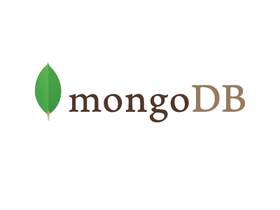


An Introduction to
Arjun
Notes:
In the bottom you can see multiple logos

Slide 3
Questions to be addressed
What ?
Who ?
Secure ?
When ?
How ?
Other important stuff !
Why ?
Notes:
What make us all interested in a topic, curiocity
During this session we will go through all the listed things

Slide 4
Questions to be addressed
Why ?
Notes:
What make us all interested in a topic, curiocity
During this session we will go through all the listed things

Slide 5
Questions to be addressed
Why NoSQL ?
Notes:
What make us all interested in a topic, curiocity
During this session we will go through all the listed things

Slide 6
A Sample Problem
Notes:
What make us all interested in a topic, curiocity
During this session we will go through all the listed things

Slide 7
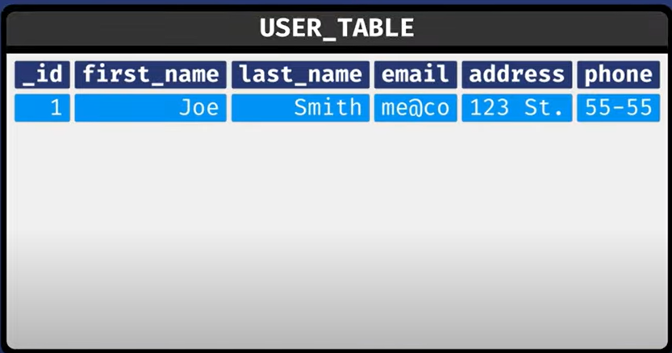
The Problem : RDBMS Traditional problem
Notes:
What make us all interested in a topic, curiocity
During this session we will go through all the listed things

Slide 8
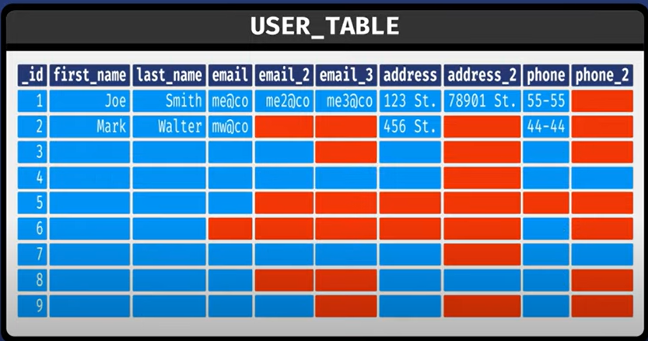
The Problem : RDBMS Traditional problem
Notes:
What make us all interested in a topic, curiocity
During this session we will go through all the listed things

Slide 9
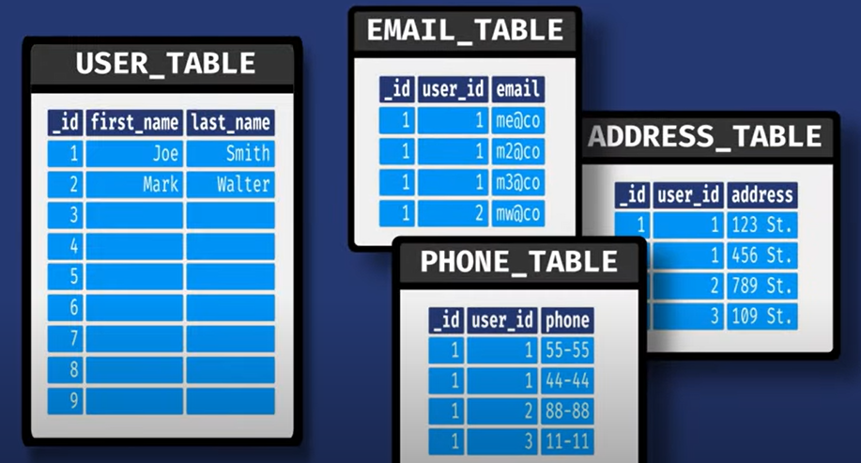
The solution : RDBMS Traditional problem
Notes:
What make us all interested in a topic, curiocity
During this session we will go through all the listed things

Slide 10
But JOINs Are Always Expensive
Notes:
What make us all interested in a topic, curiocity
During this session we will go through all the listed things

Slide 11
The Solution : Introduction
What is NoSQL
What is MongoDB
NoSQL databases use a variety of data models for accessing and managing data. These types of databases are optimized specifically for applications that require flexible data models, large data volume, and low latency, which are achieved by relaxing some of the data consistency restrictions of relational databases.
MongoDB is a source-available, cross-platform, document-oriented database program. Classified as a NoSQL database product, MongoDB utilizes JSON-like documents with optional schemas. MongoDB is developed by MongoDB Inc. and current versions are licensed under the Server Side Public License

Slide 12
Comparison
Terminologied mongo DB
SQL Server | MongoDB
Database | Database
Table | Collection
Index | Index
Row | Document
Column | Field
Joining | Linking & Embedding

Slide 13
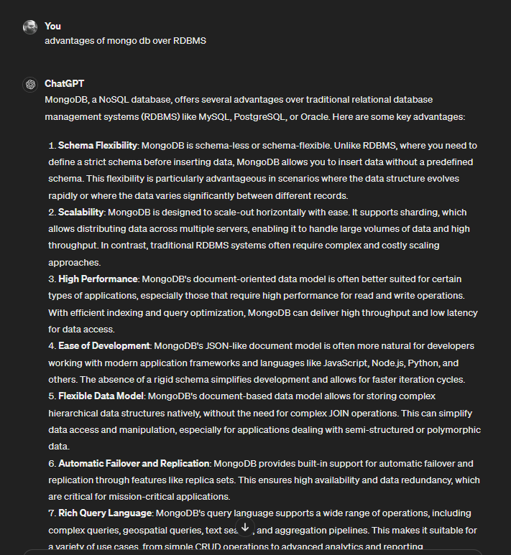
Advantage
Why mongo DB ?
Scalability
High Performance
Ease of Development
Flexible Data Model
Community and Ecosystem

Slide 14
Application
When to use MongoDB
Flexible Data Models: When your application deals with semi-structured or polymorphic data, MongoDB's document-oriented data model shines
Scalability: MongoDB is designed for horizontal scalability, making it a great choice for applications that need to scale out across multiple servers or clusters to handle growing data volumes and user loads.
Real-time Analytics and Event Logging: MongoDB's aggregation framework and native support for geospatial and text search queries make it a good fit for applications that require real-time analytics, event logging
Notes:
Improved decision-making
Big data is the key element to becoming a data-driven organization. When you can manage and analyze your big data, you can discover patterns and unlock insights that improve and drive better operational and strategic decisions.
Increased agility and innovation
Big data allows you to collect and process real-time data points and analyze them to adapt quickly and gain a competitive advantage. These insights can guide and accelerate the planning, production, and launch of new products, features, and updates.
Better customer experiences
insights for consumer understanding, personalization, and ways to optimize experience to better meet consumer needs and expectations.
Continuous intelligence
Big data allows you to integrate automated, real-time data streaming with advanced data analytics to continuously collect data, find new insights, and discover new opportunities for growth and value.
More efficient operations
reduce costs, save time, and increase your overall efficiency.
Improved risk management
Analyzing vast amounts of data helps companies evaluate risk better—making it easier to identify and monitor all potential threats and report insights that lead to more robust control and mitigation strategies.

Slide 15
Application
When to use MongoDB
Content Management and Cataloging: MongoDB is often used for content management systems, product catalogs, and other applications that involve managing large volumes of diverse content or metadata
Internet of Things (IoT) and Sensor Data: MongoDB is well-suited for storing and analyzing data from IoT devices and sensors
Mobile and Web Applications: MongoDB's scalability, performance, and ease of integration with modern application frameworks make it an excellent choice for mobile and web applications
Notes:
Improved decision-making
Big data is the key element to becoming a data-driven organization. When you can manage and analyze your big data, you can discover patterns and unlock insights that improve and drive better operational and strategic decisions.
Increased agility and innovation
Big data allows you to collect and process real-time data points and analyze them to adapt quickly and gain a competitive advantage. These insights can guide and accelerate the planning, production, and launch of new products, features, and updates.
Better customer experiences
insights for consumer understanding, personalization, and ways to optimize experience to better meet consumer needs and expectations.
Continuous intelligence
Big data allows you to integrate automated, real-time data streaming with advanced data analytics to continuously collect data, find new insights, and discover new opportunities for growth and value.
More efficient operations
reduce costs, save time, and increase your overall efficiency.
Improved risk management
Analyzing vast amounts of data helps companies evaluate risk better—making it easier to identify and monitor all potential threats and report insights that lead to more robust control and mitigation strategies.

Slide 16
Usage
Who all can use mongo DB ?
Developers: MongoDB is popular among developers due to its flexible data model
Database Administrators (DBAs): MongoDB administrators are responsible for configuring, monitoring, and maintaining MongoDB deployments.
Data Engineers: Data engineers work with MongoDB to design, implement, and optimize data pipelines for ingesting, processing, and analyzing large volumes of data.
Business Users: Business users can leverage MongoDB for reporting, dashboarding, and business intelligence (BI) purposes.
Academic and Research Institutions: MongoDB is used in academic and research institutions for educational purposesScalability

Slide 17
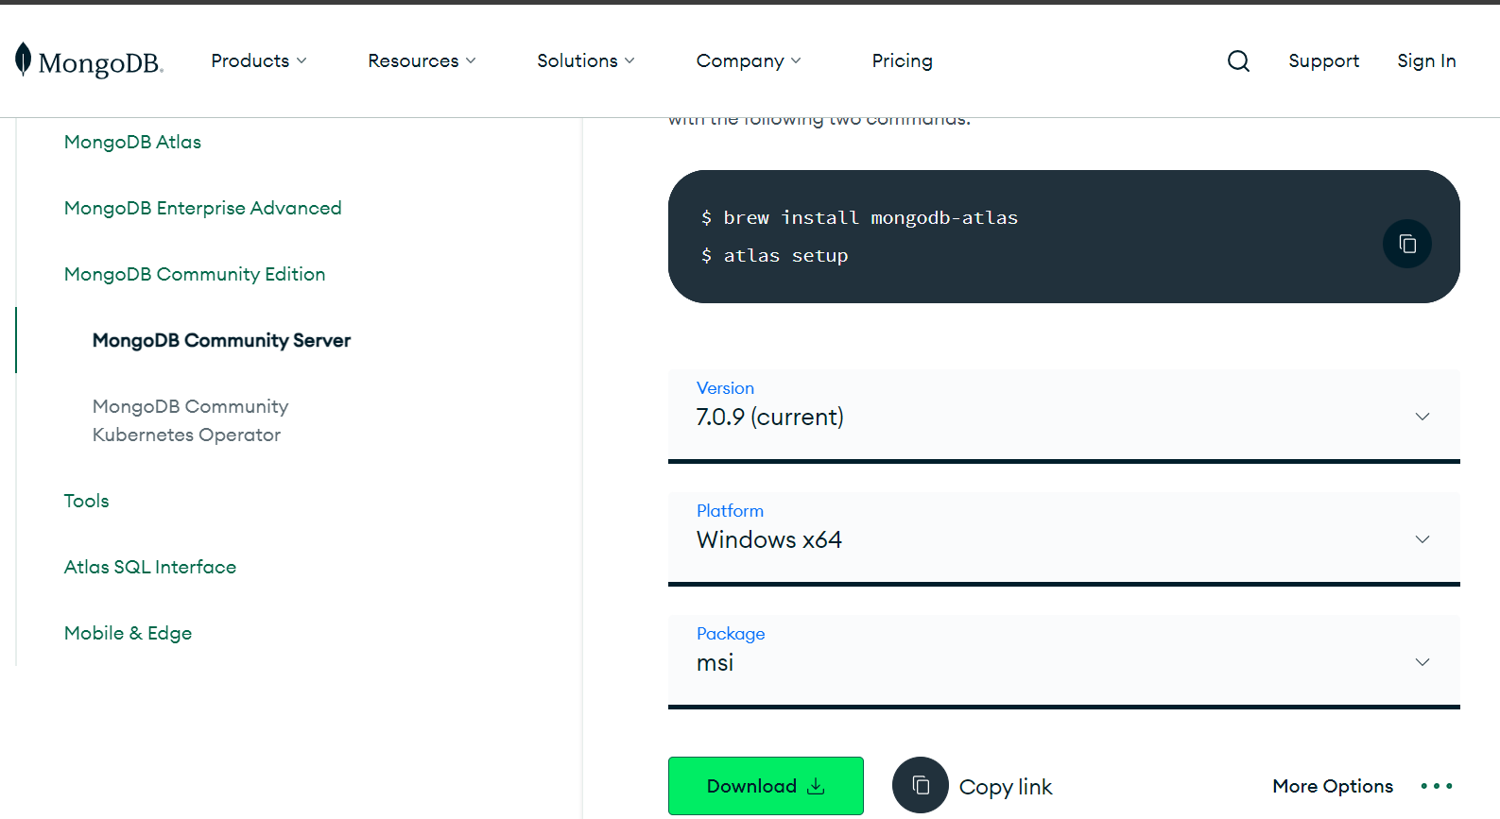
Installation
How to Mongo - Server
https://www.mongodb.com/try/download/community
Notes:
Improved decision-making
Big data is the key element to becoming a data-driven organization. When you can manage and analyze your big data, you can discover patterns and unlock insights that improve and drive better operational and strategic decisions.
Increased agility and innovation
Big data allows you to collect and process real-time data points and analyze them to adapt quickly and gain a competitive advantage. These insights can guide and accelerate the planning, production, and launch of new products, features, and updates.
Better customer experiences
insights for consumer understanding, personalization, and ways to optimize experience to better meet consumer needs and expectations.
Continuous intelligence
Big data allows you to integrate automated, real-time data streaming with advanced data analytics to continuously collect data, find new insights, and discover new opportunities for growth and value.
More efficient operations
reduce costs, save time, and increase your overall efficiency.
Improved risk management
Analyzing vast amounts of data helps companies evaluate risk better—making it easier to identify and monitor all potential threats and report insights that lead to more robust control and mitigation strategies.

Slide 18
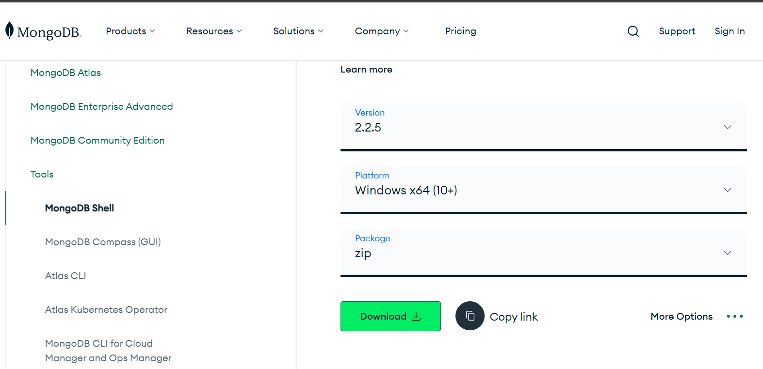
Installation
How to Mongo - bash
https://www.mongodb.com/try/download/shell
Notes:
Improved decision-making
Big data is the key element to becoming a data-driven organization. When you can manage and analyze your big data, you can discover patterns and unlock insights that improve and drive better operational and strategic decisions.
Increased agility and innovation
Big data allows you to collect and process real-time data points and analyze them to adapt quickly and gain a competitive advantage. These insights can guide and accelerate the planning, production, and launch of new products, features, and updates.
Better customer experiences
insights for consumer understanding, personalization, and ways to optimize experience to better meet consumer needs and expectations.
Continuous intelligence
Big data allows you to integrate automated, real-time data streaming with advanced data analytics to continuously collect data, find new insights, and discover new opportunities for growth and value.
More efficient operations
reduce costs, save time, and increase your overall efficiency.
Improved risk management
Analyzing vast amounts of data helps companies evaluate risk better—making it easier to identify and monitor all potential threats and report insights that lead to more robust control and mitigation strategies.

Slide 19
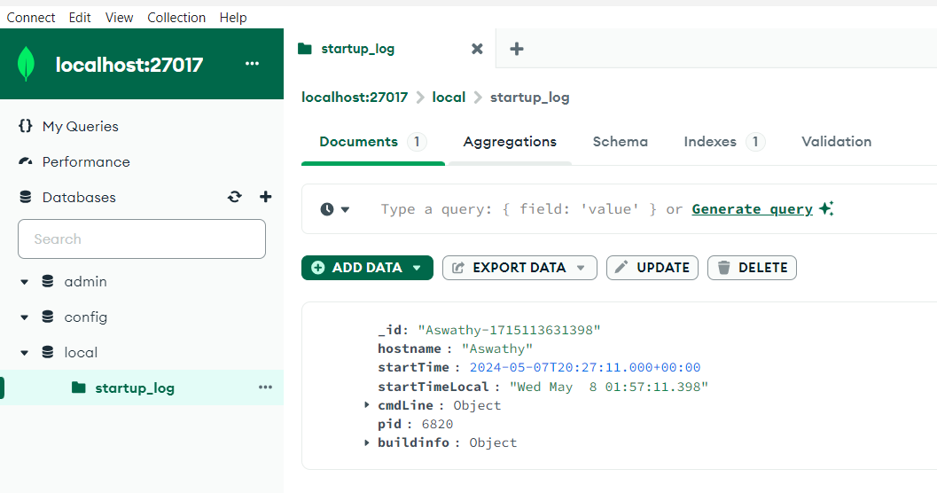
Installation
How to Mongo - Compass
https://www.mongodb.com/try/download/shell
Notes:
Improved decision-making
Big data is the key element to becoming a data-driven organization. When you can manage and analyze your big data, you can discover patterns and unlock insights that improve and drive better operational and strategic decisions.
Increased agility and innovation
Big data allows you to collect and process real-time data points and analyze them to adapt quickly and gain a competitive advantage. These insights can guide and accelerate the planning, production, and launch of new products, features, and updates.
Better customer experiences
insights for consumer understanding, personalization, and ways to optimize experience to better meet consumer needs and expectations.
Continuous intelligence
Big data allows you to integrate automated, real-time data streaming with advanced data analytics to continuously collect data, find new insights, and discover new opportunities for growth and value.
More efficient operations
reduce costs, save time, and increase your overall efficiency.
Improved risk management
Analyzing vast amounts of data helps companies evaluate risk better—making it easier to identify and monitor all potential threats and report insights that lead to more robust control and mitigation strategies.

Slide 20
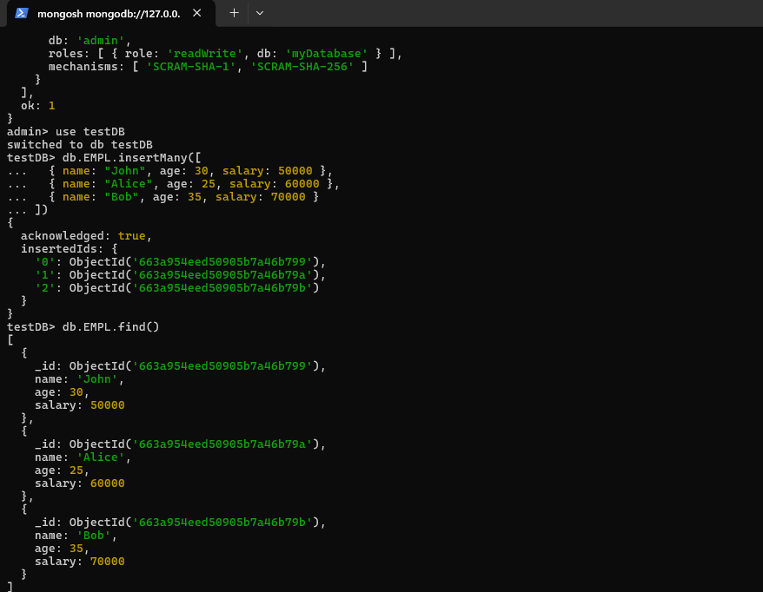
Installation
How to Mongo - mongosh
https://www.mongodb.com/try/download/shell
Notes:
Improved decision-making
Big data is the key element to becoming a data-driven organization. When you can manage and analyze your big data, you can discover patterns and unlock insights that improve and drive better operational and strategic decisions.
Increased agility and innovation
Big data allows you to collect and process real-time data points and analyze them to adapt quickly and gain a competitive advantage. These insights can guide and accelerate the planning, production, and launch of new products, features, and updates.
Better customer experiences
insights for consumer understanding, personalization, and ways to optimize experience to better meet consumer needs and expectations.
Continuous intelligence
Big data allows you to integrate automated, real-time data streaming with advanced data analytics to continuously collect data, find new insights, and discover new opportunities for growth and value.
More efficient operations
reduce costs, save time, and increase your overall efficiency.
Improved risk management
Analyzing vast amounts of data helps companies evaluate risk better—making it easier to identify and monitor all potential threats and report insights that lead to more robust control and mitigation strategies.

Slide 21
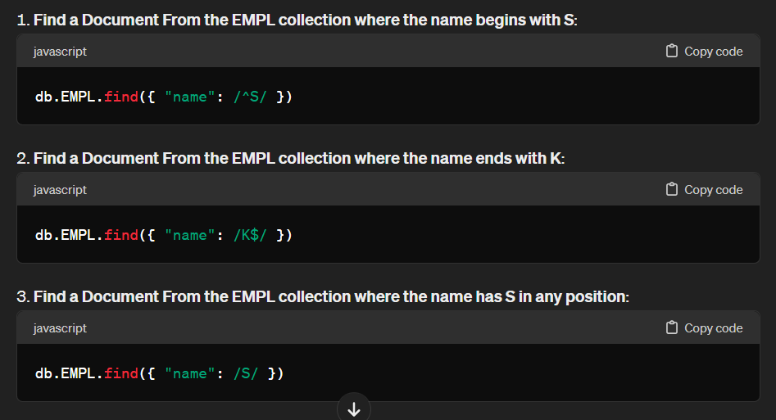
Query
How to Mongo - Query
Notes:
Improved decision-making
Big data is the key element to becoming a data-driven organization. When you can manage and analyze your big data, you can discover patterns and unlock insights that improve and drive better operational and strategic decisions.
Increased agility and innovation
Big data allows you to collect and process real-time data points and analyze them to adapt quickly and gain a competitive advantage. These insights can guide and accelerate the planning, production, and launch of new products, features, and updates.
Better customer experiences
insights for consumer understanding, personalization, and ways to optimize experience to better meet consumer needs and expectations.
Continuous intelligence
Big data allows you to integrate automated, real-time data streaming with advanced data analytics to continuously collect data, find new insights, and discover new opportunities for growth and value.
More efficient operations
reduce costs, save time, and increase your overall efficiency.
Improved risk management
Analyzing vast amounts of data helps companies evaluate risk better—making it easier to identify and monitor all potential threats and report insights that lead to more robust control and mitigation strategies.

Slide 22
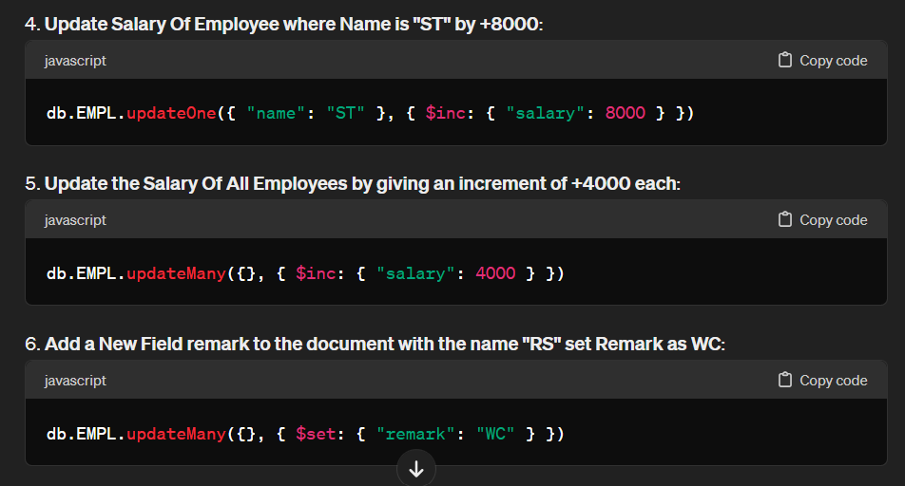
Query
How to Mongo - Query
Notes:
Improved decision-making
Big data is the key element to becoming a data-driven organization. When you can manage and analyze your big data, you can discover patterns and unlock insights that improve and drive better operational and strategic decisions.
Increased agility and innovation
Big data allows you to collect and process real-time data points and analyze them to adapt quickly and gain a competitive advantage. These insights can guide and accelerate the planning, production, and launch of new products, features, and updates.
Better customer experiences
insights for consumer understanding, personalization, and ways to optimize experience to better meet consumer needs and expectations.
Continuous intelligence
Big data allows you to integrate automated, real-time data streaming with advanced data analytics to continuously collect data, find new insights, and discover new opportunities for growth and value.
More efficient operations
reduce costs, save time, and increase your overall efficiency.
Improved risk management
Analyzing vast amounts of data helps companies evaluate risk better—making it easier to identify and monitor all potential threats and report insights that lead to more robust control and mitigation strategies.

Slide 23
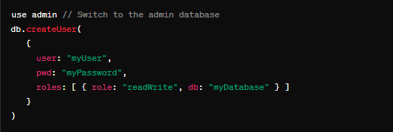

User Based Role access
Security side of MongoDB

Slide 24
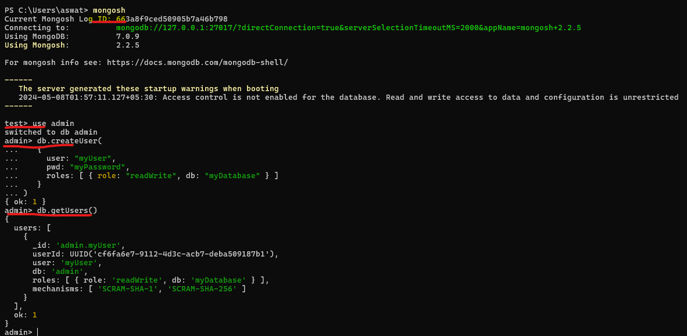
User Based Role access
Security side of MongoDB

Slide 25
Advanced NoSQL
Other concetps
Sharding
MongoDB employs sharding to horizontally partition data across multiple servers. Sharding enhances scalability by distributing data across multiple machines, enabling the database to handle large data volumes and high throughput. MongoDB's sharding architecture includes shard servers, query routers (mongos), and config servers.
Replication:
Master-Slave Replication: In this configuration, one node (the master) accepts write operations, while other nodes (slaves) replicate data from the master for read operations. It enhances fault tolerance and read scalability but does not automatically handle failover.
Masterless Replication (Replica Sets): MongoDB's primary method for replication is through replica sets. Replica sets provide automated failover, data redundancy, and read scaling. Each replica set consists of multiple nodes (usually an odd number) with one primary and multiple secondaries. If the primary fails, a new primary is automatically elected from the available secondaries.
Peer-to-Peer Replication: MongoDB also supports peer-to-peer replication, where each node can act as a master and a slave, allowing for bidirectional data replication between nodes.
Notes:
Hadoop
Java-based open-source, robust, and fault-tolerant Big Data Processing platform from the Apache software foundation
Apache Beam
Apache Beam is an open source unified programming model to define and execute data processing pipelines, including ETL, batch and stream (continuous) processing
Kafka
Kafka is a distributed event streaming platform
Apache Spark
Apache Spark is an in-memory data processing and analytics engine that can run on clusters managed by Hadoop YARN, Mesos and Kubernetes or in a standalone mode.
Airflow
Airflow is a workflow management platform for scheduling and running complex data pipelines in big data systems. It enables data engineers and other users to ensure that each task in a workflow is executed in the designated order and has access to the required system resources
Flink
Another Apache open source technology, Flink is a stream processing framework for distributed, high-performing and always-available applications. It supports stateful computations over both bounded and unbounded data streams and can be used for batch, graph and iterative processing.
Storm
Another Apache open source technology, Storm is a distributed real-time computation system that's designed to reliably process unbounded streams of data. According to the project website, it can be used for applications that include real-time analytics, online machine learning and continuous computation, as well as extract, transform and load jobs.

Slide 26
Advanced NoSQL
Other concetps
Clustering:
MongoDB's sharding feature enables clustering by distributing data across multiple servers. Additionally, you can configure replica sets for high availability and fault tolerance, forming a clustered architecture suitable for handling large-scale applications with high traffic.
Partitioning:
MongoDB partitions data across shards based on a shard key. The shard key determines how data is distributed across shards. Effective partitioning ensures data is evenly distributed and queries can be efficiently routed to the appropriate shard.
Indexing:
MongoDB supports various types of indexes to improve query performance, including single-field indexes, compound indexes, multikey indexes, text indexes, geospatial indexes, and hashed indexes. Proper indexing is crucial for optimizing query performance and ensuring efficient data retrieval.
Notes:
Hadoop
Java-based open-source, robust, and fault-tolerant Big Data Processing platform from the Apache software foundation
Apache Beam
Apache Beam is an open source unified programming model to define and execute data processing pipelines, including ETL, batch and stream (continuous) processing
Kafka
Kafka is a distributed event streaming platform
Apache Spark
Apache Spark is an in-memory data processing and analytics engine that can run on clusters managed by Hadoop YARN, Mesos and Kubernetes or in a standalone mode.
Airflow
Airflow is a workflow management platform for scheduling and running complex data pipelines in big data systems. It enables data engineers and other users to ensure that each task in a workflow is executed in the designated order and has access to the required system resources
Flink
Another Apache open source technology, Flink is a stream processing framework for distributed, high-performing and always-available applications. It supports stateful computations over both bounded and unbounded data streams and can be used for batch, graph and iterative processing.
Storm
Another Apache open source technology, Storm is a distributed real-time computation system that's designed to reliably process unbounded streams of data. According to the project website, it can be used for applications that include real-time analytics, online machine learning and continuous computation, as well as extract, transform and load jobs.

Slide 27

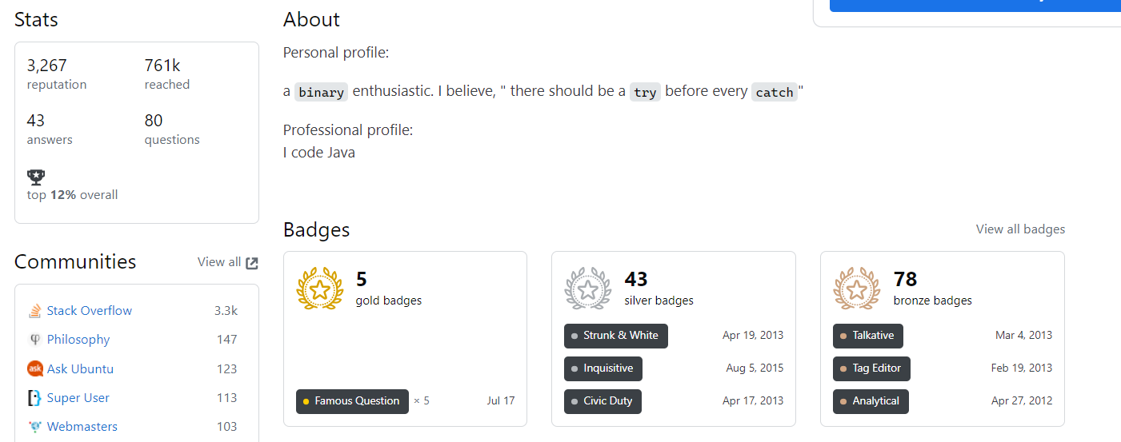

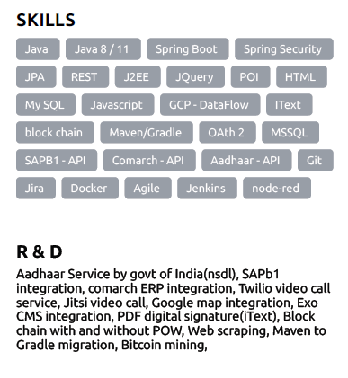
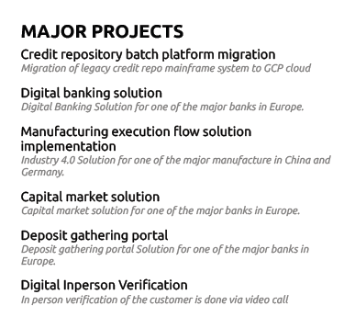
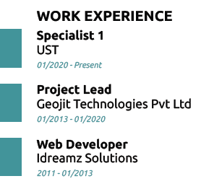
Me Arjun CC,
Thank You.

