Slide 1
Implementation of Scalable Resource Access Control
Guided by, Dr. Lino Abraham Varghese, Prof. and Head Of Department, Dept. of CSE
Presented by, Arjun c c, roll no : 2, Third Semester MTech CSE

Slide 2
01 Introduction

Slide 3
What is OAuth 2.0?
OAuth 2.0 is an open authorization protocol
Allows third-party applications to access resources on behalf of a user without exposing user credentials.
Used by companies like Google, Facebook, and GitHub for secure API access.

Slide 4
A BIT MORE ABOUT AUTH 2.0
OAuth 2.0 : is a widely used open standard protocol designed to enable secure, token-based authorization for web applications, mobile apps, and APIs.
Delegated Access Without Sharing Credentials: Allows third-party applications to access a user's resources on a server (e.g., emails, files,) without needing the user’s password. This is done through the use of tokens, which limit access scope and time.
Decoupling Authentication and Authorization: OAuth 2.0 separates the process of authenticating users (checking who they are) from authorization (granting access to resources).
Single Sign-On (SSO): Enables users to sign in once and access multiple related services without re-entering credentials.
Third-Party App Authorization: Applications can request permissions (e.g., a mobile app asking to access a user's cloud storage).
APIs & Microservices: OAuth 2.0 is used for API security, allowing developers to build scalable services that interact with one another securely.

Slide 5
ADVANTAGES - AUTH 2.0
Security: OAuth 2 enhances security by allowing limited access to resources without requiring users to share passwords with third-party applications. Instead, it uses tokens for authentication and authorization.
Token-Based Authentication: OAuth 2 uses access tokens, which can be time-limited and scoped to specific resources, providing better control over what a third-party application can do with a user's account. Once the token expires, access is revoked.
Support for Multiple Devices and Platforms: OAuth 2 works across different platforms (e.g., mobile, web, desktop) and devices. It standardizes authentication for multi-platform apps, enabling a seamless experience for users.
Granular Access Control: OAuth 2 allows granular control over what the client can access. It uses scopes to specify the level of access granted, which minimizes the risk of over-permissioning and enhances privacy.
Delegated Access : Users can grant third-party apps limited access to their resources (e.g., accessing calendar events or emails) without exposing their credentials. This delegation simplifies interaction between apps and service providers.
Broad Industry Adoption: OAuth 2 is supported by major providers like Google, Facebook, Microsoft, and GitHub. Its widespread adoption has led to strong community support and better compatibility across various systems and services.

Slide 6
02 Literature Survey

Slide 7
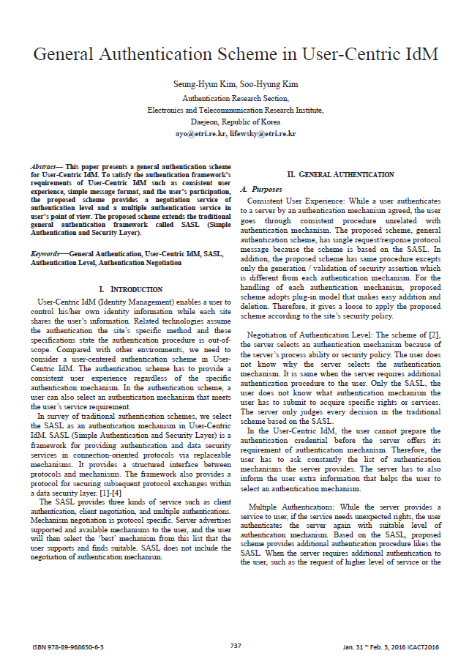
General Authentication Scheme in User-Centric IdM
Seung-Hyun Kim, Soo-Hyung Kim Authentication Research Section, Electronics and Telecommunication Research Institute, Daejeon, Republic of Korea
This paper presents a general authentication scheme for User-Centric Identity Management (IdM), aiming to provide a consistent user experience, simple message format, and user participation. The proposed scheme extends the traditional general authentication framework called SASL (Simple Authentication and Security Layer), which provides a structured interface between protocols and mechanisms. The scheme aims to provide a user-centered authentication scheme, allowing users to select an authentication mechanism that meets their service requirements.
The general authentication scheme has a single request/response protocol message based on the SASL, with the exception of the generation/validation of security assertions. The scheme adopts a plug-in model for handling each authentication mechanism, allowing easy addition and deletion. The scheme also provides additional authentication procedures like the SASL, such as when the server requires additional authentication, such as higher level of service or expiration of an authentication session.

Slide 8
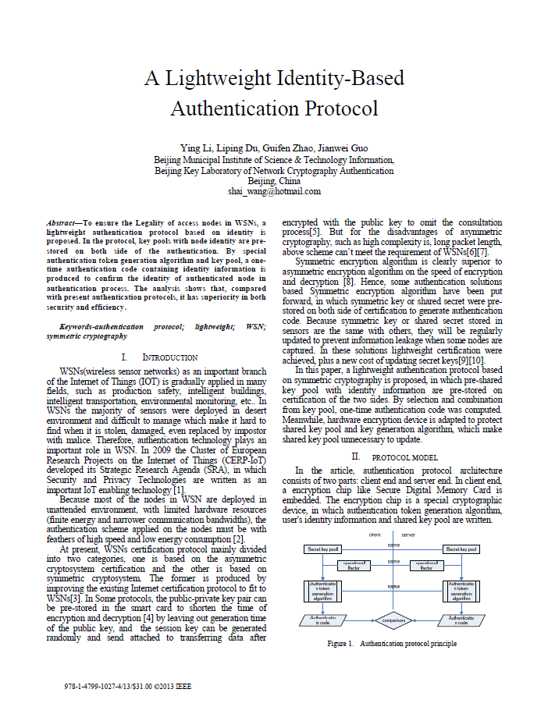
A Lightweight Identity-Based Authentication Protocol
Ying Li, Liping Du, Guifen Zhao, Jianwei Guo Beijing Municipal Institute of Science & Technology Information, Beijing Key Laboratory of Network Cryptography Authentication Beijing, China
A lightweight identity-based authentication protocol is proposed to ensure the legality of access nodes in Wireless Sensor Networks (WSNs). The protocol involves pre-storing key pools with node identity on both sides of the authentication process. A one-time authentication code containing identity information is produced to confirm the identity of the authenticated node in the authentication process. This protocol has superiority in both security and efficiency compared to present authentication protocols.
WSNs are deployed in unattended environments with limited hardware resources, making authentication technology crucial in WSNs. Currently, WSN certification protocols are divided into two categories: asymmetric cryptosystem certification and symmetric cryptosystem certification. Symmetric encryption algorithm is superior to asymmetric cryptography in terms of speed and efficiency.
This paper proposes a lightweight authentication protocol based on symmetric cryptography, where pre-shared key pools with identity information are pre-stored on certification of the two sides. By selection and combination from the key pool, a one-time authentication code is computed. Hardware encryption devices are adapted to protect the shared key pool and key generation algorithm, making the shared key pool unnecessary to update.

Slide 9
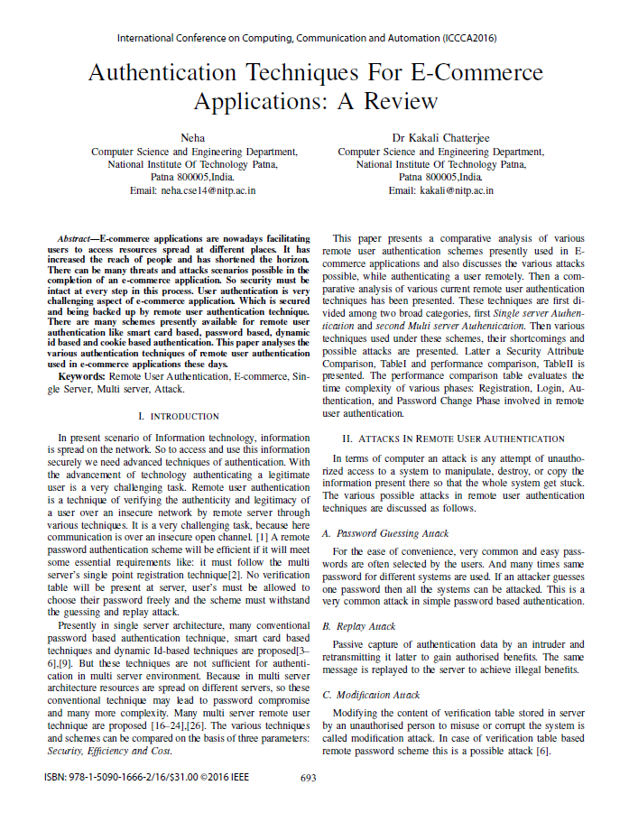
Authentication Techniques For E-Commerce Applications
Neha, Computer Science and Engineering Department, National Institute Of Technology Patna
This paper discusses the various authentication techniques used in e-commerce applications, including single server and multi server authentication. Remote user authentication is a crucial aspect of ensuring security in these applications, as it verifies the authenticity and legitimacy of a user over an insecure network. There are various schemes available for remote user authentication, such as smart card based, password based, dynamic ID based, and cookie based authentication.
Previously, conventional password-based, smart card based, and dynamic ID-based techniques have been proposed in single server architecture. However, these techniques are not sufficient for authentication in multi server environments, as resources are spread on different servers, leading to password compromise and increased complexity. Many multi server remote user techniques are proposed, with a comparative analysis of these techniques and their weaknesses and possible attacks.
The paper also discusses potential threats in remote user authentication techniques, such as password guessing, replay attack, modification attack, stolen verifier attack, server spoofing attack, smart card lost attack, dictionary attack, and man-in-the-middle attack. These attacks can lead to compromised data, loss of user information, and the possibility of unauthorized access to the system.

Slide 10
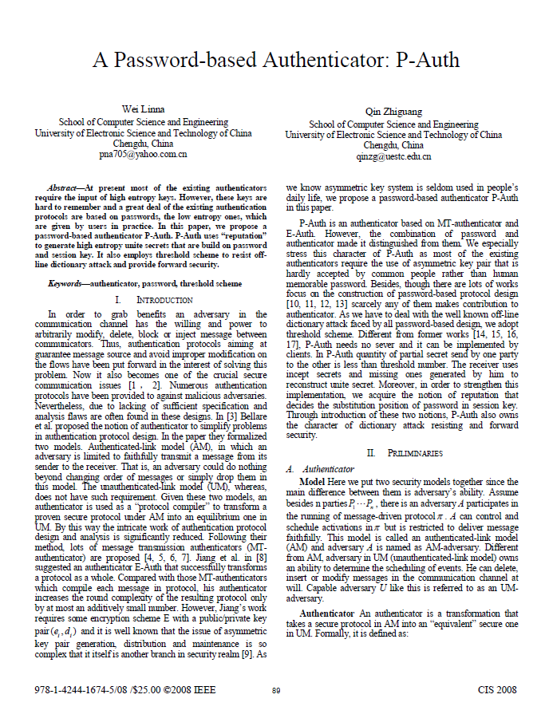
Password-based Authenticator: P-Auth
Wei Linna School of Computer Science and Engineering University of Electronic Science and Technology of China Chengdu, China
The paper proposes a password-based authenticator, P-Auth, which uses "reputation" to generate high entropy unite secrets based on password and session key. P-Auth employs a threshold scheme to resist off-line dictionary attack and provide forward security. Currently, most existing authenticators require high entropy keys, which are hard to remember. Many existing authentication protocols are based on low entropy passwords, which are given by users in practice. P-Auth uses "reputation" to generate high entropy unite secrets that are built on password and session key
P-Auth is an authenticator based on MT-authenticator and E-Auth, but with the combination of password and authenticator, it distinguishes itself from existing authenticators. Most existing authenticators require asymmetric key pairs, which are rarely accepted by common people. P-Auth adopts a threshold scheme to deal with off-line dictionary attack and requires no sever and can be implemented by clients. The receiver uses incept secrets and missing ones generated by the receiver to reconstruct unite secret. P-Auth also owns the character of dictionary attack resisting and forward security.

Slide 11
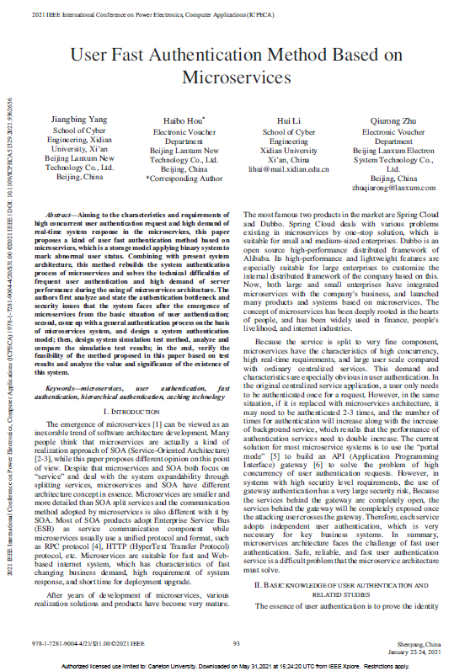
User Fast Authentication Method Based on Microservices
Jiangbing Yang School of Cyber Engineering, Xidian University, Xi’an Beijing Lanxum New Technology Co., Ltd. Beijing, China Haibo Hou
This paper proposes a user fast authentication method based on microservices, which is a storage model applying binary systems to mark abnormal user status. Combining with the present system architecture, this method rebuilds the system authentication process of microservices and solves the technical difficulties of frequent user authentication and high demand of server performance during the use of microservices architecture. The authors analyze and state the authentication bottleneck and security issues that the system faces after the emergence of microservices from the basic situation of user authentication. They come up with a general authentication process on the basis of microservices system, design a system authentication model, design system simulation test method, analyze and compare the simulation test results, and verify the feasibility of the method proposed in this paper based on test results and analyze the value and significance of the existence of this system.
User authentication is crucial in microservice architecture, as it helps prove the identity of the user who initiates a request through key information. There are various methods of user authentication, including username/password authentication, biometric authentication, hardware authentication, and third-party authorization authentication. Open authorization (OAuth) is a mature authorization authentication scheme widely used in various products and systems. In 2018, Xiuyu He published a paper that used JWT (JSON Web Token) to replace simple tokens, taking gateway as the only entrance to verify user tokens. In 2019, Wang Yue et al. published Research on Spring Security Identity Authentication Mechanism Based on SpringBoot Microservices, which combined Spring Security identity authentication with microservices.

Slide 12
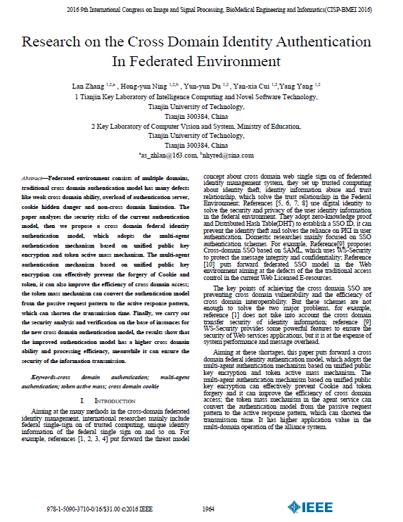
Research on the Cross Domain Identity Authentication In Federated Environment
Hong-yun Ning, Yun-yun Du,Yan-xia Cui, Yang Yang
The paper discusses the research on cross domain identity authentication in a Federated Environment. The traditional cross domain authentication model has several defects, including weak cross domain ability, overload of authentication servers, hidden dangers in cookies, and non-cross domain limitations. The paper proposes a cross domain federal identity authentication model, which adopts a multi-agent authentication mechanism based on unified public key encryption and token active mass mechanism. The multi-agent authentication mechanism effectively prevents cookie and token forgery, improves cross domain access efficiency, and shortens transmission time. The token mass mechanism in the agent service converts the authentication model from a passive request pattern to an active response pattern, reducing transmission time. The security analysis and verification of the new model show that it has higher cross domain ability and processing efficiency, while ensuring information transmission security. The paper also addresses the limitations of traditional cross-domain identity authentication models, such as not considering cross domain transfer security and WS-Security at the expense of system performance and message overhead.

Slide 13
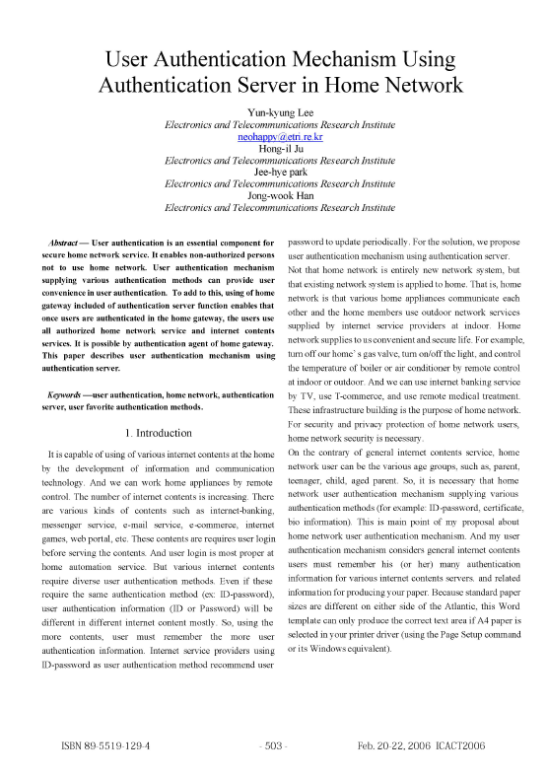
User Authentication Mechanism Using Authentication Server in HomeNetwork
Yun-kyung Lee Electronics and Telecommunications Research Institute neohappy(a) e.kr Hong-il Ju Electronics
This paper proposes a secure home network service that enables non-authorized users to use the network. The system provides various authentication methods, such as ID-password, certificate, messenger service, email service, e-commerce, and biometric information. Home network security is necessary for users to access various internet content at home.
The proposed user authentication mechanism considers the home network as a star topology, with home users authenticated by their favorite authentication gateway. The system consists of three home network services: remote home information (URL address), user application control by indoor home network service user, and authentication server security from outdoor attackers.
Home network service users must pre-register user authentication information to the authentication server, store content servers, and ensure that the authentication server is secure from outdoor attacks. The first home network service, such as remote home application control, authenticates users using a computer with database data. The second connected home network service, such as using internet content provided by user authentication, uses client devices connected to the authentication server.

Slide 14
03 Summary/gap

Slide 15
Advantage over traditional Authentications over compared systems
OAuth 2.0 offers significant advantages over traditional authentication methods like basic, password-based, and session-based authentication. In general authentication, users typically provide a username and password to authenticate their identity. However, this method exposes sensitive credentials, which can be vulnerable to attacks like phishing or data breaches. OAuth 2.0, on the other hand, enhances security by using tokens instead of credentials, allowing users to grant limited, time-bound access to third-party applications without sharing their password. Tokens can also be scoped, restricting the level of access granted to applications, which offers more granular control compared to traditional methods.
When compared to Identity-Based Authentication Protocols and cross-domain authentication, OAuth 2.0 streamlines the process of accessing resources across multiple domains without the need for repeated logins. Traditional cross-domain authentication methods often require complex configurations like cookies or federation services to handle the authentication requests. OAuth 2.0 provides a standardized approach that supports multiple devices and platforms seamlessly, making it easier for users to authenticate across services. Additionally, OAuth 2.0’s delegation mechanism enables users to authorize third-party apps to act on their behalf without revealing personal credentials, reducing security risks in scenarios where multiple domains are involved.
OAuth 2.0 also outperforms session-based and home authentication methods by offering stateless token-based access. While session-based authentication relies on server-side session storage, which can become cumbersome in distributed systems, OAuth 2.0 is more scalable since it eliminates the need for managing session data. Users can log in once and maintain secure access across multiple applications without needing session persistence. Moreover, OAuth 2.0 tokens can be refreshed without requiring the user to re-authenticate, providing a smoother and more user-friendly experience. This makes OAuth 2.0 a superior choice for modern web and mobile applications that require secure, flexible, and scalable authentication.

Slide 16
04 Objective

Slide 17
Proposed Solution
The objective of proposing OAuth 2.0 as a solution is to provide a secure, scalable, and flexible authorization framework for modern applications. OAuth 2.0 enables users to grant third-party applications access to their resources without sharing sensitive credentials, mitigating the risks of data breaches and unauthorized access. By leveraging token-based authentication, OAuth 2.0 enhances security through limited, time-bound access while offering granular control over permissions, improving both user privacy and the overall security posture.
Additionally, OAuth 2.0 supports a wide range of platforms, making it suitable for cross-domain and multi-device environments. It simplifies the authorization process, allowing seamless integration between services without the need for repeated logins or complex session management. As a solution, OAuth 2.0 ensures an optimal balance between user convenience, security, and the scalability needed for distributed and cloud-based systems.

Slide 18
05 System Architecture

Slide 19
IMPLEMENTATION : Spring Security
Spring Security provides comprehensive support for implementing OAuth 2.0 using its OAuth2 module, allowing secure access to APIs.
This module simplifies the process of integrating with various OAuth 2.0 authorization servers, such as Google, Facebook, or a custom authorization server.
Spring Boot includes built-in support for OAuth 2.0 Authorization Code Grant, Client Credentials, Password Grant, and Refresh Token flows, providing flexibility depending on the use case.

Slide 20
IMPLEMENTATION : Key Components
Resource Owner
Client
Authorization Server
Resource Server
The Resource Owner is typically the user who holds ownership of the data or resources being accessed. In most cases, this is a person using a service (e.g., a user with a Google account), but it could also be a machine or service in certain automated contexts.
The Client is the application or service that seeks to gain access to the resource owner’s data. This can be a web app, mobile app, or even a server. The Client obtains an access token from the Authorization Server to access the Resource Server on the user's behalf
The Authorization Server is responsible for authenticating the client and ensuring the request is legitimate.It issues an access token (and sometimes a refresh token) after verifying the identity of the Resource Owner and confirming their consent to share data.
The Resource Server is the server or system that holds the actual resources (e.g., data, files, services).It validates the access token provided by the Client and, if valid, grants access to the requested resources. The Resource Server must trust the Authorization Server.

Slide 21
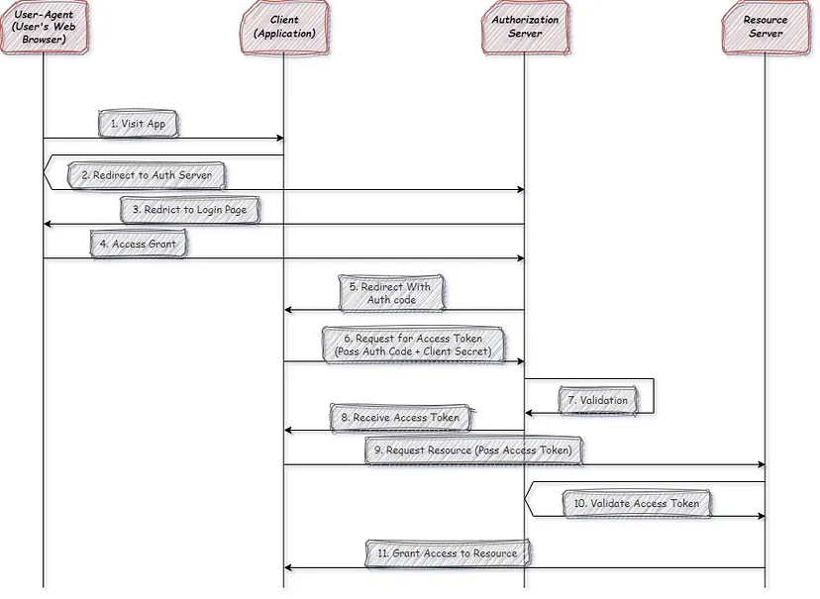
DIAGRAM : Communication flow

Slide 22
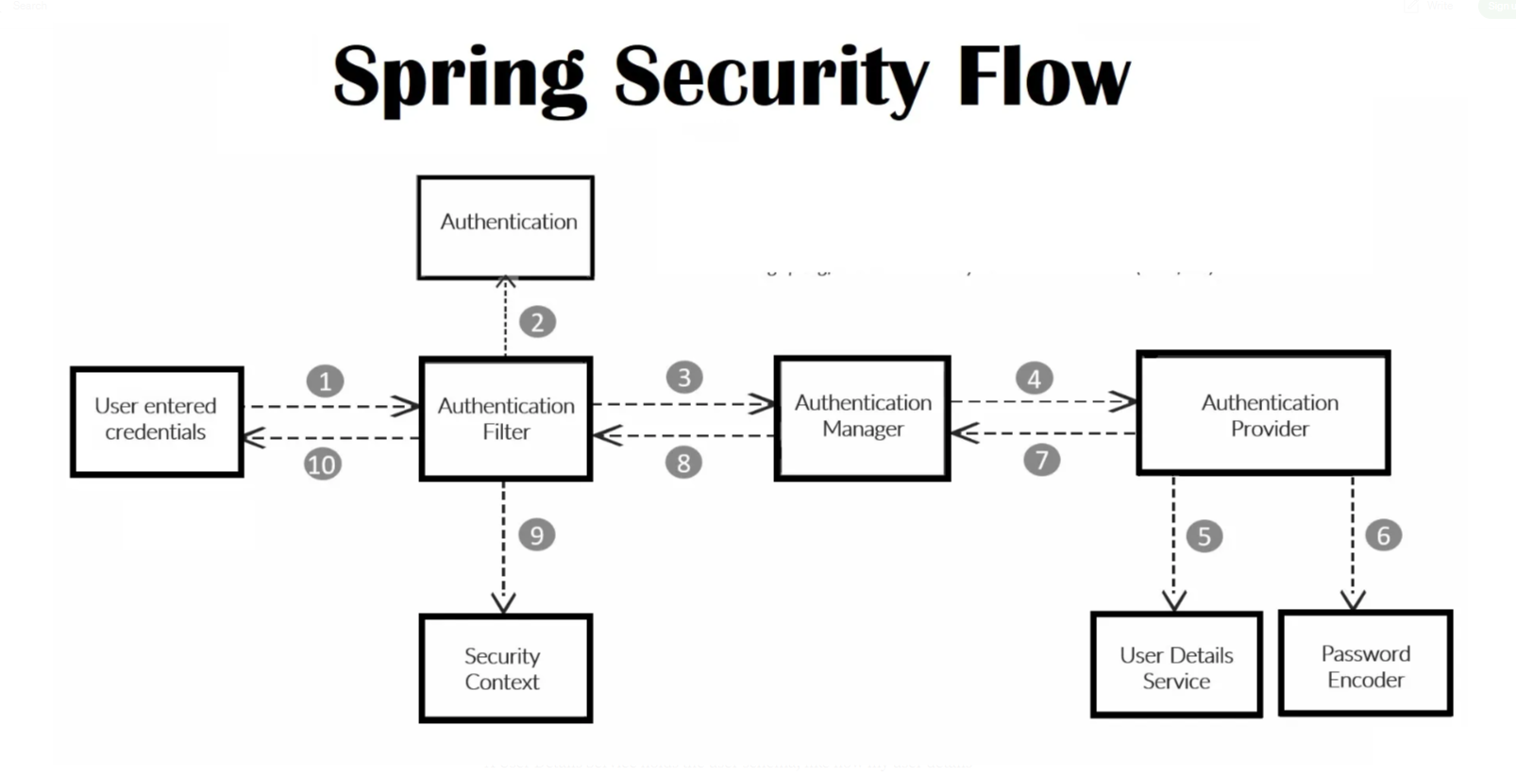
IMPLEMENTATION : Authorization Flow
Client (Spring Application) redirects the user to the Authorization Server.
The Authorization Server authenticates the user and issues an Authorization Code.
The Client exchanges the Authorization Code for an Access Token (and optionally a Refresh Token) from the Authorization Server.
The Client uses the Access Token to access the Resource Server.

Slide 23
References
Following are the references
OAuth 2.0: The Complete Guide to Understanding OAuth, Mehdi Hafid
Scalable User Authentication with OAuth 2.0 in Backend Services, Moments Log Editorial Team
OAuth 2.0 Simplified: A Complete Beginner's Guide, Aaron Parecki
OAuth 2.0 Threat Model and Security Considerations, Torsten Lodderstedt, Mark McGloin, Phil Hunt, Internet Engineering Task Force (IETF)
Security Analysis of OAuth 2.0 and Its Implementations, Antonio Sanso, Marcus Brinkmann, University of Birmingham
OAuth 2.0: Authorization Framework, D. Hardt, Internet Engineering Task Force (IETF)
An Analysis of OAuth 2.0 for User Authentication, Bhargav Amin, Rakesh K. Lenka, International Journal of Computer Applications (IJCA), 2015
Research on the Cross Domain Identity Authentication In Federated Environment, Lan Zhang, Tianjin University of Technology
User Fast Authentication Method Based on Microservices, Jiangbing Yang, 2021 IEEE International Conference on Power Electronics, Computer Applications (ICPECA)
Authentication Techniques For E-Commerce pplications: A Review, Neha, International Conference on Computing, Communication and Automation (ICCCA2016)

Slide 24
THANK YOU!

