Slide 1
The Subtle art of being an Interviewee
Standout
Arjun C C

Slide 2
01
Introduction
Chaper
What we are going to learn new ?

Slide 3

Nothing : The Things You already Know

Slide 4
02
Before
Chaper
The preparation to be started way before !

Slide 5
Code Code and Code
01
02
03
Learn
Coding
Learn
Coding
Brush Up Coding
Solve coding problems on platforms like LeetCode, HackerRank, or Codeforces. Practice whiteboard coding or using tools like CoderPad for live coding rounds.
Solve coding problems on platforms like LeetCode, HackerRank, or Codeforces. Practice whiteboard coding or using tools like CoderPad for live coding rounds.
Focus on foundational topics like Data Structures, Algorithms, and Object-Oriented Programming. Review other domain-specific subjects relevant to the job.

Slide 6
The Other Things
04
05
06
Communication Skills
Understand the Job Role
Research the Company
Practice articulating your thoughts clearly and concisely. Work on explaining your problem-solving approach step-by-step.
Research the job description and required skills. Align your preparation with the company's expectations.
Understand the company's products, services, and culture. Review common interview questions and experiences shared by others on Glassdoor or LinkedIn.

Slide 7
03
The You – 1
Chaper
What you tell them about You

Slide 8
And the Main Thing : Resume
01
02
03
Keep It
Concise
Professional Formatting
Proofread and Avoid Errors
Stick to one page unless you have significant internships or projects.
Keep the layout clean and easy to read.
Use consistent fonts, headings, and bullet points.
Check for typos, grammatical errors, and formatting inconsistencies.

Slide 9
And the Main Thing : Resume
04
05
06
Projects
Skills
Section
ATS
Friendly
Showcase 2-3 key projects
Project Title,Tools/Technologies Used, Brief Description
Include any live links
List technical skills, programming languages, or tools
If specifics can be used go for it
Applicant Tracking Systems friendly resume.

Slide 10
Resume : Things to Avoid
07
08
09
Avoid using terms like “hard-working,” “team player,” or “motivated” without specifics
Avoid Using Unprofessional Email Address
Do not list skills or experiences you cannot explain

Slide 11
Resume : Things to Avoid
10
11
12
Avoid vague objectives like “Seeking a challenging role in a reputed organization.”
Overloading with Irrelevant Information
Skip listing grades for every subject or insignificant academic achievements

Slide 12
“Last But Not Least. For the Sake of God, Created a LinkedIn page and GitHub account today itself, If you already doesn’t have one”.
— Almost all interviewers

Slide 13
04
The D-Day
Chaper
Its your day to impress someone you are meeting for the first time in life

Slide 14
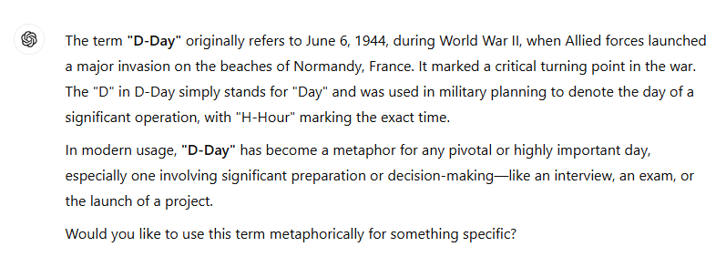
Just a Random Info

Slide 15
The Interview Day
The D-Day :

Slide 16

What Are you Going to Do?

Slide 17
The D-Day Continue.
01
02
03
Dress Professionally
Essential Documents
Arrive
Early
Wear attire appropriate for the company culture (formal for corporate roles, smart casual for startups).
Ensure your clothes are clean, well-fitted, and wrinkle-free.
Printed copies of your resume (at least 3).
A list of references (if required).
Portfolio, certificates, or work samples relevant to the job.
Government-issued ID for verification (if needed).
Reach the venue 10-15 minutes before the scheduled time.
Factor in extra time for unexpected delays like traffic or security checks.

Slide 18
The D-Day Continue.
04
05
06
Body Language Matters
Avoid Last-Minute Panic
Prepare for Common Questions
Offer a firm handshake (if in person) and maintain good eye contact.
Sit up straight and avoid fidgeting.
Smile genuinely to appear approachable and enthusiastic.
Keep everything ready the night before (outfit, documents, transportation).
Double-check the interview time, venue, and contact details.
Practice responses to typical interview questions like:
"Tell me about yourself."

Slide 19
05
The You - 2
Chaper
What you tell them about You, In person

Slide 20

“Tell me about yourself”

Slide 21
The Interview : Introduction
01
02
03
Keep It Concise
Body Language Matters
Start with a Greeting
Aim for a 1-2 minute introduction to keep it engaging and to the point.
Offer a firm handshake (if in person) and maintain good eye contact.
Sit up straight and avoid fidgeting.
Smile genuinely to appear approachable and enthusiastic.
Begin with a warm and confident greeting, including the interviewer’s name if you know it.
Clearly state your full name.
Briefly mention where you’re from or your educational background, especially if it’s relevant.
Mention key skills or strengths relevant to the job.

Slide 22

A Sample Self Intro
“
Good morning, Mr. Kiran. Thank you for this opportunity. My name is [Your Name], and I recently graduated with a Masters' degree in Computer Science from [University Name]. During my academic journey, I gained hands-on experience in software development, particularly through my internship at Voleergo Solution LLP, where I developed an automation tool that improved operational efficiency by 30%. I’m skilled in [key skills like Python, Java, or teamwork], and I’m particularly passionate about solving complex problems through technology. I’m excited about this opportunity to join [Company Name] because of its innovative projects in [specific area]. I look forward to discussing how I can contribute to your team
“

Slide 23
06
What to Expect
Chaper
The General Questions and technical stuff during the interview

Slide 24

“Ready for an interview ?”

Slide 25
The Interview
01
02
03
Teamwork and Collaboration
Adaptability and Learning
Problem-Solving and Analytical Thinking
Tell us about a time you worked on a group project.
What is your role when working in a team
Describe a time when you had to quickly learn something new.
What do you do when you don’t know the answer to a question?
Hypothetical scenarios or puzzles.
CODE
Object oriented concepts

Slide 26
The Interview
04
05
06
Practical Experiences and Internships
Industry Knowledge
Ethical or Value-Based Questions
General trends or updates in your field.
How do you stay updated with industry trends
What did you learn during your internship
Tell us about a time you solved a challenging problem at work or during a project.

Slide 27
The Interview Conclusion
07
Closing Questions
Do you have any questions for us?

Slide 28
07
The Tail End
Chaper

Slide 29
“And Still Some of you Are not going to get it Right, This is For you to remember”
— Personal Note

Slide 30
2010

Slide 31
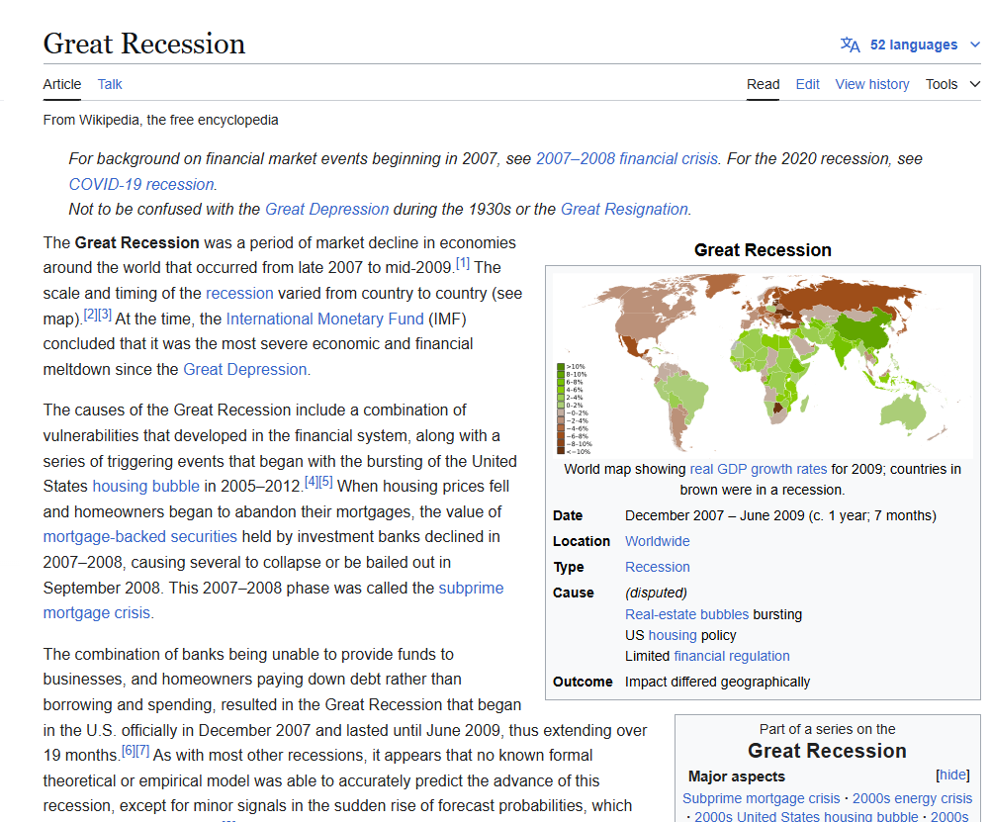
2010
34 Rejections

Slide 32
2010
34 Rejections

Slide 33

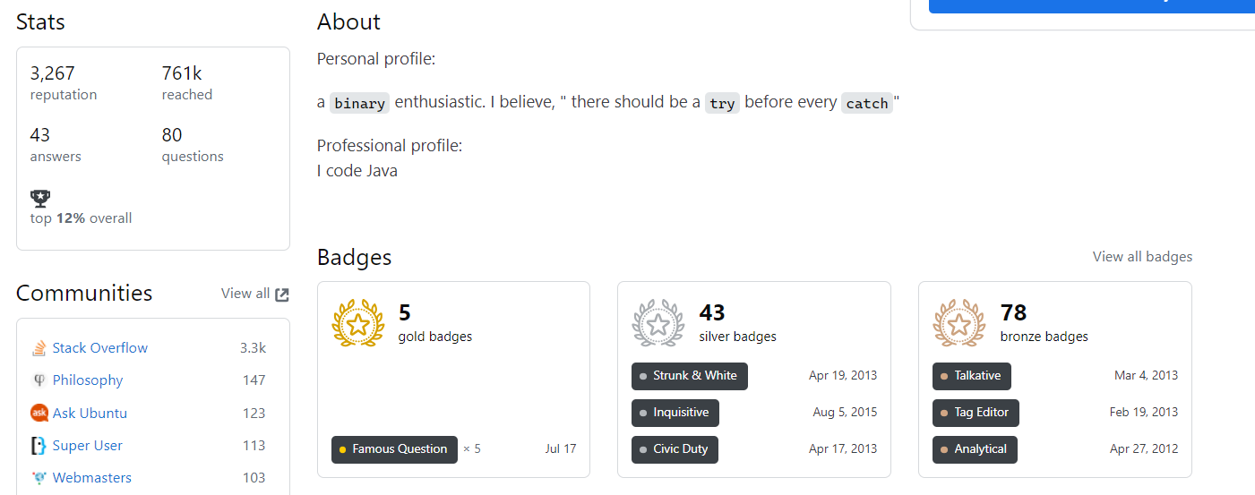
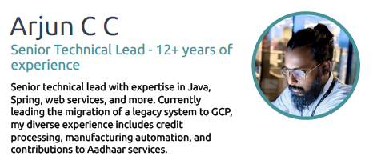
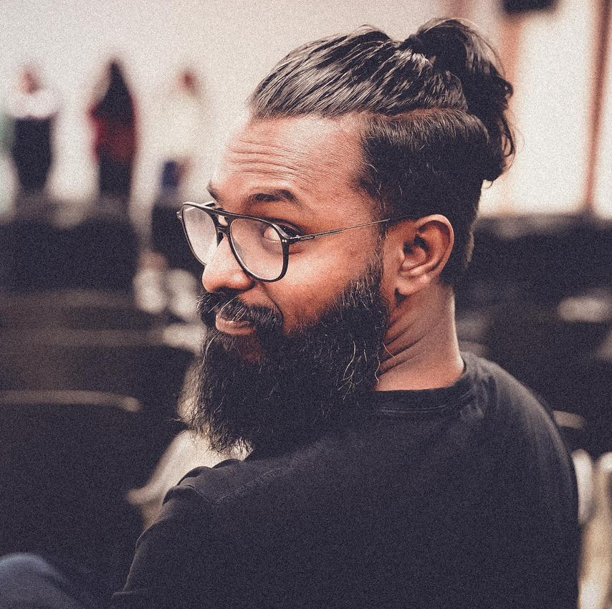
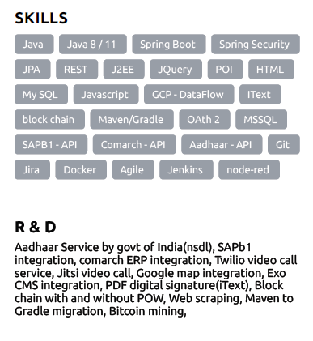
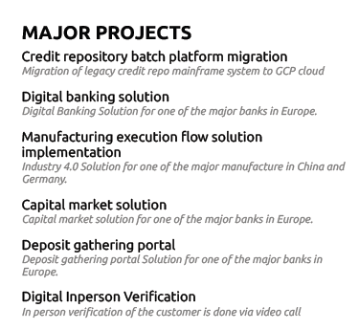
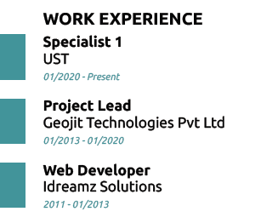

Slide 34
Adios

