Slide 1
Hungeready & Hungereadytodrive?
Cook. Manage. Deliver.
Professor: Vishal Chawla
Course: User Experience Design & Testing
Team Members: Anita Mohandas, Arjun Chandra

Slide 2
objective
Design a system (HungeReady) to support and automate a merchant’s (restaurant in our case) front and back of house operations.
Design a mobile-app (HungeReadyToDrive?) for delivery drivers.

Slide 3
How it works
HungeReady basically helps the merchant organize his orders and manage deliveries within his business. This includes monitoring delivery, dine-in and pick-up requests. The system also tracks HungeReadyToDrive? drivers that accept delivery requests posted via HungeReadyToDrive?.
HungeReadyToDrive? links to a particular HungeReady user’s system when he receives a request for delivery and accepts it. It gives drivers the flexibility to accept the delivery request if they are able to fulfill it. It is a platform that allows users to sign up as delivery drivers while also keeping a track of current deliveries, past deliveries and earnings.

Slide 4
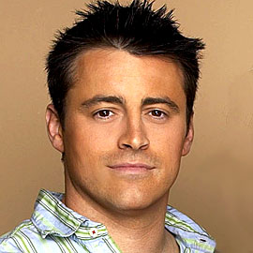
User research/persona (hungeready)
Joseph Tribbiani*
Business Owner, Joseph’s Kitchen*
“I need a system to help me manage all my orders and deliveries”
With 10 years in the restaurant business, he’s always relied on the old school ways of doing business. Joseph continues to use a pen and paper to take orders down. For Joseph, orders are no longer coming from inside the restaurant or the phone. A lot of customers are choosing to order food online. To prevent the loss of his business, Joseph decides to take on internet orders. Joseph needs to update his entire order taking process. Joseph needs a product that help organize and monitor his orders, as well as help him manage deliveries.
*Note: Original Names and Display Picture changed on request by original owner.

Slide 5
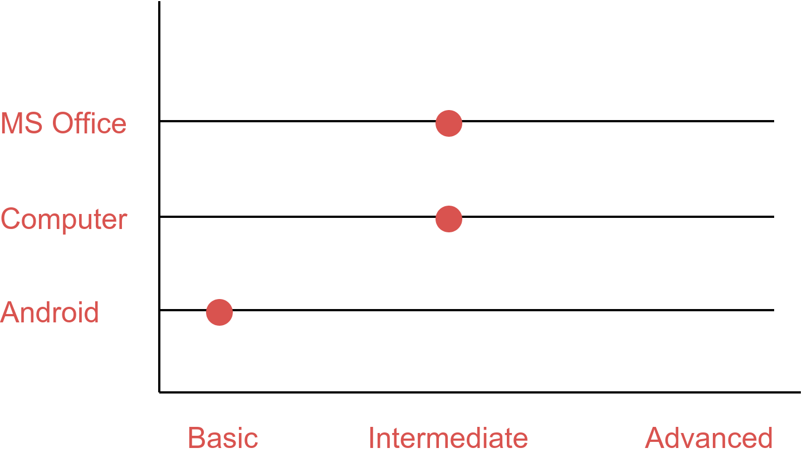
User research/persona (hungeready)
Technical Aptitude

Slide 6
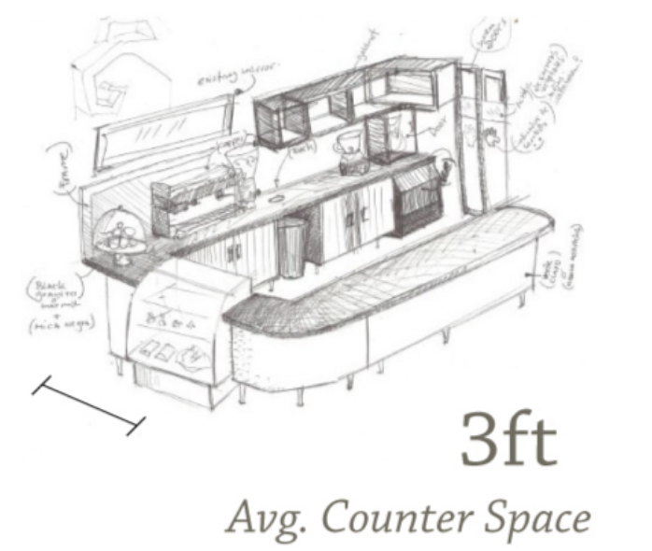
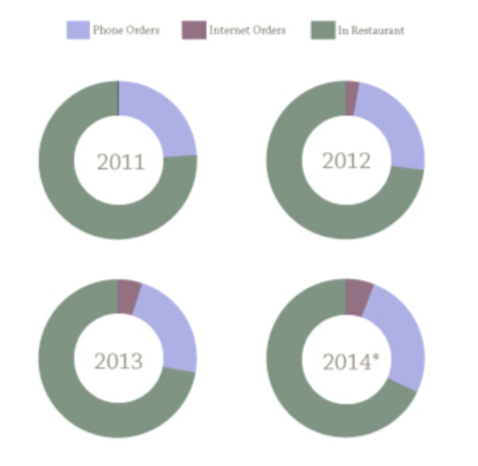
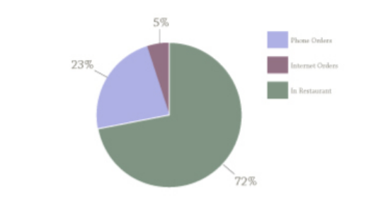
User research/persona (hungeready)
Counter Space includes:
1 Cash Register
1 Phone
Types of transactions
Daily Transactions

Slide 7
User research/persona (hungeready)
Red is the chief food color, evoking the taste buds and stimulating the appetite. The fast food industry has claimed this combination for a good reason—because it is effective.

Slide 8
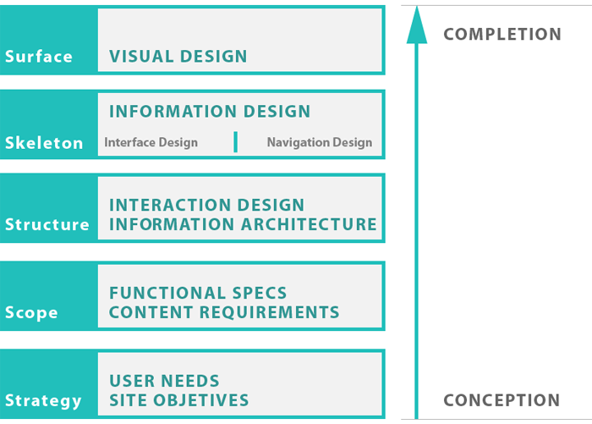
The 5 Planes of UX Design

Slide 9
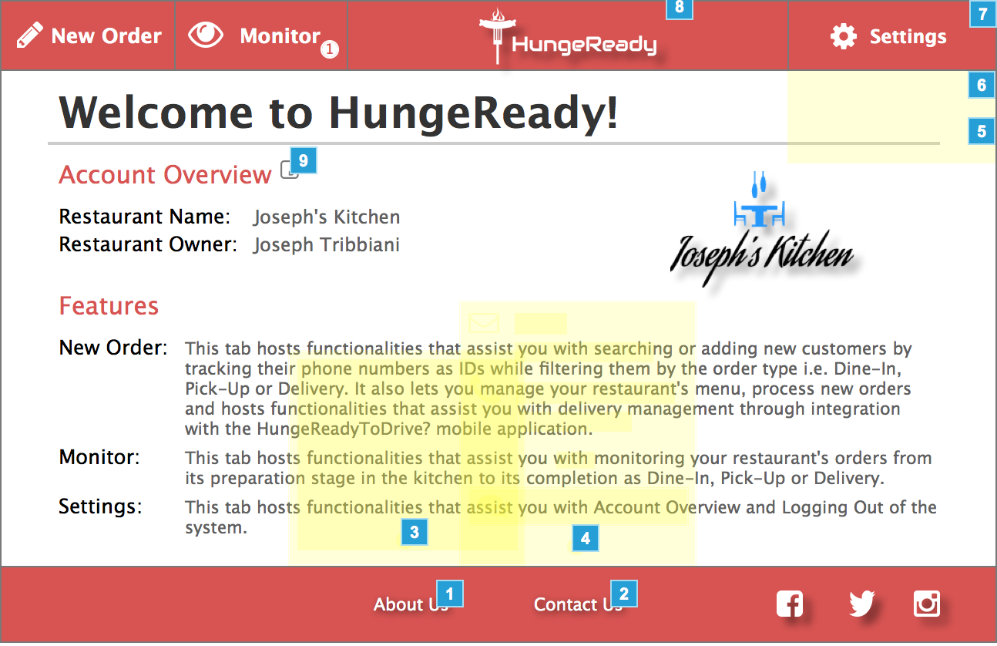
The Surface Plane
On the surface you see a series of Web pages, made up of images and text. Some of these images are things you can click on, performing some sort of function such as taking you to a shopping cart. Some of these images are just illustrations, such as a photograph of a book cover or the logo of the site itself.

Slide 10
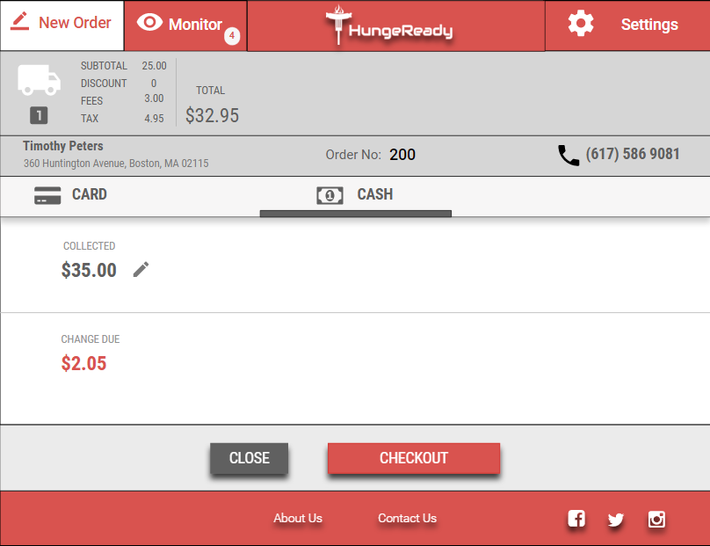
The Skeleton Plane
Beneath that surface is the skeleton of the site; the placement of buttons, tabs, photos, and blocks of text. The skeleton is designed to optimize the arrangement of these elements for maximum effect and efficiency--so that you remember the logo and can find that shopping cart button when you need it.
Navigation
Header
Content
Footer

Slide 11
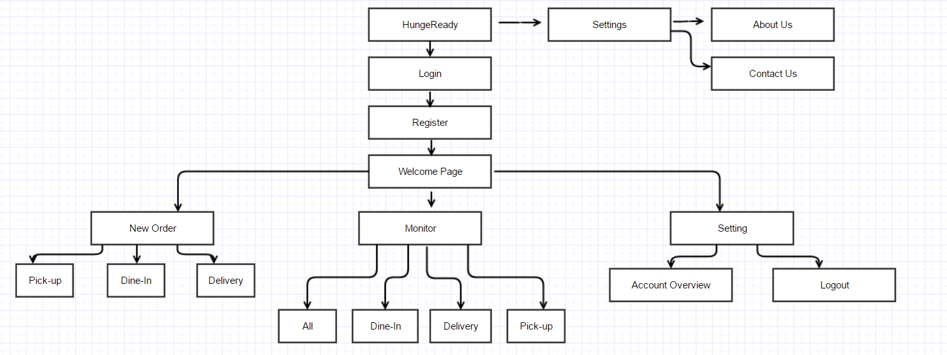
Information architecture

Slide 12
Research Methods
We used personas constantly throughout the project to guide design decisions & priorities.
Our personas hypothesis included two different archetypes which facilitated our decisions about our user needs and desires & varying contexts of use.
Through interviews and in depth analysis of our research we identified sufficient behavioral variables to segment our users and understand their motivation and goals.
Survey | Personas | Interviews | Secondary Research | Card sorting| User segmentation | Participatory Design | Think Aloud Protocol.

Slide 13
We interviewed a fast food restaurant owner in order to understand the restaurant operations, the challenges he faced with respect to order & deliveries his technical aptitude & his comfort with online platforms for order and & delivery engagement.
We discovered that over the last 4 years there was a steady increase in the internet transactions and gradual decline in the phone and restaurant transactions. This decline was primarily due to weather, time and location constraints.
We hypothesized that the priority of choosing a restaurant would be different if a customer with respect to location, weather and delivery time.

Slide 14
Owing to lack of qualitative data to support this, we performed a hierarchical card sot with 4 random participants in our university library.
Our aim was to understand how customers thought about different methods of food accessibility.
During the think aloud we noticed that the participants ranked content based on what the felt was convenient and could trust as dependable, what made them curious & finally what they were skeptical about.

Slide 15
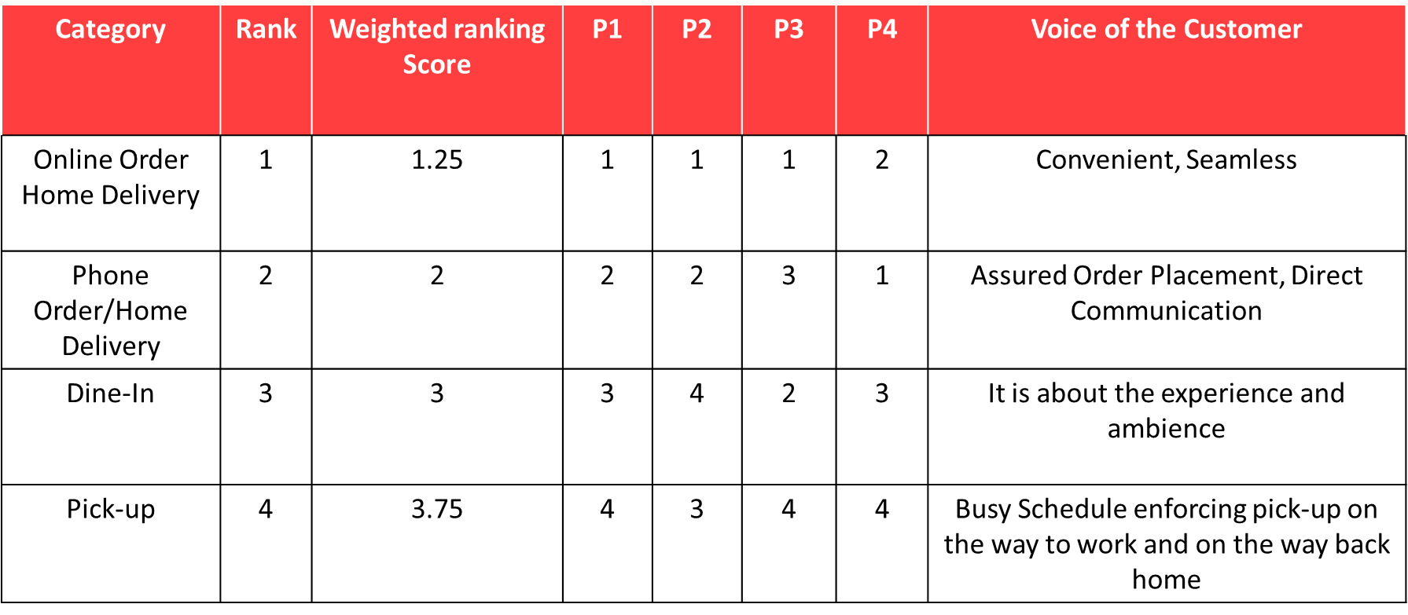
Research Summary Table

Slide 16
Usability Testing
Usability testing refers to evaluating a product or service by testing it with representative users. Typically, during a test, participants will try to complete typical tasks while observers watch, listen and takes notes. The goal is to identify any usability problems, collect qualitative and quantitative data and determine the participant's satisfaction with the product.
Questionnaire
Is the application easy to use?
Would you use the application frequently?
Can you get the information quickly?
Does the content make you explore the site more?
Does the application feature keep you coming back?
Is the application well organized?
What is the 1st attractive feature when you use the application?

Slide 17
Feature Name / Item to Test | Usability Tester / Customer Persona | Profession | Task Completed | Time on Task | Comments/Observations/Improvement Ideas | Observers Name | Rating (out of 5 *s)
The login page | Dave | Student | Yes | 2mins | The login page was accessible and minimal design easy on the eyes. | Anita & Arjun | *****
The sign up form | Ramachandra | Taxi Driver | Yes | 5mins | Too many mandatory fields. Design is appealing. | Anita & Arjun | ****
The monitor page and New order add user page. | Tom | Restaurant Owner | Yes | 7mins | Seamless website navigation. Content is not cluttered. | Anita & Arjun | *****
Payment Page | Sarika | Nanny | No | 6mins | Not interested. Wanted to physically purchase food from the restaurant. Not adept with computers. | Anita & Arjun | *
Percentage Agree: 98%
Percentage Disagree: 2%

Slide 18
Manual Testing
In Manual Testing , Testers manually execute test cases without using any automation tools.
Manual testing is the most primitive of all testing types and helps find bugs in the software system.
Any new application must be manually tested before its testing can be automated. Manual testing requires more effort, but is necessary to check automation feasibility.

Slide 19
Goal of Manual Testing
The key concept of Manual Testing is to ensure that the application is error free and it is working in conformance to the specified functional requirements.
Test Suites or cases ,are designed during the testing phase and should have 100% test coverage.
It also makes sure that reported defects are fixed by developers and re-testing has been performed by testers on the fixed defects.
Basically, this testing checks the quality of the system and delivers bug-free product to the customer.

Slide 20
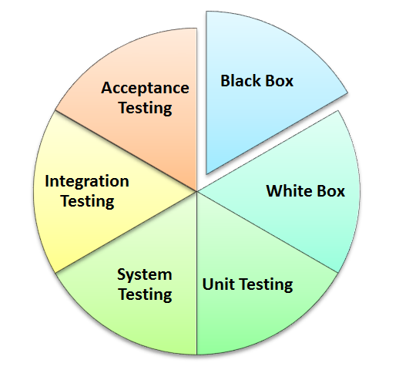
Types of Manual Testing :
Below given diagram depicts Manual Testing Types. In fact any type of software testing type can be executed both manually as well using an automation tool.

Slide 21
Manual Testing vs Automation Testing
Manual Testing
Manual testing requires human intervention for test execution.
Manual testing will require skilled labour, long time & will imply high costs.
Any type of application can be tested manually, certain testing types like ad-hoc and monkey testing are more suited for manual execution.
Manual testing can be become repetitive and boring.
Automated Testing
Automation Testing is use of tools to execute test cases.
Automation Testing saves time, cost and manpower. Once recorded, it's easier to run an automated test suite
Automated testing is recommended only for stable systems and is mostly used for regression testing
The boring part of executing same test cases time and again, is handled by automation software in automation testing.

