Slide 1
MongoDB
Banuprakash C
banu@lucidatechnologies.com
banuprakashc@yahoo.co.in

Slide 2
What is NoSQL?
NoSQL – supposed to be “No SQL”; but it is NOT
NoSQL – It is “Not Only SQL” (“NOSQL”)
NoSQL – does not mean there is no “SQL-Like” interface
Cassandra supports CQL (Cassandra Query Language)
NoSQL – does not always mean Big Data
But Big data stores are almost always NoSQL based
Hadoop HBase is a NoSQL

Slide 3
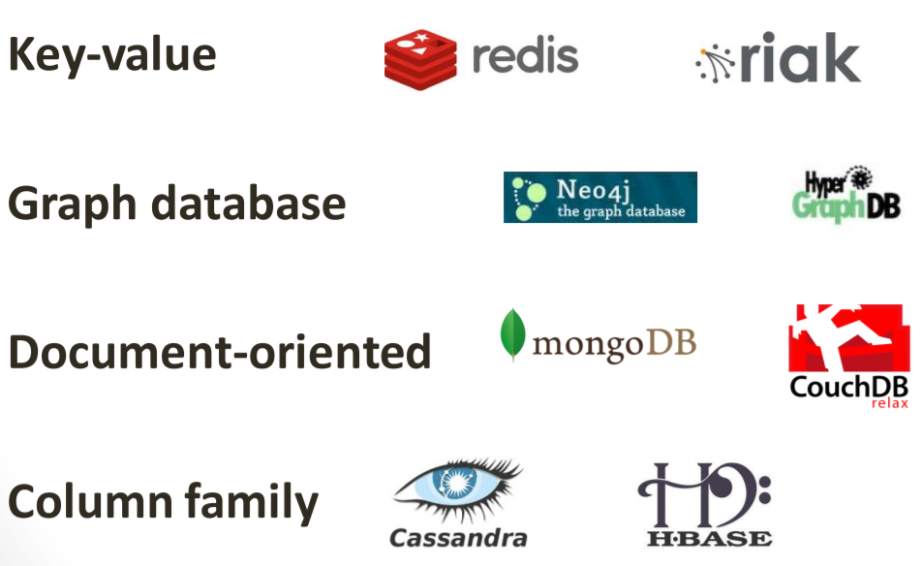
Taxonomy of NoSQL

Slide 4
Theory of NOSQL: CAP
C
GIVEN:
Many nodes
Nodes contain replicas of partitions of the data
Consistency
All replicas contain the same version of data
Client always has the same view of the data (no matter what node)
Availability
System remains operational on failing nodes
All clients can always read and write
Partition tolerance
multiple entry points
System remains operational on system split
System works well across physical network partition
A
P

Slide 5
Guide to choose the NoSQL systems
A
Consistent, Available (CA) Systems have trouble with partitions and typically deal with it with replication
Available, Partition Tolerant (AP) Systems achieve "eventual consistency" through replication and verification
RDBMS
Cassandra, DynamoDB, CouchDB
Pick Two
C
P
Consistent, Partition-Tolerant (CP) Systems have trouble with availability while keeping data consistent across partitioned nodes
MongoDB, Redis, HBase, MemCacheDB

Slide 6
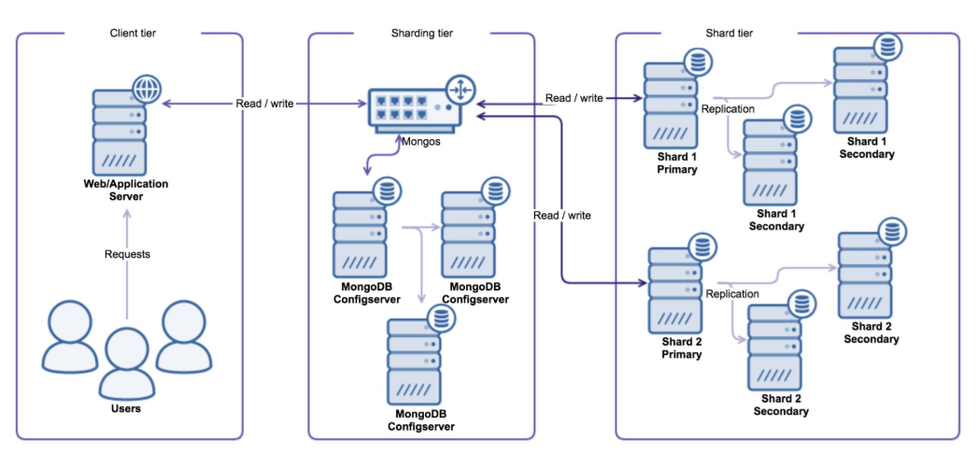
Sharding in MongoDB
Sharding, can also be called horizontal scaling.
The scaling approach divides the data set and distributes the data over multiple servers.
Each of this server can be called a shard

Slide 7
Sharding in MongoDB
Sharding tier
The first component used is the shard router called mongos.
All read and write operations must be sent to the shard router, making all shards act as a single database for the client application.
The shard router will route the queries to the appropriate shards by consulting the Configserver.
The Configserver is a special replicaSet that keeps the configuration of all shards in the cluster.
The Configserver contains information about shards, databases, collections, shard keys and the distribution of chunks of data.
Data gets partitioned by slicing the total dataset into smaller chunks of data, where these chunks are defined by the shard key.
The shard key can be either a range or hash defined. These chunks are then distributed evenly over the total number of shards.

Slide 8
Sharding in MongoDB
Sharding tier
The router will know on which shard to place the data by finding the correct chunk in the Configserver.
If the router thinks the chunk is becoming too large, it will automatically create a new chunk in the Configserver.
The sharding metadata is stored in the config database, and this database is accessible via the shard router as well.

Slide 9
Sharding in MongoDB
Shard tier
Adding a shard will increase the write capacity, but also increase the sharding complexity.
Each shard is an individual component in the cluster and there is no direct communication between them.
Shards don’t know anything about other shards in the cluster.
MongoDB distributes its data evenly by balancing the total number of chunks on each shard.
If the number of chunks is not spread evenly, a balancing process can be run to migrate chunks from one shard to another.

Slide 10
MongoDB
Developed by 10gen
Founded in 2007
A document-oriented, NoSQL database
Hash-based, schema-less database
No Data Definition Language
In practice, this means you can store hashes with any keys and values that you choose
Keys are a basic data type but in reality stored as strings
Document Identifiers (_id) will be created for each document, field name reserved by system
Application tracks the schema and mapping
Uses BSON format
Based on JSON – B stands for Binary
Written in C++
Supports APIs (drivers) in many computer languages
JavaScript, Python, Ruby, Perl, Java, Java Scala, C#, C++, Haskell, Erlang

Slide 11
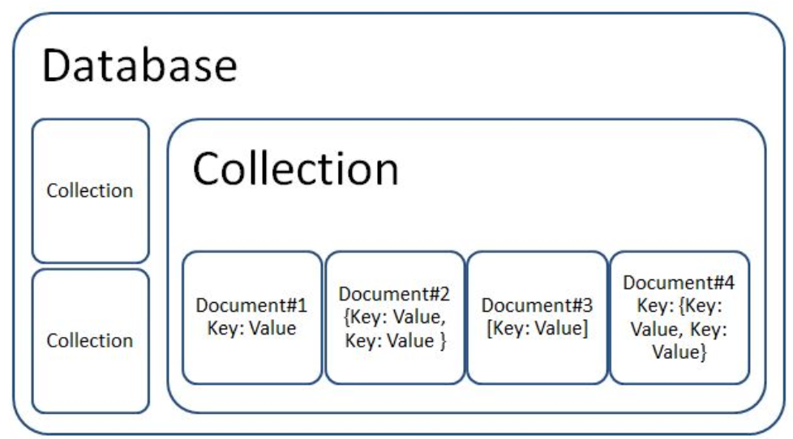
MongoDB
Database
Database is a physical container for collections. Each database gets its own set of files on the file system. A single
MongoDB server typically has multiple databases.
Collection
Collection is a group of MongoDB documents.
It is the equivalent of an RDBMS table.
A collection exists within a single database.
Collections do not enforce a schema..
Document
A document is a set of key-value pairs.
Documents have dynamic schema.
Dynamic schema means that documents in the same collection do not need to have the same set of fields or structure, and common fields in a collection’s documents may hold different types of data.

Slide 12
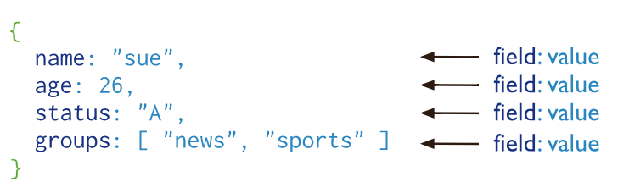
MongoDB
Document Database
MongoDB documents are similar to JSON objects.
The values of fields may include other documents, arrays, and arrays of documents.

Slide 13
_id field
_id
This is a field required in every MongoDB document.
The _id field represents a unique value in the MongoDB document.
The _id field is like the document's primary key.
If you create a new document without an _id field, MongoDB will automatically create the field.

Slide 14
Indexes

Slide 15
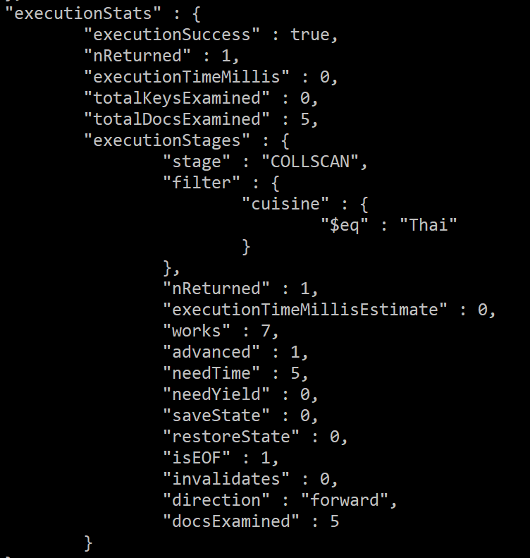
Before index
db.restaurants.find
({"cuisine":"Thai"})
.explain("executionStats")

Slide 16
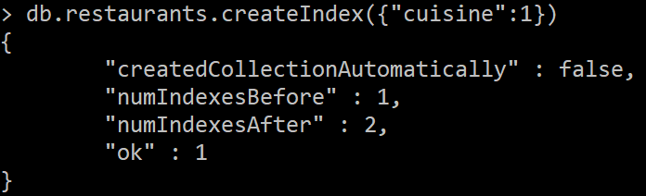
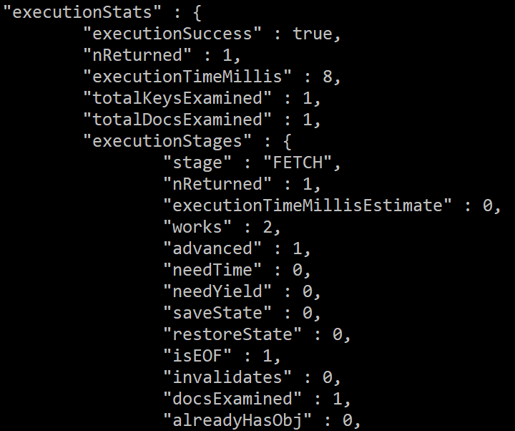
After Index

