Slide 1
Development Of Micro Rescue Robot For Human Detection Using IoT
ARJUN DEV D G
TVE18MCA012
S6 MCA
ROLL NO : 11

Slide 2
INTRODUCTION
The need for human safety is of key importance.
Huge loss of manpower in natural calamities situations can be minimized if an effective method is used despite using conventional way of identifying the buried humans.
The core idea of this underlying work is to develop such a robot which could provide the significant help and safety to the rescue workers during the rescue operations in disastrous situations.

Slide 3
Existing System
Rescue operations directed by human beings and officials that serves the purpose of detecting the alive human beings.
Hence, to make the rescue operation safer and effective, a small ground robot for humanitarian search have been proposed which detect alive human beings. This robot provides the momentous help and safety to the rescue workers during the search and rescue operations.

Slide 4
Proposed System
It proposes a self ruling automatic automobile that aides in recognizing the live individuals and salvage responsibilities.
It consist of various sensors for detecting humans, while in emergency situations.

Slide 5
Literature review
Naeem Farooq , Umar Ilyas, Muhammad Adeel , Sohail Jabbar proposed a paper called “Ground Robot for Alive Human Detection in Rescue Operations” that is used to find and rescue the victims who are buried under the rubble after natural or human-made destruction.
F Matsuno, S Tadokoro proposed a paper called “Rescue Robots and Systems in Japan” which describes the problem domain of earthquake disasters and search-and-rescue processes is clarified with introducing an overview of the Special Project for Earthquake Disaster Mitigation in Urban Areas. It uses the bird’s-eye view algorithm which improve remote controllability.

Slide 6
Literature review
Anand Vijay K M , Purustut S , Suhas R, Pavan CG, Pragyan Pradhan proposed a paper called “A Live Human Being Detector in War Fields and Earthquake Location Using Robot with Camouflage Technology” which describes alive human detection with robot; in addition, the system performs functionalities like smoke detection, metal detection, and camouflage technology implementation and compared with the existing models.

Slide 7
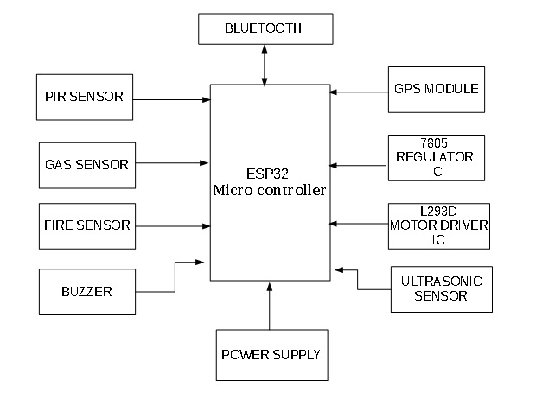
BLOCK DIAGRAM

Slide 8
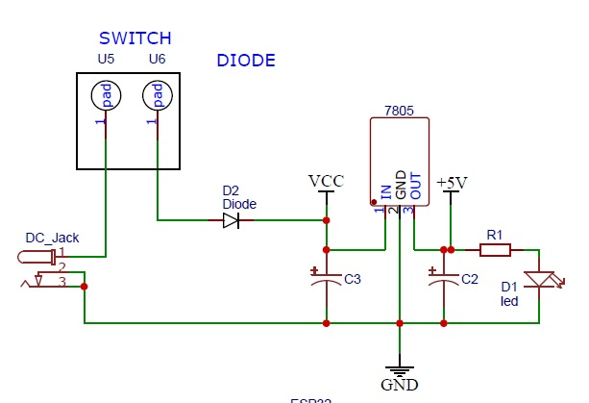
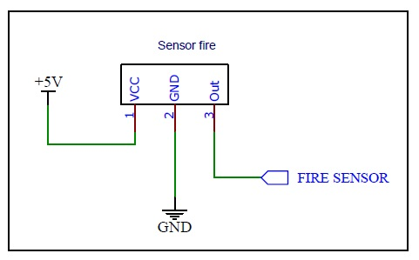
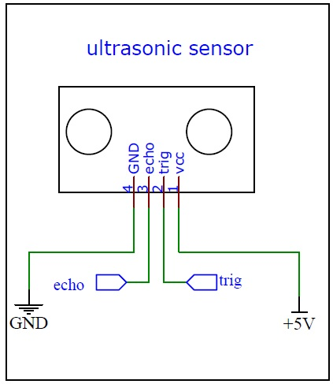
CIRCUIT DIAGRAMs

Slide 9
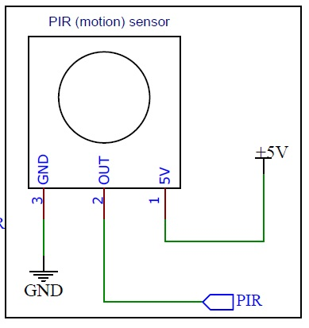
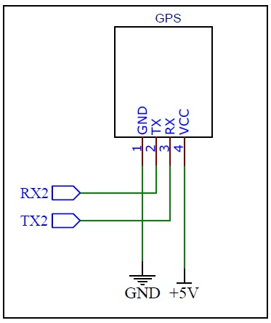
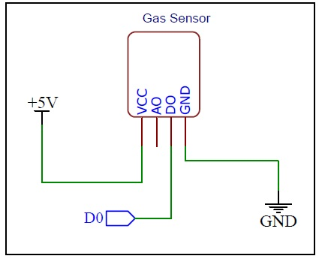
Circuit diagrams

Slide 10
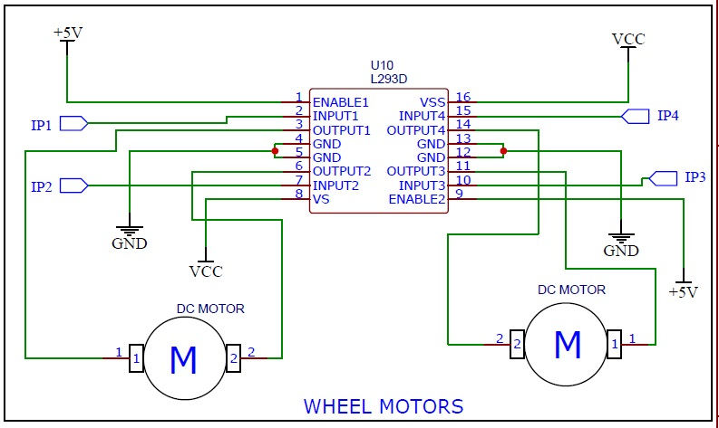
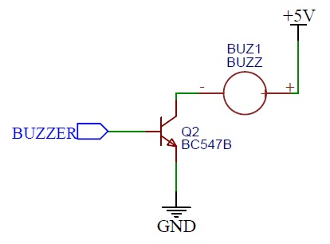
Circuit Diagrams

Slide 11
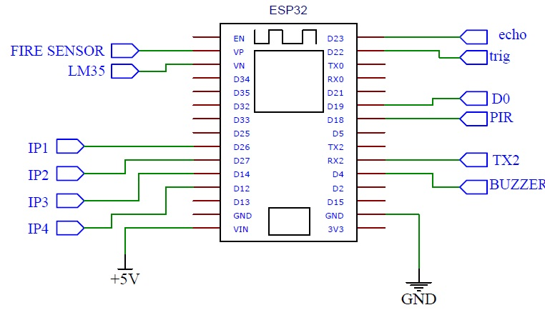
Circuit diagram

Slide 12
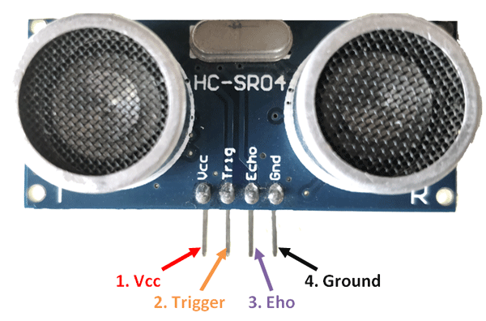
MODULES : Module 1 : ULtraSonic Sensor
This sensor is a very popular sensor used in many applications where measuring distance or sensing objects are required. The module has two eyes like projects in the front which forms the Ultrasonic transmitter and Receiver.

Slide 13
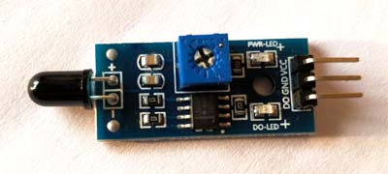
Module 2 : FIRE SENSOR
A flame detector is a sensor designed to detect and respond to the presence of a flame or fire. Responses to a detected flame depend on the installation but can include sounding an alarm, deactivating a fuel line (such as a propane or a natural gas line), and activating a fire suppression system.

Slide 14
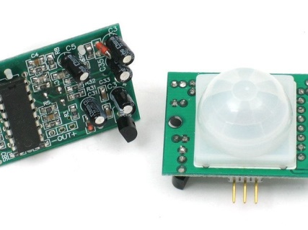
Module 3: PIR sensor
PIR sensor(Passive Infrared ) allow you to sense motion, almost always used to detect whether a human has moved in or out of the sensors range.

Slide 15
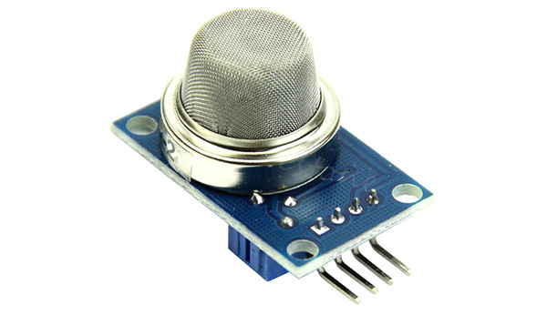
Module 4 : gas sensor
The MQ-6 Gas sensor can detect or measure gases like LPG and butane. The MQ-6 sensor module comes with a Digital Pin which makes this sensor to operate even without a microcontroller and that comes in handy when you are only trying to detect one particular gas.

Slide 16
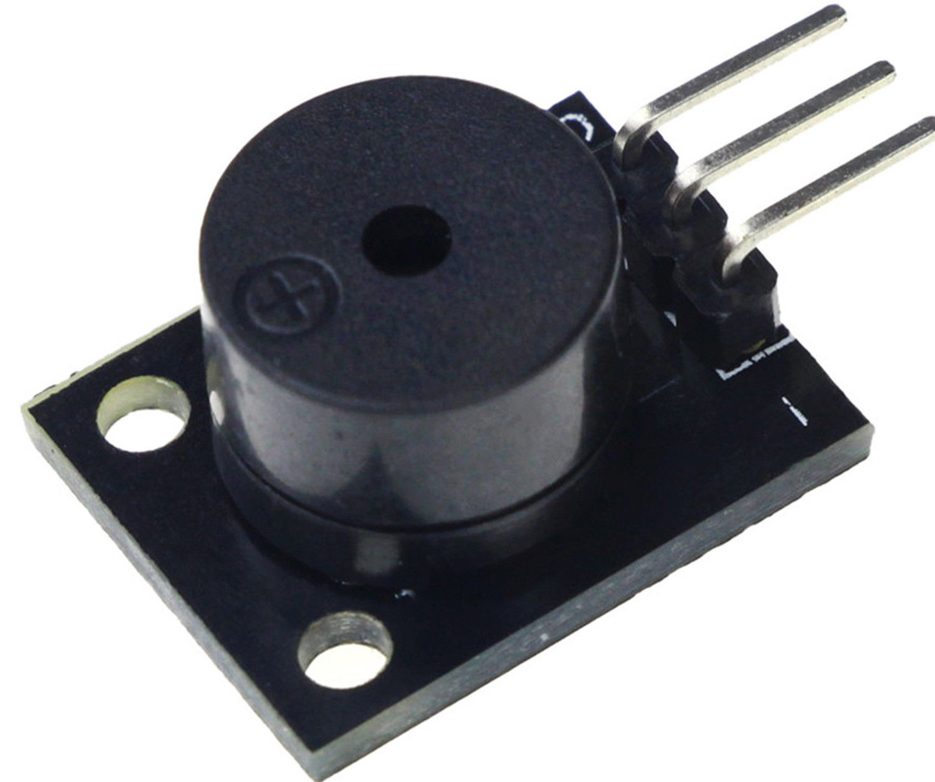
Module 5 : Buzzer
Buzzer is used for alert signaling . Here it is connected to transistor .

Slide 17
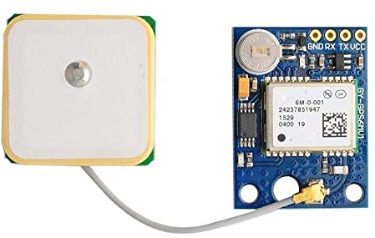
Module 6 : GPS Module
The NEO-6MV2 is a GPS (Global Positioning System) module and is used for navigation. The module simply checks its location on earth and provides output data which is longitude and latitude of its position.

Slide 18
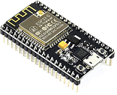
Module 7 : ESP32 Microcontroller
Esp32 is a microcontroller for controlling all the sensors connected to it.
It has inbuilt Wi-Fi and Bluetooth module.

Slide 19
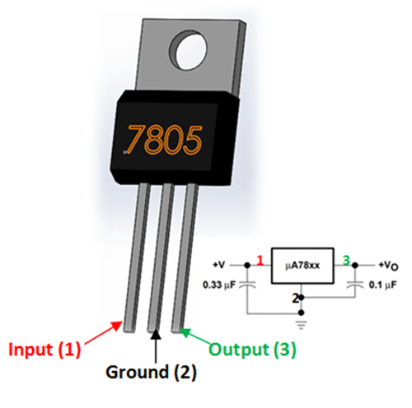
Module 8 : 7805 REGULATOR IC
The 7805 IC is an iconic regulator IC that finds its application in most of the projects.
The name 7805 signifies two meaning, “78” means that it is a positive voltage regulator and “05” means that it provides 5V as output. So our 7805 will provide a +5V output voltage.

Slide 20
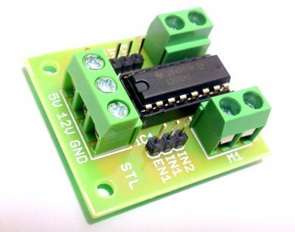
Module 9 : L293d MOTOR driver ic
The L293D is a popular 16-Pin Motor Driver IC.
It is mainly used to drive motors.
A single L293D IC is capable of running two DC motors at the same time; also the direction of these two motors can be controlled independently.

Slide 21
Experimental evaluation
Hardware Requirements :
ESP32 Microcontroller
Gas Sensor
Fire Sensor
Ultrasonic Sensor
PIR Sensor
GPS Module
Wheel Motors
Buzzer
Chassis
7805 IC
Laptop
An Android Smart Phone

Slide 22
EXPERIMENTAL evaluation
Software Requirements :
Windows 10
Arduino IDE
XAMPP
Bluetooth Electronics (App)

Slide 23
METHODOLOGY
PIR Sensor is used to detect any alive human beings.
GAS & FIRE Sensor is used to detect any gas or fire leakage.
GPS module gives the current latitude and longitude of that location.
BUZZER is used to give alarming sound.
ESP32 Microcontroller is used to control all the sensors.
Bluetooth App is used to control the wheels of the motor.

Slide 24
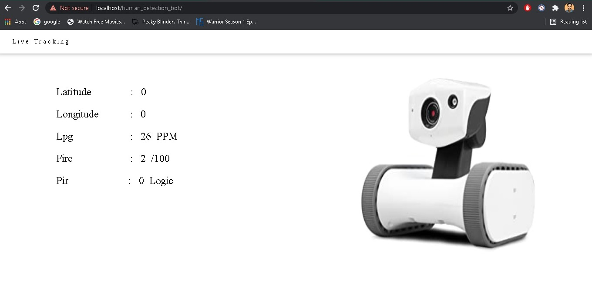
SCREENSHOTS
WEBSITE

Slide 25

SCREENSHOTS
BLUETOOTH ANDROID APP

Slide 26
Results and discussion
System performs all the functionalities as expected. This proposed system have met all the proposed requirements .
Expected Human detection and all other sensors are working perfectly.

Slide 27
FUTURE SCOPE
A camera is to be added to record live videos.
The robot can be used in the field of war to detect enemies and mines.
Battery capacity can be increased.
The robot can be made water-proof for detecting alive human beings during flood.

Slide 28
CONCLUSION
We have proposed a small ground robot for the search of alive victims in the remains of disaster sites. This robot is very helpful in searching the buried victim in no time more accurately and efficiently than any of the compared search and rescue robots.
There is no danger to risk worker's life during a search operation in risky scenarios. So the death rate of rescue workers is decreased significantly during search and rescue operation.
The implementation of this design is purely driven by usage of PIR sensor, fire sensor, Gas sensor and ultrasonic sensor etc.

Slide 29
THANK YOU

