Slide 1
GitHub Student Developer Pack
Learn to ship software like a pro. There's no substitute for hands-on experience. But for most students, real world tools can be cost-prohibitive. That's why we created the GitHub Student Developer Pack with some of our partners and friends: to give students free access to the best developer tools in one place so they can learn by doing.
Who are Eligible ?
To be eligible for the GitHub Student Developer Pack, you must:
Be currently enrolled in a degree or diploma-granting course of studies such as a high school, secondary school, college, university, homeschool, or similar educational institution.
Have a verifiable school-issued email address or upload documents (school ID, class schedule, transcript, affiliation or enrollment verification letter) that prove your current student status.
Have a GitHub user account. (Obviously!)
Be at least 13 years old.
If you are eligible for the offer you can get the pack. It might take few days to verify your information. Once your information is verified you will get access to tons of good dev tools and courses for free.

Slide 2
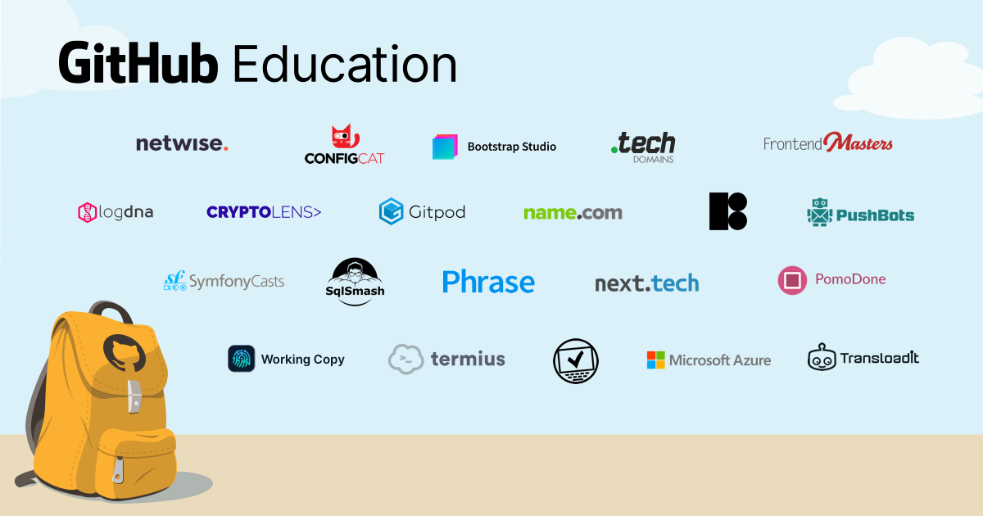
Pack Contents

Slide 3
How to Apply ?
For Students: https://education.github.com/discount_requests/student_application
For Faculty:
https://education.github.com/discount_requests/teacher_application
Enter Email id { personal / College Email }
Enter college Name
Answer the Question –
Use the below answer as a base and improvise
I plan to use the pack to learn various new technologies like cloud, Data Science, etc. and get hands-on Experience building various projects in fields like Web Development, GUI, Data Science and many more. I would make use of the resources to explore various domains....
Upload your ID Card photo and Done
If you answer well and use College Mail ID you would get the pack within 1 Hour else 23 Days.

Slide 4
Creating Personal Portfolio Websites
Use resources that you get through Student Developer Pack for Creating Awesome projects and Websites.
Link for Portfolio Templates:
https://colorlib.com/wp/resume-website-templates/ , https://templatemo.com/tag/resume
1: Use Namecheap, .tech Domain or name.com for Domain Name
2. Use GitHub Pages for Hosting Static Website
3. You can create Database Linked web applications using Heroku a cloud Platform
4. Various other resources to learn Cloud Computing, Data Science, Web Development, Graphic Design and lot more.

Slide 5
Thank you ☺

