Slide 1
AI-Driven Crop Disease Prediction and Management System
PIP4004 University Project
Review - 2
Batch Number: CSE_CAI_CAP_19
Name | Roll Number
Talla Sunil Kumar | 20211CAI0198
Challa Yogesh | 20211CAI0162
Salapakshi Sagar | 20211CAI0094
Gade Prathyusha | 20211CAI0200
Jampana Venkata Arjun Varma | 20211CAI0060
Under the Supervision of,
Dr. Afroz Pasha,
Assistant Professor Senior Scale,
School of Computer Science and Engineering,
Presidency University.
Name of the Program: CSE(AI&ML)
Name of the HoD: Dr. Zafar Ali Khan N
Name of the Program Project Coordinator: Dr. Afroz Pasha
Name of the School Project Coordinators: Dr. Sampath A K / Dr. Abdul Khadar A / Mr. Md Ziaur Rahman

Slide 2
Introduction
The AI-Driven Crop Disease Prediction and Management System is designed to help farmers detect and manage crop diseases early using artificial intelligence. The system uses deep learning and computer vision to analyze images of crops and identify diseases in real time.
Key features of the system include:
Image Annotation and Dataset Preparation (Roboflow): Collecting and labeling images of different crop diseases to train the model.
Deep Learning with CNNs: Using Convolutional Neural Networks (CNNs) to recognize disease symptoms from images.
Real-Time Disease Detection: Applying YOLOv8 and classification models like EfficientNet or ResNet for accurate disease identification.
Live Image Processing (OpenCV): Processing live video feeds from drones or smartphone cameras for quick disease detection.
Data Storage and Monitoring: Saving detection results in a database like MongoDB or Firebase for future analysis.
User-Friendly Application: Displaying disease type, severity, and treatment recommendations on a mobile or web app.
AI Chatbot for Support: Providing real-time advice on disease management, pesticide use, and farming best practices through a chatbot.
This system helps farmers take immediate action to protect their crops, improve yields, and reduce losses caused by plant diseases.

Slide 3
Literature Survey
Sl. No | Paper Title | Authors | Important Features | Drawbacks
1 | Recent Advances in Crop Disease Detection Using UAV and Deep Learning Techniques | Shahi, T. B., Xu, C.-Y., Neupane, A., & Guo, W. (2023) | Integration of UAVs with deep learning for disease monitoring. CNN-based analysis. | UAV battery and legal restrictions; high operational costs.
2 | Exploration of Machine Learning Approaches for Automated Crop Disease Detection | Singla, A., Nehra, A., Joshi, K., Kumar, A., Tuteja, N., Varshney, R.K., Gill, S.S., & Gill, R. (2024) | Analysis of ML models: CNNs, RNNs, SVMs, Random Forests for disease detection. | Challenges in data availability, imaging quality, and model adaptability.
3 | Deep Learning Based Plant Disease Detection for Smart Agriculture | Ale, L., Sheta, A., Li, L., Wang, Y., & Zhang, N. (2019) | Use of CNNs to automate plant disease detection in smart agriculture. | Requires large labeled datasets and high computational resources.
4 | A Comparative Study of Fine-Tuning Deep Learning Models for Plant Disease Identification | Too, E. C., Yujian, L., Njuki, S., & Yingchun, L. (2019) | Comparison of VGG, ResNet, Inception models. Benefits of transfer learning. | High computational costs and limited generalizability across diseases.
5 | Automatic and Reliable Leaf Disease Detection Using Deep Learning Techniques | Chowdhury, M. E. H., et al. (2021) | CNN-based approach for reliable leaf disease classification. | Performance is affected by image quality and dataset diversity.

Slide 4
Literature Survey
Sl. No | Paper Title | Authors | Important Features | Drawbacks
6 | Deep Learning-Based Leaf Disease Detection in Crops Using Images for Agricultural Applications | J., A., Eunice, J., Popescu, D. E., Chowdary, M. K., & Hemanth, J. (2022) | Utilizes CNNs for leaf disease detection with applications in agriculture. | Challenges in distinguishing between visually similar diseases.
7 | A Deep Learning Enabled Multi-Class Plant Disease Detection Model Based on Computer Vision | Roy, A. M., & Bhaduri, J. (2021) | Multi-class disease detection using CNNs. | Increased complexity, requiring more data and processing power.
8 | Machine Learning in Cereal Crops Disease Detection: A Review | Waldamichael, F. G., Debelee, T. G., Schwenker, F., Ayano, Y. M., & Kebede, S. R. (2022) | Overview of ML techniques for cereal crop disease detection. | Limited labeled datasets and symptom variations affect accuracy.
9 | Using Deep Learning for Image-Based Plant Disease Detection | Mohanty, S. P., Hughes, D. P., & Salathé, M. (2016) | Early work on CNN-based plant disease detection from leaf images. | Model robustness to varying conditions and data availability issues.
10 | An Advanced Deep Learning Models-Based Plant Disease Detection: A Review of Recent Research | Shoaib, M., Shah, B., et al. (2023) | Review of recent DL models for plant disease detection. | Challenges with imaging quality, data scarcity, and real-world deployment.

Slide 5
Literature Survey
Sl. No. | Paper Title | Authors | Important Features & Drawbacks
11 | Image-based Plant Diseases Detection using Deep Learning | Panchal, Patel, Bagyalakshmi, Khan, Soni (2021) | Uses CNNs for image-based plant disease detection. Drawbacks: Limited dataset scope.
12 | Plant Disease Detection and Classification by Deep Learning—A Review | Li, Zhang, Wang (2021) | Comprehensive survey of deep learning models. Drawbacks: Lacks experimental comparisons.
13 | Plant Disease Detection and Classification by Deep Learning | Saleem, Potgieter, Mahmood Arif (2019) | Focus on transfer learning for disease classification. Drawbacks: Computationally expensive.
14 | Plant Leaf Detection and Disease Recognition using Deep Learning | Militante, Gerardo, Dionisio (2019) | Utilizes IoT and deep learning for plant disease detection. Drawbacks: Real-time performance issues.
15 | Computer Vision, IoT, and Data Fusion for Crop Disease Detection | Ouhami, Hafiane, Es-Saady, El Hajji, Canals (2021) | Discusses IoT and data fusion techniques. Drawbacks: Integration challenges with existing systems.

Slide 6
Proposed Method
The proposed model for the AI-Driven Crop Disease Prediction and Management System is designed to detect and manage crop diseases in real-time using deep learning techniques and computer vision algorithms. The model incorporates the following key components and methodologies to ensure precise and timely detection of crop diseases and effective management strategies.
1. Image Annotation and Dataset Preparation (Roboflow):
The initial stage involves gathering and annotating images of various crop diseases. Using Roboflow, a large and diverse dataset of labeled images is prepared for training the model. These annotations include different disease symptoms on leaves, stems, and fruits, enabling the model to distinguish between healthy and diseased crops under different environmental conditions.
2. Convolutional Neural Networks (CNNs):
A CNN-based deep learning model is employed for feature extraction and disease classification. The CNN is trained to detect disease symptoms by processing the annotated images from the dataset. The CNN architecture allows the model to automatically learn spatial hierarchies of features through convolutional layers, which is particularly useful for detecting early-stage crop diseases.

Slide 7
Proposed Method
3. Crop Disease Detection:
The model uses Single Shot Detection (SSD) for real-time detection of disease-affected plant regions. Additionally, it integrates classification models such as EfficientNet or ResNet to accurately identify the type of disease affecting the crop. This helps in assessing the severity of the infection and suggesting immediate management strategies.
4. Real-Time ImageProcessing:
Once deployed on a drone, the model processes live video feeds using OpenCV for real-time image analysis and object detection. OpenCV helps in preprocessing the video frames by removing noise and enhancing image quality, ensuring better performance of the detection algorithms in real-world conditions.
5. Data Storage and Retrieval:
Detection results, including the locations of identified diseases, are stored in a database system such as MongoDB or Firebase. These results are essential for farmers and agricultural experts to track, assess, and monitor crop health over time. Additionally, storing images and detection results helps in post-analysis and improvement of disease management strategies.

Slide 8
Proposed Method
6. Output and Interface for Farmers and Agricultural Experts:
The final detection results, including the locations and conditions of humans and fire, are displayed on a control system for emergency responders. This interface provides a real-time view of the situation, enabling quicker decision-making and more effective rescue operations. The system ensures that rescue teams can access vital information, such as the number of people trapped, their locations, and fire sources, all of which are crucial for reducing casualties in fire emergencies.
7. Integration with AI Chatbot for Recommendations and Map features:
The system includes an AI-driven chatbot that provides real-time recommendations on disease treatment, pesticide use, and best farming practices. Using natural language processing (NLP), the chatbot interacts with farmers, answering queries regarding disease prevention and optimal crop management techniques.
In conclusion, the proposed AI-Driven Crop Disease Prediction and Management System effectively combines deep learning, computer vision, and real-time video analysis to deliver a robust solution for early disease detection and management in agriculture. By integrating advanced algorithms and mobile-based surveillance, the system can drastically improve crop yield and reduce losses caused by plant diseases.

Slide 9
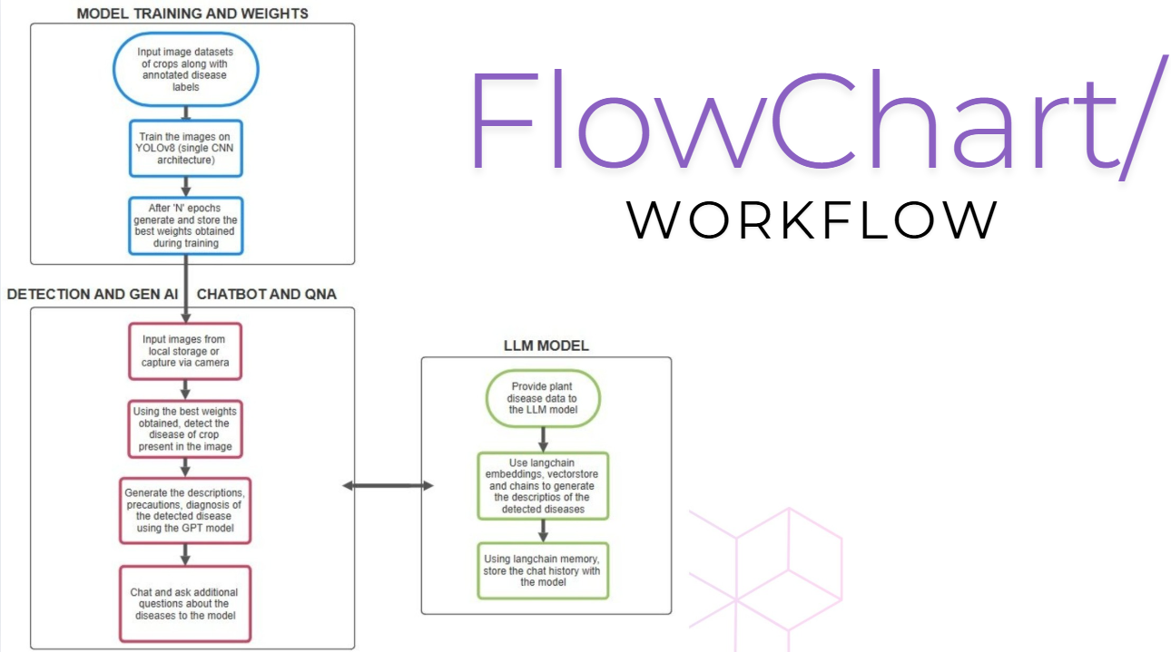
Architecture

Slide 10
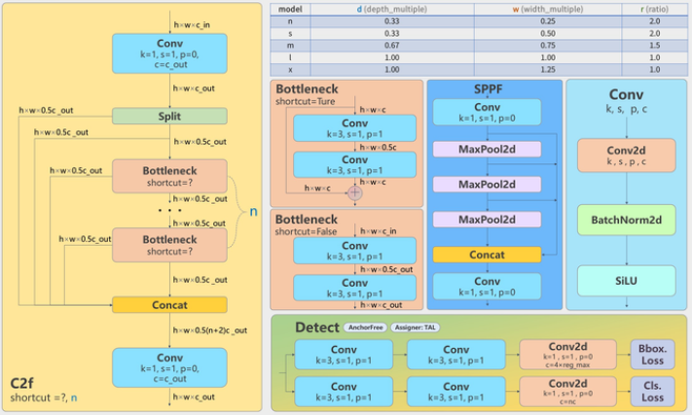
Architecture of YOLOv8

Slide 11
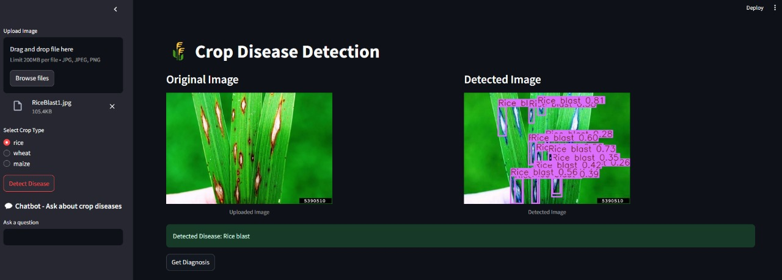
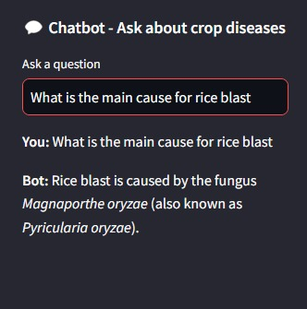
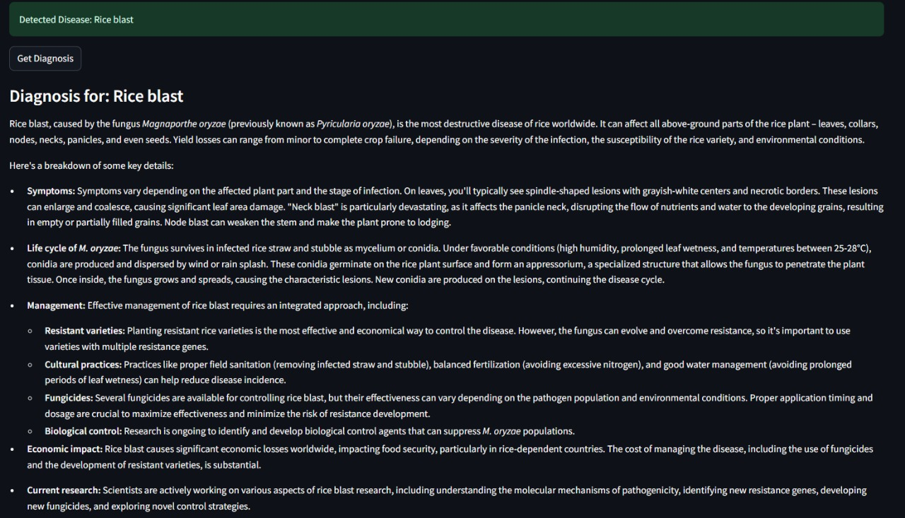
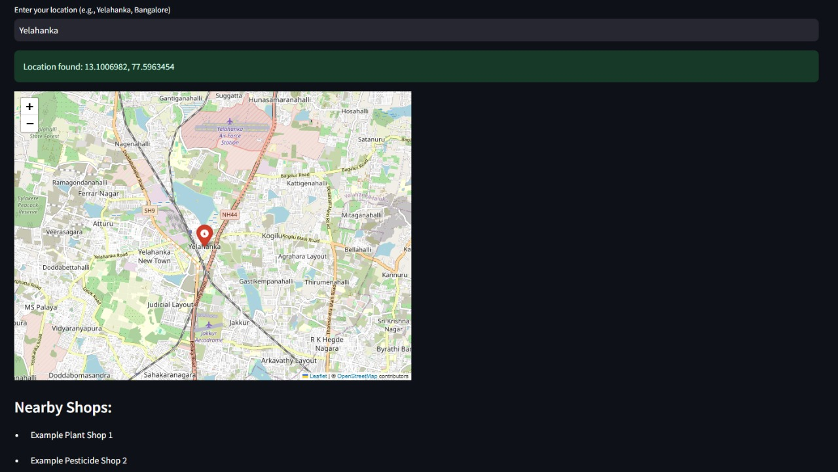
Sample Output

Slide 12
Hardware/software components
Software Requirements:
Operating System: Ubuntu/Windows for development and deployment.
Programming Language: Python for deep learning, image processing
Software Tools:
TensorFlow/PyTorch for training.
YOLOv8
OpenCV for image and video analysis.
Streamlit
Langchain, ChromaDB
Libraries:
TensorFlow/PyTorch, OpenCV, SSD (face detection), OpenPose (for pose estimation), Numpy, SciPy.
Hardware Requirements:
GPU: NVIDIA GPU for real-time deep learning inference.
RGB Camera: A high-resolution camera for capturing images in normal lighting conditions.

Slide 13
Timeline of the Project
Phase | Tasks | Review
Project Initiation | Define the project scope, conduct a literature review on AI-based crop disease detection, and finalize the technology stack. Identify suitable datasets and model architectures (YOLO, CNNs). | Review 0: Initial Plan Review
Research & Design | Gather images of diseased and healthy crops, preprocess the dataset (resizing, augmentation), and store it in Google Drive. Ensure proper labeling and annotation in roboflow for training. | Review 1: Research & Design Review
Model Development & Integration | Train YOLO models for detecting crop diseases, fine-tune hyperparameters, and evaluate model performance using precision, recall, and F1-score. Create vector embeddings for disease-related text data. | Review 2: Model Development & Integration Review
Model Development & Integration | Develop a Streamlit-based web app for disease detection, integrate trained models, and connect LangChain & GPT-4 for chatbot-based recommendations. Optimize API calls for efficiency. | Review 3: Testing & Simulation Review
Model Development & Integration | Test the web app with real images, deploy it on a cloud platform (Streamlit Cloud, Hugging Face Spaces), gather user feedback, refine the UI, and compile the final project report and research paper. | Final Viva: Overall System Validation & Paper submission

Slide 14
Github Link
https://github.com/arjundontflex/AI-based-Crop-Disease-Detection

Slide 15
References
Shahi, T. B., Xu, C.-Y., Neupane, A., & Guo, W. (2023). Recent Advances in Crop Disease Detection Using UAV and Deep Learning Techniques. Remote Sensing, 15(9), 2450. https://doi.org/10.3390/rs15092450
Singla, A., Nehra, A., Joshi, K., Kumar, A., Tuteja, N., Varshney, R.K., Gill, S.S., & Gill, R. (2024). Exploration of machine learning approaches for automated crop disease detection. Current Plant Biology.
Ale, L., Sheta, A., Li, L., Wang, Y., & Zhang, N. (2019). Deep Learning Based Plant Disease Detection for Smart Agriculture. 2019 IEEE Globecom Workshops (GC Wkshps), 1-6.
Edna Chebet Too, Li Yujian, Sam Njuki, and Liu Yingchun. 2019. A comparative study of fine-tuning deep learning models for plant disease identification. Comput. Electron. Agric. 161, C (Jun 2019), 272–279. https://doi.org/10.1016/j.compag.2018.03.032
Chowdhury, M. E. H., Rahman, T., Khandakar, A., Ayari, M. A., Khan, A. U., Khan, M. S., Al-Emadi, N., Reaz, M. B. I., Islam, M. T., & Ali, S. H. M. (2021). Automatic and Reliable Leaf Disease Detection Using Deep Learning Techniques. AgriEngineering, 3(2), 294-312. https://doi.org/10.3390/agriengineering3020020
J., A., Eunice, J., Popescu, D. E., Chowdary, M. K., & Hemanth, J. (2022). Deep Learning-Based Leaf Disease Detection in Crops Using Images for Agricultural Applications. Agronomy, 12(10), 2395. https://doi.org/10.3390/agronomy12102395
Roy, A. M., & Bhaduri, J. (2021). A Deep Learning Enabled Multi-Class Plant Disease Detection Model Based on Computer Vision. AI, 2(3), 413-428. https://doi.org/10.3390/ai2030026
Waldamichael, F. G., Debelee, T. G., Schwenker, F., Ayano, Y. M., & Kebede, S. R. (2022). Machine Learning in Cereal Crops Disease Detection: A Review. Algorithms, 15(3), 75. https://doi.org/10.3390/a15030075
Mohanty, S. P., Hughes, D. P., & Salathé, M. (2016). Using Deep Learning for Image-Based Plant Disease Detection. Frontiers in plant science, 7, 1419. https://doi.org/10.3389/fpls.2016.01419
Shoaib, M., Shah, B., Ei-Sappagh, S., Ali, A., Ullah, A., Alenezi, F., Gechev, T., Hussain, T., & Ali, F. (2023). An advanced deep learning models-based plant disease detection: A review of recent research. Frontiers in plant science, 14, 1158933. https://doi.org/10.3389/fpls.2023.1158933
Panchal, Adesh & Patel, Subhash & Bagyalakshmi, K & Khan, Ehtiram & Soni, Mukesh. (2021). Image-based Plant Diseases Detection using Deep Learning. Materials Today: Proceedings. 80. 10.1016/j.matpr.2021.07.281.
Li, Lili & Zhang, Shujuan & Wang, Bin. (2021). Plant Disease Detection and Classification by Deep Learning—A Review. IEEE Access. PP. 1-1. 10.1109/ACCESS.2021.3069646.
Saleem, M. H., Potgieter, J., & Mahmood Arif, K. (2019). Plant Disease Detection and Classification by Deep Learning. Plants (Basel, Switzerland), 8(11), 468. https://doi.org/10.3390/plants8110468
S. V. Militante, B. D. Gerardo and N. V. Dionisio, "Plant Leaf Detection and Disease Recognition using Deep Learning," 2019 IEEE Eurasia Conference on IOT, Communication and Engineering (ECICE), Yunlin, Taiwan, 2019, pp. 579-582, doi: 10.1109/ECICE47484.2019.8942686.
Ouhami, M., Hafiane, A., Es-Saady, Y., El Hajji, M., & Canals, R. (2021). Computer Vision, IoT and Data Fusion for Crop Disease Detection Using Machine Learning: A Survey and Ongoing Research. Remote Sensing, 13(13), 2486. https://doi.org/10.3390/rs13132486

Slide 16


