Slide 1
CSE 2027-Fundamental of Data Analysis
Module: 3: Data Collection, Processing and Analysis
Collection of Primary Data( Observation Method, Interview Method, Collection of Data through Questionnaires ,Collection of Data through Schedule) Difference between Questionnaires and Schedules, Some Other Methods of Data Collection, Collection of Secondary Data ,Difference between Survey and Experiment Processing Operations, correlation.

Slide 2
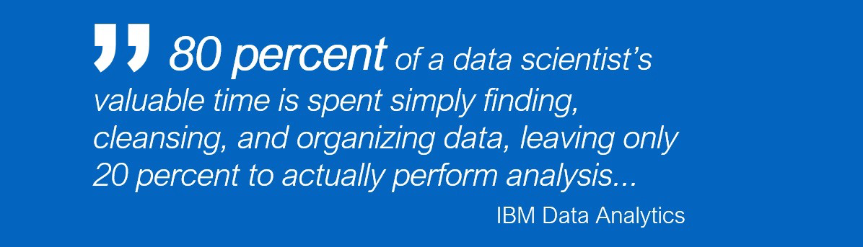

Slide 3
Definition
Data collection is a term used to describe a process of preparing and collecting data. Systematic gathering of data for a particular purpose from various sources, that has been systematically observed, recorded, organized.
Data are the basic inputs to any decision making process in business

Slide 4
PURPOSE OF DATA COLLECTION
To obtain information
To record
To take decisions about important issues
To pass information on to others

Slide 5
CLASSIFICATION OF DATA
Primary Data
Secondary Data

Slide 6
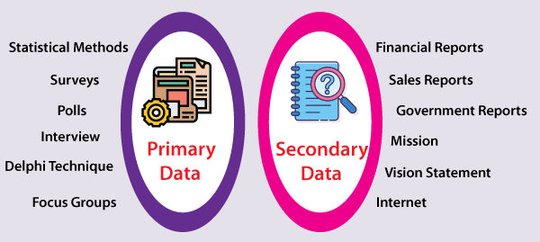
Primary and Secondary Data

Slide 7
PRIMARY DATA
The data which are collected from the field under the control and supervision of an investigator
Primary data means original data that has been collected specially for the purpose in mind
This type of data are generally afresh and collected for the first time
It is useful for current studies as well as for future studies
For example: your own questionnaire.

Slide 8
Primary
Research
Quantitative Data
Qualitative Data
Focus groups
Surveys
Personal interview (intercepts)
Mail
In-house, self- administered
Telephone, fax, e-mail, Web
Experiments
Individual depth
interviews
Mechanical
observation
Human observation
Simulation
Case Studies

Slide 9
Primary Research Methods & Techniques
Quantitative and Qualitative Information:
Quantitative – based on numbers – 56% of 18 year olds go for a trip at least four times a year - doesn’t tell you why, when, how.
Qualitative – more detail – tells you why, when and how!

Slide 10
Methods of Primary Data Collection
OBSERVATION METHOD
INTERVIEW METHOD
QUESTIONNAIRE
SCHEDULE

Slide 11

Observation Method

Slide 12
Observation Method
It is commonly used in studies relating to behavioral science.
Under this method observation becomes scientific tool and the method of data collection for the researcher, when it serves a formulated research purpose and is systematically planned and subjected to checks and controls.

Slide 13
Observation Method
(a) Structured (descriptive) and unstructured (exploratory) observation-
  When a observation is characterized by careful definition of units to be observed, style of observer, conditions of or observation and selection of pertinent data of observation it is a structured observation.
  When there characteristics are not thought of in advance or not present. it is a unstructured observation.

Slide 14
Observation Method
(b) Participant, Non-participant and disguised observation-
  When the observer observes by making himself more or less, the member of the group he is observing, it is participant observation but when the observer observes by detaching himself from the group under observation it is non participant observation.
  If the observer observes in such manner that his presence is unknown to the people he is observing it is disguised observation.

Slide 15
Observation Method
(c)Controlled(laboratory) and uncontrolled(exploratory)
  If the observation takes place in the natural setting it is a uncontrolled observation but when observation takes place according to some pre-arranged plans, involving experimental procedure it is a controlled observation.

Slide 16
Observation Method
Advantages-
  Subjective bias is eliminated.
  Data is not affected by past behavior or future intentions.
  Natural behavior of the group can be recorded.
Limitations-
  Expensive methodology.
  Information provided is limited.
  Unforeseen factors may interfere with the observational task

Slide 17

Interview Method

Slide 18
Interview Method
This method of collecting data involves presentation of oral verbal stimuli and deeply in terms of oral- verbal responses. It can be achieved by two ways:-
(A) Personal interview-
It requires a person known as interviewer to ask questions generally in a face to face contact to the other person. It can be –
Direct personal investigation- The interviewer has to collect the information personally from the services concerned.
Indirect oral examination- The interviewer has to cross examine other persons who are suppose to have a knowledge about the problem.
Structured interviews- Interviews involving the use of pre-determined questions and of highly standard techniques of recording
Unstructured interviews- It does not follow a system of pre-determined questions and is characterized by flexibility of approach to questioning.

Slide 19
Interview Method
Focused interview- It is meant to focus attention on the given experience of the respondent and its effect. The interviewer may ask questions in any manner or sequence with the aim to explore reasons and motives of the respondent.
Clinical interviews- It is concerned with broad underlying feeling and motives or individuals life experience which are used as method to collect information under this method at the interviewer direction.
Non directive interview- The interviewer`s function is to encourage the respondent to talk about the given topic with a bare minimum of direct questioning.
(B) Telephonic interviews- It requires the interviewer to collect information by contacting respondents on telephone and asking questions or opinions orally.

Slide 20
Advantages and Disadvantages
Advantages-
More information and in depth can be obtained.
Samples can be controlled.
There is greater flexibility under this method
Personal information can as well be obtained.
Mis-interpretation can be avoided by unstructured interview.
Limitations
It is an expensive method.
More time consuming.
Possibility of imaginary info and less frank responses.
High skilled interviewer is required

Slide 21

Questionnaire

Slide 22
Questionnaire
In this method a questionnaire is sent (mailed) to the concerned respondents who are expected to read, understand and reply on their own and return the questionnaire. It consists of a number of questions printed or typed in a definite order on a form or set of forms.
It is advisable to conduct a ‘pilot study’ which is the rehearsal of the main survey by experts for testing the questionnaire for weaknesses of the questions and techniques used.

Slide 23
Essential of a good questionnaire-
It should be short and simple.
Questions should processed in a logical sequence.
Technical terms expression must be avoided.
Control questions to check the reliability of the respondent must be present.
Adequate space for answers must be provided.
Brief directions with regard to filling up of questionnaire must be provided.
The physical appearances-quality of paper, color etc must be good to attract the attention of the respondent

Slide 24
Advantages and Limitations
Advantages
  Free from bias of interviewer.
  Respondents have adequate time to give answers
  Respondents are easily and conveniently approachable
  Large samples can be used to be more reliable.
LIMITATIONS
  Low rate of return of duly filled questionnaire.
  Control over questions is lost once it is sent.
  It is inflexible once it is sent.
  Possibility of ambiguous omission of replies.
  Time taking and slow process.

Slide 25
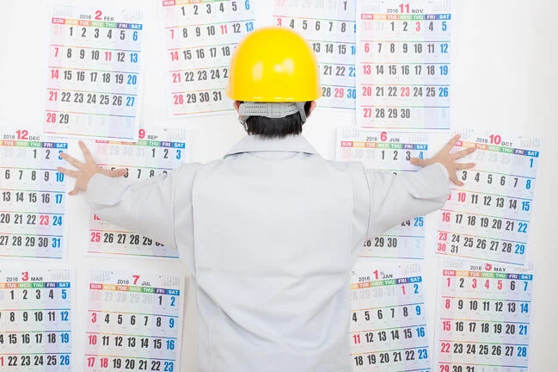
SCHEDULE

Slide 26
Schedule
The schedule is a proforma which contains a list of questions filled by the research workers or enumerators, specially appointed for the purpose of data collection.
Enumerators go to the informants with the schedule, and ask them the questions from the set, in the sequence and record the replies in the space provided. There are certain situations, where the schedule is distributed to the respondents, and the enumerators assist them in answering the questions.
Enumerators play a major role in the collection of data, through schedules.

Slide 27
Schedule
They explain the aims and objects of the research to the respondents and interpret the questions to them when required.
This method is little expensive as the selection, appointment and training of the enumerators require a huge amount.
It is used in case of extensive enquiries conducted by the government agencies, big organizations. Most common example of data collection through schedule is population census.

Slide 28
Enumerator
An enumerator is a trained person who collects information and performs all the field work related with the collection of data. They help the respondents in filling the questionnaire in case of illiterate population.

Slide 29
Suitability of Enumerators :
Wide Area: Enumerators are used when the region to be covered is wide and respondents are dispersed.
No Additional Inquiry: No additional inquiry is required to perform this type of method.
Control: The administration of enumerators is modest and effectively accessible.
Training: Enumerators are trained persons in order to collect data. They guide respondents in filling the questionnaire.

Slide 30
Merits of Enumerators:
Uneducated Persons: As the enumerator, himself tops the questionnaire, he/she can be utilized in those cases where the target population is not proficient.
Assistance: Respondents can address perplexing and troublesome inquiries with the assistance of the enumerators.
Less Chance of Bias: It leaves little scope for the poll to be biased.
Reliability: The data collected is more reliable and correct.
Responsiveness: There is less chance of non-response as the enumerator visits personally to the people.

Slide 31
Demerits of Enumerators :
Costly: It is a costly method and requires a lot of money.
Time Consuming: It is a very time-consuming process.
Skilled Personnel: The outcome of this technique relies upon the accessibility of prepared and skilled enumerators.
Personal Bias: The inclination of enumerators could impact the result of data.
Affordability: It can only be afforded by big organisations.

Slide 32
Advantages & Disadvantages of Primary Data
Advantages
  Targeted Issues are addressed
  Data interpretation is better
  Efficient Spending for Information
  Decency of Data
  Proprietary Issues
  Addresses Specific Research Issues
  Greater Control

Slide 33
Advantages & Disadvantages of Primary Data
Disadvantages
  High Cost
  Time Consuming
  Inaccurate Feed-backs
  More number of resources is required

Slide 34
SECONDARY DATA
Data gathered and recorded by someone else prior to and for a purpose other than the current project
Secondary data is data that has been collected for another purpose.
It involves less cost, time and effort
Secondary data is data that is being reused. Usually in a different context.
For example: data from a book.

Slide 35
Sources
INTERNAL SOURCES
Internal sources of secondary data are usually for marketing application-
Sales Records
Marketing Activity
Cost Information
Distributor reports and feedback
Customer feedback

Slide 36
Sources
EXTERNAL SOURCES
External sources of secondary data are usually for Financial application-
Journals
Books
Magazines
Newspaper
Libraries
The Internet

Slide 37
Advantages & Disadvantages of Secondary Data
Advantages
  Ease of Access
  Low Cost to Acquire
  Clarification of Research Question
  May Answer Research Question

Slide 38
Advantages & Disadvantages of Secondary Data
Disadvantages
  Quality of Research
  Not Specific to Researcher’s Needs
  Incomplete Information
  Not Timely

Slide 39
Comparison Questionnaire and Schedule
BASIS FOR COMPARISON | QUESTIONNAIRE | SCHEDULE
Meaning | Questionnaire refers to a technique of data collection which consist of a series of written questions along with alternative answers. | Schedule is a formalized set of questions, statements and spaces for answers, provided to the enumerators who ask questions to the respondents and note down the answers.
Filled by | Respondents | Enumerators
Response Rate | Low | High
Coverage | Large | Comparatively small
Cost | Economical | Expensive
Respondent's identity | Not known | Known
Success relies on | Quality of the questionnaire | Honesty and competence of the enumerator.
Usage | Only when the people are literate and cooperative. | Used on both literate and illiterate people.

Slide 40
EXPERIMENTS AND SURVEYS
Surveys and Experiments are two important statistical techniques used in research and data collection. When the research type is experimental, experiments are considered as a major source of primary data. On the other end, surveys are performed when the research is descriptive in nature.

Slide 41
Definition of Survey
By the term survey, we mean a method of securing information relating to the variable under study from all or a specified number of respondents of the universe.
It may be a sample survey or a census survey. This method relies on the questioning of the informants on a specific subject. Survey follows structured form of data collection, in which a formal questionnaire is prepared, and the questions are asked in a predefined order.

Slide 42
Definition of Experiment
The term experiment means a systematic and logical scientific procedure in which one or more independent variables under test are manipulated, and any change on one or more dependent variable is measured while controlling for the effect of the extraneous variable.
Here extraneous variable is an independent variable which is not associated with the objective of study but may affect the response of test units.

Slide 43
Experiment
In an experiment, the investigator attempts to observe the outcome of the experiment conducted by him intentionally, to test the hypothesis or to discover something or to demonstrate a known fact.
An experiment aims at drawing conclusions concerning the factor on the study group and making inferences from sample to larger population of interest

Slide 44
Comparison Between Survey and Experiment
BASIS FOR COMPARISON | SURVEY | EXPERIMENT
Meaning | Survey refers to a technique of gathering information regarding a variable under study, from the respondents of the population. | Experiment implies a scientific procedure wherein the factor under study is isolated to test hypothesis.
Used in | Descriptive Research | Experimental Research
Samples | Large | Relatively small
Suitable for | Social and Behavioral sciences | Physical and natural sciences
Example of | Field research | Laboratory research
Data collection | Observation, interview, questionnaire, case study etc. | Through several readings of experiment.

Slide 45
Correlation
Correlation is the degree of inter-relatedness among two or more variables.
Correlation analysis is a process to find out the degree of relationship between two or more variables by applying various statistical tools and techniques.
According to Conner
“if two or more quantities vary in sympathy, so that movement in one tend to be accompanied by corresponding movements in the other , then they said to be correlated.”

Slide 46
Types of Correlation
Positive Correlation –
  When the values of the two variables move in the same direction so that an increase/decrease in the value of one variable is followed by an increase/decrease in the value of the other variable.
Negative Correlation –
  When the values of the two variables move in the opposite direction so that an increase/decrease in the value of one variable is followed by decrease/increase in the value of the other variable.
No Correlation –
  When there is no linear dependence or no relation between the two variables.

Slide 47
Correlation Coefficient, r
The correlation coefficient, r, is a measure that describes the extent of the statistical relationship between two ratio level variables.
The correlation coefficient is scaled so that it is always between -1 and +1.
When r is close to 0 this means that there is little relationship between the variables and the farther away from 0 r is, in either the positive or negative direction, the greater the relationship between the two variables.

Slide 48
Scatter Diagram
A scatter diagram is a diagram that shows the values of two variables X and Y, along with the way in which these two variables relate to each other.
The values of variable X are given along the horizontal axis, with the values of the variable Y given on the vertical axis.
Later, when the regression model is used, one of the variables is defined as an independent variable, and the other is defined as a dependent variable.

Slide 49
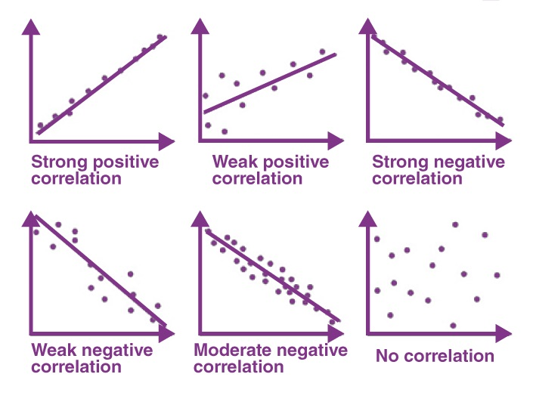
The scatter plot explains the correlation between the two attributes or variables. It represents how closely the two variables are connected. There can be three such situations to see the relation between the two variables .

Slide 50


