Slide 1
CSE 2027-Fundamental of Data Analysis
Module: 4: Data Visualization and Charting
Types of charts and their significance, Organize data interactively with tables , Visualizing data with charts, Analyzing data with pivot tables, Build presentation ready dashboards and turn real world data into business insights, Tracking trends and making forecasts, Interpretation and report writing.

Slide 2
Introduction to Excel Data Visualization
Excel is widely used for data analysis owing to the excellent data visualization features that it offers. The data visualization capability of Excel allows building insightful visualizations.

Slide 3
Various Types of Visualizations in Excel
Every chart in Excel has its own significance. Excel provides a good number of built-in charts, which can be beautifully leveraged so as to make the right use of data.

Slide 4
1. Column Chart
It is a very simple chart type that presents data in the form of vertical bars. First, to build a column chart, select the data, and then select the required option from the Column chart option, as can be seen below. As we can see, various options are there in the Column chart, and the requisite one should be selected.

Slide 5
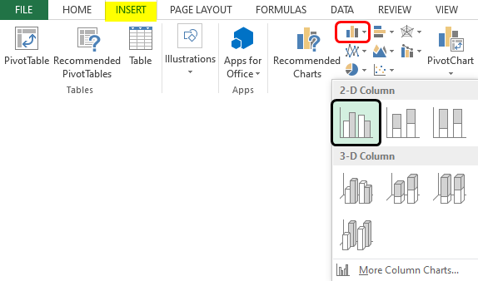

Slide 6
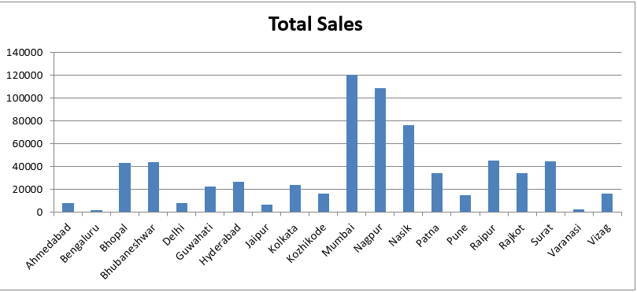
When we follow the above procedure, a column chart is created, as shown in the below screenshot. It is a very simple column chart that gives us region-wise total sales. The chart can be formatted as needed.

Slide 7
2. Line Chart
This chart is useful for observing trends. E.g. in this case, we have quarter wise data for two cities, and we shall compare the sales trend over the quarters for these two cities. First, to build a line chart, select the data, and then select the requisite line chart option as shown below.

Slide 8
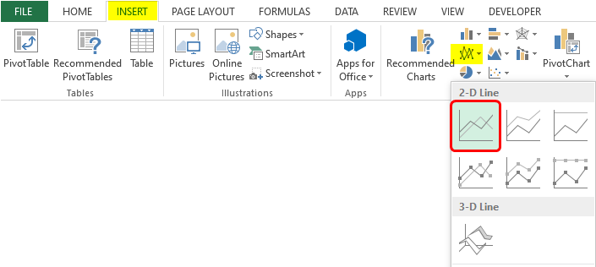

Slide 9
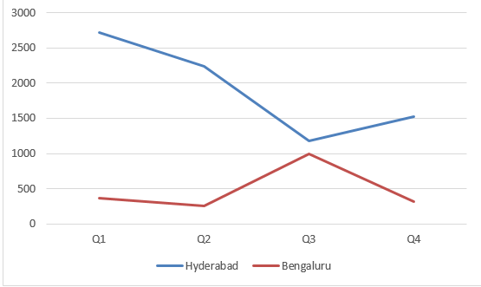
Following the above procedure leads to the creation of a line chart, as shown below:

Slide 10
3. Pie Chart
Pie Chart gives the contribution of a category, e.g., we shall build a pie chart to determine each quarter’s percentage contribution in total sales. To create a pie chart, select the requisite columns, and click on the required pie chart option from the Pie option as shown below.

Slide 11
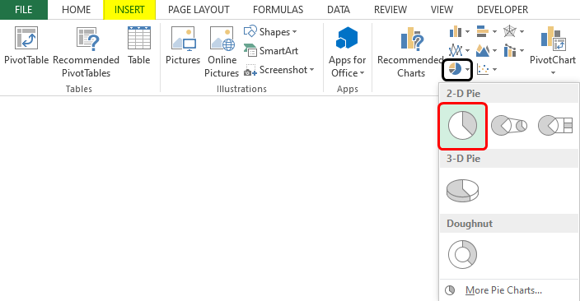

Slide 12
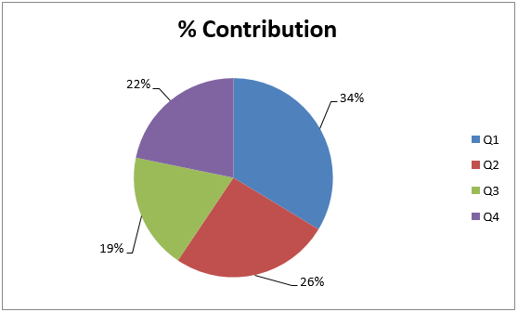
As a result of following the above procedure, a pie chart is created, which can be seen below. The pie chart gives us a quick insight into the percentage contribution.

Slide 13
4. Bar Chart
This chart type is no different than a column chart, only that here we have horizontal bars. In order to build a horizontal bar, select the requisite bar chart option from the Bar option as shown in the following screenshot.

Slide 14
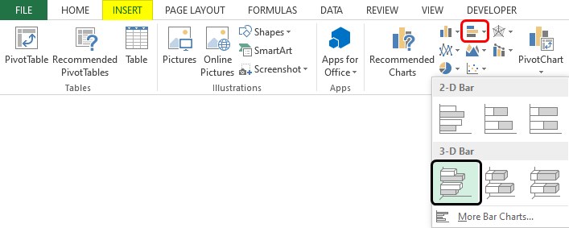

Slide 15
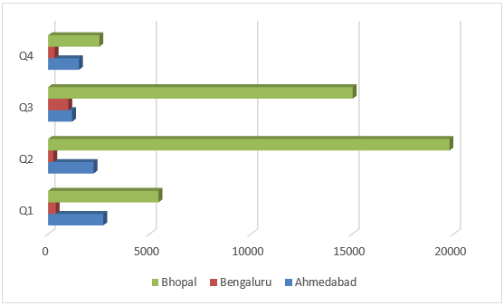
As we can see in the above screenshot, we selected clustered bar in 3-D, which gave us a clustered 3-D bar graph, as shown in the following screenshot. Using this visualization, we can compare sales for three cities for four quarters.

Slide 16
5. Area Chart
This chart represents the trend of a measure for various categories over a period of time. The chart makes use of areas to present the data. In order to generate an area chart, we shall follow the steps as mentioned in the below screenshot.

Slide 17
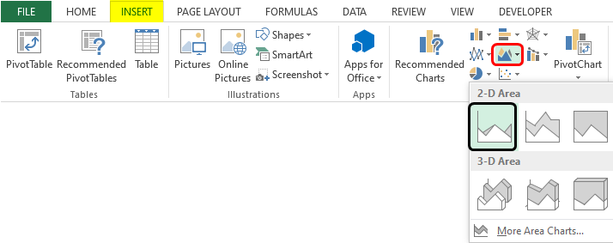

Slide 18
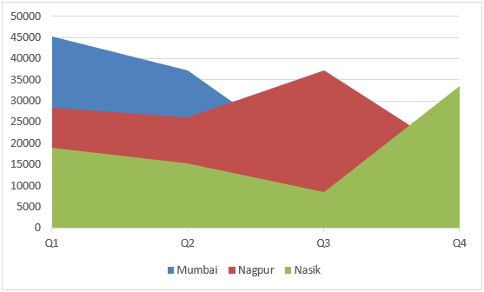
From the Area option, selected the requisite Area chart option. As a result, we got the following chart, as shown by the following screenshot. The area chart gives us a quick insight into the sales trend over the quarters for the three cities.

Slide 19
6. Scatter Chart
This chart helps in determining the relation between two variables. It is also referred to as the X-Y chart. The chart requires two series and takes individual corresponding values as x and y coordinates. In order to build a scatter plot, first, select the data and then select the requisite scatter plot option, as can be seen in the following screenshot.

Slide 20
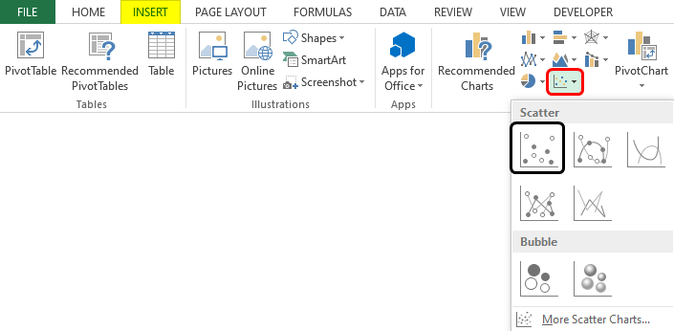

Slide 21
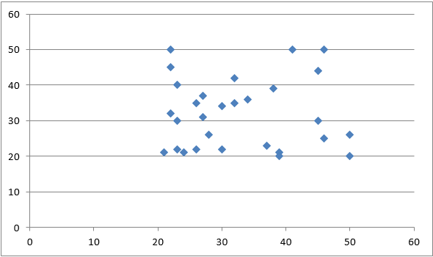
Following the above procedure leads to the creation of a scatter plot. As we can see, the pattern formed by the scatter plot allows us to derive insights based on the context.

Slide 22
7. Stock Chart
These are special types of charts that are used for stock price analysis. In order to build a stock chart, select the data and select the requisite stock chart option, as shown in the following screenshot.

Slide 23
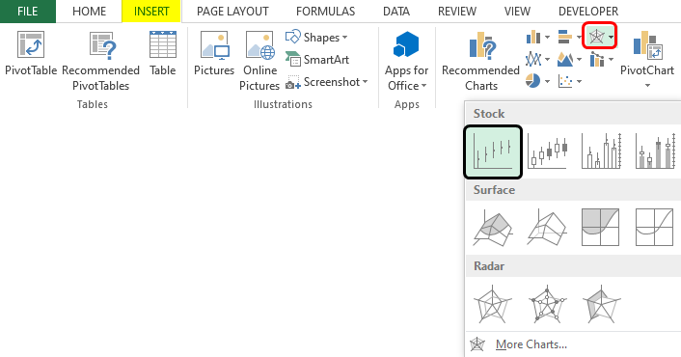

Slide 24
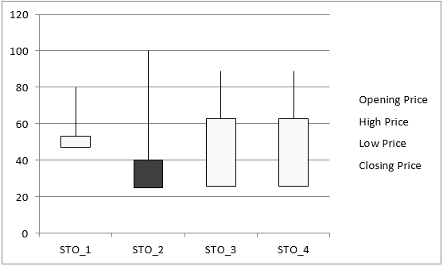
As can be seen in the above screenshot, Open-High-Low-Close stock chart. This chart requires that the Opening Price, High Price, Low Price, and Closing Price of stocks must be defined in the order. Each of the chart options in the Stock chart requires a different set of inputs. When the chart is built, it looks like as shown below.

Slide 25
8. Doughnut Chart
This chart is a type of pie chart, only that it is represented in the shape of a doughnut. Building this chart is quite simple. Select the data over which the chart needs to be built, and then from the other chart option, select the required option from the two doughnut options. This is as shown in the below screenshot.

Slide 26
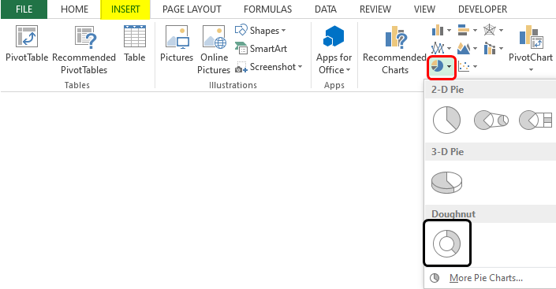

Slide 27
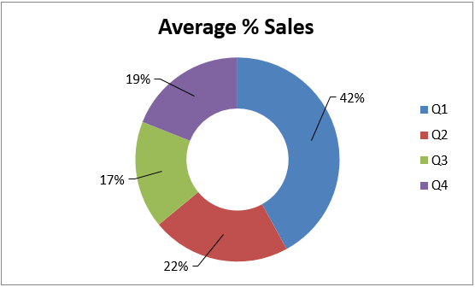
The above procedure leads to the creation of the doughnut chart, which is as shown below. The doughnut chart gives us an idea of the average % contribution in total sales. The middle space in the doughnut chart can be used to write a meaningful text that conveys some insight.

Slide 28
9. Bubble Chart
Bubble charts, though complex, can be beautifully used to derive insights from data. This chart takes into consideration three values.
Two of the three dimensions are used for representing X-axis and Y-axis, respectively, and the third value determines the size of the bubble. We shall build a bubble chart using the method as illustrated below.

Slide 29
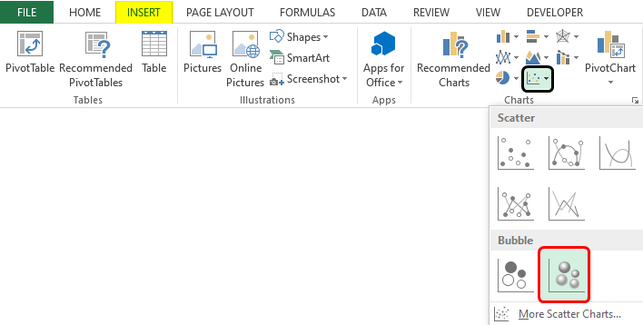

Slide 30
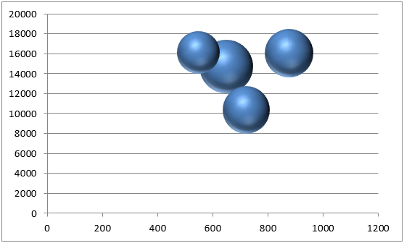
As can be seen in the above screenshot, we selected a bubble chart with a 3-D effect. Note that we selected numeric data only from the table for building the bubble chart, which can be seen in the screenshot. When we follow the above method, we get a bubble chart, as shown below.

Slide 31
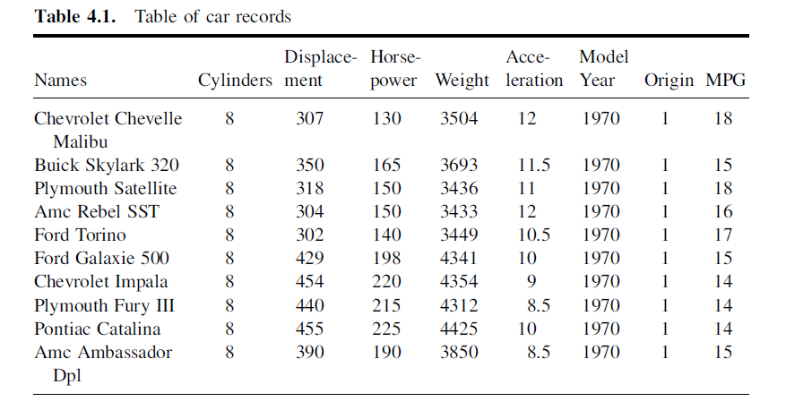
Organize data interactively with Tables
Data Tables: The most common way of looking at data is through a table, where the raw data is displayed in familiar rows of observations and columns of variables. It is essential for reviewing the raw data

Slide 32
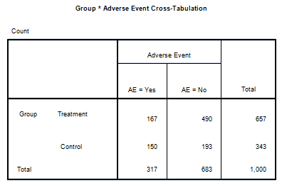
Organize data interactively with Tables
Contingency Tables : Also referred to as two-way cross-classification tables provide insight into the relationship between two variables. The variables must be categorical or transformed to a categorical variable.

Slide 33
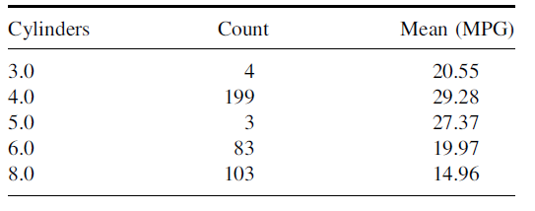
Organize data interactively with Tables
Summary Table: A summary table (or aggregate table) is a common way of understanding data. Summary tables will often show a count of the number of observations (or percentage) that have that particular value (or range).
Any number of other variables can be shown alongside. Since each row now refers to a set of observations, any other columns of variables must now contain summary information. Descriptive statistics that summarize a set of observations can be used.

Slide 34
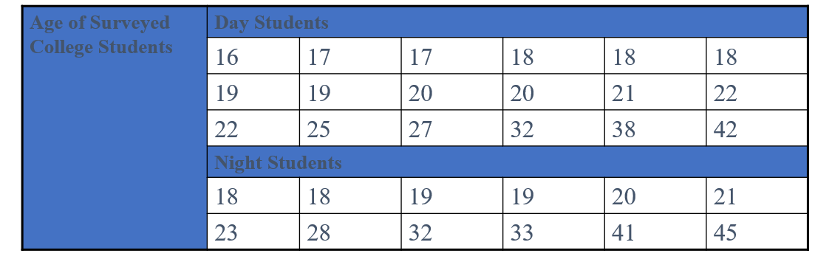
Organize data interactively with Tables
An ordered array is a sequence of data, in rank order, from the smallest value to the largest value

Slide 35
Organize data interactively with Tables
The frequency distribution is a summary table in which the data are arranged into numerically ordered class groupings.
You must give attention to selecting the appropriate number of class groupings for the table, determining a suitable width of a class grouping, and establishing the boundaries of each class grouping to avoid overlapping.
To determine the width of a class interval, you divide the range (Highest value–Lowest value) of the data by the number of class groupings desired.

Slide 36
Organize data interactively with Tables
Example: A manufacturer of insulation randomly selects 20 winter days and records the daily high temperature
24, 35, 17, 21, 24, 37, 26, 46, 58, 30, 32, 13, 12, 38, 41, 43, 44, 27, 53, 27

Slide 37
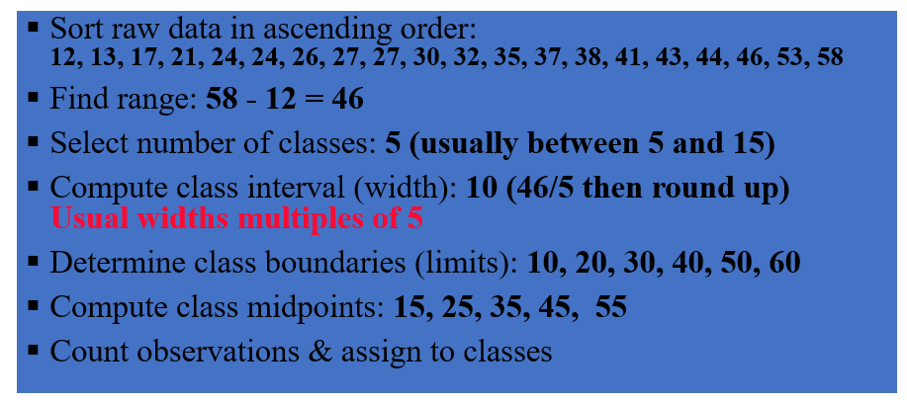

Slide 38
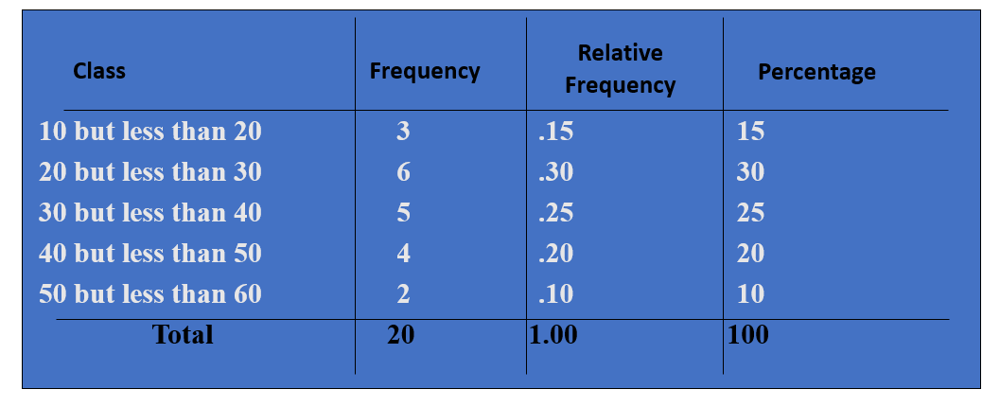

Slide 39
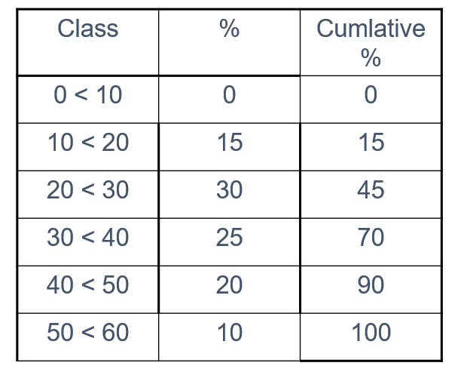
Organize data interactively with Tables
Cumulative frequency tabulation is performed from a frequency table by adding each frequency to the total of frequencies of all data values before it in the data set.

Slide 40
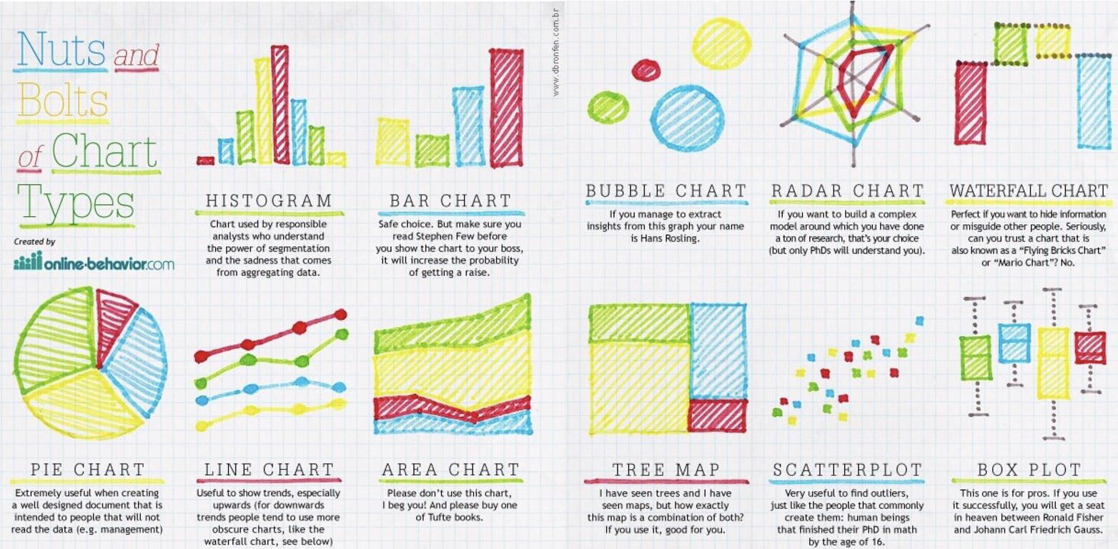
Visualizing Data with Charts

Slide 41
Visualization: Principles of Excellent Graphs
The graph should not distort the data.
The graph should not contain unnecessary adornments (sometimes referred to as chart junk).
The scale on the vertical axis should begin at zero.
All axes should be properly labeled.
The graph should contain a title.
The simplest possible graph should be used for a given set of data.

Slide 42
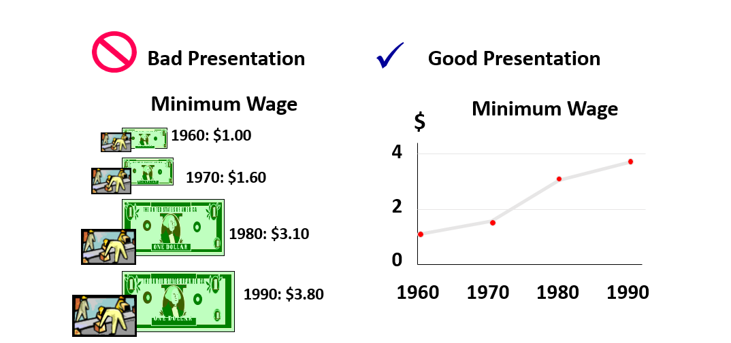
Graphical Errors: Chart Junk

Slide 43
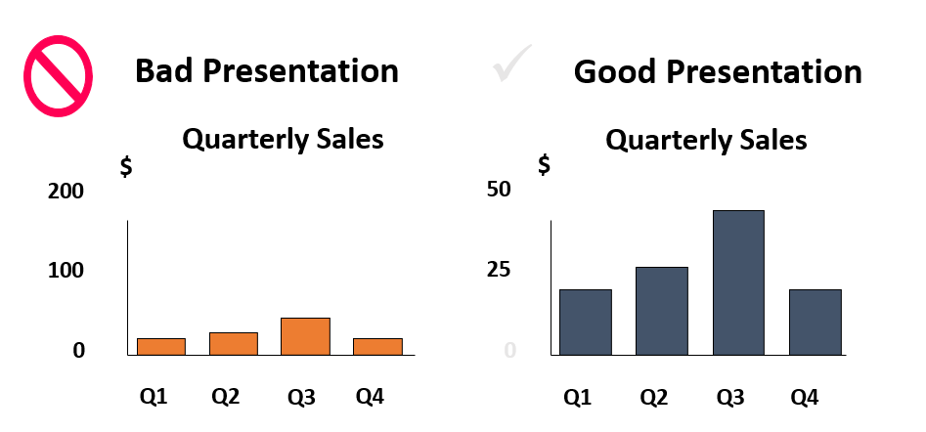
Graphical Errors: Compressing the Vertical Axis

Slide 44
Analyzing Data With Pivot Tables
If you want to see at a glance the trends, patterns, and meaning behind your data, then PivotTable reports are for you.
Imagine an Excel worksheet of company sales figures with thousands of rows of data. Everyone has questions about what the data means. How do you get answers quickly and easily?
PivotTable reports summarize and organize data into different views that present comparisons, reveal patterns and relationships, and analyze trends. Let’s find out how PivotTable reports make it so easy.

Slide 45
Analyzing Data With Pivot Tables
With a PivotTable report, you decide what data you want to be analyzed, and how to organize it.
Instead of a single arbitrary form that doesn’t really suit your needs, each PivotTable report gives you a different view of your data that is customized to your purposes and answers your questions on the spot.

Slide 46
Analyzing Data With Pivot Tables
Creating a PivotTable report is about moving pieces of information around to see how they fit together.
Not satisfied with the first report? It just takes a couple of seconds to pivot rows and columns into a different arrangement, a bit like turning a kaleidoscope to see different patterns.

Slide 47
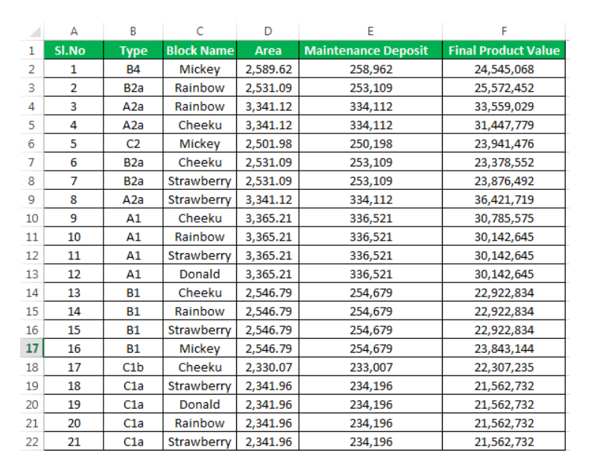
Pivot Table: Example

Slide 48
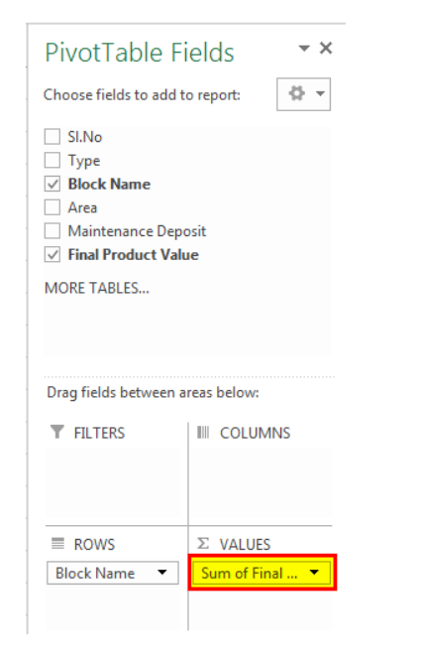
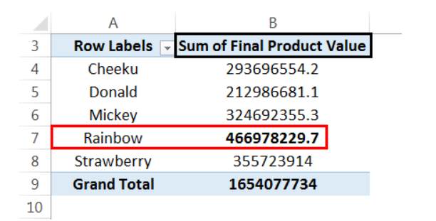
Pivot Table: Example

Slide 49
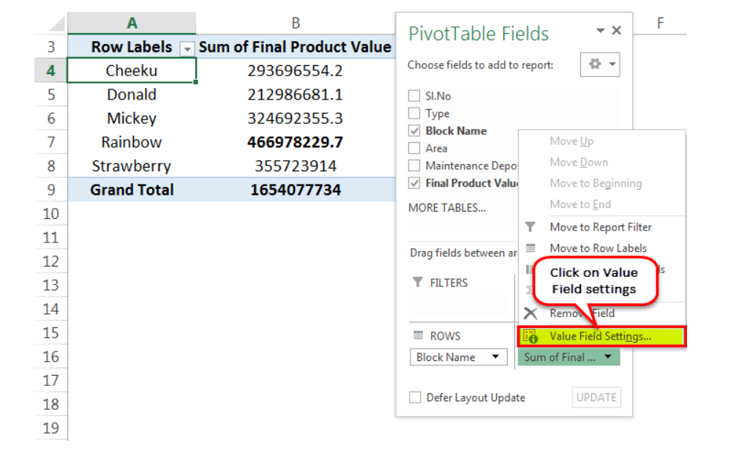
Pivot Table: Example

Slide 50
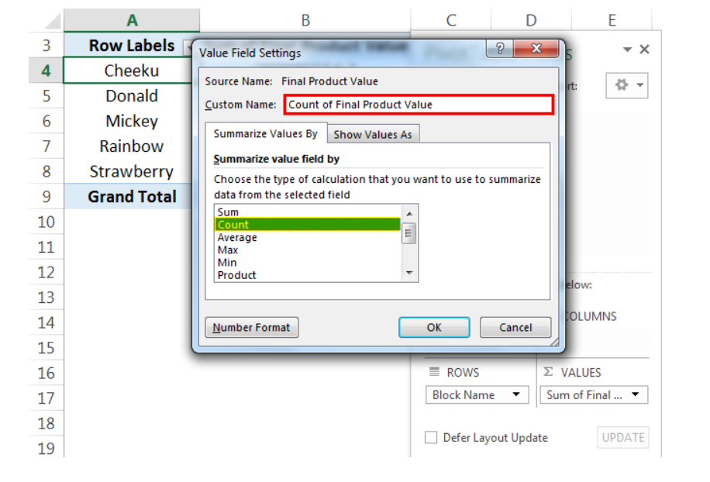
Pivot Table: Example

Slide 51
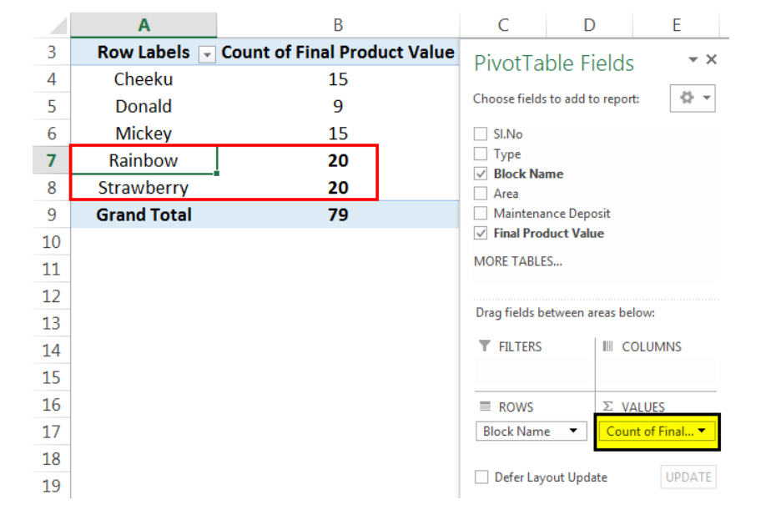
Pivot Table: Example

Slide 52

Pivot Table: Example(Animated)

Slide 53
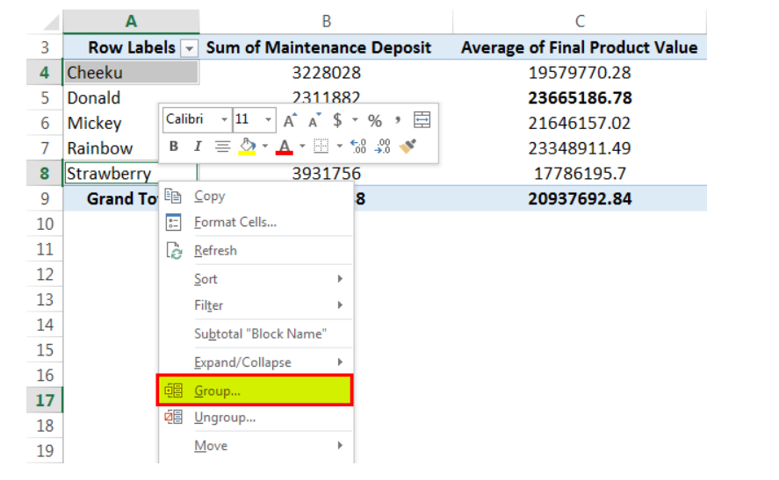
Pivot Table: Example

Slide 54
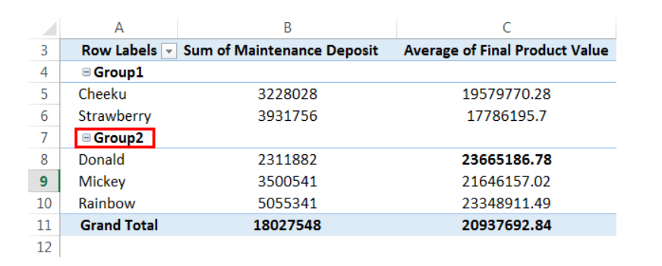
Pivot Table: Example

Slide 55
Build presentation ready dashboards
Organize data - The most important part is to have all the information you plan on graphing in one area. It can be very hard to link the graphs if data is spread out throughout the spreadsheet
Set up page - The orientation can be landscape or portrait, and the size will depend on the output you’re trying to create. The most common is to make it an 8.5” by 11” page so that it can easily print to paper or PDF in a standard size

Slide 56
Build presentation ready dashboards
3.Brainstorm – Experiment and tinker to finally come up with a great design. This step usually takes several iterations, and may even continually change and get updated based on the feedback received over time
4.Select visuals – Choose the right type of charts

Slide 57
Build presentation ready dashboards
5.Focus attention – Create comments, arrows, use appropriate colors to draw attention to information
6.Tell a story - make sure it tells a compelling story. Is it painting the picture you want it to? This is when you step back and take a bird’s-eye view of your data, the key messages, and compare that to the original purpose of the dashboard.

Slide 58
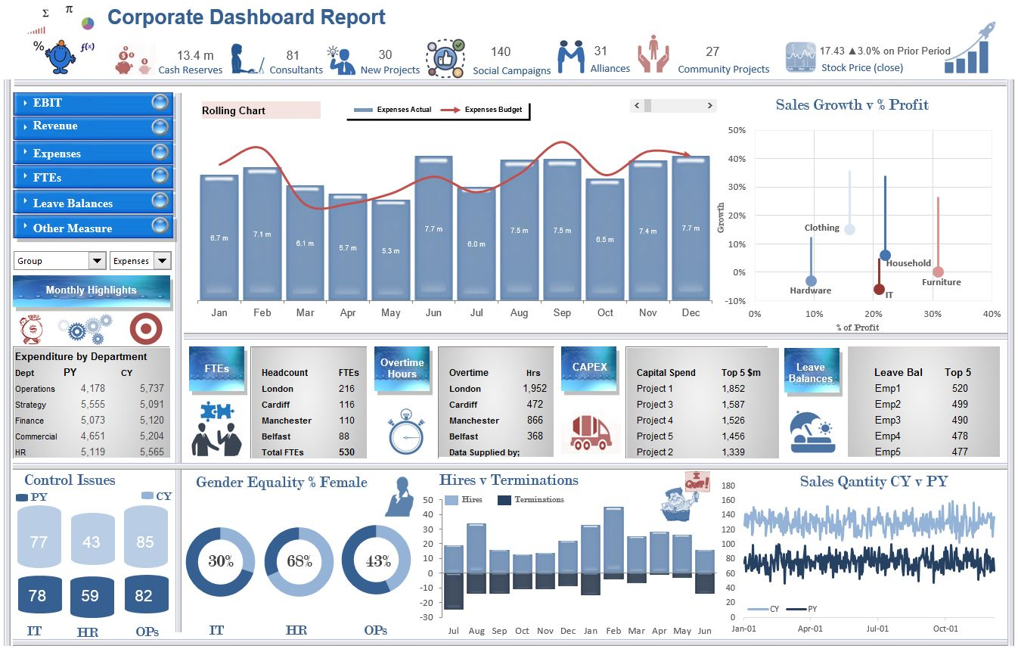
Example: Corporate Dashboard

Slide 59
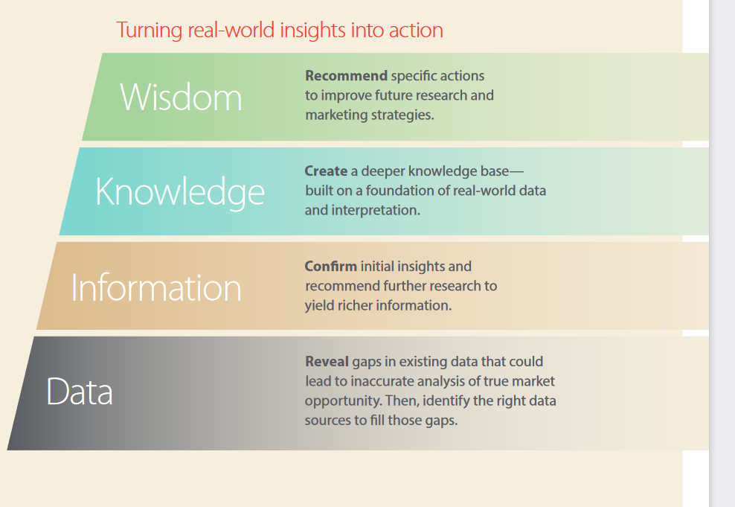
Turn real world data into business insights

Slide 60
Making Forecasts
Many types of models differ in complexity & amount of data & way they generate forecasts:
Forecasts are rarely perfect
Forecasts are more accurate for grouped data than for individual items
Forecast are more accurate for shorter than longer time periods

Slide 61
Making Forecasts
Decide what needs to be forecast
  Level of detail, units of analysis & time horizon required
Evaluate and analyze appropriate data
  Identify needed data & whether it’s available
Select and test the forecasting model
  Cost, ease of use & accuracy
Generate the forecast
Monitor forecast accuracy over time

Slide 62
Interpretation and Report Writing
Most Important Things to Remember About Data Analysis
Develop a plan before you analyse data.
Develop some dummy tables or lists to hold your analysed data – share those with others.
Identify the most important findings from your data, summarize them and then use the specific results (e.g., a table or list of data) to clarify your findings.
Present your analysis in an orderly, meaningful, simple way.

Slide 63
Interpretation and Report Writing
Things to Avoid When Analysing Data
1. Including response rates and problems with your methodology as part of your findings.
2. Reporting both numbers and percentage unless one is needed to make the other clear.
3. Listing in a sentence or a table, all of the response choices for every question on a survey in the order they appear on the survey. [Don’t do this with interview data either]
4. Report your results with excessive precision – most of the time you can just round to the nearest whole number when reporting percentages.

Slide 64
Interpretation and Report Writing
5. Feel compelled to keep your results in the same order as they appeared on the survey or the interview protocol. It is the job of the analyst to order things in the best way to clarify the findings – you are NOT REQUIRED to present things in the order you asked them.
6. Do not include any action steps or conclusions that are not clearly developed from your findings.

Slide 65
Interpretation and Report Writing: Rules for a Good Report
1. Follow the report writing outline in your manual. Feel free to be somewhat flexible with the order, but don’t leave out whole sections.
2. Make your own internal outline including who is responsible for which sections. Be sure that you leave time for stakeholders to help you with editing/making revisions.
3. Be economical in your decisions about what to include in your report. Shorter is better.
4. Avoid excessive use of jargon.
5. Read your work – if you can’t understand it, chances are others won’t be able to either. Think, in simple terms, about what you are trying to say, and then write that.
6. Use complete sentences and standard English grammar conventions. You can rely some on bullets and be limited in your transitions, but be sure your reader can follow your logic.

Slide 66
Interpretation and Report Writing: Rules for a Good Report
7. Use headers and sections to help your reader know what is happening in your report. Be consistent about where and how they appear (centered, bold, underlined, side headings etc.). NUMBER THE PAGES.
8. Use tables and Graphs to help illustrate findings. ALL TABLES AND GRAPHS MUST HAVE TITLES, LABELS AND LEGENDS OR FOOTNOTES SO THAT THEY STAND ALONE.
9. Use quotes and vignettes or snippets from field notes to illustrate your findings. Remember quotes should have quote marks around them and be attributed to the speaker or writer.
10. Be consistent in your use of language, capitalization, punctuation etc. For the most part, evaluation reports should be written in the past tense – only report what you actually did and what you found.
11. Do not introduce totally new topics into your report in the final sections.

Slide 67
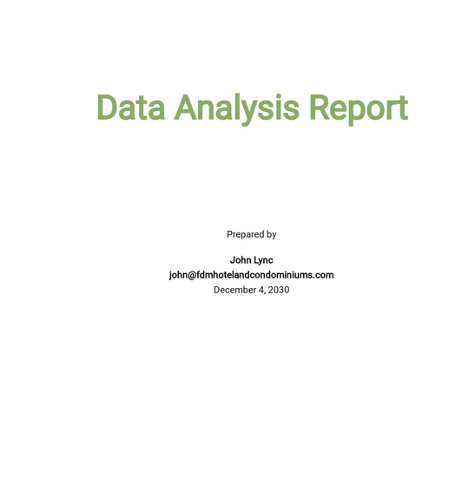
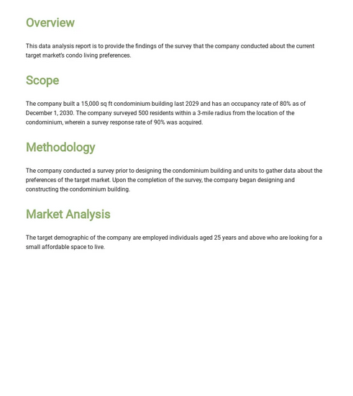
Sample Data Analysis Report Outline

Slide 68
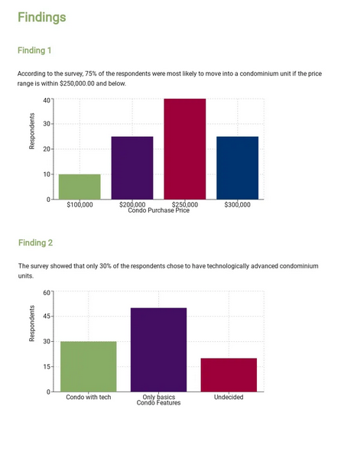

Sample Data Analysis Report Outline
Ref: https://www.template.net/pro/10766/data-analysis-report

Slide 69


