Slide 1
Board Update: Q2 2026
Community water sensor pilot
Notes:
Welcome the board. The pilot finished its second quarter on schedule.

Slide 2
Sensor rollout by region
Region | Q1 sensors | Q2 sensors
North | 120 | 150
South | 95 | 88
East | 130 | 162
West | 80 | 97
Notes:
South is the only region that shrank: seven sensors failed after the June storms.

Slide 3
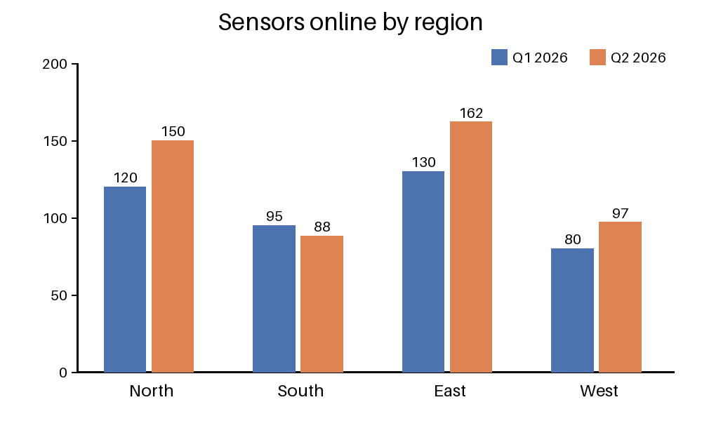
Growth by region
Notes:
Point out that East grew fastest. Ask the board to approve the Q3 budget.

