Slide 1
COMPSCI220: Programming Methodology

Slide 2
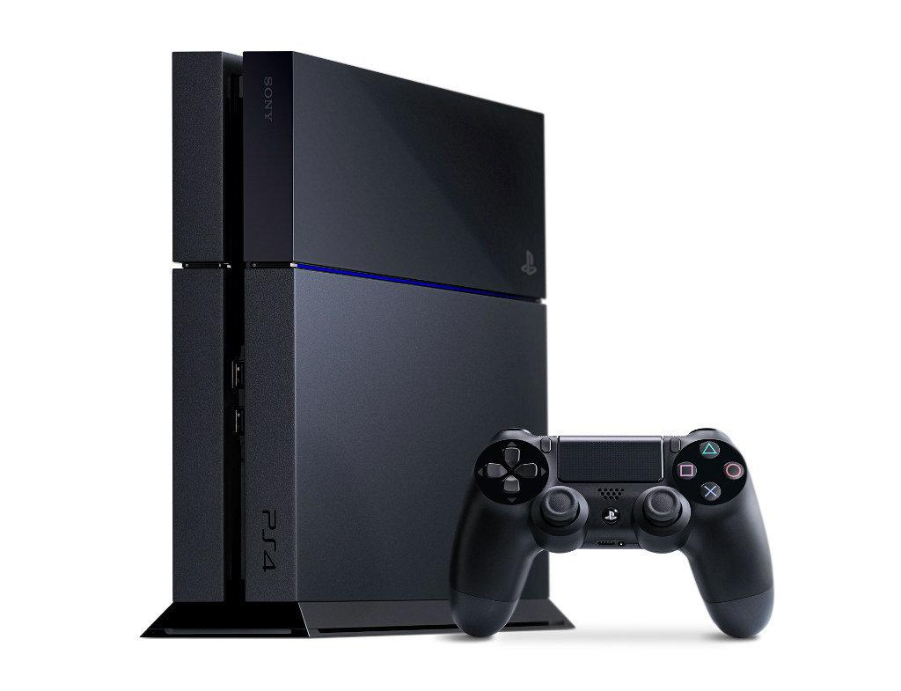
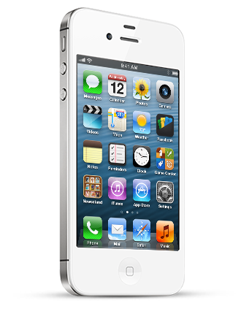
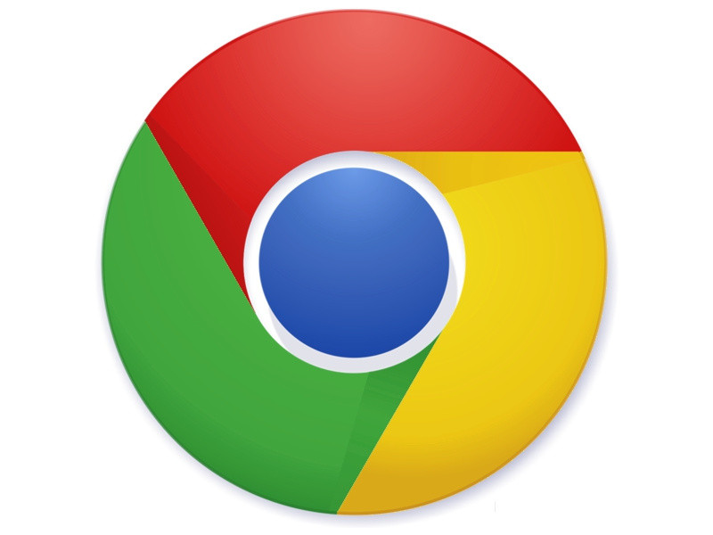
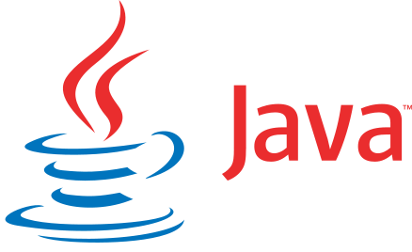
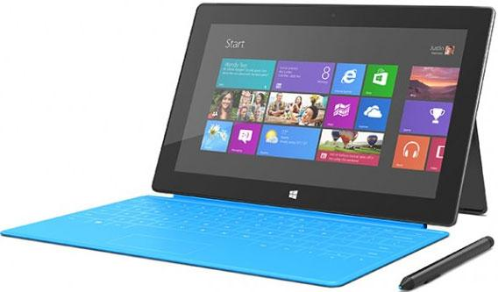

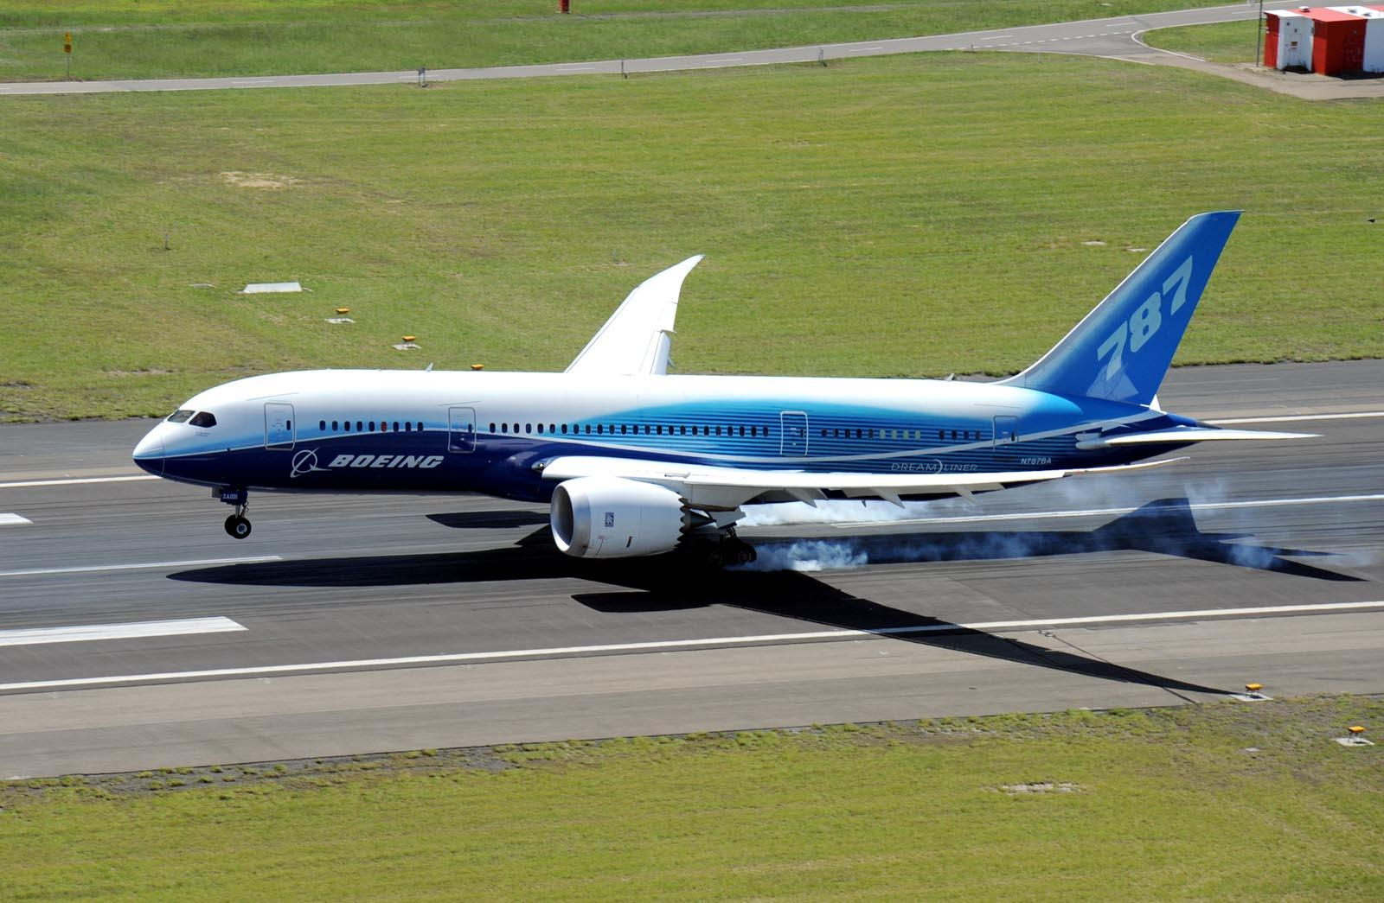
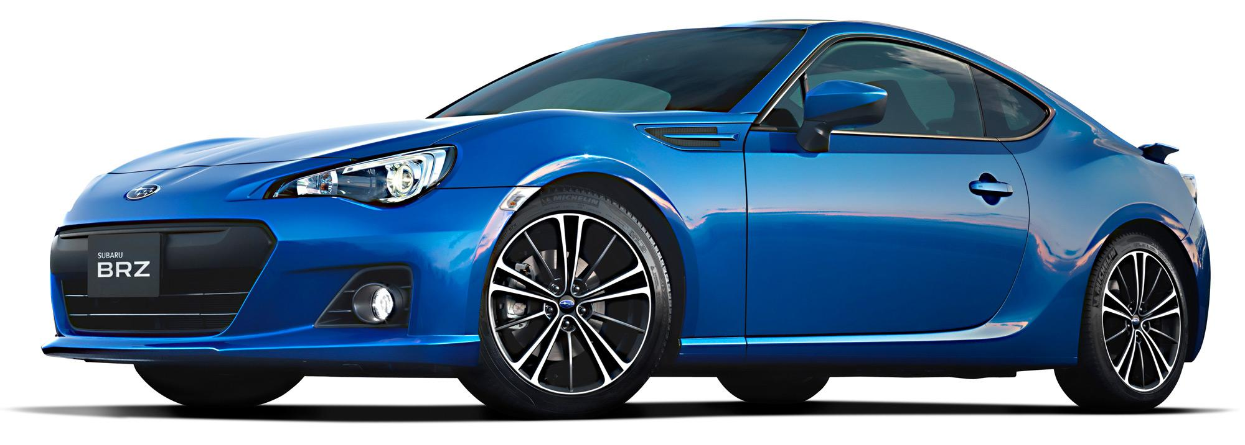
Notes:
You know Java (and perhaps C++). If you want a job programming these devices, will Java help?

Slide 3
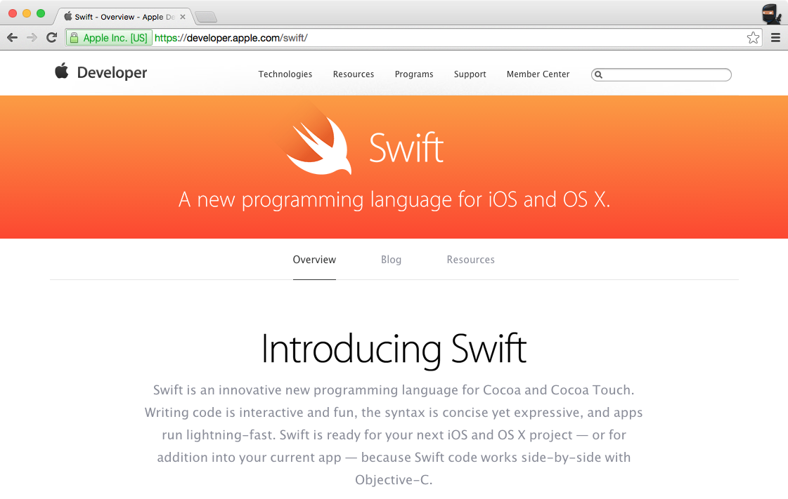
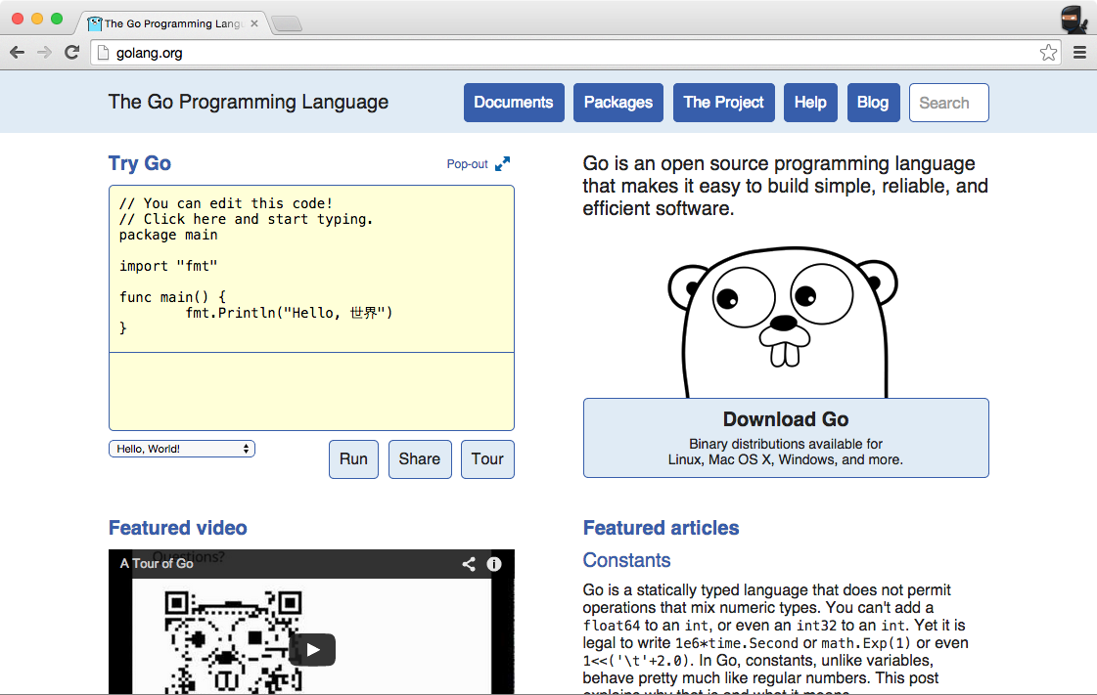
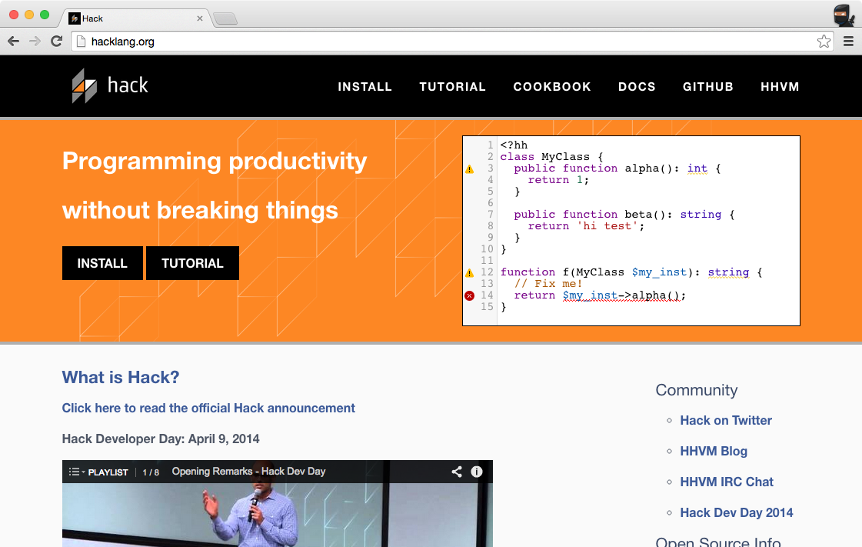
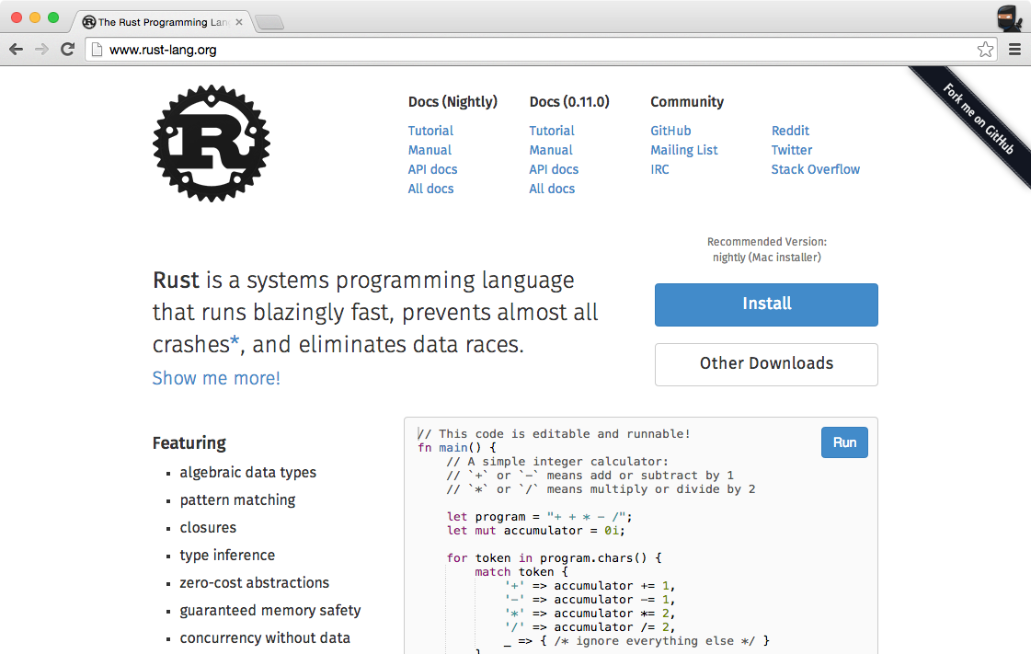

Slide 4
“C++ is a horrible language. It's made more horrible by the fact that a lot of substandard programmers use it.”
-- Linus Torvalds

Slide 5
“Java's not worth building in. Nobody uses Java anymore. It's this big heavyweight ball and chain.”
-- Steve Jobs

Slide 6
Reality Distortion Field
“Java's not worth building in. Nobody uses Java anymore. It's this big heavyweight ball and chain.”
-- Steve Jobs
“If I were to pick a language to use today other than Java, it would be Scala.”
-- James Gosling (Java creator)

Slide 7
class HelloJava {
public static void main(String[] args) {
System.out.println("Hello, world!");
}
}
println("Hello, world!")
A shorter Java

Slide 8
class Person {
String first;
String last;
public Person(String first, String last) {
this.first = first;
this.last = last
}
}
class Person(var first: String,
var last: String)
A shorter Java

Slide 9
LinkedList<String> lst = new LinkedList<String>();
lst.add(“Typing”);
lst.add(“this”);
lst.add(“is”);
lst.add(“tedious”);
val lst = List(“Typing”, “this”, “is”, “tedious”)
A shorter Java

Slide 10
This Doesn’t Really Matter

Slide 11
“A language that doesn't affect the way you think about programming, is not worth knowing.”
-- Alan Perlis. First Turing Award winner.
Type Inference
Algebraic Data Types
First-class functions
Real-eval-print loop (REPL)
and more
in the first month of 220

Slide 12
Rules
Read the course website More rules on website
Work on your own Cheating = automatic F
Your code has to compile Does not compile = 0 on assignment
No email, only Piazza Piazza Q&A is part of your grade

Slide 13
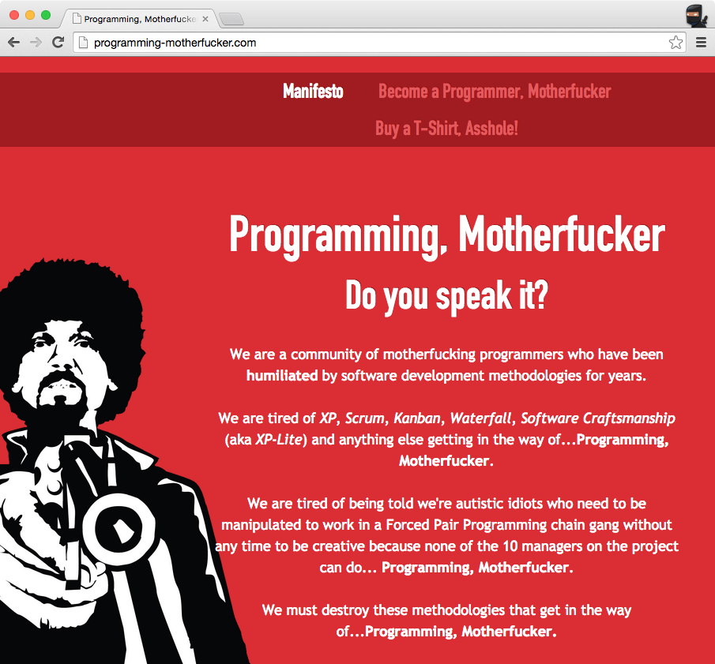

Slide 14

Grading

Slide 15
Command Line
bash$

Slide 16
Live Coding

