Slide 1
Group 2 : Maize
Arjun Gupta 2021134
Anya Hooda 2022088
Tanishq Jain 2021294
Kunal Dangi 2022261

Slide 2
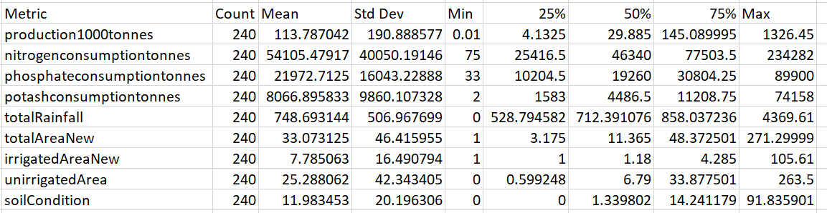
Descriptive Statistics
The dataset contains information about maize production across various districts in India for the year 2017.
crop: Single value "Maize" for all entries
area1000hectares: Area used for maize cultivation in thousands of hectares
production1000tonnes: Maize produced in thousands of tonnes
irrigatedarea1000hectares: Irrigated area for maize in thousands of hectares
districtcode: Numerical identifier for districts
statename/state: Names of Indian states where cultivation occurred
nitrogenconsumptiontonnes: Consumption of Nitrogen in tonnes
phosphateconsumptiontonnes: Consumption of Phosphate in tonnes
potashconsumptiontonnes: Consumption of Potash in tonnes
totalRainfall: Total rainfall during Kharif season in the district
Average Salinity/Alkalinity (Percentage): Soil condition measure
The dataset contains 266 entries representing different districts where Maize is grown. Out of that, 26 rows had missing values for production, irrigated area and total area. Hence, those rows were removed. The values for irrigated area were capped to total area. Moreover, new columns “totalAreaNew” and “irrigatedAreaNew” were introduced by incrementing the original values by 1. This was done to handle the undefined values while taking logs. Finally, a column “unirrigatedArea” was introduced as difference between “totalAreaNew” and “irrigatedAreaNew”.

Slide 3
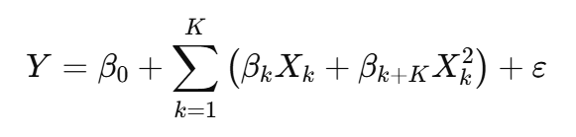
Empirical Model (Cobb-Douglas and Quadratic)
Cobb Douglas
Estimated Equation: log⁡(Production)=α+β1log⁡(Area)+β2log⁡(IrrigatedArea + 1) + β3log⁡(UnirrigatedArea) + β4log⁡(Nitrogen) +⋯+ γ1Rainfall + γ2Salinity + ϵ
The log-linear (Cobb-Douglas) specification transforms a multiplicative production function into a linear additive form: Y= A⋅(X1^β1)⋅(X2^β2) ⋯ (Xk^βk) ⇒ log⁡Y = log⁡A+ β1log⁡X1+ ⋯ +βklog⁡Xk
Coefficients βi​ can be interpreted as elasticities (i.e., % change in output due to a 1% change in input). Stabilizes variance: Helps manage heteroskedasticity by compressing large ranges of values. Linear estimation: Allows OLS to be used effectively, Enables simple, well-understood inference tools (like t-tests, R², F-tests).
Issue: Log of 0 is undefined. Solution for Irrigated Area: log⁡(Irrigated Area+1) —------> This avoids undefined values while keeping the variable interpretable. Derived Variable – Unirrigated Area: Unirrigated Area=Total Area−(Irrigated Area+1). Both Irrigated and Unirrigated areas are included to fully capture land use.
Farmer-Controlled Inputs: Chosen, managed, or influenced by the farmer directly. log(Area), log(Irrigated Area + 1), log(Unirrigated Area), log(Nitrogen), log(Phosphate), log(Potash). Environmental Controls: External conditions outside the farmer’s control but affecting productivity; included in levels (not logs). Rainfall (annual or seasonal average), Salinity Index (soil degradation %).
Quadratic
We estimate a quadratic production function to test for diminishing marginal returns to inputs. Test for diminishing marginal product: β(k+K)<0 implies diminishing returns for input Xk.
Allows nonlinear relationships between inputs and output

Slide 4
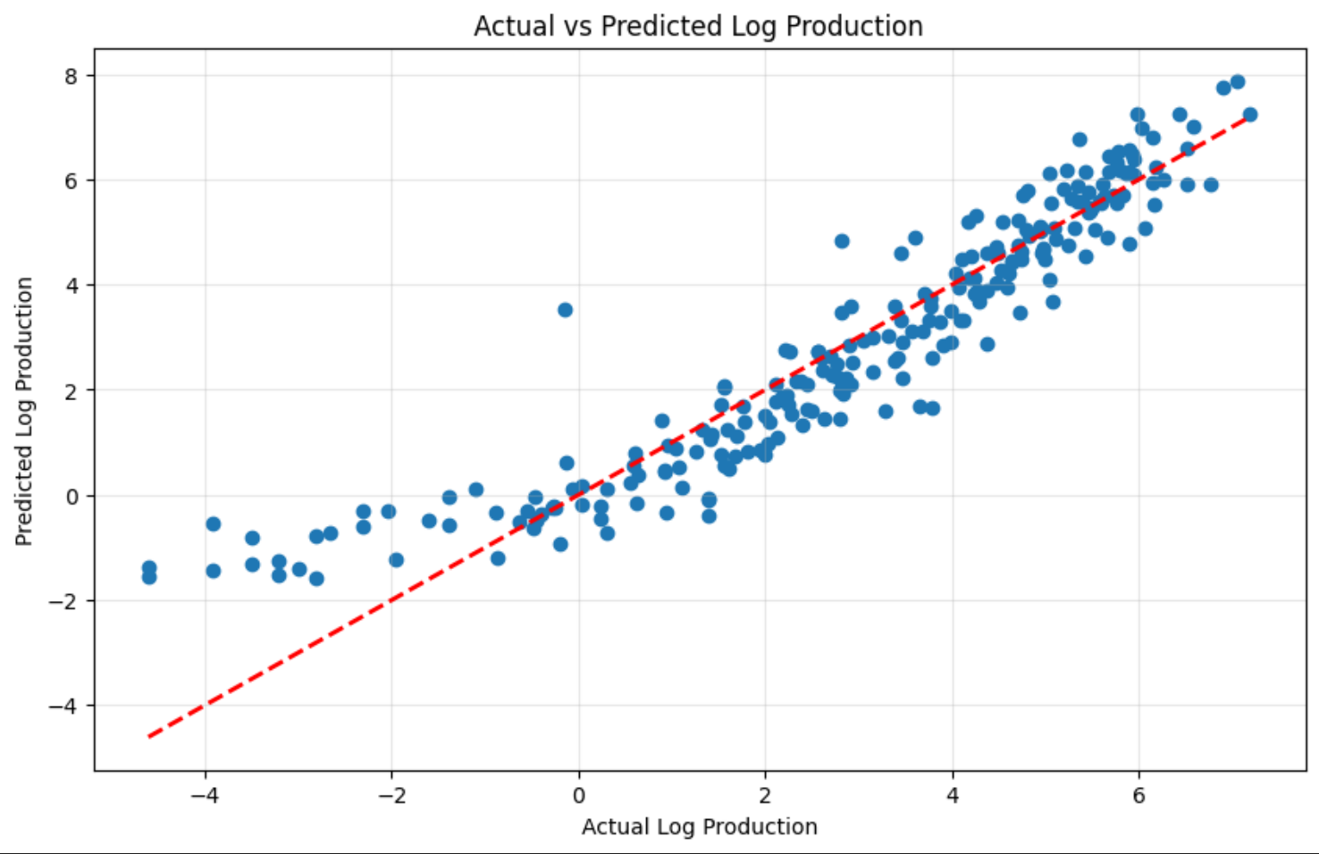
Estimation Results - Cobb-Douglas
Coefficient estimates with standard errors and significance Farmer Controlled Inputs
Variable | Coefficient | Std. Error | t-Statistic | P-value | CI 2.5% | CI 97.5%
Intercept | -0.9145 | 0.537 | -1.702 | 0.09 | -1.973 | 0.144
log_area | 1.3558 | 0.055 | 24.563 | 0 | 1.247 | 1.465
log_nitrogen | 0.1828 | 0.147 | 1.244 | 0.215 | -0.107 | 0.472
log_phosphate | -0.2216 | 0.142 | -1.557 | 0.121 | -0.502 | 0.059
log_potash | 0.0841 | 0.059 | 1.433 | 0.153 | -0.032 | 0.2
log_irrigated_area | 0.1774 | 0.061 | 2.891 | 0.004 | 0.057 | 0.298
log_unirrigated_area | 0.0349 | 0.009 | 3.767 | 0 | 0.017 | 0.053
totalRainfall | -0.0001 | 0 | -1.139 | 0.256 | 0 | 0
soilCondition | -0.0029 | 0.003 | -0.903 | 0.368 | -0.009 | 0.003
Variable | Coefficient | Std. Error | t-Statistic | P-value | CI 2.5% | CI 97.5%
Intercept | -1.0223 | 0.51 | -2.005 | 0.046 | -2.027 | -0.018
log_area | 1.357 | 0.055 | 24.657 | 0 | 1.249 | 1.465
log_nitrogen | 0.1869 | 0.145 | 1.292 | 0.198 | -0.098 | 0.472
log_phosphate | -0.2193 | 0.142 | -1.541 | 0.125 | -0.5 | 0.061
log_potash | 0.0709 | 0.056 | 1.27 | 0.205 | -0.039 | 0.181
log_irrigated_area | 0.1817 | 0.059 | 3.058 | 0.002 | 0.065 | 0.299
log_unirrigated_area | 0.0348 | 0.009 | 3.769 | 0 | 0.017 | 0.053
Elasticities of Input
R-squared and model fit
Metric | Value
R-squared | 0.875
Adjusted R-squared | 0.871
F-statistic | 202.4
Prob (F-statistic) | 7.68E-100
Log-Likelihood | -318.82
AIC | 655.6
BIC | 687
No. of Observations | 240
log_area | 1.3558
log_nitrogen | 0.1828
log_phosphate | -0.2216
log_potash | 0.0841
log_irrigated_area | 0.1774
log_unirrigated_area | 0.0349
totalRainfall | -0.0001
soilCondition | -0.0029
Estimated Cobb-Douglas Production Function:
Y = 0.4007 × Area^1.3558 × Irrigated^0.1774 × Unirrigated^0.0349
The variables not in this equation are not significant, hence excluded.
Technology Factor 0.4007.

Slide 5
Estimation Results - Quadratic Model
Coefficient estimates with standard errors and significance Complimentary Model Results
Variable | Coefficient | Std. Error | t-Statistic | P-value | CI 2.5% | CI 97.5%
Intercept | -2.5775 | 13.38 | -0.193 | 0.847 | -28.941 | 23.786
totalAreaNew | 2.7013 | 0.346 | 7.817 | 0 | 2.02 | 3.382
totalAreaNewSquared | 0.0049 | 0.004 | 1.281 | 0.201 | -0.003 | 0.013
irrigatedAreaNew | 2.9826 | 0.684 | 4.359 | 0 | 1.634 | 4.331
irrigatedAreaNewSquared | -0.0237 | 0.012 | -1.938 | 0.054 | -0.048 | 0
unirrigatedArea | -0.2813 | 0.403 | -0.698 | 0.486 | -1.076 | 0.513
unirrigatedAreaSquared | -0.0005 | 0.004 | -0.124 | 0.902 | -0.009 | 0.008
nitrogenconsumptiontonnes | -6.9E-05 | 0.001 | -0.108 | 0.914 | -0.001 | 0.001
nitrogenconsumptiontonnesSquared | 6.9E-10 | 3.19E-09 | 0.216 | 0.829 | -5.6E-09 | 6.97E-09
phosphateconsumptiontonnes | -0.0019 | 0.002 | -1.239 | 0.217 | -0.005 | 0.001
Variable | coef | std err | t | P>|t| | [0.025 | 0.975]
Intercept | -14.658 | 13.051 | -1.123 | 0.263 | -40.376 | 11.06
totalAreaNew | 2.1671 | 0.45 | 4.815 | 0 | 1.28 | 3.054
totalAreaNewSquared | 0.0034 | 0.004 | 0.917 | 0.36 | -0.004 | 0.011
irrigatedAreaNew | 1.679 | 0.901 | 1.864 | 0.064 | -0.096 | 3.454
irrigatedAreaNewSquared | -0.0347 | 0.013 | -2.681 | 0.008 | -0.06 | -0.009
unirrigatedArea | 0.4882 | 0.498 | 0.981 | 0.328 | -0.493 | 1.469
unirrigatedAreaSquared | -0.0002 | 0.004 | -0.036 | 0.972 | -0.009 | 0.008
nitrogenconsumptiontonnes | -0.00009827 | 0.001 | -0.158 | 0.874 | -0.001 | 0.001
nitrogenconsumptiontonnesSquared | 2.254E-09 | 3.07E-09 | 0.735 | 0.463 | -3.79E-09 | 8.3E-09
phosphateconsumptiontonnes | 0.0002 | 0.002 | 0.104 | 0.917 | -0.003 | 0.003
R-squared: 0.874, Adj. R-squared:0.871, F-statistic: 269.5, Prob(F-statistic): 7.81e-102, Omnibus: 50.808 Durbin-Watson: 1.772, Jarque-Bera (JB): 100.161
R-squared: 0.822,Adj. R-squared: 0.814,F-statistic: 95.93, Prob(F-statistic):4.61e-79

Slide 6
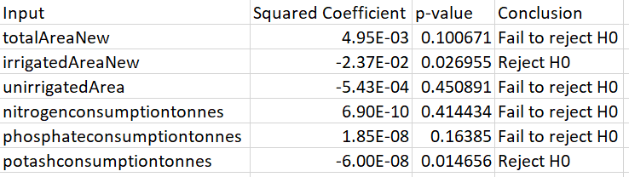
Interpretation and Hypotheses
Hypothesis Test for inputs within Farmer's control
Null Hypothesis (H0): The sum of input elasticities equals 1 (constant returns to scale)
Alternative Hypothesis (H1): The sum of input elasticities does not equal 1 (variable returns to scale)
F-statistic: 106.1280
At 5% significance level: Reject H0
Conclusion: There is evidence that the production function does not exhibit constant returns to scale
Hypothesis Testing for Diminishing Marginal Returns Null Hypothesis (H0): β_squared ≥ 0 (No diminishing returns) Alternative Hypothesis (H1): β_squared < 0 (Diminishing returns exist)

Slide 7
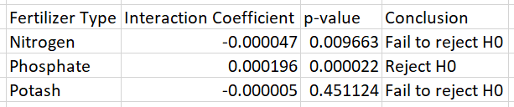
3. Hypothesis Tests for Input Complementarity
Null Hypothesis (H0): β_interaction ≤ 0 (No complementarity) Alternative Hypothesis (H1): β_interaction > 0 (Positive complementarity)
4. Hypothesis Tests for Regional Differences Null Hypothesis (H0): No regional differences in production functions Alternative Hypothesis (H1): Significant regional differences exist Perform Joint Wald test to check “Are all region-specific interaction slopes zero?” Wald test (Cobb–Douglas interactions): F test has values F = 1.780761620843653, p = 0.015956276749412985
Wald test (Quadratic interactions): F test has values F = 5.118154233426203, p = 1.297057978905117e-13

Slide 8
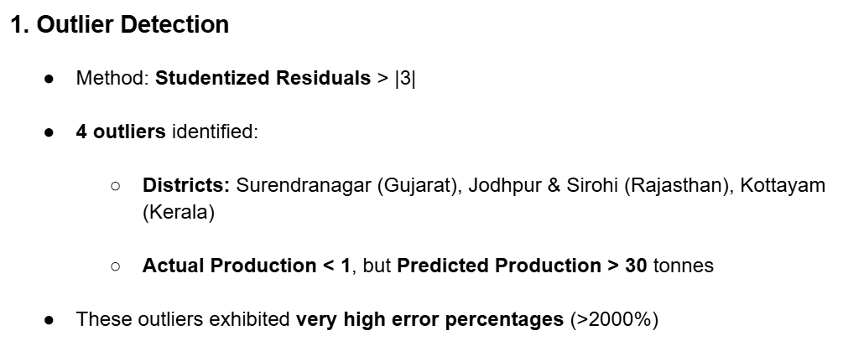
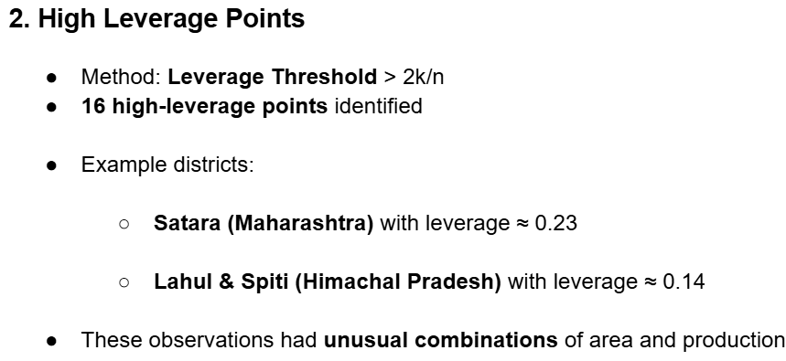
Robustness Checks

Slide 9
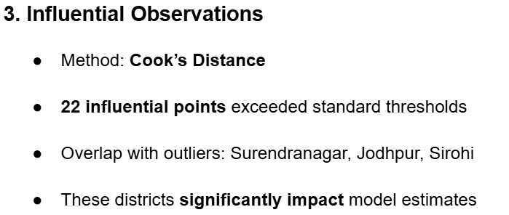
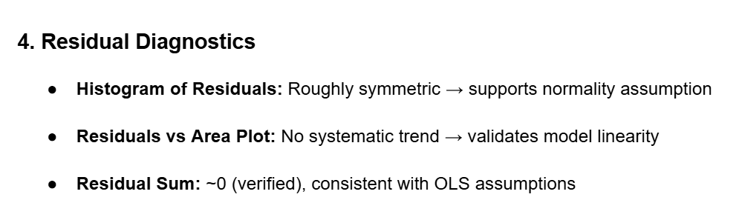

Slide 10
Rationale for Chosen Model
Between the Cobb-Douglas and Quadratic production models, I would prefer the Quadratic model. This
preference is based on the following reasons:
1. Captures Diminishing Returns: The Quadratic model explicitly includes squared terms, allowing it to test
and capture diminishing marginal productivity, which is a realistic feature of agricultural production.
2. Better Fit The Quadratic model yielded a higher R-squared value (0.915), indicating a better in-sample
fit compared to the Cobb-Douglas model.
3. Greater Flexibility: While Cobb-Douglas assumes constant elasticities and smooth returns to scale, the
Quadratic model can accommodate nonlinear relationships and turning points (e.g, peak productivity
thresholds), making it more adaptable to real-world data.
However, Cobb-Douglas is more parsimonious and interpretable, especially useful when data is limited or
multicollinearity is high. But given our dataset size and the clear presence of diminishing returns in inputs
like land, the Quadratic model offers superior explanatory power.

Slide 11
