Slide 1
RAG with LLM
By Arjun Janamatti

Slide 2
Requirement
Objective
  Develop a Retrieval-Augmented Generation (RAG) AI system to answer questions about yourself, handling inquiries in English and managing follow-up questions effectively
Core-requirements:
  Data ingestion: Ingest personal data in form of pdf or text or word documents and store these embeddings in vector database
  RAG system integrator: Retrieved information along with question has to be fed to “Language model” for response
  Orchestration: Use tools like “langchain” or “llamaindex” for indexing, retrieval and generating response
  Follow up questions: Implement logic to maintain context and provide coherent responses
  Interface options: API end points or UI like Gradio, Streamlit
Deliverables:
  Code Repository: Organized code with setup instructions.
  Documentation: System architecture, data ingestion, RAG integration, evaluation methods.
  Demonstration: Video or live demo showcasing system capabilities.

Slide 3
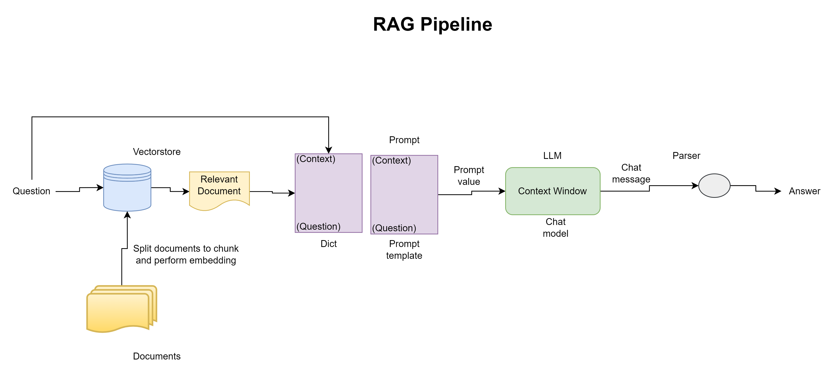

Slide 4
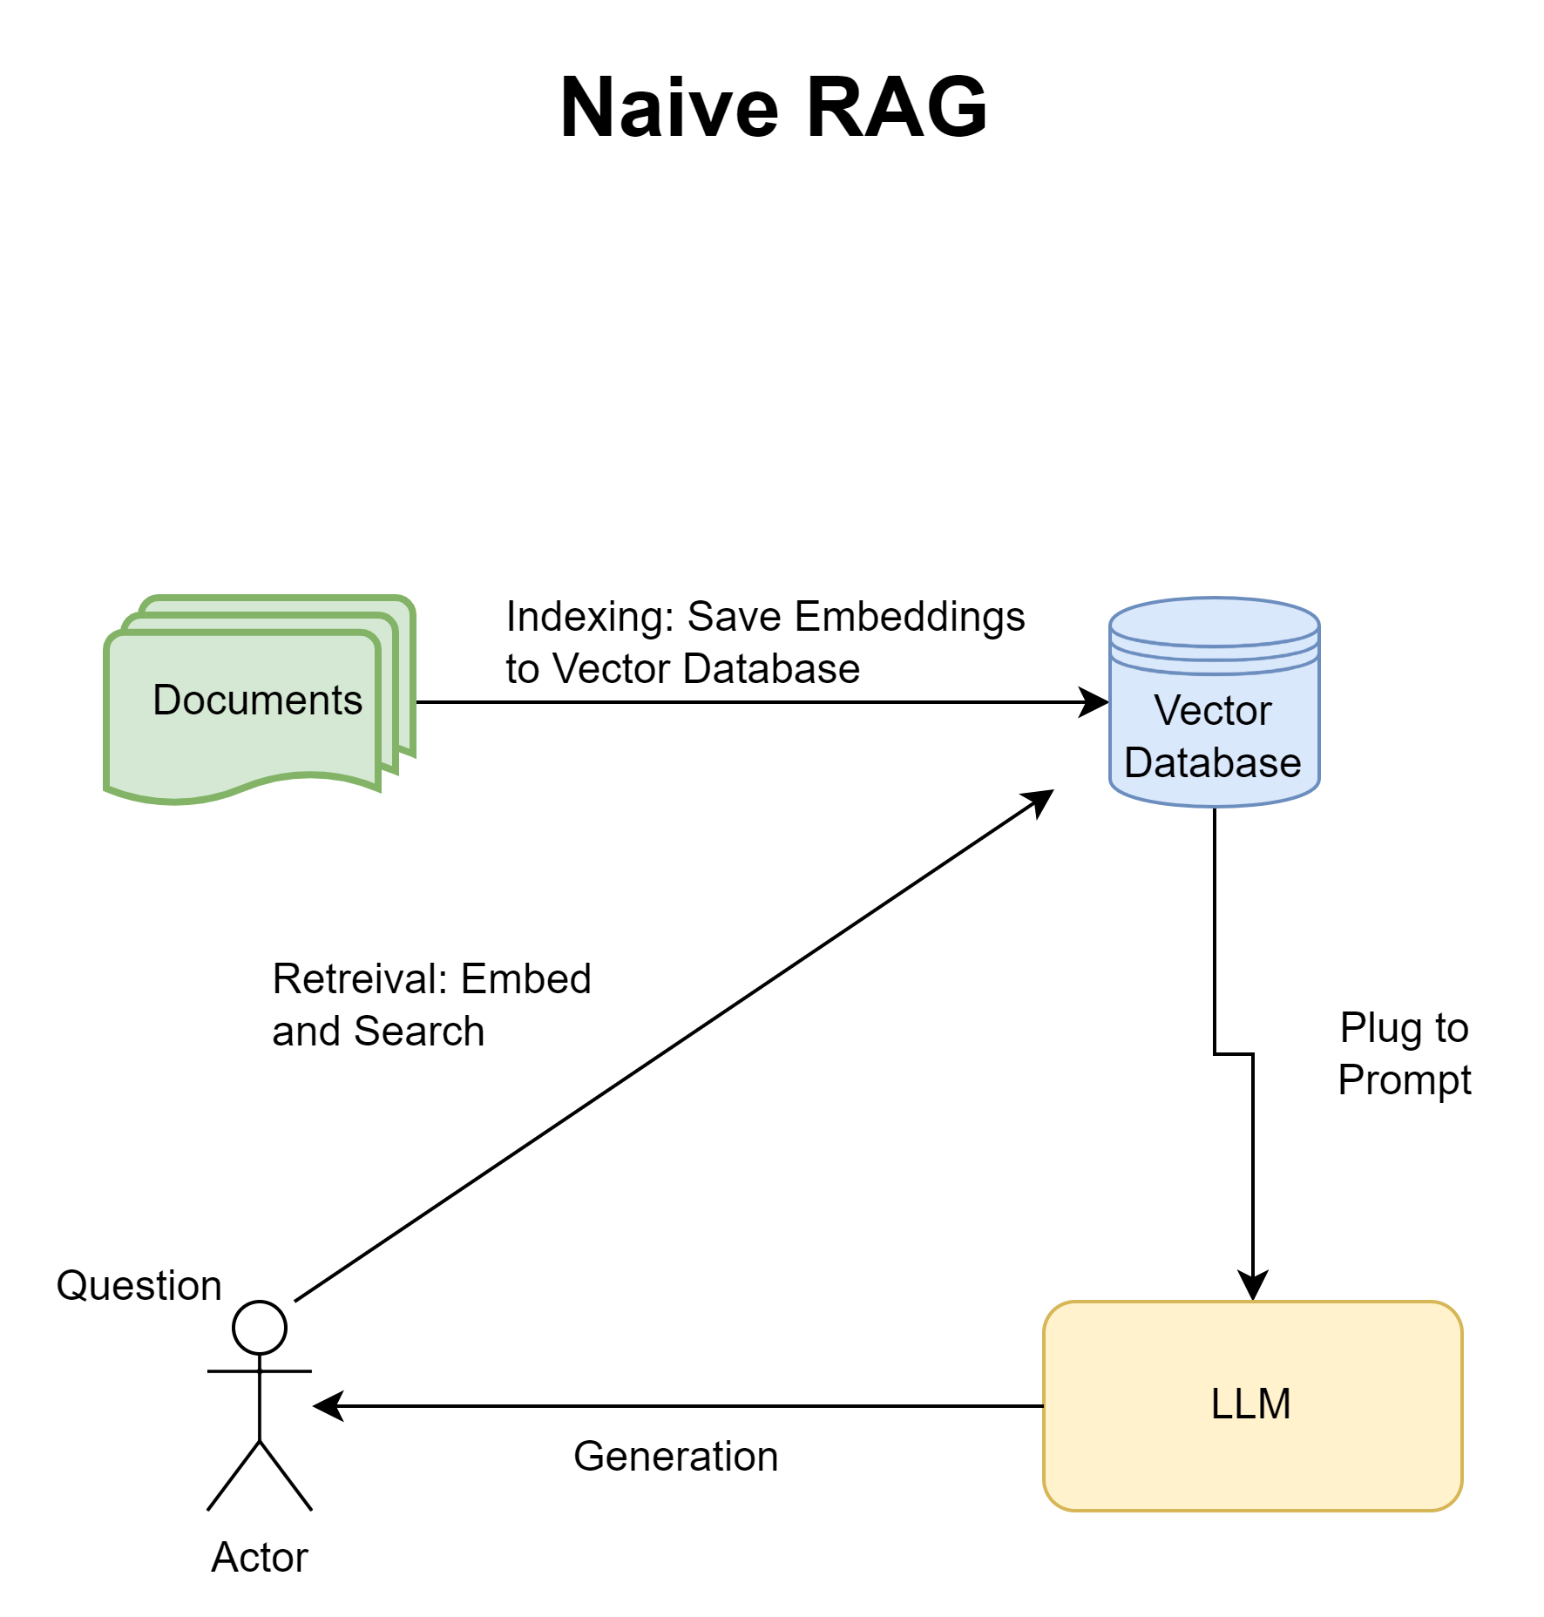
RAG involves 3 main steps:
  Indexing: Use fixed size chunking, “nomic-embed-text” embedding and save the vectors in vector database
  Retrieval: Perform embedding on the original question and perform default similarity search to find most similar chunk
  Generation: Plug the text chunks into the prompt along with the user’s question, to a open source “small language model” [used “Phi3”, since this was open source and easy to run in local RAG]

Slide 5
Naïve RAG model
Indexing:
  Chunks creation using “RecursiveCharacterTextSplitter”
  Embedding model: “nomic-embed-text”
  Vector database: “chroma”
Retrieval:
  Similarity using cosine distance
Generation:
  Basic prompt
  Language model: “Microsoft phi3”
Evaluation metrics:
  “rouge_score”
  “contextual_coherence”

Slide 6
Slight improvements to Naïve model
Handling exceptions
Using better improved prompts
Grammatically Correct Responses

Slide 7
Possible Improvements to RAG model
Implement Semantic chunking
2
Use Hybrid search
3
Implement Query expansion
4
Optimize Reranking
5
Implement Iterative Retrieval
6
Use better performing Language model and embedding model
1

Slide 8
References
https://bootcamp.uxdesign.cc/how-to-improve-rag-results-in-your-llm-apps-from-basics-to-advanced-822818014144
https://ai.gopubby.com/5-simple-yet-powerful-ways-to-improve-your-rag-pipeline-2579b8ad1444
https://medium.com/the-ai-forum/semantic-chunking-for-rag-f4733025d5f5

Slide 9
Thank you

