Slide 1
ORM

Slide 2
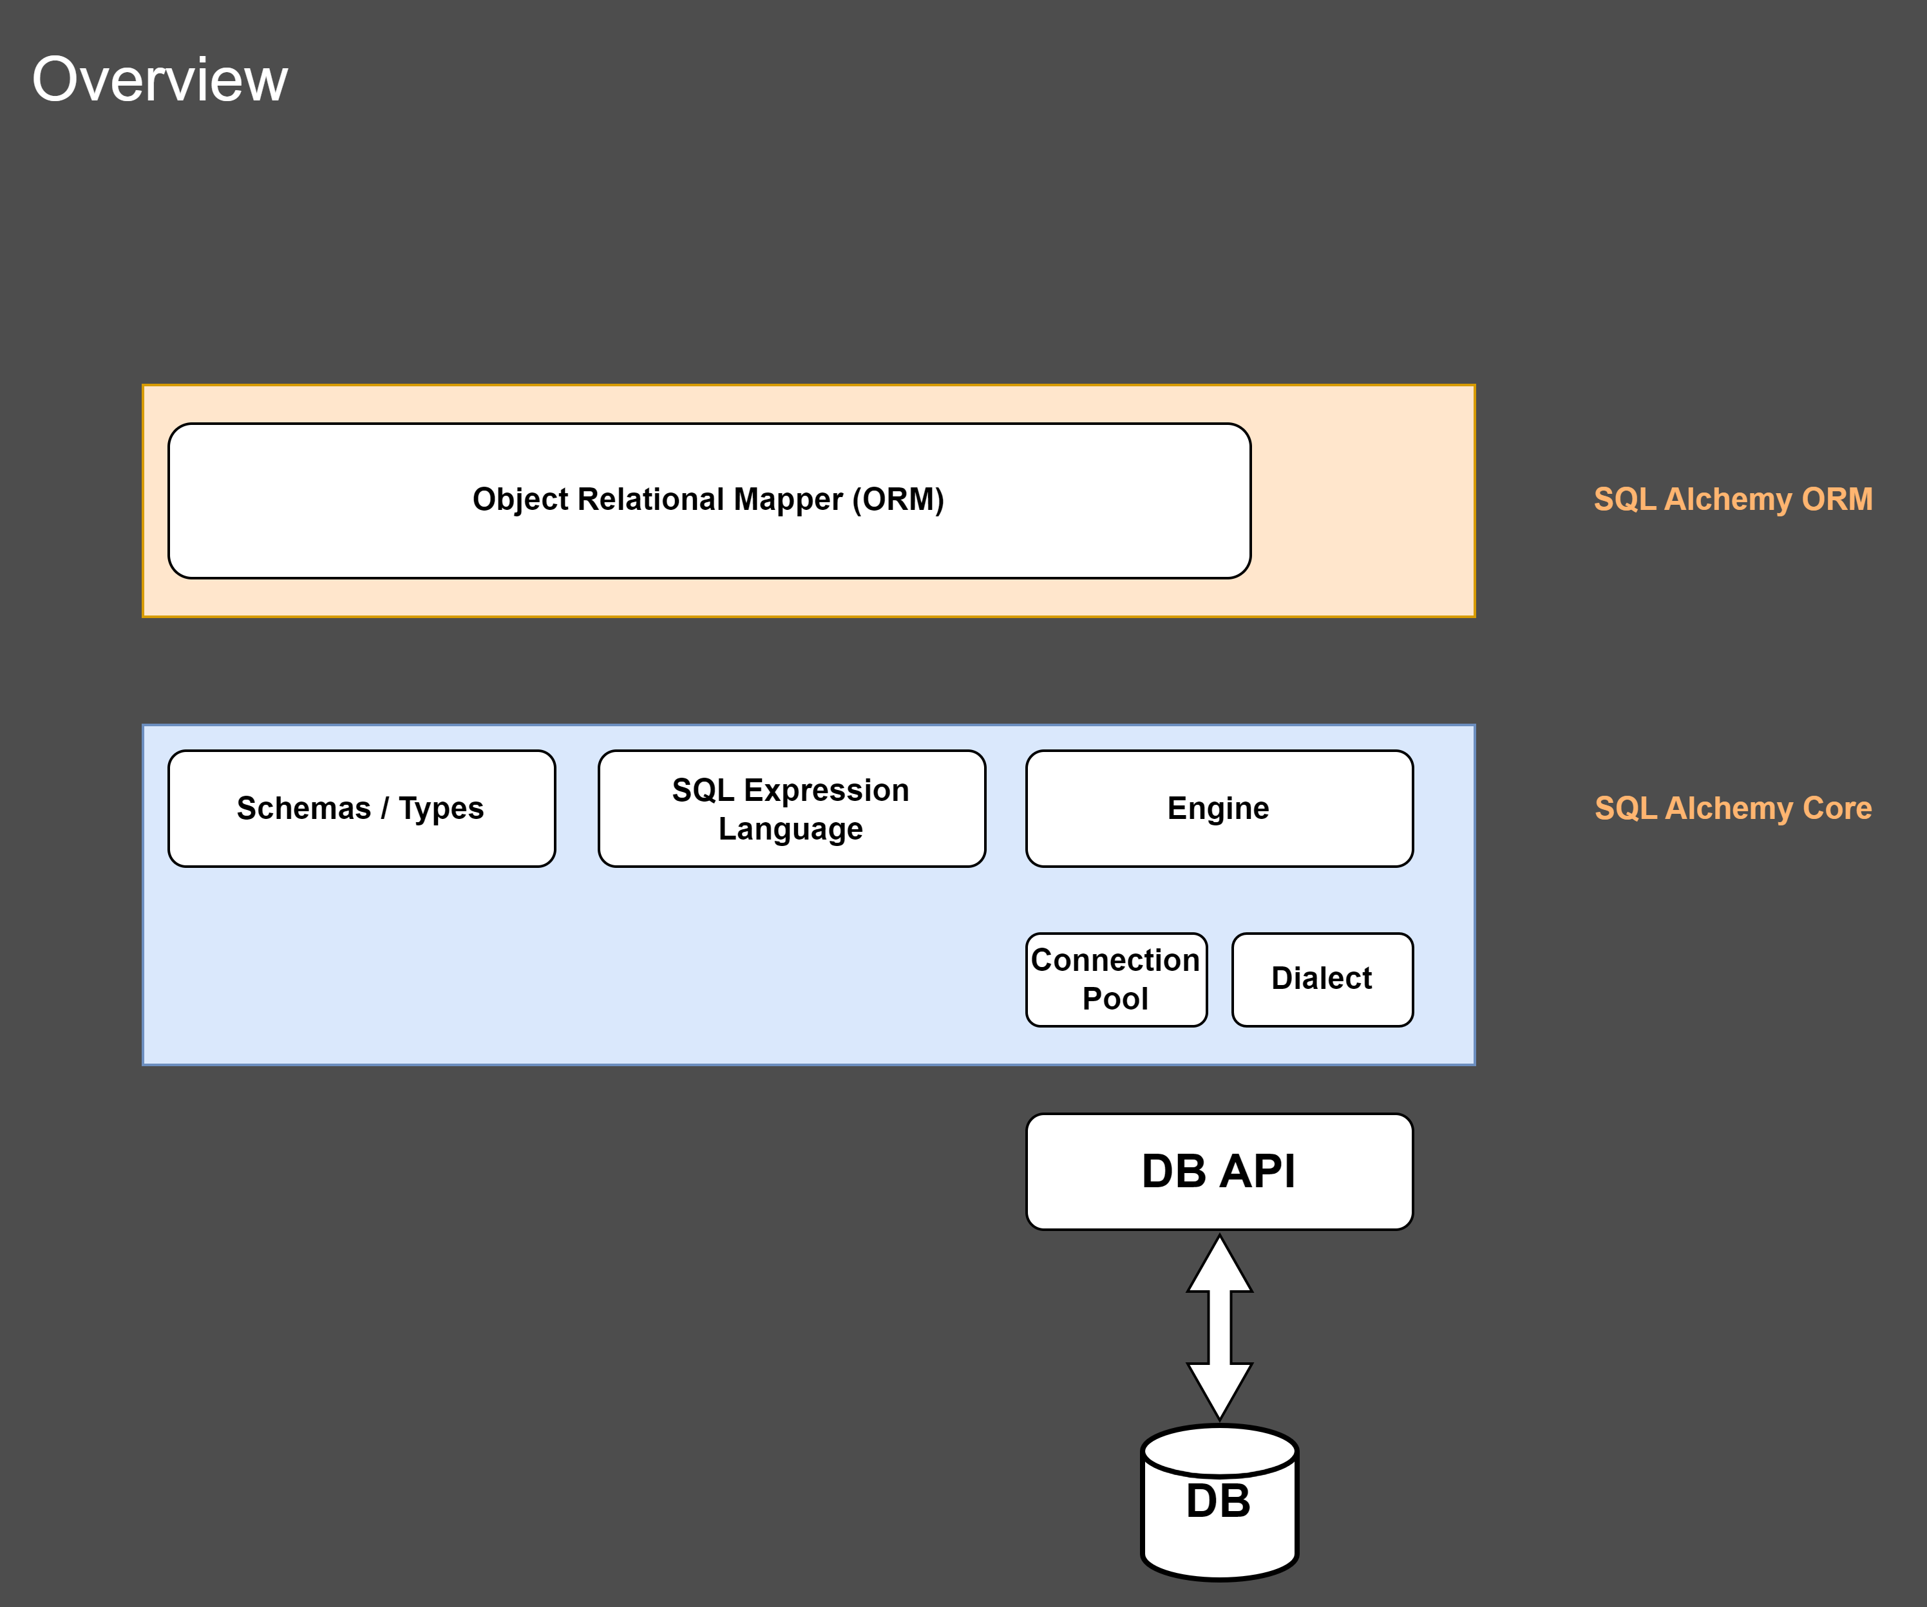
Overview

Slide 3
Core
Foundational architecture as a “database toolkit”
Allows you to:
  Manage connectivity to a database
  Interact with database queries and results
  Programmatically construct SQL statements

Slide 4
ORM
Builds upon the Core to provide object relational mapping capability
Map python classes to database tables
Extend the SQL Expression Language from the Core
Compose SQL queries in terms of user-defined objects

Slide 5
Advantages of ORM
No more raw and bulky SQL queries in Python code
Prevents SQL injection attacks
Database engine migrations become easier
Core is seperate from ORM
Various loading strategies to optimise performance
Easy to write tests and fixtures

Slide 6
