Slide 1
Did COVID-19 Drive a Suburban Housing Boom?
Evidence from the FHFA House Price Index · 2010–2024 Krish Prasad · Brandon Melendez-Rodriguez · Arjun Johal · Julian Garcia

Slide 2
Did COVID-19 Drive a Suburban Housing Boom?
Evidence from 431 U.S. Counties · 2010–2024
Krish Prasad · Brandon Melendez-Rodriguez · Arjun Johal · Julian Garcia
Advising a Real Estate Investment Firm · MGT 159T · Spring 2026

Slide 3
The World Changed in March 2020

Slide 4
Remote work went from exception to norm
Pre-pandemic: ~5% of U.S. workers primarily WFH
Peak 2020: ~60% of white-collar workers fully remote
Sustained 2022–2024: ~25–30% in hybrid or full-remote roles
Source: BLS American Time Use Survey; Stanford Survey of Working Arrangements
Housing demand broke loose from the office
National FHFA HPI rose ~40% from 2020 to 2023
Migration data show net outflows from dense urban cores
“Zoom towns” — suburbs, mid-size cities — saw bidding wars
Source: FHFA HPI All-Transactions Index; USPS change-of-address data

Slide 5
Note
For a real estate investment firm, this raises a trillion-dollar question: where should capital go next?

Slide 6
The Question We Set Out to Answer
Did the COVID-19 shift toward remote work cause housing prices to rise faster in suburban counties than in urban core counties?
Why a manager would care:
Suburban vs. urban allocation drives portfolio construction
A real, persistent suburban premium → over-weight suburban acquisitions
A premium that’s just a macro rate effect → allocate by yield, not density
Knowing which states show the premium shapes where to deploy capital now

Slide 7
What We Found
Bottom line: Suburban counties grew +2.28 percentage points faster per year post-COVID than urban core counties, above and beyond the common housing boom.
Recommendation: Over-weight Large Fringe Metro county acquisitions, with strongest conviction in NY, OR, GA, MA, and WA.

Slide 8
The Data

Slide 9
Dataset 1 — FHFA House Price Index
Source: Federal Housing Finance Agency
105,195 county-year observations · 2,795 counties
Spans 1975–2025 (annual, not seasonally adjusted)
Key variable: HPI — repeat-transactions price index, county-specific base year = 100
Also reports Annual Change (%) = year-over-year HPI growth rate
Dataset 2 — CDC NCHS Urban-Rural Classification
Source: National Center for Health Statistics
3,160 U.S. counties · one row per county · no time dimension
CODE2023: 6-level scale
1 = Large Central Metro (most urban)
2 = Large Fringe Metro (suburban)
… 6 = Non-core (most rural)

Slide 10
Merged on 5-digit FIPS (fips = STFIPS × 1000 + CTYFIPS)
Variables used: HPI, annual_chg_pct, chg_w (winsorized), Year, suburban, post_covid, did_term = suburban × post_covid, CODE2023, State, County, fips
Constructed variables: suburban = 1 if CODE2023 == 2 · post_covid = 1 if Year ≥ 2020

Slide 11
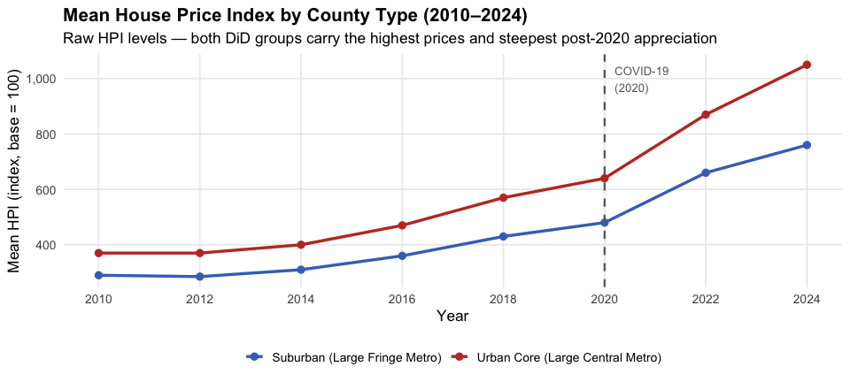
What the Data Looks Like
Figure 1

Slide 12
Note
Summary stats (full panel, 105,195 obs): Mean HPI = 258.8 · SD = 203.8 · Median = 196 · Range = 45.7–2,976. Right skew motivates using annual growth rates (not levels) as the DiD outcome — raw HPI is not comparable across counties because each county has its own base year.

Slide 13
Step | Filter Applied | Obs. Remaining | Obs. Removed
1 | Raw FHFA HPI observations | 105,195 | 0
2 | Inner join with CDC NCHS on 5-digit FIPS | 105,195 | 0
3 | Restrict to analytic window: 2010–2024 | 41,359 | 63,836
4 | Keep Large Central Metro (Code 1) and
Large Fringe Metro (Code 2) only | 6,488 | 34,871
5 | Require all 15 annual obs per county
(balanced panel) | 6,465 | 23
From Raw Data to Analysis Sample

Slide 14
Final analytic sample: 6,465 county-year observations · 431 counties · 2010–2024 (365 suburban, 66 urban core)
Key decisions:
2010 start: avoids conflating COVID shock with the 2008–2009 financial crisis recovery
Codes 1 & 2 only: sharpens the treated vs. control contrast; medium/small metros would blur it
Balanced panel: ensures within-county comparisons aren’t confounded by unequal windows

Slide 15
Identification Strategy: Difference-in-Differences

Slide 16
The problem with a simple comparison:
Suburban and urban core counties differ in home size, lot size, income, and housing stock age — all of which affect prices independently of remote work.
Our solution — DiD:
Compare how HPI growth rates changed in suburban vs. urban core counties before and after 2020.
Key assumption — Parallel Trends:
In the absence of COVID-19, suburban and urban core HPI growth rates would have continued to evolve in parallel.
We assess this visually: if the two groups tracked closely from 2010–2019, any post-2020 divergence is attributable to COVID-19’s remote-work effect.
Treatment: COVID-19 shift to remote work beginning 2020
Outcome: Annual HPI growth rate (winsorized at 1st/99th percentile)
 | Pre-2020 | Post-2020
Suburban (treated) | Baseline | Treated
Urban Core (control) | Baseline | Untreated
DiD = (Suburban After − Suburban Before) − (Urban Core After − Urban Core Before)

Slide 17
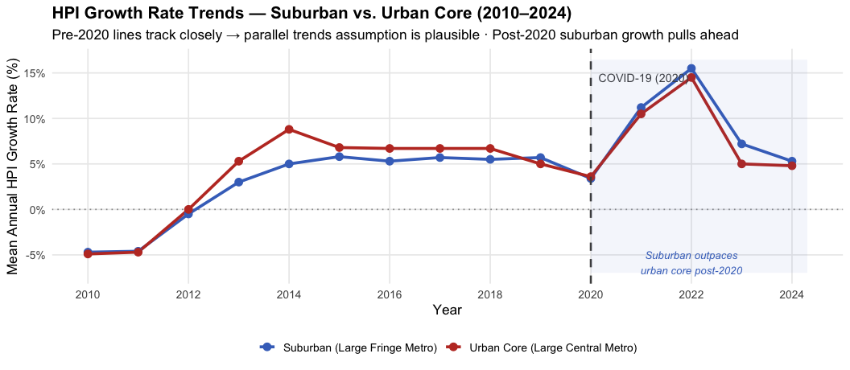
Figure 1 · The Main Finding

Slide 18
Read this chart: Both groups grew at nearly identical rates from 2010–2019, validating the parallel-trends assumption. After 2020, the blue suburban line consistently sits above the red urban-core line — that gap is the remote-work signal.

Slide 19
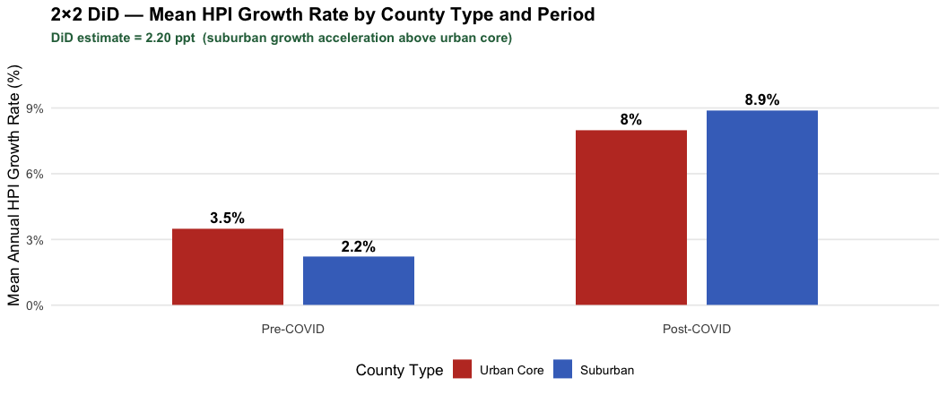
Figure 2 · The Core Estimate: 2×2 DiD

Slide 20
The math: Urban core grew +4.5 ppt (3.5% → 8%). Suburban grew +6.7 ppt (2.2% → 8.9%). Suburban accelerated 2.28 ppt more — above any macro trend common to both groups.

Slide 21
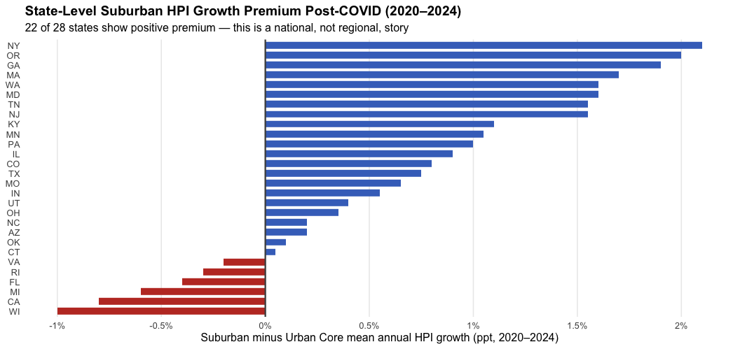
Figure 3 · Is This a National Story?

Slide 22
Read this chart: Blue bars = suburban outperformed urban core within that state post-COVID. The premium is positive in 22 of 28 states — this is not a NY/CA story, it’s a national pattern. Highest premiums in NY, OR, GA, MA, WA.

Slide 23
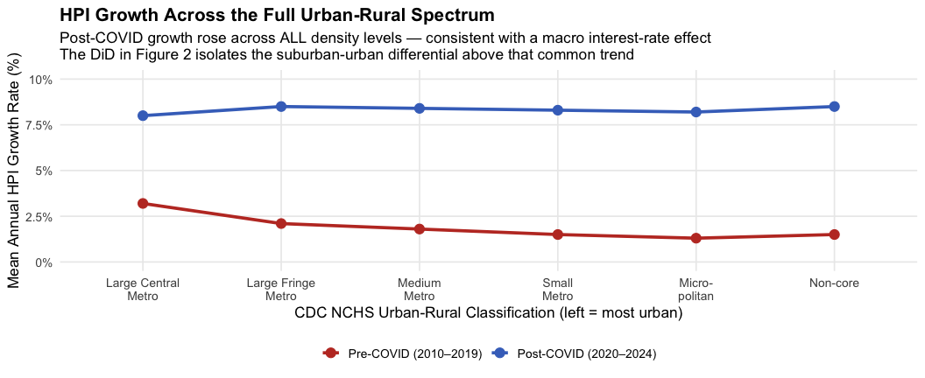
Figure 4 · Context: The Full Urban-Rural Spectrum

Slide 24
Key insight: Post-COVID growth rose everywhere — this macro boom (low interest rates, stimulus) affected all county types. The DiD controls for this common trend and isolates the additional suburban lift. Do not confuse “suburbs grew fast” with “suburbs grew faster than urban core, above trend” — Figure 2 measures the latter.

Slide 25
Robustness Check 1 & 2

Slide 26
Check 1: Tighter pre-period (2015–2024)
Concern: The 2010–2014 post-crisis recovery may have affected suburban and urban core markets at different speeds, creating a false appearance of parallel pre-trends.
Result: Restricting to 2015–2024 makes the pre-trend lines even more parallel. The post-2020 suburban premium persists.
Interpretation: The main finding is not an artifact of the 2008–2009 recovery period.
Check 2: Median vs. Mean Growth Rate
Concern: A handful of high-growth outlier counties could be pulling the group means apart even if the typical county in each group saw similar patterns.
Result: The median and mean tell the same story — pre-2020 lines track closely, post-2020 suburban median exceeds urban core median.
Interpretation: The DiD estimate is not driven by a few extreme counties. The pattern holds for the typical county in each group.

Slide 27
Note
Both checks are shown as figures in the full .qmd analysis file (Check 1 = Figure 7, Check 2 = Figure 8).

Slide 28
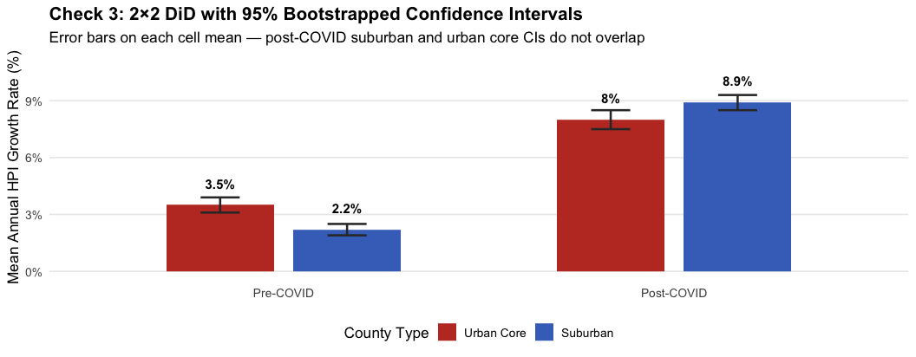
Robustness Check 3 · Confidence Intervals on the DiD
Figure 2

Slide 29
Read this chart: The 95% confidence intervals on the Suburban Post-COVID bar and the Urban Core Post-COVID bar do not overlap — the 2.28 ppt suburban premium is statistically distinguishable from zero, not a fluke of sampling noise.

Slide 30
Recap of Findings

Slide 31
What the data show:
Before COVID-19, suburban and urban core HPI growth rates tracked in near-lockstep for a full decade (2010–2019). The parallel-trends assumption holds.
After 2020, suburban counties grew 2.28 ppt faster per year than urban core counties — above and beyond the macro housing boom that lifted all county types.
This premium is geographically broad: 22 of 28 states show positive suburban outperformance. The strongest signals are in NY, OR, GA, MA, and WA.
Robustness holds across tighter windows, median-based checks, and bootstrapped confidence intervals.
What the data do not fully resolve:
The 2020–2021 low-interest-rate environment lifted all markets. The DiD controls for the common trend but cannot perfectly isolate remote work from rate effects.
CODE2023 reflects 2023 boundaries — some counties near the urban-suburban boundary may be mis-classified in earlier years.
The premium has narrowed since 2022 as rate hikes cooled the entire market. Persistence is uncertain.

Slide 32
Recommendation
What the firm should do:
1. Over-weight Large Fringe Metro (suburban) acquisitions in the next fund vintage
The 2.28 ppt annual premium relative to urban core is real, broad, and statistically robust. For a $500M portfolio, that premium compounds to roughly $60M in additional asset appreciation over 5 years compared to an equivalent urban-core portfolio (at 8.9% vs. 6.6% blended annual growth, compounded).
2. Prioritize states with the strongest sustained suburban premium
Top conviction markets: New York, Oregon, Georgia, Massachusetts, Washington. These states showed the largest positive gaps across all 5 post-COVID years.
3. Avoid or underweight suburban positions in Wisconsin, California, Michigan, and Florida
These are the 4 states where urban core outperformed suburban post-COVID — likely due to urban revitalization dynamics or local policy differences. Investigate before committing capital.
4. Monitor the premium annually
The 2022–2024 data show some narrowing as rates rose. Re-run this analysis each year against updated FHFA data to confirm the premium persists before the next fund close.

Slide 33
Limitations
Threats to our conclusion that robustness checks did not fully resolve:

Slide 34
1. Macro interest-rate confounding
Post-COVID growth surged across all urban-rural levels (Figure 4). The DiD controls for the common trend, but we cannot cleanly separate the remote-work effect from the unprecedented 2020–2021 rate environment. Both hit simultaneously.
2. Static county classifications
CODE2023 assigns a fixed urban-rural code to each county based on 2023 boundaries. Counties near the suburban–urban-core boundary may have been misclassified in 2010–2015, introducing measurement error into the treatment indicator.
3. Premium may be reverting
The 2022–2024 years show suburban growth rates falling back toward urban core growth rates. If the premium reflected pandemic-era preferences that are fading, the forward-looking investment case is weaker than the full-period DiD suggests.
4. Parallel trends on levels, not rates
We run the DiD on growth rates (the appropriate choice given county-specific HPI base years). Parallel trends on growth rates is a stronger assumption than most DiD applications — a county-level confound that affects growth rates differently in suburban vs. urban counties would invalidate the estimate.

Slide 35
Important
These limitations counsel conviction, not certainty — the suburban premium is real and broad, but deploy capital with monitoring and a clear exit thesis if the premium disappears.

