Slide 1
Unit Economics for Marketers
Blindspot Lab demo deck · Lecture 2 · synthetic examples
Notes:
This deck accompanies the primer chapter on contribution margin and ROAS. Synthetic teaching material created for the Blindspot Lab demonstration. All companies, prices and results are fictional.

Slide 2
From Visitors to Customers: The Funnel
Visitors: 20,000
Product views: 6,000
Add to cart: 1,200
Purchases: 500
Overall conversion rate = 500 ÷ 20,000 = 2.5%
Notes:
Each stage of the funnel loses people. The overall conversion rate is purchases divided by visitors, so the paid search funnel in our example converts at 2.5 percent. The biggest drop is between product views and add to cart.

Slide 3
Revenue Is Not Profit
Revenue = price × units sold
Variable costs rise with every unit sold
Profit appears only after variable and fixed costs are covered
Growing revenue can still shrink profit if each sale earns less
Notes:
A common mistake is to celebrate revenue growth that came from discounting. Always ask what each sale contributes after its variable costs.

Slide 4
Contribution Margin
Contribution margin per unit = price − variable cost
Contribution margin ratio = contribution ÷ price
Total contribution = contribution per unit × units sold
Contribution pays for fixed costs first, then becomes profit
Notes:
For a ₹1,200 jacket with an ₹800 variable cost, contribution per unit is ₹400 and the contribution margin ratio is one third.

Slide 5
Price Cuts Need More Volume Than You Think
Jacket price: ₹1,200 → ₹1,080 (a 10% cut)
Variable cost stays at ₹800
Contribution per unit: ₹400 → ₹280
Volume needed to keep contribution: 400 ÷ 280 − 1 = +42.9%
Volume needed to keep revenue: only +11.1%
Notes:
Students often answer with the revenue figure. The question is what the business keeps after variable costs, so the contribution figure of 42.9 percent is the one that protects profit.

Slide 6
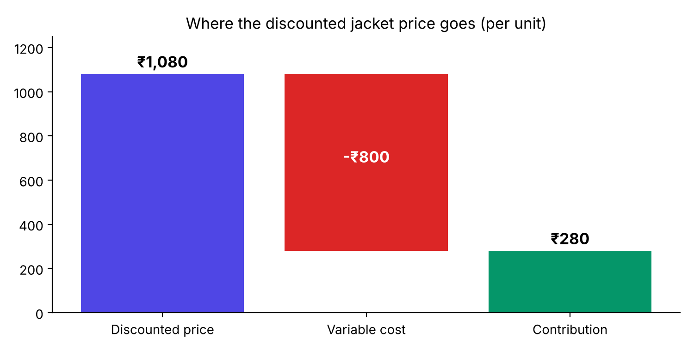
Where the Money Goes
Notes:
The waterfall shows that after the discount most of the price goes to variable costs: only ₹280 of the ₹1,080 discounted price remains as contribution per jacket.

Slide 7
ROAS by Channel
Break-even ROAS at a 40% contribution margin ratio = 2.5
Notes:
Display and Social are above 1 but below the break-even ROAS of 2.5, so they lose money on a contribution basis. Search and Email are above break-even.

Slide 8
Break-even ROAS
Contribution margin ratio | Break-even ROAS
20% | 5.0x
25% | 4.0x
40% | 2.5x
50% | 2.0x
60% | 1.67x
Notes:
Break-even ROAS is one divided by the contribution margin ratio. Lower margins need much higher ROAS.

Slide 9
Acquisition Economics
CAC = sales and marketing spend ÷ new customers
CLV should be based on contribution, not revenue
Payback period = CAC ÷ monthly contribution per customer
Example: ₹600 monthly revenue at a 30% margin = ₹180 contribution per month
Notes:
A subscription box customer paying ₹600 a month at a 30 percent contribution margin ratio generates ₹180 of contribution per month. With a CAC of ₹720 the payback period is four months.

Slide 10
Correlation Is Not Causation
Loyalty-app users spend more, but who chooses to install the app?
Confounders can create correlations without causation
Randomised A/B tests balance confounders on average
Ask whether an effect is large enough to matter, not only whether it is significant
Notes:
In our synthetic test, the holdout group that never saw the loyalty-app promotion spent ₹1,950 per month on average, compared with ₹2,050 for the promoted group, a lift of about 5 percent.

Slide 11
Key Takeaways
Judge pricing and campaigns on contribution, not revenue
Break-even ROAS = 1 ÷ contribution margin ratio
Compare CAC with contribution-based CLV
Use experiments before claiming causal effects
Notes:
Synthetic teaching material created for the Blindspot Lab demonstration. All companies, prices and results are fictional.

