Slide 1
EDES 301 Project BreatheSafe Proposal
02/28/2025
Arjun Kannan

Slide 2
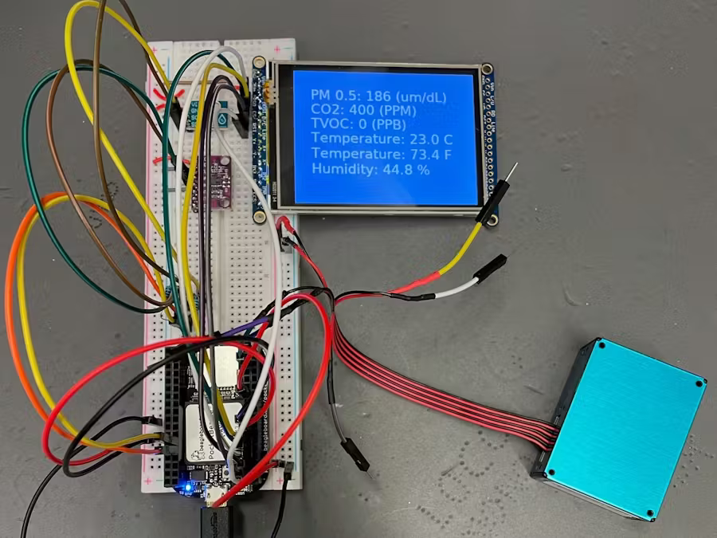
Background Information
What is being proposed?
This project aims to build a PocketBeagle-based Air Quality Monitor that
measures and displays PM2.5, CO2, TVOC, temperature, and humidity in
real time. The device will be compact, easy to use, and suitable for
personal or indoor air quality monitoring.
Existing project: https://www.hackster.io/flygonial/pocketbeagle-air-quality-data-module-ad8ce1
What improvements / additions over existing project?
The PMS5003 sensor in the existing project had unstable readings and required aggressive querying. The PMSA003I is an I2C-based air quality sensor, making it easier to interface with PocketBeagle. The project also required manual execution of the script. Implementing run-on-startup makes the device fully autonomous
What is your story?
With rising air pollution in cities like Delhi, India where my cousins live, affordable DIY air quality monitors are essential. This project aims to provide an open-source, low-cost solution for measuring air quality in real-time.

Slide 3
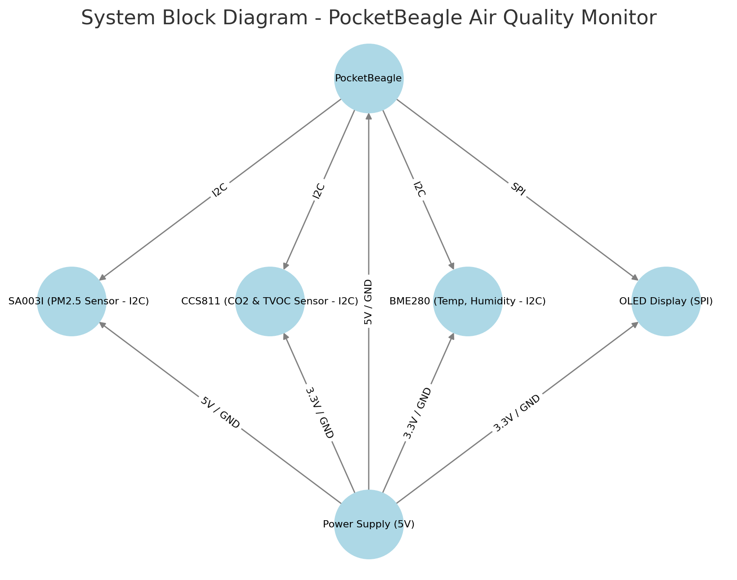
System Block Diagram
Key Components & Connections:
PocketBeagle as the central processing unit.
PMSA003I (PM2.5 Sensor) connected via I2C.
CCS811 (CO2 & TVOC Sensor) connected via I2C.
BME280 (Temperature & Humidity Sensor) connected via I2C.
OLED Display connected via SPI.
Power Supply (5V) providing power to all components.

Slide 4
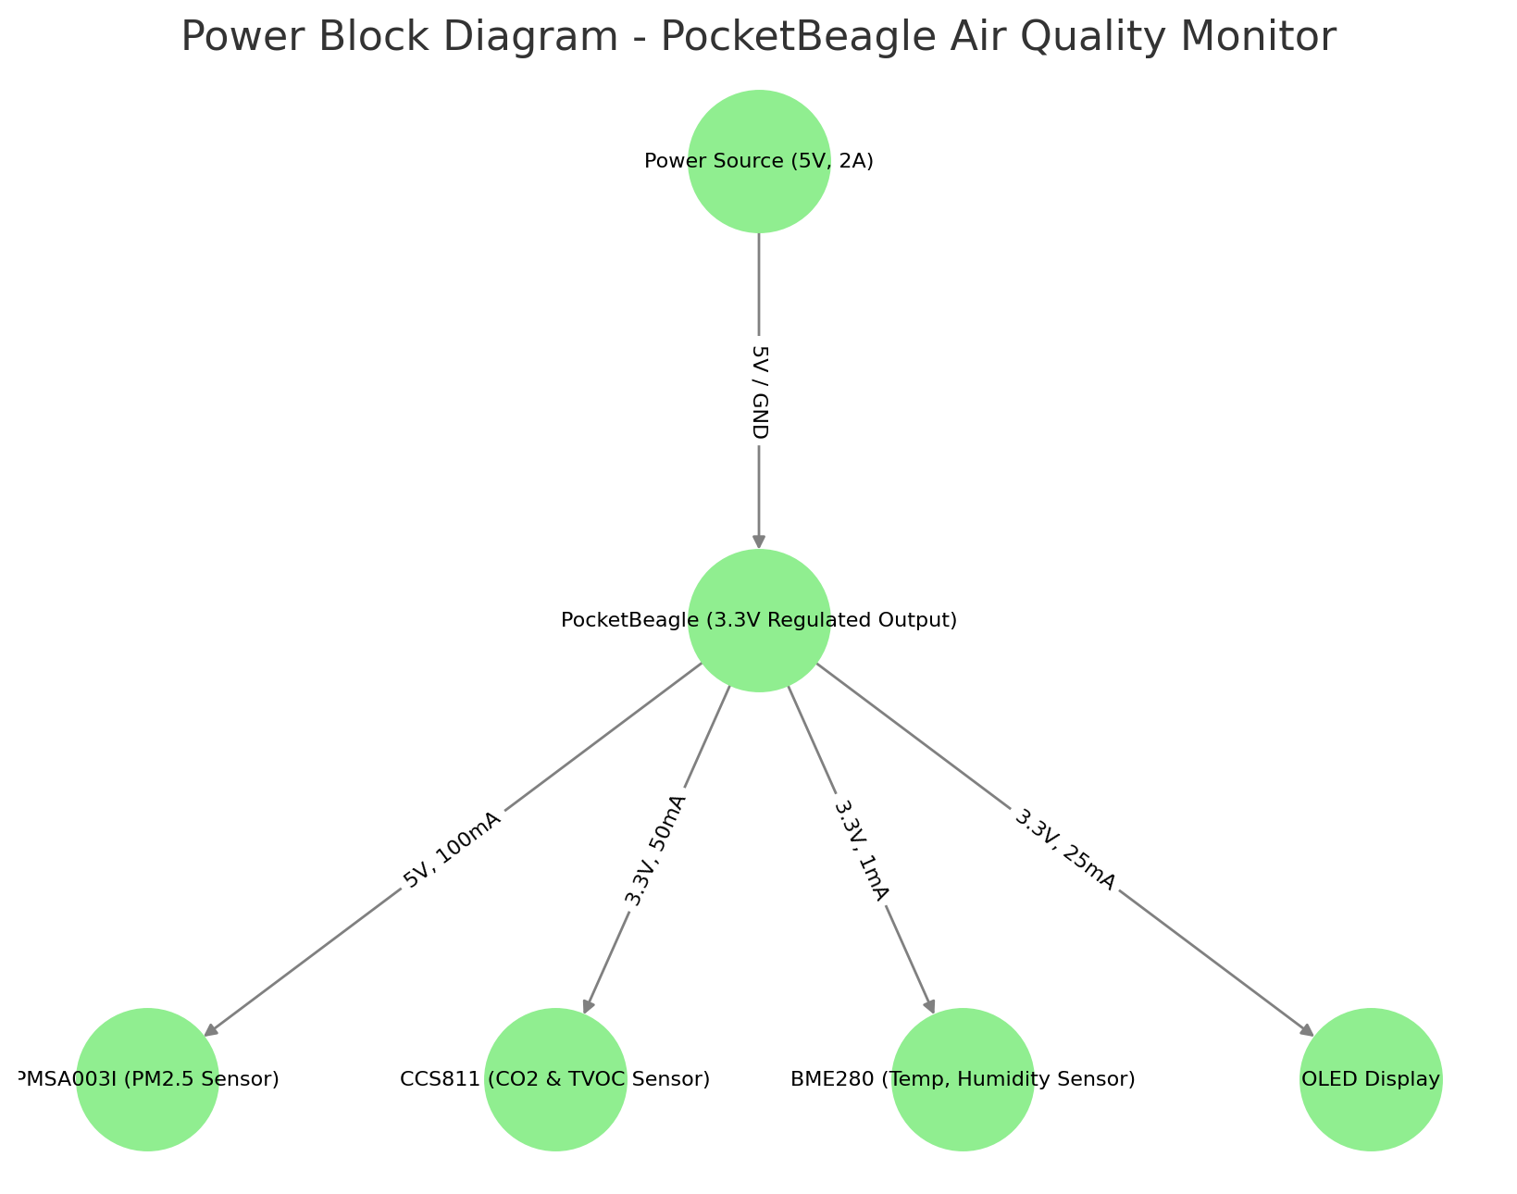
Power Block Diagram
Key Power Details:
Power Source (5V, 2A): PocketBeagle (3.3V Regulated Output).
PMSA003I (PM2.5 Sensor): 5V, 100mA.
CCS811 (CO2 & TVOC Sensor): 3.3V, 50mA.
BME280 (Temperature & Humidity Sensor): 3.3V, 1mA.
OLED Display: 3.3V, 25mA.
This ensures the system operates within the power constraints of the
PocketBeagle while providing stable operation for all component.

Slide 5
Components / Budget
Component | EDES301 to Buy? | Cost
PMSA003I (PM2.5 Sensor - I2C) - https://www.adafruit.com/product/4632 |  | 44.95
CCS811 (CO2 & TVOC Sensor - I2C) - Amazon | Yes | 15.49
BME280 (Temp, Humidity Sensor - I2C) - Amazon | Yes | 1.70
OLED Display (128x64, I2C) - Digikey | Yes | 17.50
May or may not need this - 5V Power Supply (2A) – Amazon |  | 9.99
Optional – LEDs – 3 (Red, Yellow, Green)

Slide 6
Component Selection (Remove slide for submission)
All components must be from either: Amazon, Adafruit, Sparkfun, Digi-Key, or Mouser
Select no more than two (2) components that are not on approved component spreadsheet
See Canvas → Files → assignments → EDES301_project_01_parts_list.xlsx
If there is a cheaper part that you would like to use, we can discuss in the project meeting
All components needed for the project should be listed on Slide 5
All components should have links to the website where they can be purchased
Please trim URLs for links to Amazon
EDES301 will supplement $25 to $35 dollars for components
Please indicate what components need to be purchased by EDES301
If you have a special request, we can discuss in the project meeting

