Slide 1
CLOUD SECURITY ALERT LAMP 🚨💡
S3 Security Scanner ➔ AWS IoT Core ➔ ESP32 Alert Lamp
D. Chander
Roll: 2503A52214
Project Lead & Web Twin
G. Rohan
Roll: 2503S52224
System Architecture & Security
K. Arjun
Roll: 2503A52235
Backend & Database Developer
P. Sachin
Roll: 2503A52240
Hardware & Firmware Engineer

Slide 2
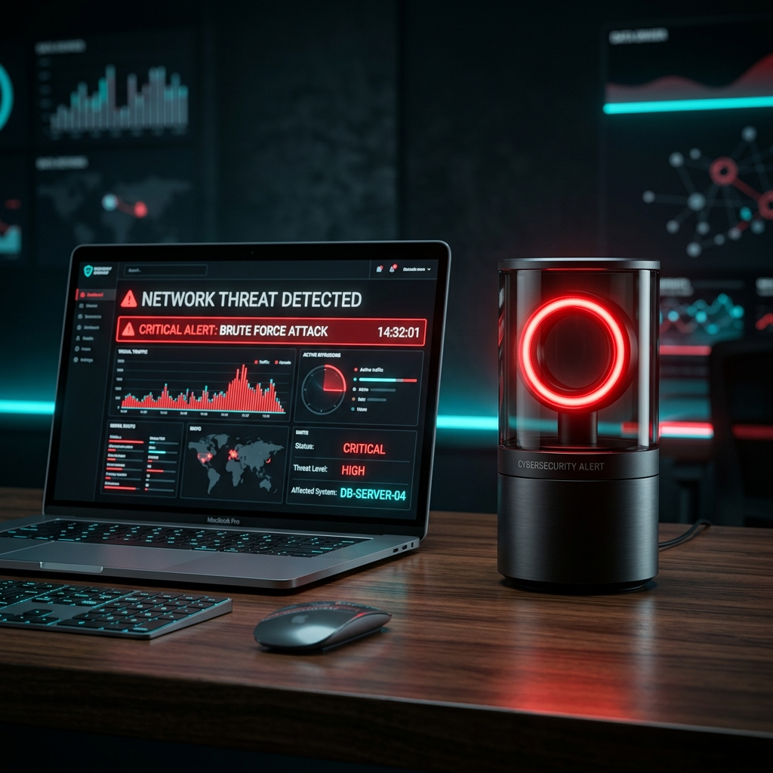
PROJECT OVERVIEW
Cloud Security Alert Lamp & Hardware Pinouts
System Overview
• IoT-Enabled Security Auditor
AWS Lambda security scanner audits S3 buckets and publishes alerts to AWS IoT Core over MQTT.
• Sub-Second Desk Actuator
ESP32 microcontroller receives MQTT alert over TLS and blinks Red LED rapidly to warn admins.
• AWS Student / Learner Lab Ready
Automated deployment supports standard AWS IAM roles and AWS Learner Lab pre-created LabRole.
• Hardware Pinout Config
Uses GPIO 4 for Red LED (with 220Ω resistor) and GPIO 2 for status LED (configurable in config.h).

Slide 3
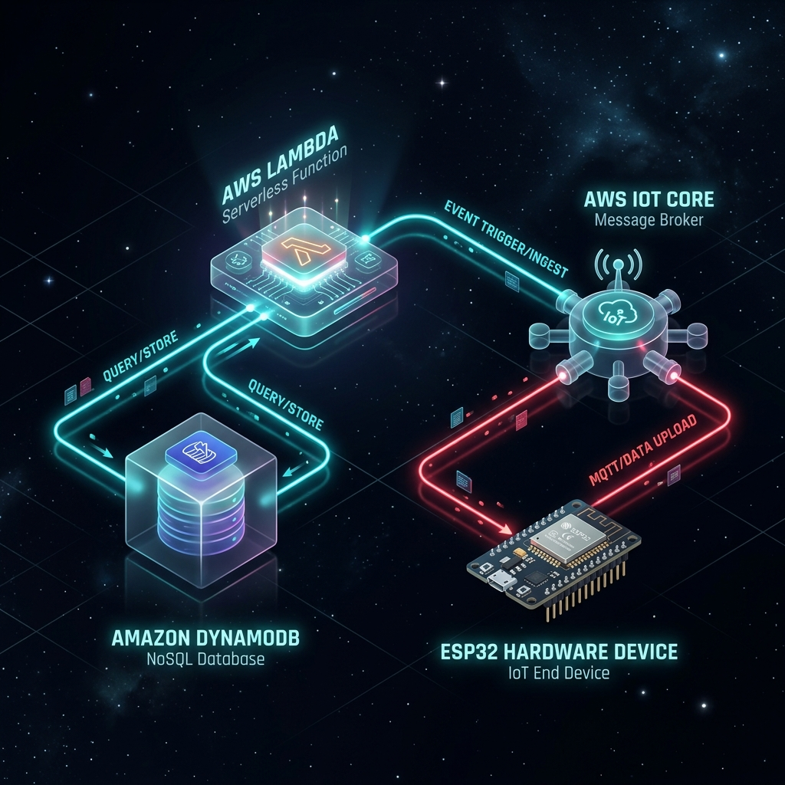
ARCHITECTURE OVERVIEW
End-to-End Cyber-Physical Data Flow
Data Flow Execution
• S3 Event / Schedule
EventBridge Rule or Cron triggers AWS Lambda Auditor Function.
• 3-Layer S3 Audit
Lambda scans PublicAccessBlock, Bucket Policy & S3 ACL Grants.
• IoT & SNS Dispatch
Publishes payload to AWS IoT Core topic cloud/security/alerts & SNS.
• Physical & Web Actuation
ESP32 blinks Red LED via Secure TLS MQTT & Web Dashboard syncs.

Slide 4
PROJECT STRUCTURE
Repository Directories & Module Organization
cloud/
AWS BACKEND & AUDITOR
• lambda/auditor.py (boto3 scanner)
• deploy_aws.py (1-click provisioner)
• test_vulnerable_bucket.py (CLI)
• aws_iot_policy.json (IAM schema)
firmware/
ESP32 C++/ARDUINO CODE
• src/main.cpp (non-blocking FSM)
• include/config.h (Wi-Fi & MQTT)
• include/secrets.h.template
• platformio.ini (build config)
web_dashboard/
WEB APP & SIMULATOR
• index.html (Dashboard & Simulator)
• styles.css (Glassmorphism UI)
• app.js (WebSocket visualizer)
• Interactive scenario runner
docs/
SETUP GUIDES & WIRING
• WIRING_GUIDE.md (Pinouts & Circuit)
• AWS_SETUP_GUIDE.md (Learner Lab)
• README.md (Master documentation)
• Step-by-step certificate guide

Slide 5
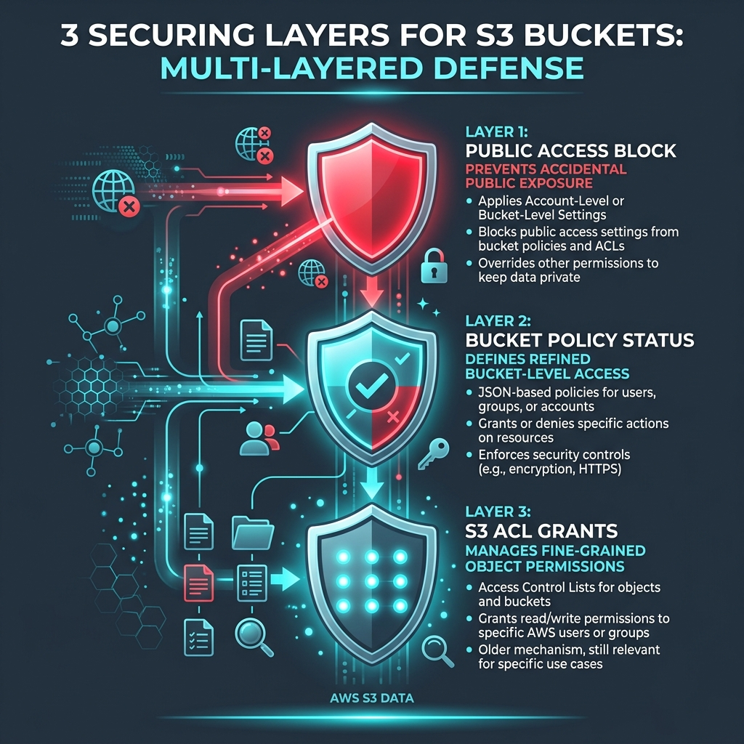
AWS CLOUD BACKEND
Lambda Auditor, Deployer & Test CLI (cloud/)
Backend Component Details
• Lambda Auditor (auditor.py)
Scans S3 GetPublicAccessBlock, GetBucketPolicyStatus & GetBucketAcl. Publishes JSON ALERT/OK payload.
• 1-Click Deployer (deploy_aws.py)
Provisions IoT Thing, Policy, Certs, Lambda zip, EventBridge cron (5 mins), and SNS Topic in < 60s.
• Test Utility (test_vulnerable_bucket.py)
CLI tool: python test_vulnerable_bucket.py create (triggers lamp) and delete (resolves alert).

Slide 6

ESP32 FIRMWARE ENGINE
TLS MQTT Client & FreeRTOS Non-Blocking State Machine
Firmware Architecture (firmware/)
• Framework & Libraries
Built on C++/Arduino using WiFiClientSecure, PubSubClient, and ArduinoJson.
• TLS X.509 Authentication
Handles mutual TLS authentication with AWS IoT Core over Port 8883.
• Non-Blocking Millis FSM
Blink state machine uses millis() timers without freezing delay() calls.
• Auto-Reconnect Engine
Monitors Wi-Fi and MQTT connection loss with automatic exponential reconnects.

Slide 7
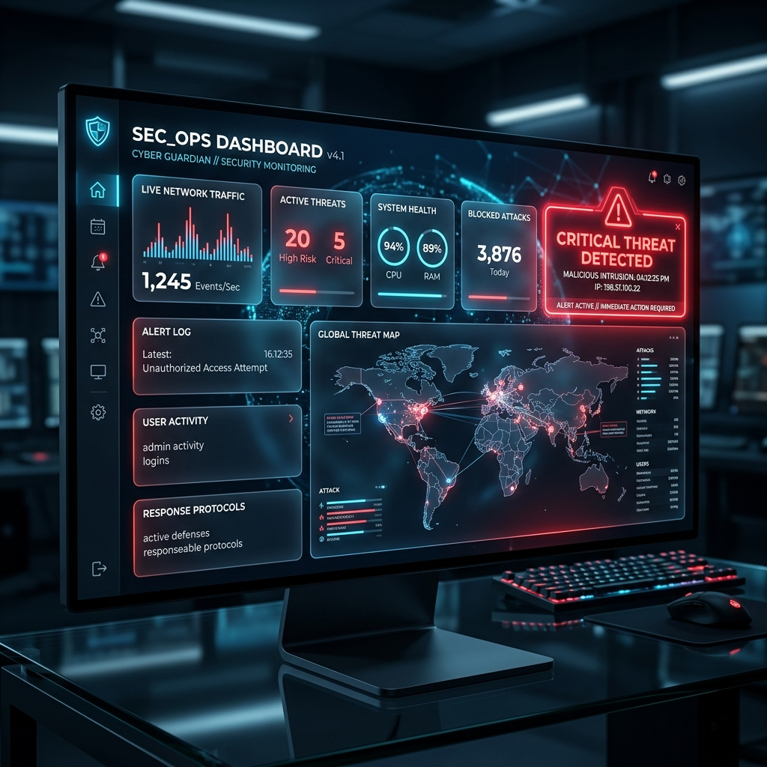
WEB DASHBOARD & SIMULATOR
Real-Time S3 Monitor & Hardware Lamp Visualizer
Web Dashboard Capabilities
• Real-Time S3 Monitor
Renders live security status, exposed bucket names, and scan timestamps.
• Hardware Lamp Simulator
Simulated glowing 2D/3D Red Alert Lamp with realistic blinking animation.
• Test Scenario Runner
Interactive browser buttons to simulate bucket vulnerability creation and fix actions.
• Learner Lab Wizard
Step-by-step interactive manual for AWS Student Account certificate configuration.

Slide 8
VERIFICATION & WIRING PLAN
ESP32 Circuit Schematics & End-to-End Verification
Hardware Wiring (docs/)
• Circuit Wiring Schematics
ESP32 DevKit v1 + High-Brightness Red LED + 220Ω limiting resistor on GPIO 4.
• AWS Student Guide
Tailored step-by-step setup guide for $50 AWS Learner Lab accounts.
Verification Plan
• Automated CLI Test
Run test_vulnerable_bucket.py create/delete to verify Lambda & IoT Core payload delivery.
• Hardware Verification
Verify TLS payload parsing and state transition (OK ➔ ALERT 200ms blink ➔ OK).
• Web Simulator Test
Verify live blinking state animations and dashboard controls in browser.

