Slide 1
CLOUD SECURITY ALERT LAMP 🚨💡
Real-Time Cyber-Physical Alerting for AWS S3 Bucket Exposure
01
D. Chander
Roll: 2503A52214
Lead & Dashboard
• Problem & Motivation
• Email Fatigue Bottleneck
• Web Twin UI
02
G. Rohan
Roll: 2503S52224
Architecture & Security
• 4-Stage Data Pipeline
• Lambda 3-Layer Auditor
• X.509 Mutual TLS
03
K. Arjun
Roll: 2503A52235
Backend & Database
• FastAPI Server & REST
• DynamoDB Audit Logging
• 1-Click AWS Deployer
04
P. Sachin
Roll: 2503A52240
Hardware & Firmware
• ESP32 Circuit Wiring
• FreeRTOS State Machine
• Live Breach Demo Flow
Notes:
SPEAKER NOTES: Welcome evaluators. Today we present the Cloud Security Alert Lamp...

Slide 2

SECTION 1: D. CHANDER (1/3) — PROBLEM STATEMENT
S3 Data Leaks & Email Alert Fatigue
$4.45 Million
Average Enterprise Cloud Data Breach Cost
• Accidental Public S3 Buckets
• Scanners Exploit Leaks in Seconds
• Dev Misconfigurations Expose PII
Notes:
SPEAKER NOTES - D. Chander: S3 publicity is a catastrophic cloud risk...

Slide 3
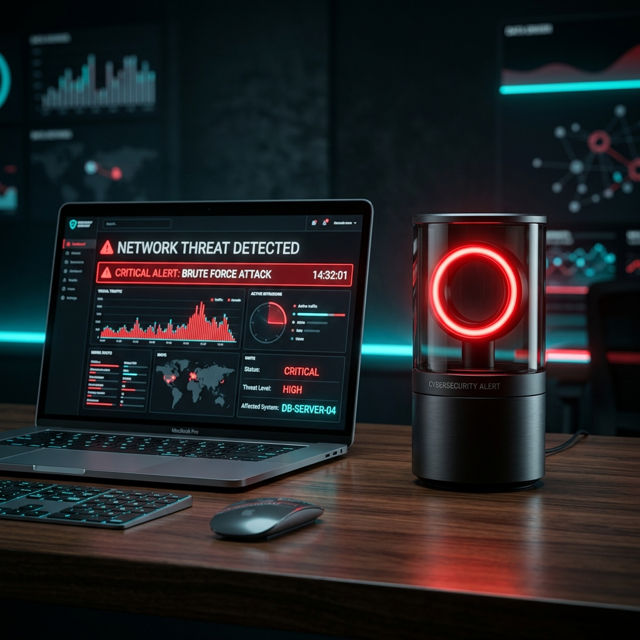
SECTION 1: D. CHANDER (2/3) — MOTIVATION
Email Alert Fatigue & Detection Latency
> 14 Hours
Average Time to Detect Silent S3 Leaks
• 500+ Security Emails Daily
• Critical Alerts Get Buried
• Zero Physical Desk Awareness
Notes:
SPEAKER NOTES - D. Chander: Email notifications create alert fatigue...

Slide 4
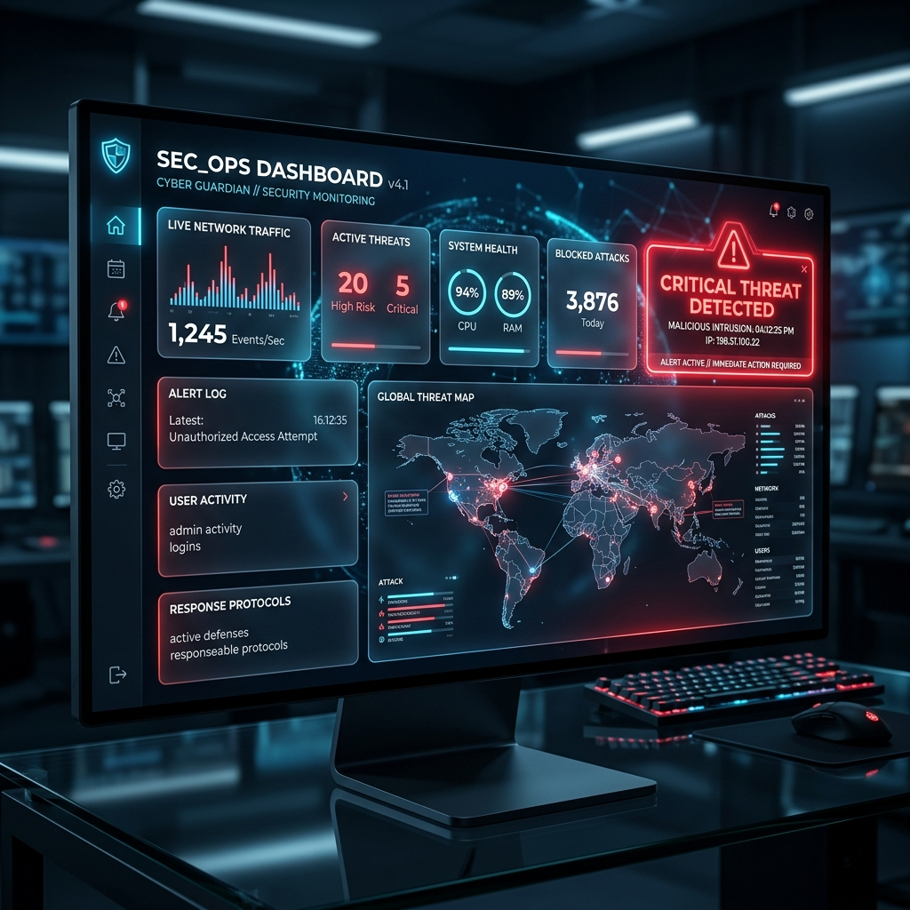
SECTION 1: D. CHANDER (3/3) — DIGITAL TWIN
Interactive Web Twin Dashboard UI
Glassmorphism UI
• Simulated Neon Lamp
Pulsating virtual LED syncs with physical lamp.
• Real-Time WebSockets
Pushes instantaneous state updates to UI.
• Interactive Test Controls
Trigger simulated scans & remediation in browser.
Notes:
SPEAKER NOTES - D. Chander: Our Web Twin Dashboard mirrors physical hardware...

Slide 5
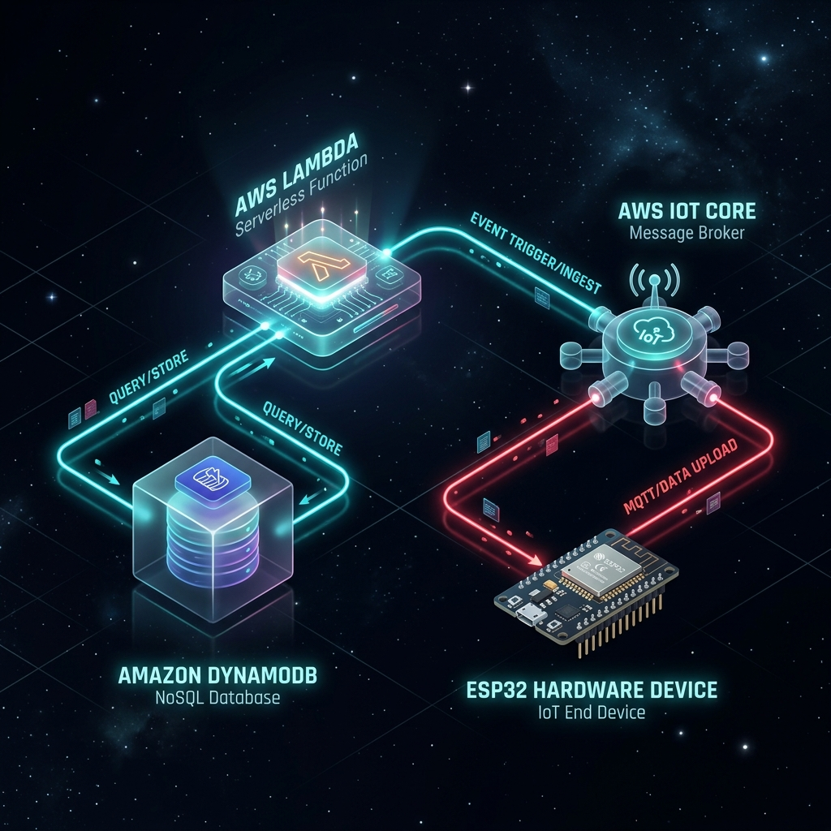
SECTION 2: G. ROHAN (1/3) — ARCHITECTURE
4-Stage Event-Driven Pipeline
< 1 Second Latency
• 1. Detection
AWS Lambda boto3 scans S3 policies.
• 2. Storage
DynamoDB logs event & SNS emails alert.
• 3. Dispatch
AWS IoT Core publishes payload over MQTT.
• 4. Actuation
ESP32 flashes Red LED & Web Twin syncs.
Notes:
SPEAKER NOTES - G. Rohan: Here is our 4-stage decoupled pipeline...

Slide 6
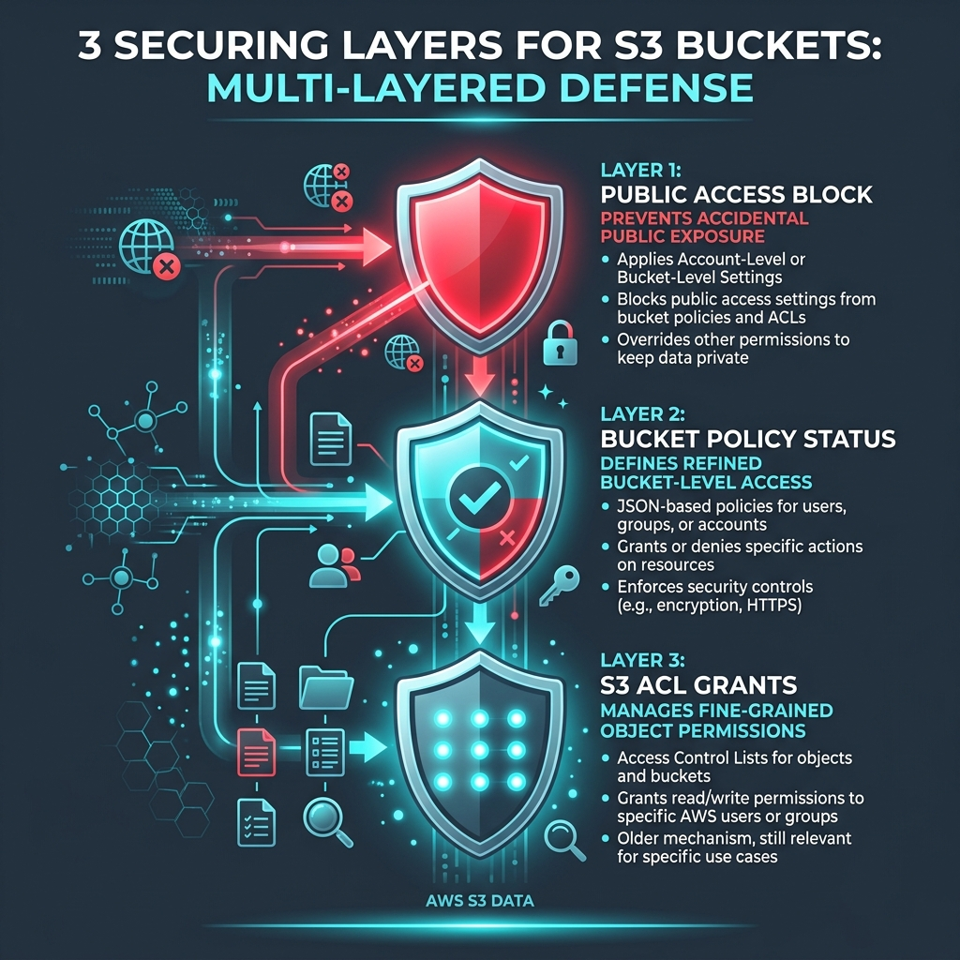
SECTION 2: G. ROHAN (2/3) — SCANNER ENGINE
AWS Lambda 3-Layer Auditor (Boto3)
3-Layer S3 Audit
• Layer 1: Public Access Block
Checks if account-level blocks are enabled.
• Layer 2: Bucket Policy Status
Queries IsPublic == True or wildcard Principal: '*'.
• Layer 3: S3 Access Control Lists
Parses AllUsers / AuthenticatedUsers grants.
Notes:
SPEAKER NOTES - G. Rohan: S3 publicity occurs via three distinct vectors...

Slide 7

SECTION 2: G. ROHAN (3/3) — SECURITY
Zero-Trust X.509 Mutual TLS Encryption
mTLS 1.2 Security
• Mutual Authentication
ESP32 validates Amazon Root CA 1.
• Hardware Cert Identity
Client X.509 cert stored on SPIFFS.
• Encrypted Transport
Port 8883 MQTT prevents packet sniffing.
• Scoped IAM Policy
Restricts hardware client strictly to alert topic.
Notes:
SPEAKER NOTES - G. Rohan: We enforce Zero-Trust mTLS on the hardware endpoint...

Slide 8
SECTION 3: K. ARJUN (1/3) — BACKEND
FastAPI Asynchronous Web Engine
FastAPI Framework
• High Concurrency Event Loop
Asynchronous Python server handles high-throughput requests.
• REST Endpoints Provided
Exposes /api/dashboard, /api/events, and /api/scan.
• WebSocket Broadcast
Pushes real-time state frames directly to connected Web Twins.
Notes:
SPEAKER NOTES - K. Arjun: I am K. Arjun, handling backend & database...

Slide 9
SECTION 3: K. ARJUN (2/3) — STORAGE & ALERTS
Amazon DynamoDB & SNS Alert Engine
DynamoDB 'SecurityEvents'
• NoSQL Audit Log
Stores immutable scan records for historical analysis.
• Key Schema
Partition Key: eventId (S) | Range Key: timestamp (S).
• On-Demand Auto Scaling
PAY_PER_REQUEST billing auto-scales effortlessly.
Amazon SNS Dispatcher
• Push Alert Broadcasting
Dispatches instant SMS and email notifications.
• Topic Configuration
CloudSecurityAlerts SNS topic manages subscribers.
• Zero Latency Delivery
Pushes alerts simultaneously with IoT MQTT payloads.
Notes:
SPEAKER NOTES - K. Arjun: Every breach event is persisted into DynamoDB...

Slide 10
SECTION 3: K. ARJUN (3/3) — AUTOMATION
1-Click AWS Provisioner (deploy_aws.py)
Automated Setup
• Single Command Execution
python cloud/deploy_aws.py provisions full stack.
• Resource Creation
Creates DynamoDB table, SNS topic, Lambda & IoT Thing.
• Student Account Ready
Auto-detects $50 AWS Learner Lab LabRole.
• Cert Auto-Injection
Populates firmware/include/secrets.h automatically.
Notes:
SPEAKER NOTES - K. Arjun: Running deploy_aws.py automates infrastructure...

Slide 11
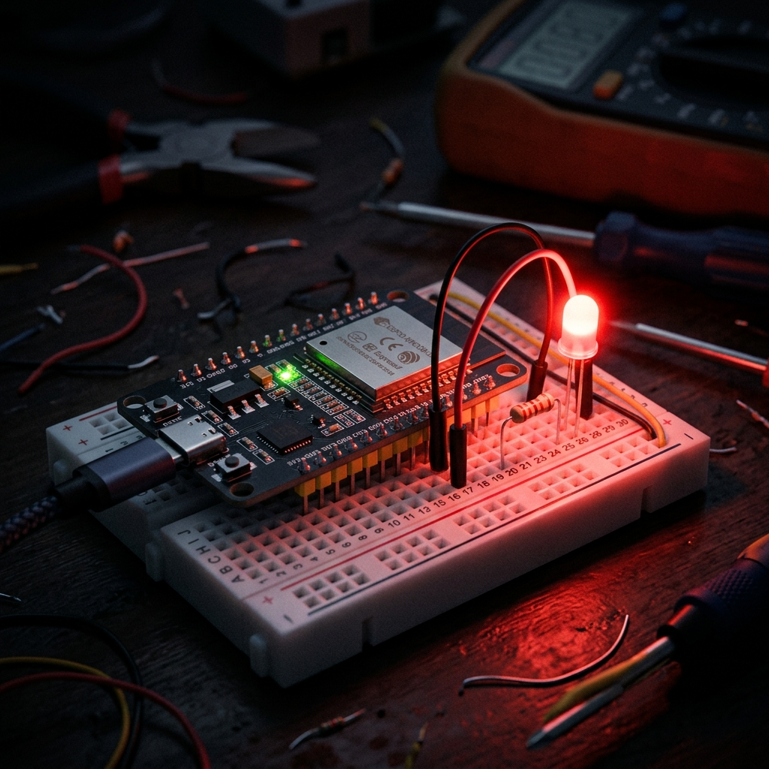
SECTION 4: P. SACHIN (1/3) — HARDWARE WIRING
ESP32 Circuit Schematics & Hardware BOM
Hardware Schematics
• ESP32 DevKit v1
Dual-core 240MHz MCU with hardware TLS crypto engine.
• Red LED Actuator
Anode connected to digital GPIO 23.
• 220Ω Limiting Resistor
Protects LED & ensures stable 3.3V GPIO operation.
• Status Blue LED
GPIO 2 indicates Wi-Fi handshake status.
Notes:
SPEAKER NOTES - P. Sachin: I am P. Sachin, handling ESP32 hardware...

Slide 12
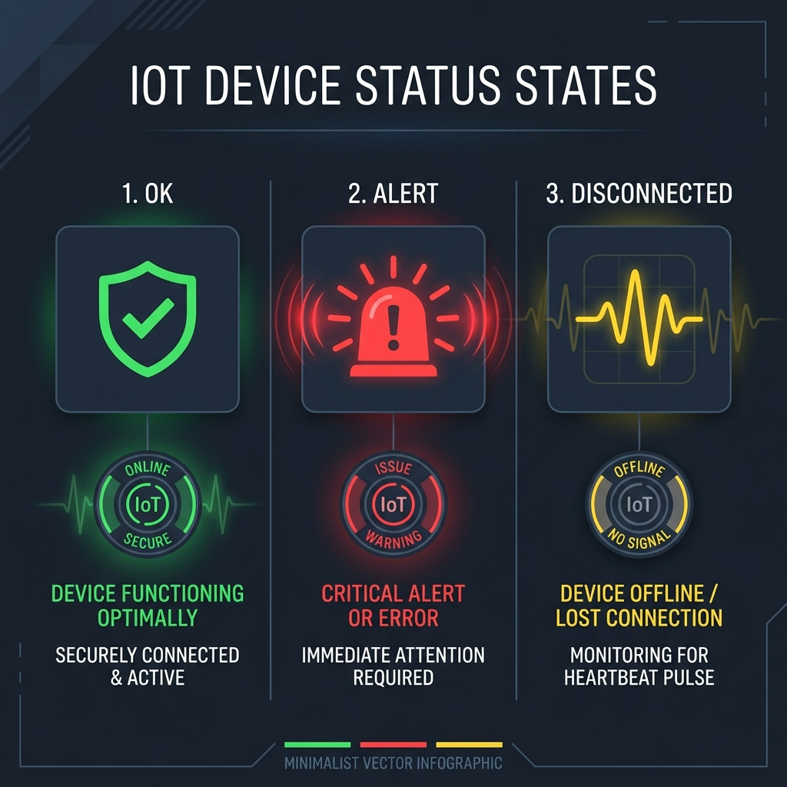
SECTION 4: P. SACHIN (2/3) — FIRMWARE ENGINE
ESP32 C++ FreeRTOS Non-Blocking State Machine
Millis() FSM Engine
• STATE_SECURE 🟢
System Idle. Red LED solid OFF.
• STATE_ALERT 🔴
Public S3 detected. Red LED blinks rapidly (200ms).
• STATE_DISCONNECTED 🟡
Network drop. Red LED pulses slowly (1000ms).
• Non-Blocking Execution
Uses millis() timers; zero blocking delay() calls.
Notes:
SPEAKER NOTES - P. Sachin: Our C++ firmware uses a non-blocking millis() state machine...

Slide 13
SECTION 4: P. SACHIN (3/3) — LIVE DEMO & Q&A
Live 4-Step Demonstration & Technical Q&A
Live Demo Test Flow
• 1. Baseline
ESP32 connected to Wi-Fi. LED solid OFF 🟢.
• 2. Breach
Run: python test_vulnerable_bucket.py create.
• 3. Actuation
Red LED blinks rapidly (200ms) 🔴. Web UI Alert.
• 4. Remediation
Run: python test_vulnerable_bucket.py delete. LED OFF 🟢.
Technical Jury Defense
Q: Wi-Fi Connection Drop?
A: Pulses slowly (1000ms) & executes auto-reconnect.
Q: MQTT Spoofing Risk?
A: Blocked by X.509 Client Cert mutual TLS.
Q: AWS Student Ready?
A: Auto-detects $50 Learner Lab LabRole.
Notes:
SPEAKER NOTES - P. Sachin & D. Chander: That concludes our presentation...

