Slide 1
CLOUD SECURITY ALERT LAMP 🚨💡
S3 Security Scanner ➔ AWS IoT Core ➔ ESP32 & Virtual Red Light Twin
D. Chander
Roll: 2503A52214
Lead & Web Twin
G. Rohan
Roll: 2503S52224
Architecture & Security
K. Arjun
Roll: 2503A52235
Backend & Database
P. Sachin
Roll: 2503A52240
Hardware & Firmware

Slide 2
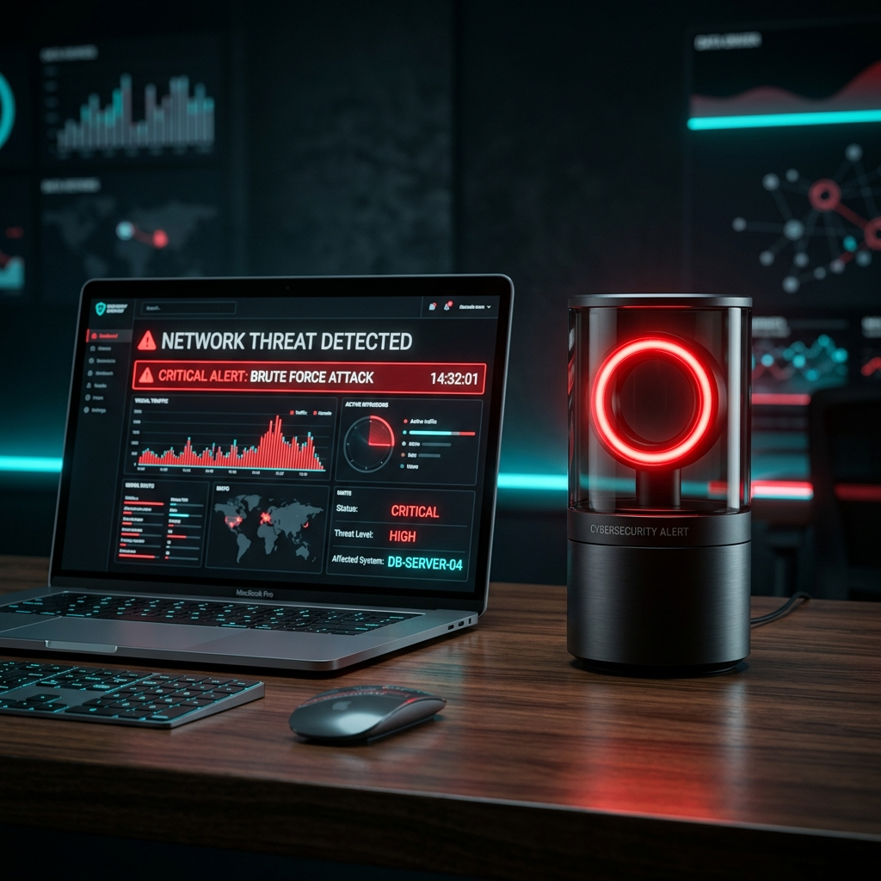
PROJECT OVERVIEW
Cloud Security Alert System & Pinout Config
System Concept
• IoT Security Auditor
AWS Lambda security scanner audits S3 buckets and publishes alerts to AWS IoT Core over MQTT.
• Physical & Virtual Red Lamp
Dual alert system: Physical ESP32 Red LED on desk + Virtual glowing Red Lamp on Web UI.
• AWS Learner Lab Ready
Automated scripts support standard AWS accounts and AWS Learner Lab pre-created LabRole.
• Hardware Pinouts
GPIO 4 drives Red LED (220Ω resistor); GPIO 2 drives status LED (configured in config.h).

Slide 3
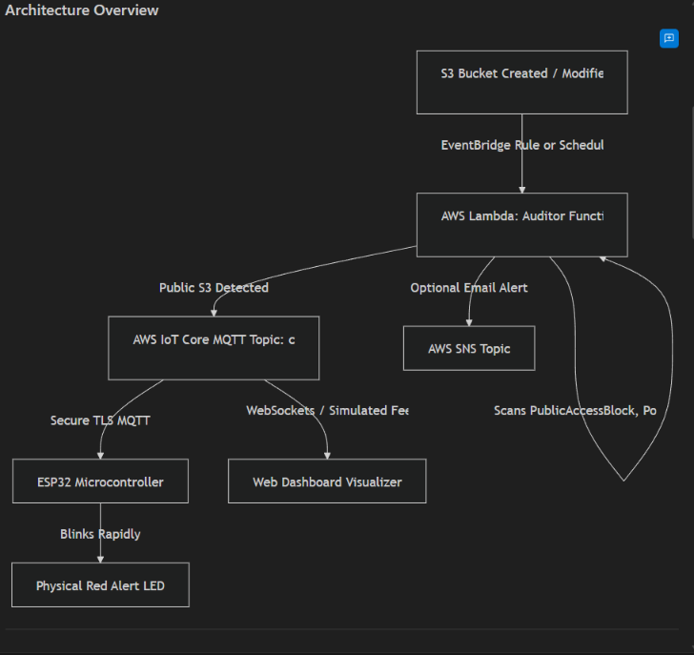
ARCHITECTURE OVERVIEW
End-to-End Cyber-Physical Data Flow Diagram
Event Execution Flow
• S3 Trigger / Schedule
EventBridge Rule or Cron triggers AWS Lambda Auditor Function.
• 3-Layer S3 Audit
Lambda evaluates PublicAccessBlock, Bucket Policy & S3 ACL Grants.
• IoT Core & SNS Dispatch
Publishes payload to AWS IoT Core topic cloud/security/alerts & SNS.
• Physical & Virtual Actuation
ESP32 blinks Red LED via TLS MQTT & WebSockets syncs Virtual Red Light.

Slide 4
PROJECT STRUCTURE
Repository Directories & Module Organization
cloud/
AWS BACKEND & SCANNER
• lambda/auditor.py (boto3 scanner)
• deploy_aws.py (1-click provisioner)
• test_vulnerable_bucket.py (CLI)
• aws_iot_policy.json (IAM schema)
backend/
FASTAPI SERVER LAYER
• main.py (REST API & WebSocket)
• led_controller.py (Desktop simulator)
• requirements.txt (Dependencies)
• WebSocket server on /ws
firmware/
ESP32 C++/ARDUINO CODE
• src/main.cpp (non-blocking FSM)
• include/config.h (Wi-Fi & MQTT)
• include/secrets.h.template
• platformio.ini (build config)
web_dashboard/
FRONTEND & VIRTUAL LAMP
• index.html (UI & Lamp Simulator)
• styles.css (Glassmorphism & Glow)
• app.js (WebSocket visualizer)
• Interactive scenario runner

Slide 5
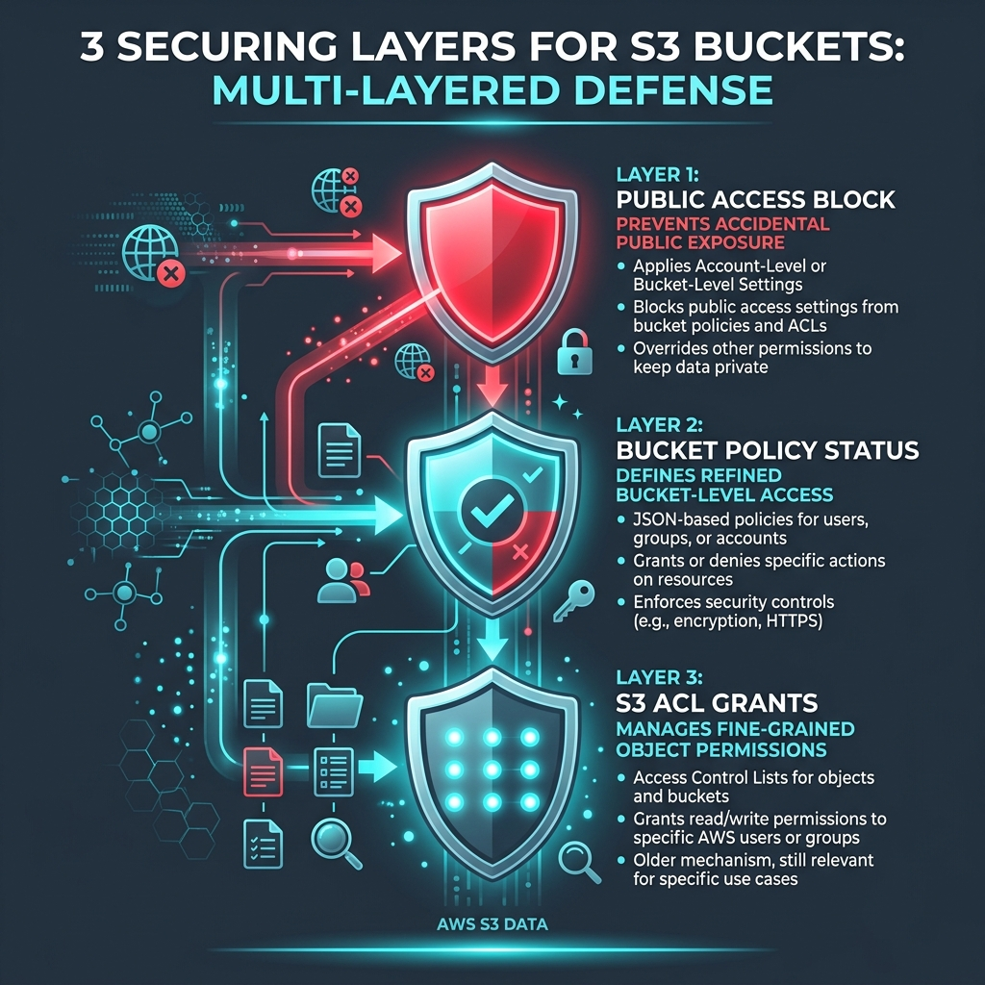
AWS CLOUD BACKEND
Lambda Auditor, Deployer & Test CLI (cloud/)
Cloud Component Details
• Lambda Auditor (auditor.py)
Scans S3 GetPublicAccessBlock, GetBucketPolicyStatus & GetBucketAcl. Publishes JSON ALERT/OK payload.
• 1-Click Deployer (deploy_aws.py)
Provisions IoT Thing, Policy, Certs, Lambda zip, EventBridge cron (5 mins), and SNS Topic in < 60s.
• Test Utility (test_vulnerable_bucket.py)
CLI tool: python test_vulnerable_bucket.py create (triggers lamp) and delete (resolves alert).

Slide 6

FASTAPI APPLICATION BACKEND
Python Async REST API & WebSocket Server (backend/)
FastAPI Backend Core
• Asynchronous Event Loop
Built on Python asyncio & uvicorn for non-blocking high throughput.
• REST API Endpoints
Exposes /api/dashboard, /api/events, and /api/scan for data retrieval.
• WebSocket Server (/ws)
Maintains persistent WebSocket connections to push live state updates to Web Twin UI.
• Desktop Lamp Simulator
python backend/led_controller.py terminal simulator for testing without physical hardware.

Slide 7

ESP32 FIRMWARE ENGINE
TLS MQTT Client & FreeRTOS State Machine (firmware/)
Firmware Architecture
• Framework & Libraries
Built on C++/Arduino using WiFiClientSecure, PubSubClient, and ArduinoJson.
• TLS X.509 Authentication
Handles mutual TLS authentication with AWS IoT Core over Port 8883.
• Non-Blocking Millis FSM
Blink state machine uses millis() timers without freezing delay() calls.
• Auto-Reconnect Engine
Monitors Wi-Fi and MQTT connection loss with automatic exponential reconnects.

Slide 8
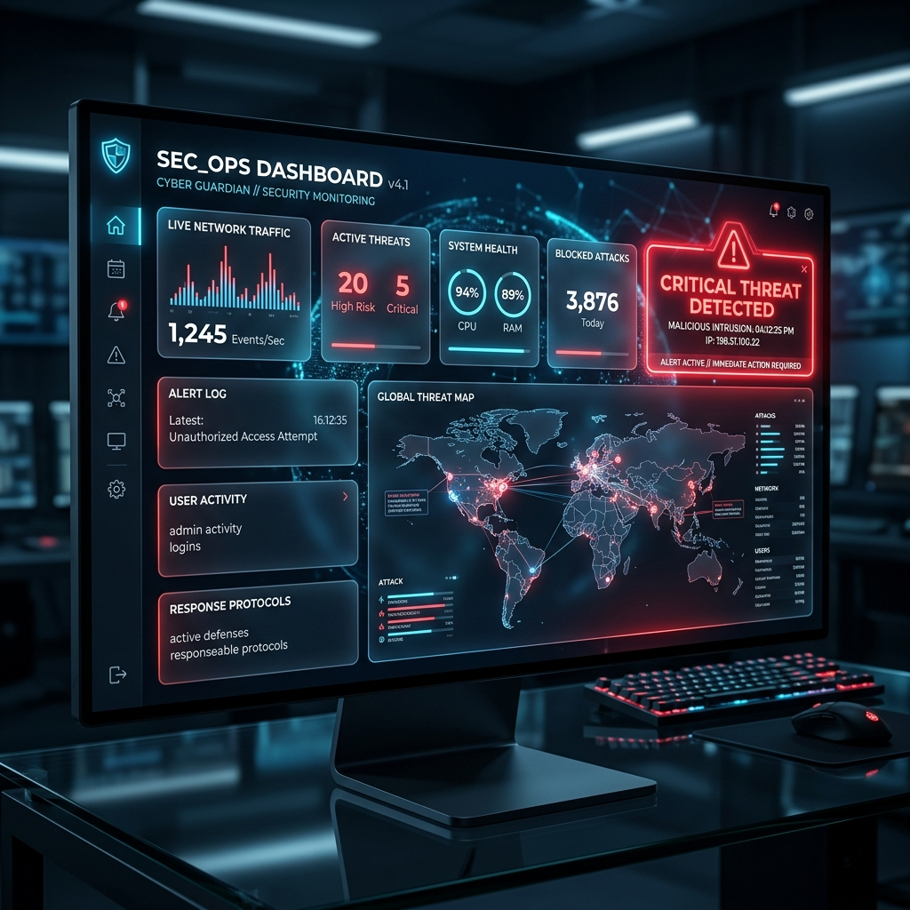
FRONTEND ARCHITECTURE
Glassmorphism UI & WebSocket Engine (web_dashboard/)
Web Dashboard Stack
• HTML5 & Glassmorphism CSS
Modern dark aesthetic with CSS backdrop-filter blur, neon glow effects & clean typography.
• JavaScript WebSocket Engine
app.js maintains persistent WebSocket connection to mirror live backend state changes.
• Real-Time Event Table
Renders history of scanned bucket names, severity levels, and scan timestamps.
• Interactive Scenario Runner
Browser control buttons to simulate public bucket creation and remediation.

Slide 9
OUR VIRTUAL RED LIGHT
Digital Twin Simulator & Synchronous Alert Visualizer
Virtual Red Light Visualizer
• Digital Twin Mirror
Glowing 2D/3D neon Red Alert Lamp rendered directly inside web_dashboard/index.html.
• Synchronous Blinking
Flashes in exact 150-200ms lockstep synchronization with the physical ESP32 hardware LED.
• Zero-Hardware Testing
Allows evaluators and students without ESP32 hardware to test full end-to-end alert flow.
• Learner Lab Wizard
Includes step-by-step interactive manual for copy-pasting AWS Learner Lab X.509 certs.

Slide 10
VERIFICATION & WIRING PLAN
ESP32 Circuit Schematics & End-to-End Verification
Hardware Wiring (docs/)
• Circuit Wiring Schematics
ESP32 DevKit v1 + High-Brightness Red LED + 220Ω limiting resistor on GPIO 4.
• AWS Student Guide
Tailored step-by-step setup guide for $50 AWS Learner Lab accounts.
Verification Plan
• Automated CLI Test
Run test_vulnerable_bucket.py create/delete to verify Lambda & IoT Core payload delivery.
• Hardware Verification
Verify TLS payload parsing and state transition (OK ➔ ALERT 200ms blink ➔ OK).
• Web Simulator Test
Verify live blinking state animations and dashboard controls in browser.

