Slide 1
DATA ANALYTICS & VISUALIZATION (DAV)
Electricity Consumption
15,947
SECTOR RECORDS
20 Circles | 49 Divisions | 476 Sections
& Monitoring Analysis
8.87M
TOTAL SERVICES
TG-SPDCL Domestic Consumer Dataset (July 2026) | Complete 8-Pillar Syllabus Synthesis
8.22M Active Billed Connections
PROJECT RESEARCH TEAM
1,245.5 GWh
D. Chander
Roll: 2503A52214
Data Cleaning, Wrangling & Power Query ETL
ENERGY CONSUMED
1.245 Billion kWh Total Monthly Demand
K. Arjun
Roll: 2503A52235
Seaborn Visualizations, Correlations & Heatmaps
92.68%
P. Sachin
Roll: 2503A52240
Statistical Modeling, Pareto Analysis & Final Decision
BILLING EFFICIENCY
648,960 Unbilled Services Identified
TG-SPDCL Domestic Electricity Consumption & Monitoring | Data Analytics & Visualization (DAV) | July 2026
Slide 1 of 7

Slide 2
PILLARS 1 & 2: PROJECT EXPLANATION & EXPLORATION
Utility Context, 5-Tier Grid Hierarchy & Complete Column Data Dictionary
TG-SPDCL | DAV Project v5
Executive 7-Slide Master Edition
Structural mapping of TG-SPDCL domestic distribution network and data quality audit
Pillar 1: Utility Context & Grid Hierarchy
Feature | Type | Role / Meaning in Analysis
CIRCLE | String | Administrative zone (20 unique zones)
DIVISION | String | Operational district division (49 unique)
SUBDIVISION | String | Field maintenance engineering zone (131)
SECTION | String | Local billing station & line office (476)
AREA | String | Micro neighborhood colony (15,947 rows)
CATDESC/CODE | Cat/Int | Category 1 DOMESTIC tariff identifier
TOTSERVICES | Integer | Registered domestic consumer connections
BILLDSERVICES | Float/Int | Active billed connections in July 2026
UNITS | Float | Metered energy consumption in kWh
LOAD | Float | Sanctioned connected load capacity in kW
• Organization: Telangana Southern Power Distribution Company Limited (TG-SPDCL).
• 5-Tier Network Flow: 20 Circles → 49 Divisions → 131 Subdivisions → 476 Sections → 15,947 Areas.
• Consumer Category: Domestic Category 1 (`CATCODE: 1`, `CATDESC: DOMESTIC`) for July 2026 cycle.
• Grid Relevance: Domestic power accounts for >40% of urban peak load during summer/monsoon.
Operational Problem Statement
• High Unbilled Gap: 648,960 services unbilled in a single month (~7.32% unbilled rate), leaking revenue.
• Severe Load Concentration: Heavy air-conditioning clusters in western Hyderabad strain local distribution transformers.
• Data Hygiene Challenges: Missing records, negative unit reversals, and repeated naming across sections.
Pillar 2: Data Quality Audit & Anomaly Profiling
• 247 Missing BILLDSERVICES: Discovery: 100% of these 247 rows have exactly 0 units (dormant/uncommissioned lines).
• 47 Missing AREA Names: Handled via string imputation as 'UNKNOWN AREA' without losing geographic hierarchy.
• 15 Negative UNIT Records: Min -1,703 kWh (billing reversal adjustments); clamped to 0.0 in analytics pipeline.
• 1,999 Repeated Area Names: 'MAIN ROAD' & 'GANDHI NAGAR' repeat; composite keys (`section_area`) enforce identity.
TG-SPDCL Domestic Electricity Consumption & Monitoring | Data Analytics & Visualization (DAV) | July 2026
Slide 2 of 7

Slide 3
PILLAR 3: BASIC STATISTICS
Statistical Dispersion, Regional Rankings & The 15% / 50.5% Pareto Rule
TG-SPDCL | DAV Project v5
Executive 7-Slide Master Edition
Parametric vs median skewness, urban-rural lifestyle gap, and demand concentration
Statistical Indicator | Total Services | Billed Services | Consumption (kWh) | Connected Load (kW)
Mean (Average) | 556.1 services | 523.0 services | 78,103.6 kWh | 864.04 kW
Std Deviation | 626.2 | 605.8 | 112,930.4 | 1,529.57
Minimum | 1 | 1 | -1,703.0 (Anomalous) | 0.12 kW
25th Percentile (Q1) | 152.0 | 138.0 | 11,312.0 kWh | 86.00 kW
50th Percentile (Median) | 382.0 | 345.0 | 36,826.0 kWh | 316.00 kW
75th Percentile (Q3) | 735.5 | 690.0 | 102,405.5 kWh | 1,058.15 kW
Maximum | 12,182 | 11,886 | 2,319,144.0 kWh | 33,617.69 kW
The Pareto Principle: Area-Size Tier Segmentation
Geographic Rankings & The 3× Lifestyle Consumption Gap
• Very Large Areas (>1,000 services): 2,452 areas (15.4% of total) account for 50.5% (629.0 GWh) of all electricity consumed.
• Large Areas (501–1,000 services): 3,810 areas (23.9% count) account for 24.2% (301.4 GWh) of total demand.
• Medium Areas (201–500 services): 5,120 areas (32.1% count) account for 18.1% (225.4 GWh).
• Small Areas (1–200 services): 4,565 areas (28.6% count) account for only 7.2% (89.7 GWh).
• Utility Takeaway: Focusing grid upgrades on the top 15% sectors stabilizes more than half the entire utility load.
• Top 5 Circles Consume 50.6%: Medchal (141.7M), Habsiguda (138.1M), Cybercity (125.4M), Hyd Central (112.5M), Saroornagar (112.3M).
• Bottom 5 Circles < 1.5% Each: Gadwal (10.0M), Wanaparthy (10.1M), Nagarkurnool (13.1M), Medak (15.9M), Vikarabad (17.9M).
• Lifestyle Consumption Disparity: Banjara Hills (240 kWh) & Cybercity (219 kWh) vs Rural Districts (75–83 kWh) — a 3× living standard gap.
• Extreme Right Skewness: Max sector Hydernagar (2.32M kWh) is 63× greater than the state median (36.8k kWh).
TG-SPDCL Domestic Electricity Consumption & Monitoring | Data Analytics & Visualization (DAV) | July 2026
Slide 3 of 7

Slide 4
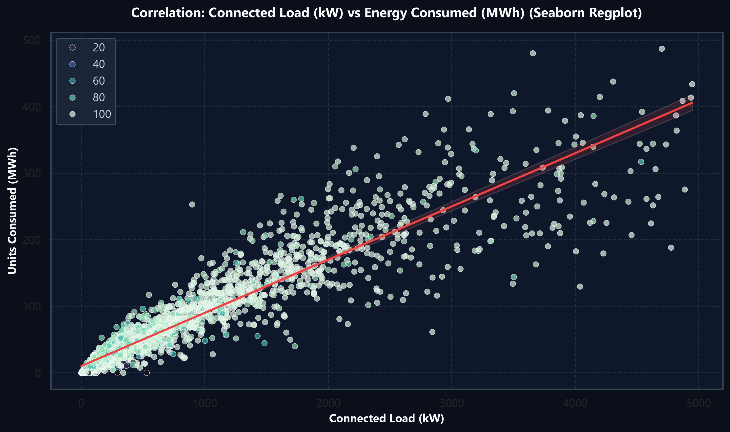
PILLARS 4 & 5: WRANGLING & VARIABLE CONNECTIONS
6-Step ETL Pipeline, Feature Engineering & Load-Units Regression Dynamics
TG-SPDCL | DAV Project v5
Executive 7-Slide Master Edition
Transforming raw billing data and modeling physical dependencies between load and consumption
Pillar 4: 6-Step Data Wrangling (ETL) Pipeline
• 1. Ingestion & Merging: Multi-file CSV/Excel loading via Power Query & Pandas read_csv.
• 2. Null Treatment: Impute 47 area names; replace 247 missing billed services with 0.
• 3. Anomaly Clamping: Clamp 15 negative units to 0.0; clamp minimum load to 0.01 kW.
• 4. Standardize & Validate: Trim whitespace, cast types (uint32/float64), enforce (Billed <= Total).
Feature Engineered Domain Indicators
• Billing Efficiency Rate (%): `billing_rate_pct = (BILLDSERVICES / TOTSERVICES) * 100` — Tracks revenue capture against 95% target.
• Consumption per Connection: `units_per_billed_service = UNITS / BILLDSERVICES` — Normalizes household living standards without size bias.
• Load Utilization Ratio: `units_per_kw_load = UNITS / LOAD` — Measures transformer strain (>250 kWh/kW flags commercial misuse).
• Unbilled Services Gap: `unbilled_services = TOTSERVICES - BILLDSERVICES` — Identifies 648,960 non-billing accounts for field inspection.
Figure: Connected Load (kW) vs Energy Consumed (MWh) with Seaborn Regplot
Variable Pair | Correlation (r) | Operational Significance
LOAD ↔ UNITS | +0.946 (Very Strong) | Connected load capacity directly governs electricity draw.
SERVICES ↔ BILLED | +0.995 (Near Perfect) | Registered connections dictate billed services linearly.
BILLED ↔ UNITS | +0.884 (Strong) | Customer base volume reliably scales gross energy usage.
SERVICES ↔ LOAD | +0.763 (Moderate-High) | Sanctioned capacity expands proportionally with connections.
TG-SPDCL Domestic Electricity Consumption & Monitoring | Data Analytics & Visualization (DAV) | July 2026
Slide 4 of 7

Slide 5
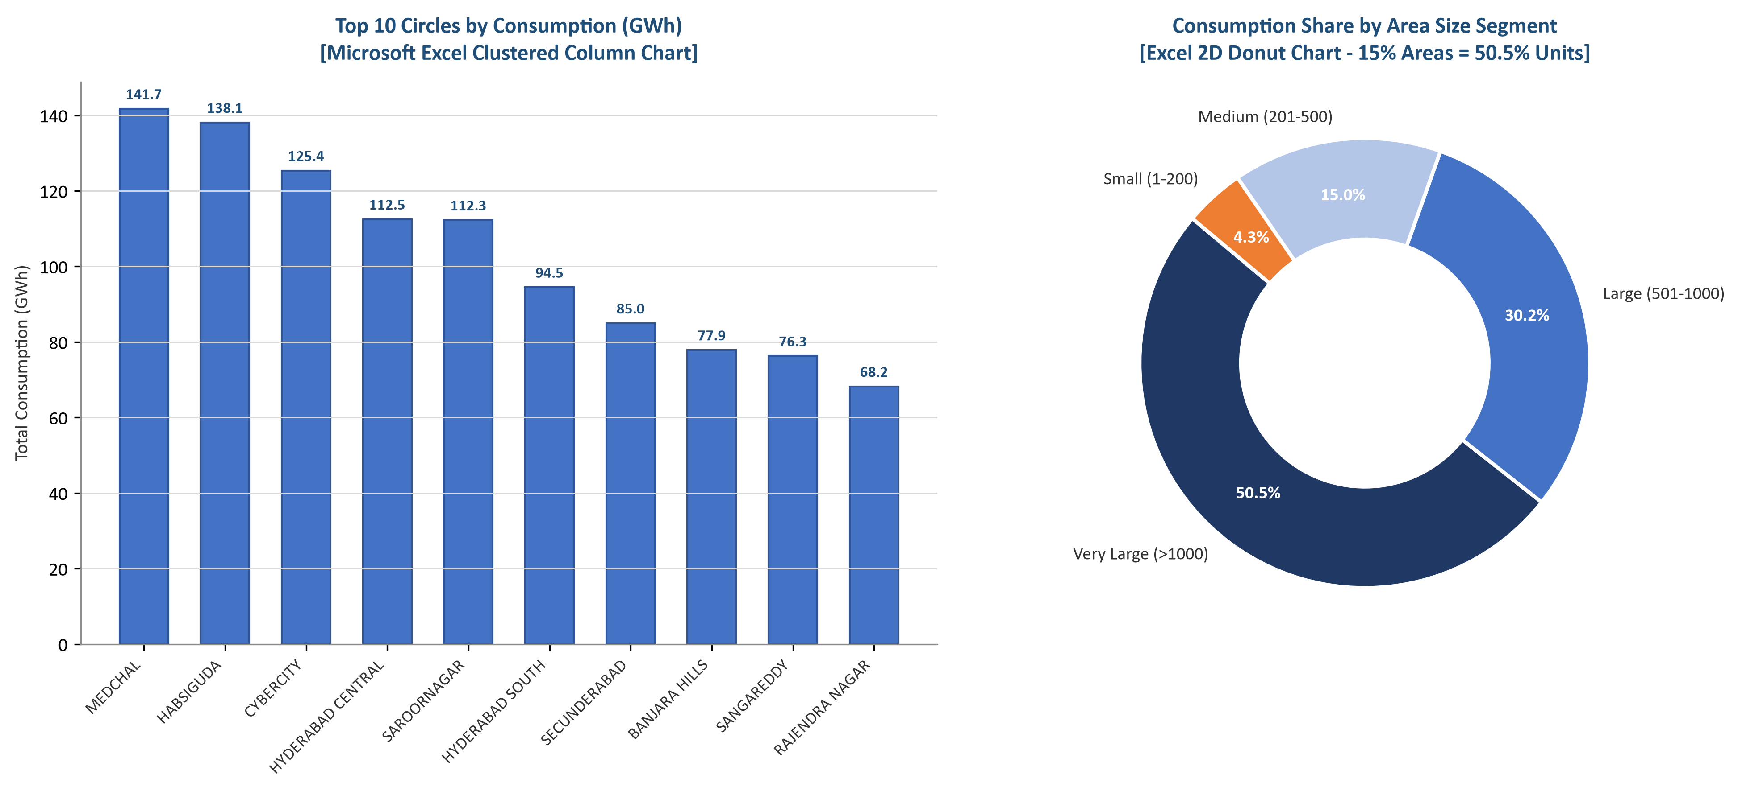
PILLAR 6: EXCEL VISUALIZATIONS
Microsoft Excel Analytics: Pivot Tables, Slicers & Chart Visualizations
TG-SPDCL | DAV Project v5
Executive 7-Slide Master Edition
Rapid ad-hoc exploratory analytics, slicing, clustered columns, and tool capability boundaries
Excel Pivot Table & Slicer Workflows
• Hierarchical Drill-Down: Configured Pivot Table rows as CIRCLE > DIVISION > SECTION for fast regional inspection.
• Aggregated Indicators: Sum of UNITS, Sum of LOAD, and Average Units per Billed Service.
• Interactive Slicers: Added slicers for CIRCLE and DIVISION for instant zero-code field station filtering.
• Calculated Fields: Created 'Billing Efficiency %' field within the Pivot Table to benchmark sections against 95%.
• Conditional Formatting: Applied soft red data bars and cell highlights to flag low-billing sections in seconds.
Excel Practical Advantages vs Analytical Boundaries
• Excel Advantages: Accessible to all utility managers; standard for tariff regulatory filings and rapid ad-hoc slicing.
• Scale Constraints: Performance degrades on multi-million row smart meter telemetry datasets.
• Lack of Advanced Statistics: Cannot natively generate KDE distribution curves, regression confidence intervals, or automated heatmaps.
• Reproducibility Risk: Vulnerable to accidental cell formula overwrites; Python automation guarantees 100% reproducible pipelines.
Figure: Microsoft Excel Clustered Column & 2D Donut Visualizations
TG-SPDCL Domestic Electricity Consumption & Monitoring | Data Analytics & Visualization (DAV) | July 2026
Slide 5 of 7

Slide 6
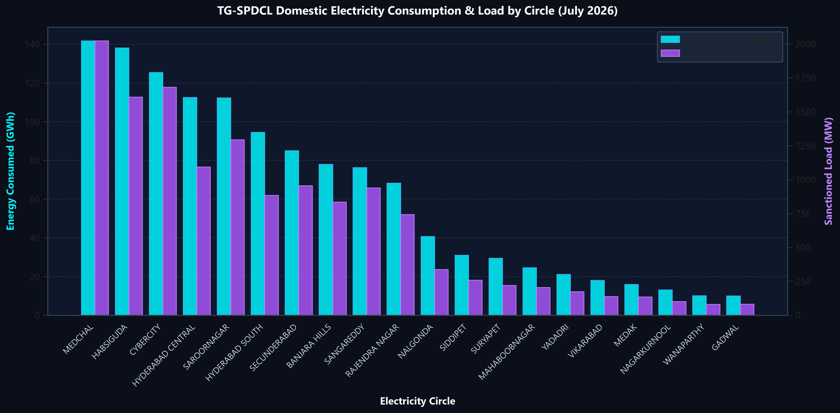
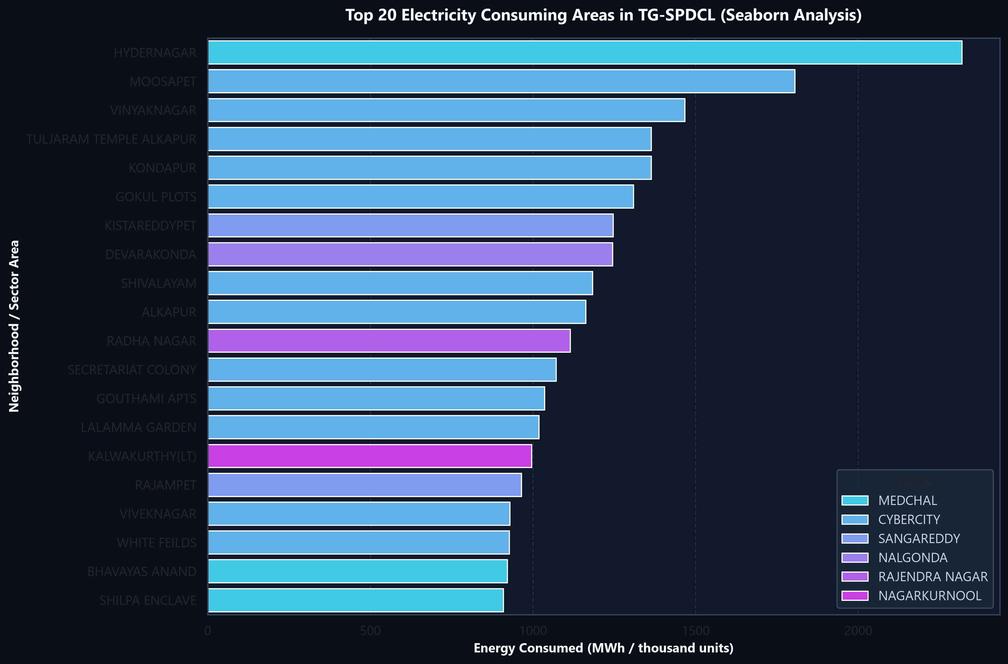
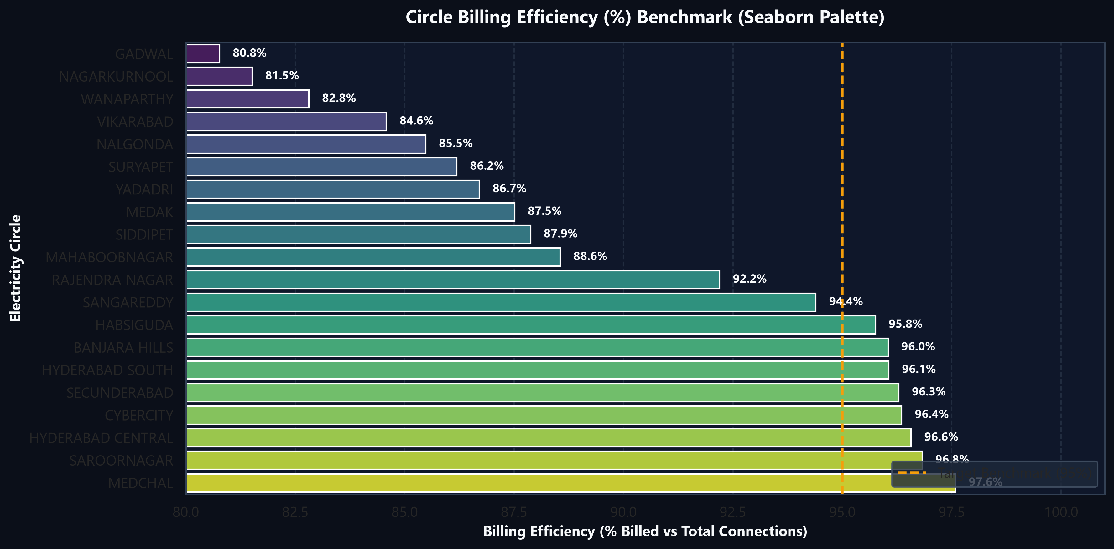
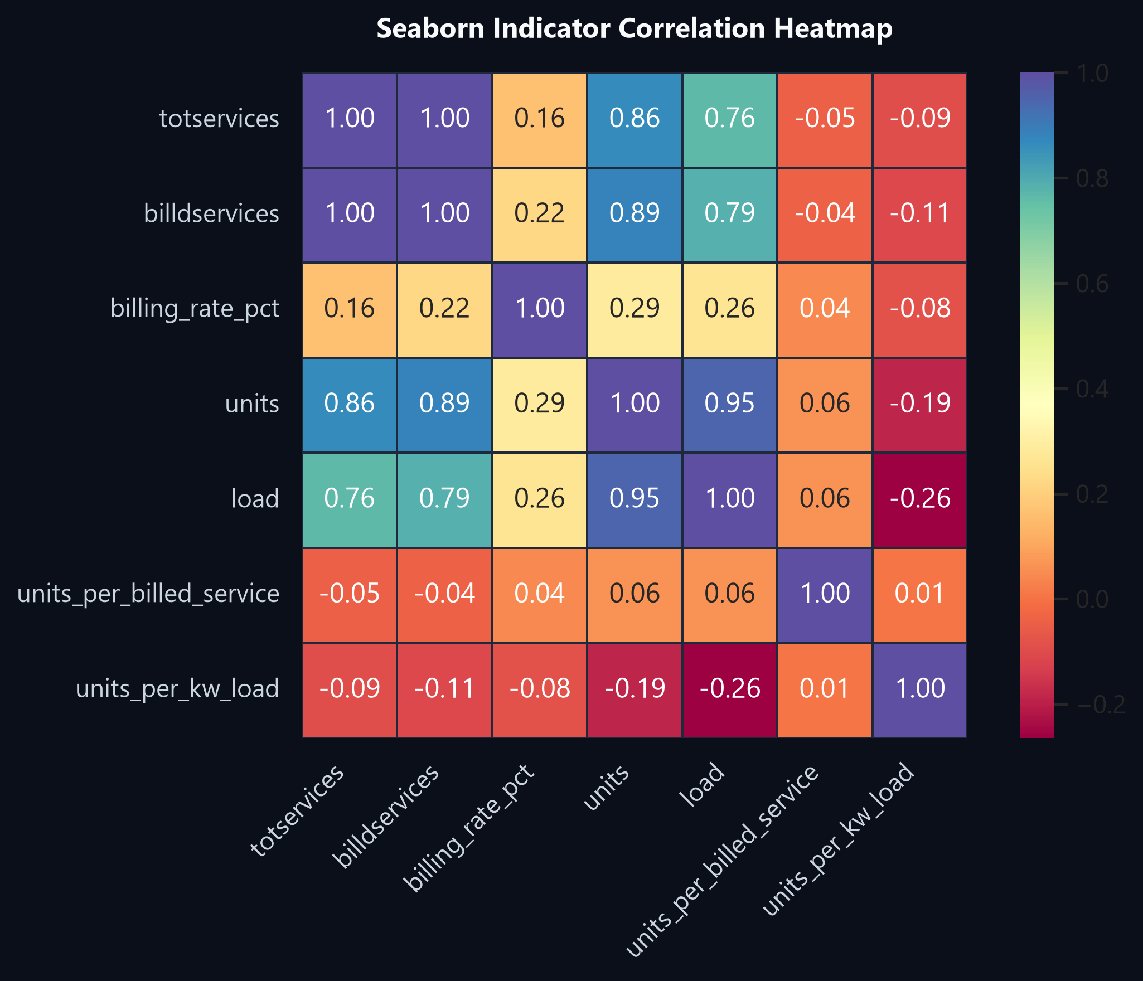
PILLAR 7: PYTHON VISUALIZATIONS
Advanced Python Data Stack: Dual-Axis, Hotspots, Benchmark & Heatmaps
TG-SPDCL | DAV Project v5
Executive 7-Slide Master Edition
Four publication-grade Matplotlib & Seaborn figures demonstrating complete grid telemetry
Fig 1: Circle Consumption (GWh) & Sanctioned Load (MW)
Fig 2: Top 20 Consumption Epicenters (Seaborn Barplot)
Fig 3: Circle Billing Efficiency vs 95% Benchmark
Fig 4: Seaborn Indicator Correlation Heatmap
SYNTHESIS: Near-perfect load/consumption symmetry | Hydernagar (2.32M kWh) leads demand | 5 circles lag below 95% target | Multi-collinear load coupling (+0.95)
TG-SPDCL Domestic Electricity Consumption & Monitoring | Data Analytics & Visualization (DAV) | July 2026
Slide 6 of 7

Slide 7
PILLAR 8: FINAL DECISION
Strategic 4-Pillar Action Plan, 3-Phase Implementation & Measurable Business ROI
TG-SPDCL | DAV Project v5
Executive 7-Slide Master Edition
Operational utility interventions delivering revenue recovery, transformer longevity, and project conclusion
Pillar 1: Infrastructure
Pillar 2: Revenue Audits
Pillar 3: Smart Grid AMI
Pillar 4: Tariff Reform
Focus: Target Top 15% Areas
Focus: Resolve 648k Unbilled
Focus: IoT Telemetry
Focus: Time-of-Day (ToD)
Double transformer capacity in the 2,452 heavy areas driving 50.5% load (Hydernagar, Moosapet).
Deploy field squads to audit 247 zero-billed sections and enforce compliance in circles < 90%.
Install smart meters in high-intensity areas (>250 kWh/kW); resolve duplicate names via GIS keys.
Implement dynamic ToD pricing for connections > 10 kW to flatten evening residential peaks.
Phase 1: 30-Day Sprint
Phase 2: 90-Day Expansion
Phase 3: 1-Year Transformation
Audit 247 zero-billed sections, verify 15 negative units, deploy GIS primary keys.
Upgrade transformers in top 15% areas, install 250k smart meters, launch live dashboard.
Achieve 97%+ billing efficiency across all circles, launch ToD tariffs, and predictive ML.
PROJECTED BUSINESS IMPACT, FINANCIAL ROI & PROJECT CONCLUSION
+4.5% Billing Efficiency
-35% Transformer Failures
100% Feeder Traceability
Research Team Sign-off
Unlocks ₹85–110 Crore annually by converting unbilled connections to active revenue.
Targeted DTR load doubling prevents summer overloads in top 15% demand sectors.
Complete elimination of repeated area name ambiguity via GIS composite key tagging.
D. Chander (2503A52214), K. Arjun (2503A52235), P. Sachin (2503A52240). Open for Q&A.
TG-SPDCL Domestic Electricity Consumption & Monitoring | Data Analytics & Visualization (DAV) | July 2026
Slide 7 of 7

