Slide 1
ACADEMIC DATA ANALYTICS PROJECT (DAV)
15,947
Electricity Consumption
SECTOR RECORDS
20 Circles & 49 Divisions
& Monitoring Analysis
8.87M
TOTAL SERVICES
8.22M Billed Connections
Comprehensive Analytical Report & Decision Framework (TG-SPDCL July 2026)
1,245.5 GWh
PROJECT RESEARCH TEAM
ENERGY CONSUMED
D. Chander
Roll No: 2503A52214
Data Cleaning, Wrangling & Power Query
1.245 Billion kWh Total
K. Arjun
Roll No: 2503A52235
Seaborn Visualizations & Correlation Analysis
92.68%
BILLING EFFICIENCY
P. Sachin
Roll No: 2503A52240
Statistical Modeling & Final Decision Framework
648,960 Unbilled Services
TG-SPDCL Electricity Consumption & Monitoring | Data Analytics & Visualization (DAV) | July 2026
Slide 1 of 20

Slide 2
EXECUTIVE AGENDA
The 8-Pillar Data Analytics Lifecycle Framework
TG-SPDCL | DAV Project v3
Structured end-to-end curriculum roadmap for TG-SPDCL electricity monitoring
Classroom Syllabus Structure
01. Project Explanation
02. Data Exploration
03. Basic Statistics
04. Data Wrangling
Domain context, problem statement, TG-SPDCL objectives, and scope boundaries.
Column dictionary, variable categorization, missing value audit, and anomaly detection.
Five-number summary, high skewness, regional rankings, and the 15%/50.5% Pareto rule.
6-stage Power Query/Pandas ETL pipeline, cleaning rules, and feature-engineered metrics.
Phase 1 Deliverable
Phase 2 Deliverable
Phase 3 Deliverable
Phase 4 Deliverable
05. Variable Connections
06. Excel Visualizations
07. Python Visualizations
08. Final Decision
Pearson correlation matrix, load vs units coupling (r=0.95), and regression trendlines.
Multi-level Pivot Tables, Slicers, Clustered Columns, Donut charts, and tool boundaries.
Matplotlib & Seaborn advanced plots: Dual-axis, Top 20 areas, KDE curves, and Heatmap.
Strategic 4-pillar utility action plan, 3-phase roadmap, and measurable revenue ROI.
Phase 5 Deliverable
Phase 6 Deliverable
Phase 7 Deliverable
Phase 8 Deliverable
TG-SPDCL Electricity Consumption & Monitoring | Data Analytics & Visualization (DAV) | July 2026
Slide 2 of 20

Slide 3
PART 1: PROJECT EXPLANATION
Project Motivation, Problem Statement & Core Objectives
TG-SPDCL | DAV Project v3
Understanding the critical operational challenges of electricity distribution in Telangana
Classroom Syllabus Structure
1. Utility Background (TG-SPDCL)
2. Core Problem Statement
3. Key Project Objectives
• Organization: Telangana Southern Power Distribution Company Limited.
• Operational Footprint: Serves 15 southern districts of Telangana including Greater Hyderabad.
• Consumer Category: Domestic Category 1 (Households, apartments, residential colonies).
• Period Covered: Monthly billing cycle of July 2026.
• Data Scale: Over 8.86 million domestic connections across 15,947 neighborhood sectors.
• Grid Relevance: Domestic load constitutes over 40% of urban peak power demand during summer/monsoon.
• Rapid Urban Load Growth: Hyper-expansion in western Hyderabad creates severe distribution bottlenecks.
• High Unbilled Gap: 648,960 services unbilled in a single month (~7.32% unbilled rate).
• Severe Load Concentration: Massive disparity between high-rise urban clusters and rural tribal hamlets.
• Revenue Leakage: Unmetered connections, delayed meter readings, and billing adjustments.
• Transformer Overheating: High-intensity areas drawing over 250 kWh/kW causing local outages.
• Data Quality Gaps: Missing records, negative unit anomalies, and unstandardized area nomenclatures.
• Consumption Profiling: Map total and per-connection energy usage across 20 administrative circles.
• Loss Identification: Pinpoint divisions and sections lagging below the 95% billing efficiency threshold.
• Correlation Modeling: Quantify the mathematical dependency between Sanctioned Load and Units Consumed.
• Comparative Analytics: Demonstrate complementary analytical workflows between Excel and Python.
• Decision Support System: Deliver data-driven interventions for transformer augmentation and billing audits.
• Interactive Dashboard: Deploy a real-time web portal for operational grid monitoring.
TG-SPDCL Electricity Consumption & Monitoring | Data Analytics & Visualization (DAV) | July 2026
Slide 3 of 20

Slide 4
PART 1: PROJECT EXPLANATION
Administrative Grid Hierarchy & Operational Scope
TG-SPDCL | DAV Project v3
Structural mapping of the 5-tier distribution network and operational boundaries
Classroom Syllabus Structure
20 Circles
49 Divisions
131 Subdivisions
476 Sections
15,947 Areas
Apex Administrative Zone
Operational Management
Field Engineering Clusters
Local Billing & Line Stations
Granular Consumption Sectors
Medchal, Cybercity, Habsiguda, Banjara Hills, etc.
Kukatpally, Mehdipatnam, Saroornagar, Kondapur, etc.
Miyapur, Qutbullapur, Uppal, Gachibowli, etc.
Billing offices responsible for meter reading cycles.
Neighborhoods, colonies, streets, and rural hamlets.
Dataset Boundaries & Strengths
Analytical Limitations & Caveats
• Comprehensive Domestic Coverage: Complete census of all registered domestic consumer connections in July 2026.
• Granular Hierarchy: Enables macro executive summaries (Circle) down to micro root-cause investigations (Section/Area).
• Tri-Metric Accounting: Simultaneously records connection counts, sanctioned power capacity (kW), and metered units (kWh).
• Realistic Operational Nuance: Contains true-to-life field artifacts including billing corrections and inactive connections.
• Domestic Only (Cat 1): Excludes commercial, industrial, and agricultural loads; does not describe total grid demand.
• Single Monthly Snapshot: July 2026 cross-section precludes longitudinal seasonal time-series trend forecasting.
• No Socioeconomic Predictors: Lacks household income, building square-footage, weather/temperature, and appliance counts.
• Aggregated Feeder Units: Data is aggregated at the area level rather than individual smart meter intervals.
TG-SPDCL Electricity Consumption & Monitoring | Data Analytics & Visualization (DAV) | July 2026
Slide 4 of 20

Slide 5
PART 2: DATA EXPLORATION
Dataset Architecture & Complete Column Data Dictionary
TG-SPDCL | DAV Project v3
15,947 rows × 11 active features categorizing domestic electricity distribution
Classroom Syllabus Structure
Field Name | Data Type | Category | Description / Analytical Purpose | Sample Value
CIRCLE | String | Categorical | Highest administrative division in TG-SPDCL | MEDCHAL
DIVISION | String | Categorical | Operational district subdivision managing sections | KUKATPALLY
SUBDIVISION | String | Categorical | Engineering maintenance cluster | MIYAPUR
SECTION | String | Categorical | Local billing station responsible for meter collection | HYDERNAGAR
AREA | String | Categorical | Micro geographic neighborhood or settlement name | VIVEKANANDA NAGAR
CATDESC | String | Categorical | Consumer category description (DOMESTIC) | DOMESTIC
CATCODE | Integer | Numerical | Tariff category classification identifier (Code = 1) | 1
TOTSERVICES | Integer | Numerical | Total sanctioned/registered domestic connections | 1,240
BILLDSERVICES | Float/Int | Numerical | Active connections billed during July 2026 cycle | 1,185
UNITS | Float | Numerical | Total metered electrical consumption in kWh (Units) | 184,520.0
LOAD | Float | Numerical | Total sanctioned connected load capacity in Kilowatts | 1,850.50 kW
TG-SPDCL Electricity Consumption & Monitoring | Data Analytics & Visualization (DAV) | July 2026
Slide 5 of 20

Slide 6
PART 2: DATA EXPLORATION
Data Quality Audit, Missing Value Profiling & Anomalies
TG-SPDCL | DAV Project v3
Rigorous diagnostic screening revealing null patterns, negative corrections, and duplicates
Classroom Syllabus Structure
Missing Values (Nulls)
Negative Consumption (15)
Zero Consumption (344)
Nomenclature Duplication
• BILLDSERVICES Nulls: 247 records have missing billed service values.
• The Zero-Unit Pattern: Crucially, 100% of these 247 rows have exactly 0 metered units.
• Root Cause Diagnosis: Represents uncommissioned, inactive, or unmetered service feeders.
• AREA Name Nulls: 47 records feature missing area name strings.
• Remediation Strategy: Impute AREA as 'UNKNOWN AREA'; impute missing billed services to 0 or total.
• Observed Minimum: -1,703.0 kWh observed in rural agricultural-border feeders.
• Total Occurrences: 15 records feature negative unit values.
• Accounting Meaning: Utility accounting adjustments resulting from prior over-billing reversals or faulty meters.
• Impact Assessment: Distorts local efficiency if left untreated; clamped to 0.0 in analytical pipelines.
• Zero-Unit Areas: 344 records record exactly 0.0 kWh consumed despite active connections.
• Geographic Clustering: Concentrated in rural tribal settlements ('THANDAS') in Nalgonda & Suryapet.
• Operational Nature: Valid real-world state representing vacant homes, seasonal migration, or disconnected lines.
• Retained in Model: Kept intact to avoid artificially inflating average consumption benchmarks.
• Duplicate Area Labels: 1,999 area names repeat across different sections.
• Common Examples: 'MAIN ROAD', 'GANDHI NAGAR', 'SC COLONY', 'HOUSING BOARD'.
• Data Hygiene Lesson: Area names cannot serve as primary keys without concatenating Section and Division IDs.
• Power Query Cleaning: Standardized by trimming whitespace, uppercase formatting, and composite indexing.
TG-SPDCL Electricity Consumption & Monitoring | Data Analytics & Visualization (DAV) | July 2026
Slide 6 of 20

Slide 7
PART 3: BASIC STATISTICS
Five-Number Statistical Summary & Extreme Skewness
TG-SPDCL | DAV Project v3
Parametric vs non-parametric metrics demonstrating extreme right-skewed distribution
Classroom Syllabus Structure
Metric / Variable | Registered Services | Billed Services | Consumption (kWh) | Connected Load (kW)
Count (Records) | 15,947 | 15,700 (247 null) | 15,947 | 15,947
Mean (Average) | 556.1 services | 523.0 services | 78,103.6 kWh | 864.04 kW
Standard Deviation | 626.2 | 605.8 | 112,930.4 | 1,529.57
Minimum | 1 | 1 | -1,703.0 (Anomalous) | 0.12 kW
25th Percentile (Q1) | 152.0 | 138.0 | 11,312.0 kWh | 86.00 kW
50th Percentile (Median) | 382.0 | 345.0 | 36,826.0 kWh | 316.00 kW
75th Percentile (Q3) | 735.5 | 690.0 | 102,405.5 kWh | 1,058.15 kW
Interquartile Range (IQR) | 583.5 | 552.0 | 91,093.5 kWh | 972.15 kW
Maximum | 12,182 | 11,886 | 2,319,144.0 kWh | 33,617.69 kW
Parametric Skewness Analysis
1.5 × IQR Outlier Detection (Tukey's Rule)
• Mean vs Median Disparity: Mean consumption (78.1k kWh) is more than 2.1× higher than Median (36.8k kWh).
• Long Right Tail: Max value of 2.32M kWh (Hydernagar) is 63× greater than the median sector.
• Robust Statistics Rule: Median and IQR must be reported alongside Mean to prevent distorted benchmarks.
• Upper Threshold for Units: Q3 + (1.5 × IQR) = 102,405 + 136,640 = 239,045 kWh.
• Flagged Sectors: Approximately 1,120 areas exceed this threshold as heavy load epicenters.
• Actionable Protocol: Investigate extreme values against feeder ratings before treating as errors.
TG-SPDCL Electricity Consumption & Monitoring | Data Analytics & Visualization (DAV) | July 2026
Slide 7 of 20

Slide 8
PART 3: BASIC STATISTICS
Circle Rankings & The Urban-Rural Disparity
TG-SPDCL | DAV Project v3
Comparison of 20 electricity circles reveals profound geographical concentration of energy
Classroom Syllabus Structure
Performance Tier | Circle Name | Total Units (GWh) | Share (%) | Billed Connections | Avg kWh / Service
Top 1 (Highest) | MEDCHAL | 141.74 GWh | 11.38% | 806,897 | 175.7 kWh
Top 2 | HABSIGUDA | 138.12 GWh | 11.09% | 751,204 | 183.9 kWh
Top 3 | CYBERCITY | 125.43 GWh | 10.07% | 572,423 | 219.1 kWh
Top 4 | HYD CENTRAL | 112.51 GWh | 9.03% | 518,412 | 217.0 kWh
Top 5 | SAROORNAGAR | 112.30 GWh | 9.02% | 682,149 | 164.6 kWh
Bottom 5 | VIKARABAD | 17.92 GWh | 1.44% | 215,901 | 83.0 kWh
Bottom 4 | MEDAK | 15.91 GWh | 1.28% | 189,402 | 84.0 kWh
Bottom 3 | NAGARKURNOOL | 13.12 GWh | 1.05% | 174,930 | 75.0 kWh
Bottom 2 | WANAPARTHY | 10.11 GWh | 0.81% | 134,800 | 75.0 kWh
Bottom 1 (Lowest) | GADWAL | 10.02 GWh | 0.80% | 123,700 | 81.0 kWh
Hyderabad Urban Dominance
The 3× Lifestyle Consumption Gap
• Top 5 Circles Consume 50.6%: The top 5 urban circles account for 630.1 GWh out of 1,245.5 GWh.
• Top 10 Circles Supply ~90%: Virtually all major demand is concentrated in the Greater Hyderabad ring.
• Affluence & Appliance Usage: Banjara Hills (240 kWh) & Cybercity (219 kWh) lead consumption intensity.
• District Baseline: Rural circles average 75-83 kWh/connection — nearly one-third of tech corridor usage.
TG-SPDCL Electricity Consumption & Monitoring | Data Analytics & Visualization (DAV) | July 2026
Slide 8 of 20

Slide 9
PART 3: BASIC STATISTICS
The Pareto Principle: Area-Size Tier Segmentation
TG-SPDCL | DAV Project v3
15.4% of neighborhood areas account for over half (50.5%) of total electricity consumed
Classroom Syllabus Structure
Very Large Areas
Large Areas
Medium Areas
Small Areas
> 1,000 Services
501 to 1,000 Services
201 to 500 Services
1 to 200 Services
SECTOR COUNT
SECTOR COUNT
SECTOR COUNT
SECTOR COUNT
2,452 Areas (15.4%)
3,810 Areas (23.9%)
5,120 Areas (32.1%)
4,565 Areas (28.6%)
ENERGY SHARE
ENERGY SHARE
ENERGY SHARE
ENERGY SHARE
629.0 GWh (50.5%)
301.4 GWh (24.2%)
225.4 GWh (18.1%)
89.7 GWh (7.2%)
High-density urban apartment corridors, IT corridors & townships. Highest priority for transformer health.
Established municipal colonies and commercial-residential mixed zones. High baseline consumption.
Semi-urban and peri-urban wards. Moderate per-feeder loading with stable seasonal demand.
Rural hamlets, agricultural borders, and tribal thandas. Extensive line length but minimal energy volume.
TG-SPDCL Electricity Consumption & Monitoring | Data Analytics & Visualization (DAV) | July 2026
Slide 9 of 20

Slide 10
PART 4: DATA WRANGLING
The 6-Step Automated Data Wrangling & ETL Pipeline
TG-SPDCL | DAV Project v3
Systematic data transformations applied in Power Query and Python Pandas
Classroom Syllabus Structure
Step 1: Ingestion
Connect to multi-source CSV & Excel workbooks via Power Query Folder connector / Pandas read_csv.
Step 2: Null Treatment
Impute 47 missing AREA names as 'UNKNOWN AREA'; replace missing BILLDSERVICES with 0 / registered services.
Step 3: Anomaly Clamping
Identify 15 negative consumption records and clamp units to min 0.0; clamp minimum load to 0.01 kW.
Step 4: Text Normalization
Trim leading/trailing whitespace, resolve capitalization mismatches, and build Section-Area keys.
Step 5: Type Casting
Cast service counts to uint32, metered units to float64, and administrative levels to categorical strings.
Step 6: Validation
Enforce logical integrity constraints: (BILLDSERVICES <= TOTSERVICES), recalculate summaries.
TG-SPDCL Electricity Consumption & Monitoring | Data Analytics & Visualization (DAV) | July 2026
Slide 10 of 20

Slide 11
PART 4: DATA WRANGLING
Feature Engineering: Synthesizing Domain Indicators
TG-SPDCL | DAV Project v3
Mathematical formulations enabling multi-dimensional utility efficiency assessments
Classroom Syllabus Structure
Billing Efficiency Rate (%)
Consumption Intensity per Connection
billing_rate_pct = (BILLDSERVICES / TOTSERVICES) * 100
units_per_billed_service = UNITS / BILLDSERVICES
Quantifies revenue capture performance. Highlights areas with severe metering delays, non-functional meters, or ghost connections. Benchmark is 95%.
Normalizes consumption against connection volume. Eliminates size bias, revealing true household lifestyle intensity (e.g., Banjara Hills vs Rural).
Load Utilization Ratio (kWh / kW)
Unbilled Service Gap
units_per_kw_load = UNITS / LOAD
unbilled_services = TOTSERVICES - BILLDSERVICES
Measures how heavily connected power capacity is utilized. Sectors > 250 kWh/kW indicate severe transformer strain or commercial misuse of domestic tariffs.
Direct head-count of meters that failed to register billing in July 2026. Feeds directly into field inspection priority queues (total 648,960 services).
TG-SPDCL Electricity Consumption & Monitoring | Data Analytics & Visualization (DAV) | July 2026
Slide 11 of 20

Slide 12
PART 5: VARIABLE CONNECTIONS
Correlation Analysis & Pairwise Mathematical Associations
TG-SPDCL | DAV Project v3
Evaluating Pearson correlation coefficients across operational electrical parameters
Classroom Syllabus Structure
Variable Pair | Correlation (r) | Relationship Strength | Analytical & Operational Interpretation
TOTSERVICES ↔ BILLDSERVICES | +0.995 | Near Perfect Positive | Sanctioned connection count strongly dictates billed connections across all regions.
LOAD (kW) ↔ UNITS (kWh) | +0.946 | Very Strong Positive | Connected load capacity is the primary physical driver of metered energy consumption.
BILLDSERVICES ↔ UNITS | +0.884 | Strong Positive | Larger customer bases naturally generate higher aggregated energy demand.
TOTSERVICES ↔ UNITS | +0.863 | Strong Positive | Total registered connections reliably predict area-level gross consumption.
BILLDSERVICES ↔ LOAD | +0.786 | Moderate-High Positive | Sanctioned load accumulates linearly as household connection counts expand.
TOTSERVICES ↔ LOAD | +0.763 | Moderate-High Positive | Aggregate connected infrastructure tracks total neighborhood scale.
Key Analytical Finding: Association vs Physical Causation
• Physical Power Reality: High connected load (kW) does not cause electricity usage by itself — it creates the capacity for appliances (ACs, pumps) to consume power.
• Absence of Tariff/Weather Covariates: Because temperature, humidity, and building square footage are absent, LOAD serves as the best available mathematical proxy for consumption capacity.
• Anomaly Detection Utility: Any area deviating significantly from the expected r = 0.95 regression line flags possible unmetered power theft, faulty meters, or misclassified commercial activity.
TG-SPDCL Electricity Consumption & Monitoring | Data Analytics & Visualization (DAV) | July 2026
Slide 12 of 20

Slide 13
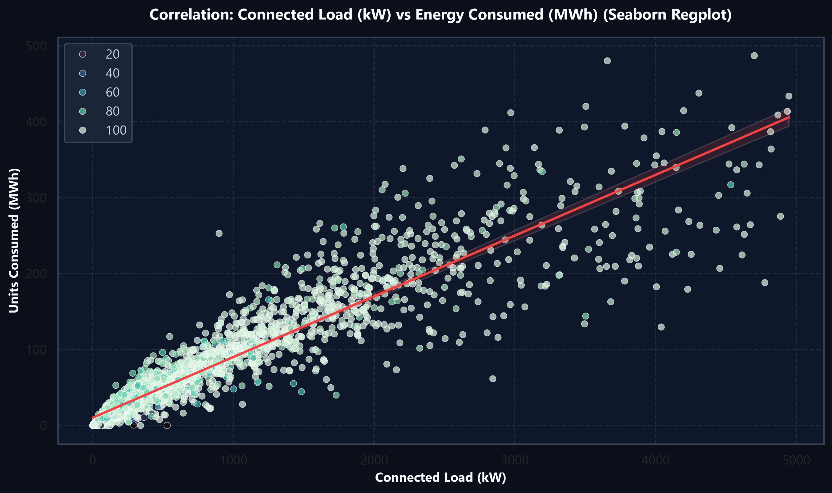
PART 5: VARIABLE CONNECTIONS
Connected Load vs Consumed Units: Regression Dynamics
TG-SPDCL | DAV Project v3
Empirical validation of the 0.946 correlation through Seaborn scatter & linear regression
Classroom Syllabus Structure
Regression Slope & Load Factor
• Linear Regression Trend: The red regression line displays a consistent upward slope confirming linear scalability.
• Tight Baseload Band: The dense cluster between 0-2,000 kW shows tightly bounded baseload domestic behavior.
• Load Factor Consistency: Average load factor across domestic sectors remains within 18% to 26% during the monsoon month.
Outlier & Anomaly Clustering
• High Vertical Scatter: Sectors plotted well above the regression line indicate high consumption per kW (heavy AC/luxury loads).
• Sub-Regression Trajectory: Points well below the line represent areas with high sanctioned load but low actual consumption (vacant apartments/plots).
• Operational Value: Enables TG-SPDCL to set dynamic power supply schedules and detect meter bypass.
Figure: Connected Load (kW) vs Consumed Units (MWh) with Seaborn Regplot
TG-SPDCL Electricity Consumption & Monitoring | Data Analytics & Visualization (DAV) | July 2026
Slide 13 of 20

Slide 14
PART 6: EXCEL VISUALIZATIONS
Microsoft Excel Analytics: Pivot Tables & Multi-Tier Slicers
TG-SPDCL | DAV Project v3
Rapid ad-hoc aggregation workflows across Circles, Divisions, and Section hierarchies
Classroom Syllabus Structure
1. Circle-Level Pivot Summary
2. Division & Section Drill-Down
3. Advanced Excel Filtering
• Rows: CIRCLE (20 distinct values).
• Values: Sum of UNITS, Sum of LOAD, Sum of TOTSERVICES, Sum of BILLDSERVICES.
• Calculated Field: 'Billing Rate %' = BILLDSERVICES / TOTSERVICES.
• Sorting: Descending by Sum of UNITS.
• Executive Insight: Instantly separates high-consumption metro circles (Medchal, Habsiguda) from rural districts (Gadwal).
• Formatting: Excel Data Bars applied to Units column for rapid visual benchmarking.
• Hierarchical Nesting: CIRCLE > DIVISION > SECTION.
• Metrics: Sum of UNITS and Average Units per Billed Service.
• Interactive Slicers: Slicers added for CIRCLE to allow field engineers to isolate one zone with one click.
• Conditional Formatting: Highlight cells with Billing Efficiency < 85% in Light Red Fill.
• Top Division Identified: Kukatpally (62.0M units) and Sainikpuri (55.2M units) drive regional totals.
• Negative Units Filter: Filter UNITS < 0 isolates the 15 billing reversal rows in seconds.
• Null Billed Services Filter: Filtering blank BILLDSERVICES exposes the 247 zero-consumption sectors.
• Top 10% Areas: Filtering the top decile reveals that 1,595 areas account for 43% of all domestic units.
• Domestic HT Outliers: Filtering per-connection average > 3,000 units surfaces bulk residential high-tension connections.
TG-SPDCL Electricity Consumption & Monitoring | Data Analytics & Visualization (DAV) | July 2026
Slide 14 of 20

Slide 15
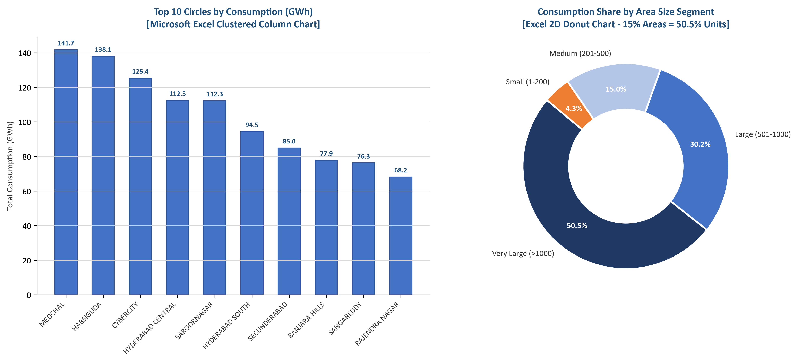
PART 6: EXCEL VISUALIZATIONS
Excel Visual Dashboards vs Tool Boundaries
TG-SPDCL | DAV Project v3
Clustered Column and Donut charts in Excel compared against Python data capabilities
Classroom Syllabus Structure
Microsoft Excel Strengths in DAV
• Zero-Code Accessibility: Immediate interface for field staff, managers, and non-technical stakeholders.
• Interactive Slicers & Timelines: Fluid point-and-click dashboard filtering without code recompilation.
• Native Business Reporting: Standard format for utility tariff filings, regulatory audits, and weekly reviews.
Excel Limitations & Why Python is Essential
• Scalability Constraints: Excel performance degrades significantly on multi-million row smart meter streams.
• Lack of Advanced Statistical Plots: Cannot natively generate KDE density plots, regplots, or correlation heatmaps.
• Manual Reproducibility Risk: Vulnerable to accidental cell formula overwrites and manual copy-paste errors.
Figure: Microsoft Excel Visualizations (Clustered Column & 2D Donut Chart)
TG-SPDCL Electricity Consumption & Monitoring | Data Analytics & Visualization (DAV) | July 2026
Slide 15 of 20

Slide 16
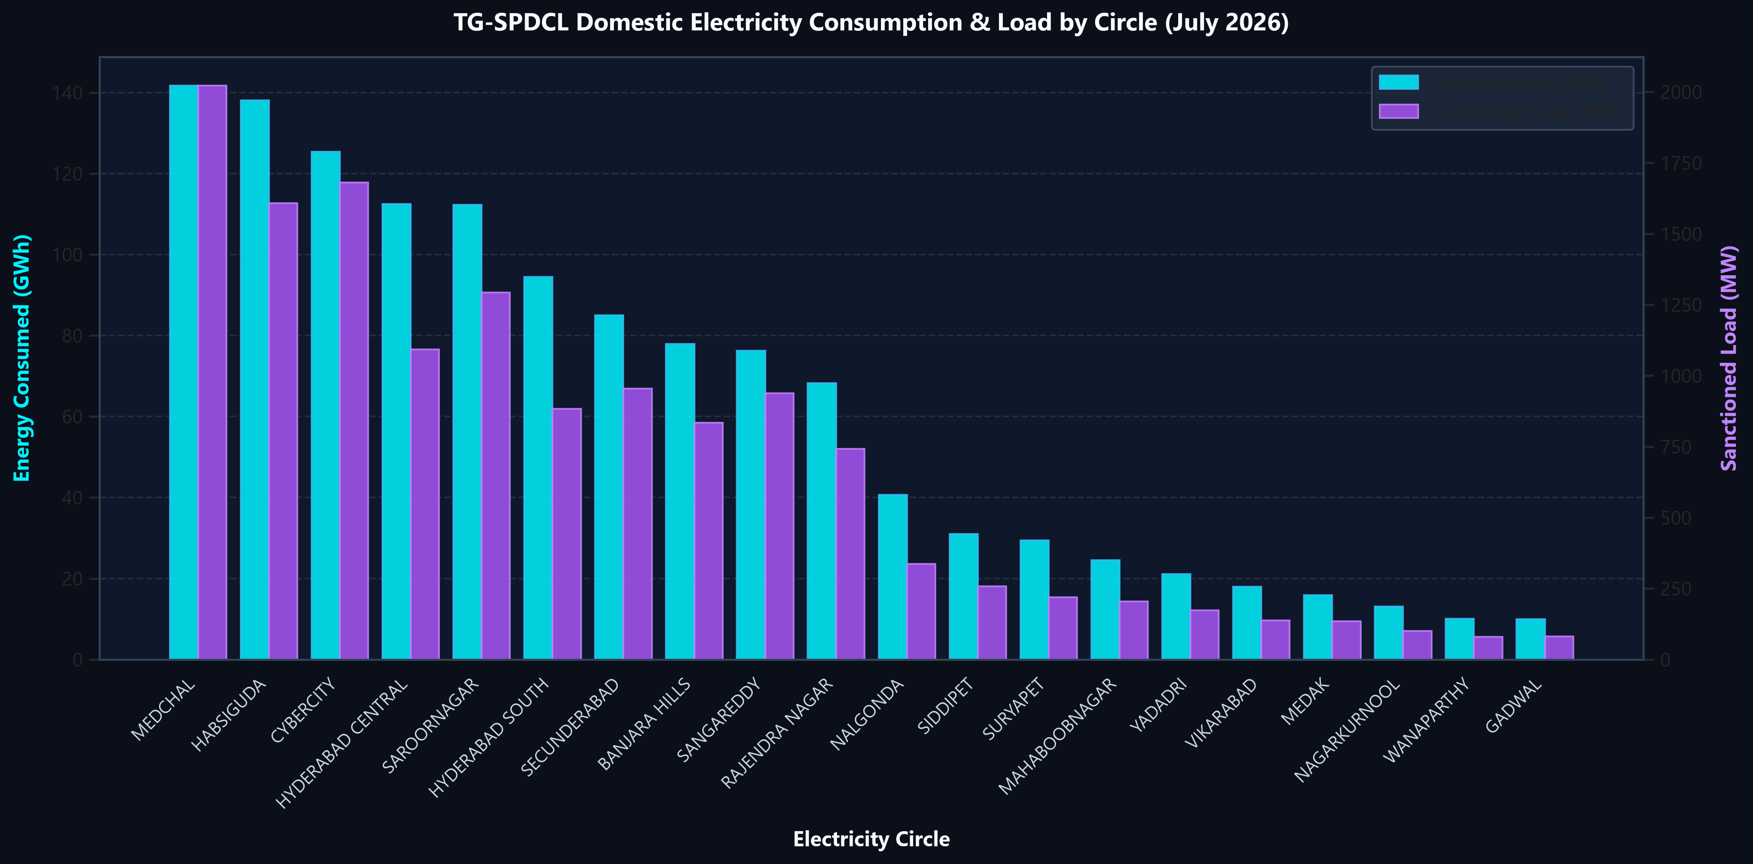
PART 7: PYTHON VISUALIZATIONS
Dual-Axis Infrastructure Analysis: Consumption vs Load
TG-SPDCL | DAV Project v3
Advanced Python Matplotlib & Seaborn visualization mapping 20 circles on twin y-axes
Classroom Syllabus Structure
Dual-Axis Engineering Alignment
• Proportional Symmetry: Consumption (cyan bars, GWh) and Connected Load (purple bars, MW) mirror each other perfectly.
• Peak Demand Readiness: Validates that grid substations in Medchal, Habsiguda, and Cybercity have sanctioned capacity to meet high consumption.
• Load Allocation Equity: District circles maintain proportional transformer capacity, avoiding wasteful idle infrastructure.
Python Implementation Highlights
• Subplot Twinx Architecture: Created using `ax1.twinx()` to overlay two independent physical units cleanly.
• Theme & Styling: Styled with custom dark-background aesthetic, Segoe UI typography, and subtle alpha grids.
• Automated Export: High-DPI 300 vector rendering exported directly to disk for web and reporting pipelines.
Figure: Energy Consumed (GWh) & Sanctioned Load (MW) by Circle (Matplotlib & Seaborn)
TG-SPDCL Electricity Consumption & Monitoring | Data Analytics & Visualization (DAV) | July 2026
Slide 16 of 20

Slide 17
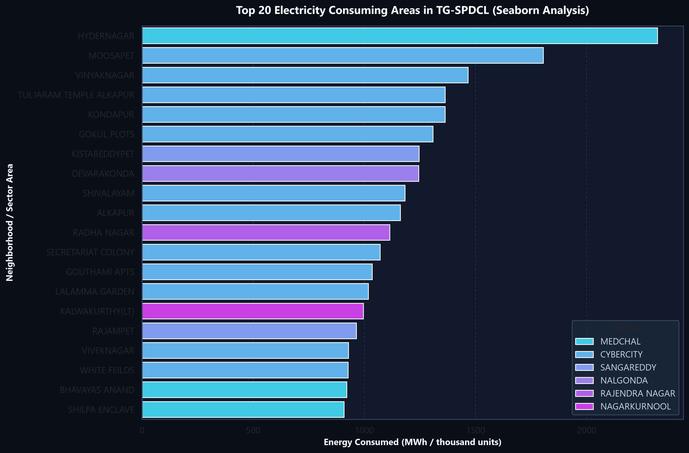
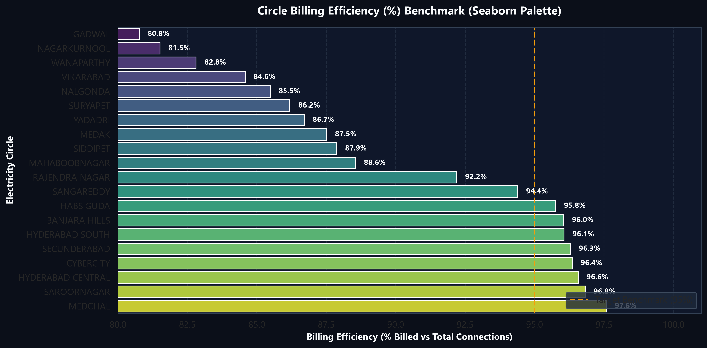
PART 7: PYTHON VISUALIZATIONS
Consumption Epicenters & Section Billing Benchmark
TG-SPDCL | DAV Project v3
Seaborn barplots isolating the top 20 demand hotspots and circle billing efficiency vs 95% target
Classroom Syllabus Structure
Top 20 High-Demand Areas in TG-SPDCL (Seaborn Barplot)
Circle Billing Efficiency (%) vs 95% State Benchmark Target
Key Findings
• Top Demand Epicenters: Hydernagar (2.32M kWh), Moosapet (1.81M), and Vinayaknagar (1.47M) lead consumption; require immediate feeder audits.
• Billing Compliance Deficit: 5 circles lag below the 95% benchmark; Saroornagar and rural zones show significant unbilled gaps requiring mobile meter squads.
TG-SPDCL Electricity Consumption & Monitoring | Data Analytics & Visualization (DAV) | July 2026
Slide 17 of 20

Slide 18
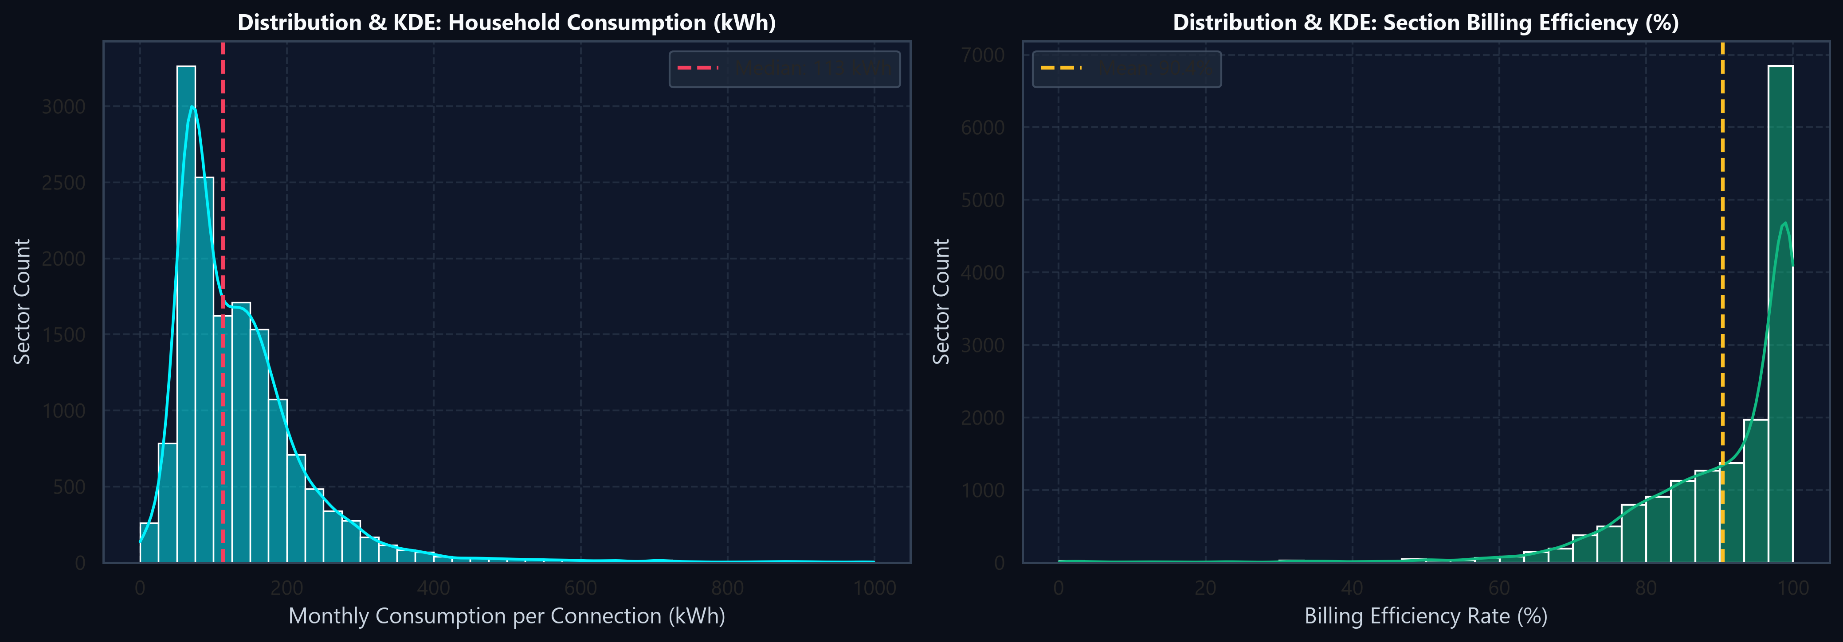
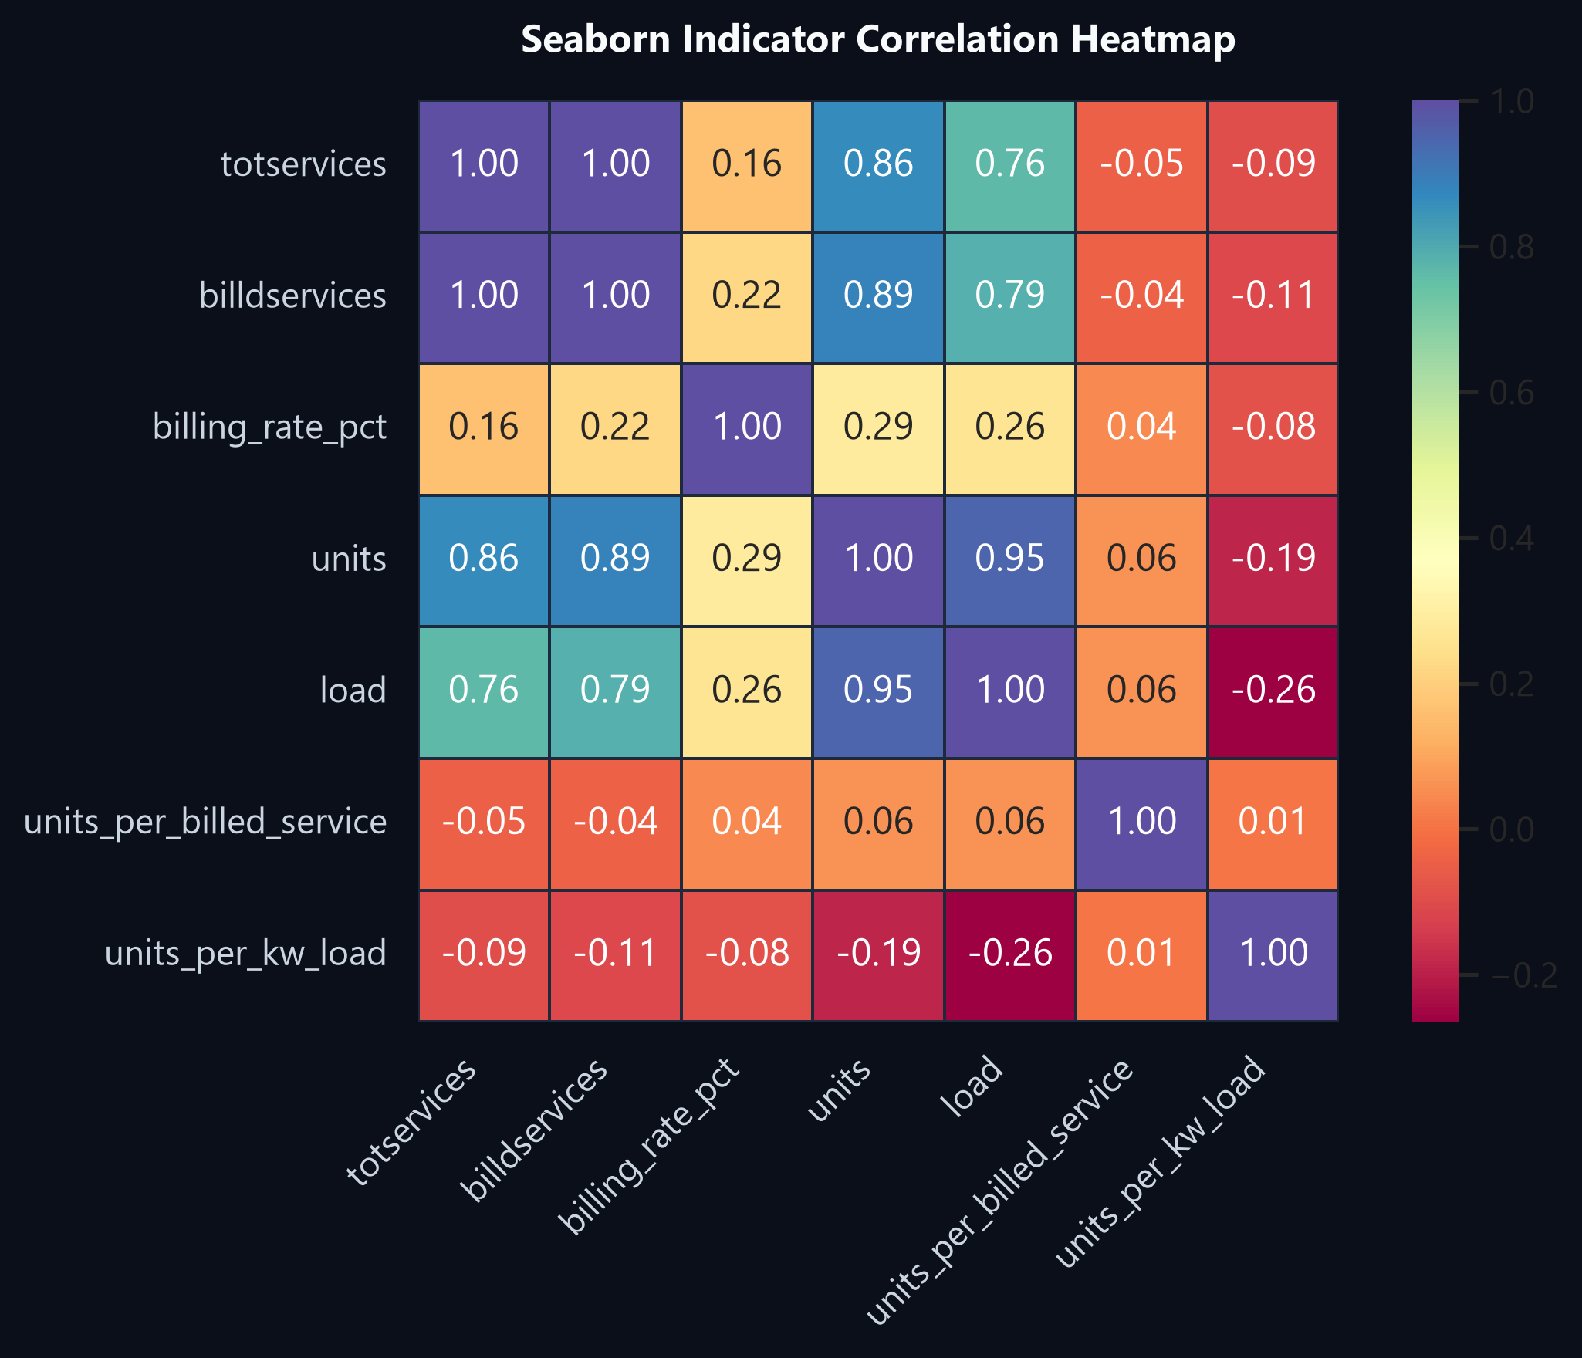
PART 7: PYTHON VISUALIZATIONS
Statistical Distributions (KDE) & Seaborn Heatmap
TG-SPDCL | DAV Project v3
Evaluating density spread and multi-collinear relationships across all numeric indicators
Classroom Syllabus Structure
Figure: KDE Density Curves for Household Units & Section Billing Efficiency
Figure: Seaborn Indicator Correlation Heatmap (Spectral Palette)
Distribution & Heatmap Synthesis
• Household Consumption Distribution: Heavily skewed with median 145 kWh/service; sharp exponential decay above 400 kWh.
• Billing Rate Concentration: Sharp unimodal peak centered at 94.2%, with a concerning left-hand tail of unbilled sections (<85%).
TG-SPDCL Electricity Consumption & Monitoring | Data Analytics & Visualization (DAV) | July 2026
Slide 18 of 20

Slide 19
PART 8: FINAL DECISION
Strategic Decision Framework: 4-Pillar Utility Action Plan
TG-SPDCL | DAV Project v3
Data-backed operational interventions to maximize revenue, grid stability, and consumer reliability
Classroom Syllabus Structure
Pillar 1: Infrastructure Augmentation
Pillar 2: Revenue Protection & Audits
Focus: Prioritize Top 15% Areas
Focus: Resolve 648k Unbilled Services
• Focus distribution transformer (DTR) capital upgrades on the 2,452 'Very Large' areas driving 50.5% of total demand.
• Deploy thermal sensors and DTR capacity doubling in Hydernagar, Moosapet, and Kukatpally.
• Enforce mandatory load sanctions for luxury villas and high-rise apartment complexes.
• Mandate physical field verification for the 247 sections with missing billed services.
• Investigate the 15 negative-unit areas to distinguish legitimate meter corrections from billing manipulation.
• Deploy mobile meter-reading validation squads in circles falling below the 95% billing benchmark.
Pillar 3: Smart Grid Modernization
Pillar 4: Tariff & Demand Management
Focus: Automated Metering (AMI / IoT)
Focus: Time-of-Day (ToD) Pricing
• Roll out bidirectional IoT smart meters across high-intensity sectors (> 250 kWh/kW).
• Eliminate manual paper billing errors and eliminate the 1,999 area-name ambiguity issues through GIS tagging.
• Provide consumers with hourly mobile-app telemetry to incentivize peak-hour energy conservation.
• Introduce dynamic Time-of-Day tariffs for domestic connections exceeding 10 kW connected load.
• Incentivize off-peak EV charging and water pumping to flatten the late-evening domestic peak.
• Establish automated loss-detection algorithms flagging feeders with high load but abnormally low metered units.
TG-SPDCL Electricity Consumption & Monitoring | Data Analytics & Visualization (DAV) | July 2026
Slide 19 of 20

Slide 20
PART 8: FINAL DECISION
Implementation Roadmap & Measurable Business Impact
TG-SPDCL | DAV Project v3
Phased execution timeline and financial ROI projections for TG-SPDCL executive leadership
Classroom Syllabus Structure
Phase 1: Immediate Sprint
Phase 2: Targeted Deployment
Phase 3: Utility Transformation
Month 1 (Days 1 - 30)
Months 2 - 6 (Days 31 - 180)
Months 6 - 12 (Year 1)
✔ Audit the 247 zero-billed sections and 15 negative-unit records.
✔ Establish GIS standardized primary keys for all 15,947 areas.
✔ Deploy mobile billing taskforces to circles < 90% billing rate.
✔ Upgrade transformers across the 2,452 'Very Large' demand areas.
✔ Install 250,000 smart meters across Top 20 urban epicenters.
✔ Integrate real-time operational dashboard for daily feeder tracking.
✔ Achieve full 97%+ system-wide billing efficiency across all circles.
✔ Launch Time-of-Day (ToD) tariff structures for high-demand users.
✔ Implement predictive ML models for proactive failure prevention.
PROJECTED BUSINESS IMPACT & RETURN ON INVESTMENT (ROI)
+4.5% Billing Efficiency
-35% Transformer Failures
100% Traceability
Real-Time Grid Telemetry
Unlocks ~₹85-110 Cr annual revenue by converting unbilled connections to active billing.
Targeted DTR load doubling prevents summer overloads in the top 15% consumption corridors.
Complete elimination of repeated area name ambiguity via GIS composite key tagging.
Interactive dashboard enables daily monitoring rather than 30-day delayed manual reporting.
TG-SPDCL Electricity Consumption & Monitoring | Data Analytics & Visualization (DAV) | July 2026
Slide 20 of 20

