Slide 1
DATA ANALYTICS PROJECT
Electricity Consumption
& Monitoring Analysis
15,947
20
TG-SPDCL | Domestic Consumer Dataset | July 2026
Sector Records
Circles
Team Members
1,245
92.68%
D. Chander
Roll: 2503A52214
K. Arjun
Roll: 2503A52235
GWh Consumed
Billing Rate
P. Sachin
Roll: 2503A52240
TG-SPDCL Domestic Electricity Consumption Analysis | July 2026
1 / 17

Slide 2
Table of Contents
What we cover in this presentation
TG-SPDCL | Data Analytics
01
Dataset Overview
02
Column Guide
03
Key Metrics (KPIs)
Source, scope & structure
Data types & variable definitions
GWh, billing rate, load
04
Circle Rankings
05
Analysis Pipeline
06
Top 20 Areas
Top & bottom performing circles
End-to-end data workflow
Highest demand neighborhoods
07
Billing Efficiency
08
Load vs Consumption
09
Statistical Distributions
vs 95% benchmark target
Correlation & regression
KDE histograms & spread
10
Data Quality & Cleanup
11
Key Insights
12
Limitations & Conclusion
Issues, outliers & fixes
Patterns & analytical takeaways
Scope boundaries & summary
TG-SPDCL Domestic Electricity Consumption Analysis | July 2026
2 / 17

Slide 3
Dataset Overview
TG-SPDCL Domestic Electricity Consumption — July 2026
TG-SPDCL | Data Analytics
About the Dataset
Geographic & Data Scope
Source
TG-SPDCL — Telangana Southern Power Distribution Co.
20 CIRCLES
Period
July 2026 (single-month snapshot)
49 DIVISIONS
131 SUBDIVISIONS
Category
DOMESTIC consumers only
476 SECTIONS
Total Rows
15,947 sector-level records
15,947 RECORDS
Columns
11 columns (6 categorical + 5 numerical)
Circles
20 circles across Telangana
Divisions
49 divisions | 131 sub-divisions | 476 sections
File Size
~1.4 MB CSV | Dataset link: TG-SPDCL Open Data
TG-SPDCL Domestic Electricity Consumption Analysis | July 2026
3 / 17

Slide 4
Dataset Column Guide
Variable descriptions, data types & roles
TG-SPDCL | Data Analytics
COLUMN
DTYPE
TYPE
DESCRIPTION
CIRCLE
Object
Categorical
Top-level geographic region (20 unique circles)
DIVISION
Object
Categorical
Sub-region within a circle (49 divisions)
SUBDIVISION
Object
Categorical
Subdivision within a division (131 total)
SECTION
Object
Categorical
Service section area (476 sections)
AREA
Object
Categorical
Specific neighborhood / locality (47 NULLs)
CATDESC/CODE
Object/Int
Categorical
Consumer category — DOMESTIC only (code=1)
TOTSERVICES
Int64
Numerical
Total registered electricity connections
BILLDSERVICES
Float64
Numerical
Billed connections (247 NULLs = zero-unit areas)
UNITS
Float64
Numerical
Monthly electricity consumed in kWh (15 negatives)
LOAD
Float64
Numerical
Sanctioned connected load in kW (decimal values)
TG-SPDCL Domestic Electricity Consumption Analysis | July 2026
4 / 17

Slide 5
Key Performance Indicators
Overall summary metrics for July 2026 domestic supply
TG-SPDCL | Data Analytics
TOTAL RECORDS
CIRCLES COVERED
TOTAL CONNECTIONS
BILLED CONNECTIONS
15,947
20
8,867,827
8,218,867
Sector-level area rows
20 circles | 49 divisions
Registered domestic services
Connections that received a bill
BILLING EFFICIENCY
TOTAL ENERGY
SANCTIONED LOAD
AVG / HOUSEHOLD
92.68%
1,245 GWh
13,779 MW
151.5 kWh
Gap: ~649K unbilled | Target: 95%+
1,245,523,023 kWh total monthly
13,778,816 kW connected capacity
Per billed connection per month
Note: Billing efficiency gap of 7.32% represents approximately 649,000 connections not billed — a key operational priority for TG-SPDCL.
TG-SPDCL Domestic Electricity Consumption Analysis | July 2026
5 / 17

Slide 6
End-to-End Analysis Pipeline
From raw CSV to interactive dashboard — data flow
TG-SPDCL | Data Analytics
INGEST
CLEAN
ENGINEER
AGGREGATE
OUTPUT
RAW DATA
DATA CLEANING
FEATURE ENG.
AGGREGATION
EXPORT
TG-SPDCL CSV
15,947 rows
Fill NULLs
Clip negatives
Billing rate %
Units per service
Group by circle
Division pivots
analysis_summary
.json
ANALYSIS OUTPUTS
circle_consumption.png
top20_areas.png
billing_efficiency.png
load_vs_units.png
distribution_metrics.png
Circle GWh & Load chart
Top demand zones
Billing rate vs target
Regression scatter
KDE histograms
WEB DASHBOARD
KPI Cards
Chart.js Graphs
Filter Slicers
Anomaly Alerts
CSV Export
Live metric tiles
Interactive visuals
Circle / Division
<85% billing flags
Paginated data table
$ python main.py → $ python -m http.server 8000 → http://localhost:8000
TG-SPDCL Domestic Electricity Consumption Analysis | July 2026
6 / 17

Slide 7
Circle-Wise Consumption Rankings
Highest and lowest consuming electricity circles
TG-SPDCL | Data Analytics
TOP 5 CIRCLES — Highest Consumption
BOTTOM 5 CIRCLES — Lowest Consumption
1
Medchal
1
Gadwal
141.7M units | 11.4% share
10.0M units | Smallest consumer
2
Habsiguda
2
Wanaparthy
138.1M units | 11.1% share
10.1M units | Rural district
3
Cybercity
3
Nagarkurnool
125.4M units | 10.1% share
13.1M units | District circle
4
Hyderabad Central
4
Medak
112.5M units | 9.0% share
15.9M units | District circle
5
Saroornagar
5
Vikarabad
112.3M units | 9.0% share
17.9M units | District circle
Key Insight: Top 10 circles (all Hyderabad region) account for ~90% of all domestic units. District circles use ~1/3 per service compared to urban circles.
TG-SPDCL Domestic Electricity Consumption Analysis | July 2026
7 / 17

Slide 8
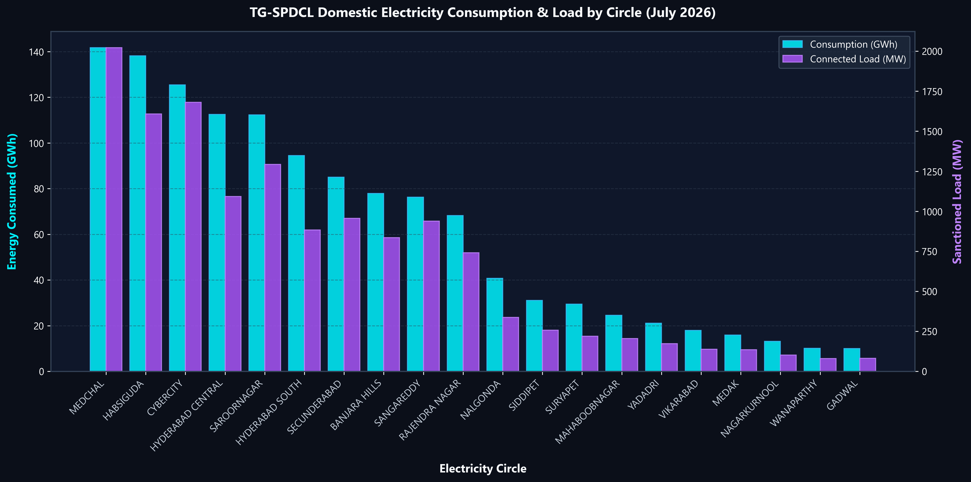
Circle Consumption & Sanctioned Load
Energy consumed (GWh) vs Connected load (MW) — all 20 circles
TG-SPDCL | Data Analytics
Cyan bars = Energy consumption (GWh) | Purple line = Sanctioned load (MW) | Sorted: highest to lowest
TG-SPDCL Domestic Electricity Consumption Analysis | July 2026
8 / 17

Slide 9
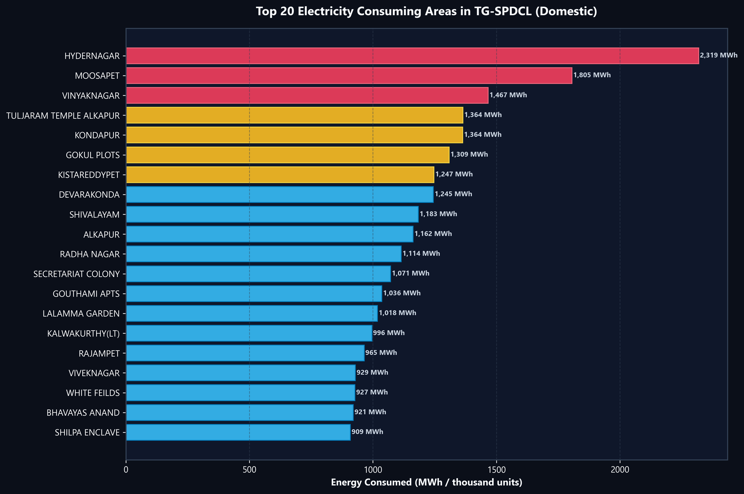
Top 20 Highest Demand Areas
Largest electricity consuming neighborhoods — Seaborn barplot with circle hue
TG-SPDCL | Data Analytics
TOP 3 HIGHLIGHTS
01
Hydernagar
2.32M kWh
Largest single sector
02
Moosapet
1.81M kWh
Borabanda division
03
Vinayaknagar
1.47M kWh
Medchal circle
TG-SPDCL Domestic Electricity Consumption Analysis | July 2026
9 / 17

Slide 10
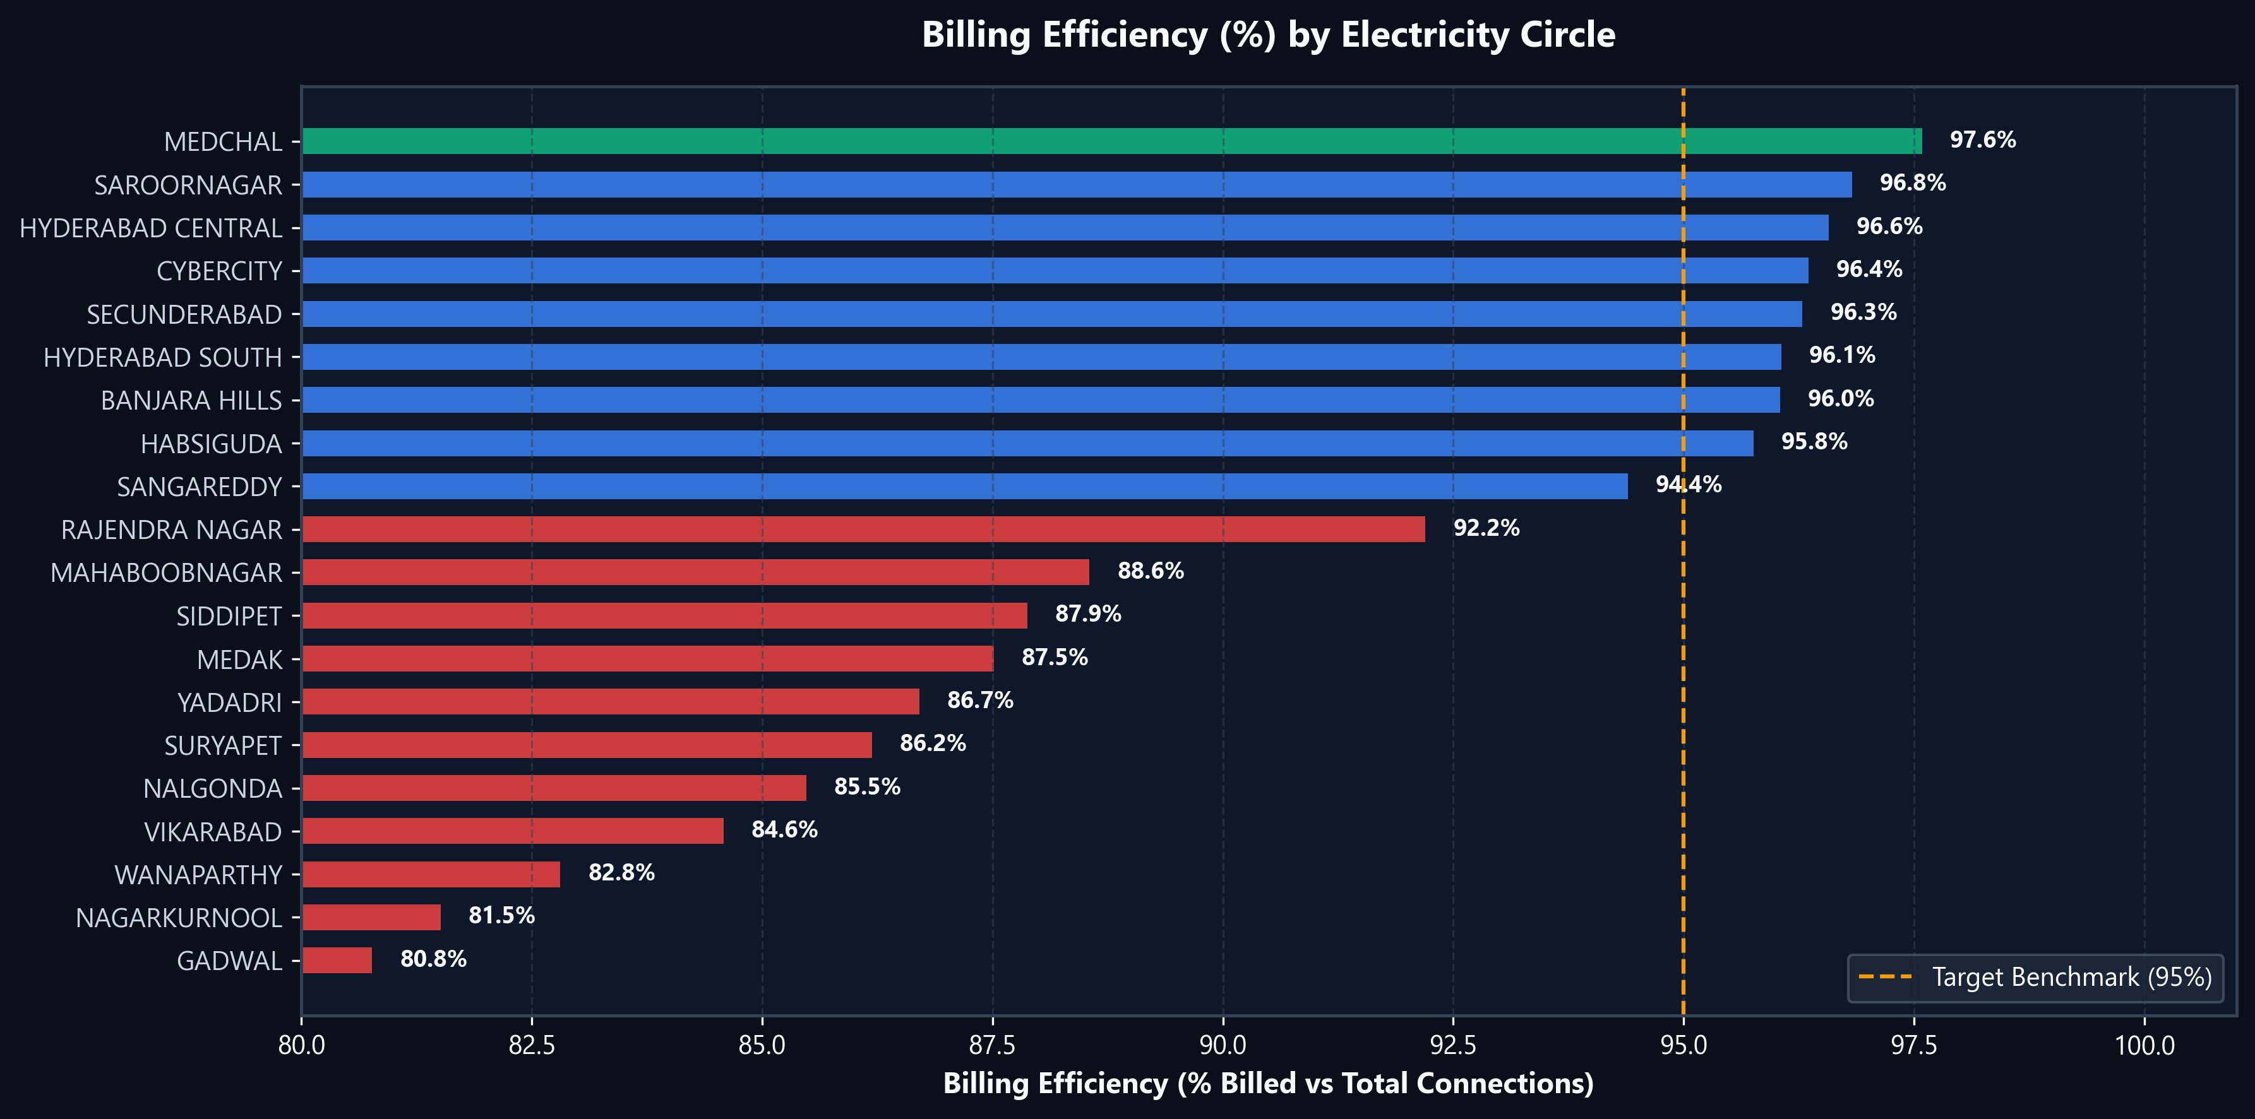
Billing Efficiency by Circle
% billed connections vs 95% target benchmark
TG-SPDCL | Data Analytics
BILLING LEGEND
> 97%
High performer
93–97%
On target
< 93%
Needs attention
Overall Rate
92.68%
Gap: ~649K connections
Target: 95%
TG-SPDCL Domestic Electricity Consumption Analysis | July 2026
10 / 17

Slide 11
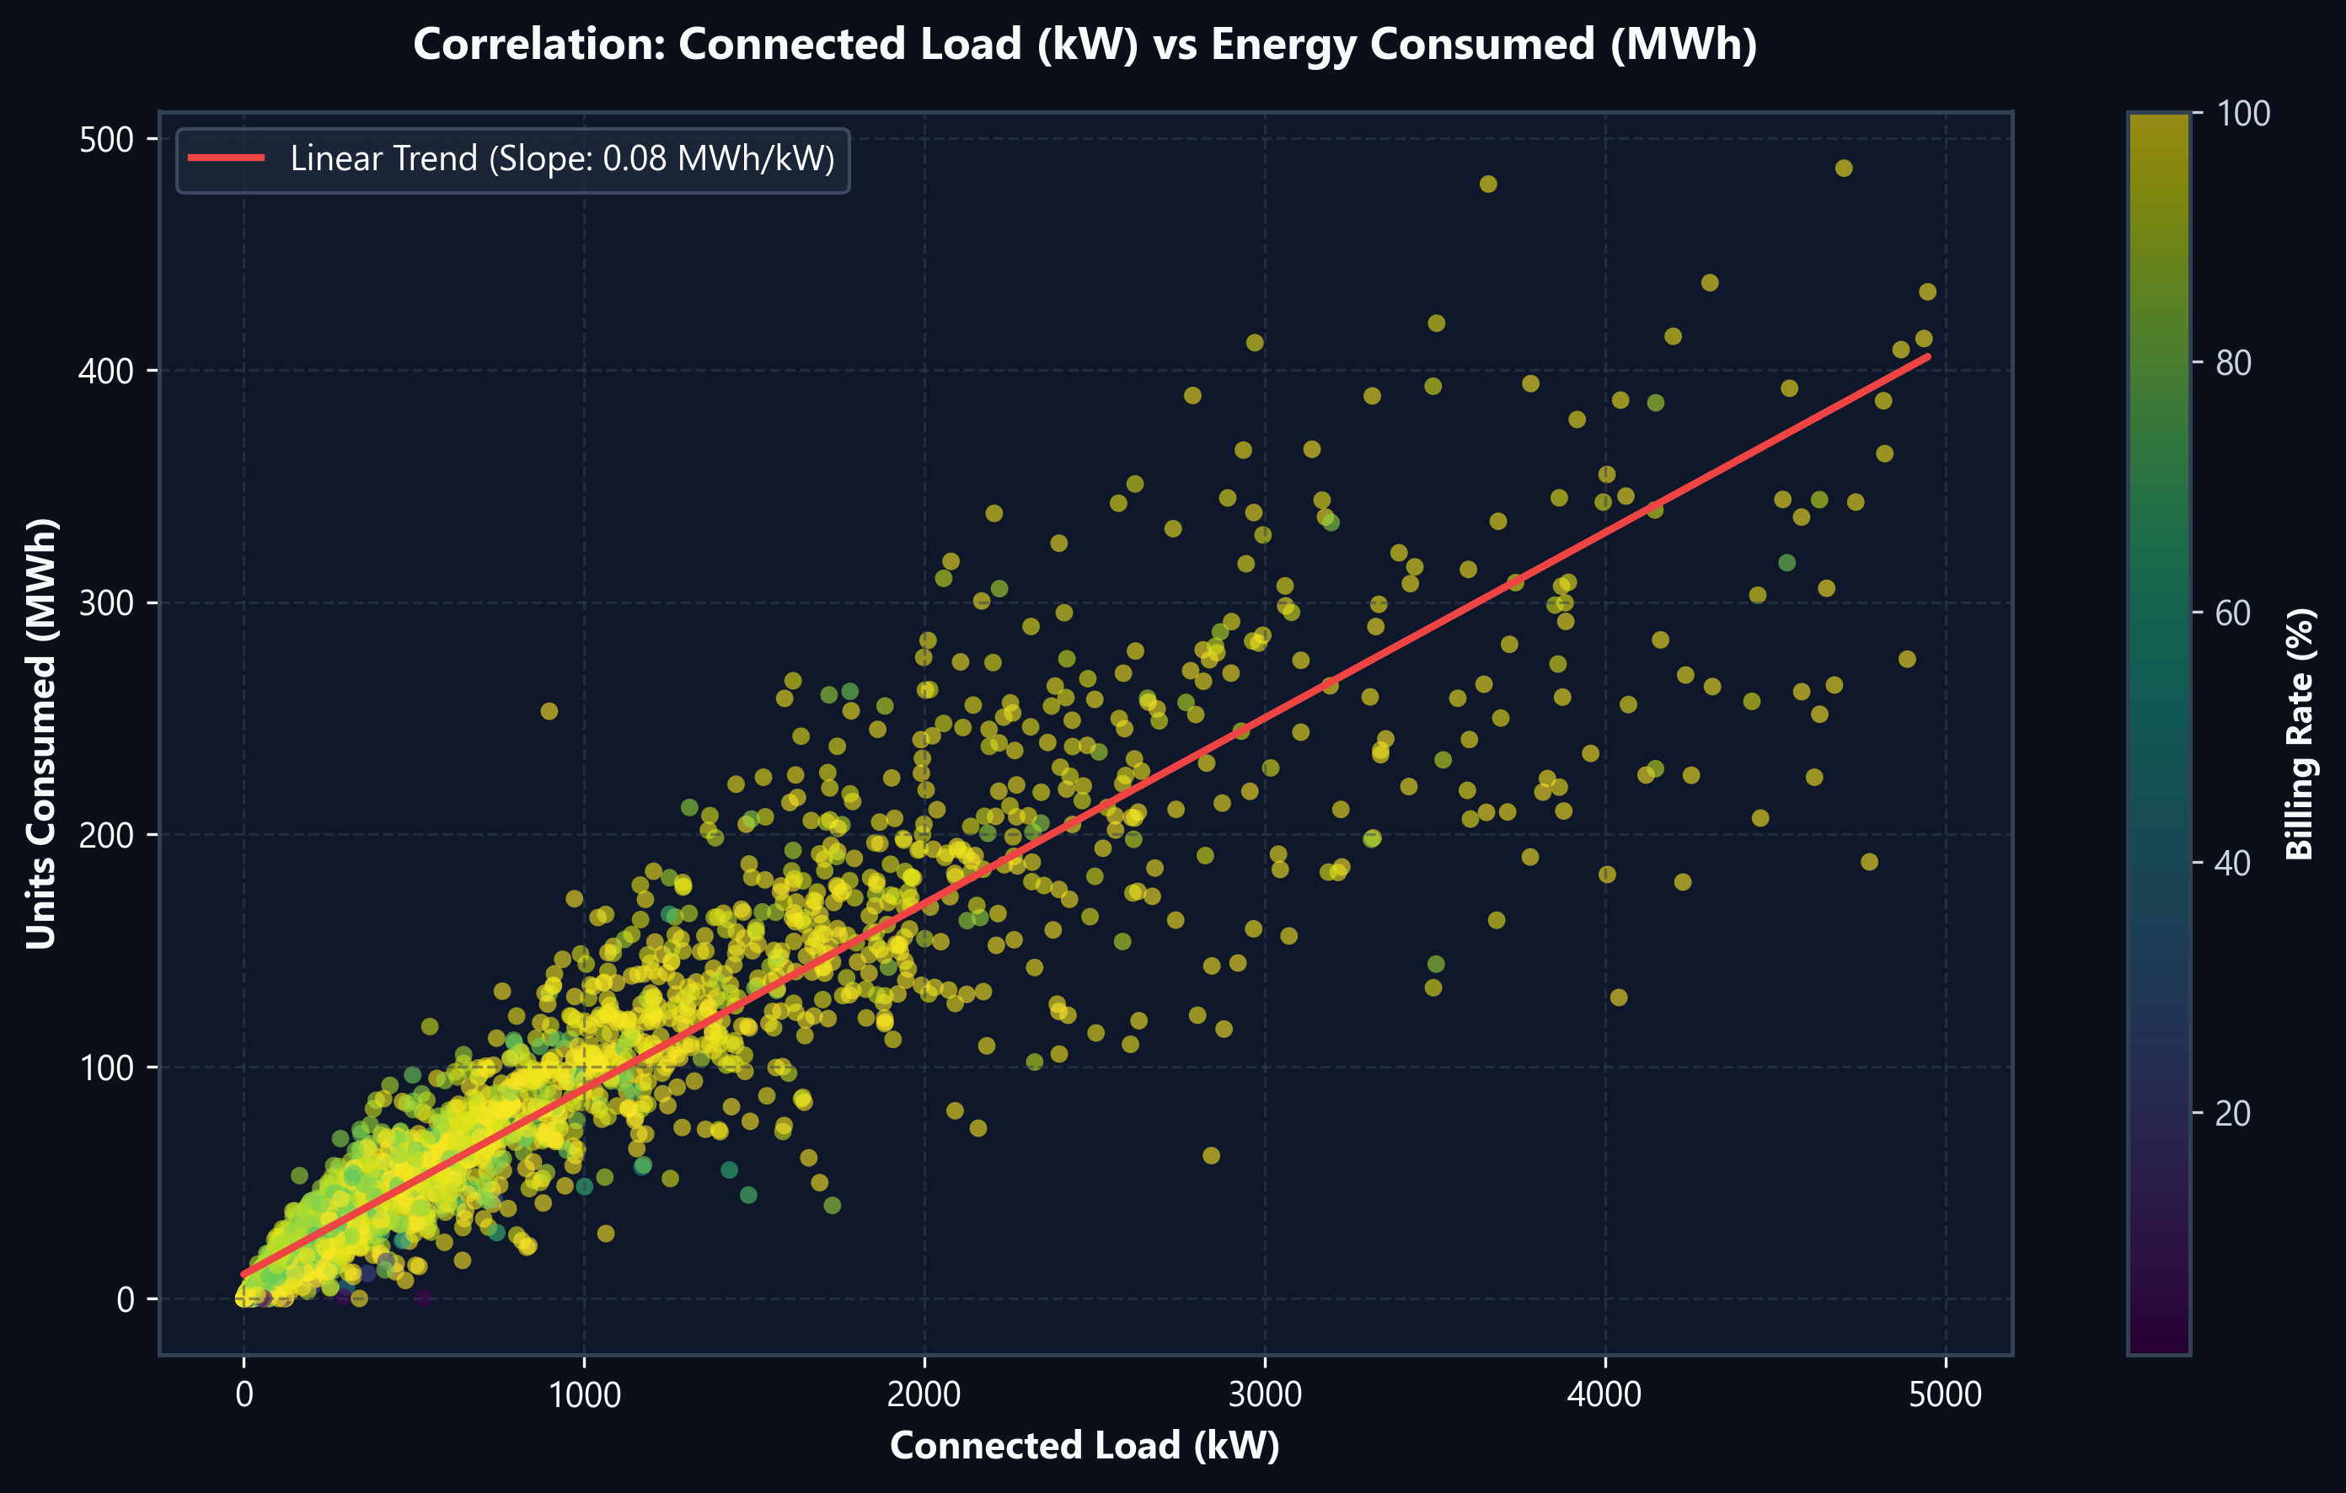
Connected Load vs Units Consumed
Seaborn regplot — linear correlation analysis
TG-SPDCL | Data Analytics
CORRELATION STATS
Correlation
r ≈ 0.95
Strong positive
Relationship
Linear
Load → Units
Hue mapping
Billing %
Color = efficiency
Interpretation
Areas with higher sanctioned load reliably show higher consumption. Load data can serve as a proxy for demand forecasting.
TG-SPDCL Domestic Electricity Consumption Analysis | July 2026
11 / 17

Slide 12
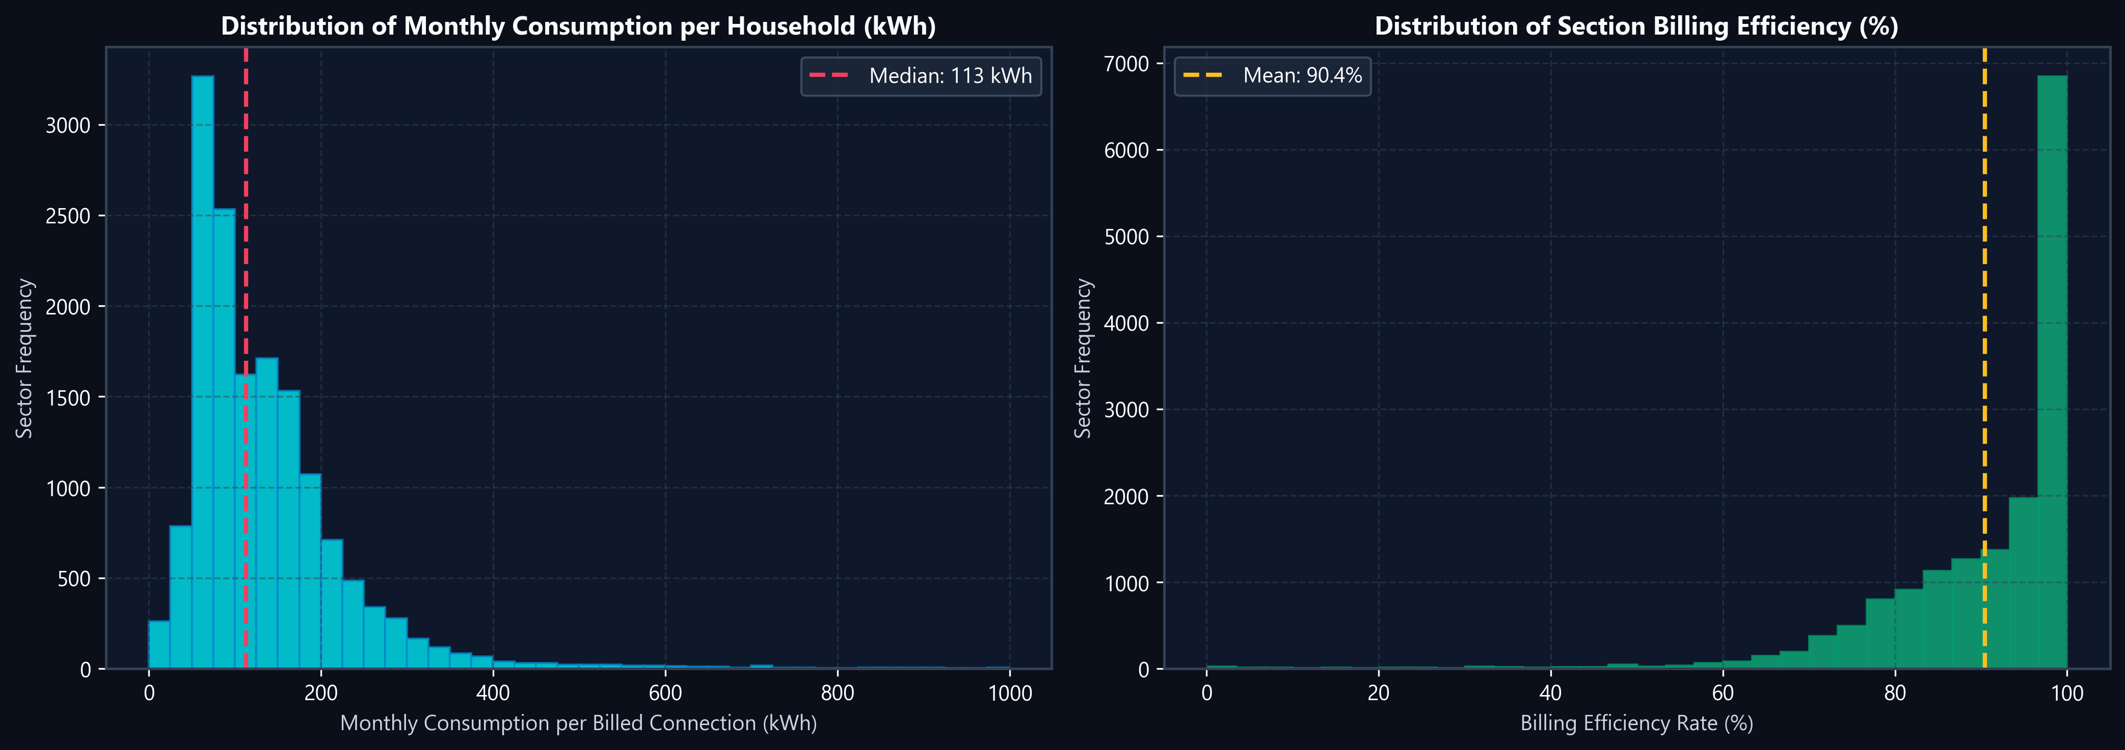
Statistical Distributions (KDE + Histogram)
Seaborn histplot with kernel density estimation
TG-SPDCL | Data Analytics
Household Consumption
Right-skewed distribution. Median ~90 kWh/month. Some sectors show extreme values (HT/bulk consumers).
Billing Efficiency Distribution
Strongly left-skewed (peak at 97-100%). Most sectors bill nearly all connections. ~7% have significant gaps.
TG-SPDCL Domestic Electricity Consumption Analysis | July 2026
12 / 17

Slide 13
Data Quality Issues & Cleaning
Identified problems and the handling strategy applied
TG-SPDCL | Data Analytics
ISSUE
ISSUE
ISSUE
247 NULL
BILLDSERVICES
47 NULL
AREA Names
15 Negative
UNITS Values
FIX
FIX
FIX
All 247 rows also have 0 UNITS
→ Impute from TOTSERVICES
Geographic label missing
→ Fill as 'UNKNOWN AREA'
Billing corrections / adjustments
→ Clip to 0 (not errors)
ISSUE
ISSUE
ISSUE
1,999 Repeated
Area Names
Extreme Outliers
(IQR ×1.5)
Zero Consumption
Rows
FIX
FIX
FIX
Same name, different sections
→ Retain — not duplicates
Max: 2.32M kWh vs median 37K
→ Flag & retain valid records
Inactive / seasonal areas
→ Keep — may be temporarily idle
TG-SPDCL Domestic Electricity Consumption Analysis | July 2026
13 / 17

Slide 14
Key Analytical Insights
Most important patterns discovered in the data
TG-SPDCL | Data Analytics
Urban Concentration
Per-Service Gap
Billing Revenue Risk
Top 10 Hyderabad-region circles = ~90% of total domestic units consumed.
Banjara Hills: ~240 kWh/service vs district circles: ~75–83 kWh. Urban = 3x higher.
92.68% billing rate means ~649,000 unbilled connections — a significant revenue leakage.
Load as Predictor
Demand Concentration
Bulk Consumer Distortion
Units & load correlation r≈0.95. Sanctioned load is a reliable consumption proxy.
Top 15% of sectors by size (2,452 areas) account for 50.5% of all kWh consumed.
'DOMESTIC HT/HV/CT' rows show 3,000–11,500 kWh/service — likely bulk, not household.
TG-SPDCL Domestic Electricity Consumption Analysis | July 2026
14 / 17

Slide 15
Dataset Limitations
Boundaries of the analysis — what the data cannot tell us
TG-SPDCL | Data Analytics
LIMITATION
IMPACT & EXPLANATION
CATEGORY
No Time-Series
Single July 2026 snapshot only — cannot track consumption trends over time.
Time
Domestic Only
Commercial & industrial consumers excluded — incomplete total demand picture.
Scope
No Weather Data
Cannot explain seasonal consumption peaks without temperature/climate variables.
Context
No Household Details
Income, family size, appliance usage unknown — cannot explain why consumption differs.
Depth
Repeated Area Names
1,999 area names appear in multiple sections — spatial deduplication needed.
Quality
Negative Units
15 billing-correction rows cannot be distinguished from real negative consumption.
Quality
HT/HV Domestic Rows
Bulk consumers billed as 'domestic' inflate category averages significantly.
Accuracy
No Socioeconomic Data
Cannot correlate consumption with poverty index, HDI, or household density.
Context
TG-SPDCL Domestic Electricity Consumption Analysis | July 2026
15 / 17

Slide 16
Technology Stack
Tools, libraries & technologies used in this project
TG-SPDCL | Data Analytics
PYTHON ANALYSIS STACK
WEB DASHBOARD STACK
Pandas
HTML5 + CSS3
Data loading, cleaning, groupby aggregation & feature engineering
Glassmorphism dark UI, CSS variables, responsive grid layout
NumPy
JavaScript
Vectorized operations: billing rate, outlier detection, clipping
Dynamic filter slicers, search, pagination & CSV export logic
Matplotlib
Chart.js
Publication-quality dark-theme static charts (5 PNG outputs)
Interactive bar/line combo, scatter plots, doughnut charts
Seaborn
KPI Cards
Statistical plots: regplot, histplot+KDE, barplot with hue palette
Real-time metric tiles recalculated on every filter change
python-pptx
Anomaly Alerts
Automated generation of this presentation programmatically
Auto-flags sections with billing rate < 85% or high load intensity
json
Gallery Modal
Exports analysis_summary.json for live dashboard data feed
Click-to-expand viewer for all 5 Matplotlib PNG reports
TG-SPDCL Domestic Electricity Consumption Analysis | July 2026
16 / 17

Slide 17
Conclusions & Summary
TEAM
Thank You
Urban Dominance
Top 10 Hyderabad circles = ~90% of all domestic electricity consumed
Per-Service Gap
Banjara Hills: 240 kWh vs district circles: ~80 kWh/month (3x difference)
D. Chander
2503A52214
B.Tech CSE
Billing Gap
92.68% efficiency → ~649K unbilled connections = revenue recovery opportunity
K. Arjun
Strong Correlation
Load–consumption r ≈ 0.95 → load data is a reliable demand proxy
2503A52235
B.Tech CSE
Demand Skew
Top 15% of sectors (by size) consume over 50% of all electricity
P. Sachin
2503A52240
GitHub:
https://github.com/arjunkanukuntla/dav-project
B.Tech CSE
$ python main.py | $ python -m http.server 8000 → localhost:8000
Data Analytics & Visualization | July 2026

